Slide 1
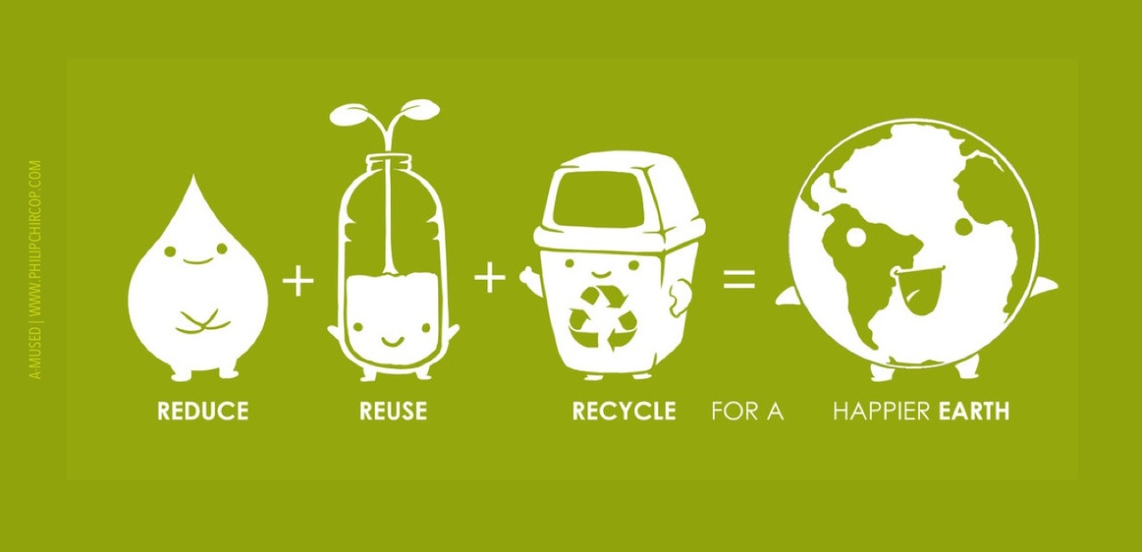
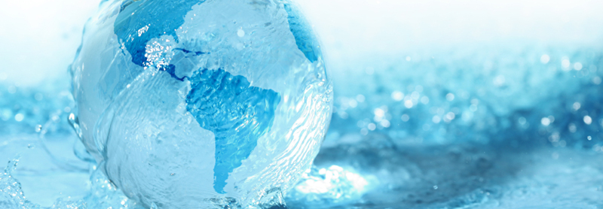


Water
USA EPA,
Region 10
EcoLearn
1st Grade: Water and the Water Cycle
Notes:
http://www.philipchircop.com/post/117077877097/reduce-reuse-recycle-today-the-22nd-of-april

Slide 2

Today:
Today you will learn:
How the water cycle works and why water is important
Keywords:
Water cycle
Evaporation
Condensation
Precipitation
Notes:
http://fergusonfoundation.org/hbf-kids-zone/the-water-cycle/

Slide 3
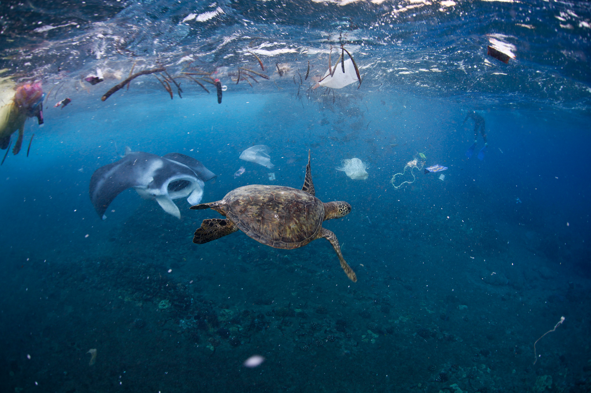
Students will learn the importance of water and have an understanding of the water cycle.
Notes:
http://news.nationalgeographic.com/news/2014/04/140414-ocean-garbage-patch-plastic-pacific-debris/

Slide 4

What is the Water Cycle?

Slide 5

Evaporation
The sun heats up water in the rivers or lakes or the ocean and turns it into vapor or steam.
The water vapor or steam leaves the river, lake, or ocean and goes into the air.
Notes:
http://www.tigtagcarolina.com/film/separation-by-evaporation-PRM00347/

Slide 6


Condensation
Change of water vapor into water droplets.
The water vapor in the air cools off and changes back into liquid, forming clouds.
Notes:
https://www.brusheezy.com/textures/49057-clouds-textures
http://www.viwintech.com/condensation

Slide 7
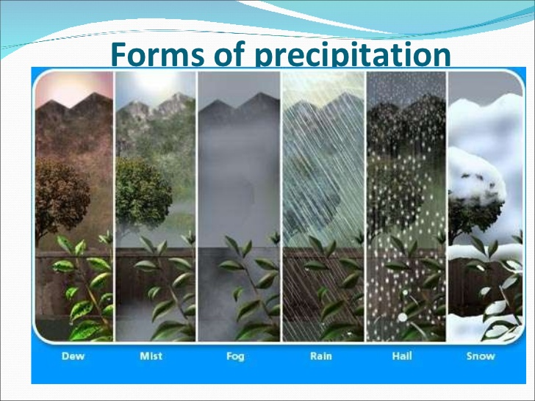
Precipitation
Water falling from the sky like rain, snow, sleet, hail
Notes:
https://www.slideshare.net/hamza07/precipitation-presentation

Slide 8
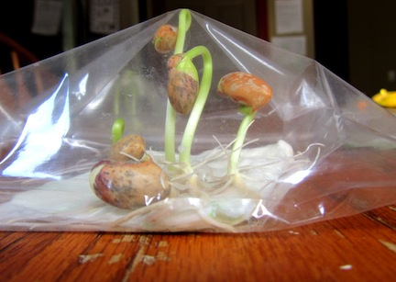
Follow-Up Activity
1. Fill a large Ziploc bag 1/3 full with dirt, water, and a bean pod. Seal the bag.
2. Tape the bag to a sunny window.
3. Spend a few minutes each day observing the evaporation, condensation, and precipitation that occurs in the bag.
4. If time allows, have students keep a journal of the experiment, drawing the changes they see each day.
Notes:
https://www.babble.com/crafts-activities/6-very-simple-diy-science-experiments/

Slide 9
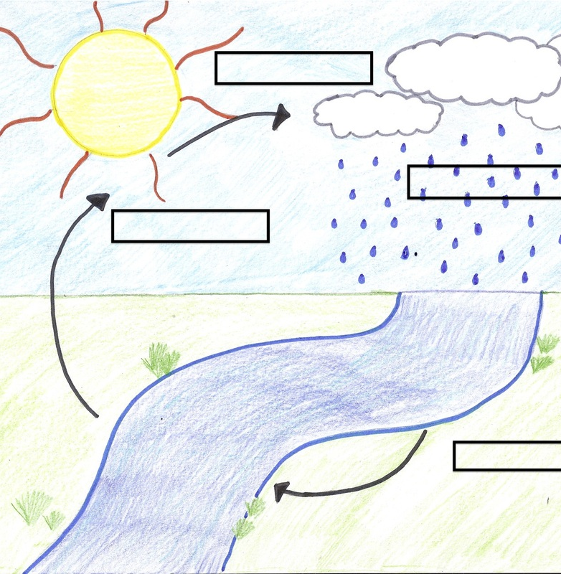
Water Cycle Adventure

Slide 10

Question:
What did we learn about water and the water cycle today?
Can you tell me about the water cycle?
When and where do you use the most water every day?

Slide 11


EcoLearn
Developed by the Environmental Protection Agency
With support from Department of State
Virtual Students of Foreign Service Interns
https://www.epa.gov/education
US EPA
Region 10
EcoLearn
For more information: hanft.sally@epa.gov or salazar.viccy@epa.gov

