Slide 1

2nd Grade
Marine Debris
Learn what we can do to keep our oceans clean
US EPA
Region 10
EcoLearn
Notes:
Source: https://washedashore.org/marine-debris/

Slide 2
Marine Debris
Notes:
Sources: http://thankyouocean.org/threats/marine-debris/
Today, we will learn about marine debris, also called aquatic trash. Marine debris is any kind of trash that has made its way to the ocean, such as plastic bags, bottles, or other kinds of litter.

Slide 3
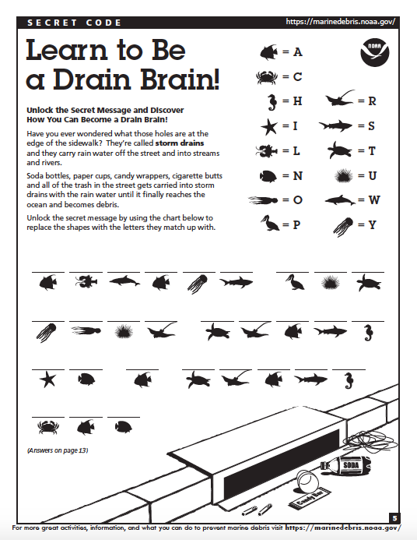
Do Now
Notes:
*Hand out copies of “Learn How to be a Brain Drain” to each student from https://marinedebris.noaa.gov/understanding-marine-debris-games-and-activities-kids-all-ages and discuss:1) what is marine debris? 2) what is a storm drain? 3) How does this impact our water and our beaches?*
Directions: Unlock the Secret Message and Discover How You Can Become a Drain Brain!
- Have you ever wondered what those holes are at the edge of the sidewalk? They’re called storm drains and they carry rain water off the street and into streams and rivers.
- Soda bottles, paper cups, candy wrappers, cigarette butts and all of the trash in the street gets carried into storm drains with the rain water until it finally reaches the ocean and becomes debris.
- Unlock the secret message by using the chart below to replace the shapes with the letters they match up with.
Answer: ALWAYS PUT YOUR TRASH IN A TRASH CAN.

Slide 4

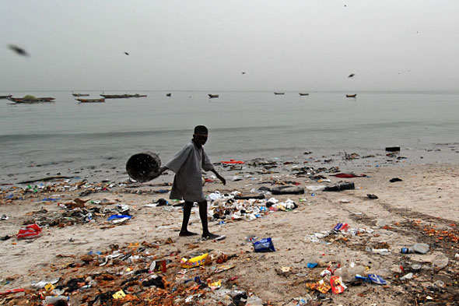
Keywords
Notes:
http://coastalcare.org/2009/11/plastic-pollution/
For today’s lesson, we will learn the following key words.
Waste
Trash in our water/Aquatic Trash
Marine Debris
4 R’s

Slide 5
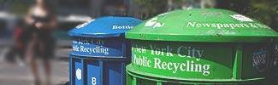


The 4 Rs
Notes:
https://www.epa.gov/sites/production/files/styles/large/public/2013-06/recycle.jpg
The 4 Rs: Today, we are going to learn about plastics, trash, and our big waste problem. Have you ever seen trash that isn’t in trash cans? Where? Trash can accidentally flow into our streams, rivers, and oceans, which upsets our animal friends. Sometimes, trash can leak nasty chemicals into the soil. It’s important to follow the four Rs – refuse, reduce, reuse, and recycle – as much as we can.
Refuse means that you can choose not to use or buy something in the first place!
Reduce means using less stuff in general.
Reuse means trying to use something until it can’t be used any more.
Recylce means properly disposing of plastics, metals, and other recyclable materials so they can be made into other things.
8 million metric tons of garbage end up in the ocean every year. This is the same as a garbage truck dumping its trash into the ocean every minute of every day for a whole year! Almost all of this trash, 88%, is plastic. Plastics don’t break down, or biodegrade, like apples or other products, but instead break into tinier and tinier pieces that can stick around for thousands of years! Litter is ugly, can hurt animals, and costs people billions of dollars every year. Let’s play a game called “how long til it’s gone?”
Source: http://brucemctague.com/wp-content/uploads/2016/01/dirty-water-clean-water.jpg

Slide 6
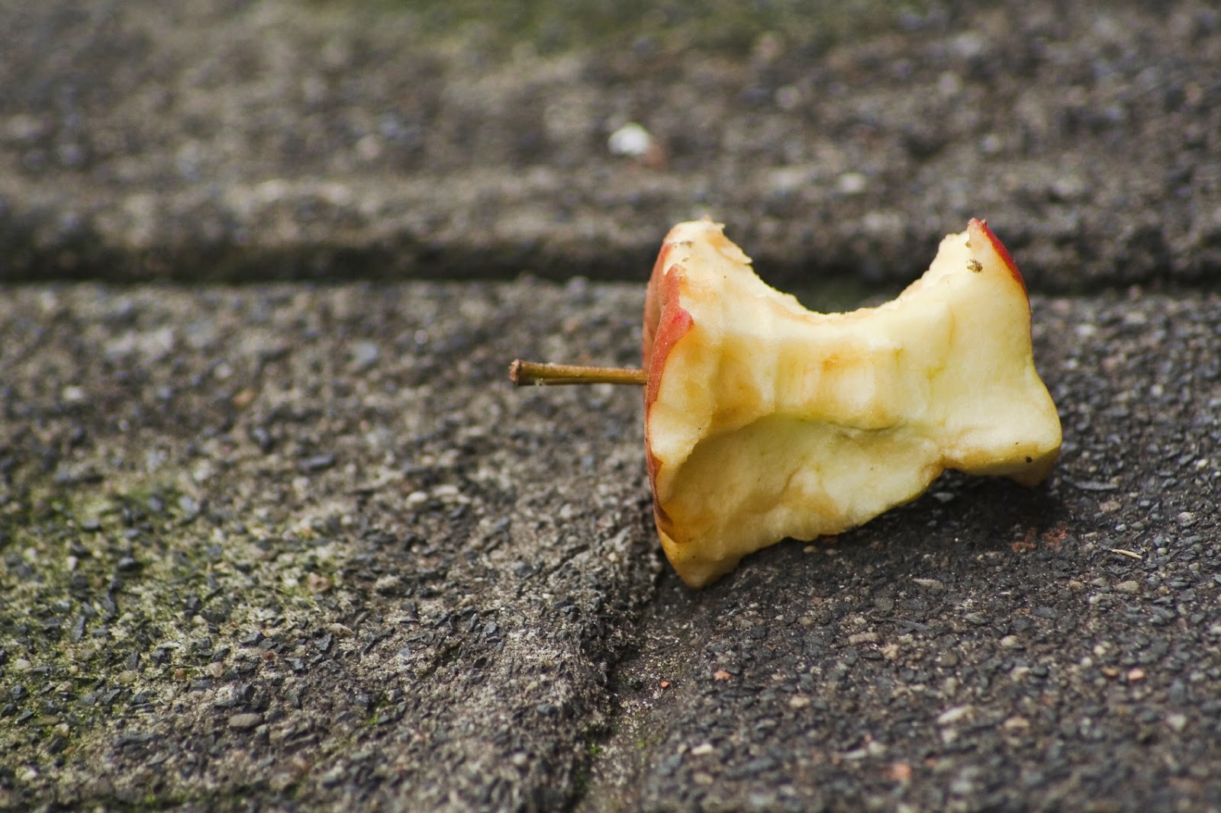
How Long ‘till it’s GONE?
Notes:
How long till an apple is gone?

Slide 7
How Long ‘till it’s GONE?
2 months
Click for audio.
Notes:
An apple will break down in about 2 months!

Slide 8
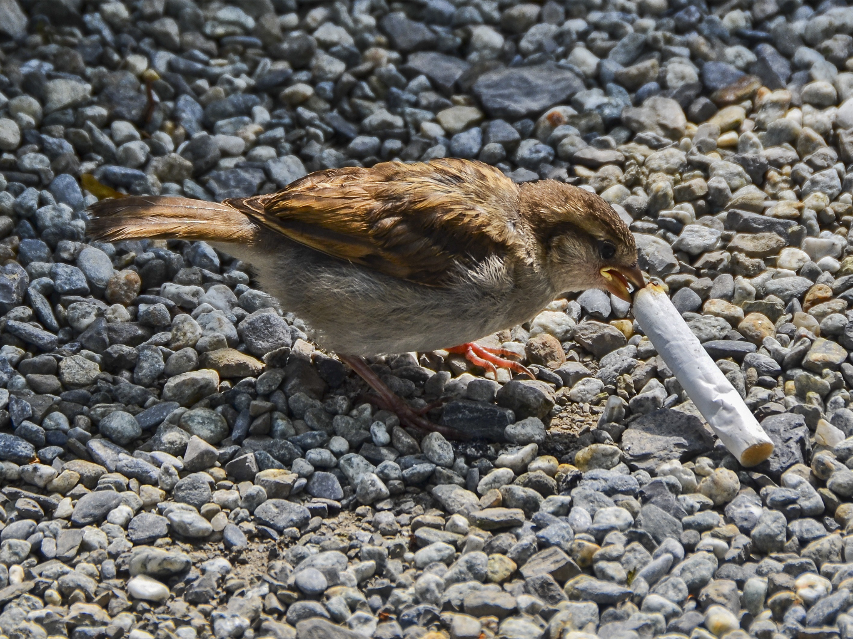
How Long ‘till it’s GONE?
Click for audio.
Notes:
How long until a cigarette is gone?

Slide 9
How Long ‘till it’s GONE?
5 years
Click for audio.
Notes:
A cigarette won’t break down for 5 years!

Slide 10
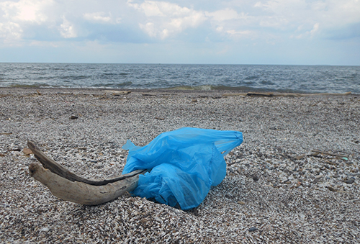
How Long ‘till it’s GONE?
Click for audio.
Notes:
We think it takes about 20 years for a plastic bag to break down.

Slide 11
How Long ‘till it’s GONE?
20-1000 years
Click for audio.
Notes:
How long ‘till a plastic bag breaks down?

Slide 12
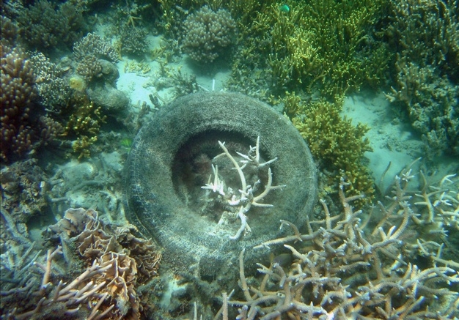
How Long ‘till it’s GONE?
Click for audio.
Notes:
How long ‘till a tire breaks down?

Slide 13
How Long ‘till it’s GONE?
80 years
Click for audio.
Notes:
How long ‘till a tire breaks down?

Slide 14
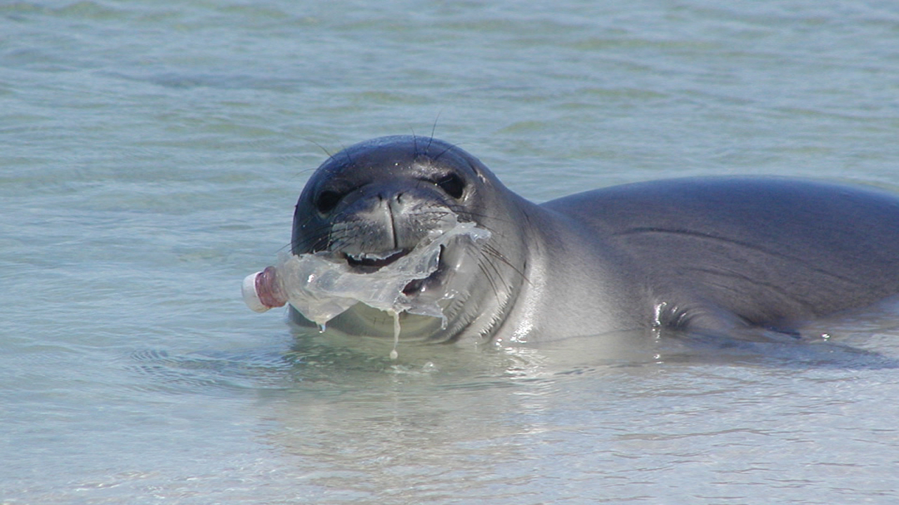
How Long ‘till it’s GONE?
Click for audio.
Notes:
How long ‘till a plastic bottle is gone?

Slide 15
How Long ‘till it’s GONE?
450 years
Click for audio.
Notes:
It takes 450 years for a plastic bottle to break down!

Slide 16
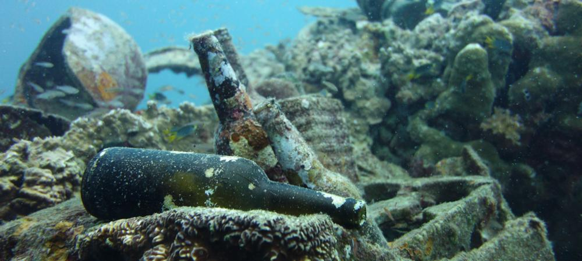
How Long ‘till it’s GONE?
Click for audio.
Notes:
How long ‘till a glass bottle is gone?

Slide 17
How Long ‘till it’s GONE?
1,000,000 years!
Click for audio.
Notes:
It takes one *million* years for a glass bottle to break down!

Slide 18
How can we help?
Click for audio.
Notes:
How can we help? These issues may seem huge and scary, but there are things all of us can do to help keep our oceans clean and our animals safe. Let’s brainstorm ways we can help. Why is there trash in the water? Why does it keep happening? What are steps you can take at school or at home to help?

Slide 19
Click for audio.
Notes:
Answer? Reduce, Reuse, Recycle and Refuse!
If we don’t need an extra bottle of sunscreen, we should do what? We should refuse it! If we only need one paper plate at our beach picnic, we should do what? We should reduce how many we use! If we have an empty water bottle, we should do what? Refill it and reuse it! If we eat a snack at the beach and have trash, we should do what? We should put the trash in the right bin and recycle it!

Slide 20
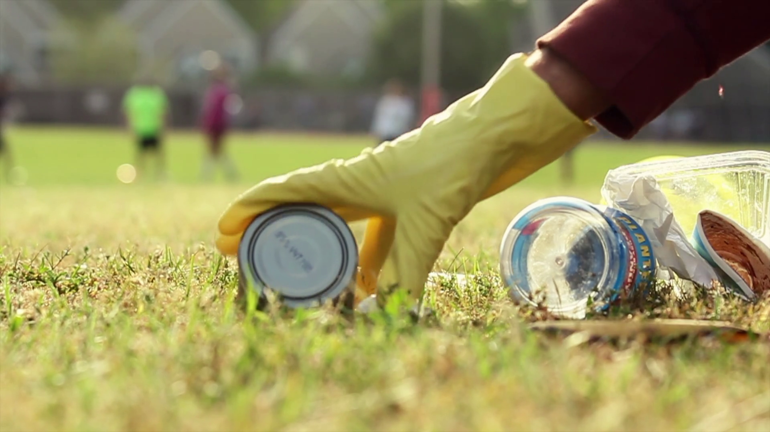
Trash Tracking
Click for audio.
Notes:
Trash Tracking: Let’s do an activity. This activity happens outdoors.
Pollution that comes from our rivers and streams usually goes into the ocean. To see this ourselves, we will be going outside to observe the places trash comes from, and the damage it can cause! For today’s assignment we will be counting pollution as all litter or trash we can see easily – these things that can become marine debris. It is important to avoid any sharp items, like broken glass, and to wear gloves during this assignment.
Source: https://www.videoblocks.com/video/picking-up-trash-in-park-r7cd_w9nxix15ycz5

Slide 21

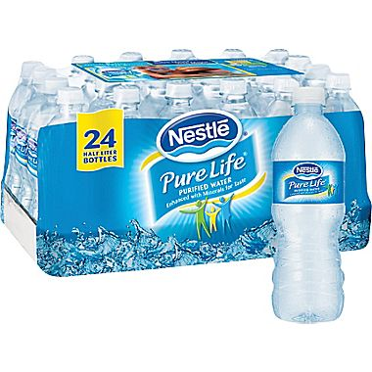
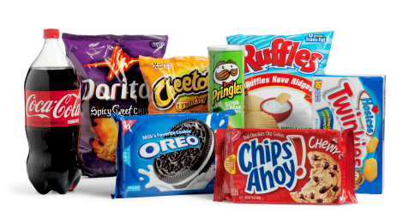
Trash Tracking Predictions
Click for audio.
Notes:
Let’s make predictions. What do you think you will find outside? What types of trash will you find most? Where will you find the most trash? At the end of this activity, you will each pick one piece of trash that stands out to you for any reason.
** Some sort of form or template. Activity they can do at tables

Slide 22
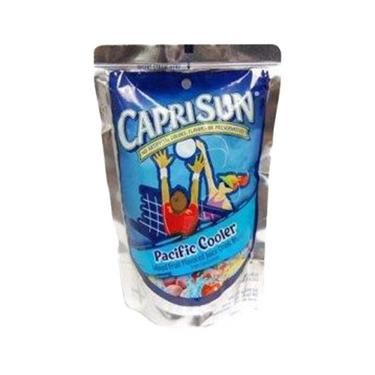




Trash Tracking Conclusions
Click for audio.
Notes:
Let’s reflect. What did you find when looking for litter outside? What type of trash did you find most? What was the one piece of trash you found that stands out to you, and why?
Source: https://etownpubliclibrary.org/event/wild-wednesday-copy-copy-copy/
http://pluspng.com/plastic-bottles-png-170.html
https://yocartdelivery.com/products/capri-sun-pacific-cooler-6oz
https://unixtitan.net/explore/straw-clipart-png/

Slide 23
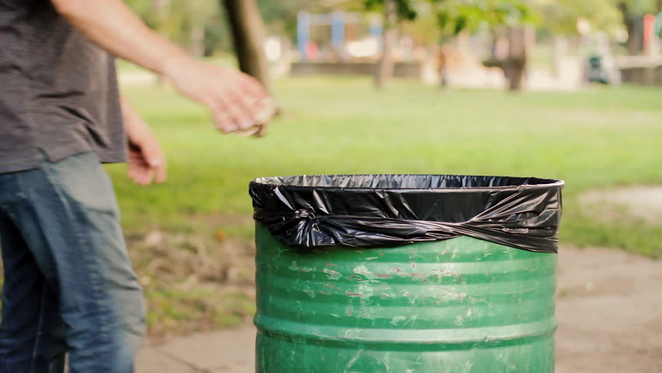
How Can We Help?
Click for audio.
Notes:
You can also help by simply throwing your trash away! Which leads us to our final activity.
https://www.shutterstock.com/video/clip-10758917-throwing-away-garbage-public-trash-can

Slide 24
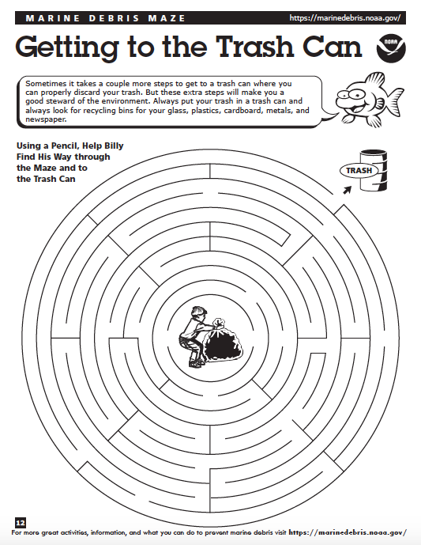
Getting to the
Trash Can!
Click for audio.
Notes:
*Hand out a copy of “Getting to the Trash Can” maze (Source: https://marinedebris.noaa.gov/understanding-marine-debris-games-and-activities-kids-all-ages) to each student and discuss:
Where did your trash come from? What risks or harm does it pose to humans, animals, or the environment? What could be done to prevent similar items from being littered in the future? Why is it important to properly dispose of waste?

Slide 25
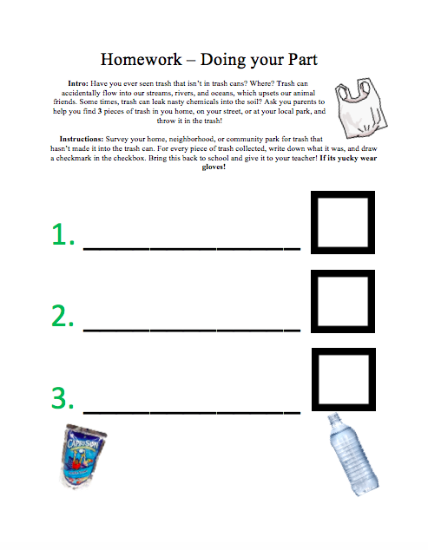
Homework
Notes:
*Handout a copy of “Homework – Doing Your Part”
Intro: Have you ever seen trash that isn’t in trash cans? Where? Trash can accidentally flow into our streams, rivers, and oceans, which upsets our animal friends. Some times, trash can leak nasty chemicals into the soil? Ask you parents to help you find 3 pieces of trash in you home, on your street, or at your local park, and throw it in the trash!
Instructions: Survey your home, neighborhood, or community park for trash that hasn’t made it into the trash can. For every piece of trash collected, write down what it was, and draw a checkmark in the checkbox. Bring this back to school and give it to your teacher! If its yucky wear gloves!

Slide 26
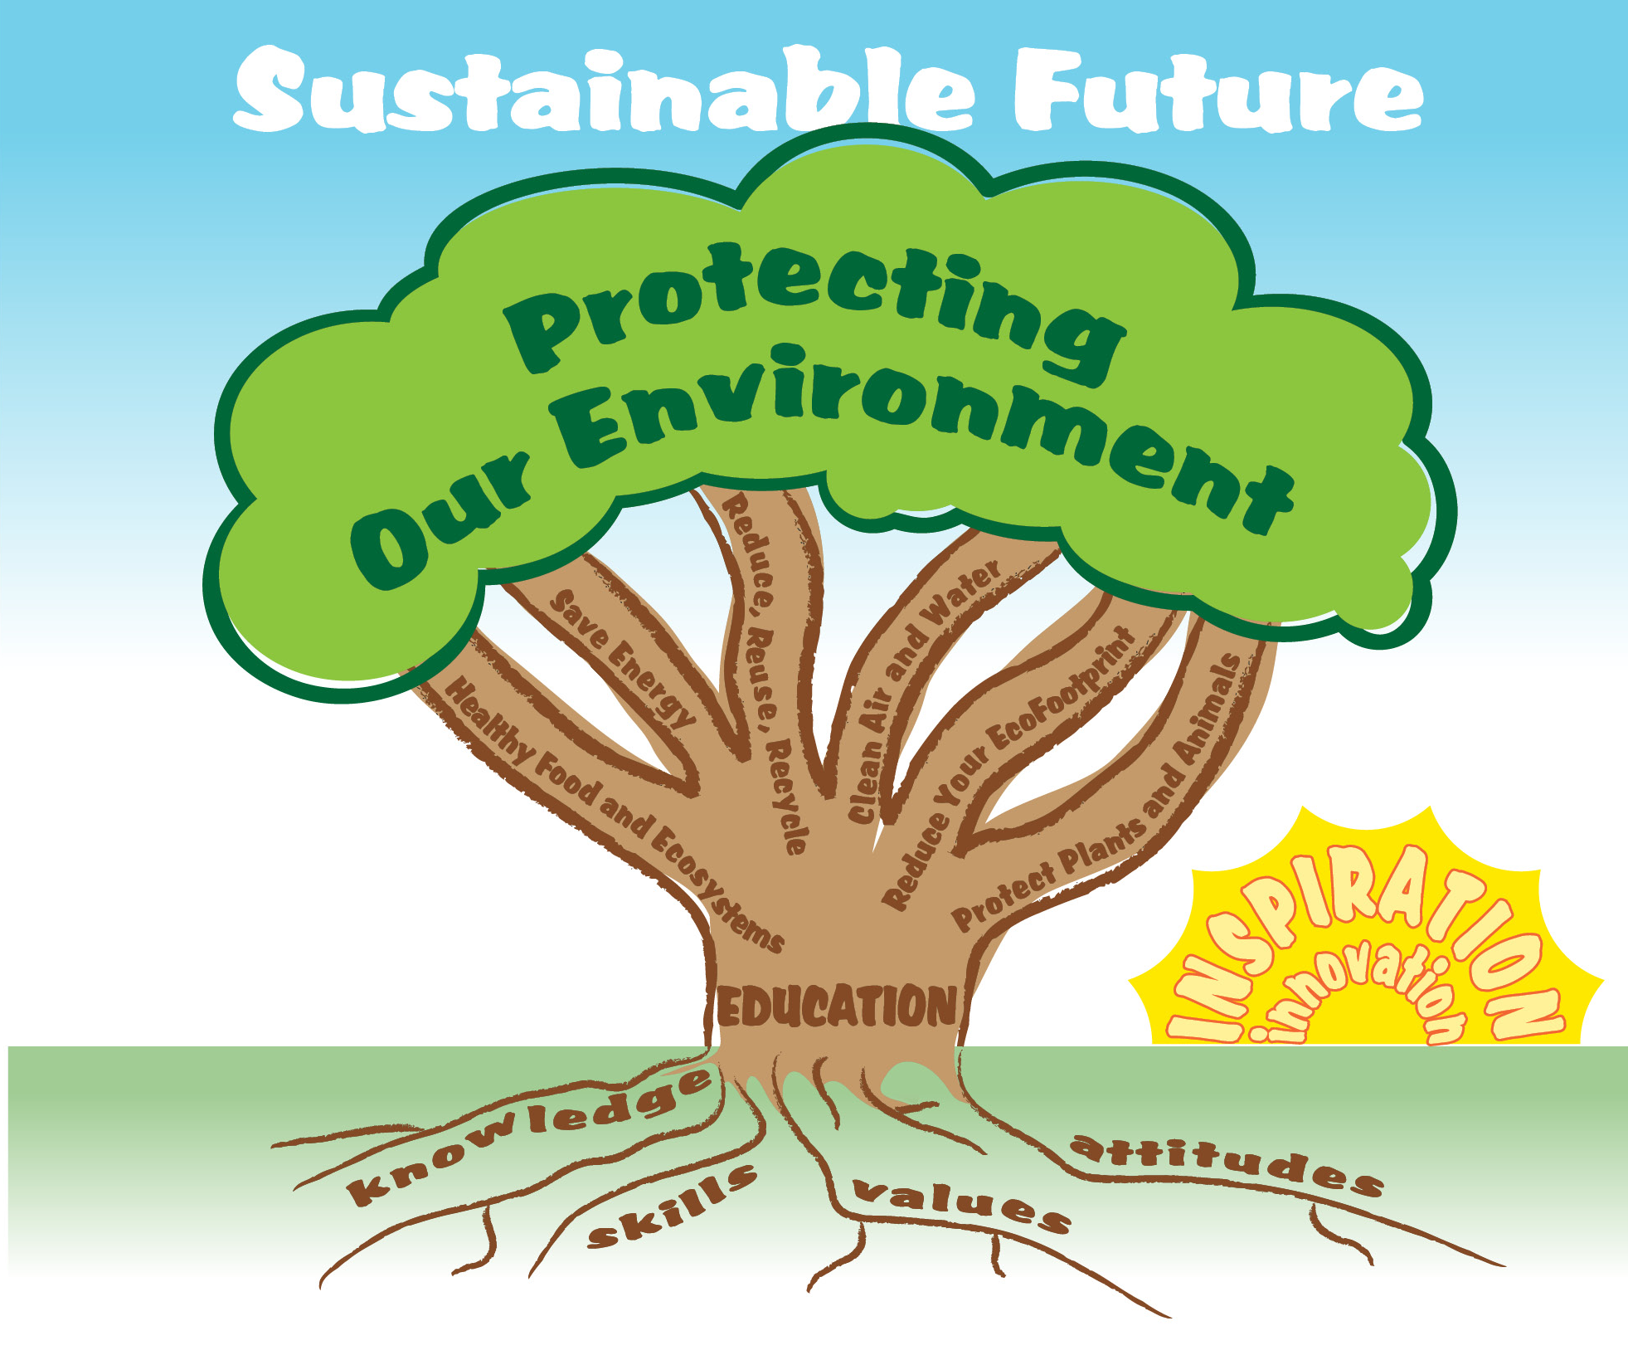
EcoLearn
Developed by the Environmental Protection Agency
With support from Department of State
Virtual Students of Federal Service Interns
https://www.epa.gov/education
US EPA
Region 10
EcoLearn
For more information: hanft.sally@epa.gov or salazar.viccy@epa.gov

