Slide 1










Major Energy Sources
Primary energy sources Non-renewable Energy Sources | Primary energy sources Renewable Energy Sources | Secondary Energy Sources
Oil and Petroleum Products | Hydropower | Electricity
Gasoline | Biomass | Electricity is the flow of electrical power or charge. Consumers use energy in the form of electricity, which is produced from the conversion of other sources of energy, such as coal, natural gas, nuclear, solar, or wind energy.
Diesel Fuel | Ethanol
Natural Gas | Biodiesel
Coal | Wood/wood waste
Nuclear | Solid waste
 | Landfill gas/biogas
 | Wind
 | Geothermal
 | Solar
Notes:
Sources: http://www.eia.gov/kids/energy.cfm?page=environment_home-basics
and http://www.eia.gov/kids/energy.cfm?page=electricity_home-basics

Slide 2
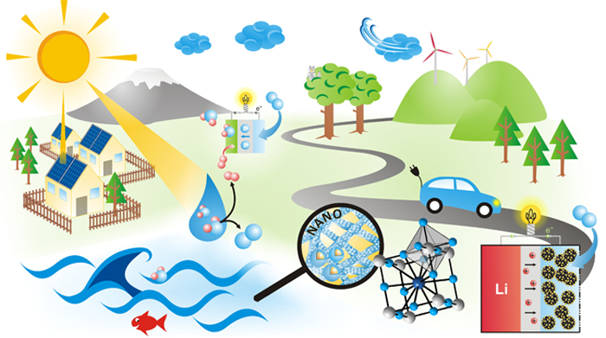
Energy Units
Different types of energy are
measured by different physical units:
  Barrels or gallons for petroleum
  Cubic feet for natural gas
  Tons for coal
  Kilowatt-hours for electricity
  British Thermal Unit (BTU), Calorie, and Joule for energy or heat
Source: http://www.eia.gov/KIDS/energy.cfm?page=about_energy_units
Notes:
Energy exists in many forms, so there are many ways to quantify it. Two of the most widely used for general purposes are the British Thermal Unit (BTU), which is a measure of energy content, and the watt, which is a measure of power, or how fast energy is used.
http://www.nap.edu/reports/energy/sources.html

Slide 3
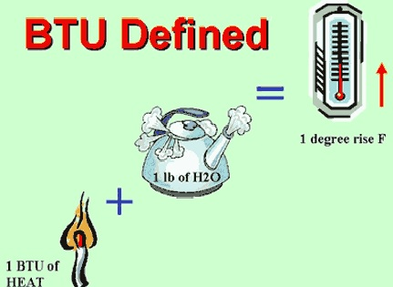
Units for comparing energy
  1 barrel (42 gallons) of crude oil = 5,800,000 BTU
  1 gallon of gasoline = 120,476 BTU
  1 gallon of diesel fuel = 137,381 BTU
Notes:
In the United States, British thermal units (BTU) is the most commonly used unit for comparing fuels. BTU is the amount of work needed to raise the temperature of one pound of water by one degree Fahrenheit

Slide 4

Electricity Units
Electricity is measured in units of power called Watts.
A Watt is the unit of electrical power equal to one ampere under a pressure of one volt.
The consumption of small devices is usually measured in Watts, and the consumption of larger devices is measured in kilowatts (kW), or 1,000's of Watts.
Notes:
Source: http://www.eia.gov/kids/energy.cfm?page=electricity_science-basics

Slide 5
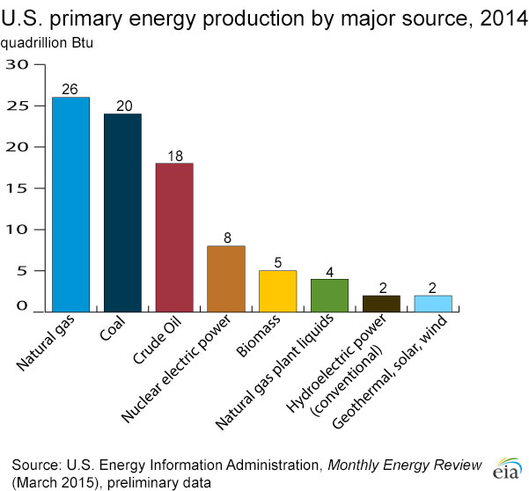
U.S. primary energy production by major source, 2014
Notes:
In 2014, energy produced in the United States provided about 89% of the nation's energy needs. The remaining energy was supplied mainly by imports of petroleum. http://www.eia.gov/energyexplained/?page=us_energy_home

Slide 6
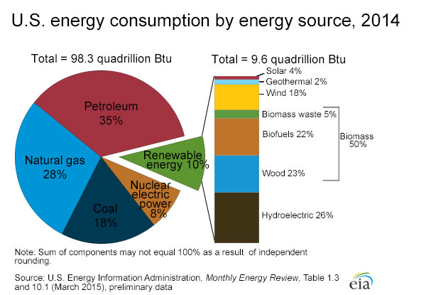
U.S. energy consumption by energy source, 2014

Slide 7
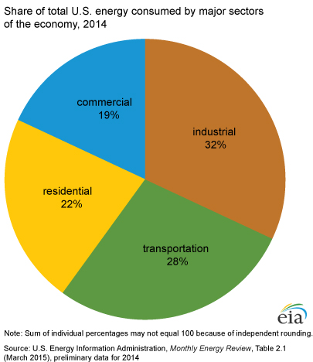
Industrial sector: facilities and equipment used for manufacturing, agriculture, mining, and construction.
Transportation sector: vehicles that transport people or goods. Cars, trucks, buses, motorcycles, trains, aircraft, boats, barges, and ships are included in the transportation sector.
Residential sector: homes and apartments.
Commercial sector: offices, malls, stores, schools, hospitals, hotels, warehouses, restaurants, places of worship, and more.
Notes:
Source: http://www.eia.gov/kids/energy.cfm?page=us_energy_use-basics

Slide 8
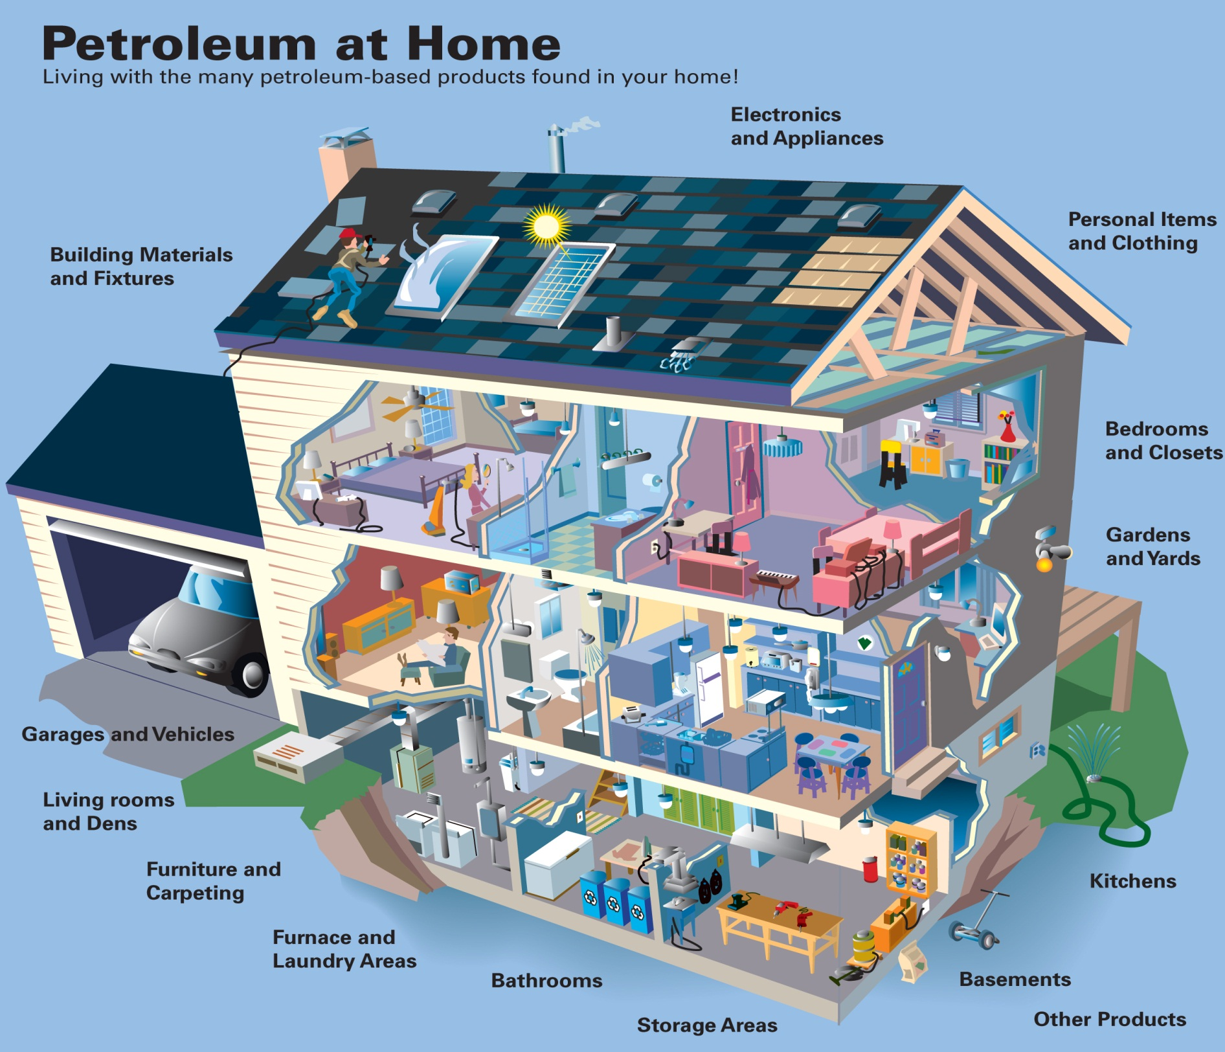
http://www.energy.alberta.ca/Org/graphics/petro1.jpg
Notes:
Petroleum products include transportation fuels, fuel oils for heating and electricity generation, asphalt and road oil, and the feedstocks used to make chemicals, plastics, and synthetic materials found in nearly everything we use today.
About 76% of the 6.97 billion barrels of petroleum products that were consumed in the United States in 2014 were gasoline, heating oil, diesel fuel, and jet fuel
http://www.eia.gov/tools/faqs/faq.cfm?id=41&t=6

Slide 9
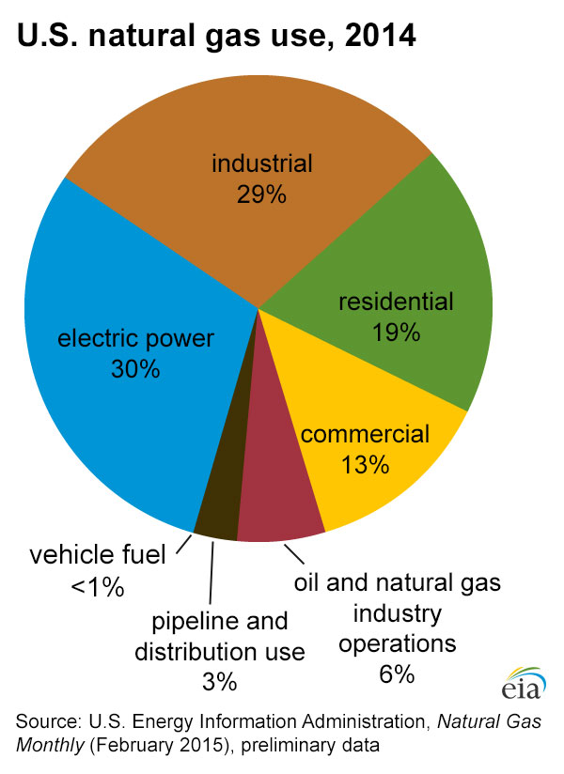
How natural gas is used?
Fuel to produce steel, glass, paper, clothing, brick, and electricity
Raw material for products, including
  paints, fertilizer, plastics, antifreeze, dyes, photographic film, medicines, and explosives
Notes:
Source: http://www.eia.gov/energyexplained/index.cfm?page=natural_gas_use

Slide 10
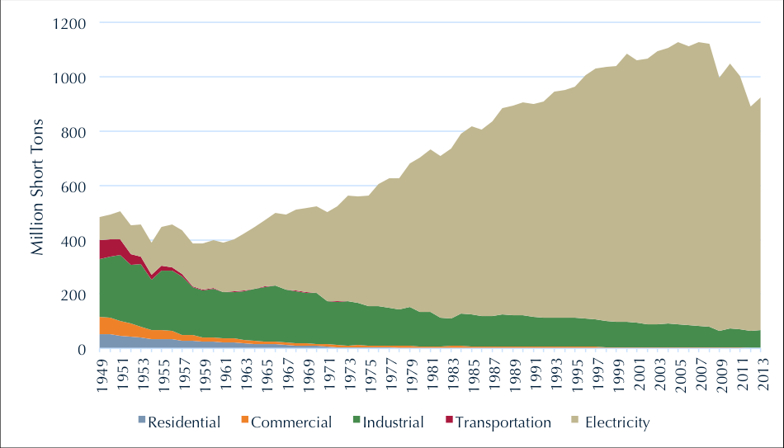
U.S. Coal Consumption, 1949 – 2013
http://www.c2es.org/energy/source/coal
Notes:
About 93% of the coal consumed in the United States is used to generate electricity by the electric power sector. The remaining 7% of coal is used as an energy source in many industries like the steel, cement, and paper industries. http://www.eia.gov/energyexplained/index.cfm?page=coal_use

Slide 11
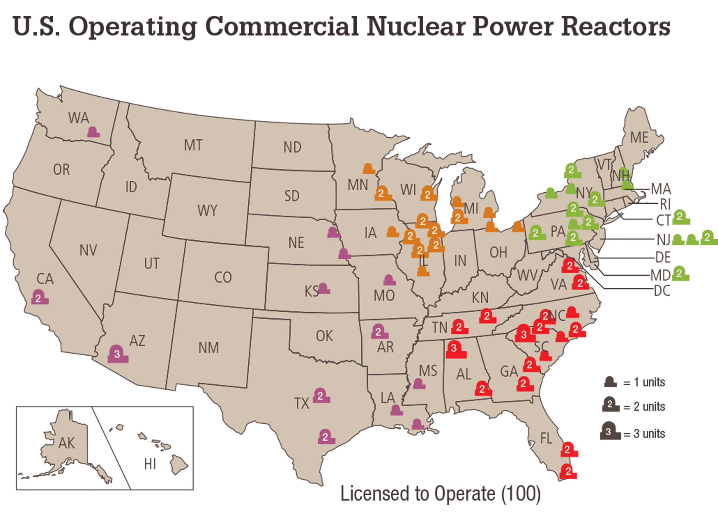
http://www.nrc.gov/reactors/operating/map-power-reactors.html
Notes:
Uranium is the fuel most widely used by nuclear plants for nuclear fission. Nuclear power plants use a certain kind of uranium, referred to as U-235, for fuel because its atoms are easily split apart. U-235 is relatively rare. http://www.eia.gov/energyexplained/index.cfm?page=nuclear_home

Slide 12
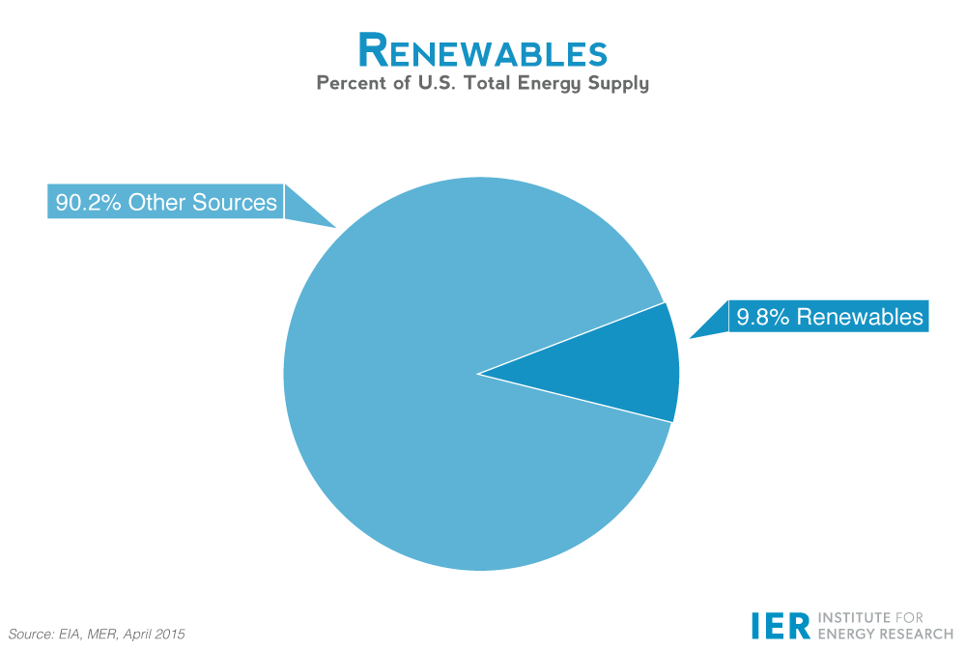
Renewables
Percent of U.S. Total Energy Supply
90.2 % Other resources
9.8 % Renewable
In 2014, the distribution of U.S. renewable consumption by source was
Hydropower 26%
Biomass Wood 23%
Biomass Waste 5%
Biomass Biofuels 21%
Wind 18%
Geothermal 2%
Solar 4%
Notes:
Source: http://instituteforenergyresearch.org/topics/encyclopedia/renewable-energy/#_edn3

Slide 13
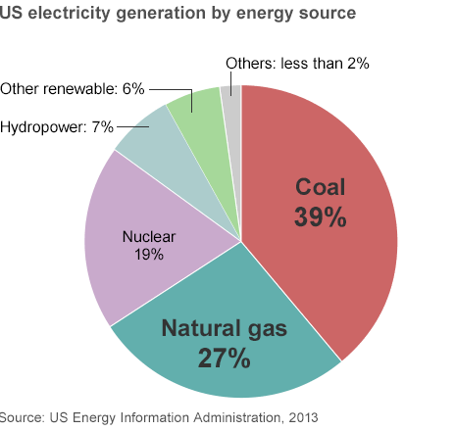
U.S. electricity generation by source
Notes:
Source: https://www.eia.gov/tools/faqs/faq.cfm?id=427&t=3

Slide 14
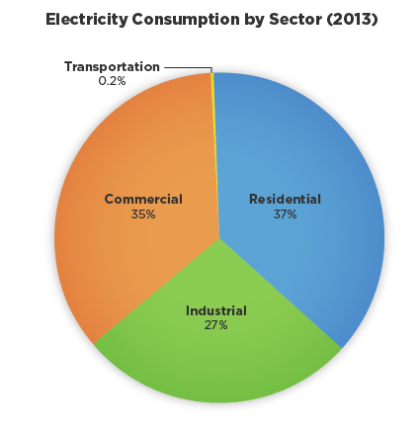
U.S. electricity consumption by sector, 2013
Notes:
Source: http://www.epa.gov/energy/electricity-system

Slide 15
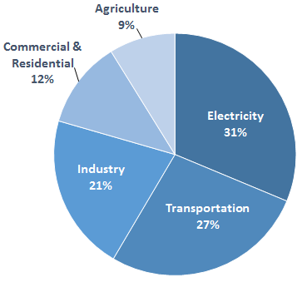
Total U.S. Greenhouse Gas Emissions by Economic Sector in 2013
EPA
Notes:
Greenhouse gases trap heat and make the planet warmer. Human activities are responsible for almost all of the increase in greenhouse gases in the atmosphere over the last 150 years. The largest source of greenhouse gas emissions from human activities in the United States is from burning fossil fuels for electricity, heat, and transportation. http://www3.epa.gov/climatechange/ghgemissions/sources.html

Slide 16
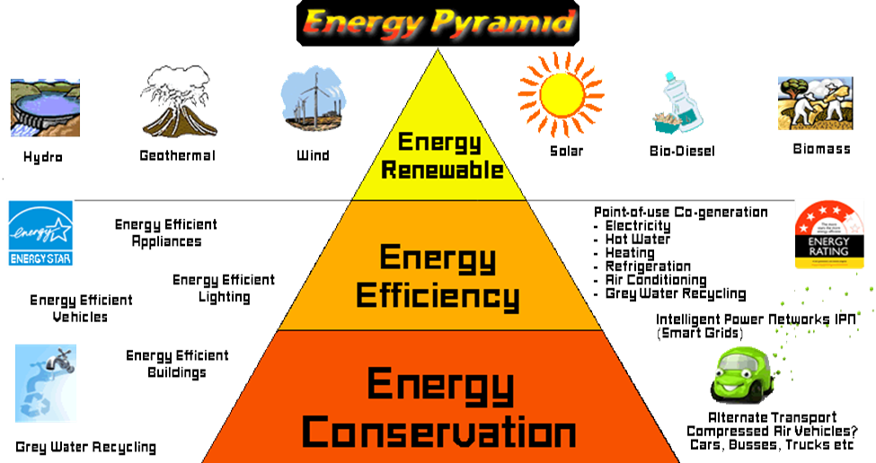
Saving energy
Energy Pyramid
https://dinct.wordpress.com/
Notes:
People use energy each day for transportation, cooking, heating and cooling rooms, manufacturing, lighting, entertainment, and many other uses. The choices people make about how they use energy—turning machines off when they're not using them or choosing to buy fuel-efficient vehicles and energy-efficient appliances—affects the environment and everyone's lives.
Energy conservation is any behavior that results in the use of less energy.
For instance, turning the lights off when leaving the room and recycling aluminum cans are both ways of conserving energy.
Energy efficiency is the use of technology that requires less energy to perform the same function.
For instance, using a compact fluorescent light bulb that requires less energy rather than using an incandescent bulb to produce the same amount of light is an example of energy efficiency.
http://www.eia.gov/energyexplained/index.cfm?page=about_energy_efficiency

