Slide 1
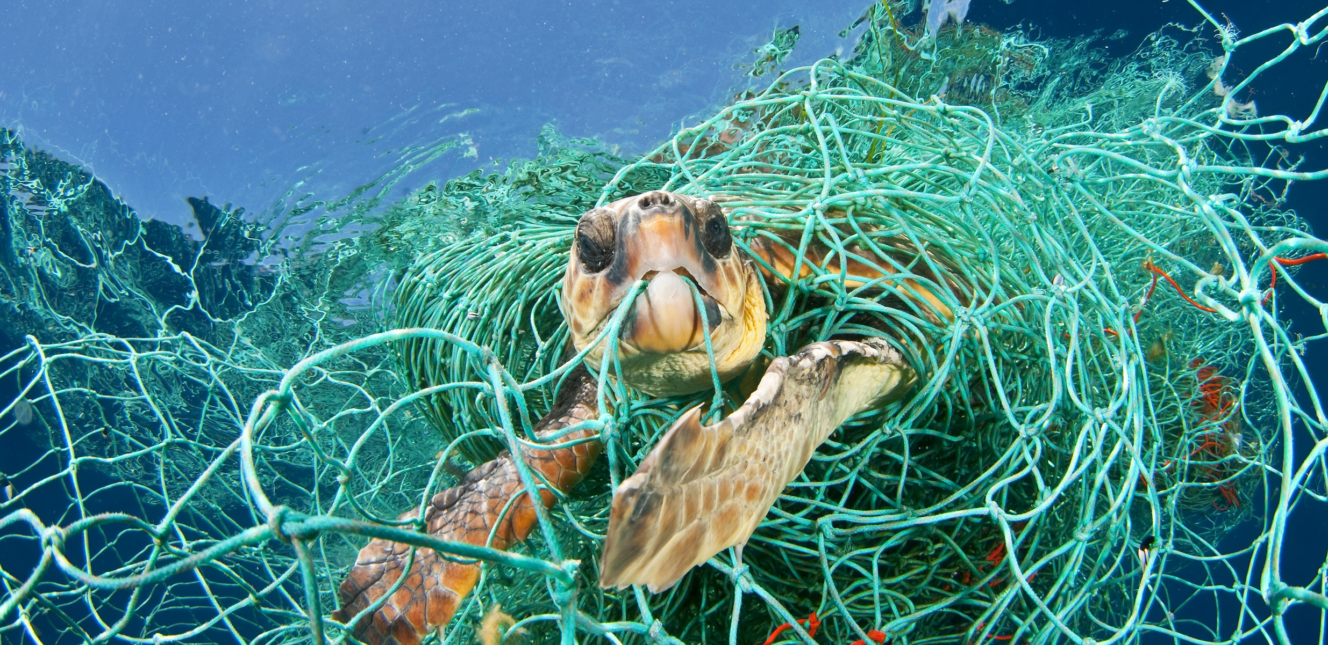

3rd Grade
Marine Debris
Learn what we can do to keep our oceans clean.
US EPA
Region 10
EcoLearn
Notes:
Source: Source: https://teenkidsnews.com/tkn-news/science/marine-debris-a-legacy-of-litter/

Slide 2
Marine Debris
Notes:
Sources: http://thankyouocean.org/threats/marine-debris/
Today, we will learn about marine debris, also called aquatic trash. Marine debris is any kind of trash that has made its way to the ocean, such as plastic bags, bottles, or other kinds of litter.

Slide 3

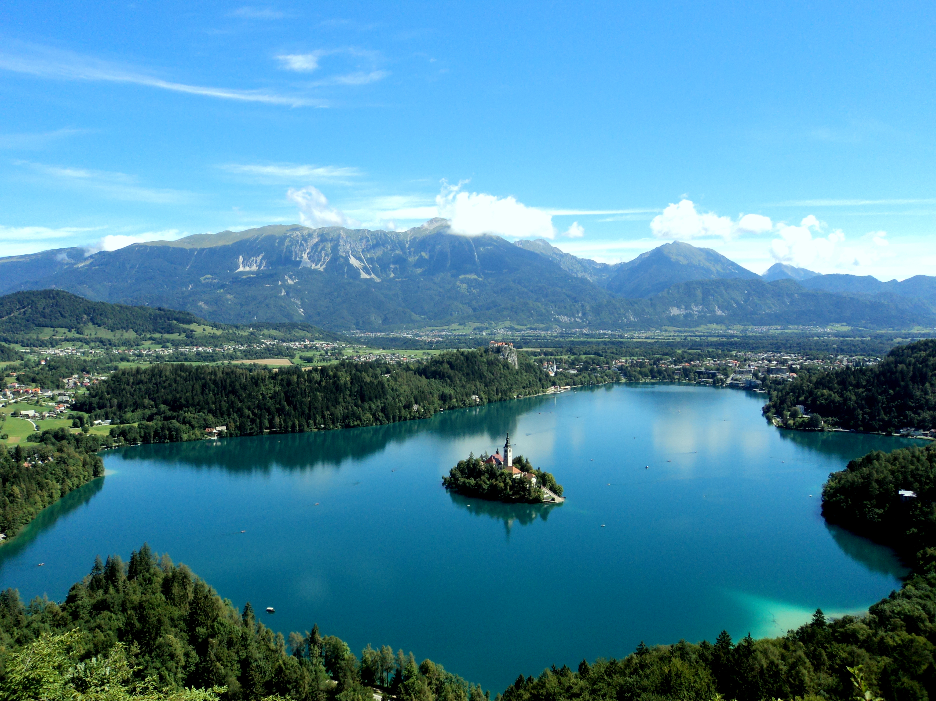
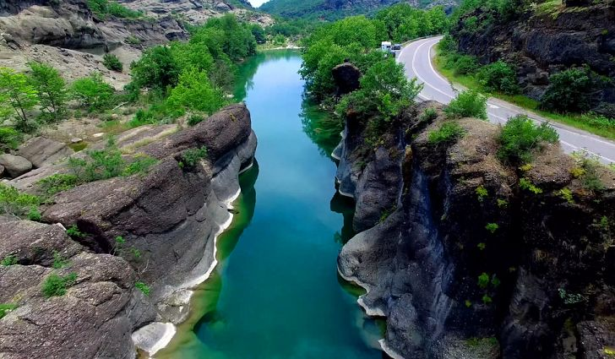
DO NOW: What is a Watershed?
Notes:
What is a watershed? Name an example. Where does water flow to? What can be carried with water as it moves downstream? What impacts can this have on the environment?
Ocean: https://www.unenvironment.org/news-and-stories/press-release/pioneering-global-framework-sustainable-ocean-finance-launched-our
River: https://www.worldatlas.com/articles/major-rivers-of-greece.html
Lake: https://en.wikipedia.org/wiki/Lake_Bled

Slide 4
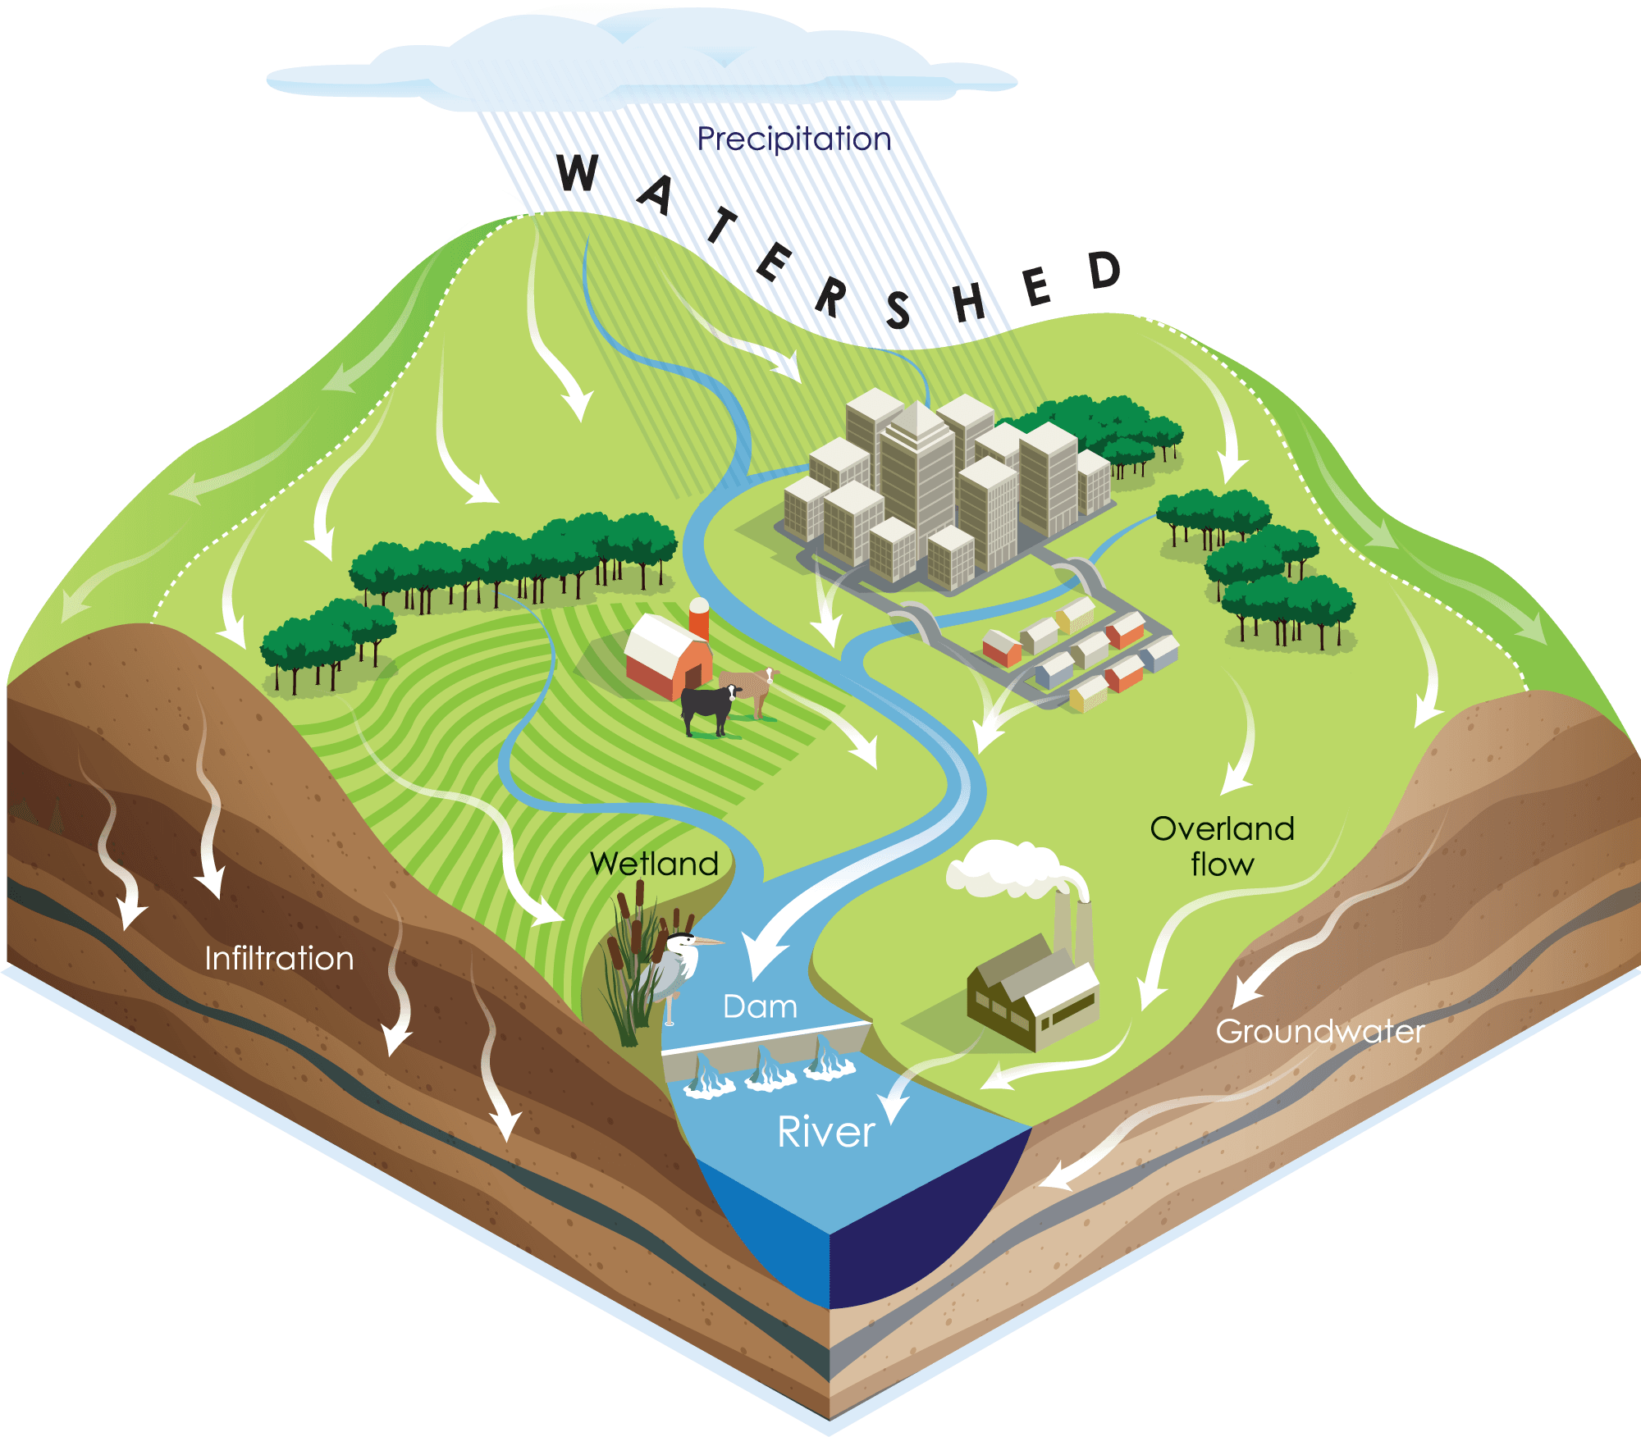
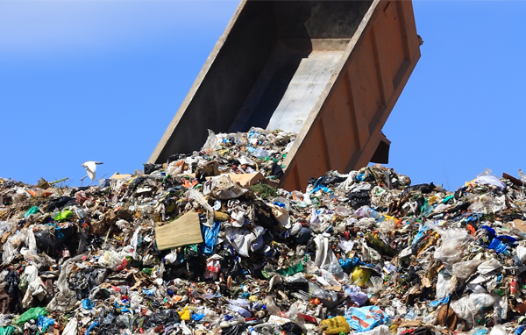

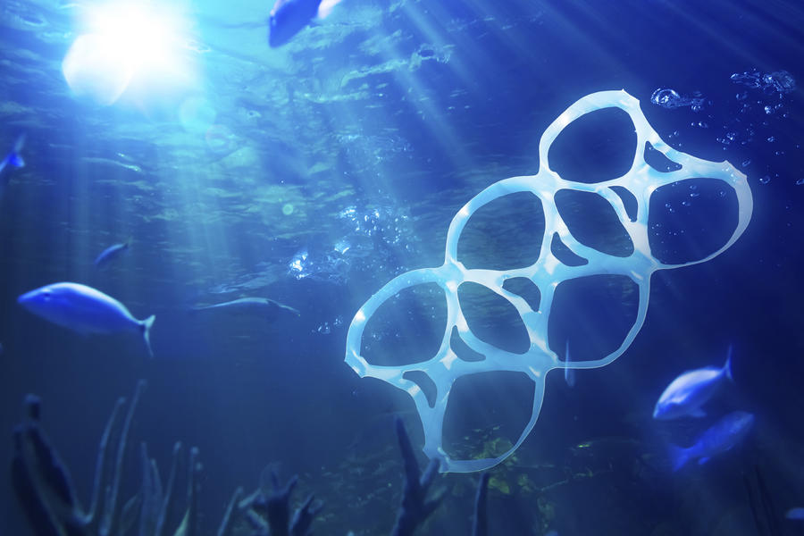
Keywords
Notes:
Waste
Watershed
Marine Debris/Aquatic Trash
4R’s
Watershed: http://www.lakecountyil.gov/2375/Watersheds
Waste: https://www.buncombecounty.org/governing/depts/solid-waste/news_detail.aspx?newsid=16877

Slide 5
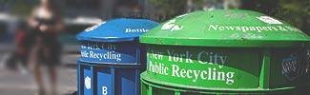


The 4 Rs
Notes:
https://www.epa.gov/sites/production/files/styles/large/public/2013-06/recycle.jpg
The 4 Rs: Today, we are going to learn about plastics, trash, and our big waste problem. Have you ever seen trash that isn’t in trash cans? Where? Trash can accidentally flow into our streams, rivers, and oceans, which upsets our animal friends. Sometimes, trash can leak nasty chemicals into the soil. It’s important to follow the four Rs – refuse, reduce, reuse, and recycle – as much as we can.
Refuse means that you can choose not to use or buy something in the first place!
Reduce means using less stuff in general.
Reuse means trying to use something until it can’t be used any more.
Recylce means properly disposing of plastics, metals, and other recyclable materials so they can be made into other things.
8 million metric tons of garbage end up in the ocean every year. This is the same as a garbage truck dumping its trash into the ocean every minute of every day for a whole year! Almost all of this trash, 88%, is plastic. Plastics don’t break down, or biodegrade, like apples or other products, but instead break into tinier and tinier pieces that can stick around for thousands of years! Litter is ugly, can hurt animals, and costs people billions of dollars every year. Let’s play a game called “how long til it’s gone?”
Source: http://brucemctague.com/wp-content/uploads/2016/01/dirty-water-clean-water.jpg

Slide 6
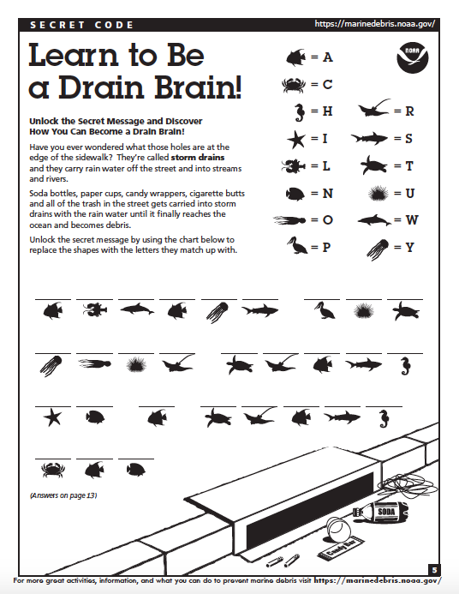
Notes:
*Hand out copies of “Learn How to be a Brain Drain” to each student from https://marinedebris.noaa.gov/understanding-marine-debris-games-and-activities-kids-all-ages and discuss:1) what is marine debris? 2) what is a storm drain? 3) How does this impact our water and our beaches?*
Directions: Unlock the Secret Message and Discover How You Can Become a Drain Brain!
- Have you ever wondered what those holes are at the edge of the sidewalk? They’re called storm drains and they carry rain water off the street and into streams and rivers.
- Soda bottles, paper cups, candy wrappers, cigarette butts and all of the trash in the street gets carried into storm drains with the rain water until it finally reaches the ocean and becomes debris.
- Unlock the secret message by using the chart below to replace the shapes with the letters they match up with.
Answer: ALWAYS PUT YOUR TRASH IN A TRASH CAN.

Slide 7
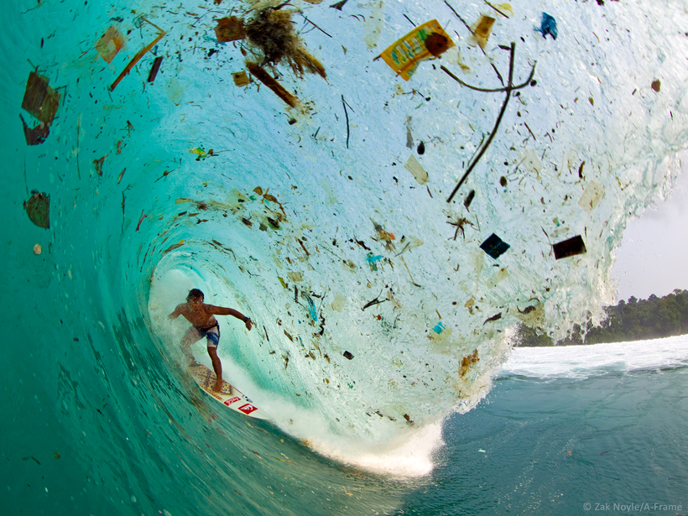
Intro
Notes:
Today, we’re going to learn about plastics, trash, and our big waste problem. Have you seen trash that isn’t in trash cans? Where? Trash can accidentally flow into our streams, rivers, and oceans, which upsets our animal friends. Sometimes, trash can leak nasty chemicals into the soil. It’s important to Refuse, Reduce, Reuse and Recycle as much as we can.
“Refuse” means that you can choose not to use or buy something in the first place!
“Reduce” means using less stuff in general.
“Reuse” means trying to use something until it can’t be used any more.
“Recycle” means properly disposing of plastics, metals, and other recyclable materials so they can be made into other things.
Use PowerPoint.
8 million metric tons of garbage enter the world’s oceans each year. This is the equivalent to a garbage truck unloading its contents into the ocean every minute of every day for the entire year. 88% of this garbage entering the ocean is made up of plastic. Plastics are especially frightening because they do not biodegrade like apples and other products but instead break into smaller and smaller pieces persisting in the environment for thousands of years. Litter on land is ugly, harmful to animals and their habitats, and cost humans billions of dollars annually.
Let’s play a game called “how long ‘til it’s gone!” (On PowerPoint)
Source: https://eos.org/meeting-reports/developing-a-remote-sensing-system-to-track-marine-debris

Slide 8
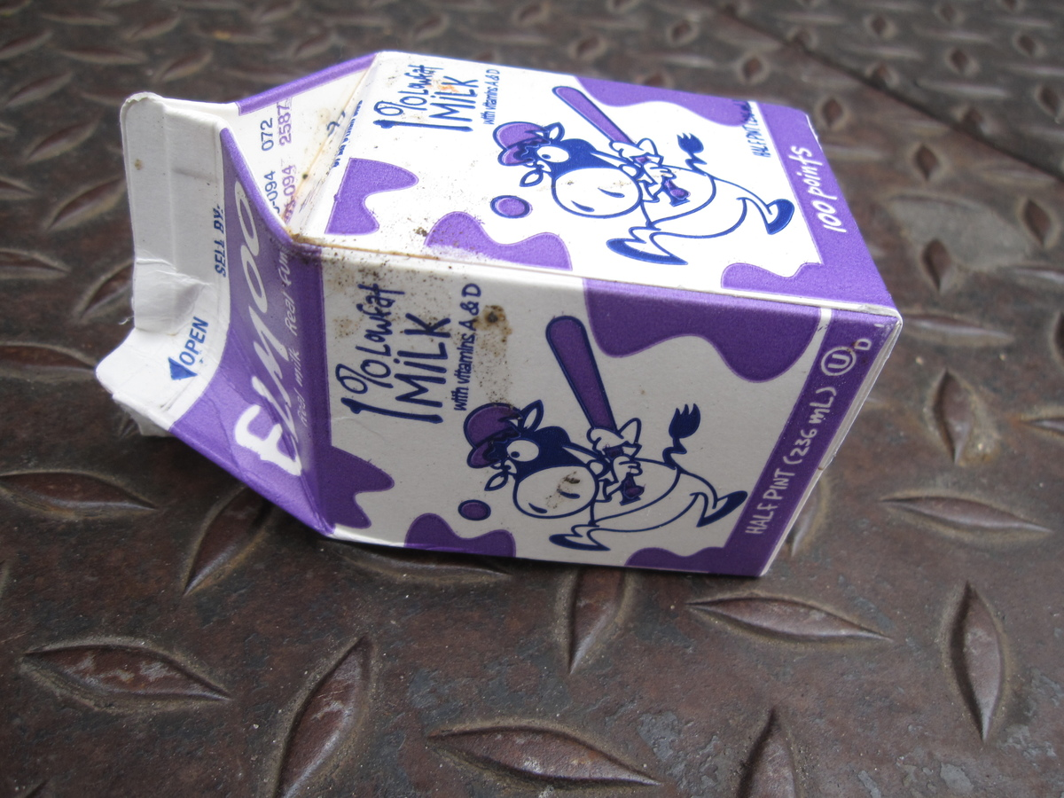
How Long ‘till it’s GONE?

Slide 9
How Long ‘till it’s GONE?
3 months
Notes:
A wax milk carton takes about 3 months to break down!
Source: http://cowbird.com/print/story/16668/Milk_Carton/

Slide 10
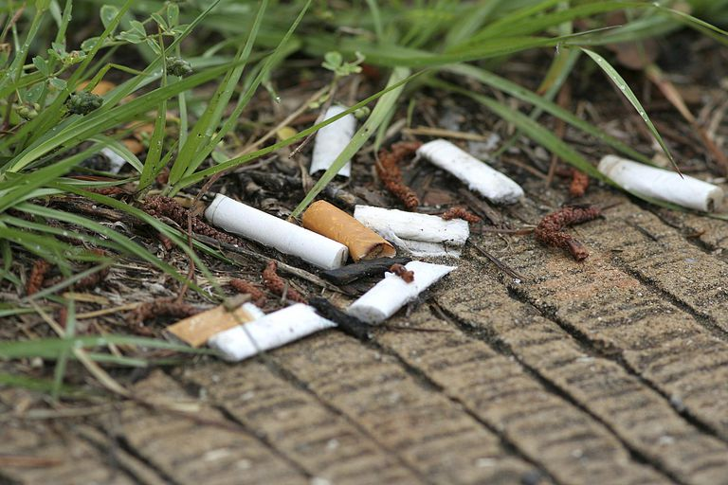
How Long ‘till it’s GONE?
Notes:
How long until a cigarette is gone?

Slide 11
How Long ‘till it’s GONE?
5 years
Notes:
A cigarette won’t break down for 5 years!

Slide 12
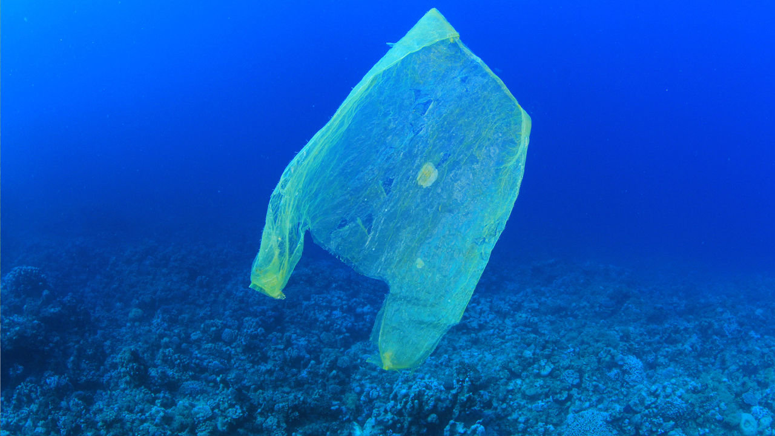
How Long ‘till it’s GONE?
Notes:
We think it takes about 20 years for a plastic bag to break down.

Slide 13
How Long ‘till it’s GONE?
20-1000
years
Notes:
We think it takes about 20-1000 years for a plastic bag to break down.

Slide 14
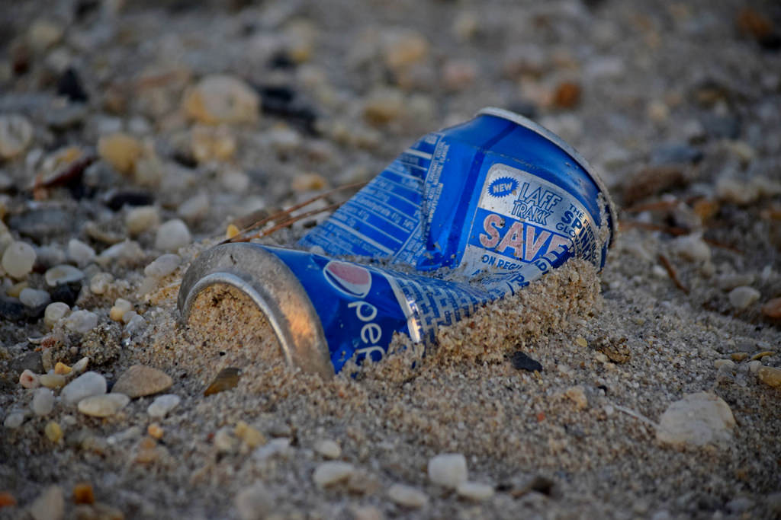
How Long ‘till it’s GONE?
Notes:
On average, it takes an aluminum can 100 years to break down!
https://www.flickr.com/photos/schuminweb/32613215440

Slide 15
How Long ‘till it’s GONE?
100years
Notes:
We think it takes about 20 years for a plastic bag to break down.

Slide 16
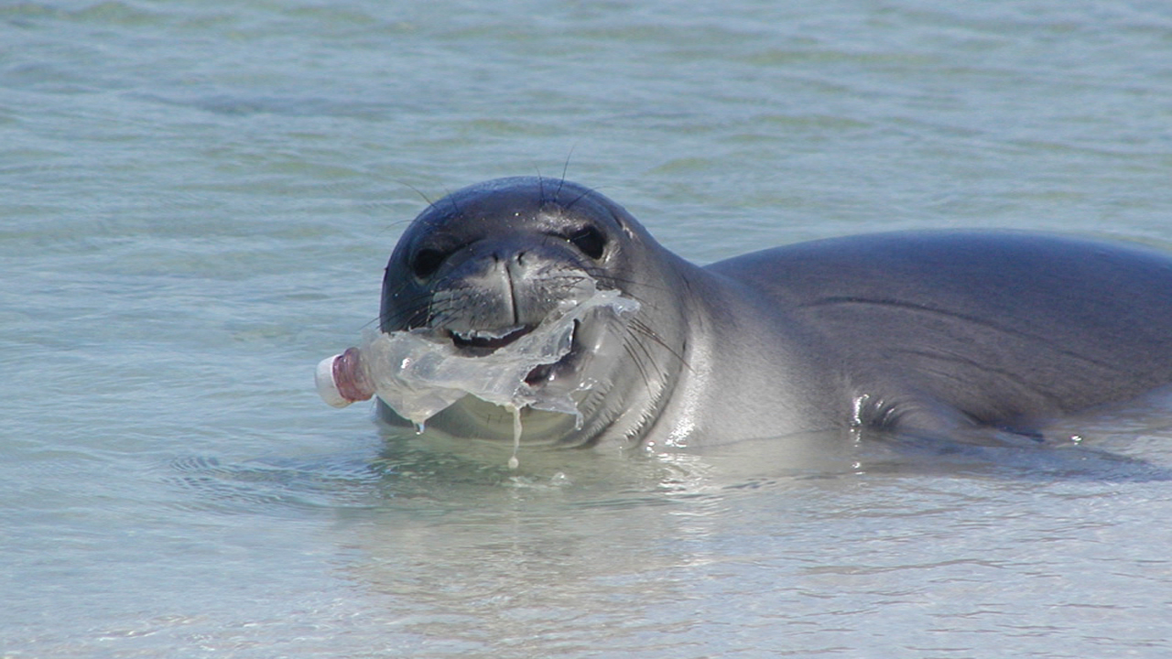
How Long ‘till it’s GONE?
Notes:
How long ‘till a plastic bottle is gone?

Slide 17
How Long ‘till it’s GONE?
450 years
Notes:
It takes 450 years for a plastic bottle to break down!

Slide 18
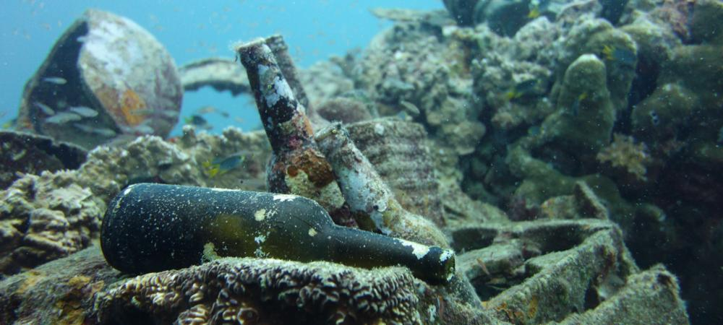
How Long ‘till it’s GONE?
Notes:
How long ‘till a glass bottle is gone?

Slide 19
How Long ‘till it’s GONE?
1,000,000 years!
Notes:
It takes one *million* years for a glass bottle to break down!

Slide 20
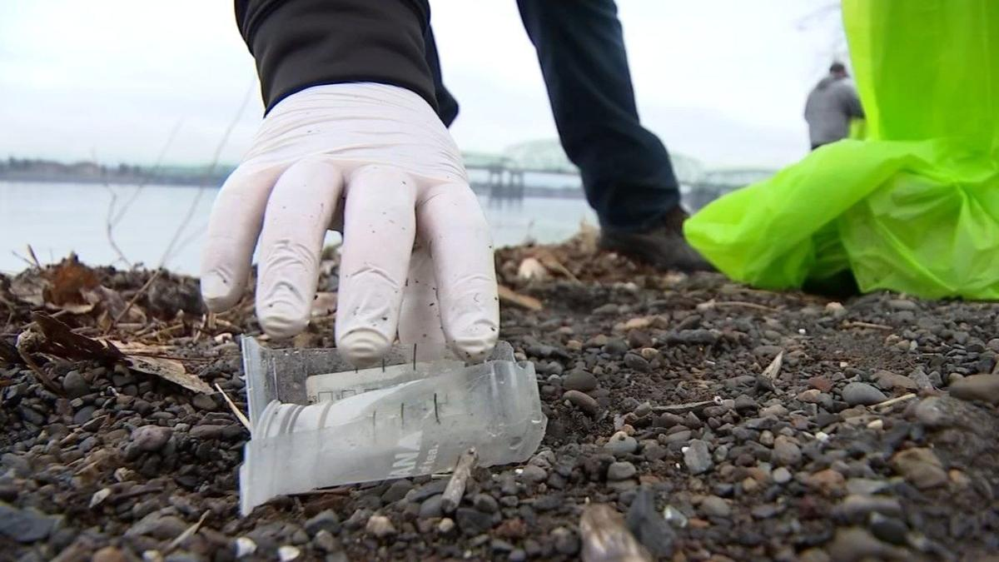
Trash Tracking
Notes:
Trash Tracking: Let’s do an activity. This activity happens outdoors.
Pollution that comes from our rivers and streams usually goes into the ocean. To see this ourselves, we will be going outside to observe the places trash comes from, and the damage it can cause! For today’s assignment we will be counting pollution as all litter or trash we can see easily – these things that can become marine debris. It is important to avoid any sharp items, like broken glass, and to wear gloves during this assignment.

Slide 21

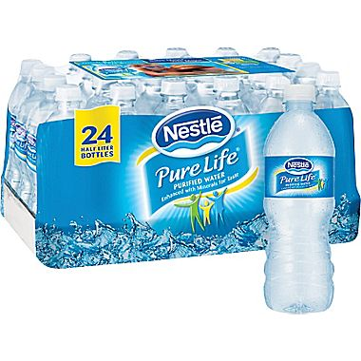
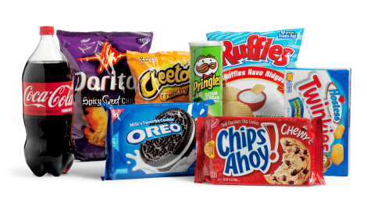
Trash Tracking Predictions
Notes:
Let’s make predictions. What do you think you will find outside? What types of trash will you find most? Where will you find the most trash? At the end of this activity, you will each pick one piece of trash that stands out to you for any reason.

Slide 22
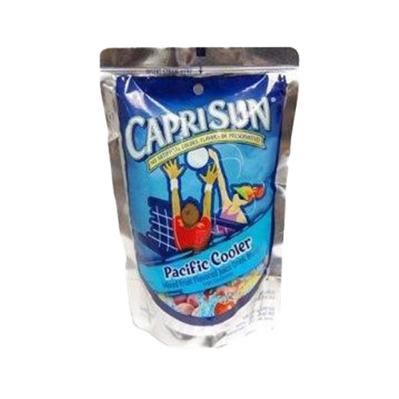
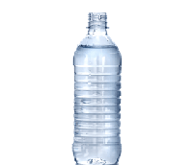



Analyzing the Data
Notes:
Let’s reflect. What did you find when looking for litter outside? What type of trash did you find most? What was the one piece of trash you found that stands out to you, and why?
Source: https://etownpubliclibrary.org/event/wild-wednesday-copy-copy-copy/
http://pluspng.com/plastic-bottles-png-170.html
https://yocartdelivery.com/products/capri-sun-pacific-cooler-6oz
https://unixtitan.net/explore/straw-clipart-png/

Slide 23
How can we help?
Notes:
How can we help? These issues may seem huge and scary, but there are things all of us can do to help keep our oceans clean and our animals safe. Let’s brainstorm ways we can help. Why is there trash in the water? Why does it keep happening? What are steps you can take at school or at home to help?

Slide 24
Notes:
Answer? Reduce, Reuse, Recycle and Refuse!

Slide 25
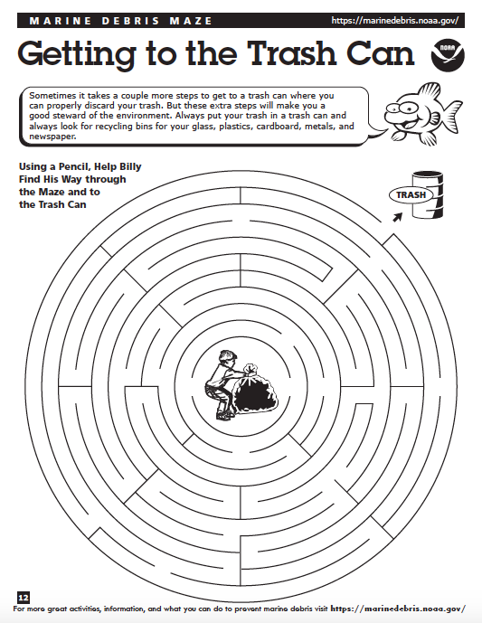
Getting to the
Trash Can!
Notes:
*Hand out a copy of “Getting to the Trash Can” maze (Source: https://marinedebris.noaa.gov/understanding-marine-debris-games-and-activities-kids-all-ages) to each student and discuss:
Where did your trash come from? What risks or harm does it pose to humans, animals, or the environment? What could be done to prevent similar items from being littered in the future? Why is it important to properly dispose of waste?

Slide 26
How to Solve the Problem - Practice
If we don’t need a plastic bag at the grocery store we should _______
Notes:
Brainstorm solutions to this problem.
Brainstorm solutions to this problem. Cause and Effect: What is the reason for this trash in the water? Why does it keep happening? How can we fix this problem? What can you do each day at school or at home?
Consider the 4 R’s: Refuse, Reduce, Reuse, and Recycle.
Ask students to talk about this as a group.
Source: Source: https://etownpubliclibrary.org/event/wild-wednesday-copy-copy-copy/

Slide 27

Practice
If we don’t need a plastic bag at the grocery store we should _______
REFUSE it
Notes:
Brainstorm solutions to this problem.
Brainstorm solutions to this problem. Cause and Effect: What is the reason for this trash in the water? Why does it keep happening? How can we fix this problem? What can you do each day at school or at home?
Consider the 4 R’s: Refuse, Reduce, Reuse, and Recycle.
Ask students to talk about this as a group.
Source: https://etownpubliclibrary.org/event/wild-wednesday-copy-copy-copy/
http://clipart-library.com/no-cliparts.html

Slide 28

Practice
If we only need one paper towel to clean up our mess, we should ______
Notes:
Brainstorm solutions to this problem.
Brainstorm solutions to this problem. Cause and Effect: What is the reason for this trash in the water? Why does it keep happening? How can we fix this problem? What can you do each day at school or at home?
Consider the 4 R’s: Refuse, Reduce, Reuse, and Recycle.
Ask students to talk about this as a group.
Source: https://www.pinterest.com/pin/250653535488324657/

Slide 29

Practice
If we only need one paper towel to clean up our mess, we should ______
REDUCE
the number we use and only tear off one!
Notes:
Brainstorm solutions to this problem.
Brainstorm solutions to this problem. Cause and Effect: What is the reason for this trash in the water? Why does it keep happening? How can we fix this problem? What can you do each day at school or at home?
Consider the 4 R’s: Refuse, Reduce, Reuse, and Recycle.
Ask students to talk about this as a group.

Slide 30
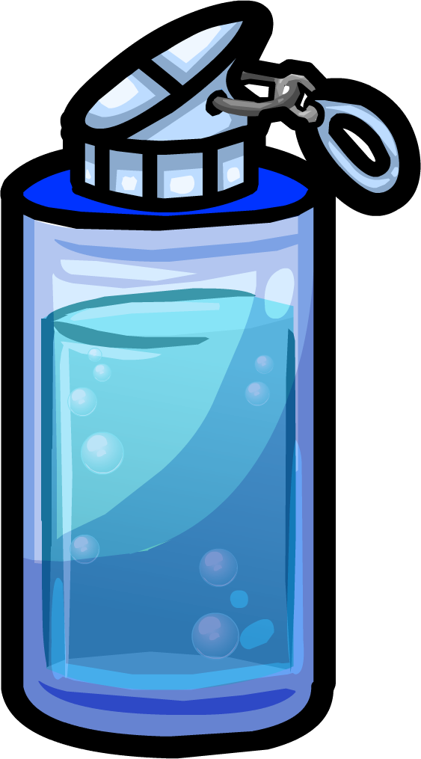
Practice
If we have an empty water bottle, we should refill it and ______!
Notes:
Brainstorm solutions to this problem.
Brainstorm solutions to this problem. Cause and Effect: What is the reason for this trash in the water? Why does it keep happening? How can we fix this problem? What can you do each day at school or at home?
Consider the 4 R’s: Refuse, Reduce, Reuse, and Recycle.
Ask students to talk about this as a group.
Source: http://clipart-library.com/water-bottles-cliparts.html

Slide 31
Practice
If we have an empty water bottle, we should refill it and ______!
REUSE it
Notes:
Brainstorm solutions to this problem.
Brainstorm solutions to this problem. Cause and Effect: What is the reason for this trash in the water? Why does it keep happening? How can we fix this problem? What can you do each day at school or at home?
Consider the 4 R’s: Refuse, Reduce, Reuse, and Recycle.
Ask students to talk about this as a group.
Source: http://clipart-library.com/water-bottles-cliparts.html

Slide 32
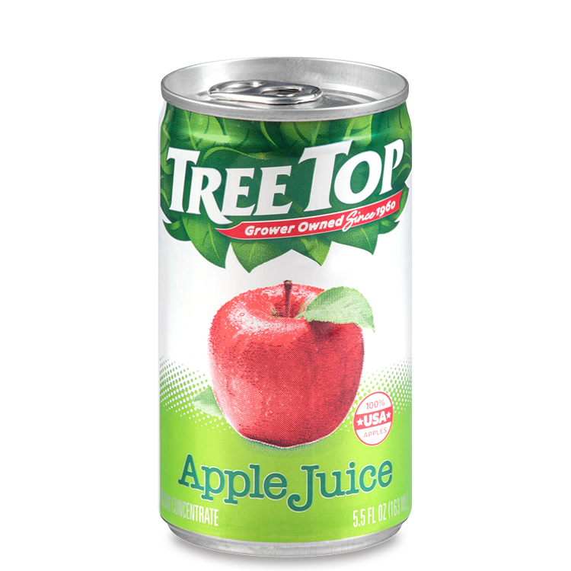
Practice
It we drink something out of a tin can, we should throw it in the right bin and ______
Notes:
Brainstorm solutions to this problem.
Brainstorm solutions to this problem. Cause and Effect: What is the reason for this trash in the water? Why does it keep happening? How can we fix this problem? What can you do each day at school or at home?
Consider the 4 R’s: Refuse, Reduce, Reuse, and Recycle.
Ask students to talk about this as a group.
Source: https://www.treetop.com/consumer/fruit-products/juice/apple-juice/5pt5oz-can/

Slide 33
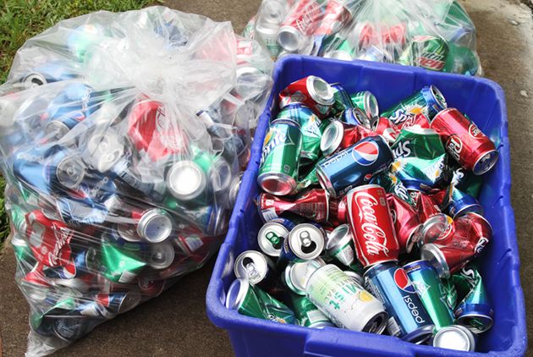
Practice
It we drink something out of a tin can, we should throw it in the right bin and ______ !
RECYLE it
Notes:
Brainstorm solutions to this problem.
Brainstorm solutions to this problem. Cause and Effect: What is the reason for this trash in the water? Why does it keep happening? How can we fix this problem? What can you do each day at school or at home?
Consider the 4 R’s: Refuse, Reduce, Reuse, and Recycle.
Ask students to talk about this as a group.
Source: https://recyclenation.com/2014/03/recycle-cans/

Slide 34
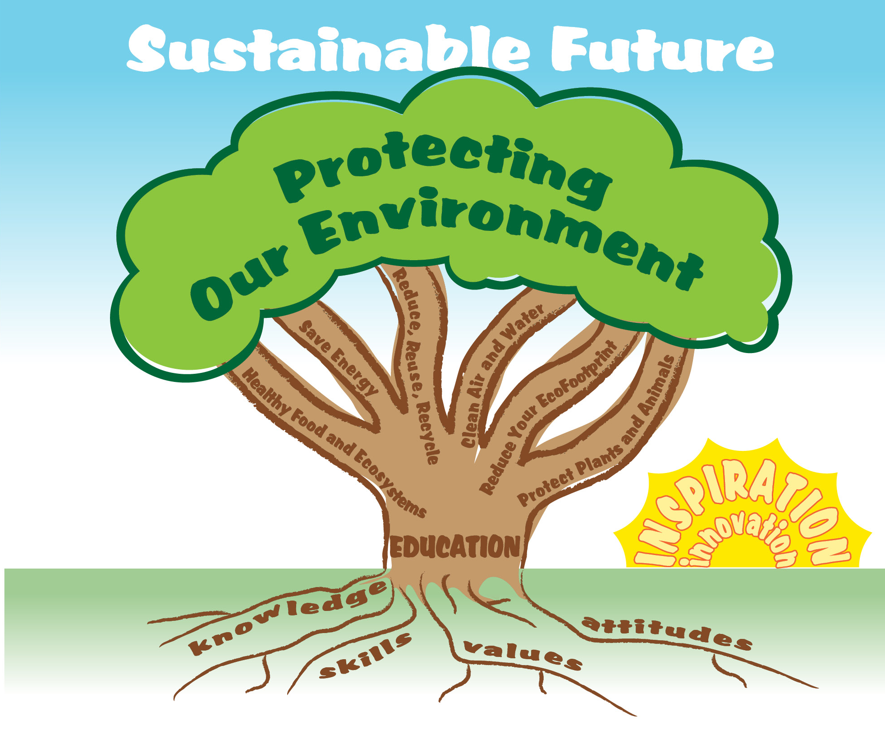
EcoLearn
Developed by the Environmental Protection Agency
With support from Department of State
Virtual Students of Federal Service Interns
https://www.epa.gov/education
US EPA
Region 10
EcoLearn
For more information: hanft.sally@epa.gov or salazar.viccy@epa.gov

