Slide 1
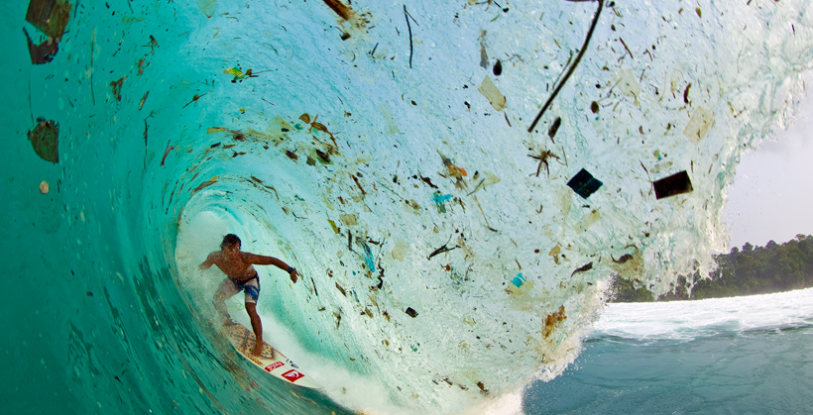

5th Grade
Marine Debris
Learn what we can do to keep our oceans clean and prevent plastic from entering out waterways and polluting our oceans.
US EPA
Region 10
EcoLearn
Notes:
https://eos.org/meeting-reports/developing-a-remote-sensing-system-to-track-marine-debris

Slide 2
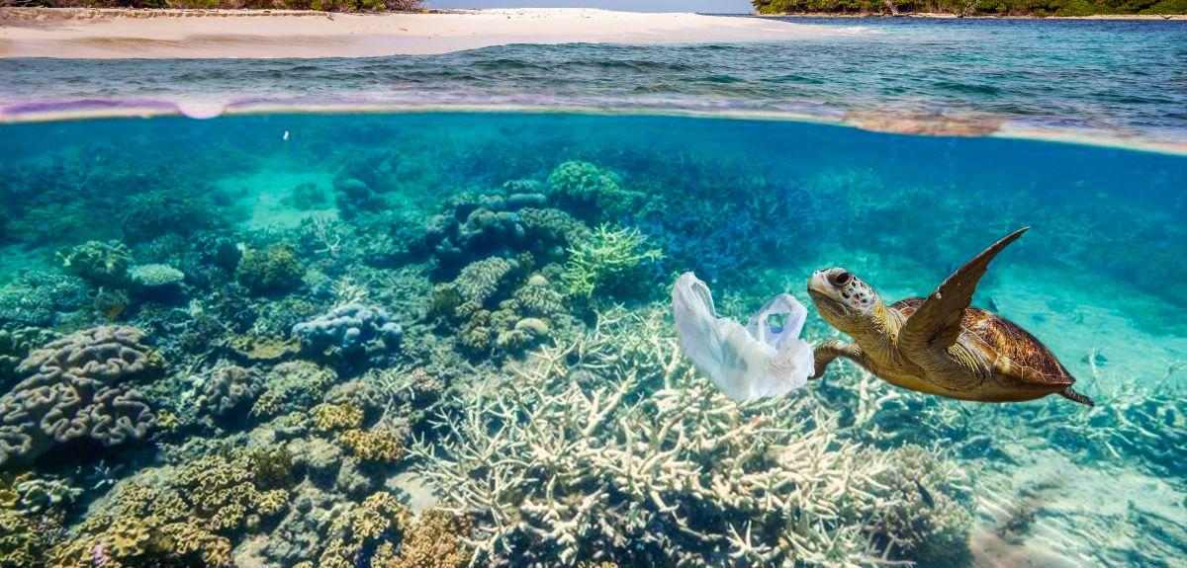
Marine Debris
Marine debris = any kind of trash that has made its way to the ocean, such as plastic bags, bottles, or other kinds of litter.
Notes:
Today, we will learn about marine debris, also called aquatic trash. Marine debris is any kind of trash that has made its way to the ocean, such as plastic bags, bottles, or other kinds of litter.
https://phys.org/news/2017-07-urgently-oceans-scientists.html

Slide 3
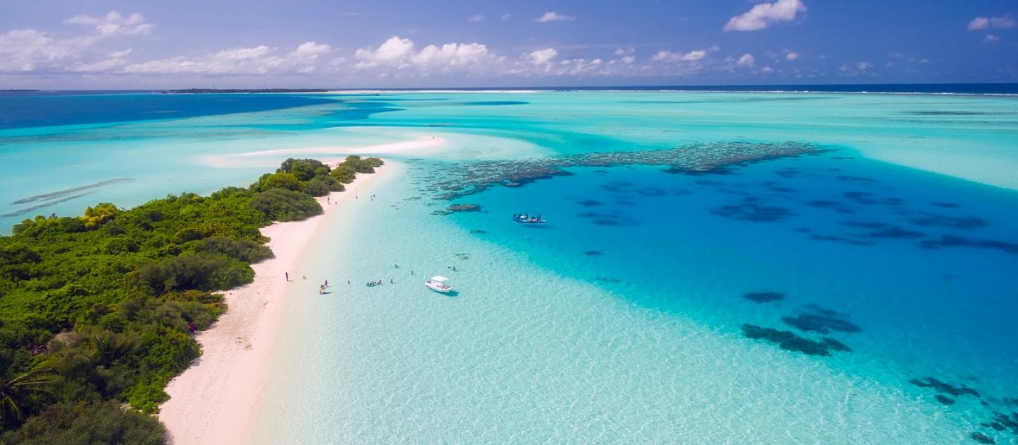
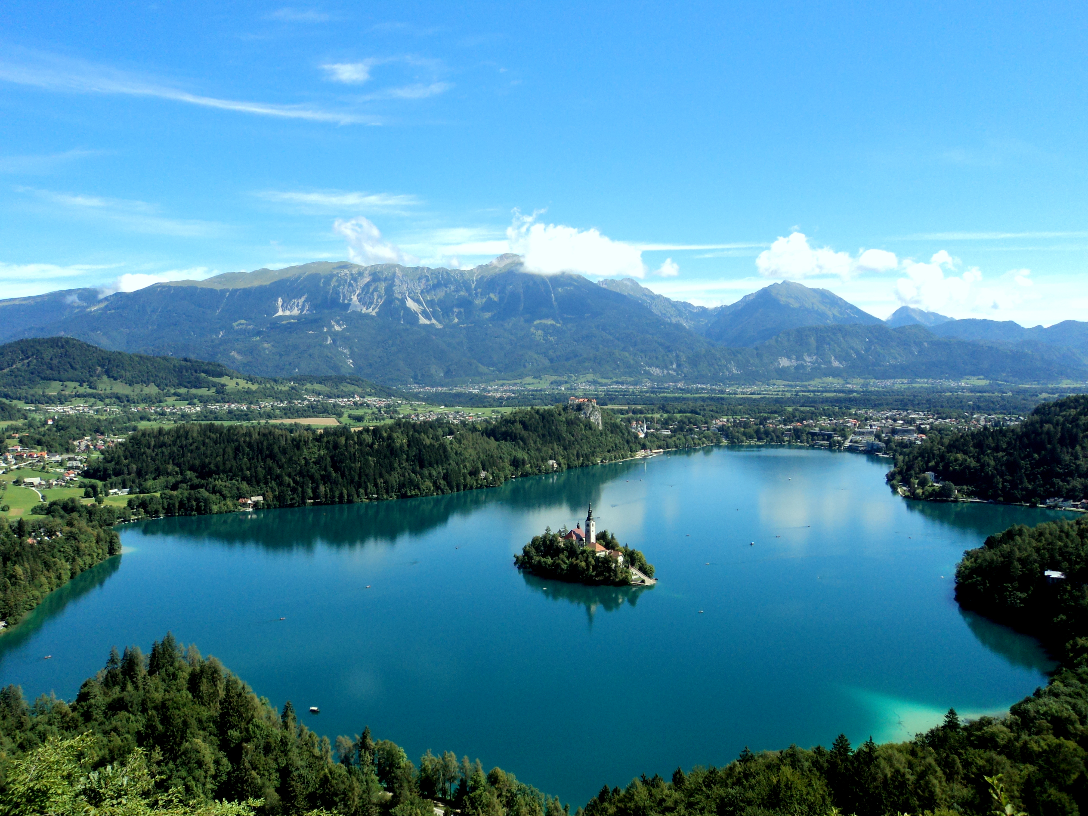
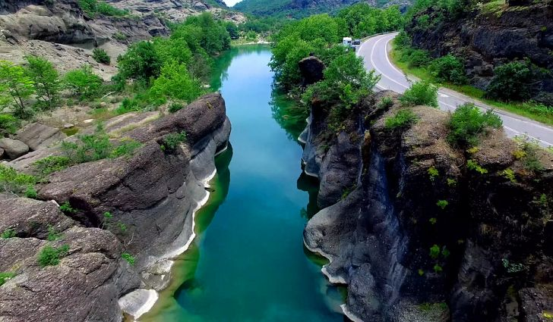
DO NOW: What is a Watershed?
Notes:
What is a watershed? Name an example. Where does water flow to? What can be carried with water as it moves downstream? What impacts can this have on the environment?
Ocean: https://www.unenvironment.org/news-and-stories/press-release/pioneering-global-framework-sustainable-ocean-finance-launched-our
River: https://www.worldatlas.com/articles/major-rivers-of-greece.html
Lake: https://en.wikipedia.org/wiki/Lake_Bled

Slide 4
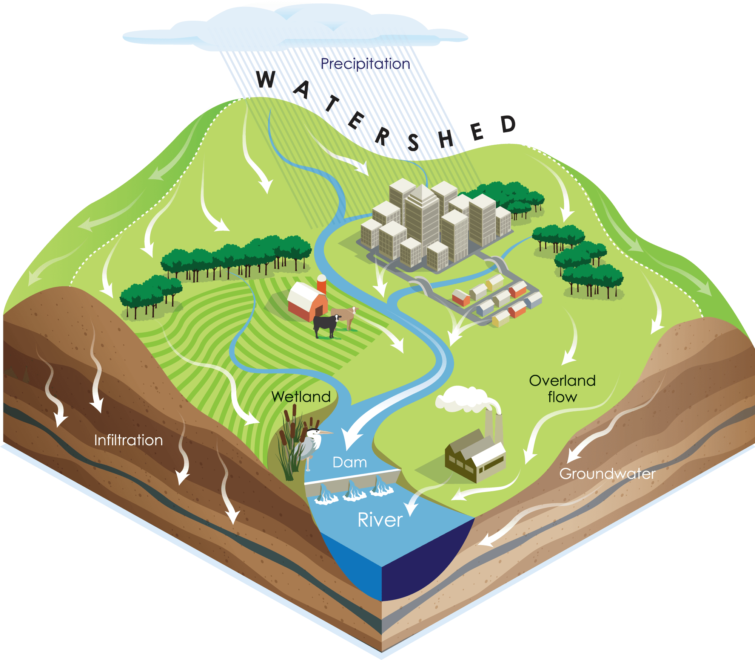
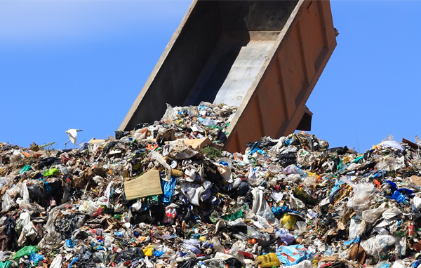

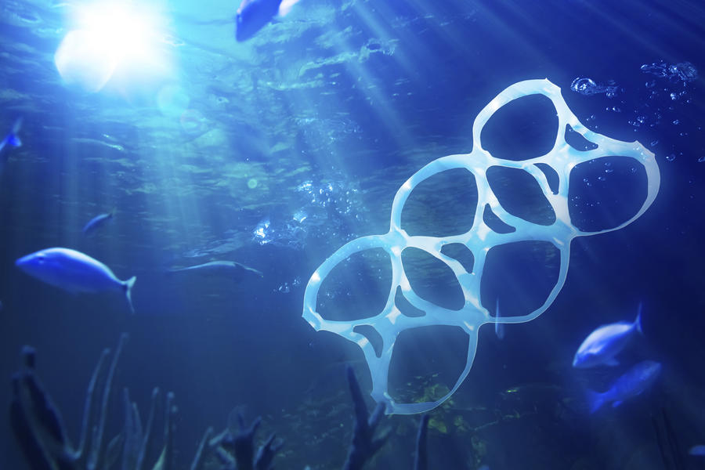
Keywords
Click for audio.
Notes:
Waste
Watershed
Marine Debris/Aquatic Trash
4R’s
Watershed: http://www.lakecountyil.gov/2375/Watersheds
Waste: https://www.buncombecounty.org/governing/depts/solid-waste/news_detail.aspx?newsid=16877

Slide 5
The 4 Rs
1) Refuse = means that you can choose not to use or buy something in the first place!
2) Reduce = means using less stuff in general.
3) Reuse = means trying to use something until it can’t be used any more.
4) Recycle = means properly disposing of plastics, metals, and other recyclable materials so they can be made into other things.
Click for audio.
Notes:
Today, we’re going to learn about plastics, trash, and our big waste problem. Have you seen trash that isn’t in trash cans? Where? Trash can accidentally flow into our streams, rivers, and oceans, which upsets our animal friends. Sometimes, trash can leak nasty chemicals into the soil. It’s important to Refuse, Reduce, Reuse and Recycle as much as we can.
“Refuse” means that you can choose not to use or buy something in the first place!
“Reduce” means using less stuff in general.
“Reuse” means trying to use something until it can’t be used any more.
“Recycle” means properly disposing of plastics, metals, and other recyclable materials so they can be made into other things.

Slide 6
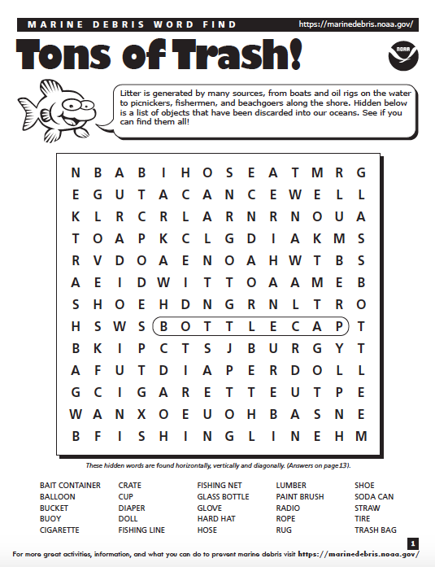
Tons of Trash
Click for audio.
Notes:
Let’s start with a word find activity!
*Hand out the “Tons of Trash” activity to each student and give the students a few minutes to find as many types of marine debris as possible. (Source: https://marinedebris.noaa.gov/understanding-marine-debris-games-and-activities-kids-all-ages)

Slide 7
Trash Talk
8 million metric tons of garbage enter the world’s oceans each year.
That’s equal to a garbage truck dumping its contents into the ocean every MINUTE of EVERY DAY for a YEAR.
Click for audio.
Notes:
8 million metric tons of garbage enter the world’s oceans each year. This is the equivalent to a garbage truck unloading its contents into the ocean every minute of every day for the entire year. 88% of this garbage entering the ocean is made up of plastic. Plastics are especially frightening because they do not biodegrade like apples and other products but instead break into smaller and smaller pieces persisting in the environment for thousands of years. Litter on land is ugly, harmful to animals and their habitats, and cost humans billions of dollars annually.
Lets play a game called “how long til its gone”
Source: https://www.buncombecounty.org/governing/depts/solid-waste/news_detail.aspx?newsid=16877

Slide 8
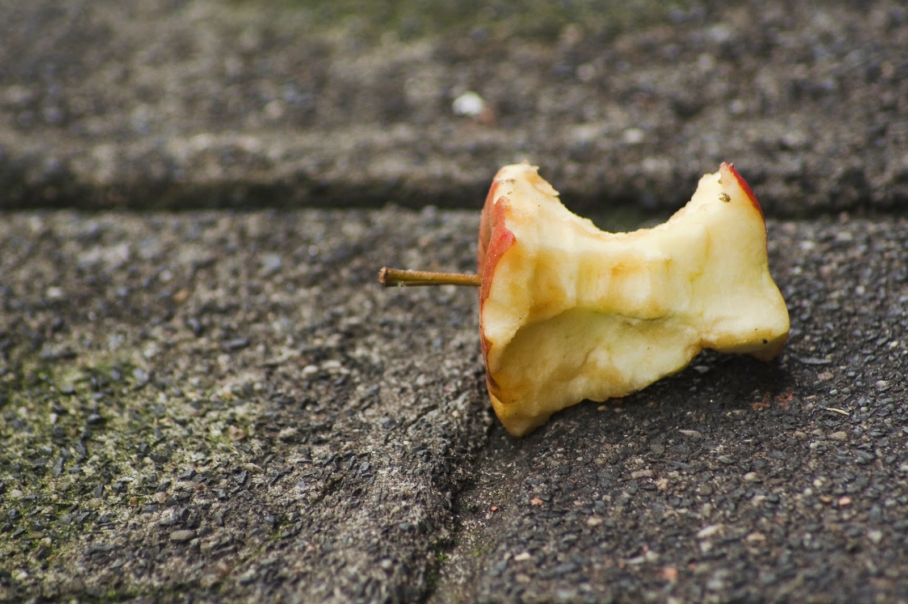
How Long ‘till it’s GONE?
Click for audio.
Notes:
How long till an apple is gone?

Slide 9
How Long ‘till it’s GONE?
2 months
Click for audio.
Notes:
An apple will break down in about 2 months!

Slide 10
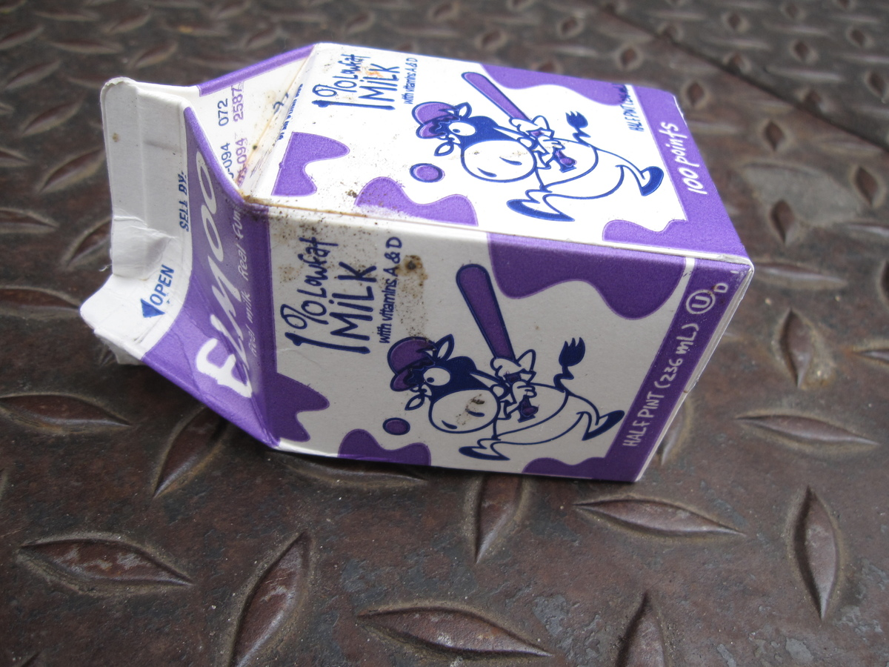
How Long ‘till it’s GONE?
Click for audio.

Slide 11
How Long ‘till it’s GONE?
3 months
Click for audio.
Notes:
A wax milk carton takes about 3 months to break down!
Source: http://cowbird.com/print/story/16668/Milk_Carton/

Slide 12
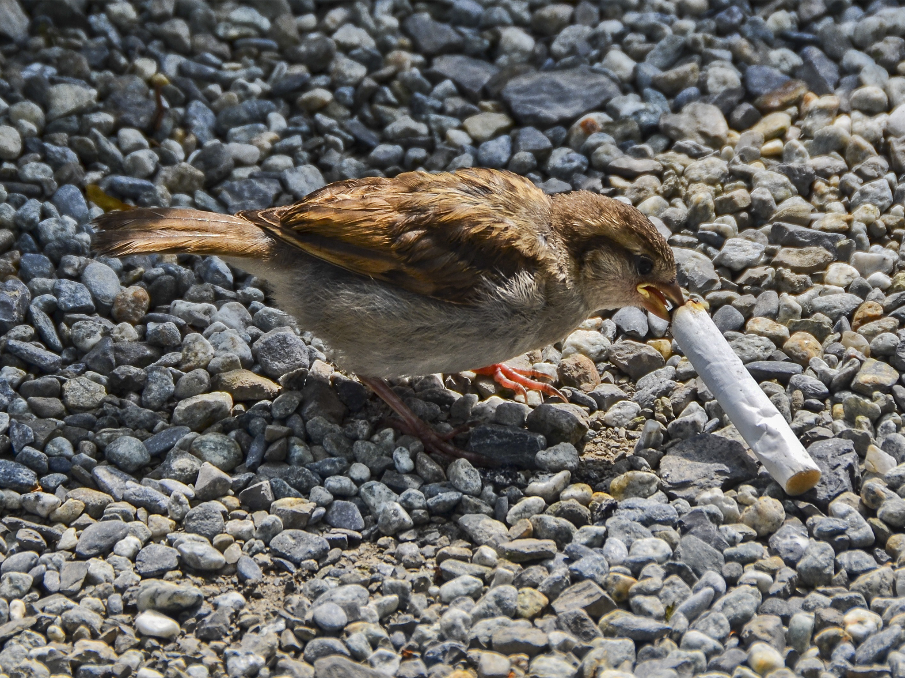
How Long ‘till it’s GONE?
Click for audio.
Notes:
How long until a cigarette is gone?

Slide 13
How Long ‘till it’s GONE?
5 years
Click for audio.
Notes:
A cigarette won’t break down for 5 years!

Slide 14
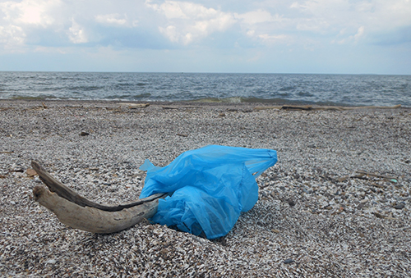
How Long ‘till it’s GONE?
Click for audio.
Notes:
We think it takes about 20 years for a plastic bag to break down.

Slide 15
How Long ‘till it’s GONE?
20 years
Click for audio.
Notes:
How long ‘till a plastic bag breaks down?

Slide 16
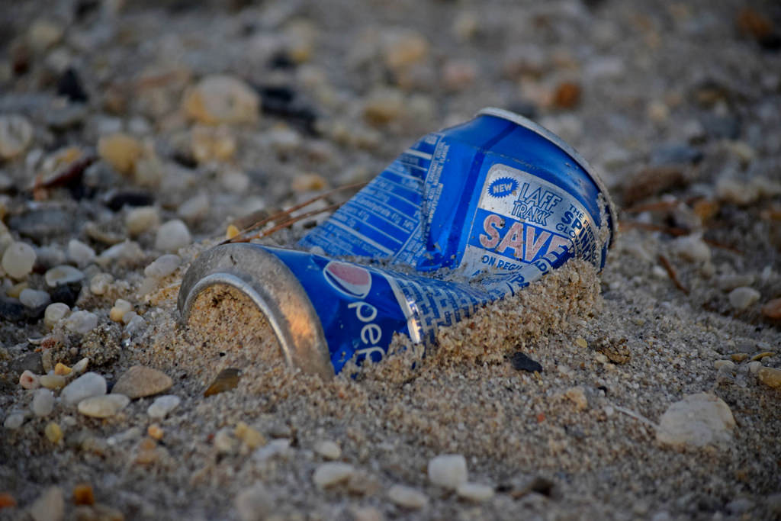
How Long ‘till it’s GONE?
Click for audio.
Notes:
On average, it takes an aluminum can 100 years to break down!
https://www.flickr.com/photos/schuminweb/32613215440

Slide 17
How Long ‘till it’s GONE?
100years
Click for audio.
Notes:
We think it takes about 20 years for a plastic bag to break down.

Slide 18
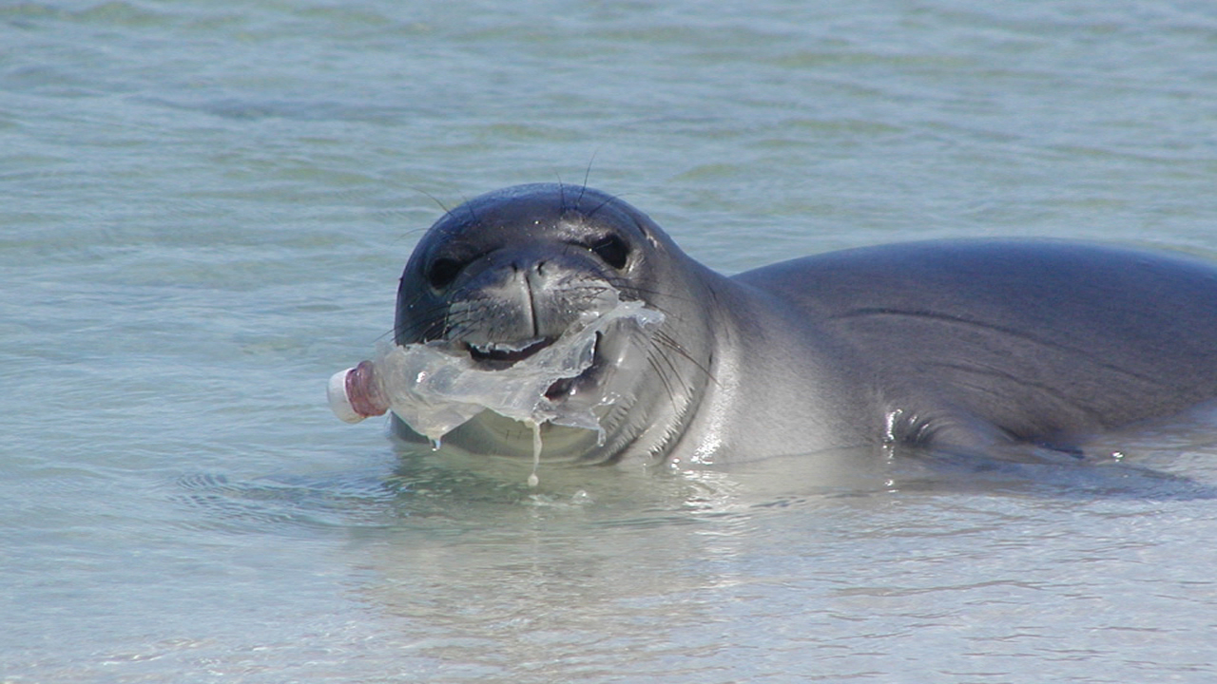
How Long ‘till it’s GONE?
Click for audio.
Notes:
How long ‘till a plastic bottle is gone?

Slide 19
How Long ‘till it’s GONE?
450 years
Click for audio.
Notes:
It takes 450 years for a plastic bottle to break down!

Slide 20
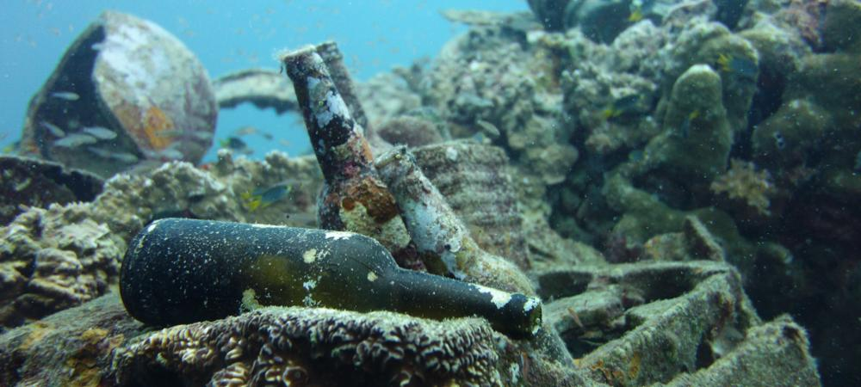
How Long ‘till it’s GONE?
Click for audio.
Notes:
How long ‘till a glass bottle is gone?

Slide 21
How Long ‘till it’s GONE?
1,000,000 years!
Click for audio.
Notes:
It takes one *million* years for a glass bottle to break down!

Slide 22
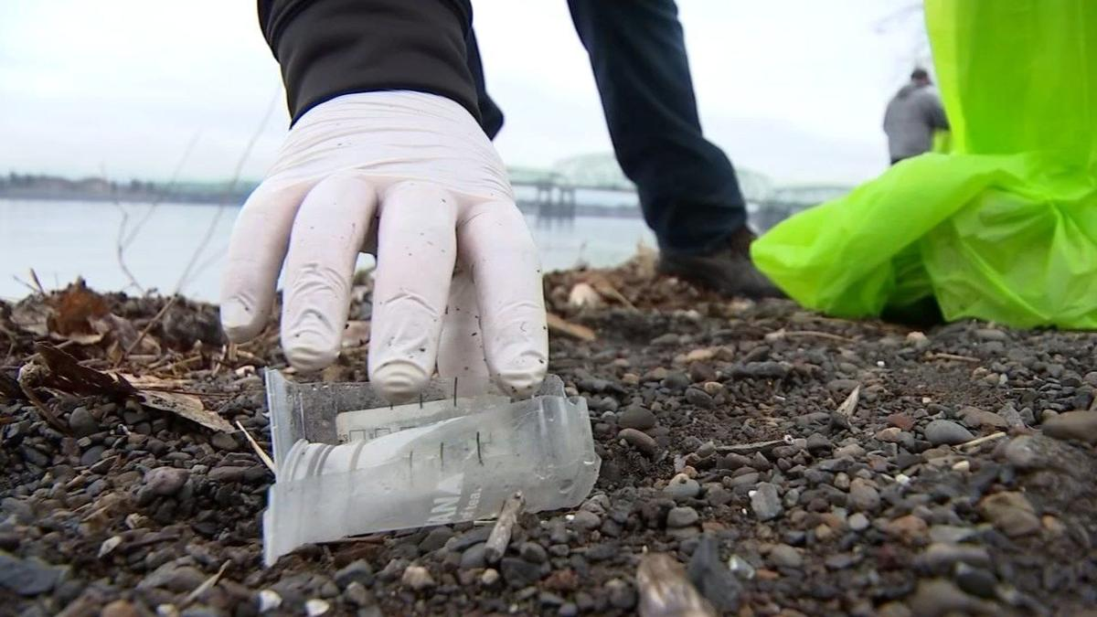
Trash Tracking
Click for audio.
Notes:
Trash Tracking: Let’s do an activity. This activity happens outdoors.
This activity occurs outdoors.
Introduce the activity:
Pollution that comes from our waterways more often than not travels into the ocean. In order to observe this, we will be going outside to observe and examine the sources and damages of this waste. For today’s assignment we will be counting pollution as easily seen litter, or trash -- these are things that can become “marine debris.”
Go over safety and sanitation rules with the students before going outside.
Avoid sharp items (needles, broken glass, etc.)
Wear gloves
Split the students up into groups of 4-5 and provide them with equipment. Before they head outside, ask them to make predictions about:
Where they will find the most trash and from what sources?
What types of trash will be the most prominent?
Once outside, have the students pick 100-foot sections and have them collect data, as well as trash. Each student must choose one piece of found trash that stands out to them for any reason and bring it into the classroom for a discussion. and describe how they can tell that it was transported by a waterway.

Slide 23
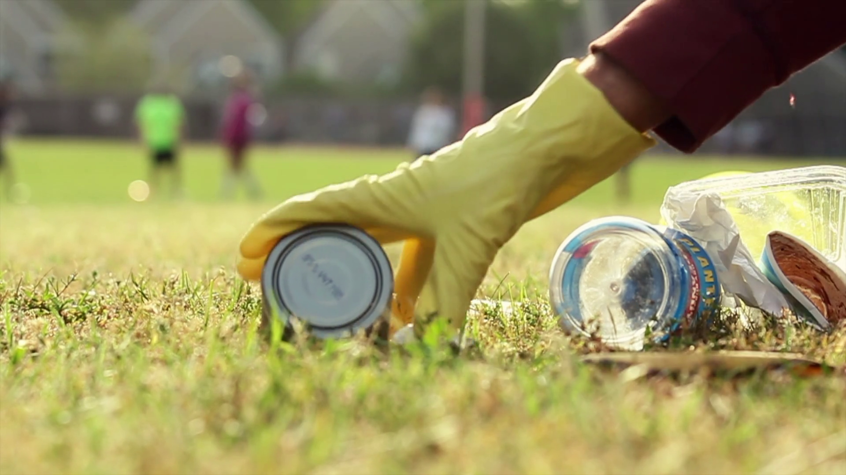
Trash Tracking Rules:
Avoid sharp items
2) Wear gloves!
Click for audio.
Notes:
Trash Tracking: Let’s do an activity. This activity happens outdoors.
This activity occurs outdoors.
Introduce the activity:
Pollution that comes from our waterways more often than not travels into the ocean. In order to observe this, we will be going outside to observe and examine the sources and damages of this waste. For today’s assignment we will be counting pollution as easily seen litter, or trash -- these are things that can become “marine debris.”
Go over safety and sanitation rules with the students before going outside.
Avoid sharp items (needles, broken glass, etc.)
Wear gloves
Split the students up into groups of 4-5 and provide them with equipment. Before they head outside, ask them to make predictions about:
Where they will find the most trash and from what sources?
What types of trash will be the most prominent?
Once outside, have the students pick 100-foot sections and have them collect data, as well as trash. Each student must choose one piece of found trash that stands out to them for any reason and bring it into the classroom for a discussion. and describe how they can tell that it was transported by a waterway.

Slide 24
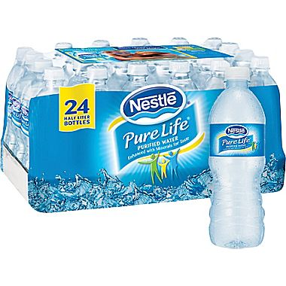
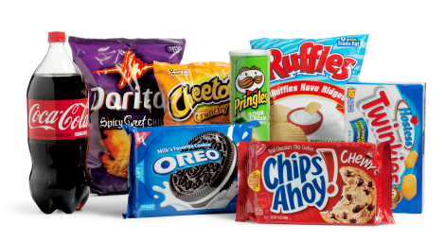

Trash Tracking Predictions
Where they will find the most trash and from what sources?
What types of trash will be the most prominent?
Click for audio.
Notes:
Let’s make predictions. What do you think you will find outside? What types of trash will you find most? Where will you find the most trash? At the end of this activity, you will each pick one piece of trash that stands out to you for any reason.

Slide 25

Analyzing the Data
Where is the biggest source of this trash?
Was it dropped there or transported
and how do you know?
What is the biggest threat to wildlife from your data? How about for human?
What is the most common type of trash that you found? Are you surprised?
What was the most unique type of trash that you found?
Notes:
Move to a place where all the students can quietly interpret the data.
Tell them to discuss questions such as:
Where is the biggest source of this trash? Was it dropped there or transported and how do you know?
What is the biggest threat to wildlife from your data? How about for human?
What is the most common type of trash that you found? Are you surprised?
What was the biggest pattern in this type of trash? What was the most unique type of trash that you found?

Slide 26
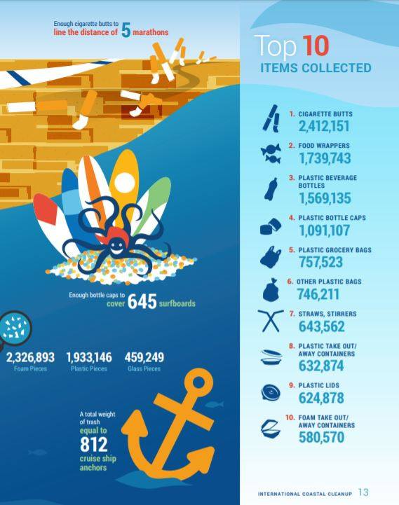
Notes:
Move to a place where all the students can quietly interpret the data.
Tell them to discuss questions such as:
Where is the biggest source of this trash? Was it dropped there or transported and how do you know?
What is the biggest threat to wildlife from your data? How about for human?
What is the most common type of trash that you found? Are you surprised?
What was the biggest pattern in this type of trash? What was the most unique type of trash that you found?

Slide 27
What Can we do to Help?
Click for audio.
Notes:
Answer? Reduce, Reuse, Recycle and Refuse!
Use the next few slides as practice!

Slide 28

Practice
If we don’t need a plastic bag at the grocery store we should _______
Click for audio.
Notes:
Brainstorm solutions to this problem.
Brainstorm solutions to this problem. Cause and Effect: What is the reason for this trash in the water? Why does it keep happening? How can we fix this problem? What can you do each day at school or at home?
Consider the 4 R’s: Refuse, Reduce, Reuse, and Recycle.
Ask students to talk about this as a group.
Source: Source: https://etownpubliclibrary.org/event/wild-wednesday-copy-copy-copy/

Slide 29

Practice
If we don’t need a plastic bag at the grocery store we should _______
REFUSE it
Click for audio.
Notes:
Brainstorm solutions to this problem.
Brainstorm solutions to this problem. Cause and Effect: What is the reason for this trash in the water? Why does it keep happening? How can we fix this problem? What can you do each day at school or at home?
Consider the 4 R’s: Refuse, Reduce, Reuse, and Recycle.
Ask students to talk about this as a group.
Source: https://etownpubliclibrary.org/event/wild-wednesday-copy-copy-copy/
http://clipart-library.com/no-cliparts.html

Slide 30

Practice
If we only need one paper towel to clean up our mess, we should ______
Click for audio.
Notes:
Brainstorm solutions to this problem.
Brainstorm solutions to this problem. Cause and Effect: What is the reason for this trash in the water? Why does it keep happening? How can we fix this problem? What can you do each day at school or at home?
Consider the 4 R’s: Refuse, Reduce, Reuse, and Recycle.
Ask students to talk about this as a group.
Source: https://www.pinterest.com/pin/250653535488324657/

Slide 31

Practice
If we only need one paper towel to clean up our mess, we should ______
REDUCE
the number we use and only tear off one!
Click for audio.
Notes:
Brainstorm solutions to this problem.
Brainstorm solutions to this problem. Cause and Effect: What is the reason for this trash in the water? Why does it keep happening? How can we fix this problem? What can you do each day at school or at home?
Consider the 4 R’s: Refuse, Reduce, Reuse, and Recycle.
Ask students to talk about this as a group.

Slide 32

Practice
If we have an empty water bottle, we should refill it and ______!
Click for audio.
Notes:
Brainstorm solutions to this problem.
Brainstorm solutions to this problem. Cause and Effect: What is the reason for this trash in the water? Why does it keep happening? How can we fix this problem? What can you do each day at school or at home?
Consider the 4 R’s: Refuse, Reduce, Reuse, and Recycle.
Ask students to talk about this as a group.
Source: http://clipart-library.com/water-bottles-cliparts.html

Slide 33
Practice
If we have an empty water bottle, we should refill it and ______!
REUSE it
Click for audio.
Notes:
Brainstorm solutions to this problem.
Brainstorm solutions to this problem. Cause and Effect: What is the reason for this trash in the water? Why does it keep happening? How can we fix this problem? What can you do each day at school or at home?
Consider the 4 R’s: Refuse, Reduce, Reuse, and Recycle.
Ask students to talk about this as a group.
Source: http://clipart-library.com/water-bottles-cliparts.html

Slide 34
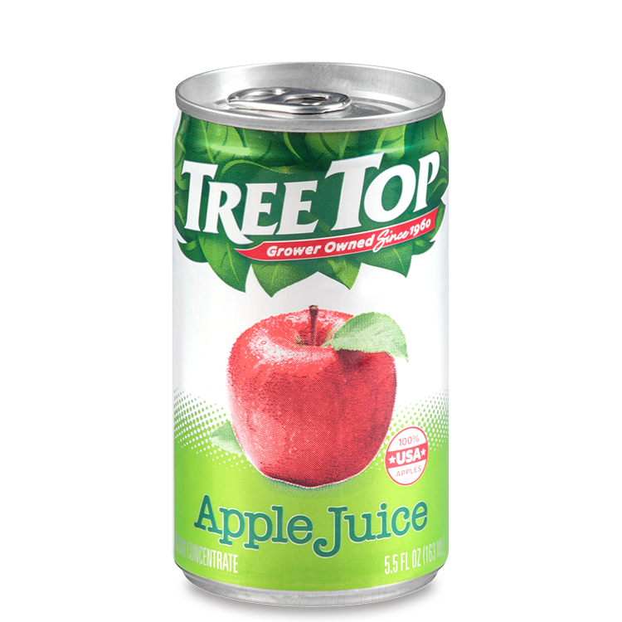
Practice
It we drink something out of a tin can, we should throw it in the right bin and ______
Click for audio.
Notes:
Brainstorm solutions to this problem.
Brainstorm solutions to this problem. Cause and Effect: What is the reason for this trash in the water? Why does it keep happening? How can we fix this problem? What can you do each day at school or at home?
Consider the 4 R’s: Refuse, Reduce, Reuse, and Recycle.
Ask students to talk about this as a group.
Source: https://www.treetop.com/consumer/fruit-products/juice/apple-juice/5pt5oz-can/

Slide 35
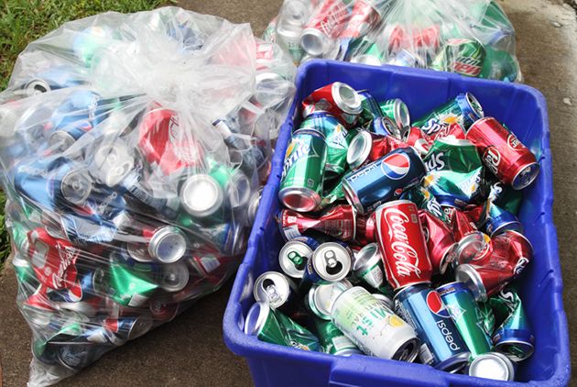
Practice
It we drink something out of a tin can, we should throw it in the right bin and ______ !
RECYLE it
Click for audio.
Notes:
Brainstorm solutions to this problem.
Brainstorm solutions to this problem. Cause and Effect: What is the reason for this trash in the water? Why does it keep happening? How can we fix this problem? What can you do each day at school or at home?
Consider the 4 R’s: Refuse, Reduce, Reuse, and Recycle.
Ask students to talk about this as a group.
Source: https://recyclenation.com/2014/03/recycle-cans/

Slide 36
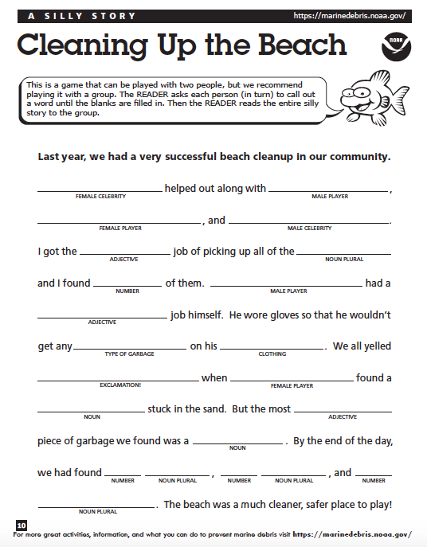
Practice
Click for audio.
Notes:
Since we know that we need to clean up our trash, let’s practice by creating our own story!
*Use the “Cleaning Up the Beach” sheet* and ask the students to work as a group, calling out each of the required types of words. Read the story aloud at the end. (Source: https://marinedebris.noaa.gov/understanding-marine-debris-games-and-activities-kids-all-ages)

Slide 37
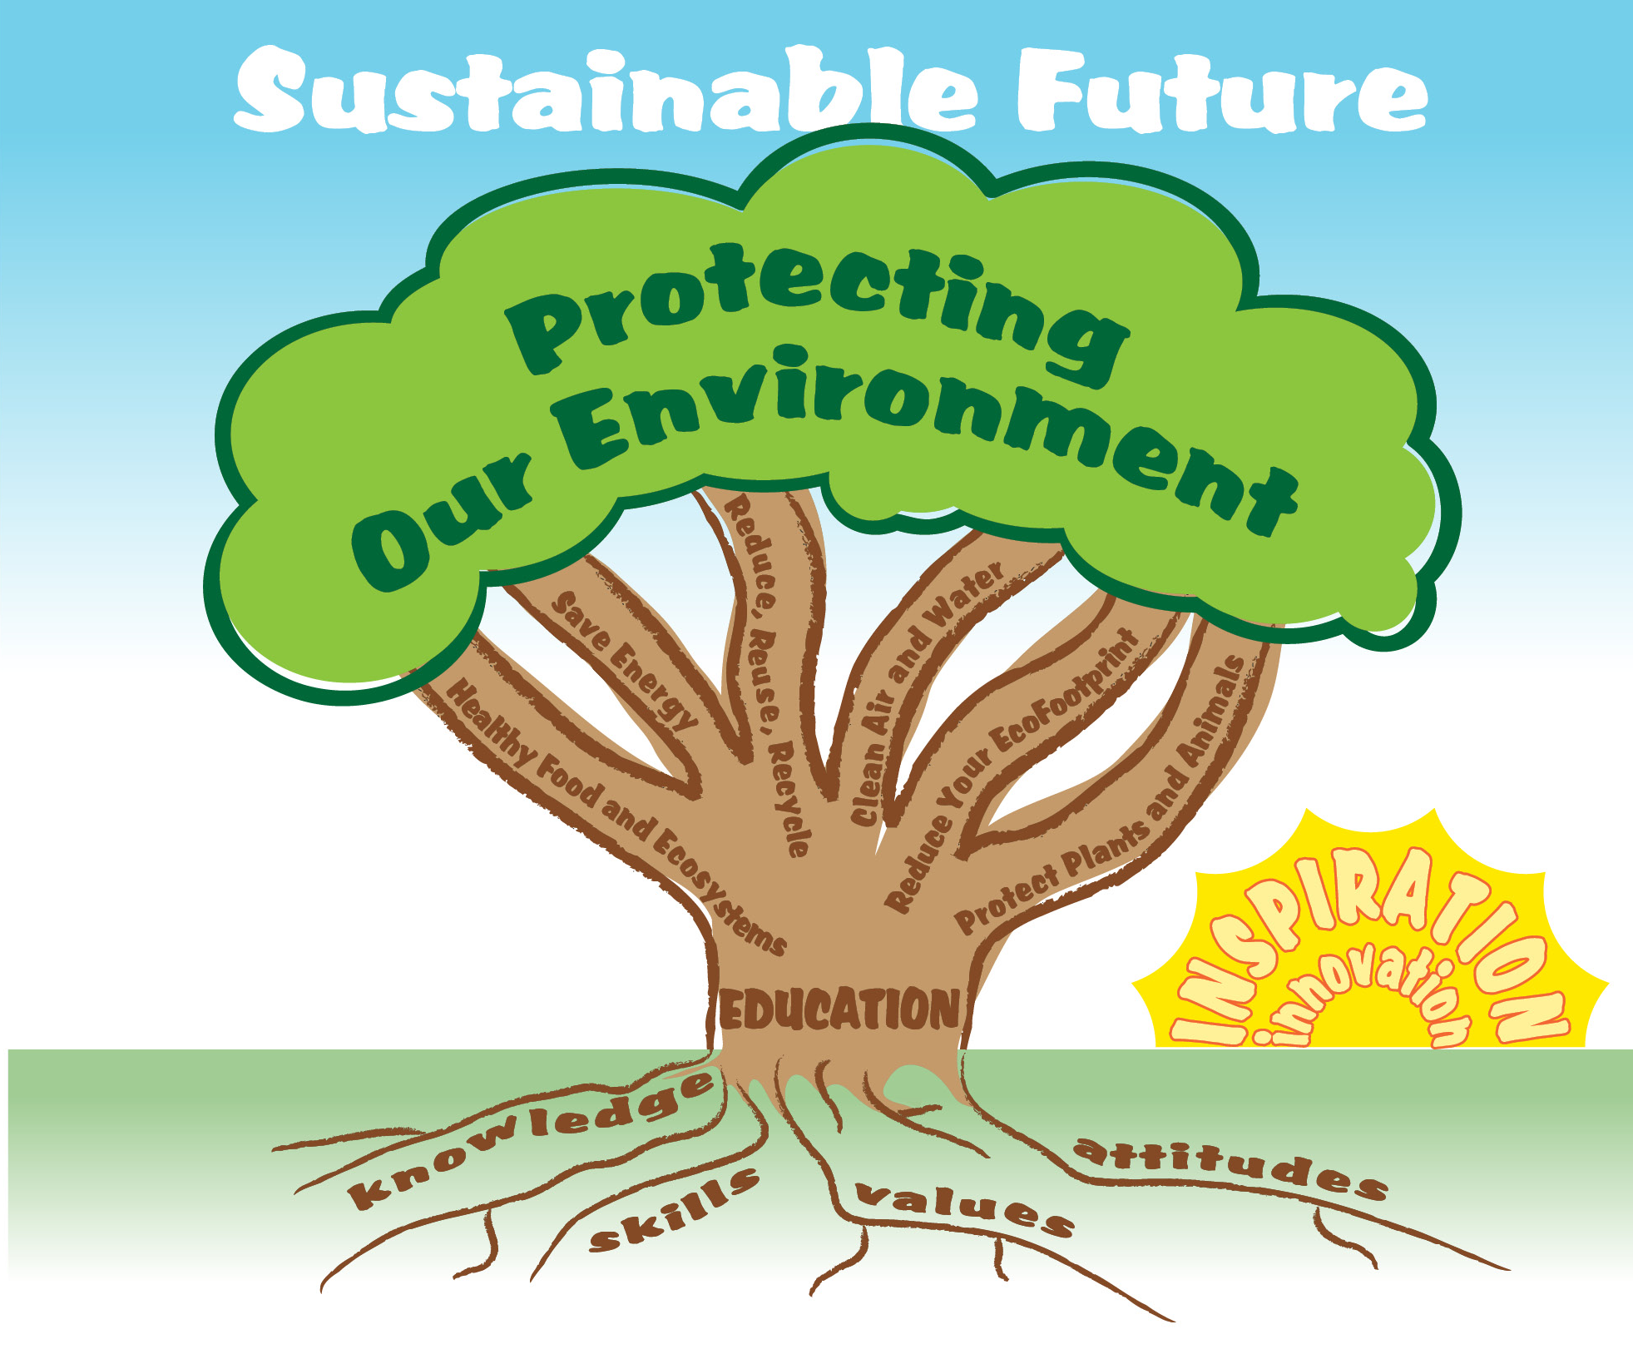
EcoLearn
Developed by the Environmental Protection Agency
With support from Department of State
Virtual Students of Federal Service Interns
https://www.epa.gov/education
US EPA
Region 10
EcoLearn
For more information: hanft.sally@epa.gov or salazar.viccy@epa.gov

