Slide 1

Kindergarten
Waste
Materials are limited! We can use “disposable” things for other purposes.
US EPA
Region 10
EcoLearn
Notes:
Source: https://www.theodysseyonline.com/learning-bees-american-honey-queen

Slide 2

Today you will learn…
Many of the things we normally throw away can be used for other purposes!
Click for audio.
Notes:
Source: http://greenenergysavingtips.com/wp-content/uploads/how-to-reduce-reuse-recycle-for-kids-2-.jpg

Slide 3
Keywords
Reduce
Wasted Food
Recycle
Reuse
Waste
Refuse
Food Waste
Click for audio.
Notes:
Source: https://img.clipartfest.com/2da805a6cad9c39b29e8a66e25a3d21e_tree-blossoming-in-springtime-clipart-of-animated-trees_700-671.png

Slide 4
Do Now
What is this?
Where do you see these boxes?
What are they used for?
What do we do with the boxes once they’re empty?
Click for audio.
Notes:
https://4.imimg.com/data4/AU/VR/MY-1521570/car-facial-tissue-boxe-250x250.png

Slide 5
How to reduce waste
Waste is the stuff nobody wants, so it is thrown into the trash. Many of these things are made by humans and can be bad for our planet!
Click for audio.
Notes:
Source: https://img.clipartfox.com/ce06949c5c33baf3bbce5915a03c7ed7_trash-can-clip-art-animated-trash-can-clipart_582-595.png

Slide 6
Reduce, Reuse, Recycle, and Refuse!
It is important to refuse, reduce, reuse, and recycle as much as we can so that trash does not flow into our oceans and harm animals.
Click for audio.
Notes:
Source: https://encrypted-tbn1.gstatic.com/images?q=tbn:ANd9GcQ1w-oHlemh7EWF8qb7-S0JH4U65YYri25IZwvL2ULVJksgtb2m

Slide 7
Reduce, Reuse, Recycle, and Refuse!
“Refuse” means that you can choose not to use or buy something
“Reduce” means using less
“Reuse” means trying to use something until it can’t be used anymore
"Recycle" means properly throwing away materials so they can be turned into other things.
Click for audio.
Notes:
Source: http://www.iconsdb.com/icons/preview/white/trash-3-xxl.png
https://upload.wikimedia.org/wikipedia/commons/thumb/7/7b/Recycling_symbol.svg/2000px-Recycling_symbol.svg.png

Slide 8
Making a Piggybank!
We will be learning how to reuse! Usually, we throw things like tissue boxes away. But today we will repurpose them so they can be used for much longer!
Decorate a box to make your own piggybank to take home and save money in!
Click for audio.
Notes:
Source: http://gallery.yopriceville.com/var/resizes/Free-Clipart-Pictures/Money.PNG/Piggy_Bank_PNG_Clip_Art_Image.png?m=1468235672
https://4.imimg.com/data4/AU/VR/MY-1521570/car-facial-tissue-boxe-250x250.png

Slide 9
“Waste Not, Want Not” by Two of a Kind
Use both sides of the paper, there'll be twice as many trees. Don't leave the water running, save our lakes and rivers, please. Take only what you'll eat, whether it's cake or lima beans. Let's help to save the planet, so that we can live in peace.
To make all this paper, it takes a lot of wood. So when you write or draw, you know you really should use each piece of paper as much as you can. And then recycle it, so that you can use it again!
Click for audio.

Slide 10

Practice
Look at the items on the table. Brainstorm what some of the trash could be used for! This is your chance to think creatively.
Visit this website for more ideas!
http://www.recycling-revolution.com/reuse-trash-ideas.html
Click for audio.
Notes:
Source: http://www.recycling-revolution.com/reuse-trash-ideas.html

Slide 11
Closure
What have we learned today about waste? Why is it important to stop wasting things?
What do you think you can do to produce less waste?
Click for audio.
Notes:
Source; http://upstreampolicy.org/wp-content/uploads/2013/09/Zero-Waste-Truck.jpg

Slide 12
Homework
See what things you can repurpose at home! Try to think about what you can do about boxes or newspaper. If anyone comes up with a good idea, bring it to class for show and tell!
Click for audio.
Notes:
Image Sources:
Newspaper: http://www.pngall.com/wp-content/uploads/2016/05/Newspaper-Free-Download-PNG.png

Slide 13
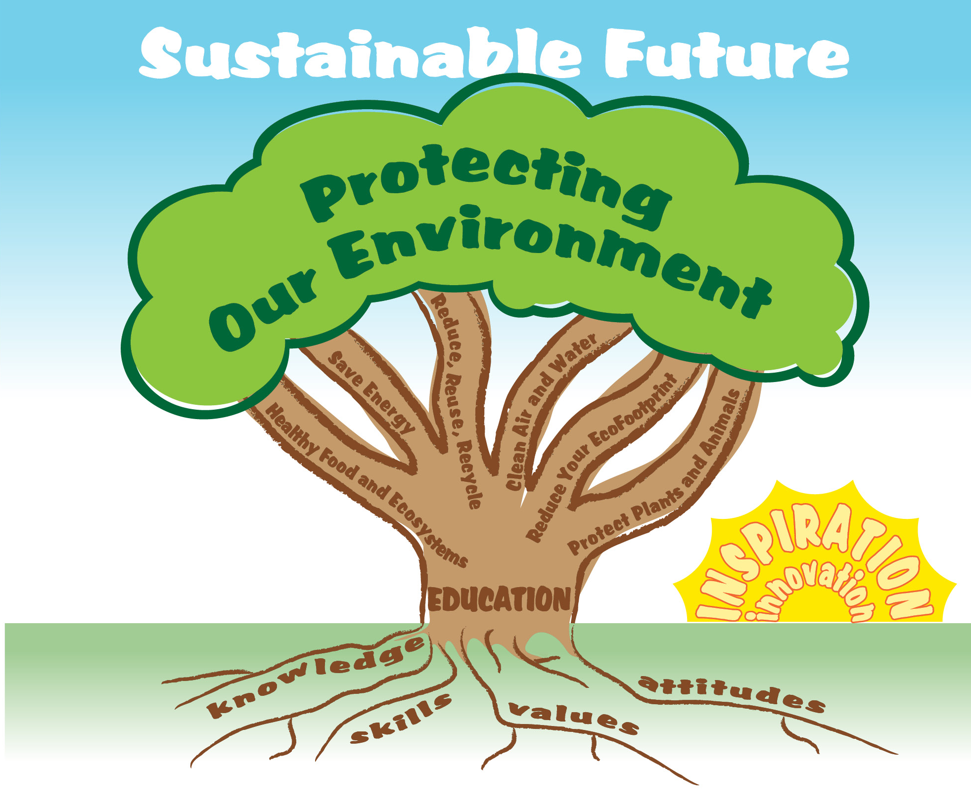
EcoLearn
For more information:
hanft.sally@epa.gov or
salazar.viccy@epa.gov
Developed by the Environmental Protection Agency
With support from Department of State
Virtual Students of Foreign Service Interns
https://www.epa.gov/education
US EPA
Region 10
EcoLearn

