Slide 1


2nd Grade
Animals and Endangerment
Learn what endangered, extinct, and threatened species are and what causes them to become endangered, extinct, or threatened.
EcoLearn
Notes:
Source: https://goo.gl/images/Y0cyFd

Slide 2
Do Now
Complete the Polar Bear worksheet

Slide 3
Extinct, Endangered or Threatened?

Slide 4
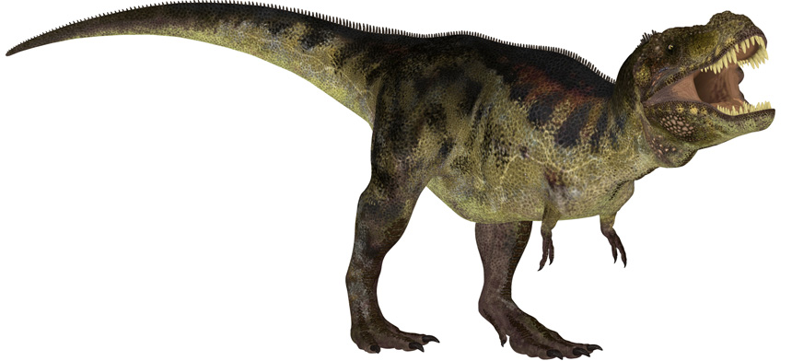
Dinosaurs
Extinct
Source: https://www.sciencenews.org/article/brain-reconstruction-hints-dinosaur-communication
Notes:
Have students guess answer, then show the answer. Play audio after answer is revealed

Slide 5
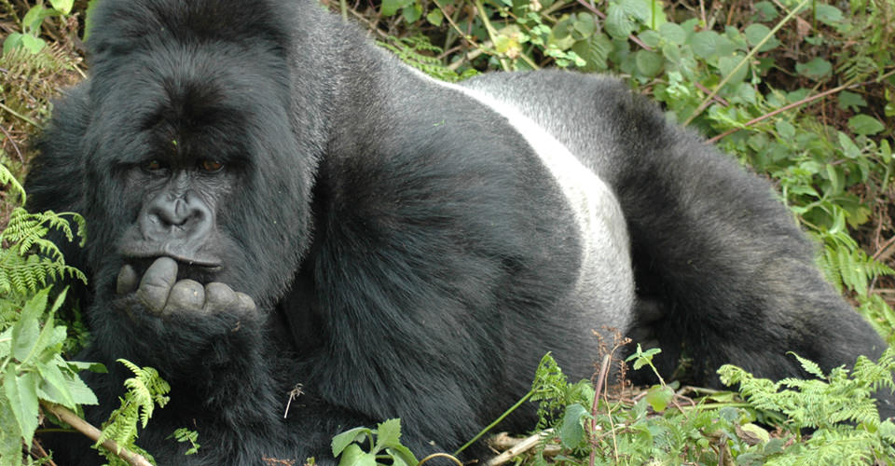
Gorillas
Source: http://www.nathab.com/photo-tours/africa/ultimate-gorilla-photo-safari/
Endangered
Notes:
Have students guess answer, then show the answer. Play audio after answer is revealed

Slide 6
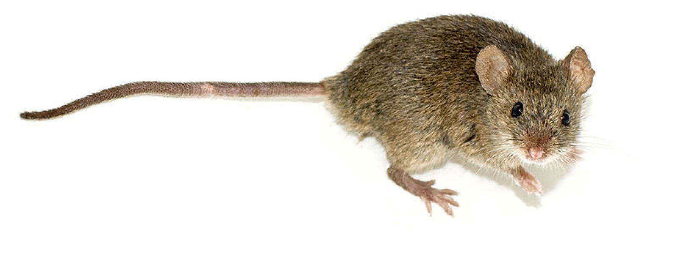
Mice
Source: http://ddar.manchester.ac.uk/blog/?attachment_id=377
Not Threatened
Notes:
Have students guess answer, then show the answer. Play audio after answer is revealed

Slide 7
What other animals are endangered?

Slide 8
Blobfish
Notes:
Source: https://s-media-cache-ak0.pinimg.com/736x/fe/d2/f5/fed2f5ca8fbe85d060c627b0b5f62be3.jpg

Slide 9
Axolotl
Source: http://animals.nationalgeographic.com/animals/amphibians/axolotl/
Notes:
Source: http://yourshot.nationalgeographic.com/u/ss/fQYSUbVfts-T7pS2VP2wnKyN8wxywmXtY0-Fwsgxpz6twqwD4YxsOSZbP8nvIRdwtHZd0XNfL4GCI8JsjjDu/

Slide 10
Chinese Giant Salamander
Source: http://www.edgeofexistence.org/conservation/conservation_project.php?id=111
Notes:
Source: https://www.zsl.org/sites/default/files/image/2014-02/chinese-giant-salamander.jpg

Slide 11
Purple Frog
Source: http://scribol.com/environment/bizarre-animals-on-the-edge-of-extinction?utm_campaign=Feed%3A%20environmentalgraffiti%20%28Environmental%20Graffiti%29&utm_medium=feed&utm_source=feedburner
Notes:
Source: http://voices.nationalgeographic.com/files/2014/02/indian-purple-frog-01.jpg

Slide 12
Proboscis Monkey
Source: http://www.zoochat.com/159/proboscis-monkey-apenheul-30-05-12-a-275139/
Notes:
Source: http://www.factzoo.com/sites/all/img/mammals/monkeys/proboscis-monkey-male.jpg

Slide 13
Why do animals become endangered?
Notes:
Source: http://constantine.typepad.com/.a/6a0120a7fc3be9970b01bb089915ba970d-pi

Slide 14
What kinds of activities do humans practice that affect animals?
Notes:
Source: https://upload.wikimedia.org/wikipedia/commons/0/00/Chilean_purse_seine.jpg

Slide 15
Closure
Notes:
Source: http://i.dailymail.co.uk/i/pix/2016/05/13/12/341D78E900000578-0-image-m-31_1463139259476.jpg

Slide 16
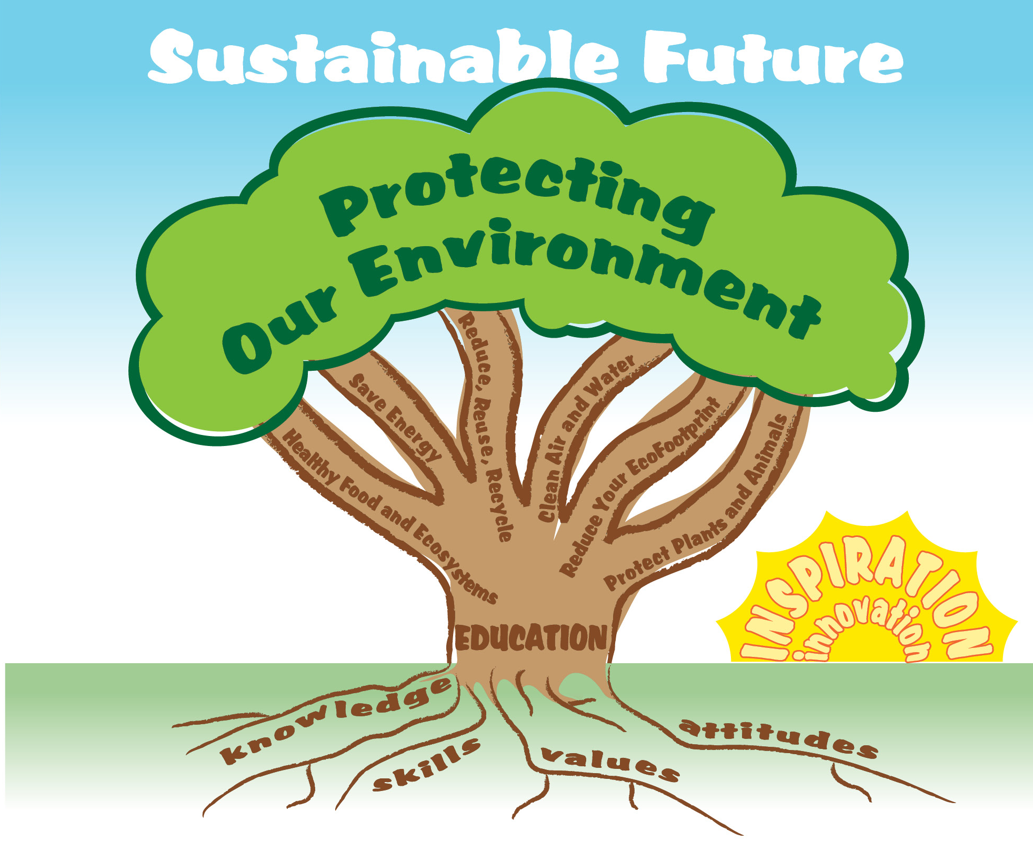
EcoLearn
For more information:
hanft.sally@epa.gov or
salazar.viccy@epa.gov
Developed by the Environmental Protection Agency
With support from Department of State
Virtual Students of Foreign Service Interns
https://www.epa.gov/education
US EPA
Region 10
EcoLearn

