Slide 1


2nd Grade
The Water Cycle
Learn about the water cycle and the importance of conserving water.
EcoLearn

Slide 2
Do Now
Water Cycle
Evaporation
Condensation
Precipitation
Conservation
Notes:
Source: http://cfaes.osu.edu/sites/cfaes_main/files/site-library/site-images/news/Bee%20on%20rapeseed%20flower_0.jpg

Slide 3
The Water Cycle
Evaporation
Condensation
Precipitation

Slide 4
The Drought Problem
http://droughtmonitor.unl.edu
Notes:
Play audio 1 then discuss. Play audio 2 for possible answers. Then play audio 3 to go to link

Slide 5
Practice

Slide 6
Closure

Slide 7
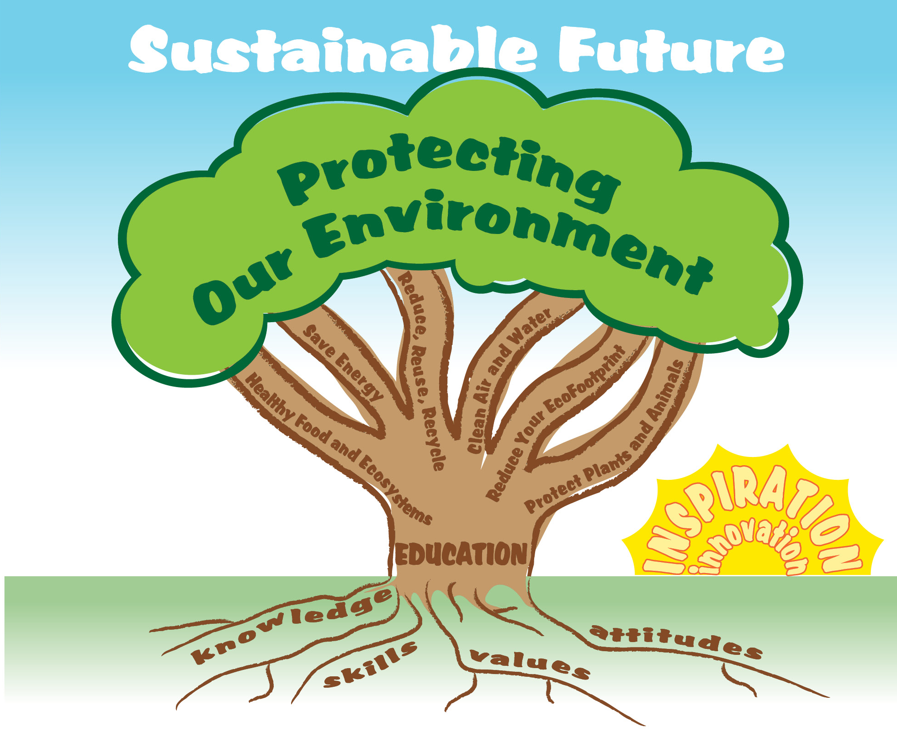
EcoLearn
Developed by the Environmental Protection Agency
With support from Department of State
Virtual Students of Foreign Service Interns
https://www.epa.gov/education
US EPA
Region 10
EcoLearn
For more information: hanft.sally@epa.gov or salazar.viccy@epa.gov

