Slide 1
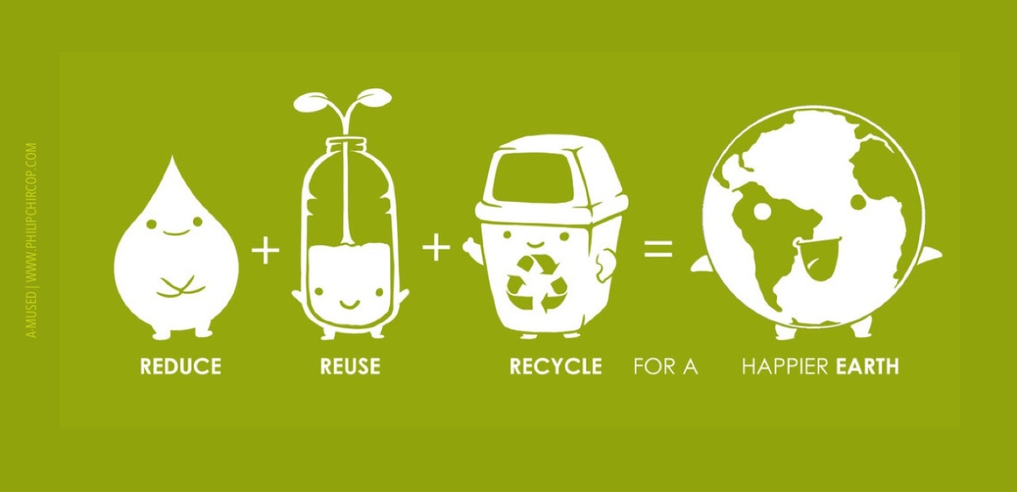
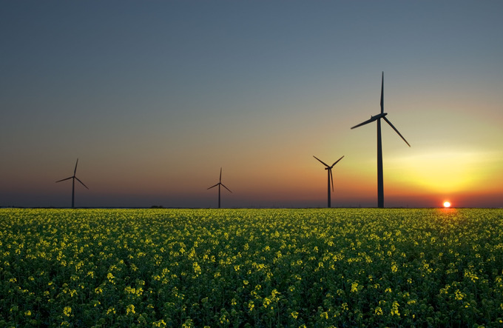


Waste
USA EPA,
Region 10
EcoLearn
3rd Grade: Waste and Natural Resources
Notes:
http://www.philipchircop.com/post/117077877097/reduce-reuse-recycle-today-the-22nd-of-april

Slide 2
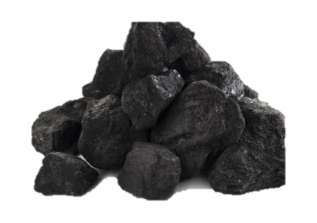
Today:
Today you will…
Learn about how human use of natural resources can damage the environment, about the importance of using resources responsibly, and pledge to improve the way that you consume resources to protect the environment
Key Words:
Pollution
Natural resources
Ecosystem
Consumption
Waste

Slide 3

Human resource use has a broad impact on the environment. Creating awareness of the consequences of overconsumption is a key step toward responsible resource usage.
Notes:
http://www.yourarticlelibrary.com/environment/the-importance-of-natural-resources-of-planet-earth/9914/

Slide 4
Natural Resources
Natural resources are useful materials from the Earth, they can be renewable or nonrenewable.
People use natural resources as raw materials to manufacture or create a range of modern conveniences.
Many of the same natural resources used by people are important to plants and wildlife for survival as well

Slide 5
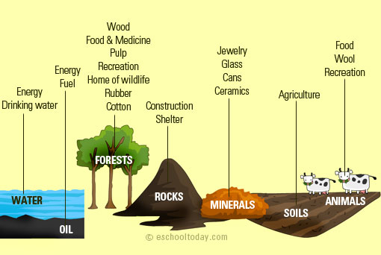
Notes:
Source: https://ducnguyennguyen403.wordpress.com/

Slide 6
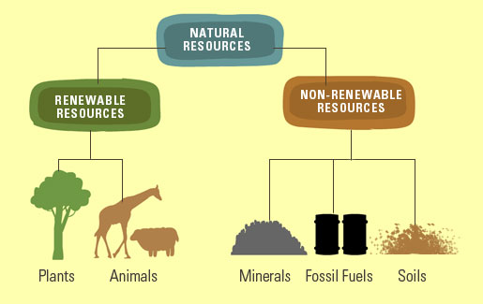
Notes:
Source: http://www.eschooltoday.com/natural-resources/types-of-natural-resources.html

Slide 7
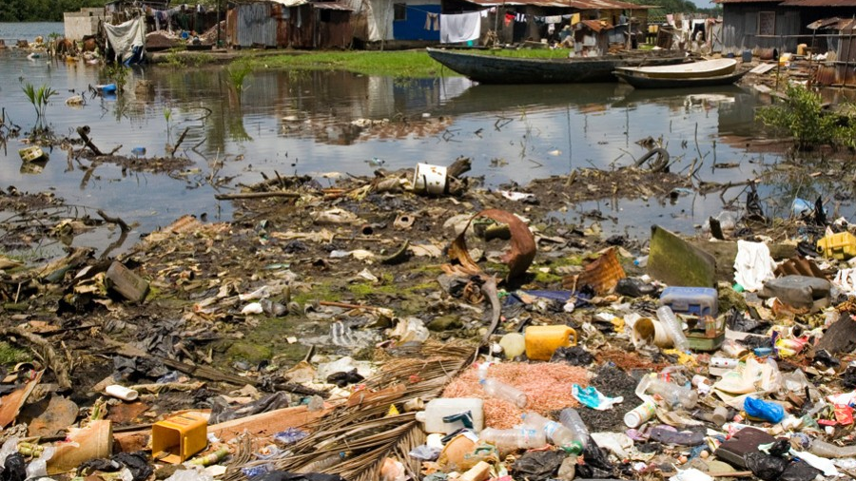
Pollution
The action or process of making land, water, air, etc., dirty and not safe or suitable to use
Notes:
Source: http://ocean.nationalgeographic.com/ocean/explore/pristine-seas/critical-issues-marine-pollution/

Slide 8
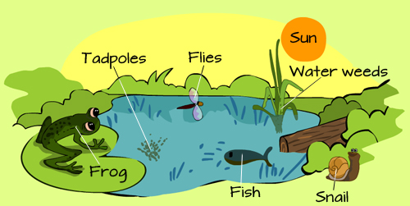
Ecosystem
An ecosystem includes all of the living things (plants, animals and organisms) in a given area interacting with each other and their non-living environments (weather, earth, sun, soil, climate, atmosphere).

Slide 9
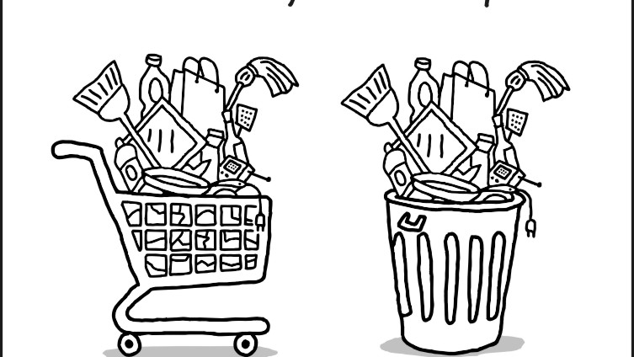
Consumption
The use of something (such as fuel) by a particular group of people
Notes:
Source: https://wronghands1.com/2013/03/26/consumption-transumption/consumption-transumption-2/

Slide 10
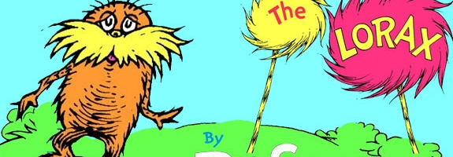
The Lorax, by Dr. Seuss

Slide 11
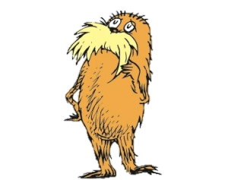
1. Why did Once-ler cut down the Truffula trees? 2. Why did the Brown Bar-ba-loots have to leave the forest after the Once-ler starts his thneed production? Could something like this happen in real life? How? 3. List three ways the Thneed factory caused problems for the Truffula Tree forest and its residents. 4. Explain what the Lorax’s message “Unless” means (answers should include the need for future generations to protect and care for the Earth).
Discussion Questions:
Notes:
http://www.leegov.com/solidwaste/residential/recycling

Slide 12
Homework
Instruct students to create a collage of their needs and wants, labeling them “thneeds” and “thwants,” by cutting pictures out of magazines. Once the collages are complete, ask the students to tell the class about opportunities to use fewer resources with the thneeds and thwants.

Slide 13
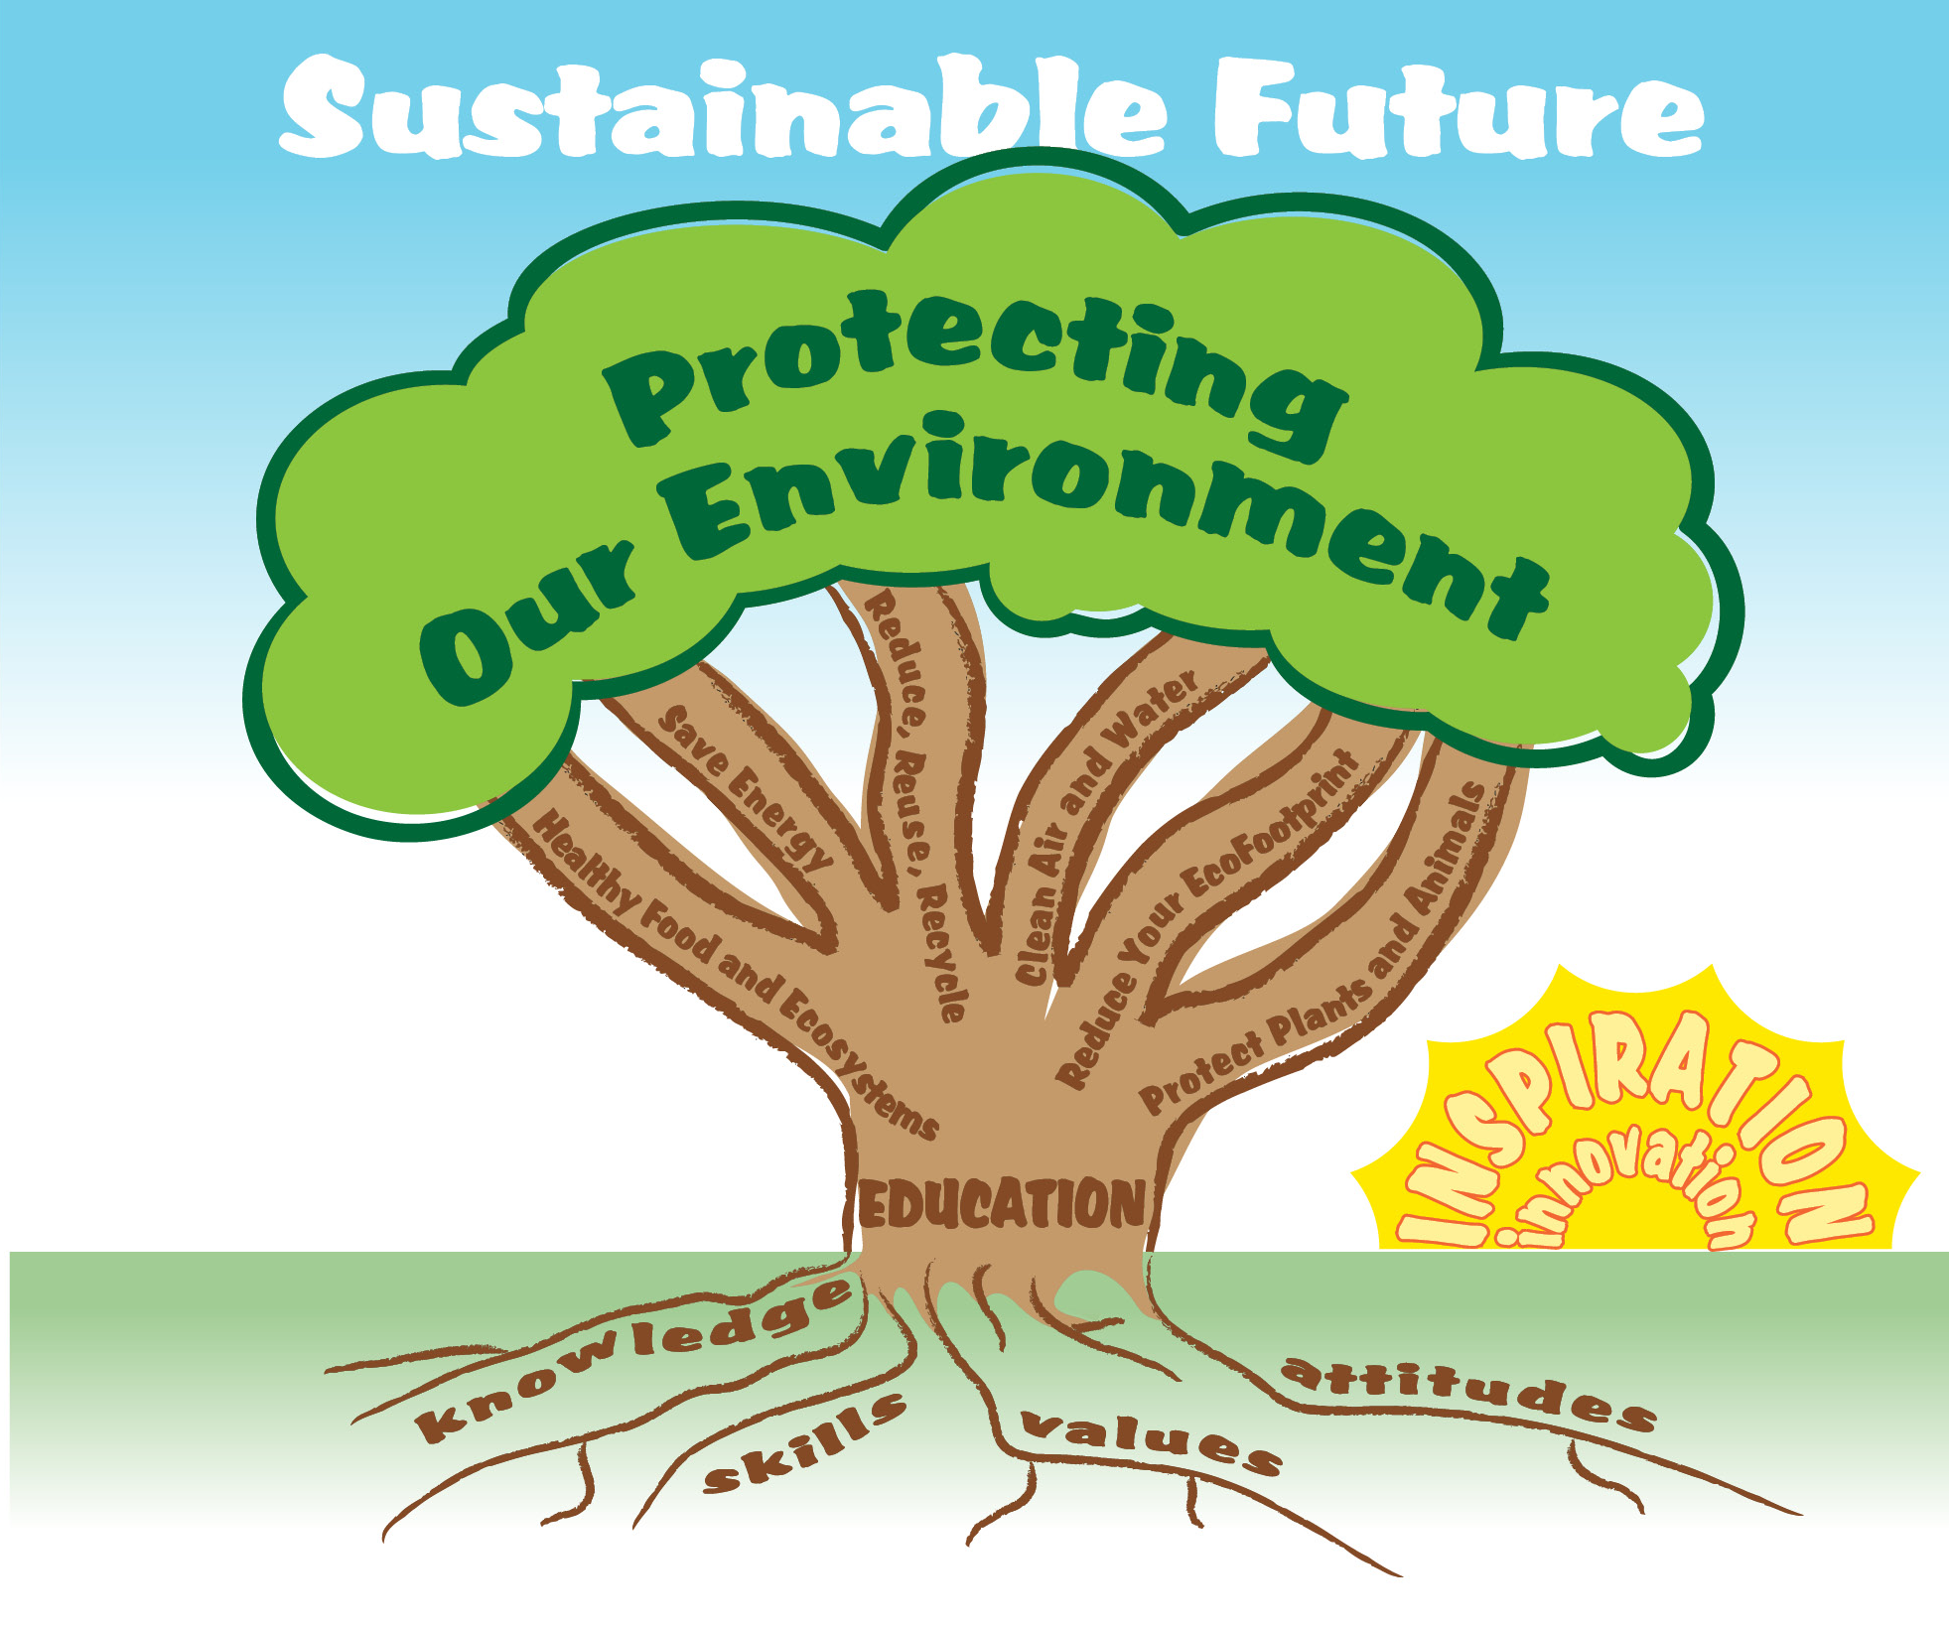

EcoLearn
Developed by the Environmental Protection Agency
With support from Department of State
Virtual Students of Foreign Service Interns
https://www.epa.gov/education
US EPA
Region 10
EcoLearn
For more information: hanft.sally@epa.gov or salazar.viccy@epa.gov

