Slide 1
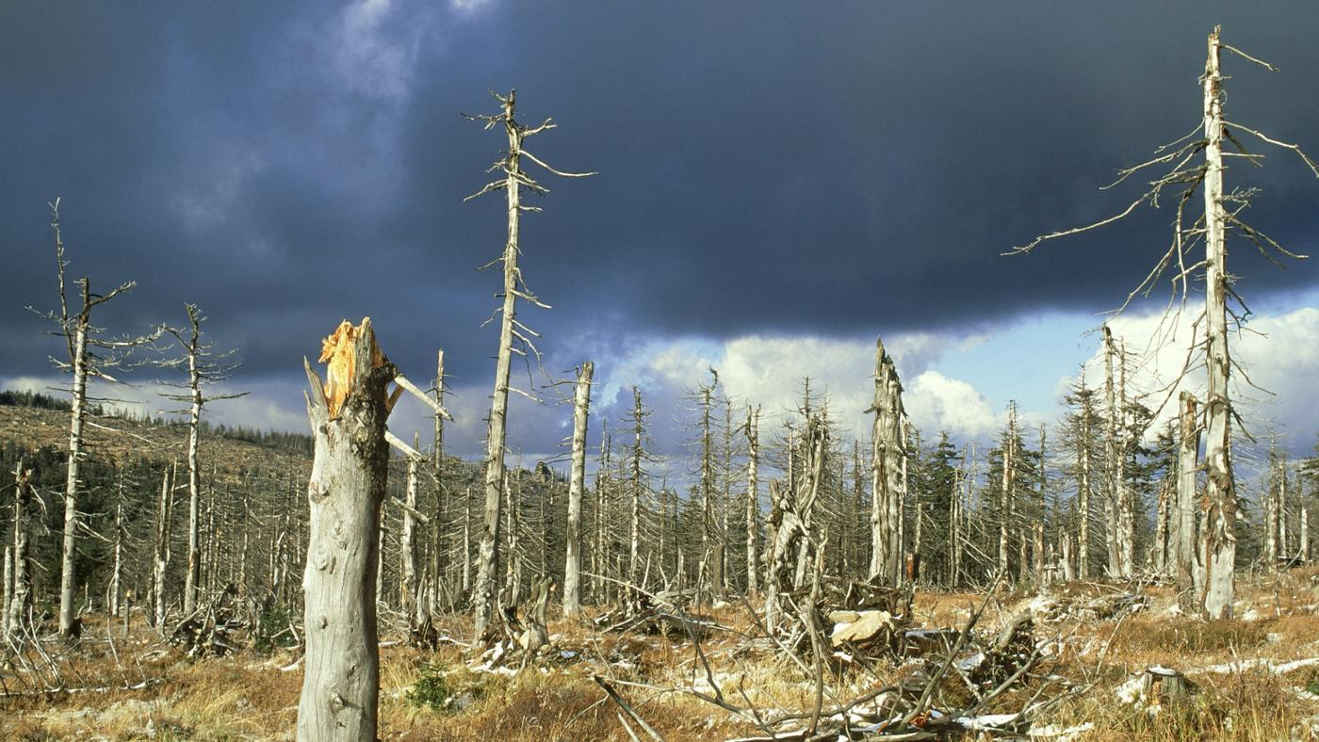


4th Grade: Air Pollution To see how pollution affects the environment around us, and learn what we can do to help.
Click for Audio
US EPA, Region 10 EcoLearn
Notes:
Image Source: https:https://infograph.venngage.com/p/216017/acid-rain

Slide 2

Objective
Today you will learn…
About acid rain and how it affects the environment
What we can do to reduce the pollution that leads to acid rain
Click for Audio
Notes:
Image Source: http://www.publishyourarticles.net/eng/question-and-answers/what-are-the-major-causes-of-water-and-air-pollution/2584/

Slide 3
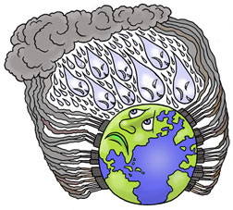
Key Words
Acid
Acid rain
Air pollution
Base
pH
Erosion
Click for Audio
Notes:
Image Source: http:http://www.slate.com/articles/health_and_science/the_green_lantern/2009/08/whatever_happened_to_acid_rain.html

Slide 4
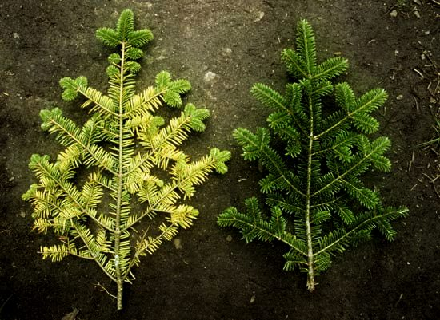

Review
Acid Rain
Notes:
Image Source: https://www.britannica.com/science/acid-rain

Slide 5
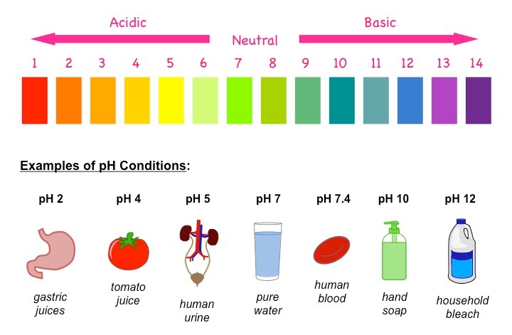
What are acids and bases?
Click for Audio
Notes:
Image Sources: http://herb.co/2016/08/10/growing-huge-buds/

Slide 6
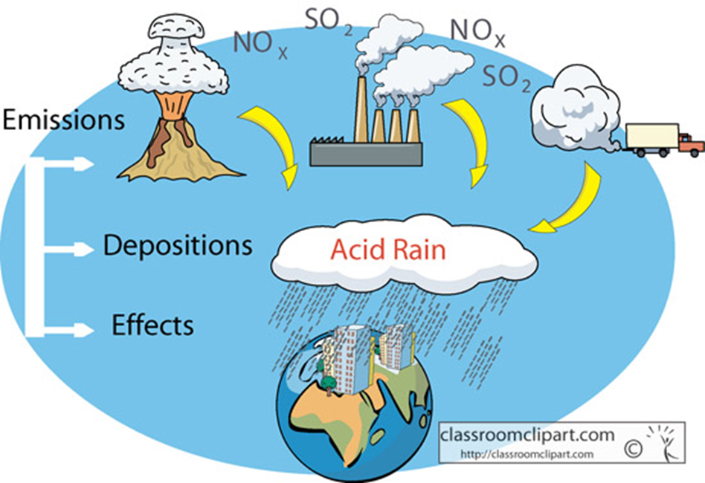

What is acid rain?
Notes:
Image Source:http://tunza.eco-generation.org/ambassadorReportView.jsp?viewID=13017

Slide 7
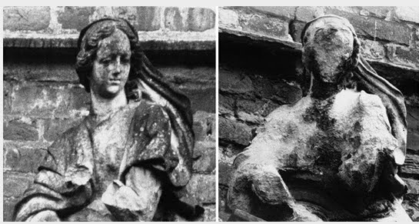
Acid Erosion activity
1908 1969
Notes:
Image source: http://www.glogster.com/zstrangeway/acid-rain/g-6l43g428c79lnq406pu87a0

Slide 8
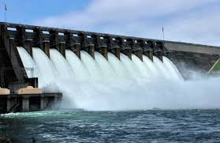
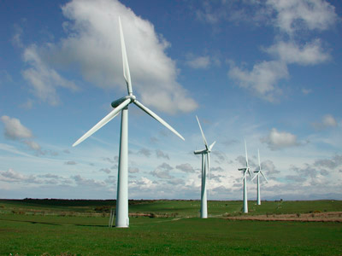
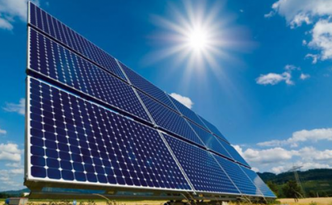

What has been done to stop acid rain?
Renewable sources of energy:
hydropower, wind power, and solar power.
Fuel-efficient cars
Notes:
Image sources: https://www.stimson.org/content/myanmar-case-study-improving-hydropower-through-system-scale-planning, http://antarcticajournal.com/10-best-places-to-harness-solar-power/, http://www.dailytech.com/Syracuse+University+UM+Researchers+Improve+Wind+Turbine+Efficiency/article20208.htm,

Slide 9
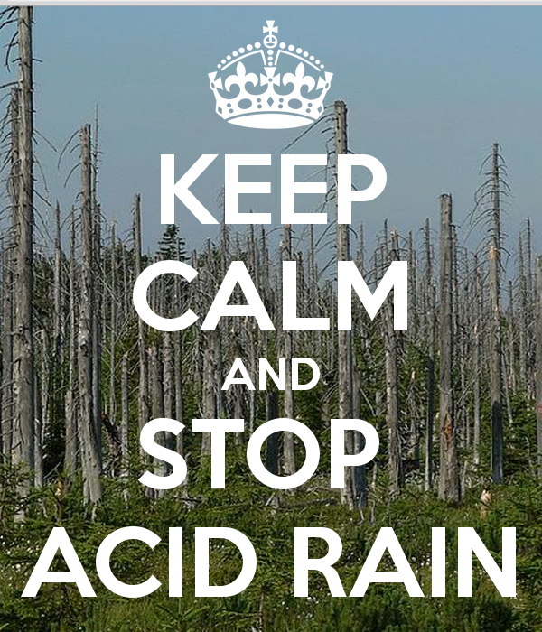

What can you do?
Conserve energy by:
Carpooling, walking, or biking when you can!
Notes:
Image source:https://www.keepcalm-o-matic.co.uk/p/keep-calm-and-stop-acid-rain-8/

Slide 10

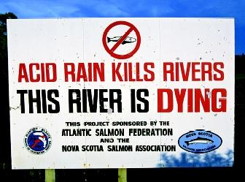

Practice
Notes:
Image sources: https://www.etsy.com/listing/240126092/acid-rain-poster-it-falls-on-everyonehttp://www.waterencyclopedia.com/A-Bi/Acid-Rain.html

Slide 11


Homework
Notes:
Image source:https://www.haikudeck.com/acid-rain-education-presentation-Bupj5PVIgv

Slide 12


EcoLearn
Developed by the Environmental Protection Agency
With support from Department of State
Virtual Students of Foreign Service Interns
https://www.epa.gov/education
For more information: hanft.sally@epa.gov or salazar.viccy@epa.gov
US EPA
Region 10
EcoLearn

