Slide 1
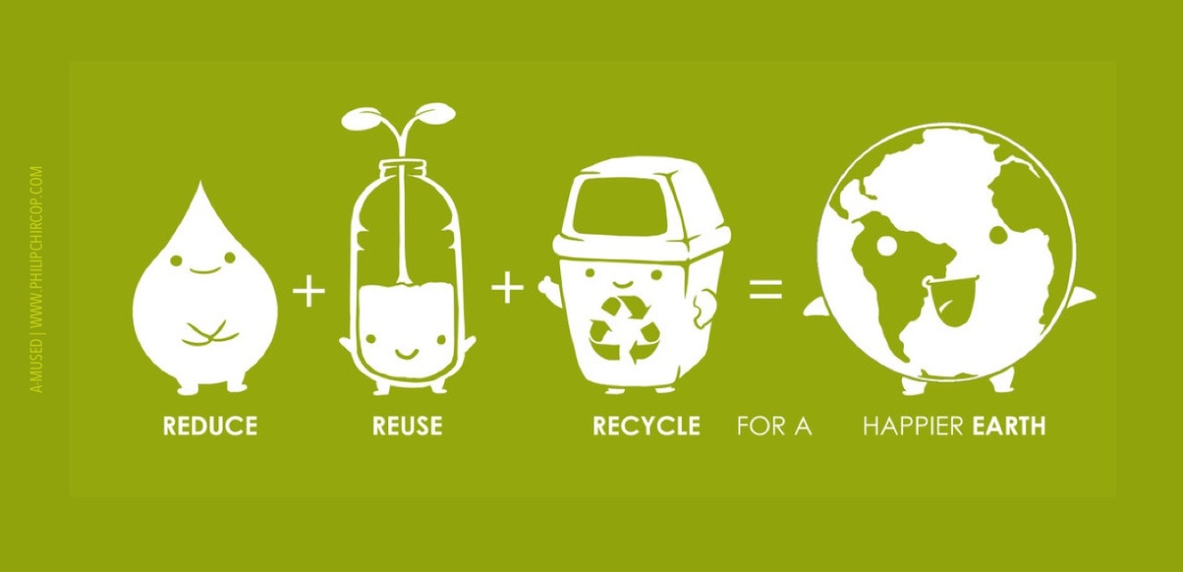
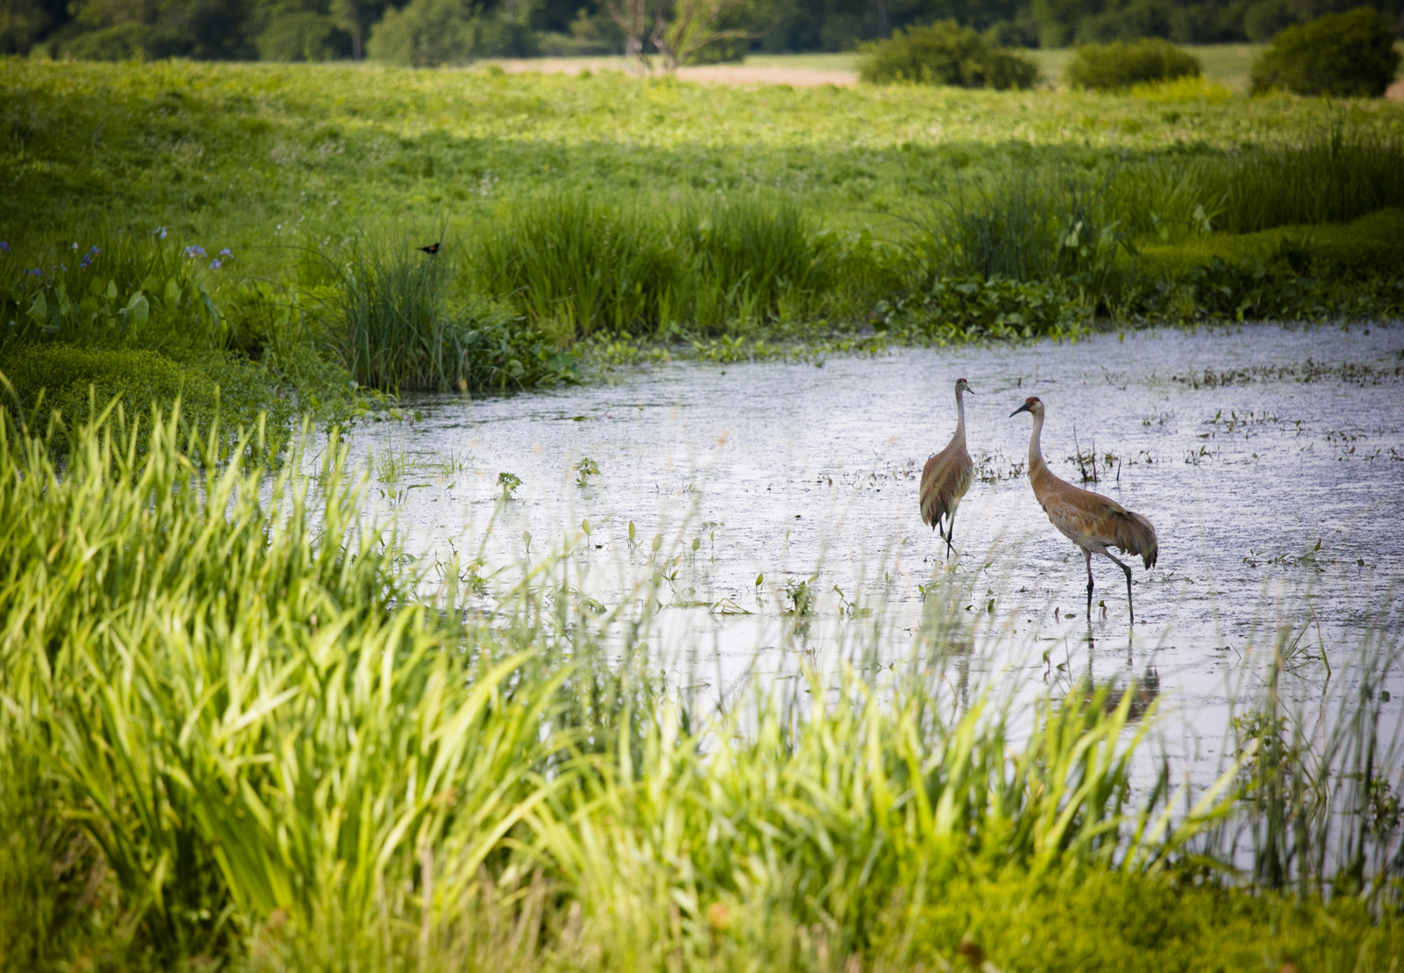


Ecosystems
USA EPA,
Region 10
EcoLearn
4th Grade: Wetland Ecosystems
Notes:
http://www.philipchircop.com/post/117077877097/reduce-reuse-recycle-today-the-22nd-of-april

Slide 2
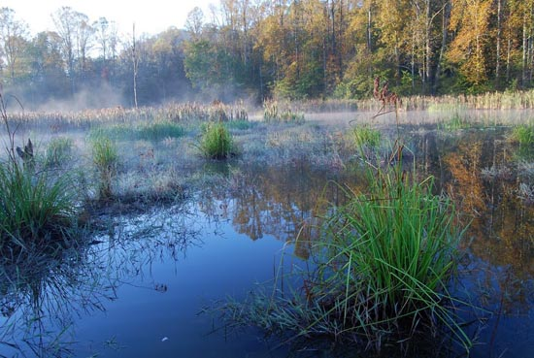
Today:
Today you will learn:
  What a wetland is; the different types of wetlands; how the different parts of a wetland work together to make a unique ecosystem; and why wetlands are important
Keywords:
  Ecosystem
  Wetland
Notes:
http://www.savethefrogs.com/ponds/wetlands.html

Slide 3
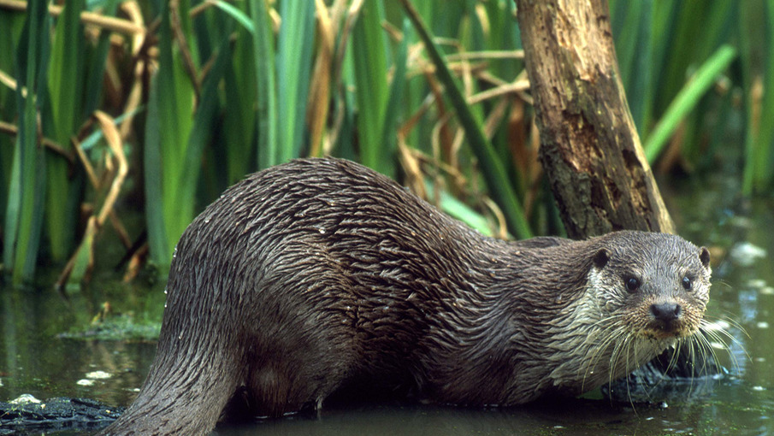
Wetlands are important because they are an ecosystem that provides very valuable services: flood prevention, filtering water to decrease water pollution; and are home to plants and animals.
Notes:
http://simplebooklet.com/publish.php?wpKey=Joa8wynwgmK68dpgwIzBnj

Slide 4
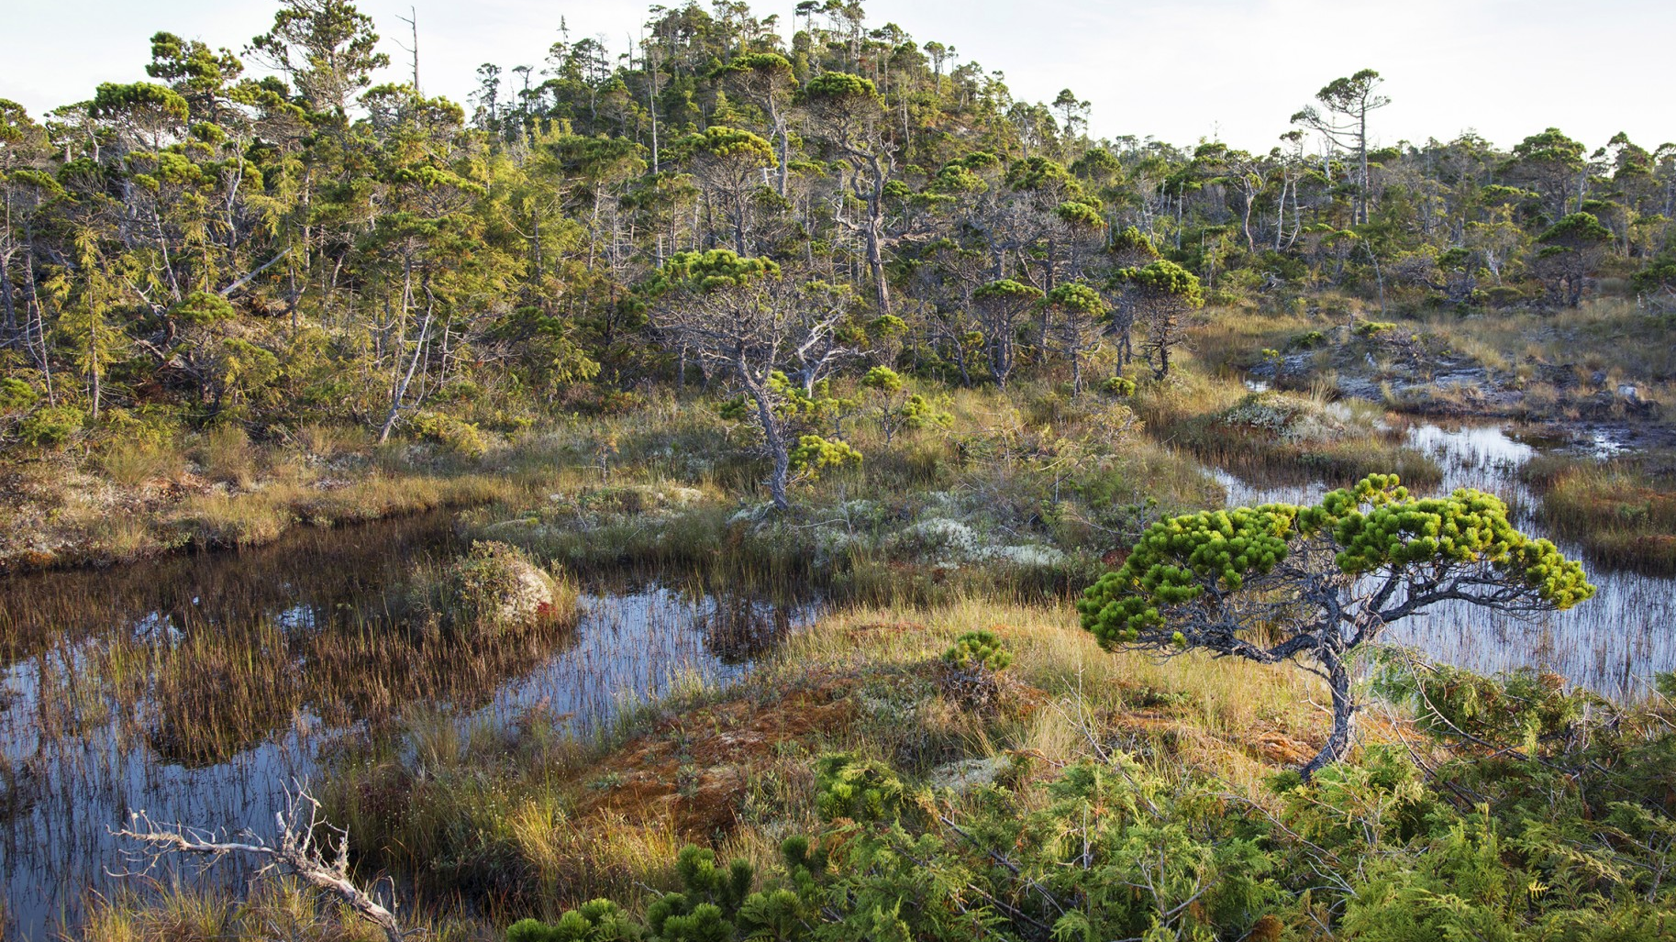
What is a Wetland?
What do you think it means?
There are many kinds of wetlands.
All of the continents except Antarctica have wetland ecosystems.
Notes:
https://www.hakaimagazine.com/photo-essay/secret-world-bog
It really means just land that is wet, or “saturated land”.
The wet, saturated soils found in wetlands have unique properties that lead to the development of a wetland ecosystem. The plants and animals that live in and near wetlands have to be able to tolerate, or even like, living by these soils.

Slide 5
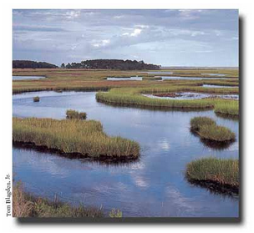
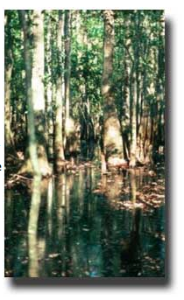
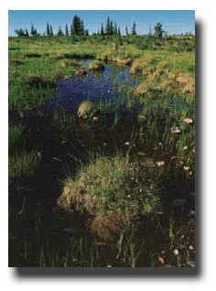
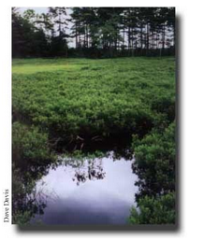
Swamp
Marsh
Fen
Bog
Photos from EPA wetlands site

Slide 6
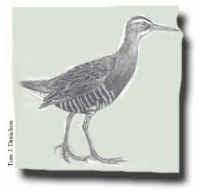
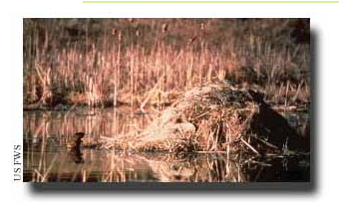
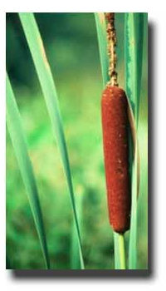
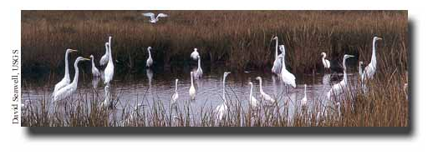
Marsh Habitat (can be fresh or salt water)
Muskrat den
Clapper Rail (salt water)
Cattail (freshwater)
Great Egret (salt water)

Slide 7
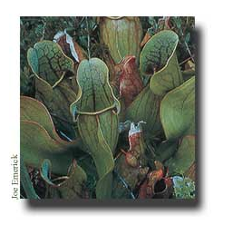
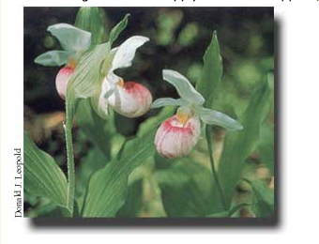
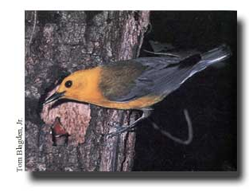
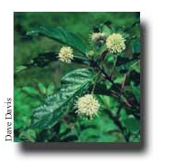
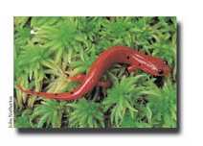
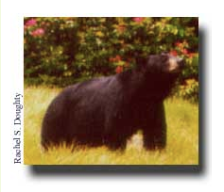
BOGS
FENS
SWAMPS
Pitcher plant
Lady Slipper
Warbler
Salamander
Black bear
Button Bush

Slide 8
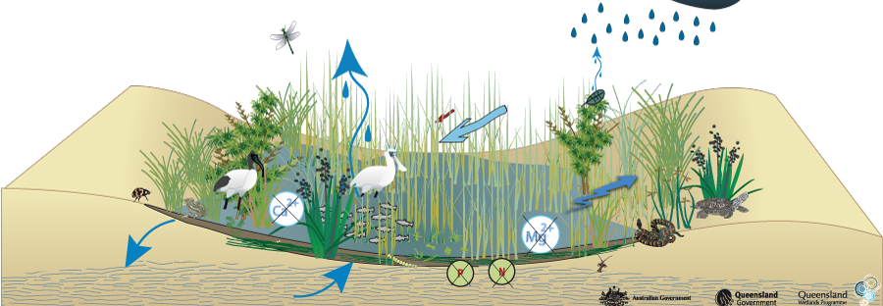
Building a Wetland Model
Notes:
https://wetlandinfo.ehp.qld.gov.au/wetlands/ecology/aquatic-ecosystems-natural/palustrine/non-floodplain-grass-sedge-herb-swamp/associated.html

Slide 9
Step 1:
Fill half of the pie pan with clay to represent land.
The empty part of the pie pan represents water (a lake, river, ocean).
Shape the clay so that it slopes gradually towards the water.

Slide 10
Step 2:
Places pieces of a sponge in a line along the edge of the clay (basically dividing the land from the water).
The sponge represents the wetland.
Make sure the sponges completely separate the clay from the empty part of the pie tin and that the sponges lie flat on the bottom of the pan.
On the clay, mark a spot near the sponge that represents a house.

Slide 11
Step 3:
Explain to students the benefits of wetlands and that you are going to explore them in your model.
Wetlands can help reduce floods, filter out pollutants, prevent erosion, and have a wide variety of plants and animals.

Slide 12
Step 4:
Ask the students what will happen if it rains on the land. After discussing, try it!
Pour water onto the clay and have the students write their observations down.
The water runs down the slope of the land. Then some of the water is slowed down by the wetland (the sponge), and the rest is absorbed by the wetland.
The “house” is not flooded, but remains safe.

Slide 13
Step 5:
Now have the students try the same experiment without the wetland. Have them take the sponge out of their model and try the rain experiment again.
This time, the “rain” will run off the land quickly and might even flood part of the land.
This shows how a wetland can help prevent flooding, and also can help stop erosion. Point out what happens to the house in this event – it is a lot closer to the water or is even flooded!
Sometimes wetlands are removed in order to build houses – how do you think these housing developments handle storms?

Slide 14
Step 6:
Empty the water out of your model.

Slide 15
Step 7:
Now, mix dirt with colored glitter (small pieces of glitter will work best).
Explain to the students that this represents dirt that has pollution in it (the glitter is pollution).
Spread some of the soil over the “land” (clay).
With the “wetland” (sponge) in place, make it rain. Have the students write down what they observe.
The soil and glitter moved across the land and some of it ended up in the lake/ocean/river. Have the students take a sample of the water that flowed into the bottom of the pie pan.

Slide 16
Step 8:
Have the students clean out their model and then repeat the experiment without the wetland (no sponge).
Once the students have taken a sample of the water that ended up in the pan, have them compare the two samples. What happened? Why?

Slide 17
Step 9:
The experiment with the wetland does not have as much soil or as much glitter compared to the one with no wetland.
  That is because the wetland can help trap the soil (prevent erosion) and filter out pollutants from the water!
Have the students brainstorm what could have helped stop the soil from running out into the bottom of the pie tin.
What do real wetlands have that could help stop erosion?
Wetlands have plants with stems and roots that help hold together the land and stop pollutants and soil from going into bodies of water.

Slide 18
Step 10:
Ask students why we would not want pollution going into the water. Brainstorm reasons on the board together as a class.
  Examples include: poison fish, crabs, birds, pollute potential drinking water and food (fish, crabs, etc.), unsafe for human activities like swimming.
Then brainstorm why we wouldn’t want soil going into the water.
  Examples include: erosion problems if too much soil leaves the land, stop sunlight from going into the water (killing the plants that live in the water), make it hard for animals that live in the water to see

Slide 19
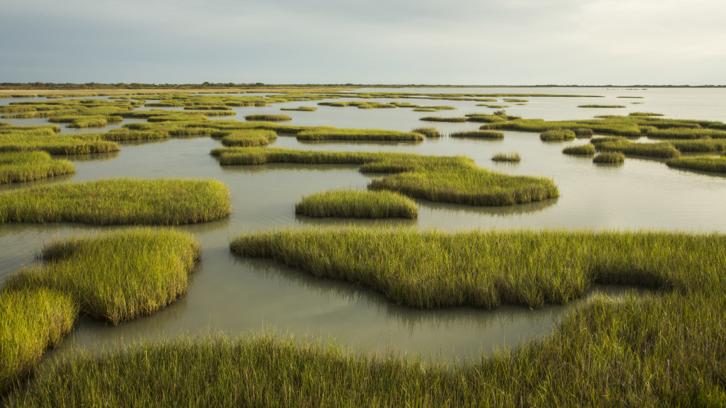
Practice:
Have each student create a web of different parts of their wetland model.
On a piece of paper, write down all of the different components of their wetland
  For example: the land, the ocean, the wetland “buffer zone”, the different types of plants, the different types of animals.
Draw lines between things that interact with each other, work together, eat one another, etc. Label your lines on how these different components of the wetland ecosystem work together
  How plants and the land work together to prevent erosion, or how the birds eat the fish.
Notes:
http://coastalresilience.tamu.edu/home/wetland-protection/

Slide 20
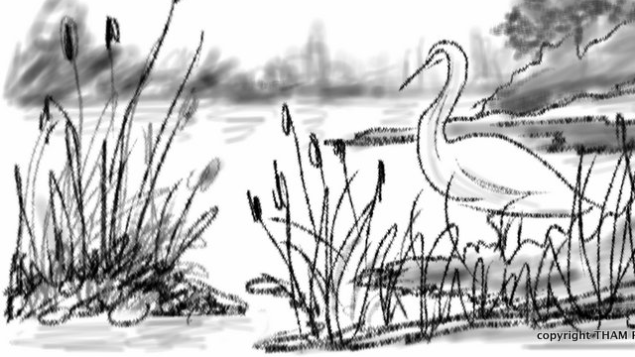
Homework:
Do a homework project in which you research a local wetland habitat.
  You can make a drawing of their particular habitat labeling key feature (i.e. plants, animals, where it is located, etc.).
Notes:
https://artinwetlands.wordpress.com/2015/03/24/sketches-for-my-students/

Slide 21
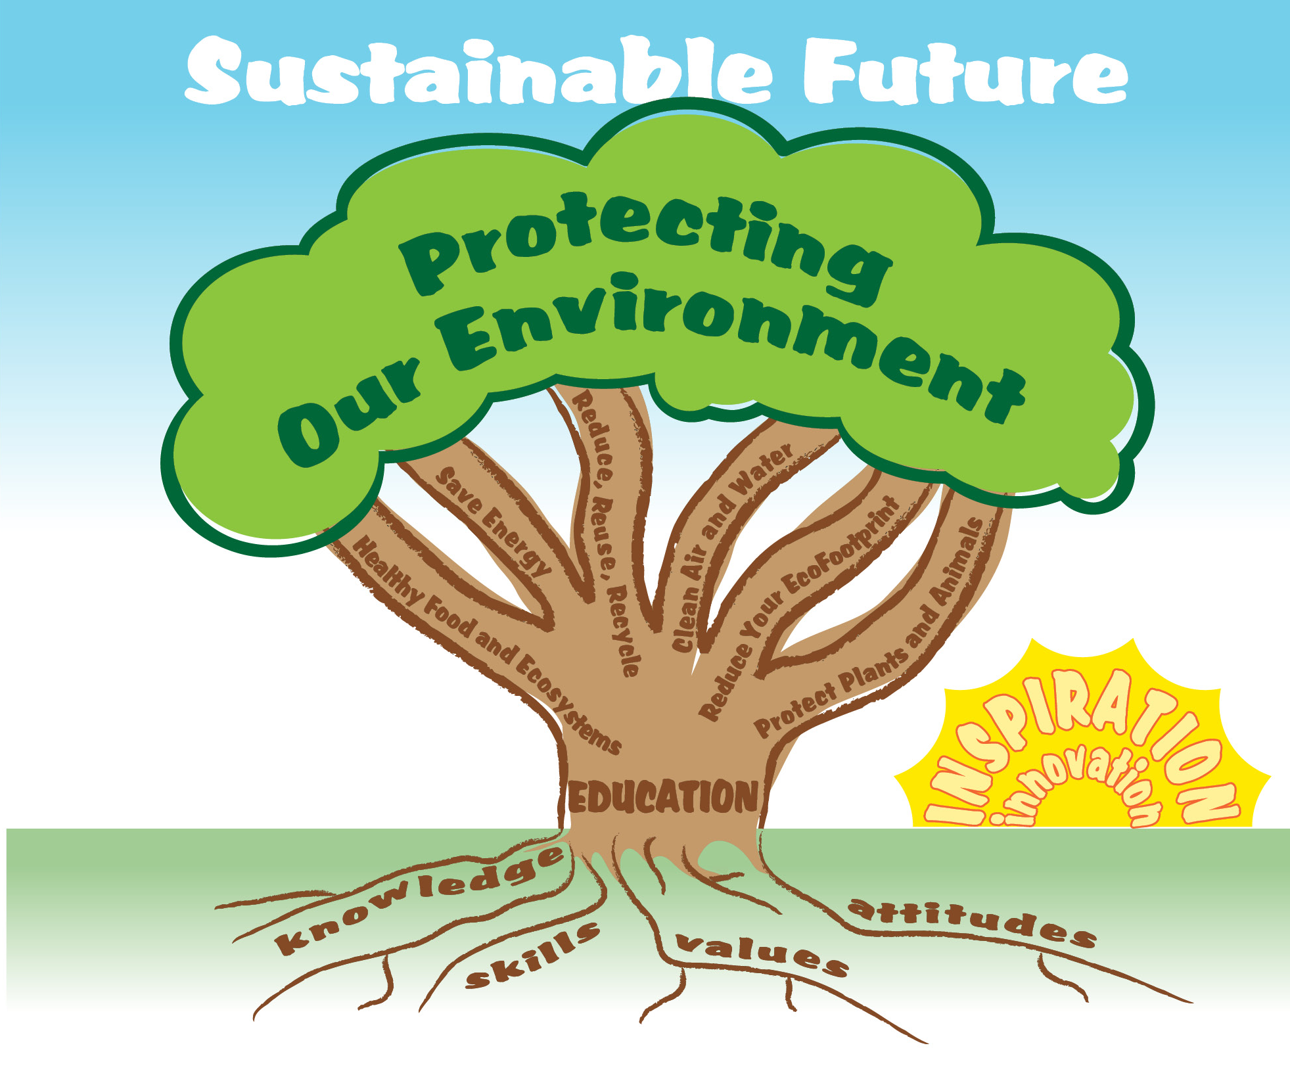

EcoLearn
Developed by the Environmental Protection Agency
With support from Department of State
Virtual Students of Foreign Service Interns
https://www.epa.gov/education
US EPA
Region 10
EcoLearn
For more information: hanft.sally@epa.gov or salazar.viccy@epa.gov

