Slide 1
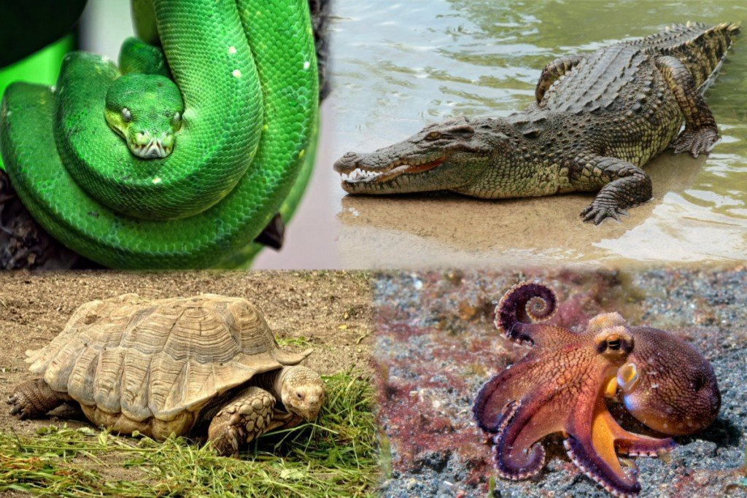


5th Grade: Animals Learn about animal species and their habitats that are endangered, reflect on why it is important to protect these species to maintain biodiversity on the planet and to think about ways in which we as humans can help protect these species
Click for Audio
US EPA, Region 10 EcoLearn
Notes:
Image Source:
https://www.google.com/url?sa=i&rct=j&q=&esrc=s&source=images&cd=&ved=0ahUKEwjkhvGt-LnSAhVP82MKHay5AjIQjxwIAw&url=https%3A%2F%2Fwww.scienceabc.com%2Fnature%2Fanimals%2Fare-there-limits-to-how-big-an-animal-can-get.html&bvm=bv.148747831,d.cGc&psig=AFQjCNFTRlbk5wKy5v5PhUmrBRMBZYR3rw&ust=1488616833255068&cad=rjt

Slide 2
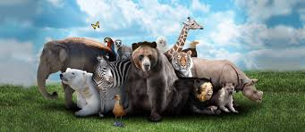

Objective
Today you will learn…
Endangered Animals of the Americas
The meanings of vocabulary terms
Explain facts about an endangered or threatened animal, its habitat, and its obstacles
Write a persuasive argument about why people should try to save endangered or threatened animals
Notes:
Image Source:
http://livescienceatsagratcor.blogspot.com/
What do animals need to survive?4

Slide 3
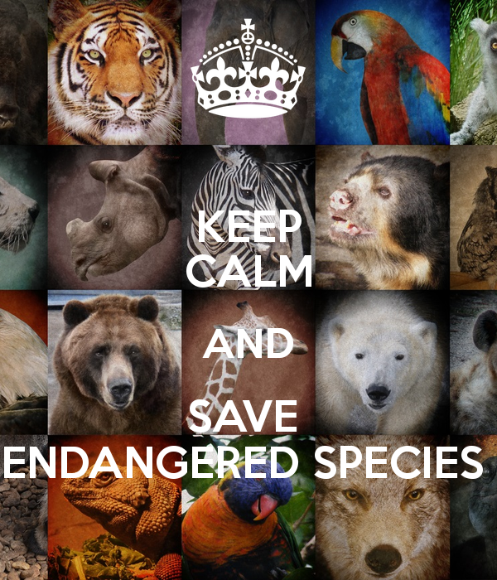

Key Words
Endangered species
Threatened species
Extinct
Notes:
Image Source:
https://steemit.com/animals/@levycore/7-animals-became-extins-due-to-human-activity

Slide 4
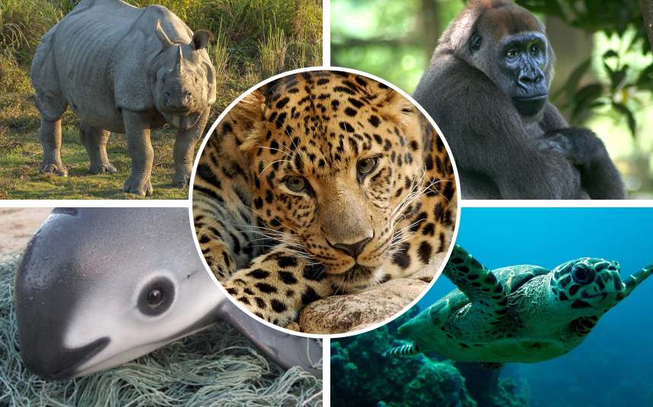

Endangered Animals of the Americas
National Geographic
The animals of the Americas that are in danger of becoming extinct. Use the National Geographic Animals website to research the listed animals and complete the worksheet. List interesting facts about where each animal lives, what its habitat is like, what obstacles it faces, and other facts that interest you.
Notes:
Image Source:https://endangeredanimals.neocities.org/

Slide 5
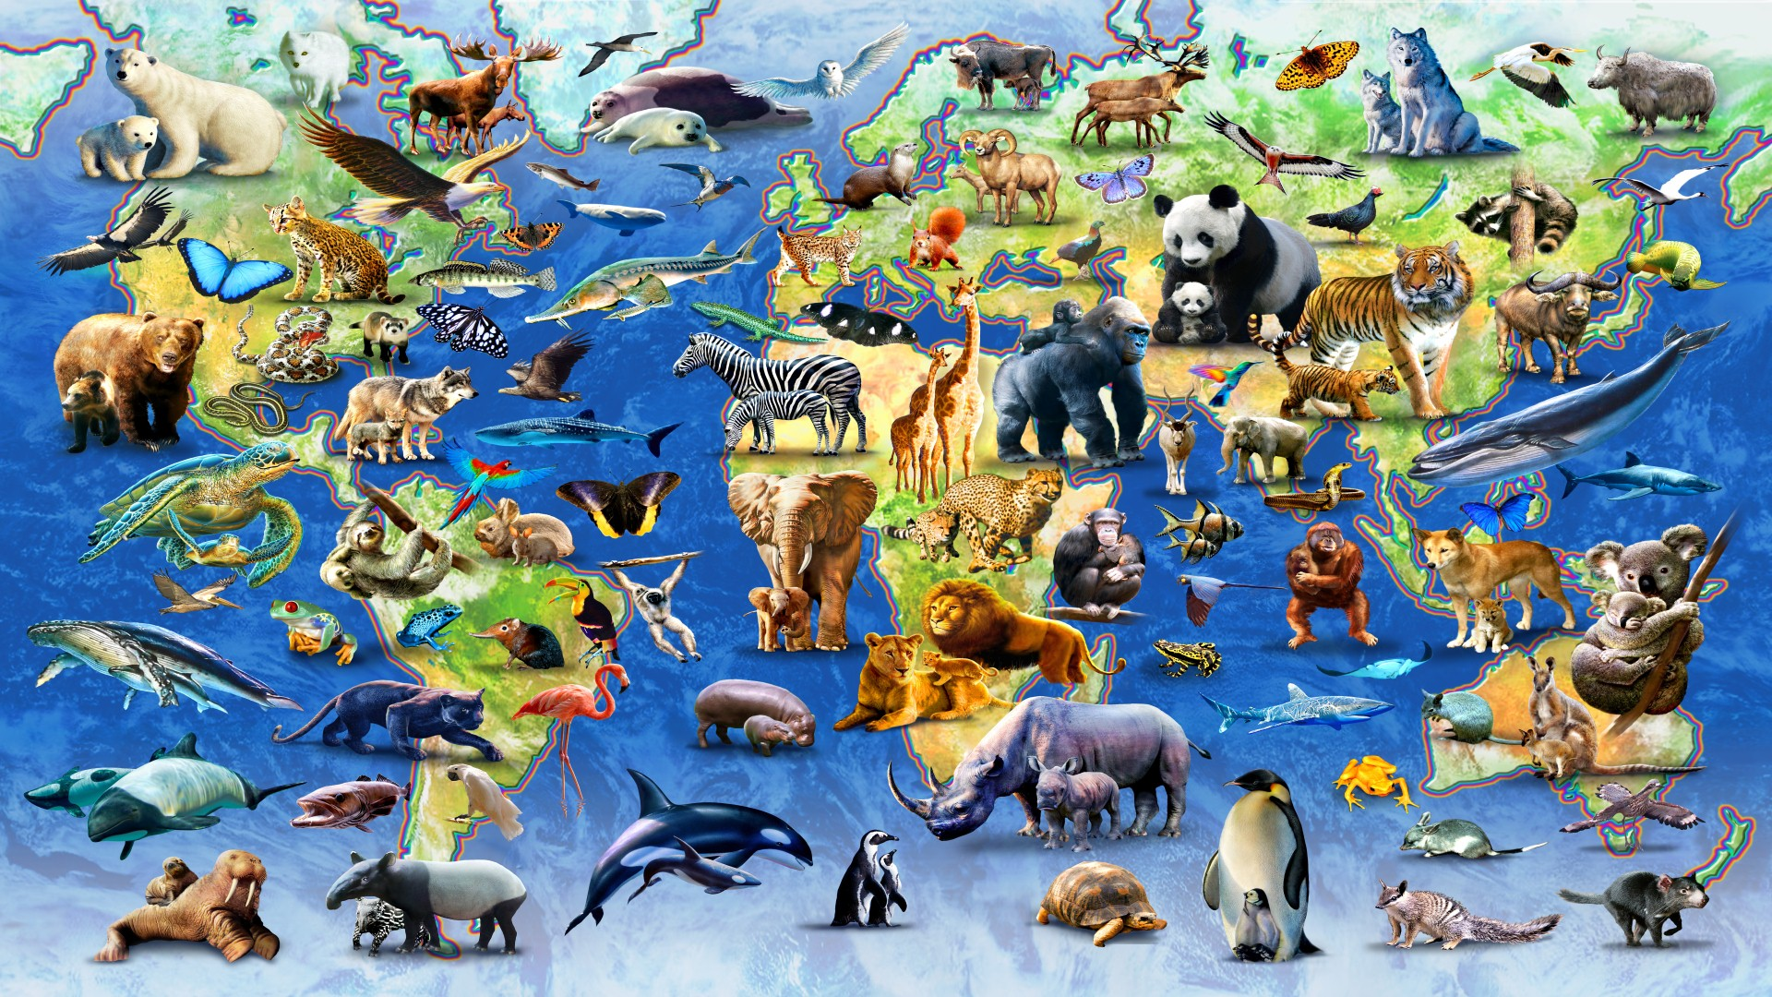

Endangered Animals of the Americas
Use your group's research to create a poster about why people should try to save your chosen animal.
Notes:
Image Source:https://www.pinterest.com/pin/111041947036853713/

Slide 6
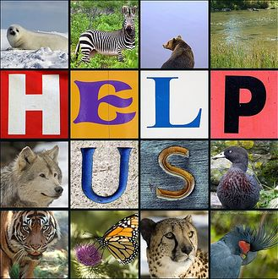

Endangered Animals of the Americas
Where does this animal live?
Why is it endangered?
What can be done to save it?
Why should people care about this animal?
Notes:
Image Source: http://www.howeisd.net/Page/1481

Slide 7
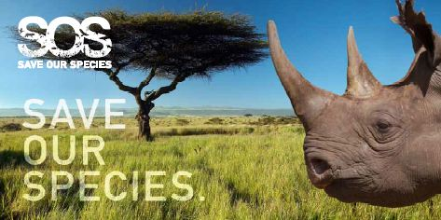

Closure
As a class, review “10 Easy Things You Can Do to Save Endangered Species”
Notes:
Image Source:https://www.thegef.org/

Slide 8
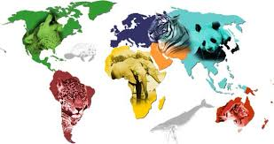

Homework
Where does this animal live?
Why is it endangered?
What can be done to save it?
Why should people care about this animal?
Notes:
Image Source:
http://www.kidsplanet.org/factsheets/map.html

Slide 9


EcoLearn
Developed by the Environmental Protection Agency
With support from Department of State
Virtual Students of Foreign Service Interns
https://www.epa.gov/education
For more information: hanft.sally@epa.gov or salazar.viccy@epa.gov
US EPA
Region 10
EcoLearn

