Slide 1
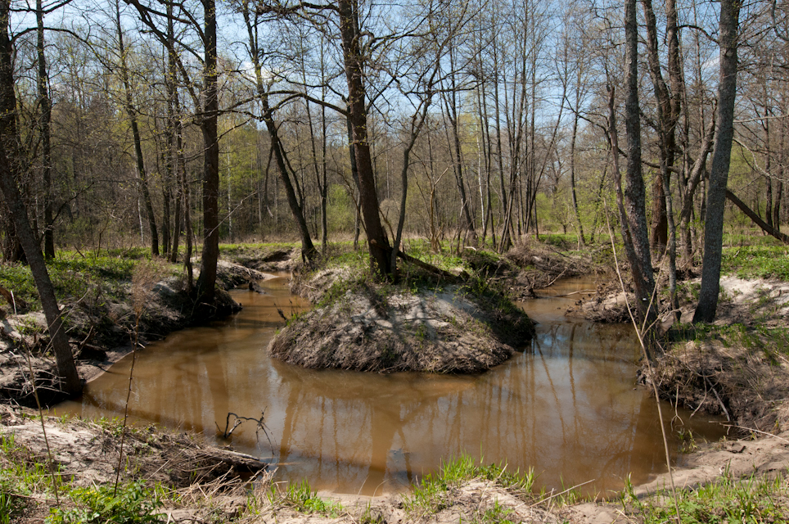



5th Grade: Ecosystems Ecosystems are a web relationships between different animals and plants. Affecting one link in the web has ripple effects for the entire system. Students will develop respect for the diversity of species on the planet and learn the important ways in which all living things are connected.
US EPA, Region 10 EcoLearn
Notes:
Image Source:http://k--k.club/?p=51502

Slide 2
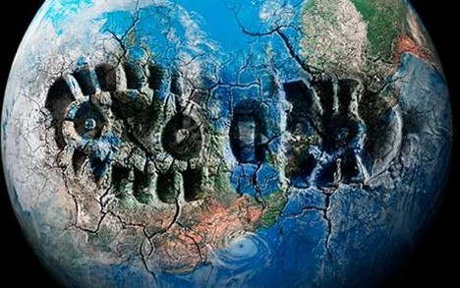
Objective
Today you will learn…
The interdependence of organisms, including humans, involved in a food web
Human impacts on ecosystems
Notes:
Image Source:http://sparkleberrylane.com/mind-body-and-earth-wellness/20-feasible-ways-to-be-greener-cuz-its-the-thing-to-do/

Slide 3
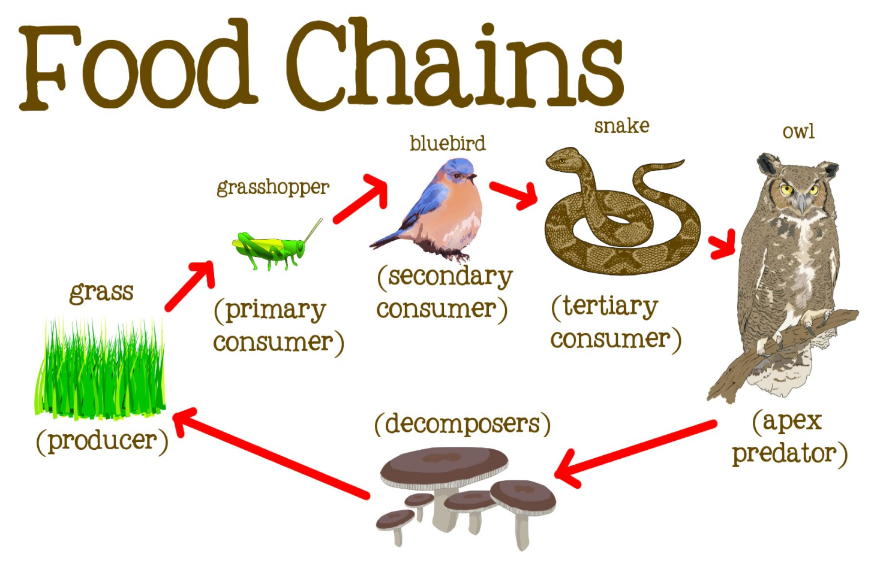
Key Words
Ecosystem
Food chain
Food web
Energy flow
Top predator
Notes:
Image Source:https://i.ytimg.com/vi/hLq2datPo5M/maxresdefault.jpg

Slide 4
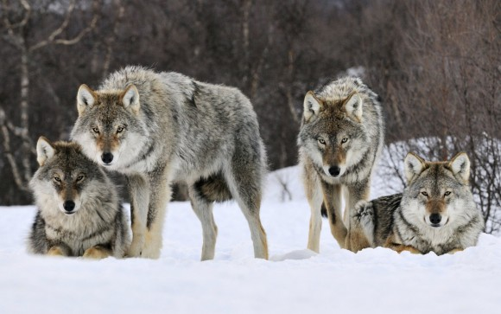
Do Now
How Wolves Change Rivers
Click for Audio
Notes:
Image Sources: http://earthsky.org/earth/did-glaciers-lure-wolves-back-to-california

Slide 5
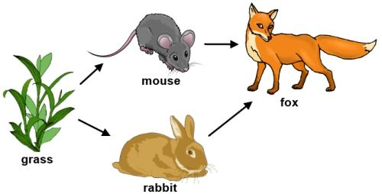
Ecosystem Worksheet
Fill out your Ecosystem Activity Worksheet
Refresh your knowledge of
Ecosystems
Species interconnection
Food chains and webs
Notes:
Image Source:https://www.pinterest.com/pin/532621093403114661/

Slide 6
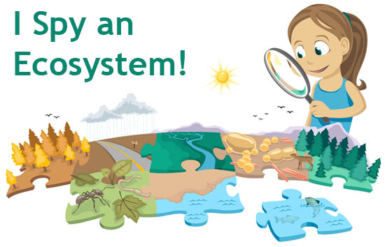
Closure: Ecosystem Investigation
Go outside and pick a small area to investigate (a playground, garden, etc.)
Identify as many different types of plants and animals (including insects) as you can and record the data on a worksheet.
Notes:
Image Source:https://askabiologist.asu.edu/explore/i-spy-ecosystem

Slide 7
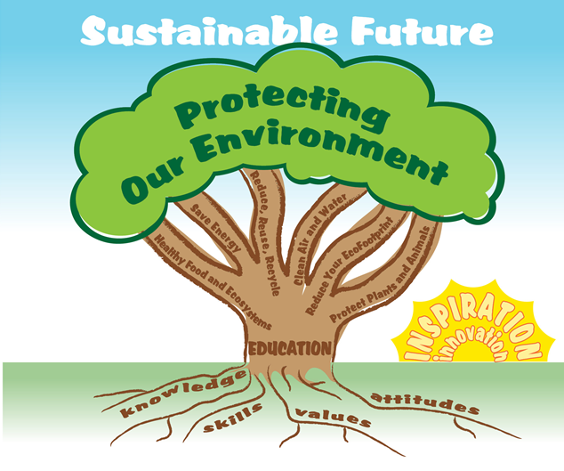

EcoLearn
Developed by the Environmental Protection Agency
With support from Department of State
Virtual Students of Foreign Service Interns
https://www.epa.gov/education
US EPA
Region 10
EcoLearn
For more information: hanft.sally@epa.gov or salazar.viccy@epa.gov

