Slide 1
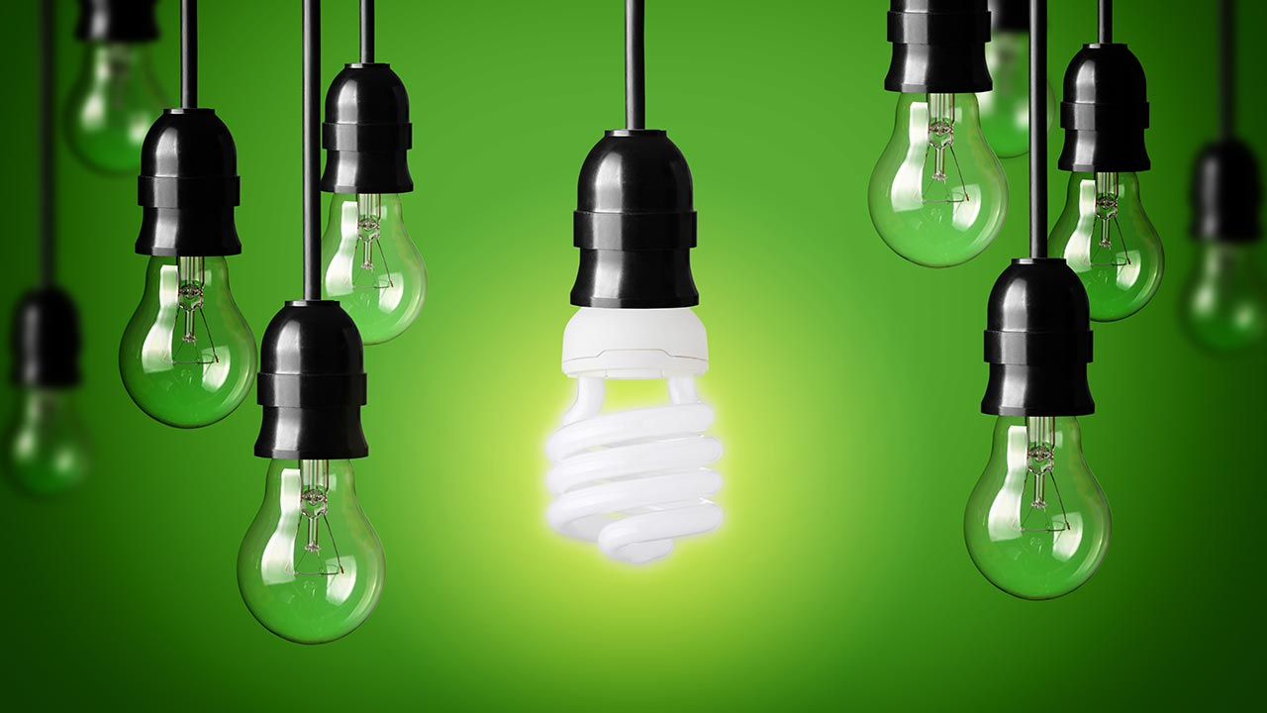



5th Grade: Energy Learn the importance of conservation, and understand how your daily activities affect consumption.
US EPA, Region 10 EcoLearn
Notes:
Image Source:
http://www.jackandpatty.com/2016/09/29/11-simple-ways-to-save-energy-and-money-at-home/

Slide 2
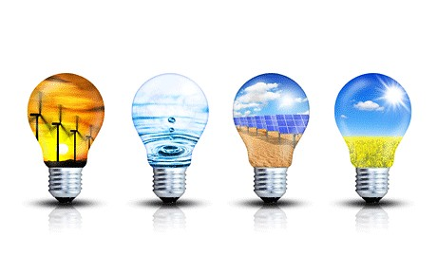
Objective
Today you will…
Learn how much our society depends on electricity
Analyze and contrast two graphs measuring the consumption of a resource
Regulating the rate of consumption of a resource allows it to last longer
Learn the difference between a non-renewable and renewable energy resources
Energy conservation
Notes:
Image Source:
http://mightymuirhead.blogspot.com/2016/09/gr-5-energy.html

Slide 3
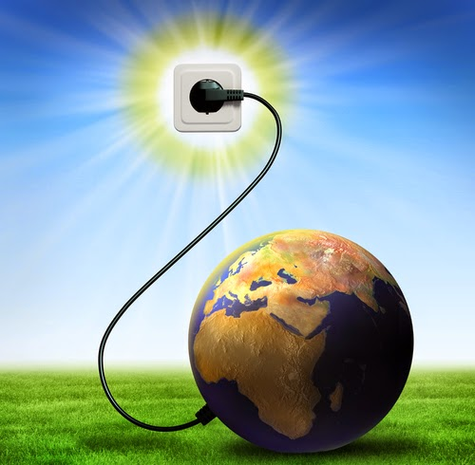
Key Words
Resources
Renewable energy
Electricity
Energy consumption
Conservation
Energy efficiency
Notes:
Image Source:
http://smartestabanell.blogspot.com/2015_03_01_archive.html

Slide 4
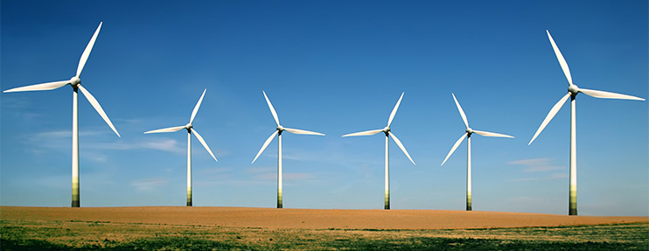
Do Now
Watch the video “Energy Literacy Essential Principle #1”
Click for Audio
Notes:
Image Sources:
http://www.bauer.uh.edu/centers/uhgemi/

Slide 5
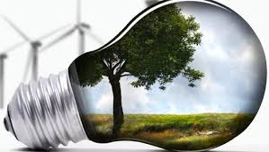

Energy Efficiency Interactive
Activity
Notes:
Image Source:https://www.ppi.coop/environmental/energy-efficiency/

Slide 6
Discussion Questions
During what season is electricity usage the highest?
How could people use electricity more efficiently in the summer?
How can your school be made more efficient?
Is it better for the environment to put solar panels on your roof or be more energy efficient?
What do you think the energy mix for electricity generation will be in the future?
Click on Audio for Answers

Slide 7
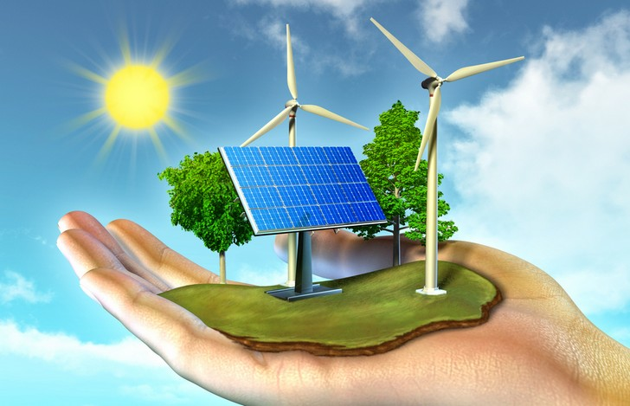
Closure
Notes:
Image Source:
http://championnat-er.be/category/energia-renovable/

Slide 8
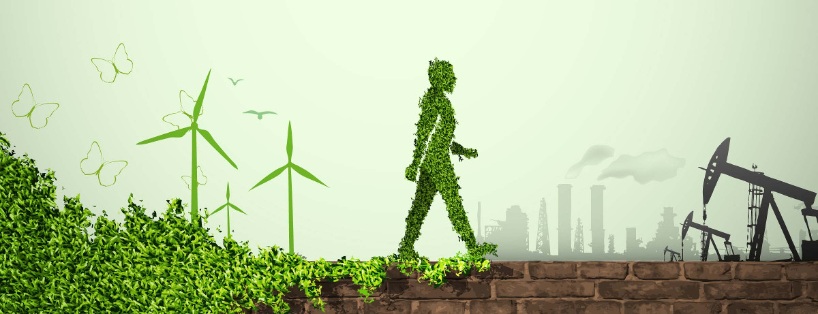
Homework
Website
Notes:
Image Source:
http://www.energyinspection.com.au/

Slide 9
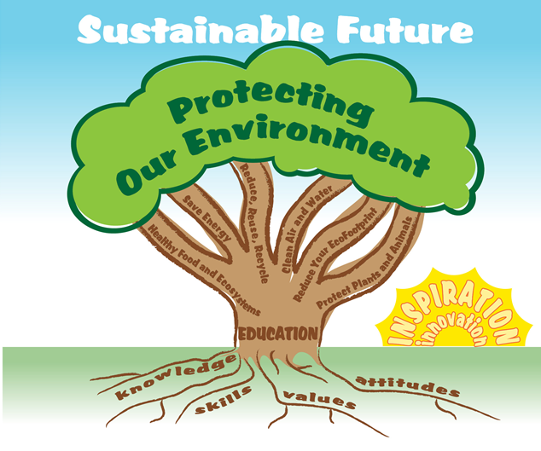

EcoLearn
Developed by the Environmental Protection Agency
With support from Department of State
Virtual Students of Foreign Service Interns
https://www.epa.gov/education
US EPA
Region 10
EcoLearn
For more information: hanft.sally@epa.gov or salazar.viccy@epa.gov

