Slide 1
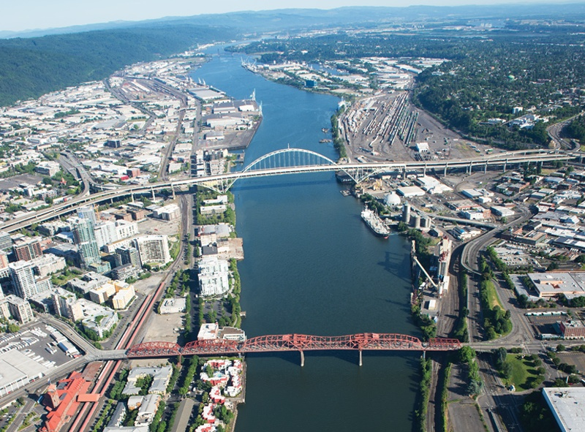
Portland Harbor Superfund Site
Prepared for: Congresswoman Maxine Dexter
March 12, 2026

Slide 2
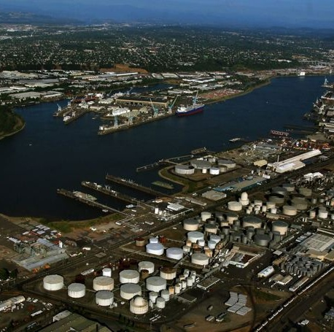
64 Contaminants of Concern
Major Contaminants:
  Polychlorinated Biphenyl (PCBs)
    Used in electrical equipment, oil, plastics
  Polycyclic Aromatic Hydrocarbons (PAHs)
    Produced when coal, oil, gas are burned
  DDx (DDT, DDE, DDD)
    Commonly used in pesticides
  Dioxins/Furans
    Created when certain products are made, like herbicides, pulp/paper or when products are burned

Slide 3







Portland Harbor by the numbers . . .
3 Million
Cost to cleanup Portland Harbor
$1.05 Billion
3 Million
10 Miles
More than 150
Cost to cleanup Portland Harbor
Cubic yards to be removed from site during cleanup
River miles as part of the Superfund Site
Potentially Responsible Parties (PRPs)
64
13 Years
18
Over 5,300
Contaminants of concern threatening human health and the environment
Time it will take to actively construct the remedy
Number of designs actively underway
Comments received on EPA’s cleanup plan

Slide 4
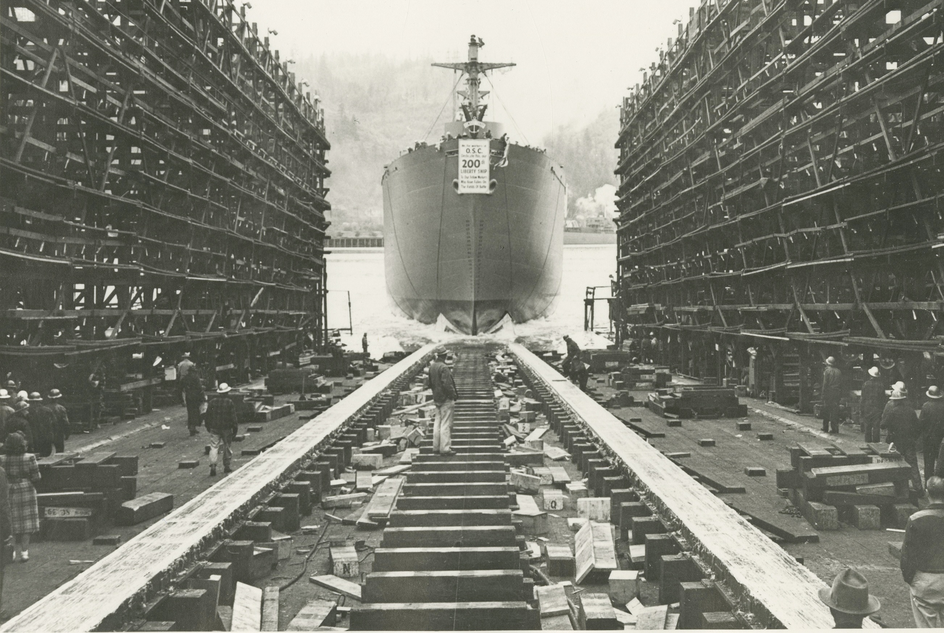
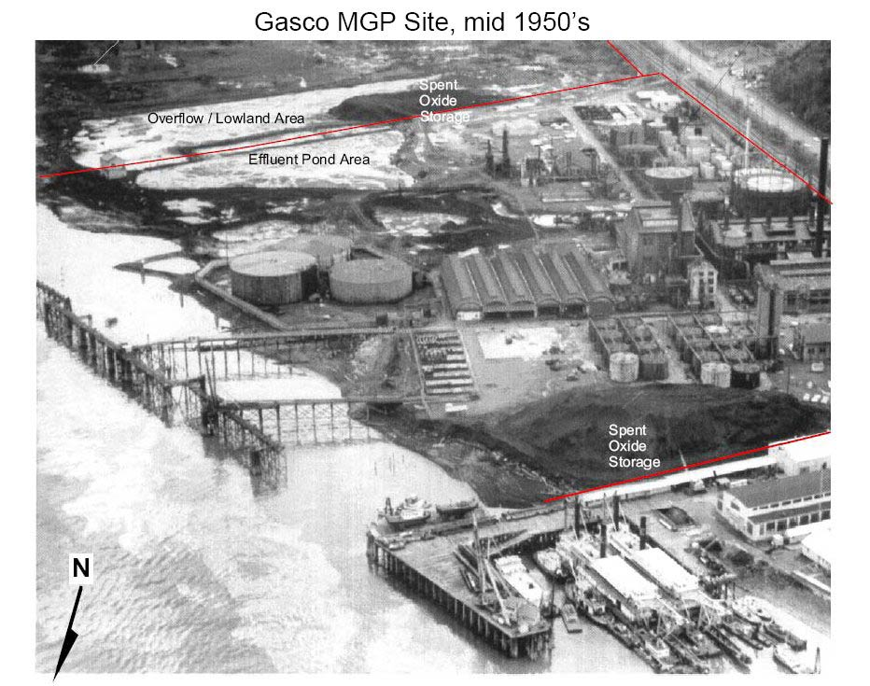
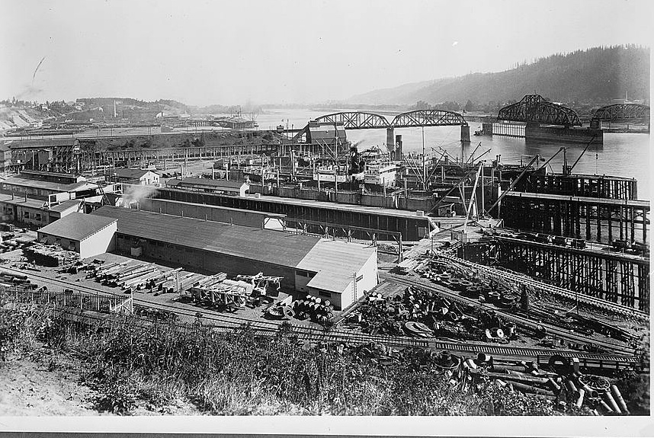
Source: The Oregon Encyclopedia

Slide 5
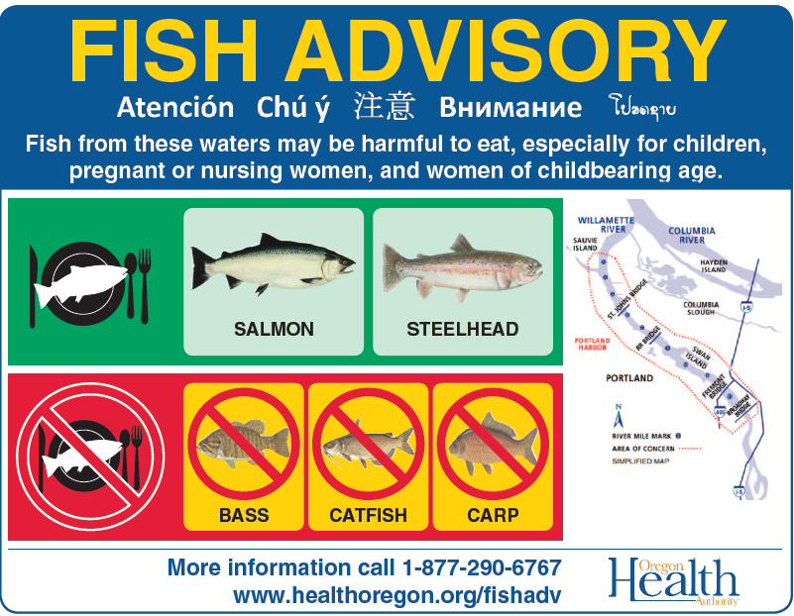
What are the risks to people?
Mainly from eating contaminated fish
Resident fish pose greatest risk
Children and infants are most vulnerable

Slide 6
Superfund Process
We are here
REMEDIAL
INVESTIGATION
FEASIBILITY
STUDY
RECORD OF
DECISION
SITE LISTING
EXPLAINATION OF SIGNIFICANT DIFFERNCES
REMEDIAL DESIGN
REMEDIAL ACTION
LONG-TERM MONITORING
What and where are the risks
Cleanup plan and public comment
There is a problem
How can it be cleaned up
Refining and planning cleanup
2000
2010
2016
2017
2019

Slide 7
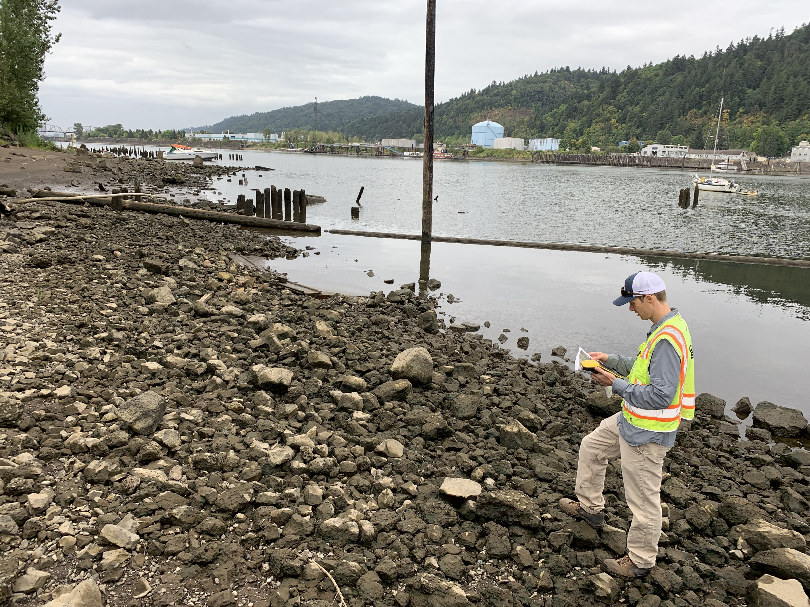
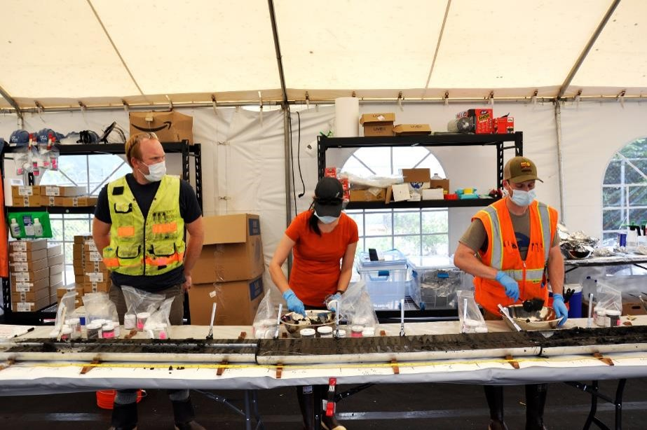
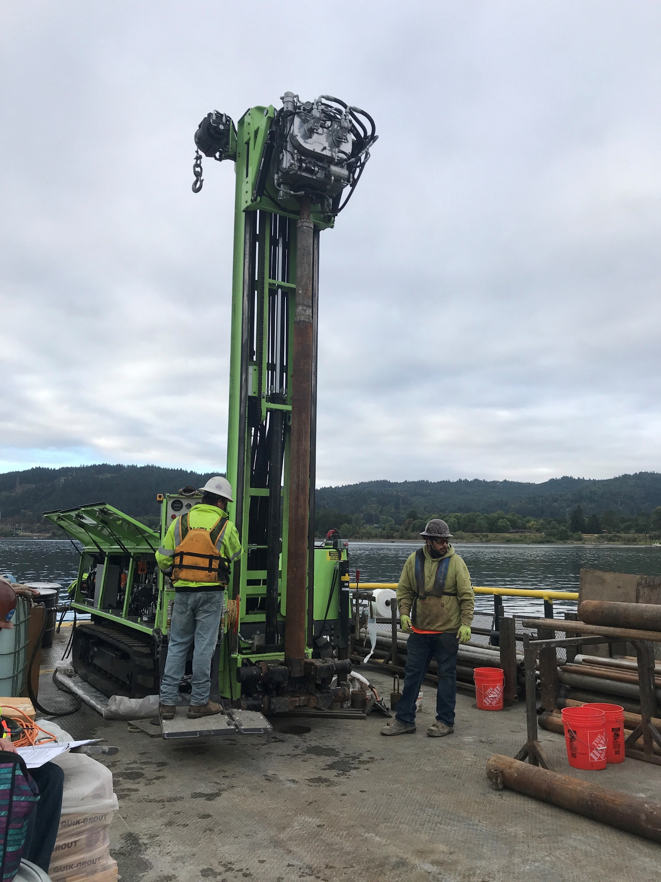
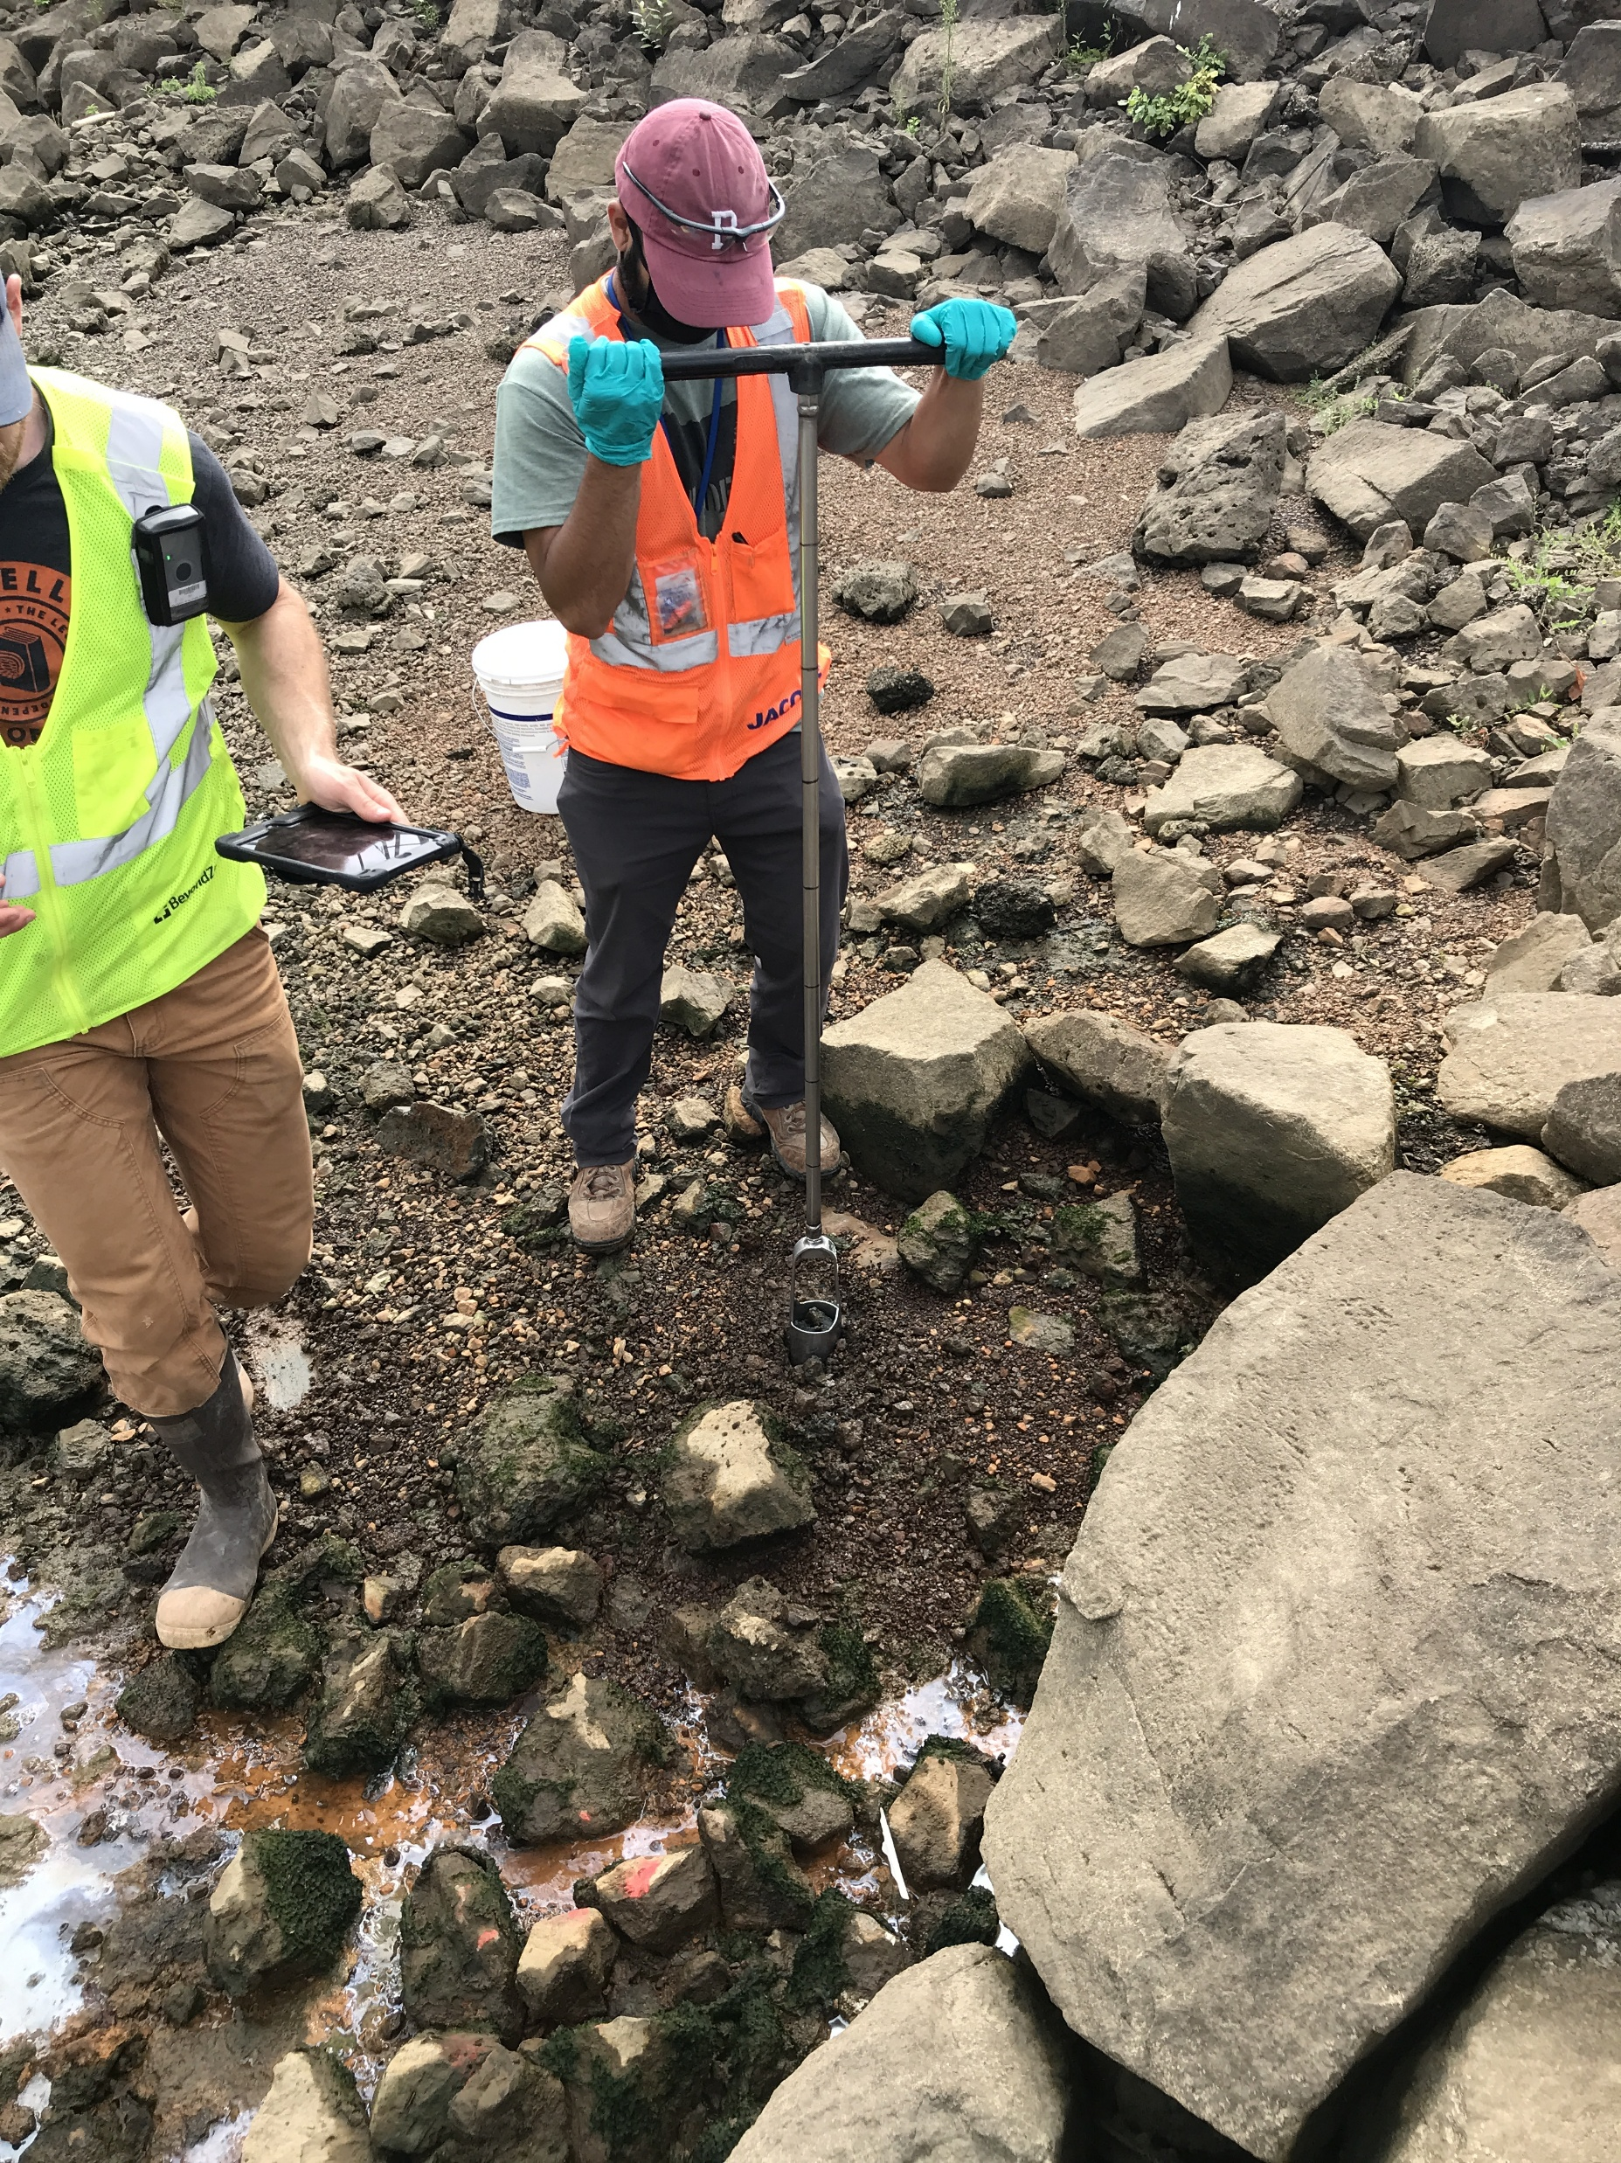
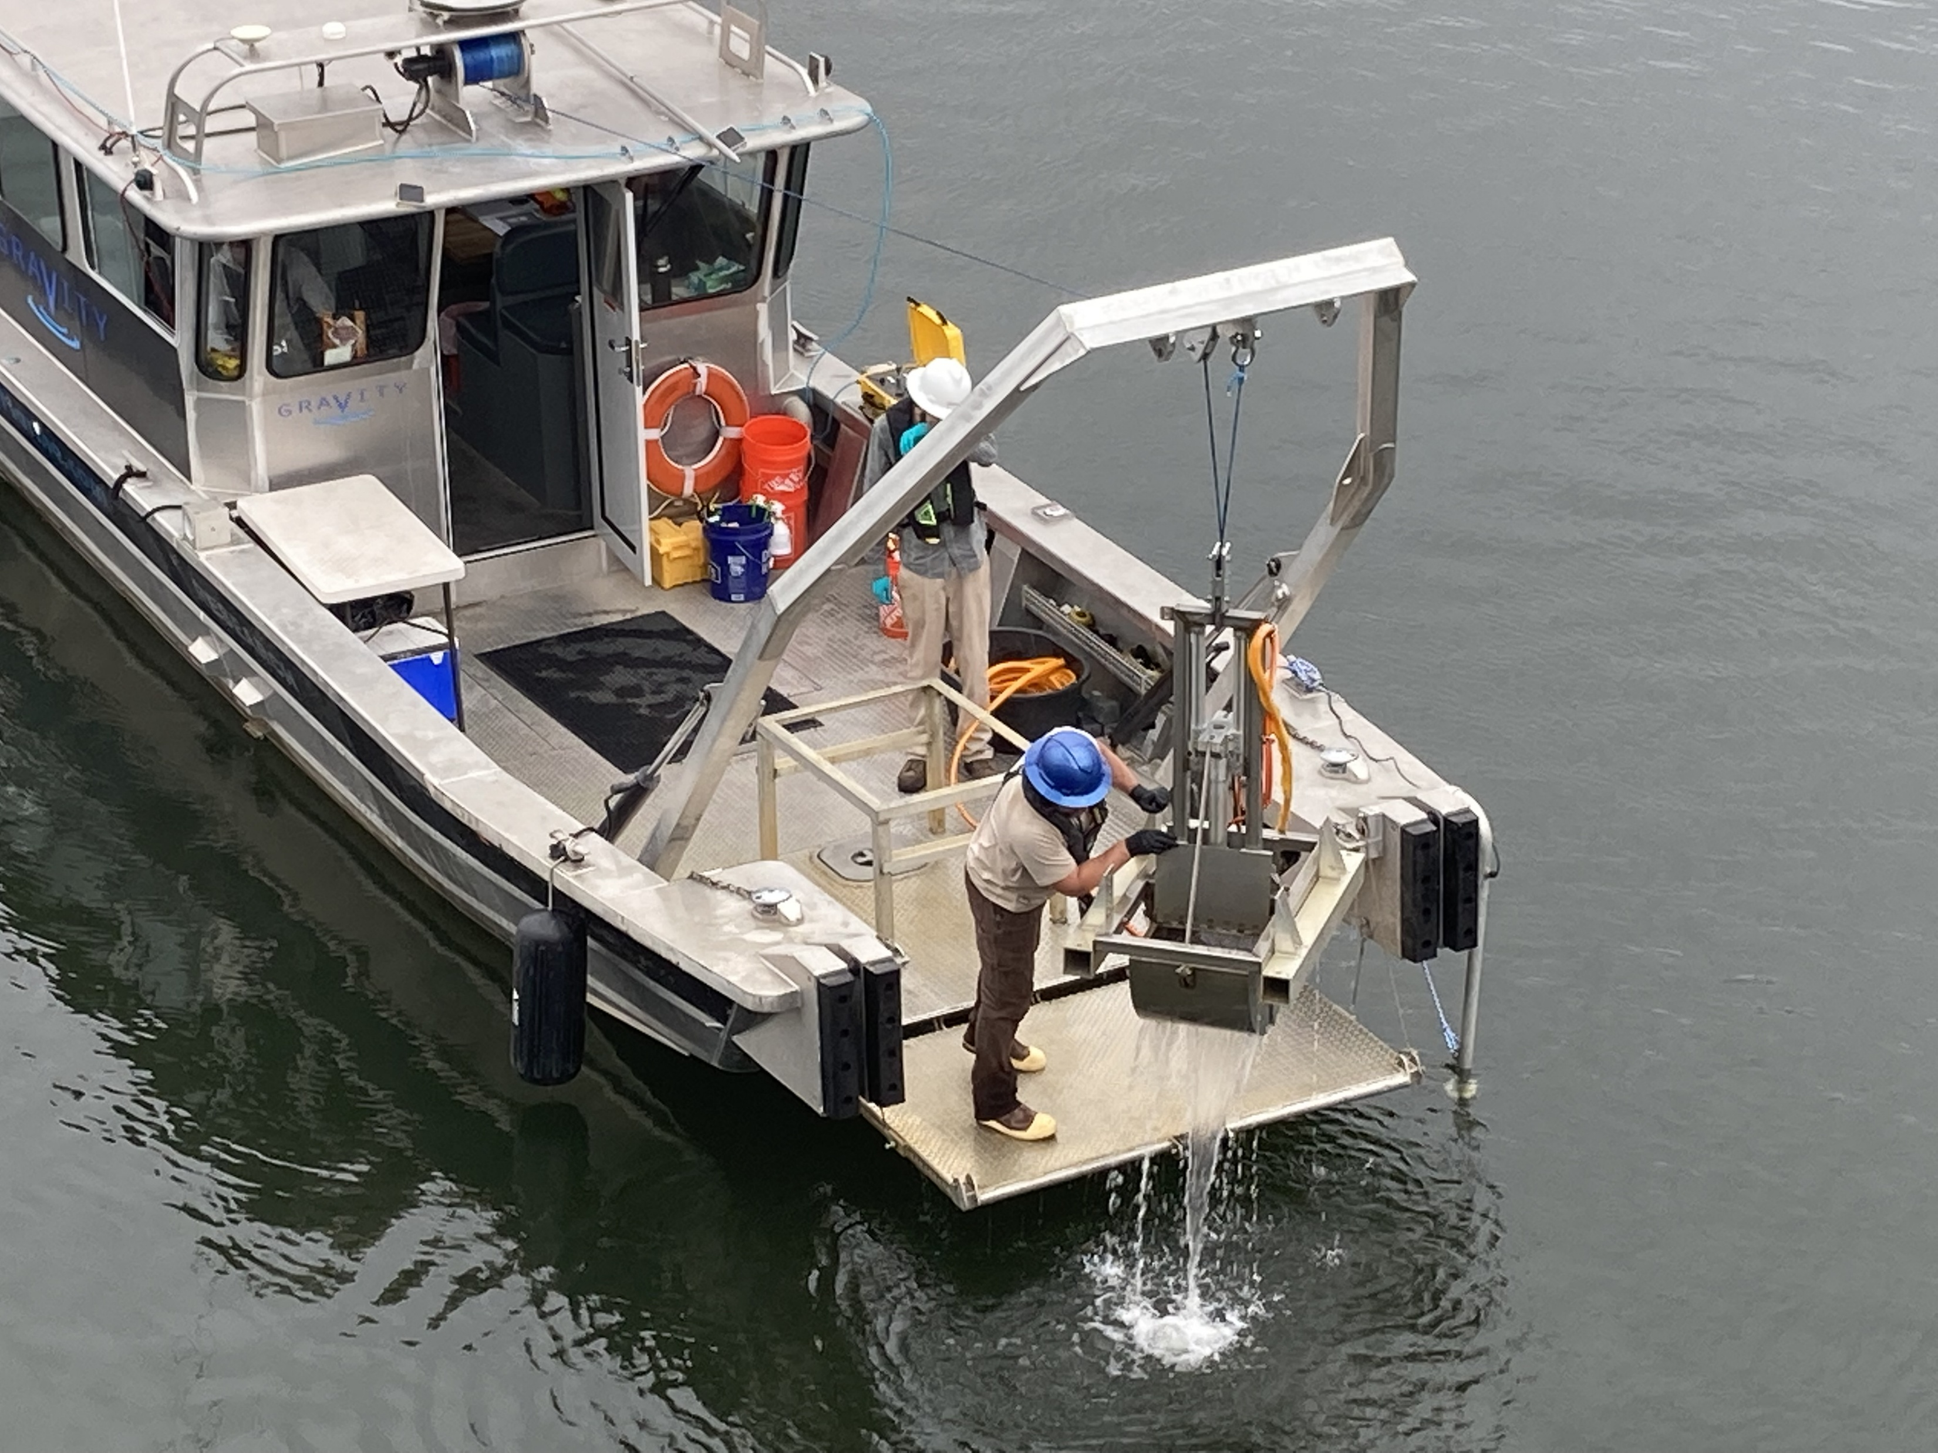
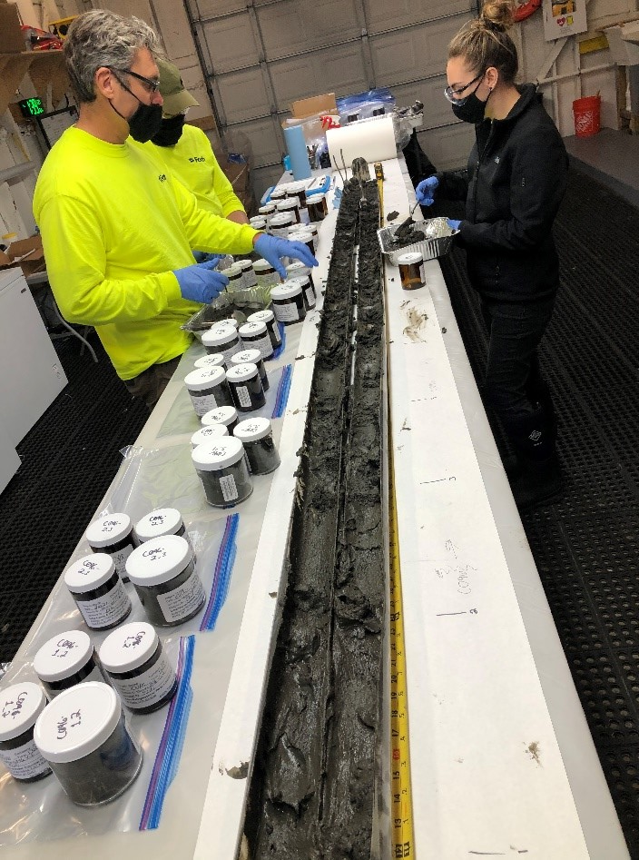
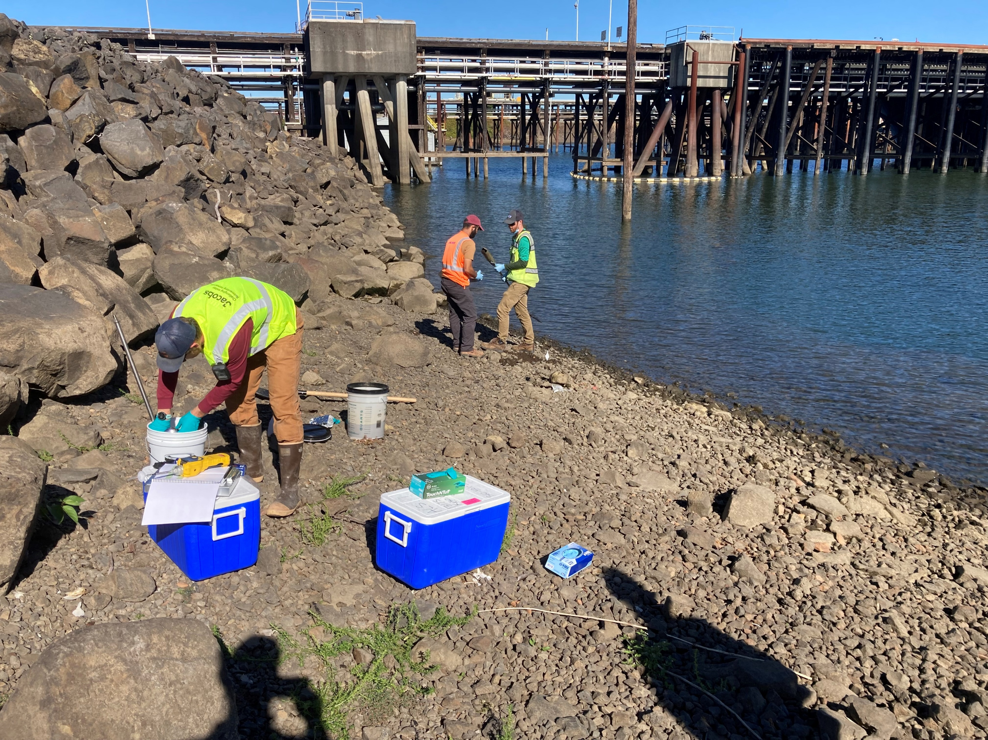
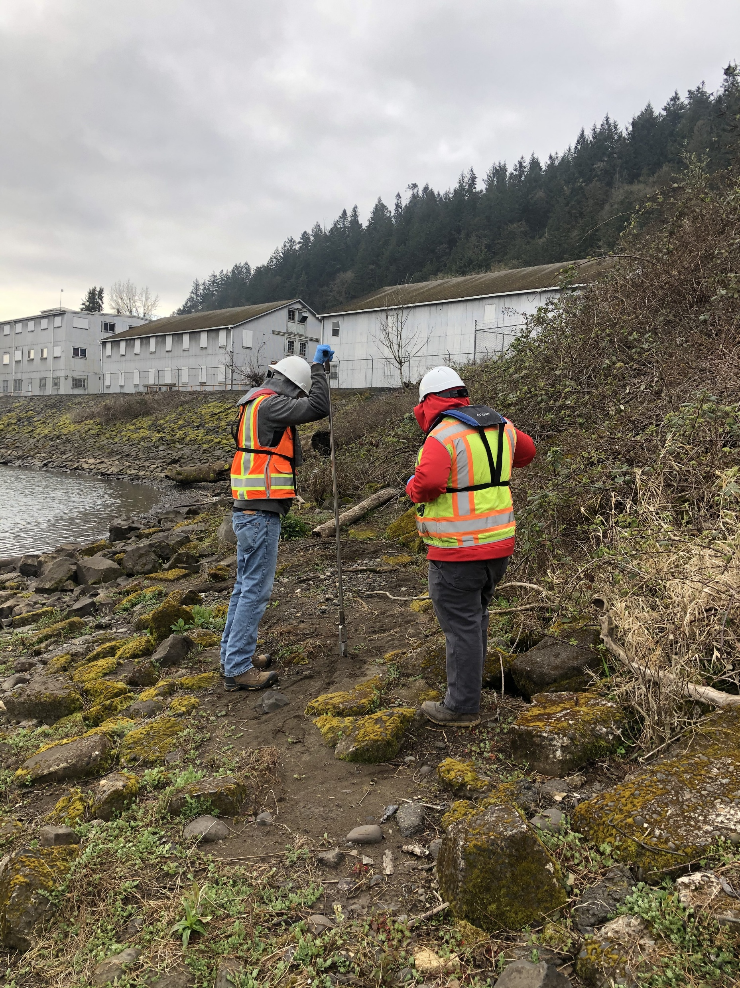
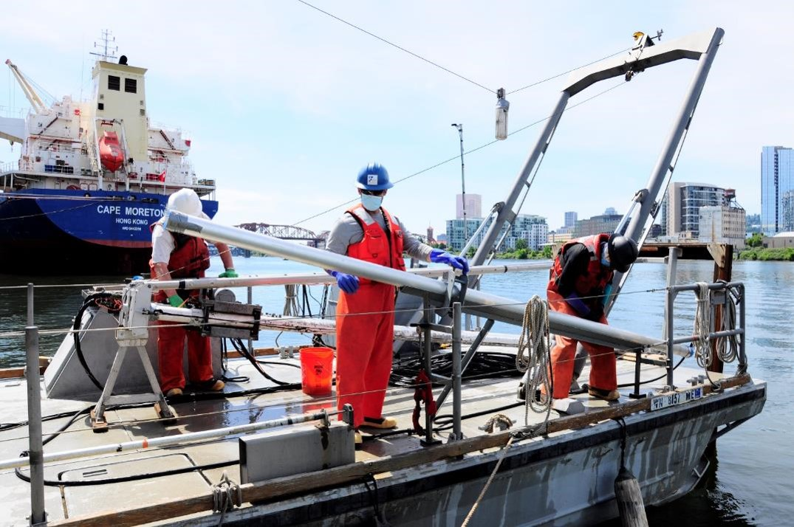
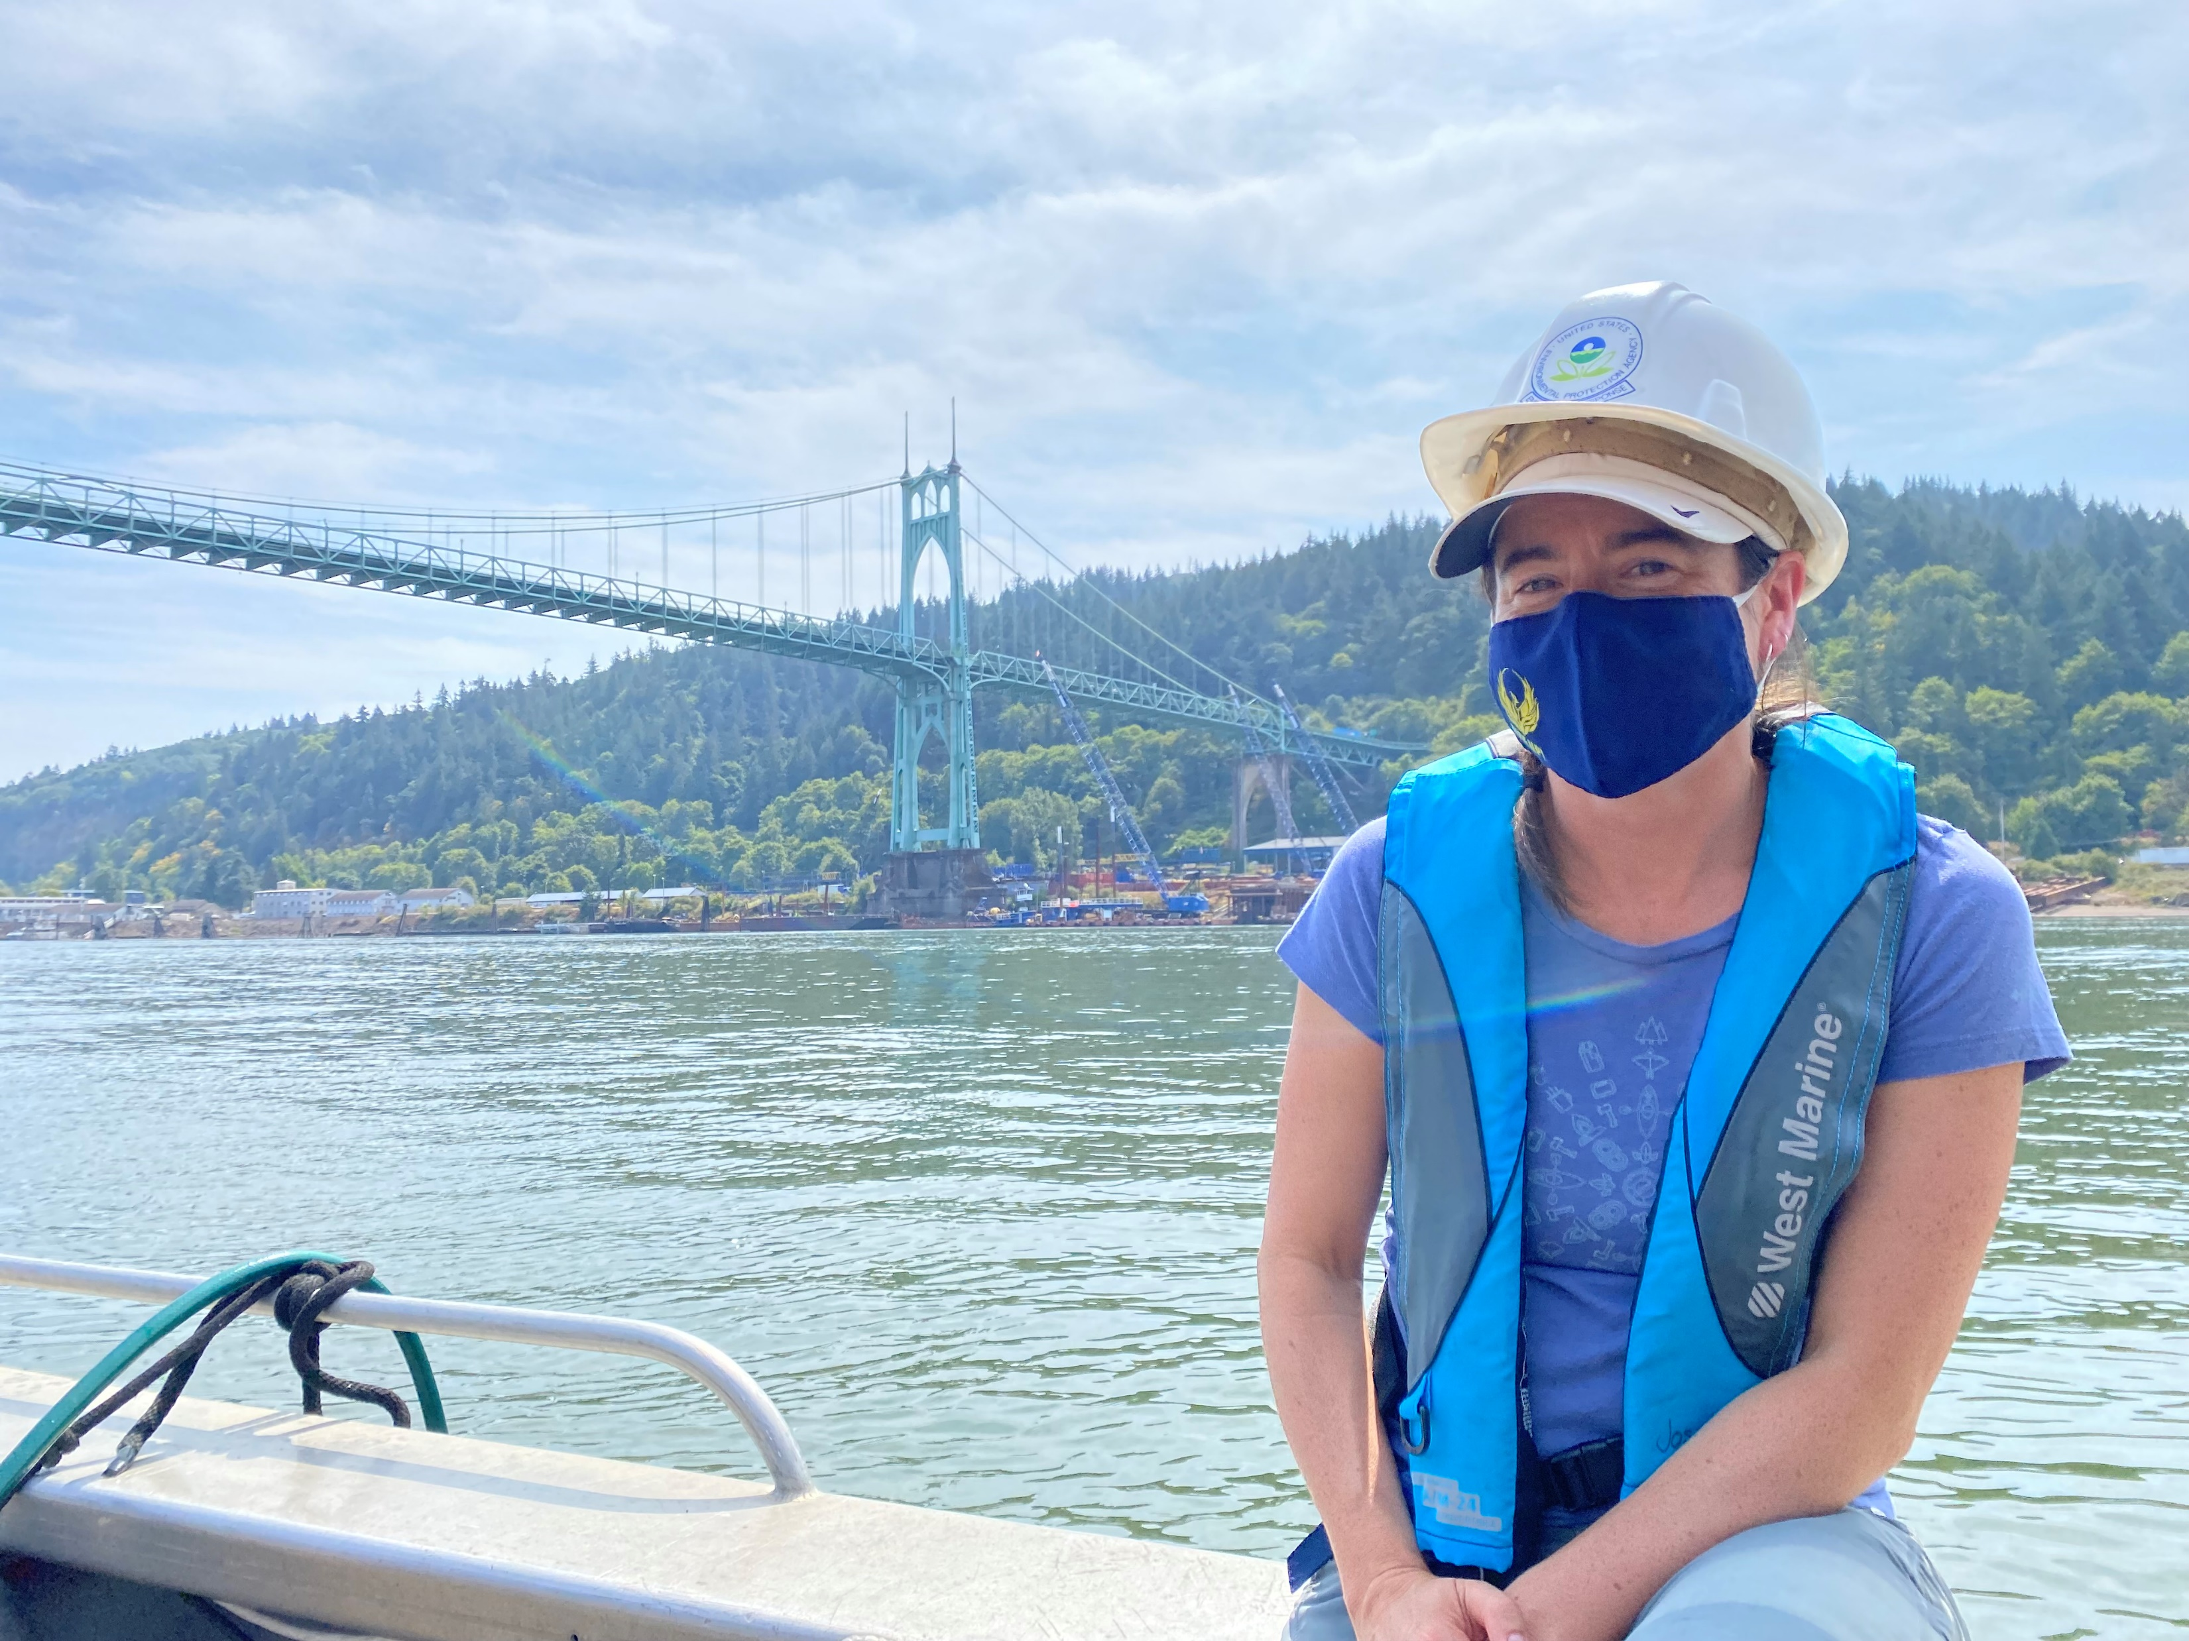
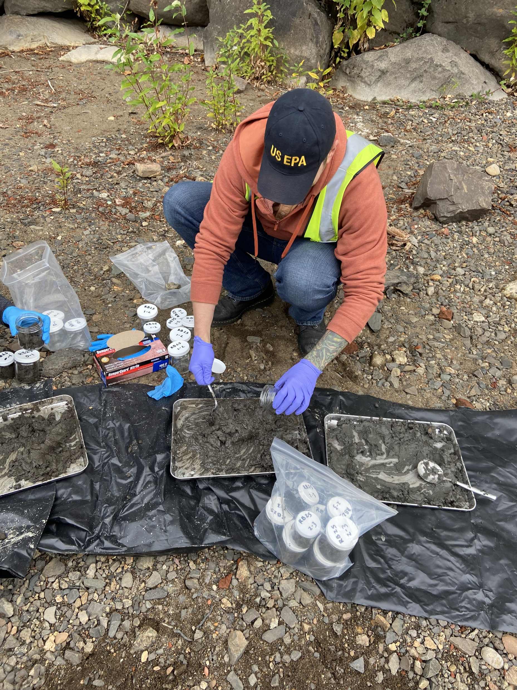
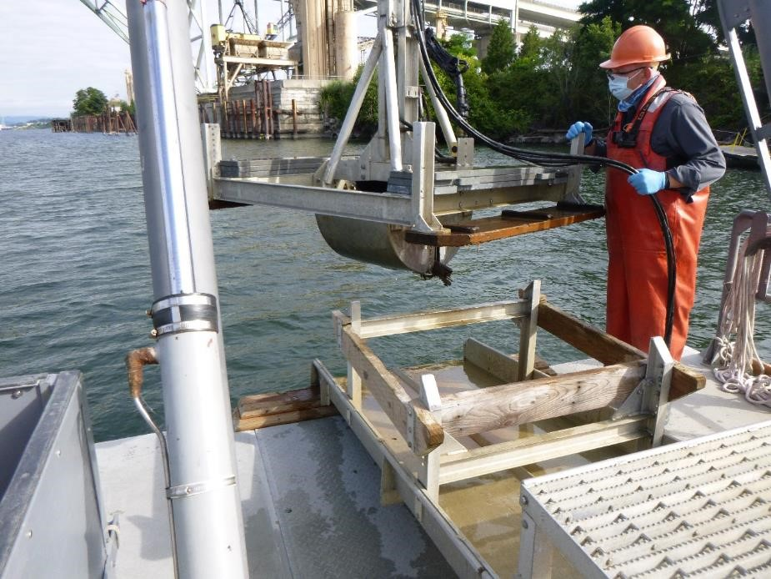

Slide 8
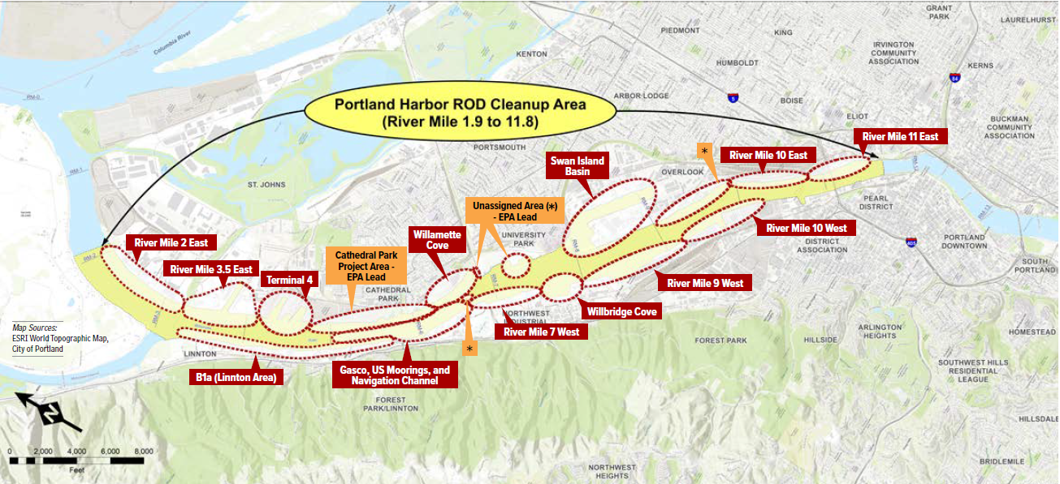

Slide 9
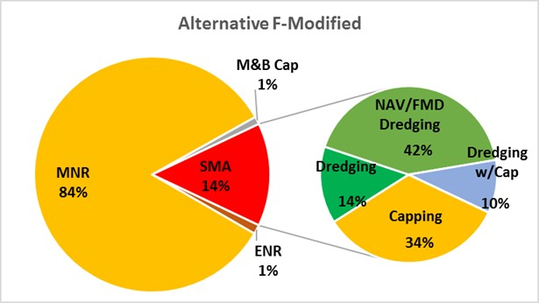
Record Of Decision issued January 2017
  Dredging (215 acres)
  Capping (150 acres)
  Enhanced Natural Recovery (28 acres)
  Monitored Natural Recovery (1770 acres)

Slide 10
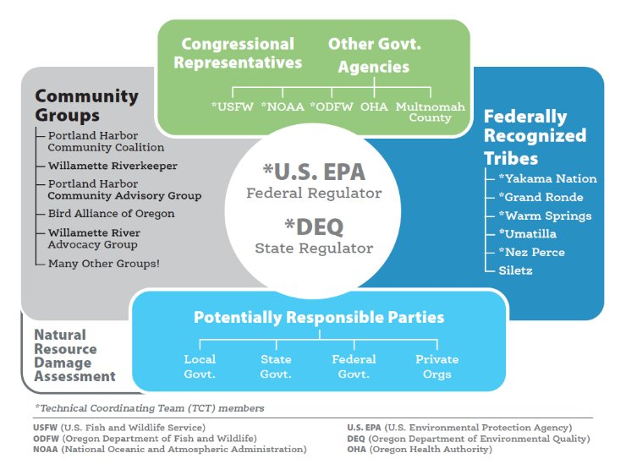

Slide 12
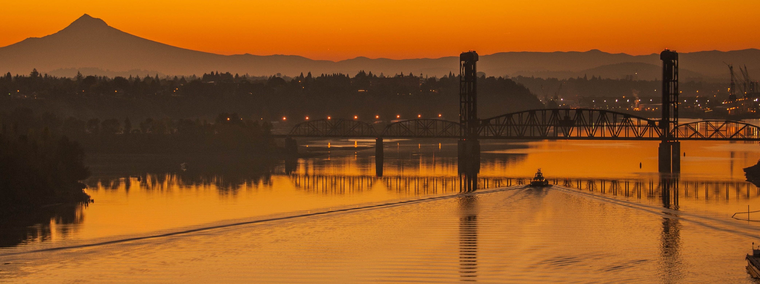
Consent Decree Negotiations
Next phase is to enter a consent decree (CD) with potentially Responsible Parties for Remedial Action.
One sitewide CD requiring implementation of all of EPA’s ROD, ensuring the remedy is implemented efficiently, on schedule, and with minimal disruption between areas.
EPA and DOJ have communicated that we are allowing a 2-year negotiation, with a signed CD no later than March 2027.
In water cleanup would begin summer of 2028.

Slide 13
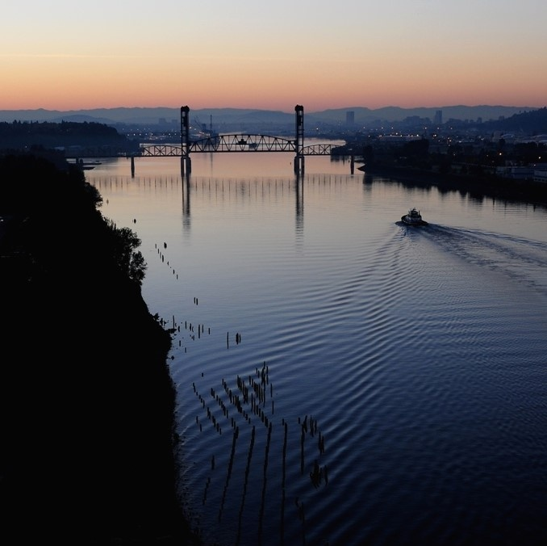
Federal Navigation Channel Issues
Shoaling is occurring in the Federal Navigation Channel that is impacting ship traffic
Challenges identified are related to cost and liability concerns raised by the USACE
EPA and USACE have been working together to identify a solution

Slide 14
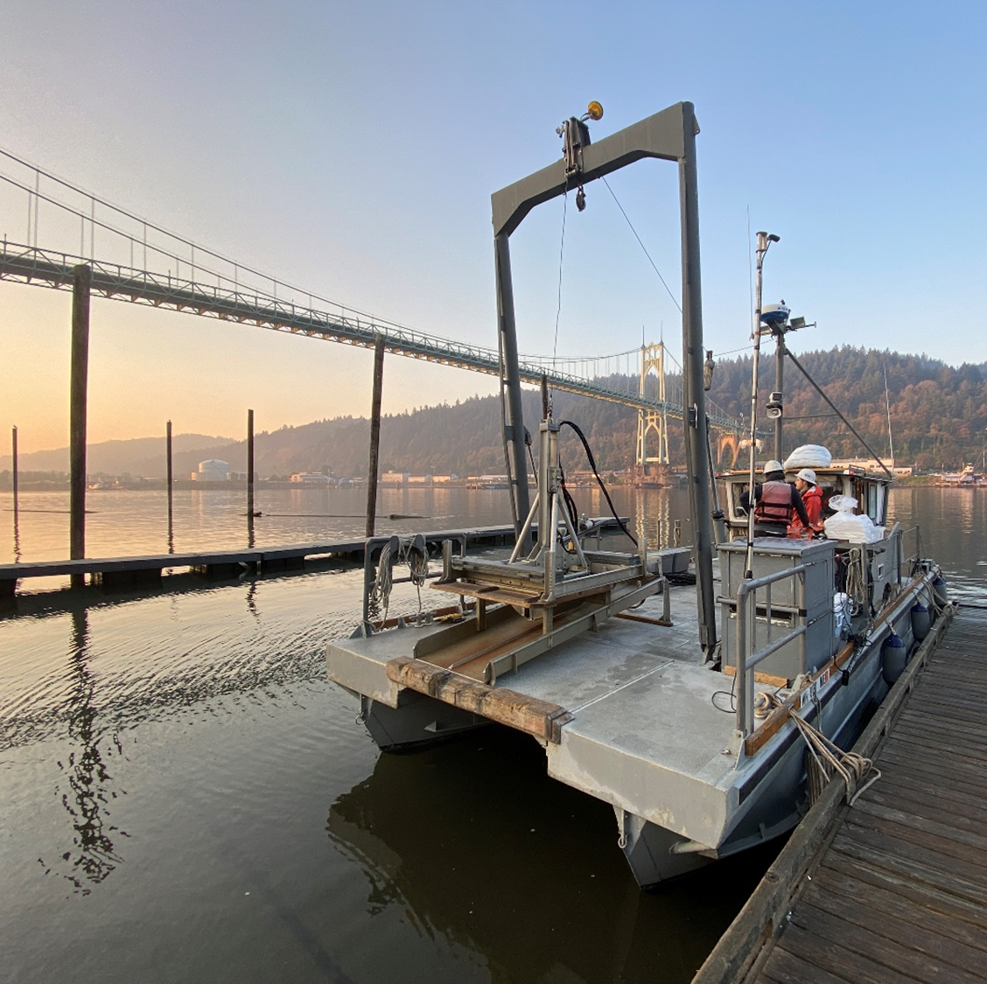
Questions?

