Slide 1
Upper Columbia River Site
Project Update
Helen Bottcher
Bottcher.Helen@epa.gov
August 2011

Slide 2
Site is located wholly within Washington State
Significant source in Canada 10 miles north of border
Extends 150 miles south to Grand Coulee Dam

Slide 3
Site Background
Primary source – Teck smelter in Trail, BC
  Discharged 13 – 25 million tons of slag, liquid effluents
  Transboundary pollution claim (smoke) settled in 1938
  Current operations produce lead, zinc, gold, silver, cadmium, specialty metals (e.g., germanium, indium)
Other mines and mills, smelters, POTWs, pulp and paper facilities, agricultural and municipal runoff in watershed
River is dammed, flows highly managed

Slide 4
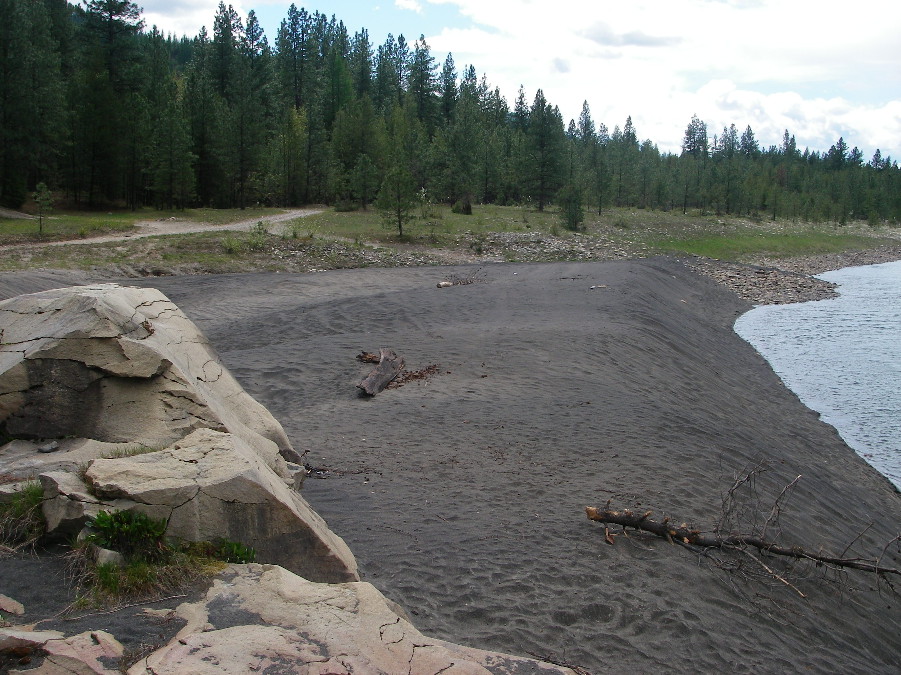

Slide 5
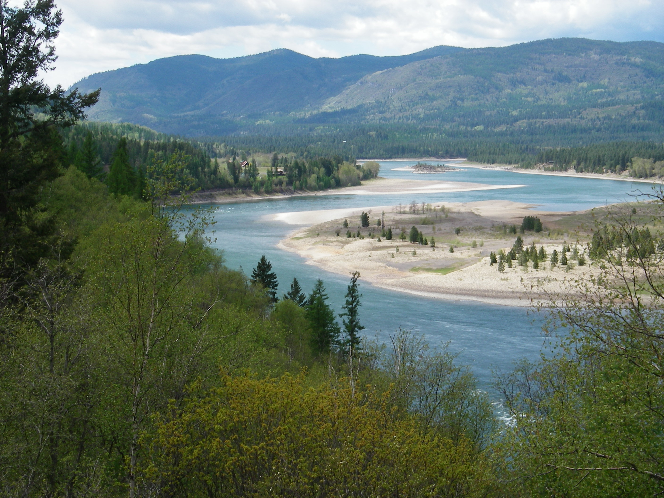

Slide 6
Enforcement History
EPA involvement began with petition from Colville Tribes in 1999
EPA issued cleanup order to Teck in 2003
Colville Tribes and State of Washington sued in 2004 to enforce cleanup order
Settlement Agreement between Teck and EPA signed in 2006, current studies being conducted under the agreement

Slide 7
EPA Project Partners
EPA Memorandum of Agreement with:
  Department of Interior – 6 bureaus
    NPS, USGS, FWS, BOR, BIA, BLM
  Colville Tribes
  Spokane Tribe
  WA Dept of Ecology
WA Dept of Health
Citizens for a Clean Columbia

Slide 8



RI / FS Studies Summary
DONE | UNDERWAY | STILL TO DO
Fish Tissue | Beaches | Sediment Toxicity
Surface Water | Recreational Use Survey | Soil / Upland Chemistry
 | Tribal Exposure Survey | FW Mussels Tissue Collection
 | White Sturgeon Toxicity Studies | Other Data Gaps?

Slide 9
Fish Tissue
More than 2,300 fish collected Nov 2009
3 size classes, 13 species
For large fish, both fillet and whole body (calculated) samples
Metals, exotic metals, dioxins / furans, PCBs, PBDEs, PAHs, pesticides, SVOCs
DOH currently updating fish tissue advisory

Slide 10
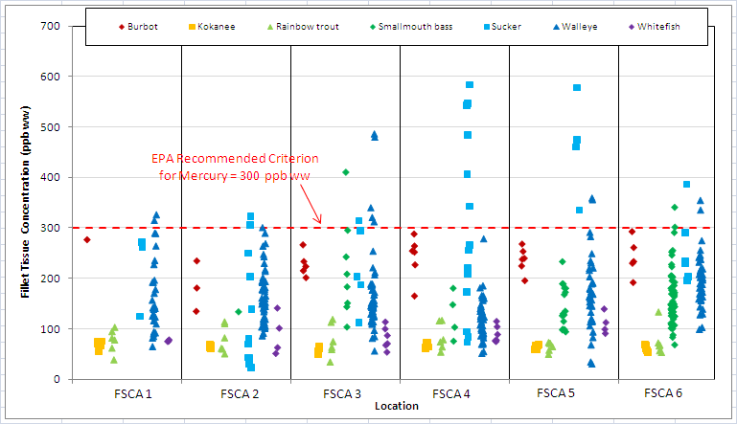
Results Example
Mercury in Fillet Tissues (>12 in.)
Note: The fish tissue-based criterion is presented to provide a frame of reference for these results; risk management decisions will be based on risk calculations using the site-specific exposure survey data.

Slide 11
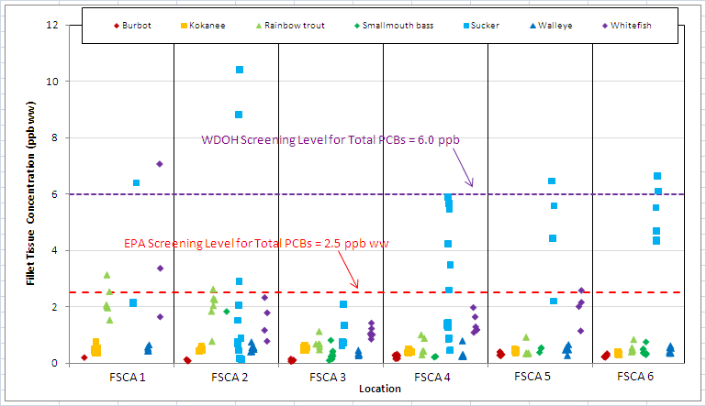
Results Example
PCBs in Fillet Tissues (>12 in.)
Note: The fish tissue-based criteria are presented to provide a frame of reference for these results; risk management decisions will be based on risk calculations using the site-specific exposure survey data.

Slide 12
Surface Water Sampling
Sampling 2009, 2010 repeated 3 times to capture seasonal variability
10 transects starting in Canada above smelter, surface & near bottom samples
90 or more samples per event
“Disturbed” surface water samples at recreational beaches
> 400 analytes -- including metals, pesticides, PBDEs, PCB congeners

Slide 13
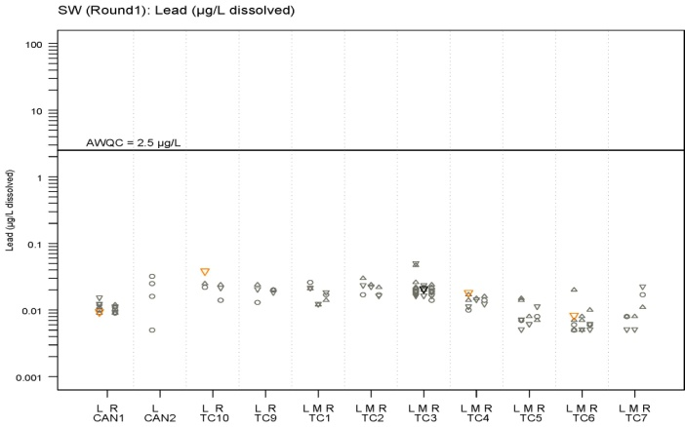
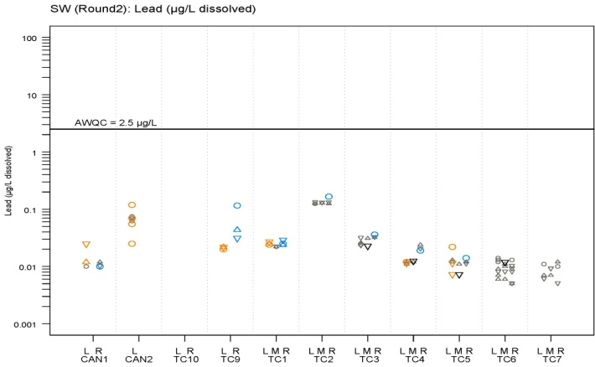
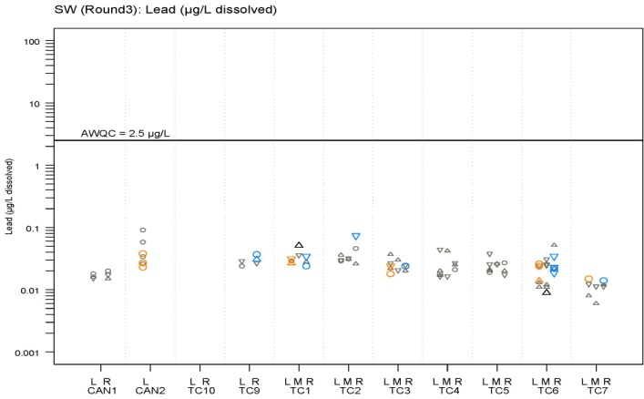
Surface Water Results Example
Lead (µg/L dissolved)
Near-surface
L =
Left bank (orange)
Nearshore
M =
Mid-channel (black)
Near-bottom
R =
Right bank (blue)
Undetected (full detection limit)
Note: Disturbed samples are not shown.
Note: Y-axes are on log₁₀ scale.
AWQC Chronic EPA ambient water quality criterion

Slide 14
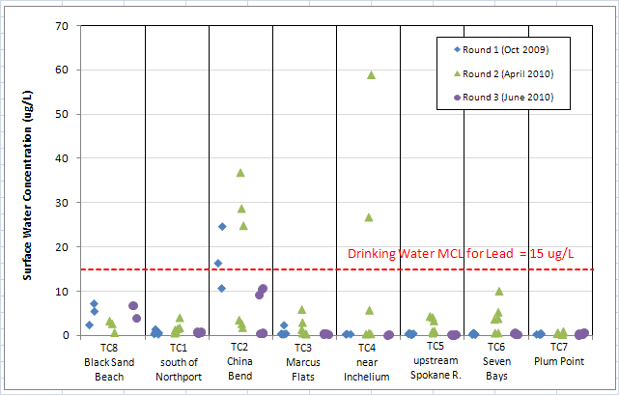
Surface Water Results Example
Lead in in Disturbed Samples
Note: The Drinking Water MCLs are presented to provide a frame of reference for these results; risk management decisions will be based on risk calculations using the site-specific exposure survey data.

Slide 15
Beaches
43 beaches have been sampled to date
15 beaches sampled by EPA in 2005
28 others sampled by Teck in 2009, 2010, and 2011
Some beaches sampled twice

Slide 16
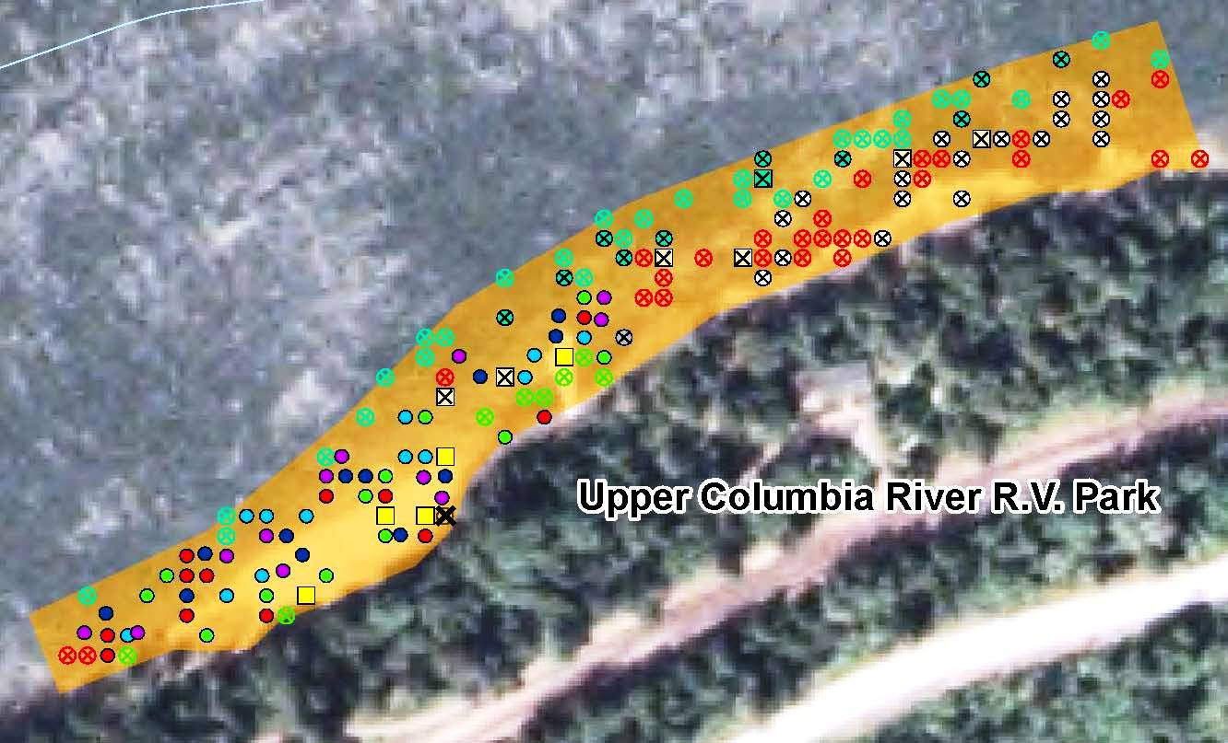
Beaches
Surface samples collected per 5 x 12 design
  60 individual grab samples per beach
5 subsurface samples (cores) per beach @ 3 depth intervals

Slide 17
Beaches
Most recent samples from 26 beaches collected Spring 2011
Data from 2011 samples still in validation and QA process
EPA will perform screening-level evaluation, distribute results in Fact Sheet
Final evaluation will be in Human Health Risk Assessment

Slide 18
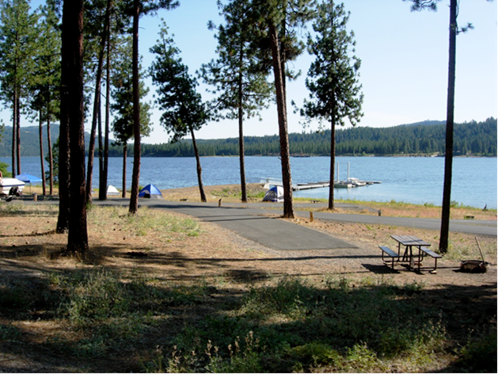
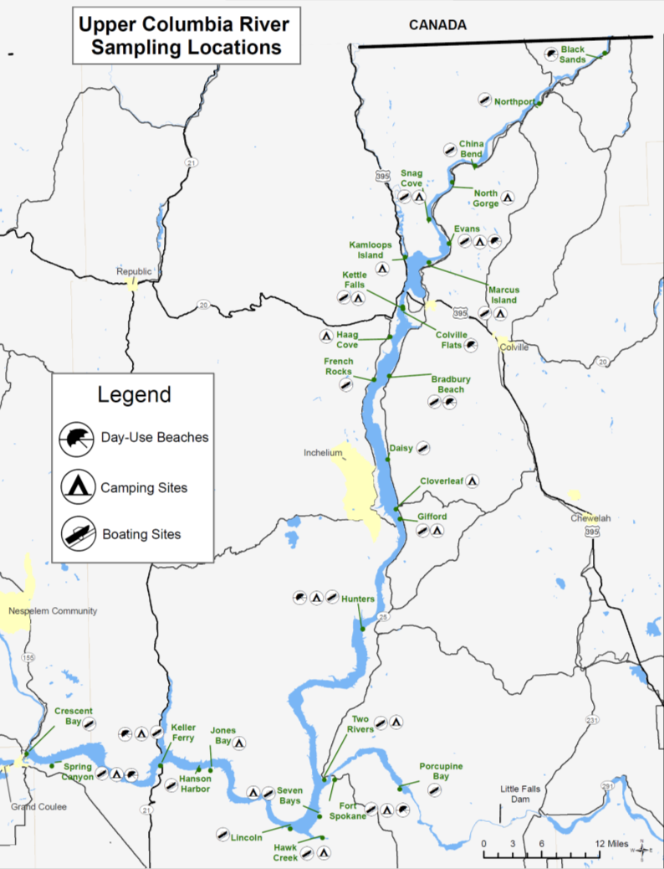
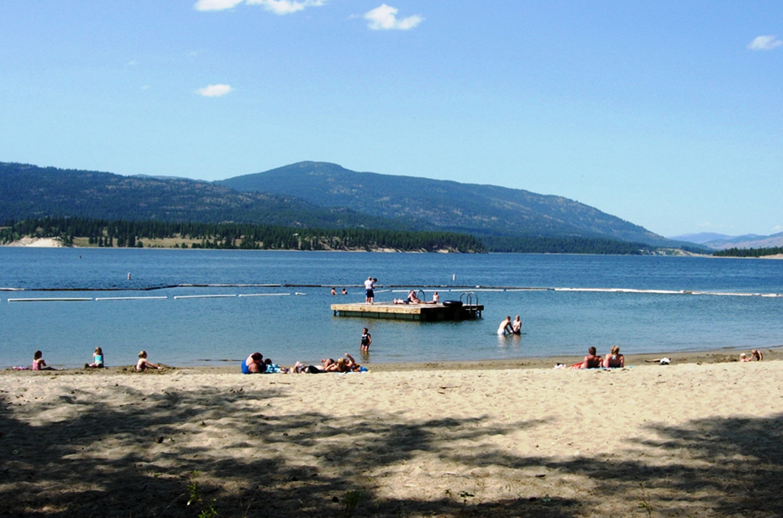
Recreational Use Survey
Campgrounds
Beaches

Slide 19
Recreational Use Survey
Survey participants asked about:
  Current trip
  Past trips
  Fish consumption
  Demographics
Survey ongoing, data collection will be complete in early 2012
Report expected late 2012 / early 2013

Slide 20
CCT Tribal Exposure Survey
Joint EPA / CCT effort to assess tribal exposure
Fish, game, plants, non-consumption uses
Standardized dietary recall instrument and 2 CCT-specific tribal survey instruments
Started October 2009, ended April 2011
Survey data now being analyzed, report expected next year
Most comprehensive, statistically sound survey in history of Superfund program

Slide 21
Sturgeon Toxicity Studies
Sturgeon early life stage toxicity to metals – copper, cadmium, lead, zinc
Acute and chronic tests
2 laboratory studies - exposure to water column and to contaminated sediment from the site
Comparative tests with rainbow trout
Reports expected in 2012

Slide 22
Sediment
Extensive EPA sampling in 2005
Big question is bioavailability, toxicity
Will assess through paired sediment chemistry, porewater chemistry, and bioassay studies
Teck submitted draft QAPP in March 2011
EPA and project partners currently developing comments on draft QAPP
Sampling currently planned for 2012
Will require multiple rounds of sampling

Slide 23
Other upcoming studies
Soil / upland habitats – to look at aerial deposition of stack emissions
Freshwater mussels – collection of tissue from field for contaminant analysis
Other data gaps?

Slide 24
Overall schedule
Currently planned sampling 2012, 2013
Initial risk assessment reports 2014
Additional sampling to fill data gaps 2015 and 2016
Remedial Investigation report 2018

Slide 25
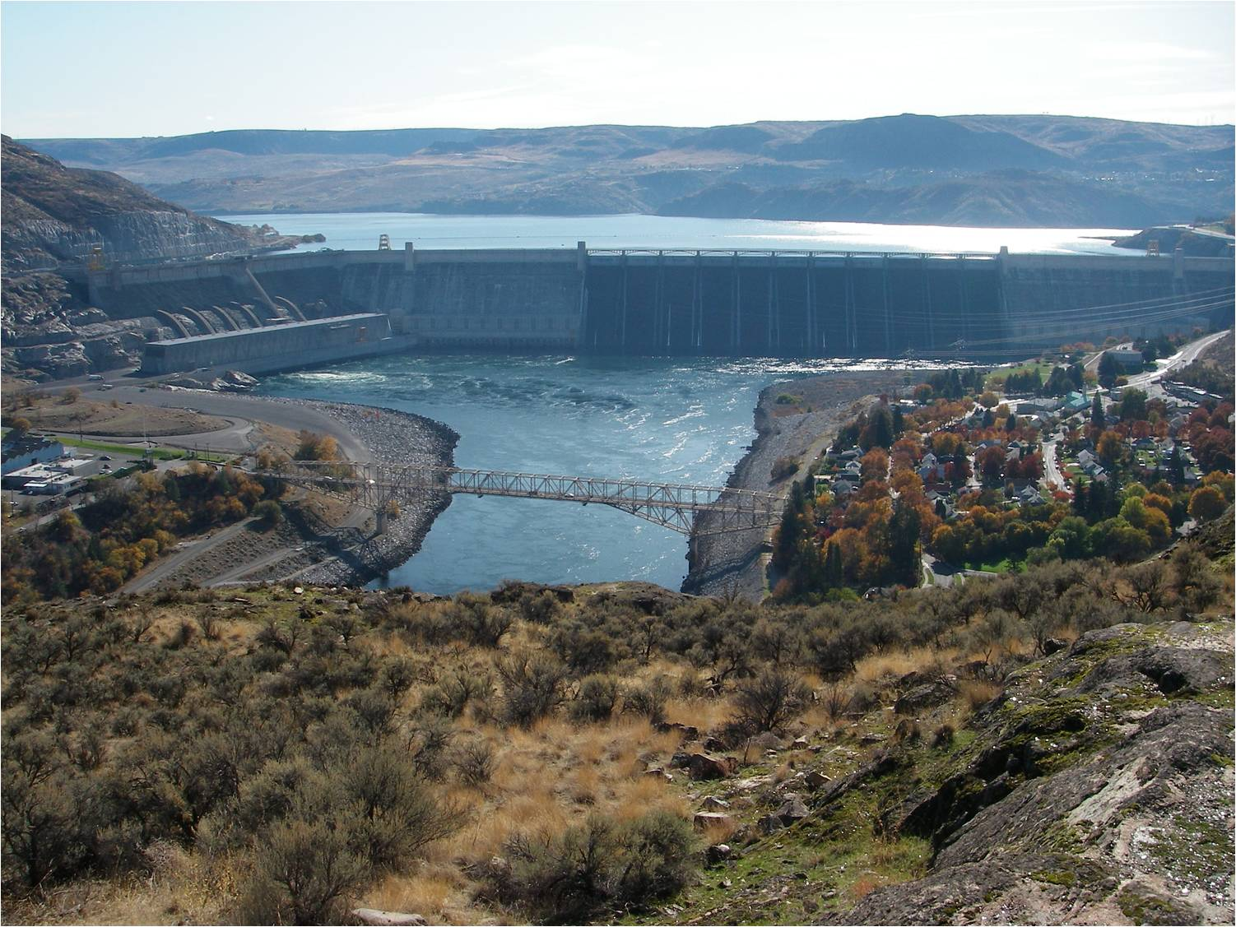
Questions?
(yes, that’s the Grand Coulee Dam)

