Slide 1
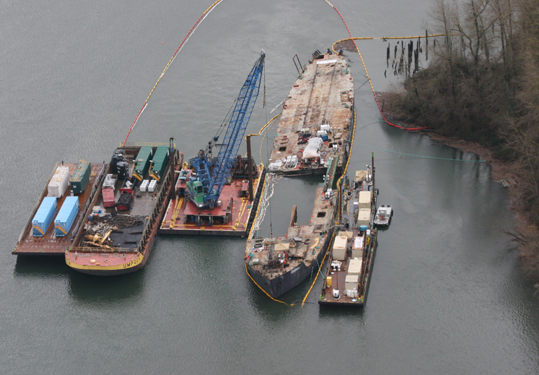
Barge Davy Crockett Response
Columbia River Toxics Reduction Work Group Discussion
Jim Sachet March 8, 2011

Slide 2
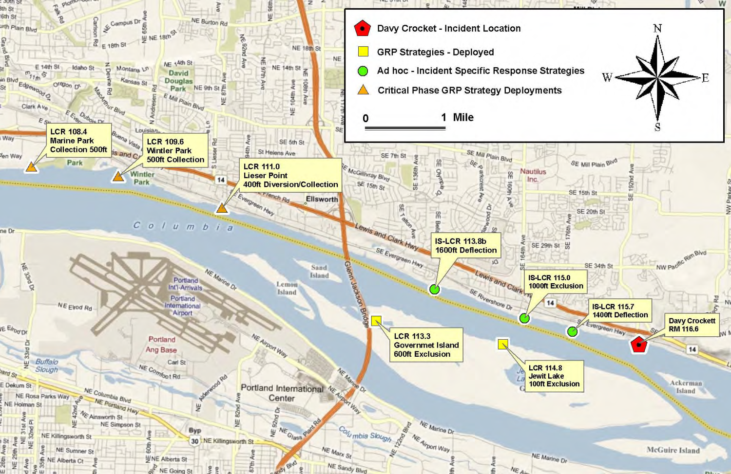
Location & Background

Slide 3
Status

Slide 4
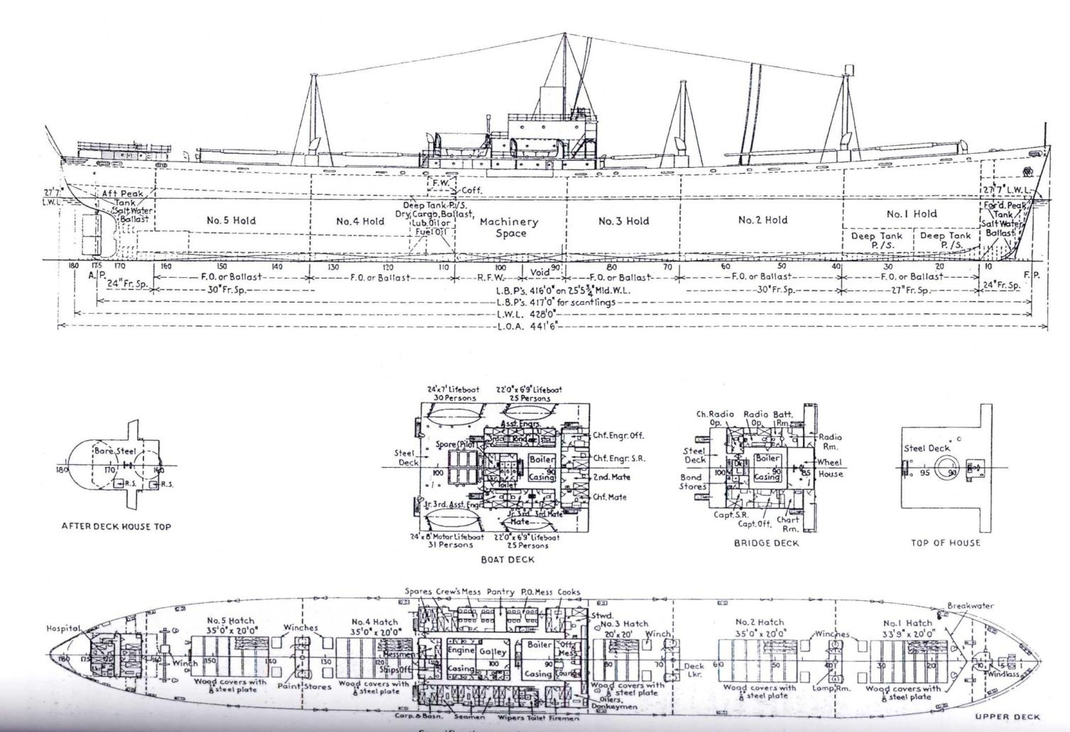

Slide 5
Incident Summary
Mystery Sheen on CR – Jan 14
Sheen on CR – Jan 20, 21; D Crockett source
Sheen on CR – Jan 27, 28; D Crockett source
Jan 27 – sheen 11 mi long, down to I-5 Bridge
Estimate of volume of discharge = 70 gal based on dimensions, time, thickness

Slide 6
Sampling Results
Source samples from tanks, spaces, containers on the vessel
Analysis for HCID, PCB, VOC, SVOC, Metals
HCID indicates presence of diesel, lube oil and gasoline range hydrocarbons
Environmental samples
Sheen; analysis for HCID
Sediment; analysis for HCID, PCB

Slide 7
Preliminary Report on PCB, Metals
Source samples
Tanks in the machine space appear to be where PCBs are present, various samples show levels at < 0.001 mg/kg to a high of 33 mg/kg
Metals found in some samples include copper, chrome, cadmium, zinc, nickel and lead
Also found solvents in samples of oil in two small tanks; MEK and PCE
Bunker fuel in deep tanks; No PCBs, No heavy metals, very low VOC, specific gravity 0.96

Slide 8
Environmental samples
Sheen samples; HCID show diesel and lube oil discharged, also suspect some release of bunker based on behavior of sheen near vessel
Sheen samples not sufficient to run for PCB
Sediment samples near vessel; 6 samples with 1 sample showing detect for PCB (0.0636 mg/kg)

Slide 9
What Else?
Response Coordination and Organization
Geographic Response Plans
Spill Response Plan, Resources, Targets for recovery & storage
Outreach to Stakeholders & Public
Budget & Funding
Investigation
Next Steps

Slide 10
Questions
Jim Sachet, Ecology Spill Response, SOSC
360/407-6328
jsac461@ecy.wa.gov
Rebecca Post, Ecology Spill Response, Sampling Specialist
360/407-7114
repo461@ecy.wa.gov

