Slide 1

Overview of PNAMP’s Monitoring Resources
July 30, 2012
Jacque Schei, U.S. Geological Survey
Jen Bayer, U.S. Geological Survey

Slide 2
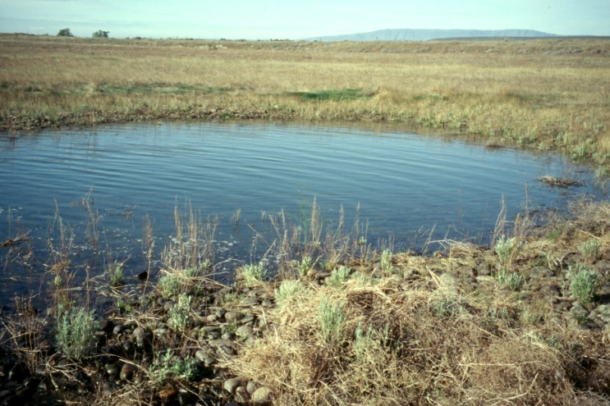
Pacific Northwest Aquatic Monitoring Partnership (PNAMP)
What does PNAMP do?
  Provides a forum to enhance the capacity of multiple entities to collaborate to produce an effective and comprehensive network of aquatic monitoring programs in the PNW based on sound science designed to inform public policy and resource management decisions.
Participants
  State, federal, and tribal
  Open, inclusive process
  Voluntary participation
Supported by partner funding and in-kind contributions
USGS
Notes:
Jen intro

Slide 3
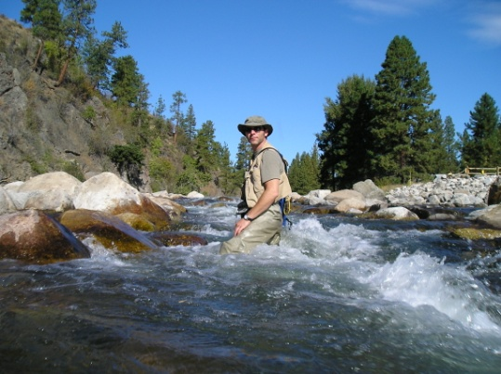
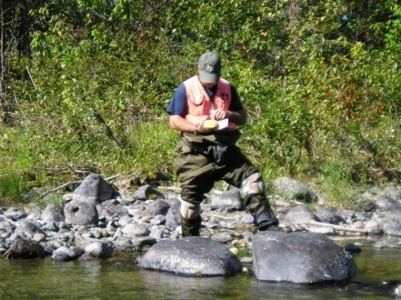
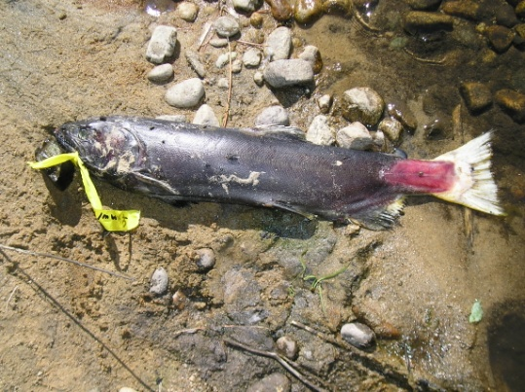
PNAMP
  Guidance – monitoring design, methods for data collection, analysis, management, and sharing
  Tools to make it easier to:
    Design and document
    Collaborate
    Discover data
Started with Protocol Manager/Monitoring Methods, prototype for Master Sample (sample design) tool
USGS
KWA
KWA
KWA

Slide 4
Tools – Online Resources
Current state
  Existing: MonitoringMethods.org, Salmon Monitoring Advisor, prototype Master Sample tool
  In Dev: Master Sample tool (Sample Designer), Site Manager, prototype metadata builder
Ideal state
  Integration– central homepage, single sign on
  Common terminology, consistent documentation
  Enter once, share many times
  Enough information to adequately assess monitoring
USGS

Slide 5
Online
Resources
MonitoringMethods.org
Metadata Builder
MonitoringResources.org
Monitoring Sample Designer
Data Repositories
Program Implementation
Monitoring Site Manager
Salmon Monitoring Advisor

Slide 6

Online Resources Support
  Guidance from PNAMP SC & Leadership Teams
  User Testing Groups convened during development
  PNAMP staff time
  Software development – contract with private vendor
    Sitka Technology Group
  Funding from Bonneville Power Administration & Gordon and Betty Moore Foundation; in-kind support from many organizations

Slide 7
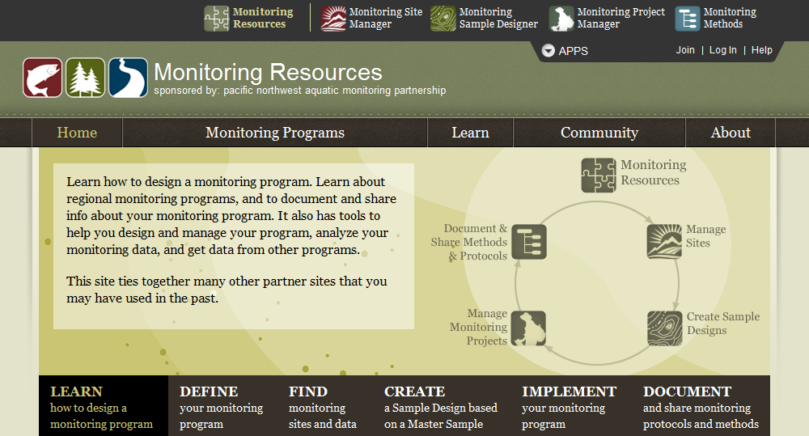
MonitoringResources.org
  In development, mock up of central homepage
  Integrate all tools
  Provide underlying framework for single sign on
  Provide guidance, details of users and projects/programs

Slide 8
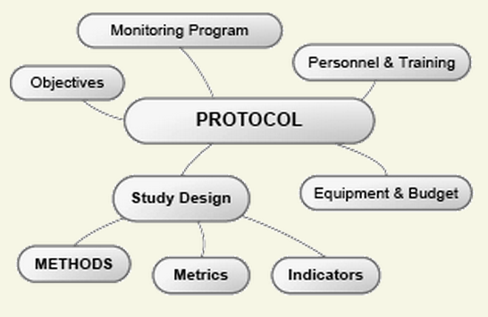
MonitoringMethods.org
Free, web application to document and discuss monitoring protocols, methods, metrics and indicators, and study designs
Purpose:
  Promote consistent documentation
  Improve access to monitoring information
  Promote community discussions among a variety
of users - insight and experience
Streamline creation of metadata
Help increase interoperability between data systems
www.monitoringmethods.org/
Notes:
8

Slide 9
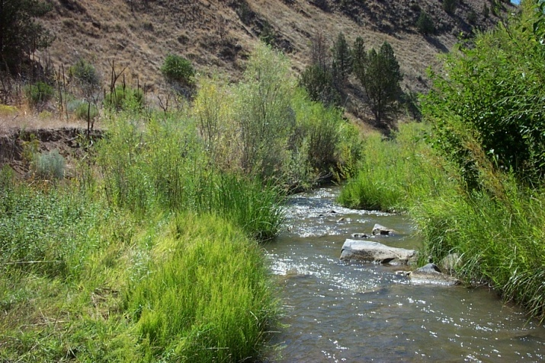
Monitoring Sample Designer
Many agencies interested in regional scale monitoring of stream networks/watersheds, using similar attributes and similar protocols
Can’t afford to monitor everywhere (i.e., can’t census)
  Monitor a representative set of sites
GRTS: Generalized Random-Tessellation Stratified design
  Incorporates randomization
  Is spatially balanced
  Creates ordered list of sites
Collaborate/Integrate: Data from different sample surveys can be combined if certain design principles are followed
USFS
Notes:
9

Slide 10
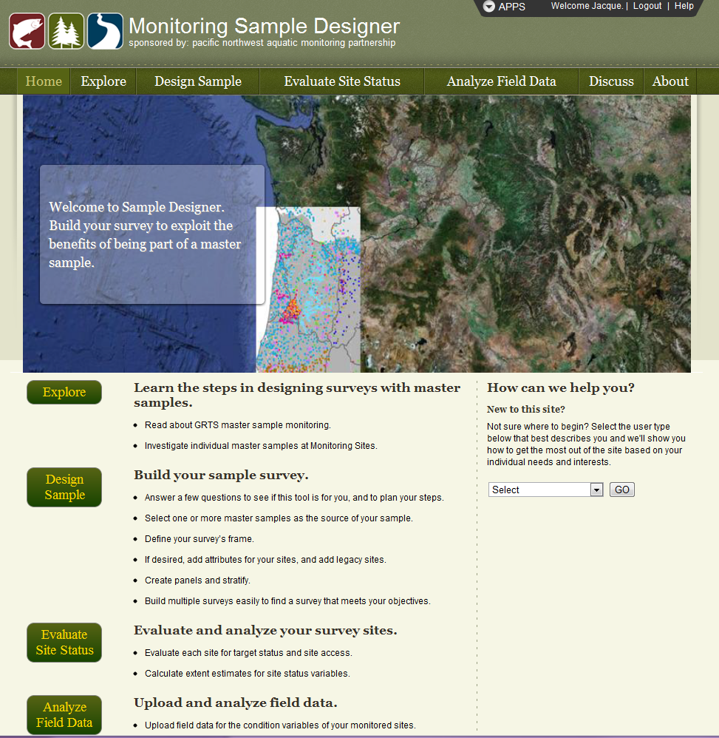
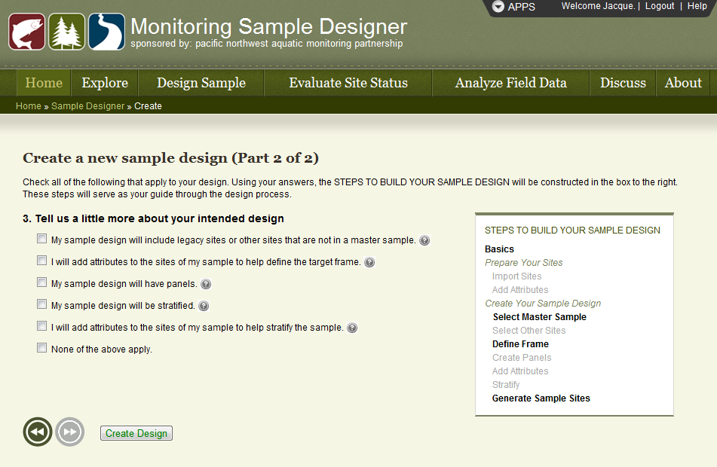
Monitoring Sample Designer
In development – product expected November 2012
Support development of sample design using a Master Sample, site evaluation, offer basic analysis functions
Intended user group – knowledgeable about GRTS design
Notes:
10

Slide 11
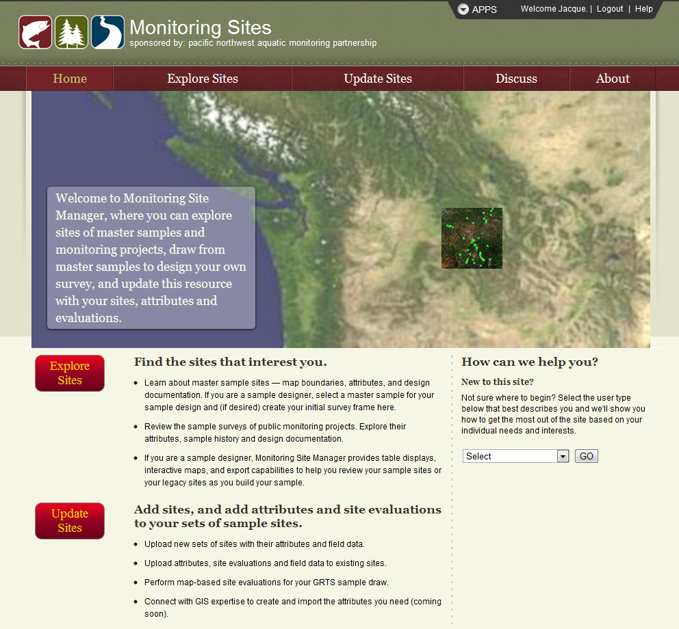
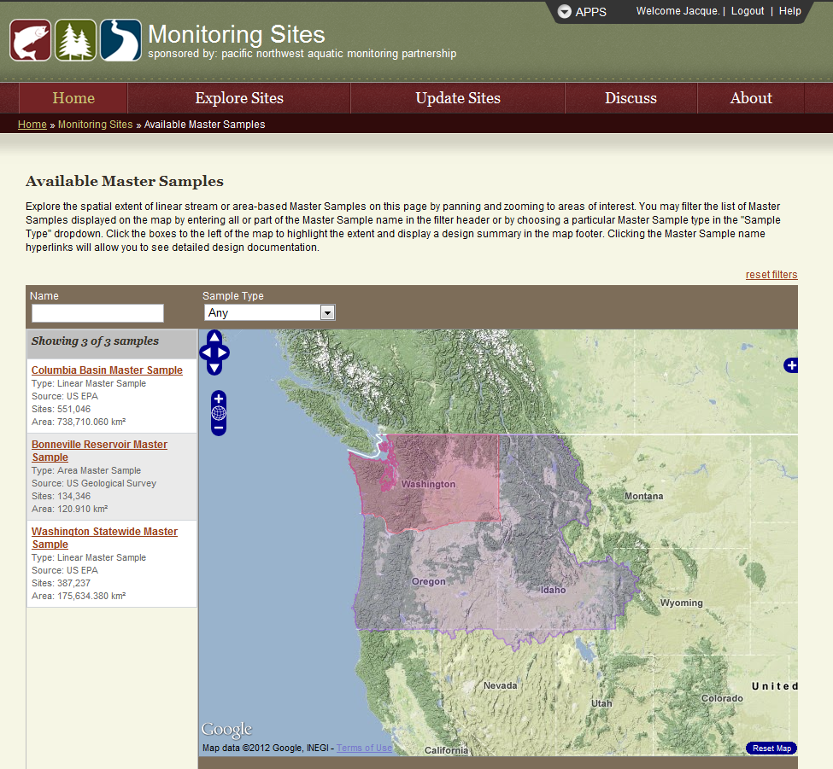
Monitoring Site Manager
In development – product expected November 2012
Sampling site management– import samples/legacy sites, add attributes
Will work closely with Sample Designer – sites, master samples will be stored here
Notes:
11

Slide 12
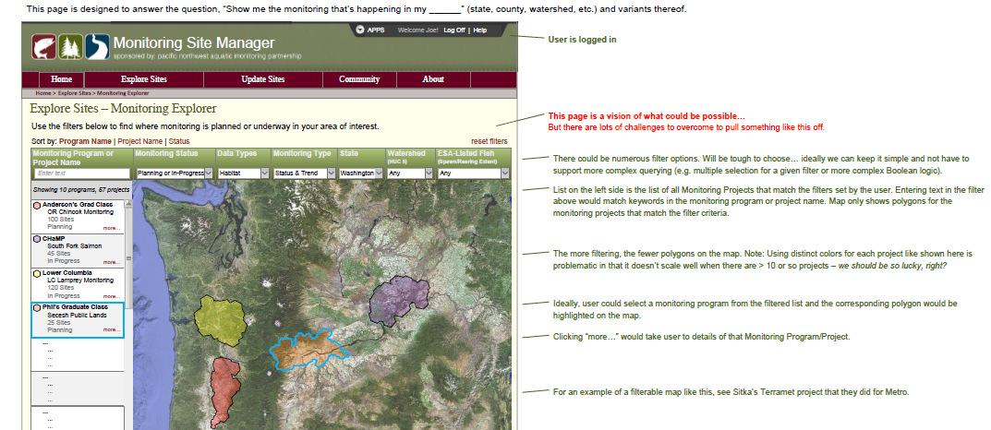
Site Manager – Explorer Feature
Explore sites – locate, find information about, and see regional monitoring projects displayed on a map
  With continued support for entering and updating content, this tool will support many ‘inventory’ needs
  Gather content via web services and manually
Notes:
12

Slide 13
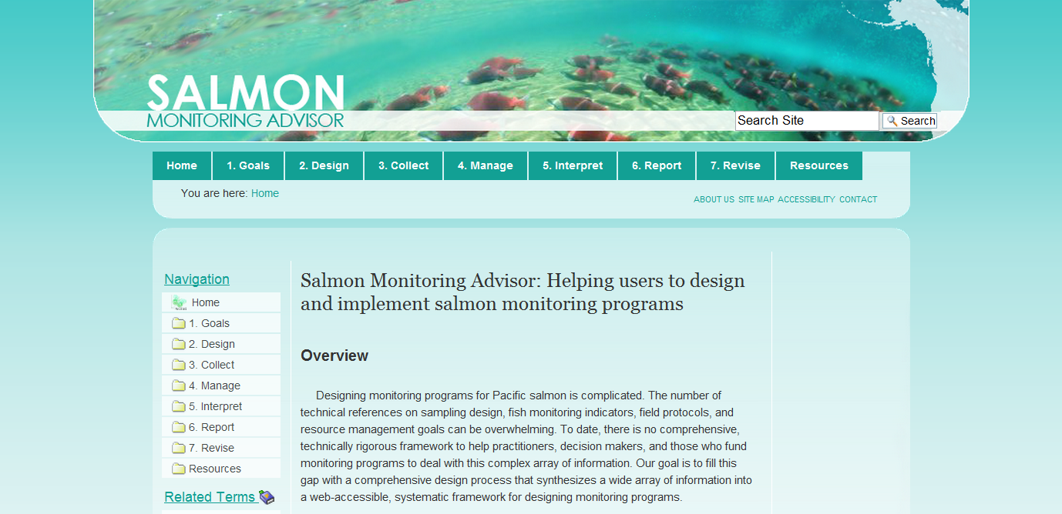
SalmonMonitoringAdvisor.org
Complete website transferred from NCEAS
Educational resource – monitoring program design
Integrate generic concepts into MonitoringResources.org
Future – add topics beyond salmon
Notes:
13

Slide 14
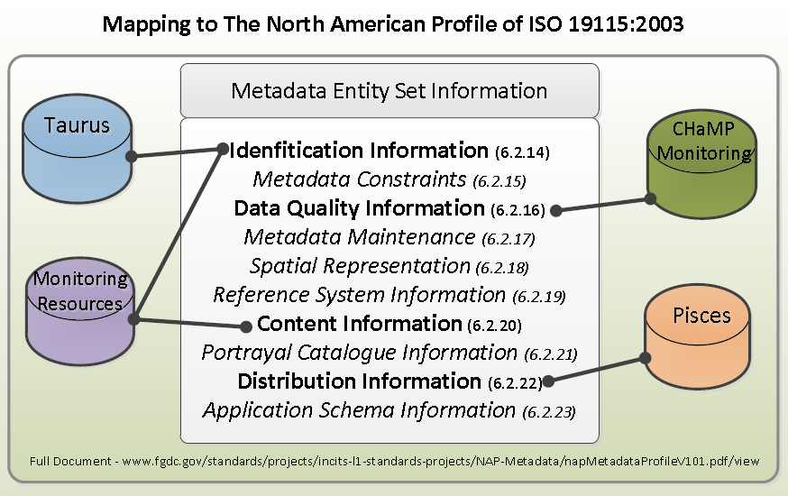
Metadata Builder
Pilot project – prototype tool development
  Concept – support for development of a complete metadata record for datasets
  Pull information from existing online resources into a metadata record template (prototype BPA-focused)
    Different organizations would need different web services
    Not all elements will be found; users will need to fill in
Seek review
  Feedback on tool
  Regional use
  Costs
Notes:
14

Slide 15
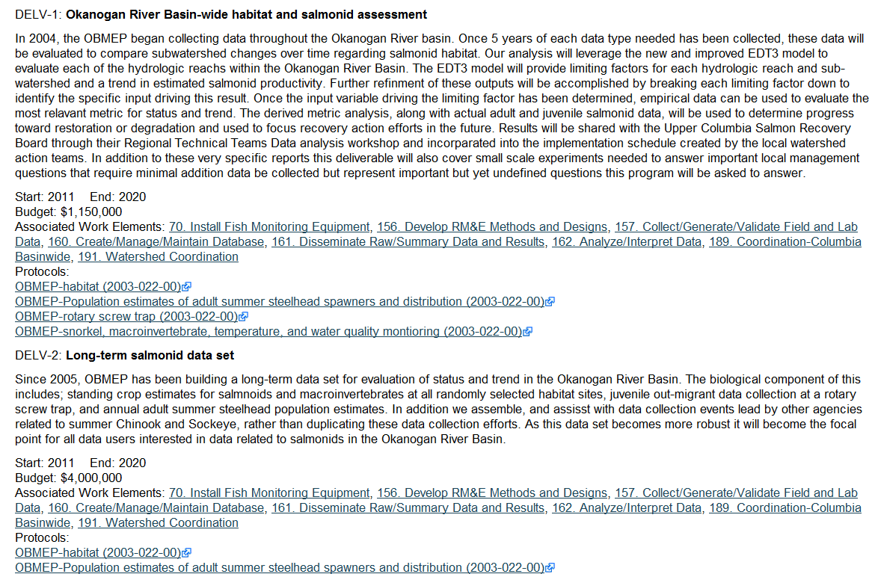
Web Services with Regional Systems
Offer web services to exchange information
Encourage use of bi-directional web services (dynamic)
Ex: Bonneville Power Administration’s cbfish.org – system for selecting and funding projects
Screenshot of portion of a proposal in cbfish.org
Links to MonitoringMethods.org protocols

Slide 16
Web Services
Looking for other systems to connect with…some ideas mentioned so far include:
  StreamNet
  PCSRF
  CRITFC Tribal Data Network
  Habitat Work Schedule
  PRISM
  Washington Department of Ecology EIM
  JMX
  ODFW Salmon & Steelhead Recovery Tracker
  Others?

Slide 17
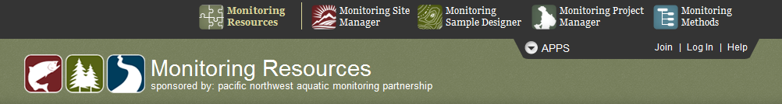
Online Tools: What’s in it for You?
Improved communication
  Collaboration & data sharing opportunities
  Who’s doing what, where, how?
  Information discovery; best practices; interaction with peers
Long term storage of content
Associate info with data, next contract
Support for:
  Data management and sharing processes
  Documentation for reports
  Metadata record creation
Potential to lead to more efficient use of limited funds

Slide 18
Online Tools: Final Points
Feedback & participation – very important!
  MonitoringMethods.org – developed, but still welcome input
  Sample Designer, Site Manager, Explorer, etc. – feedback & participation encouraged
    Frustrations, ideas, concerns, needs - used to guide development
    Example: "I would be more likely to come back to the tool if it did X, Y, Z for me"
  Visit www.monitoringresources.org; create an account; try out different apps
  Contact Jacque

Slide 19
Questions?
www.pnamp.org
Jacque Schei
jschei@usgs.gov
503.201.0880
  www.monitoringresources.org/

