Slide 1
Scappoose Bay/Multnomah Channel DEQ Cleanup Sites
Columbia River Basin Toxics Reduction Working
Group Meeting
July 30, 2012
Debbie Bailey, Project Manager
Oregon DEQ – Northwest Region

Slide 2
Cleanup Sites
Armstrong World Industries
Boise Cascade Pulp and Paper Mill
Former Pope and Talbot Creosote/Port of St. Helens

Slide 3
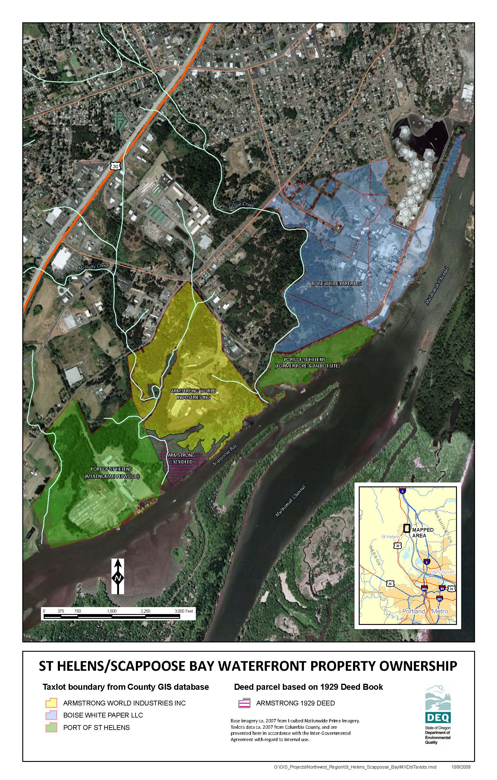

Slide 4
Armstrong World Industries
Active Ceiling Tile Manufacturer since 1929
Wastewater discharged to lowlands until 1987
Contamination primarily with dioxins/furans, arsenic, and mercury found in upland, lowland/wetland, and in-water areas
Remedial Investigation and Risk Assessment work plan in progress
Soil, sediment, groundwater, tissue data

Slide 5
Armstrong World Industries
Two data reports by Windward Environmental:
2010 Aquatic Biota Tissue Data Report, Armstrong St. Helens Facility, dated July 26, 2011 (carp, clams, crayfish, and sculpin)
2011 Smallmouth Bass Tissue Data Report, Armstrong St. Helens Facility, dated February 16, 2012

Slide 6
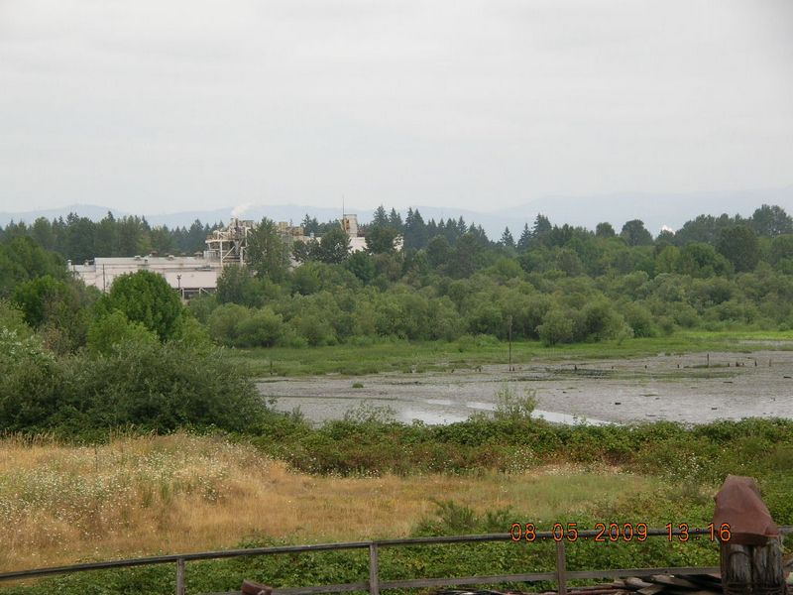
Armstrong

Slide 7
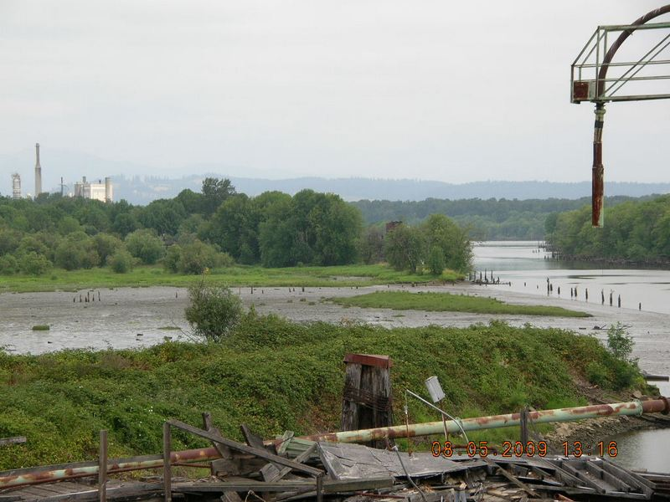
Armstrong

Slide 8
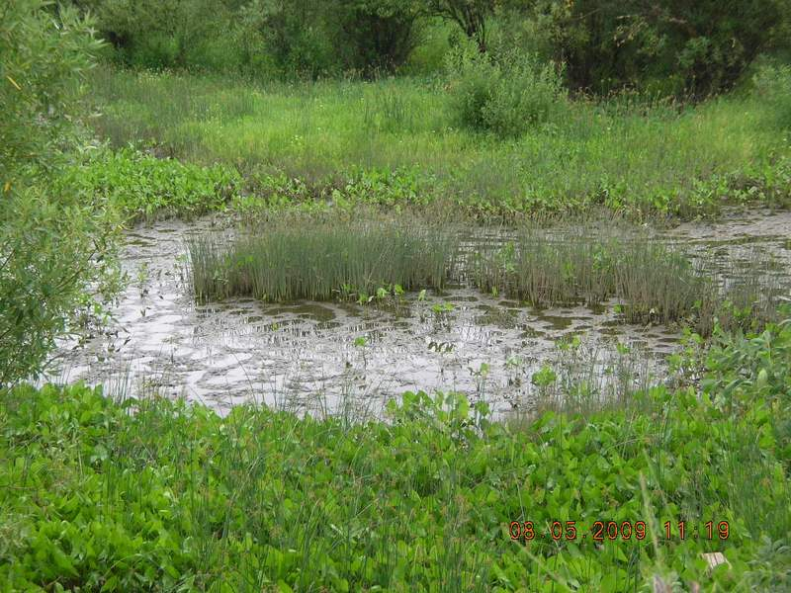
Armstrong

Slide 9
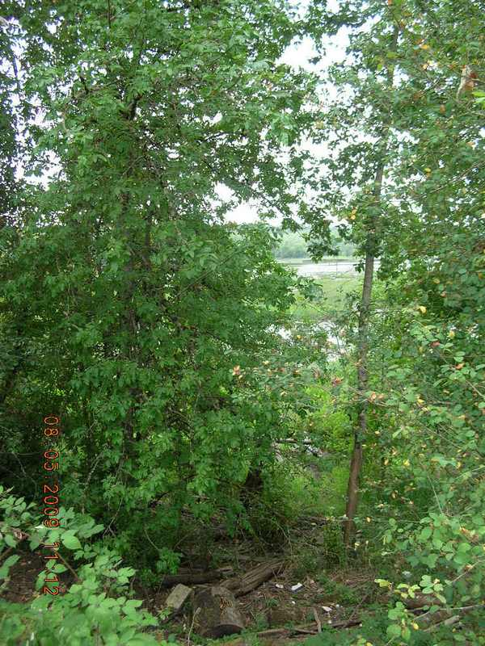
Armstrong

Slide 10
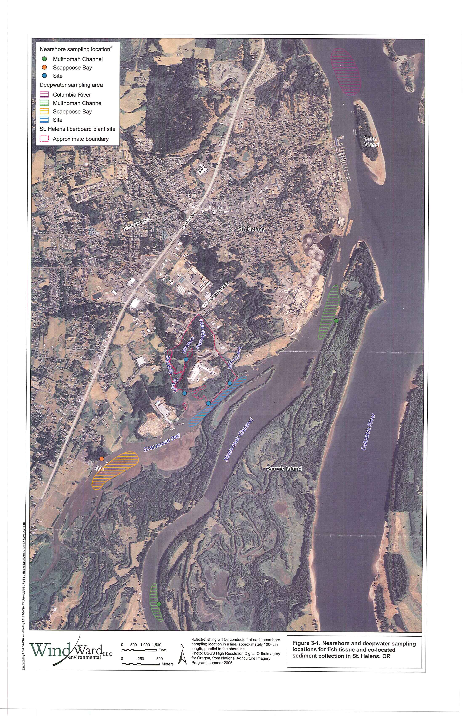

Slide 13
Collection Locations
Site
Scappoose Bay potentially impacted by Site due to tidal influence
Multnomah Channel upstream: reference site
Multnomah Channel across from Boise and Columbia River, north of Sand Island

Slide 14
Samples Collected
Tissue: Carp, Smallmouth bass, Crayfish, Sculpin, Clams
Collocated Sediment: Crayfish, Sculpin, Clams

Slide 15
Analytes for tissue samples
Arsenic: total and inorganic
Dioxins/furans: congeners
Mercury: total and methylmercury
PCB congeners
Lipids
Percent solids

Slide 16
Carp
Collected in September 2010 in all 5 locations
6 composites
5 individuals per composite
Fillet and Carcass
Whole body, reconstituted from fillet and carcass data

Slide 17
Carp
Arsenic and Mercury
Concentrations similar across investigation area.
Columbia River might be highest for arsenic.
Analysis for inorganic arsenic not performed for carp.
Mercury: Almost all above human health screening levels but below eco levels.

Slide 18
Carp
Dioxins/Furans
Results for congeners vary.
TCDD not detected at site location.
Hepta congeners appear to be higher at the site. Consistent with many site samples.
Many congeners above HH but below Eco screening levels.

Slide 19
Smallmouth bass
Collected in Spring 2011 in four locations
5 Composites analyzed three locations
3 individuals per composite
2 individual fish analyzed, 1 at site (largest fish) and 1 in Columbia River location
Fillet and carcass
Whole body data generated through reconstitution of fillet and carcass data.

Slide 20
Smallmouth bass
Arsenic concentrations similar across investigation area. Total arsenic exceeds HH while inorganic arsenic is non detect except for one location at the Site.
Mercury concentrations similar across investigation area. Exceed ecological screening levels slightly and exceed subsistence fish consumption screening level.

Slide 21
Smallmouth bass
Dioxins/furans:
Results for congeners vary.
TCDD detected at all locations (reference and site) above the HH screening levels but below eco screening levels.
For many congeners little difference across sampling locations although PeCDD and HxCDD may be slightly higher at the site.

Slide 22
Smallmouth bass
In general, the individual larger fish from the site showed higher concentrations than composite samples of smaller size fish.

Slide 23
Crayfish, Sculpin, and Clams
Crayfish: Site and 2 Multnomah Channel location, 8 composites (5)
Sculpin: Site only, 2 composites (5)
Clams (Corbicula sp): All 5 locations, 9 composites (64). Some elevation of specific dioxins/furans compared to reference site.

Slide 24
Observations
Large difference in sediment concentrations from site to reference site but not for tissue concentrations.
Although there are exceedances of human health screening concentrations, exceedances of various chemicals are observed throughout the investigation area. Risk assessment will provide conclusions to these observations.

Slide 25
Data Evaluation for
Fish Advisory
Oregon Health Authority (OHA) reviewed the Armstrong data
Verbal conclusion: an advisory will not be issued using the Armstrong data.
Written conclusion in preparation

Slide 26
Next steps
Complete the risk assessment work plan discussions
Complete risk assessment reports

Slide 27
Contact Information
Debbie Bailey (503) 229-6811
bailey.deborah.a@deq.state.or.us

