Slide 1
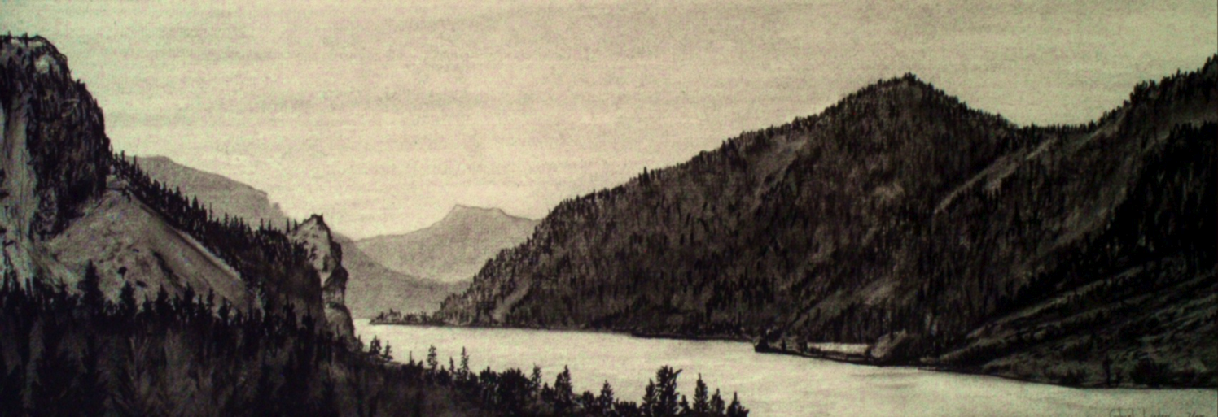

Columbia River | Honor. Protect. Restore.
Confederated Tribes and Bands of the Yakama Nation

Slide 2
Overview
Governmental Status/Structure
Commitment to the Natural Resources
Co-Management of Natural Resources
Cleanup Priorities in the Columbia River
Yakama Nation’s Vision

Slide 3
Yakama Nation’s Governmental Status
As a sovereign Nation, the Yakama Tribe signed a Treaty with the United States.
The Yakama Tribe conditionally ceded vast quantities of land to the US.
The Yakama Tribe retained all rights not expressly relinquished.
Yakamas have a right to take fish, fish not diminished by contamination.

Slide 4
YAKAMA NATION
General
Council
Tribal
Council
Thirteen Tribal Council Committees
Tribal Administrative Director
Justice Services
Human Services
Natural Resources
Public Safety
Fisheries

Slide 5
Commitment to Resources
The sacred relationship of the Yakama people, the Salmon, and the Columbia River was established in ancient time.
This relationship is the foundation of time-honored laws of the Yakama people;
the laws that protect life and the cycles of nature and provide for human well-being;
the laws that govern longhouse traditions;
The laws that support the practices that sustained the Yakama people since time immemorial.

Slide 6
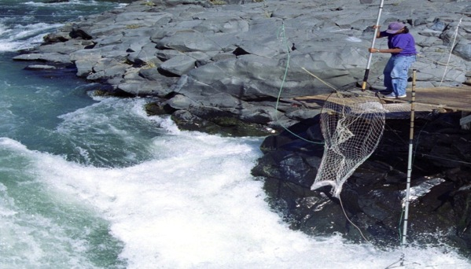
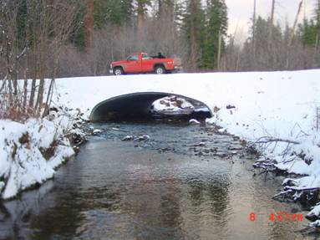
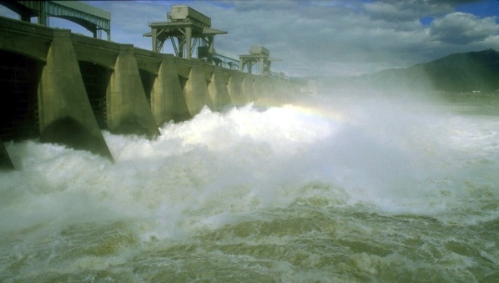
Co-Management of Resources
HARVEST
HABITAT
HATCHERIES
HYDRO

Slide 7
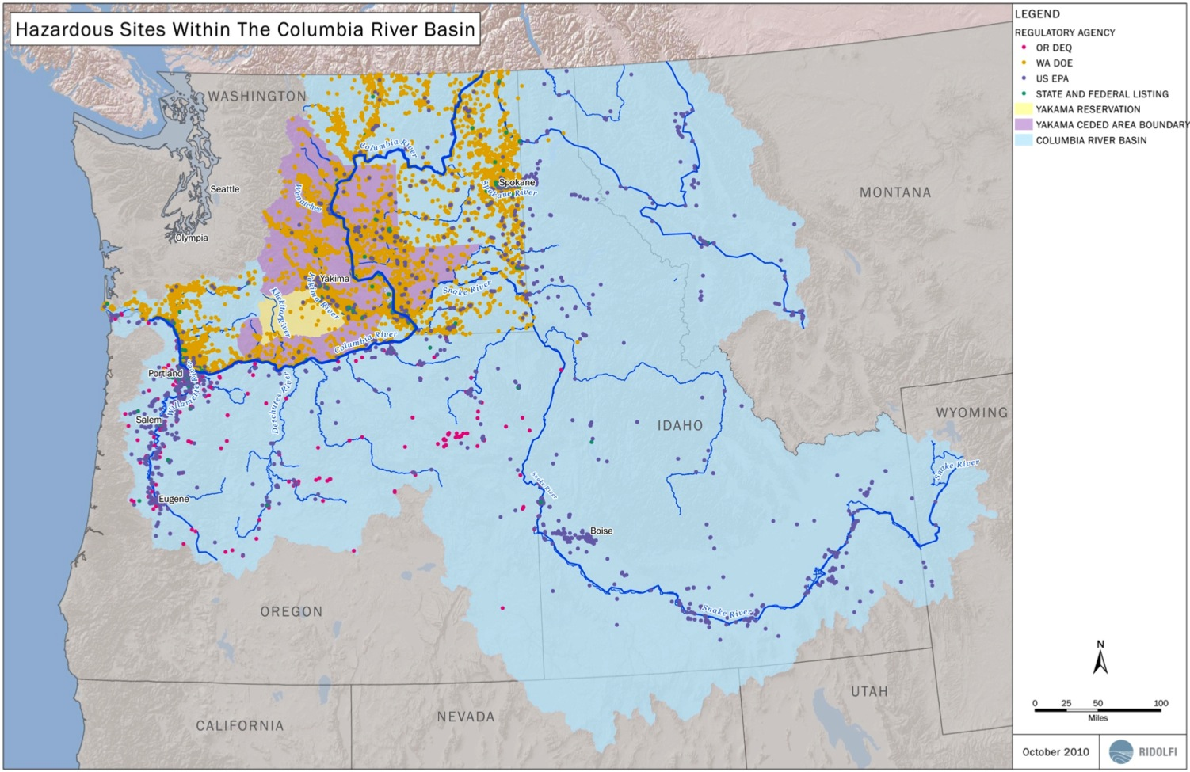

Slide 8
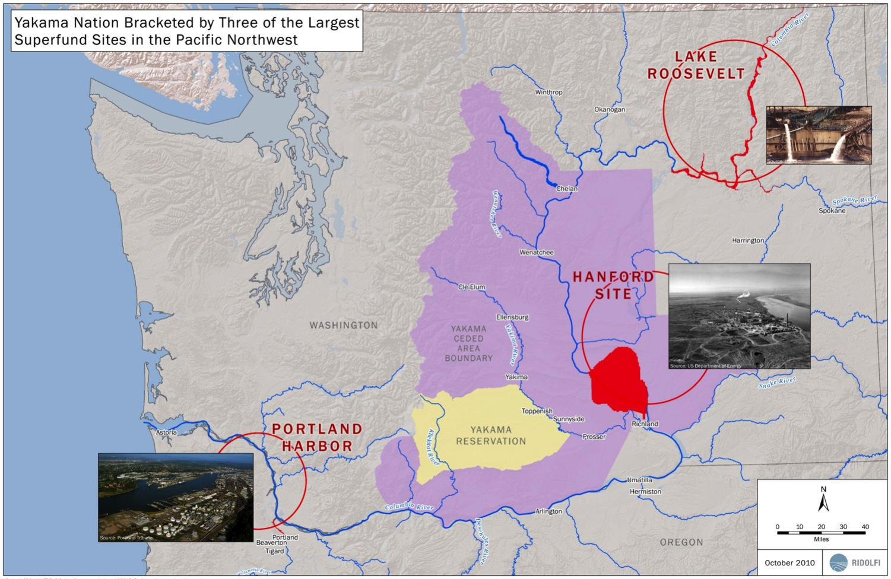

Slide 9
Prioritization of Hazardous Waste Sites
Identify
Screen
Prioritize
Concentrated on state-led sites
Sites within a ¼ mile of the Columbia River or major tributary
799 sites along the Columbia River
Initial focus area, below Bonneville Dam
Concerned with areas near critical habitat
Priority sites:
24 sites on WA side
31 sites on OR side

Slide 10
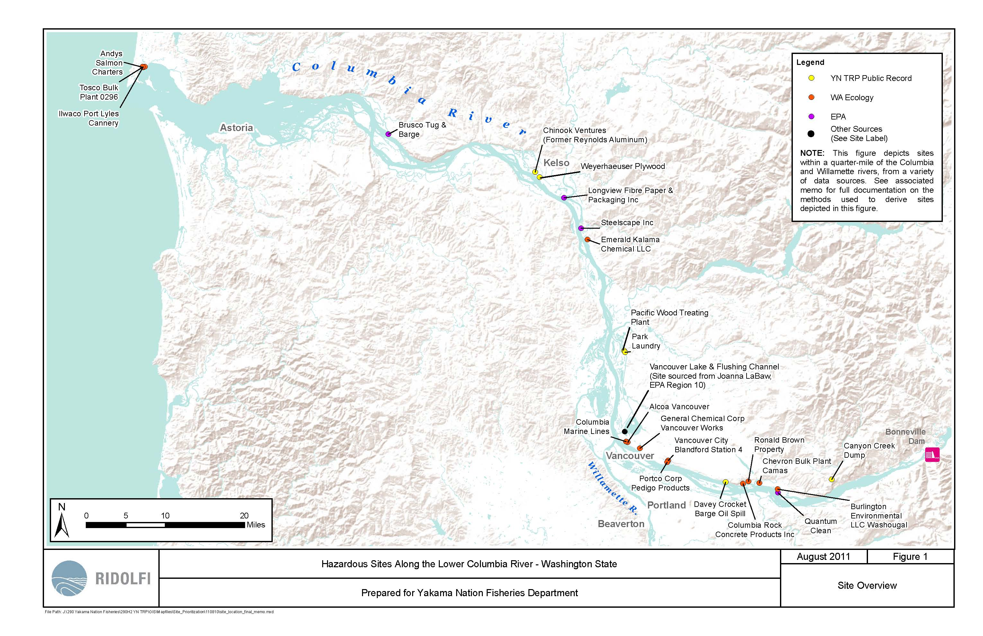

Slide 11
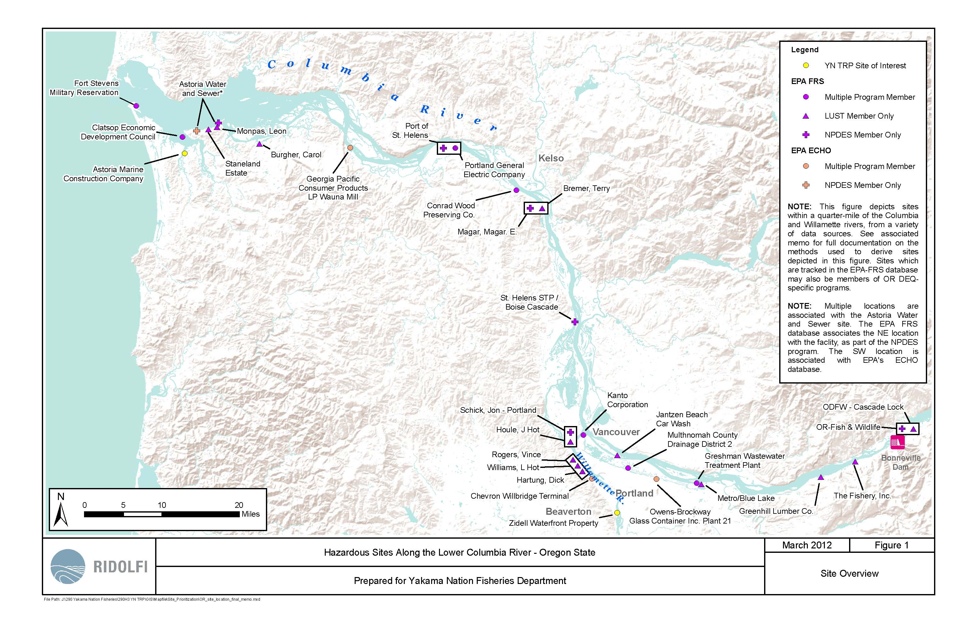

Slide 12
Next Steps…
Honor.
Protect.
Restore.
Continue site prioritization effort for the rest of the Columbia River
Discuss identified sites with state and federal agencies
Fill in data gaps
Address contamination concerns at priority sites throughout the Columbia River

Slide 13
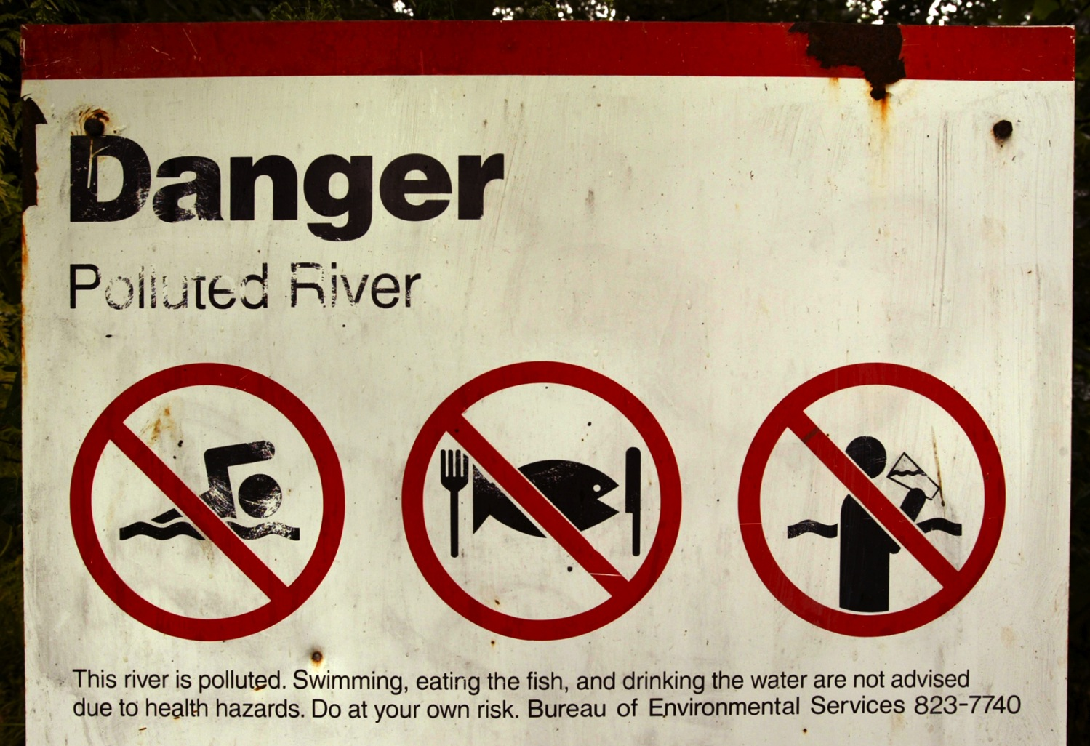

Slide 14
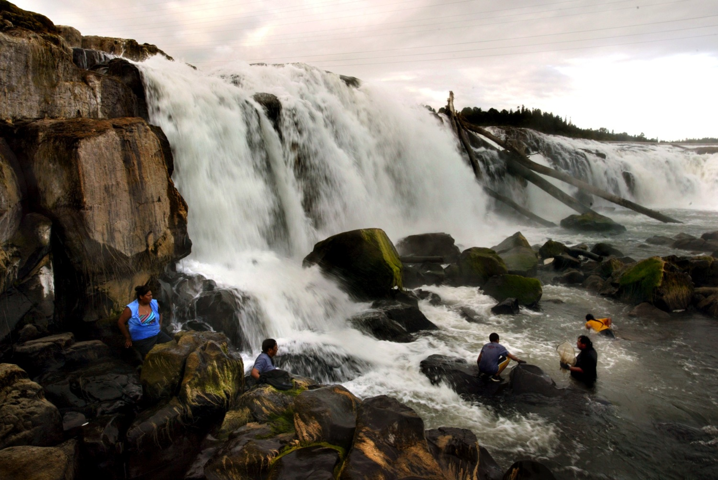

Slide 15
