Slide 1


Prioritization of Monitoring for Contaminants of Emerging Concern (CECs)
Columbia River Toxic Reduction Work Group Meeting
Andy James
University of Washington
Puget Sound Ecosystem Monitoring Program
June 12, 2014

Slide 2
CEC Prioritization Process
Puget Sound Ecosystem Monitoring Program
Coordinate monitoring efforts to provide credible, high quality and accessible monitoring findings
Toxics Work Group –
Contaminants of Emerging Concern subgroup
Develop a process to identify a priority set of CECs for monitoring programs
  integration of CEC science and technology advancements into key monitoring decisions;
  maintaining programmatic transparency; and
  engaging stake-holders and end users.

Slide 3
Key Questions for Monitoring Programs
What are the appropriate CECs to be monitored?
Brandenberger, 2014
Notes:
Impacts –
Fong and Hoy, 2012, Marine and Freshwater Behavior and Physioogy – exposure to antidepressants venlafaxine and citalopram at ng/L level lead to increased foot attachment ability of two freshwater snails
Brodin et al, 2013, Science - benzodiazepine anxiolytic drug (oxazepam) alters behavior and feeding rate of wild European perch (Perca fluviatilis) at concentrations encountered in effluent-influenced surface waters. Individuals exposed to water with dilute drug concentrations (1.8 micrograms liter–1) exhibited increased activity, reduced sociality, and higher feeding rate.

Slide 4
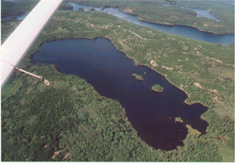
Contaminants of Emerging Concern
No widely accepted definition of CECs Generally:
  Trace organics present at very low levels
  (μg/L or ng/L)
  Previously unknown due to analytical limitations
  Unregulated
  May have biological impacts
http://www.unb.ca/saintjohn/sase/research/kiddlab/_resources/ela.jpg
Notes:
ng/L – part per trillion
1 drop of ink in 20 Olympic swimming pools
First – show biological impacts
Next – Show specific uses

Slide 5
Key Questions for Monitoring Programs
What are the appropriate CECs to be monitored?
What is the fate and relative loadings of CECs from WWTPs, stormwater, and industry?
What is the appropriate matrix and monitoring design?
What approaches should be used to assess biological effects?
What levels of CECs should trigger additional action? What range of actions should be considered?
Brandenberger, 2014
Notes:
Impacts –
Fong and Hoy, 2012, Marine and Freshwater Behavior and Physioogy – exposure to antidepressants venlafaxine and citalopram at ng/L level lead to increased foot attachment ability of two freshwater snails
Brodin et al, 2013, Science - benzodiazepine anxiolytic drug (oxazepam) alters behavior and feeding rate of wild European perch (Perca fluviatilis) at concentrations encountered in effluent-influenced surface waters. Individuals exposed to water with dilute drug concentrations (1.8 micrograms liter–1) exhibited increased activity, reduced sociality, and higher feeding rate.

Slide 6

Challenges of Prioritization:
Toxicity data are frequently absent or incomplete
Occur at low environmental concentrations
Not generally a lethality risk
Concerns are for sub-lethal effects impacting growth, reproduction, development
  Appropriate assessment tools are generally lacking
  CECs are a complex mixture, multi-modal mechanisms of biological activity
  Growing recognition that traditional analytical based monitoring programs will need to be augmented with biomonitoring
Schultz, 2014

Slide 7
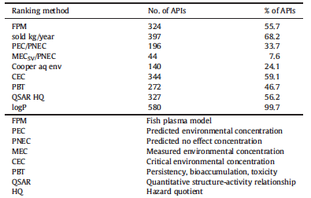
Challenges of Prioritization:
Data Limitations
Number and percentage of Active Pharmaceutical Ingredients in the prioritisation database (total: 582) that could be ranked according to nine different prioritisation schemes.
Roos, V.; Gunnarsson, L.; Fick, J.; Larsson, D. G. J.; Ruden, C., Prioritising pharmaceuticals for environmental risk assessment: Towards adequate and feasible first-tier selection. Science of the Total Environment 2012, 421, 102-110.

Slide 8
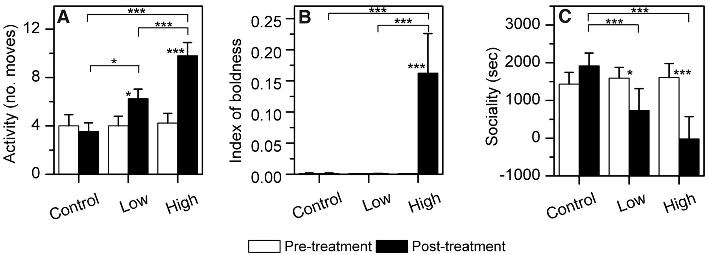

Challenges of Prioritization:
Biological Impacts
Fish (European perch) behavioral response to two concentrations (low: 1.8 μg L⁻¹; high: 910 μg L⁻¹) of dissolved oxazepam compared to control (0 μg L⁻¹).(A) Activity, measured as number of swimming bouts (>2.5 cm) during 10 min. (B) Boldness, measured as the inverse of latency to enter a novel area during the total trial time (900 s). (C) Sociality, measured as the cumulative time (in seconds) spent close to a group of conspecifics. Error bars represent ±1 SE (n = 25 in all treatments); statistically significant differences between the pre- and posttreatments are indicated (*P < 0.05 or ***P < 0.001).
T Brodin et al. Science 2013;339:814-815
Published by AAAS

Slide 9
CEC Prioritization Framework:
PSEMP White Paper
Objective: Develop a process to prioritize monitoring of CECs in the environment
Literature Review
  Other prioritization processes and regional monitoring data

Slide 10
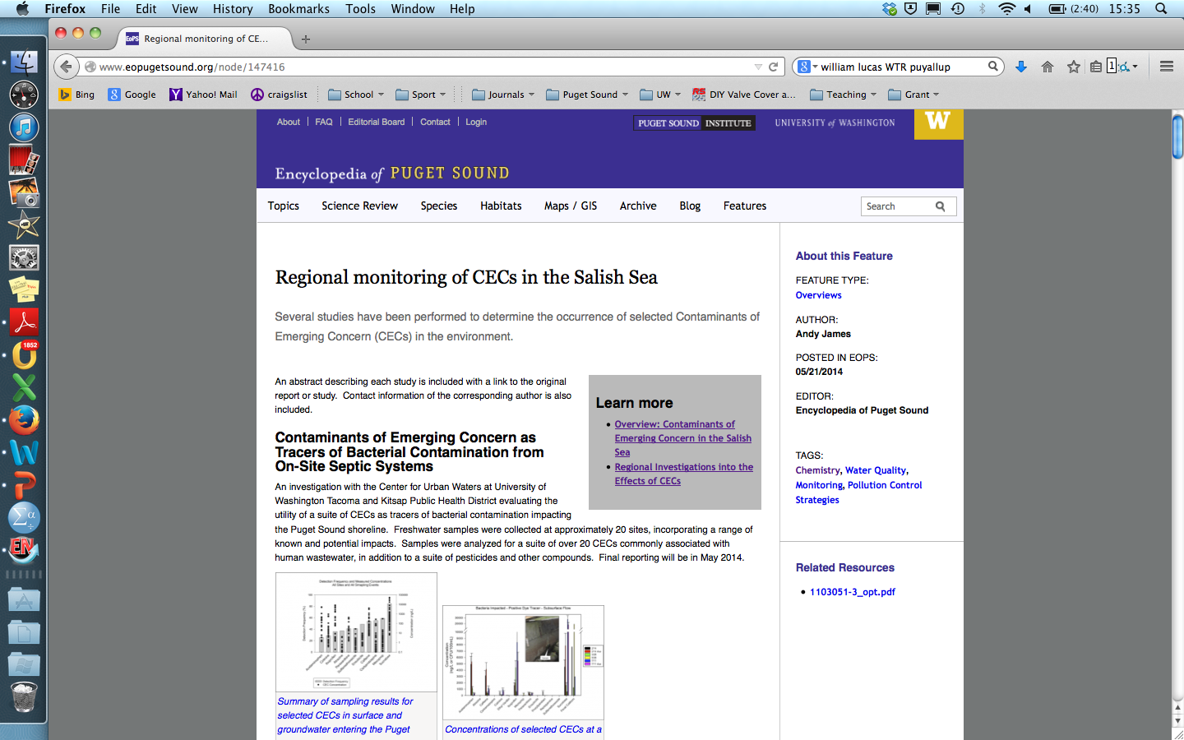
Regional CEC Investigations:
Encyclopedia of Puget Sound

Slide 11
CEC Prioritization Framework:
PSEMP White Paper
Objective: Develop a process to prioritize monitoring of CECs in the environment
Literature Review
  Other prioritization processes and regional monitoring data
Conceptual Exposure Models
  Pressure framework (what are likely sources?)
  Exposure framework (fate and transport?)

Slide 12
CEC Prioritization Framework:
PSEMP White Paper
Define Prioritization Process
What chemical characteristics are important to prioritization
  usage
  occurrence
  persistence
  bioaccumulation
  toxicity/sublethal impacts
  human exposure
How are the criteria determined
  toxicity - QSAR (e.g., ECOSAR) or through experimental data. What threshold?
  sublethal effects?
  mixture effects?
  occurrence – predicted or measured environmental concentration

Slide 13
CEC Prioritization Framework:
PSEMP White Paper
Define Prioritization Process
Other factors important in the prioritization process
  available data
  status of analytical methods
  analytical capabilities
  costs
  programmatic concerns
  opportunities for reduction
Define how are the criteria/properties applied
  screening (e.g., any compound with a BCF < 5000 will be ignored; t½>7days ➔ persistent)
  weighting
  risk based
  hazard based
  extent of exceedance over threshold value

Slide 14
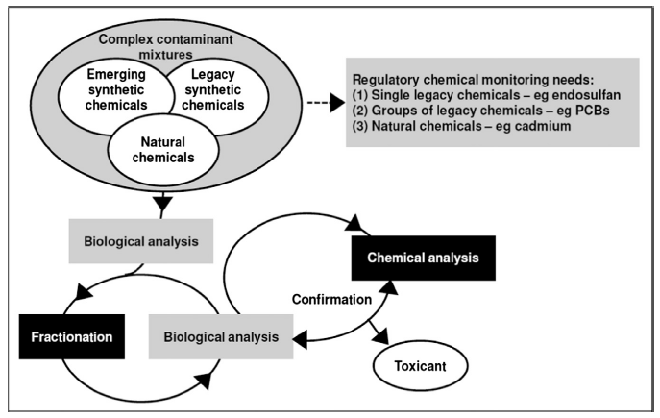
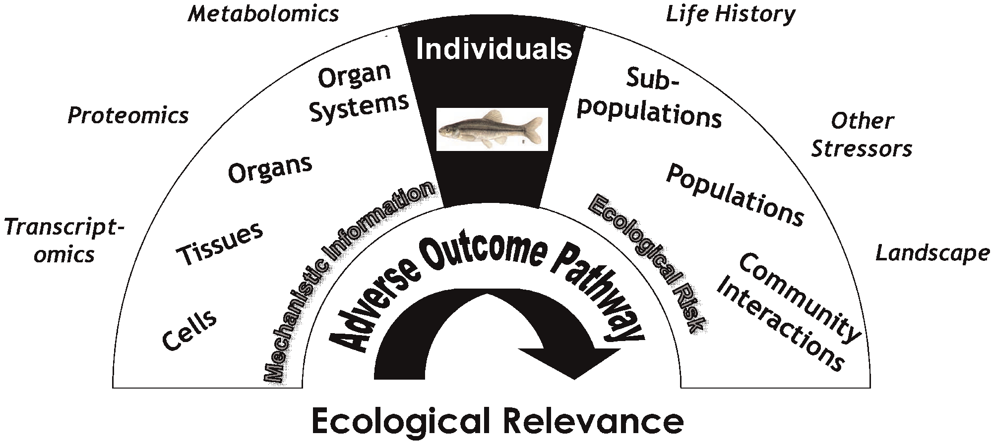
CEC Prioritization Framework:
PSEMP White Paper
Define Prioritization Process
How to incorporate measures of biological endpoints?
Adverse outcome pathways (AOPs) relating individual organisms to ecologically relevant levels of biological organization (Kramer et al. 2011)
Schematic of biological effects-directed analysis with chemical monitoring to focus investigation and identification of priority chemicals (Hutchinson et al. 2013)

Slide 15
CEC Prioritization Framework:
PSEMP White Paper
Apply Prioritization Process
Identify List of CECs for Monitoring
Include Method for Removing CECs from List
Stakeholder Engagement
Create Formal Review Process
Develop Advisory Team
Currently PSEMP
Recommendations

Slide 16
A new risk assessment approach for the prioritization of 500 classical and emerging organic microcontaminants as potential river basin specific pollutants under the European Water Framework Directive. von der Ohe et al., Sci of the Total Envr, 2011, 409, 2064-2077.
CEC Prioritization Framework
Illustrative Example of Prioritization Framework
Categorize compounds based on available information
Rank compounds utilizing a risk-based approach

Slide 17
Step 1:
CATEGORIZE COMPOUNDS
Is there sufficient environmental monitoring data?
Does the environmental monitoring data suggest risk?
CATEGORY 3
Perform a rigorous effect assessment
Is Level of Quantification less than
PNEC?
CATEGORY 4
Develop Analytical Methods
CATEGORY 1
Derivation of Water Quality Standards
Inclusion in Monitoring Program
CATEGORY 6
No Predicted Impacts
Remove from Monitoring
Is there sufficient effects data?
Is there sufficient effects data?
CATEGORY 2
Environmental Monitoring
CATEGORY 5
Hazard Assessment and Screening Study
YES
NO
YES
NO
NO
YES
YES
NO
YES
NO
von der Ohe et al., A new risk assessment approach for the prioritization of 500 classical and emerging organic microcontaminants as potential river basin specific pollutants under the European Water Framework Directive. Sci of the Total Envr 2011, 409, 2064-2077.

Slide 18
STEP 1: CATEGORIZE COMPOUNDS
Criteria Details
Is there sufficient environmental monitoring data?
Does the environmental monitoring data suggest risk?
CATEGORY 3
Perform a rigorous effect assessment where needed
Is Level of Quantification less than
PNEC?
CATEGORY 4
Develop Analytical Methods
CATEGORY 1
Derivation of Water Quality Standards
Inclusion in Monitoring Program
CATEGORY 6
No Predicted Impacts
Remove from Monitoring
Is there sufficient effects data?
Is there sufficient effects data?
CATEGORY 2
Screening Study to Inform On Risk
CATEGORY 5
Hazard Assessment and Screening Study
Are the >20 sites with reportable concentrations?
MEC > LOQ?
YES
NO
YES
NO
NO
YES
YES
NO
NO
YES
von der Ohe et al., A new risk assessment approach for the prioritization of 500 classical and emerging organic microcontaminants as potential river basin specific pollutants under the European Water Framework Directive. Sci of the Total Envr 2011, 409, 2064-2077.

Slide 19
STEP 1: CATEGORIZE COMPOUNDS
Criteria Details
Is there sufficient environmental monitoring data?
Does the environmental monitoring data suggest risk?
CATEGORY 3
Perform a rigorous effect assessment where needed
Is Level of Quantification less than
PNEC?
CATEGORY 4
Develop Analytical Methods
CATEGORY 1
Derivation of Water Quality Standards
Inclusion in Monitoring Program
CATEGORY 6
No Predicted Impacts
Remove from Monitoring
Is there sufficient effects data?
Is there sufficient effects data?
CATEGORY 2
Screening Study to Inform On Risk
CATEGORY 5
Hazard Assessment and Screening Study
Is the PNEC based on experimental data from three trophic levels (D. magna,
S. capricornutum, and P. promelas)? or is it predicted based on chemical properties?
YES
NO
YES
NO
NO
YES
YES
NO
NO
YES
von der Ohe et al., A new risk assessment approach for the prioritization of 500 classical and emerging organic microcontaminants as potential river basin specific pollutants under the European Water Framework Directive. Sci of the Total Envr 2011, 409, 2064-2077.

Slide 20
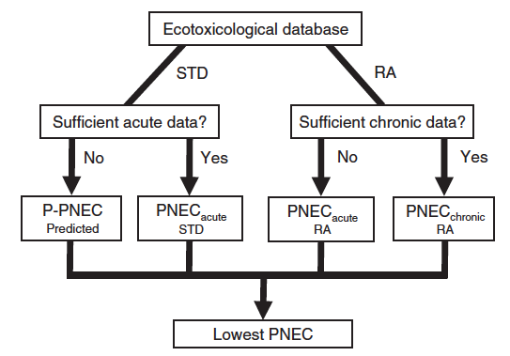
STEP 1: CATEGORIZE COMPOUNDS
Criteria Details
Is there sufficient environmental monitoring data?
Does the environmental monitoring data suggest risk?
CATEGORY 3
Perform a rigorous effect assessment where needed
Is Level of Quantification less than
PNEC?
CATEGORY 4
Develop Analytical Methods
CATEGORY 1
Derivation of Water Quality Standards
Inclusion in Monitoring Program
CATEGORY 6
No Predicted Impacts
Remove from Monitoring
Is there sufficient effects data?
Is there sufficient effects data?
CATEGORY 2
Screening Study to Inform On Risk
CATEGORY 5
Hazard Assessment and Screening Study
IS MEC₉₅ > PNEC_{lowest}?
MEC₉₅= 95th percentile of all measured environmental concentrations
YES
NO
YES
NO
NO
YES
YES
NO
NO
YES

Slide 21
STEP 1: CATEGORIZE COMPOUNDS
Categories Determine Next Steps
Is there sufficient environmental monitoring data?
Does the environmental monitoring data suggest risk?
CATEGORY 3
Perform a rigorous effect assessment
Is Level of Quantification less than
PNEC?
CATEGORY 4
Develop Analytical Methods
CATEGORY 1
Derivation of Water Quality Standards
Inclusion in Monitoring Program
CATEGORY 6
No Predicted Impacts
Remove from Monitoring
Is there sufficient effects data?
Is there sufficient effects data?
CATEGORY 2
Environmental Monitoring
CATEGORY 5
Hazard Assessment and Screening Study
YES
NO
YES
NO
NO
YES
YES
NO
YES
NO
von der Ohe et al., A new risk assessment approach for the prioritization of 500 classical and emerging organic microcontaminants as potential river basin specific pollutants under the European Water Framework Directive. Sci of the Total Envr 2011, 409, 2064-2077.

Slide 22
Step 2: PRIORTIZATION WITHIN CATEGORIES
For each compound calculate:
Frequency of Exceedance = Σn/N
  where,
  n = number of sites with MEC_{site}/lowest PNEC > 1, and
  N = total number of sites with analytical measurements
Extent of Exceedance = MEC₉₅/lowest PNEC
  1-10 → 0.1 point
  10-100 → 0.2 points
  100-1000 → 0.5 points
  1000 → 1 points
von der Ohe et al., A new risk assessment approach for the prioritization of 500 classical and emerging organic microcontaminants as potential river basin specific pollutants under the European Water Framework Directive. Sci of the Total Envr 2011, 409, 2064-2077.
Notes:
Can still prioritize for categories with insufficient data.
Category 2 (effects data but no monitoring) → hazard based evaluation
Category 3 (monitoring data but not good effects) → categorized based on provisional PNEC values

Slide 23
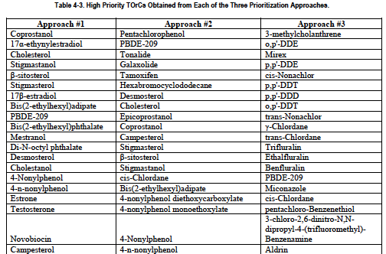
Comparison of Prioritization Schemes
Decision points impact the final list of priority CECs.
Notes:
Approach 1 – Hazard based
Approach 2 – Hazard based + P + B
Approach 3 – PBT
Only one compound appears on all three lists.

Slide 24
PSEMP CEC Prioritization:
Next Steps
Complete the White Paper
  Summarize Each of the Decision Issues and Recommendations
Implementation
  Decide/Refine Important Factors that can be Evaluated
  Identify Staffing/Funding for Longer Range Issues
Notes:
ng/L – part per trillion
1 drop of ink in 20 Olympic swimming pools
First – show biological impacts
Next – Show specific uses

