Slide 1
Columbia River Toxic Reduction Work Group Compounds of Emerging Concern (CEC) Research & Monitoring Issue Paper Vancouver, WA June 12, 2014 Alec Maule (USGS Retired)

Slide 2
Columbia River Basin Toxics Reduction Action Plan September 2010

Slide 3
Columbia River Toxic Reduction Work Group Compounds of Emerging Concern Research & Monitoring Issue Paper Writing Team
Mike Cox (EPA)*
Helena Christiansen (USGS)
Kathy Conn (USGS)
Jay Davis (USFWS)
Lorraine Edmond (EPA)
Lyndal Johnson (NOAA-F)*
Mitch Kostich (EPA, Grt Lakes)
Jennifer Morace (USGS)*
Dale Norton (WA DOE)*
Tony Paulson (USGS)
Lori Pillsbury (OR DEQ)
Joel Salter (EPA)*

Slide 4
Other CEC Research & Monitoring Work Groups
Puget Sound CEC Prioritization Process
PS Ecosystem Monitoring Program (PSEMP)
Jill Brandenburg, Chair
Andy James
Dale Norton
Lyndal Johnson
Jay Davis
Calif. Water Resources Control Board
Science Advisory Panel
Report April 2012
Anderson et al. 2012

Slide 5
COLUMBIA RIVER TOXICS REDUCTION WORKING GROUP:
RESEARCH STRATEGY FOR CHEMICALS OF EMERGING CONCERN
DRAFT
Objective: Provide a strategy for developing research & monitoring plan
The strategy contains:
Four conceptual models
Generalized model of the Basin
Sources, fate and pathways biotic & abiotic
Flow of energy & CECs in (3) estuarine and (4) stream food webs
List of CECs in the Basin & example of a CEC prioritization plan
Biological effects of CECs
Biological indicators of CEC exposure in aquatic and terrestrial food webs.
A summary & conclusions.

Slide 6
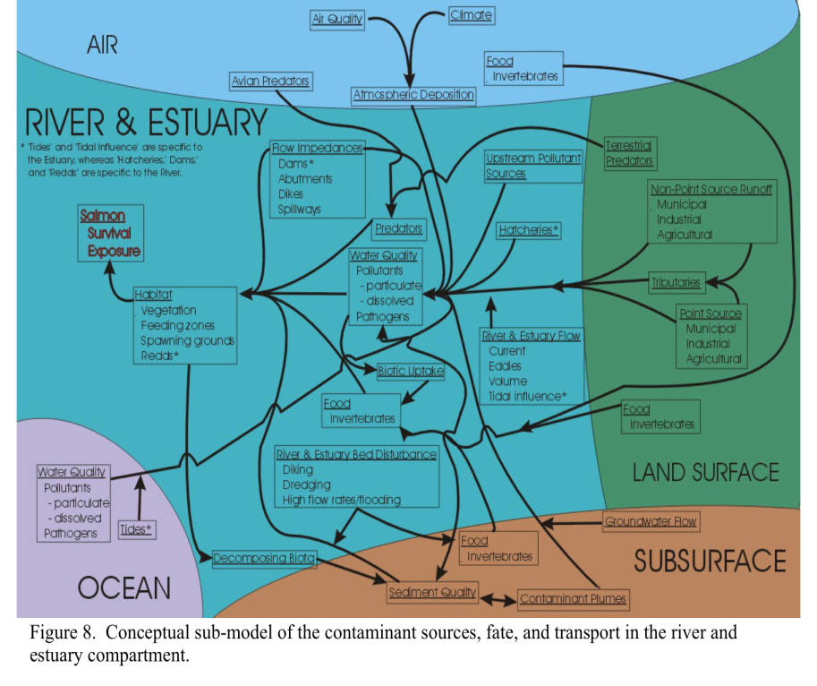
Sources, Fates and Transport
(Dietrich et al. 2005, Leary et al. 2005)

Slide 7
Issue Paper: Classes of CECs in Columbia River
Brominated flame retardants (PBDEs)
Estrogens
Pharmaceuticals and Personal Care Products
Perfluorinated compounds (PFC)
Legacy chemicals

Slide 8
CEC Prioritization: California example (Anderson et al. 2012)
1. Monitoring Trigger Levels (MTLs) based on literature
2. Measured or Predicted Environmental Concentrations (MEC / PEC)
3. Compare MEC to MTL for Monitoring Trigger Quotient
(MTQ = MEC/MTL). If MTQ > 1, then candidate to monitor.

Slide 9
Issue Paper: Categories of Biological Effects of CECs
Reproductive Success
Increased Stress & Bioaccumulation
Reproductive & Genetic Impacts
Long Term Exposure & Mixtures

Slide 10
Issue Paper: Biological Indicators
Macroinvertebrate Community
Fish Health
Fish Community
Pathology
Biochemical & Physiological
Molecular
Wildlife Health

Slide 11
Issue Paper: Conclusions- Address these needs:
Determine initial list of CECs
Decide on criteria to prioritize CECs
Determine sources, amounts released & pathways of CECs in the prioritized list
Develop Guidelines to determine threat-level of CEC
Establish standardized research approach to assess CEC
Establish standardized monitoring program to track CEC pathways and biological effects

Slide 12
Northwest Power & Conservation Council Public Review Draft Columbia River Fish & Wildlife Program 2013 / 2014 (comments by July 9, 2014)
6. Water Quality (p. 53)

Slide 13
NPCC Public Review Draft Columbia River Fish & Wildlife Program
6. Water Quality
Water Temperature
Total dissolved gas
Toxic contaminants

Slide 14
NPCC Public Review Draft Columbia River Fish & Wildlife Program
6. Water Quality (p. 53)
“The Columbia River Basin has been designated by EPA as a priority
Large Aquatic Ecosystem... While each of these other ecosystems
has designated funding sources to protect and restore the water
quality within their defined areas, the Columbia River Basin does not.”

Slide 15
NPCC Public Review Draft Columbia River Fish & Wildlife Program
6. Water Quality (p. 54)
“The federal action agencies, in cooperation with the Environmental
Protection Agency and other federal, tribal, regional, and state agencies, should: … support implementation of the Regional 2010
Columbia River Basin Toxics Reduction Action Plan … containing water quality monitoring, research and improvement measures needed to enhance the survival of anadromous and native resident fish ”

Slide 16
NPCC Public Review Draft Columbia River Fish & Wildlife Program
6. Water Quality (p. 55)
“The Council urges Congress to provide funding, similar to the funding of other Large Aquatic Ecosystems, to protect and restore water quality in the Columbia River Basin, including efforts to:
Develop sensitive diagnostic indicators of chemical exposure and salmon health, such as biomarkers, for use in field studies in the Columbia Basin;
Determine the extent to which toxics limit prey quality and abundance in degraded habitats and otherwise affect the food web; and
Improve understanding of contaminants of emerging concern, such as endocrine-disrupting pharmaceuticals and chemicals in personal care products, and their effects on salmonids, sturgeon and lamprey.”

Slide 17
Northwest Power & Conservation Council Public Review Draft Columbia River Fish & Wildlife Program 2013 / 2014 (comments by July 9, 2014)

Slide 18
Possible outlets for publishing CEC Issue Paper
EPA
USGS
Other?

