Slide 1
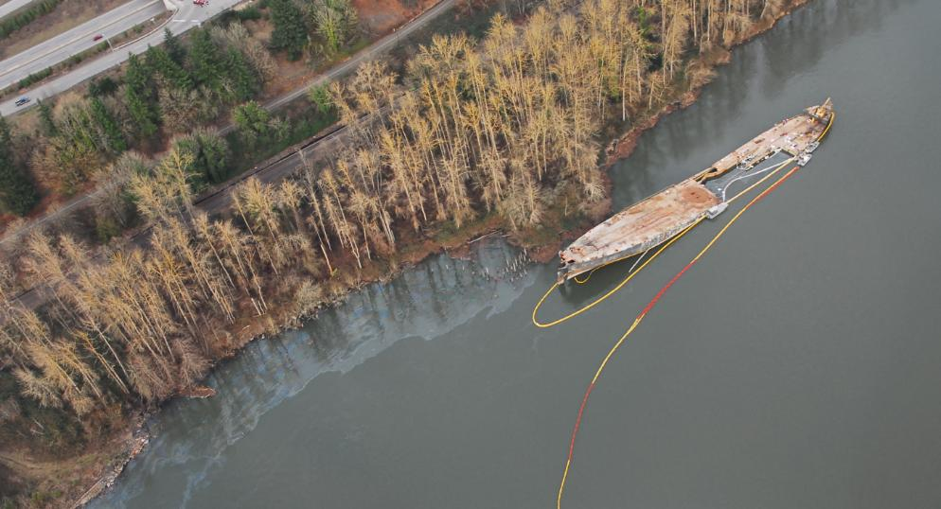
Derelict Vessel Task Force

Slide 2
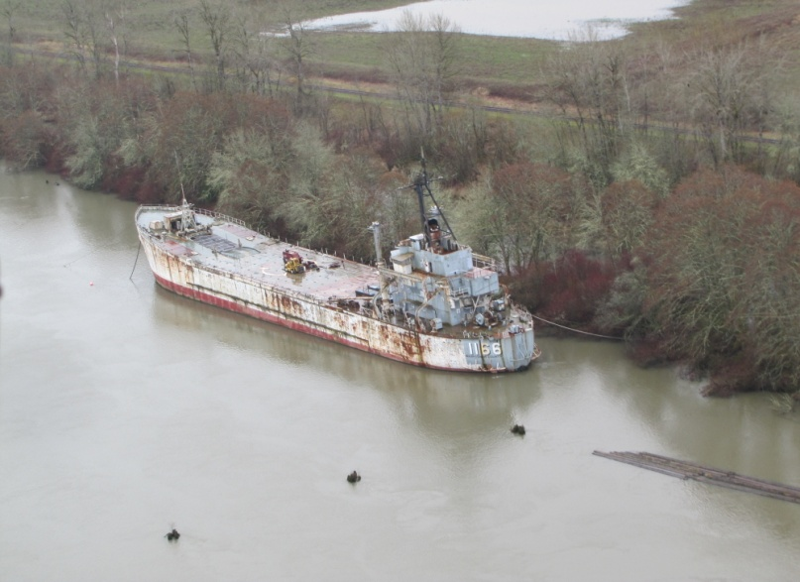
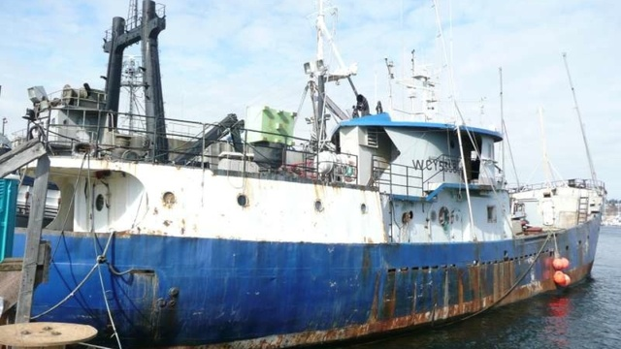
What is the Problem?
Derelict, abandoned and neglected vessels have become a concern for Federal, State, local, and Tribal partners. In 3 recent cases, 30 million dollars of Oil Spill Liability Trust Funds were expended.
In response, USCG Sector Columbia formed the Derelict Vessel Task Force
LST 1166 $5.5 M
Davy Crocket $22 M
Davy Crocket $22 M
F/V Deep Sea $2.6 M
Notes:
All of these vessels ended up in trespass on state submerged lands. All had fallen out of registration and/or documentation.

Slide 3
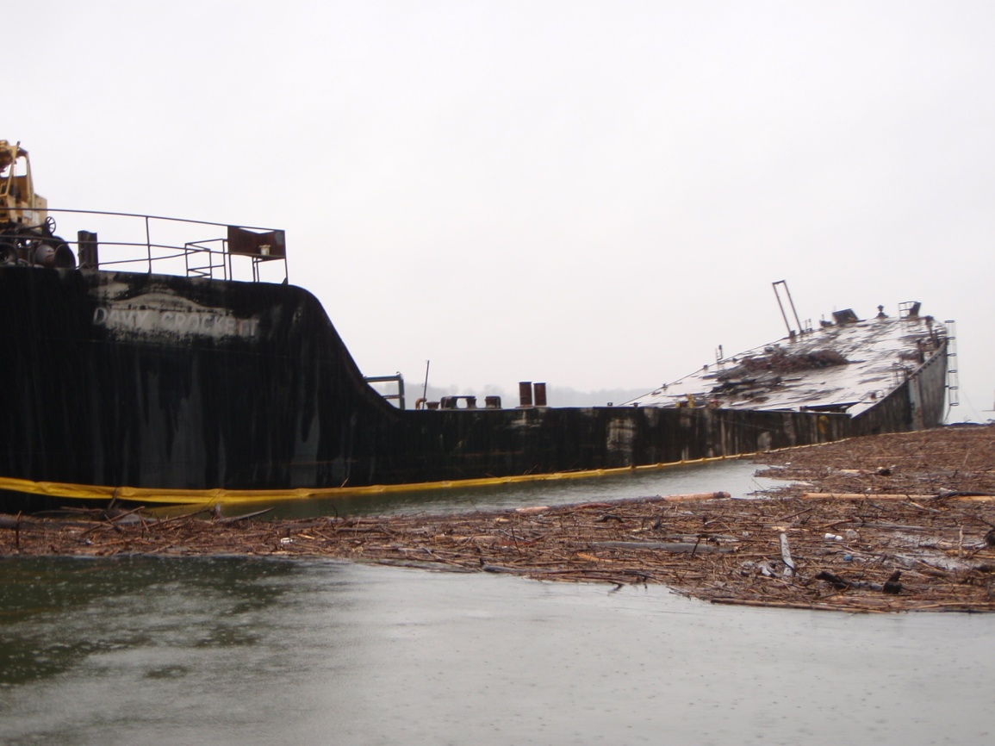
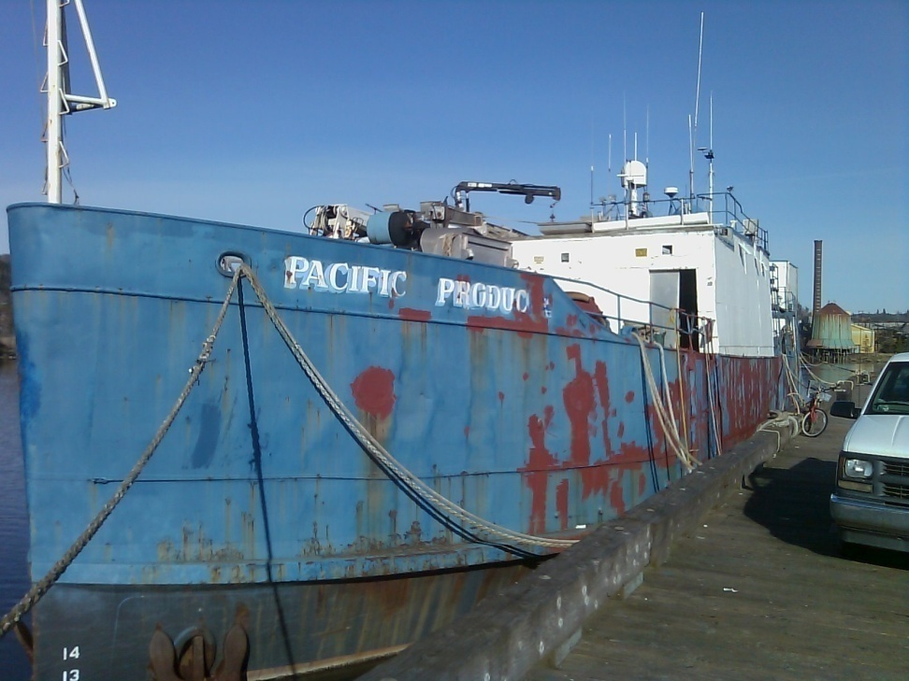
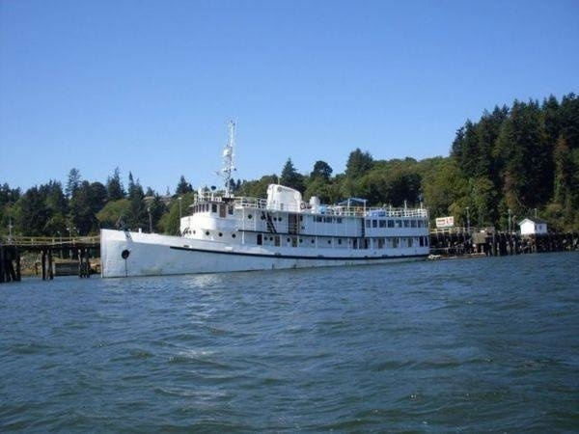
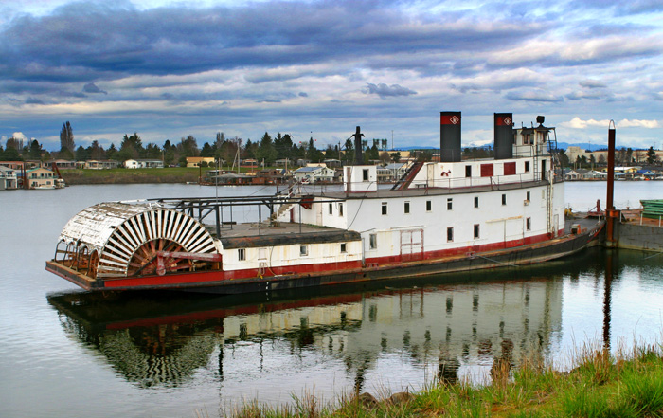
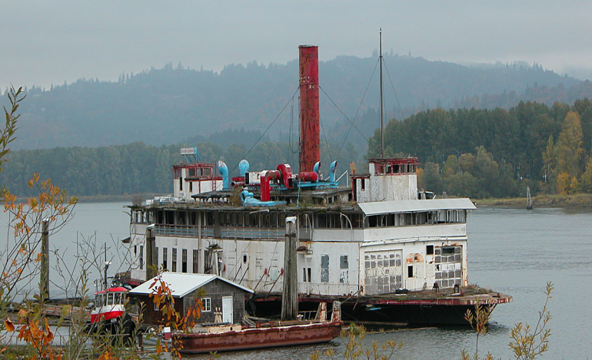
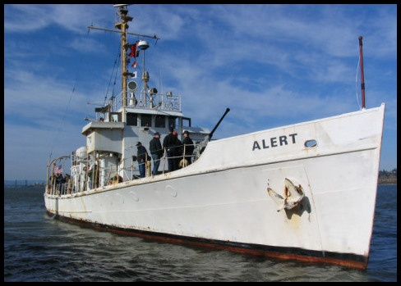
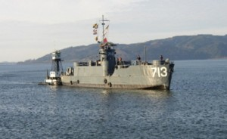
The Problem - Derelicts in Columbia & Willamette Rivers posing pollution, navigation, and other threats

Slide 4
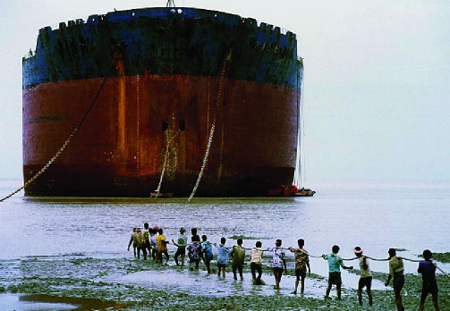
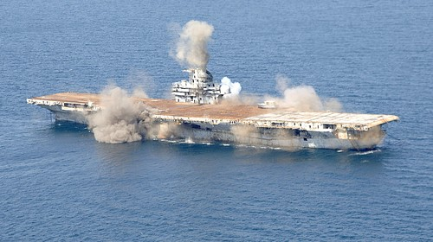
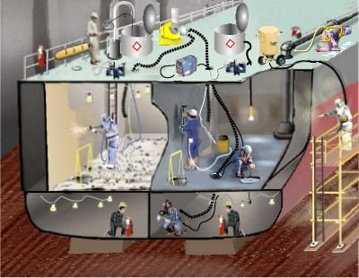
Why is This a Problem
Impediments to exporting – Basel Convention
Impediments to Ocean Dumping – Conflicts between Toxic Substances Act & Marine Protection, Research & Sanctuaries Act over PCB levels
Impediments to recycling – costs of proper recycling almost always exceed value of materials
Economic Downturn – Abandonment due to economic hardships
Notes:
The London Convention is for the Prevention of Marine Pollution by the Dumping of Waste and other matter that may harm the environment; but it allows for placement of matter that serves an “alternate purpose”.
The Marine Protection Research and Sanctuaries Act (MPRSA) enforces provisions of the London Convention.
The Clean Water Act (CWA) and the Rivers and Harbors Act (RHA) allow for artificial reefing to be exempt from the MPRSA. CWA within 3 miles; RHA outside 3 miles
The Toxic Substances Control Act (TSCA) regulates the distribution in commerce and the disposal of PCB’s. In 2001 TSCA changed the classification of PCB’s in ships that were used as reefs from continued use to disposal. This was a result of the Spiegel Grove artificial reefing plan because it could not meet the 2ppm remediation requirements.
The Basel Convention prohibits the international transfer of toxic substance to developing nations that do not have equivalent standards to deal with them. In 2006 it was amended to specifically address ships that contain hazardous substances for the same purpose.
The EPA viewed the sinking of vessels for the purpose of artificial reefing as disposal under TSCA and thus allowed levels of PCB at 50 ppm. It also viewed it as placement under the London Convention and MPRSA therefore avoiding the dumping prohibitions of the black listed substances.
If disposal under TSCA vessels should be considered ocean dumping under the London Convention and MPRSA and only trace elements of PCB’s should apply.
If artificial reefing then MPRSA should apply and categorized as continued use and therefore have a standard of 2ppm of PCB’s.
The upshot is that we can no longer export vessels under the Basel Convention (under most conditions) and we can no longer sink vessels (if they contain certain hazardous substances and they almost always do) due legal action against the EPA for inconsistent application of the various laws. That only leaves recycling.

Slide 5
Why not use Existing Guidance & Programs?
Existing regulations, relevant CG instructions, the Abandoned Barge Act, & derelict programs from Sector’s Columbia River, Puget Sound & San Francisco were analyzed
No one reference was comprehensive enough to span this complex interagency environment
The Task Force Structure and goals are a composite of this analysis
Major effort to define the scope of the problem; required a multi-agency database and/or review MISLE, EPIC, Homeport, NRC pollution log, EPA OSC, WA Dept of Natural Resources, Sector PS Derelict Vessel Access, etc.
Notes:
The USCG has never implemented the requirements under the Abandoned Barge Act to create a registration or numbering system for barges over 100 GT.
USCG Sector Juneau and San Francisco have asked for our Task Force model and database.

Slide 6
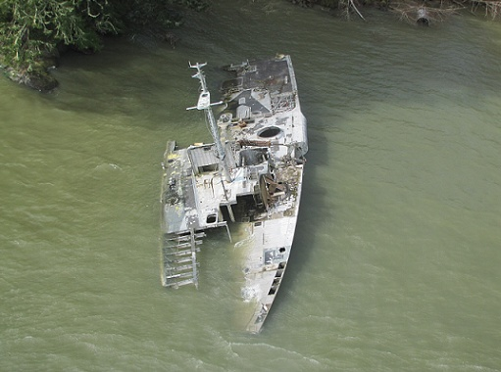
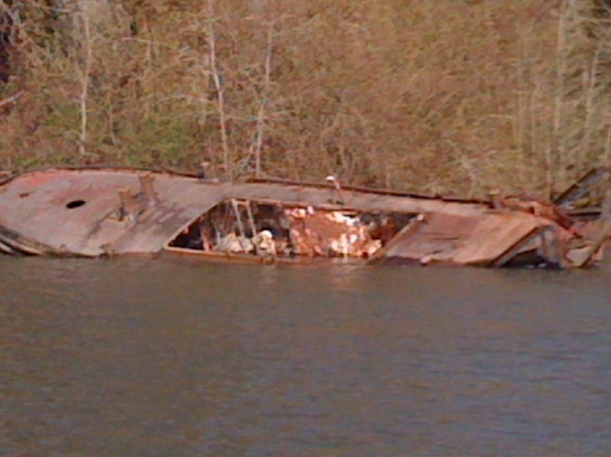
What is the Purpose?
The Columbia River Derelict Vessel Task Force is a forum of stakeholders whose purpose is to identify and remove imminent pollution and hazard to navigation threats from derelict vessels, barges, and houseboats along the upper, middle and lower Columbia River and Willamette Rivers in the states of Washington and Oregon.

Slide 7
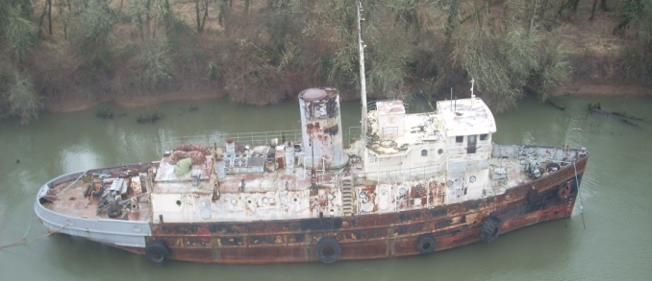
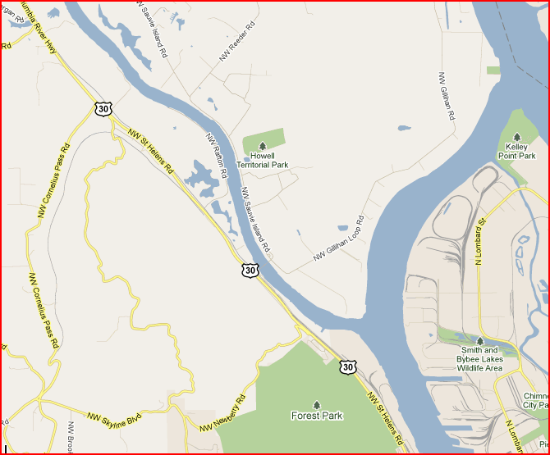
What is the Mission?
To recommend policy, share information, and foster the collaborative and shared efforts of Task Force members to identify and mitigate the harmful effects of derelict vessels, barges, and houseboats along the middle and lower Columbia River and Willamette Rivers. (originally only vessels > 35’ and not in a marina; some mission creep).

Slide 8
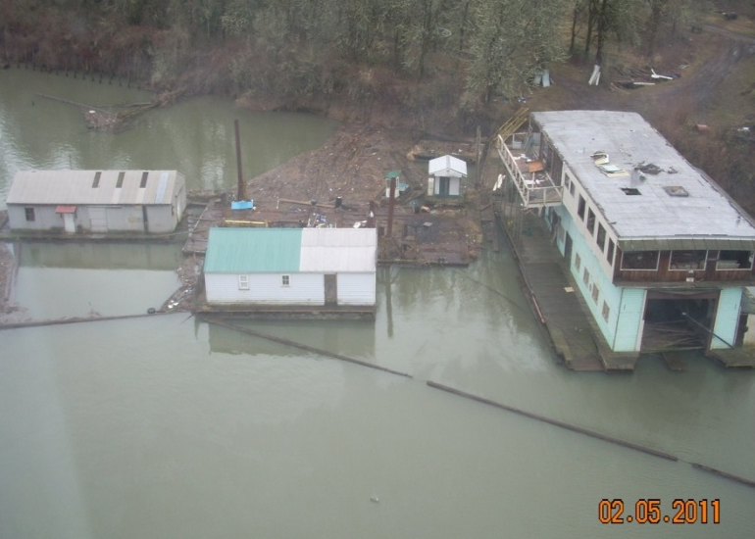
Who are the Members?
USCG Sector Columbia River MTS Recovery and Salvage Planner OR State Marine Board Oregon Clean Marina Coordinator WA Department of Ecology, Spill Response Section Manager OR DEQ, Emergency Response/Enviro Cleanup, Lands Division Manager WA Dept of Natural Resources, Derelict Vsl Removal Program Manager EPA Federal On-Scene Coordinator OR Division of State Lands, Western Region Manager NOAA Scientific Support Coordinator
US Army Corps of Engineers
Director, Oregon State Lands
Other Participants include: Oregon DOJ Multnomah County Marine Patrol Supervisor Senator Wyden’s Office

Slide 9
What are the Objectives?
1. Inventory derelict vessels, barges, and houseboats along the Columbia and Willamette Rivers.
2. Determine derelict vessels, barges, and houseboats that pose actual or potential pollution threats and hazard to navigation.
3. Prioritize and remove all pollution, HAZMAT, and navigational threats from identified derelict vessels, barges, and houseboats. Prioritize and facilitate the removal of vessels that do not pose an immediate threat of pollution or hazard to navigation through the Task Force collective authority.
4. Conduct regular, intense, smart surveillance for prevention of pollution, HAZMAT, or navigational threats stemming from derelict vessels, barges, and houseboats.

Slide 10
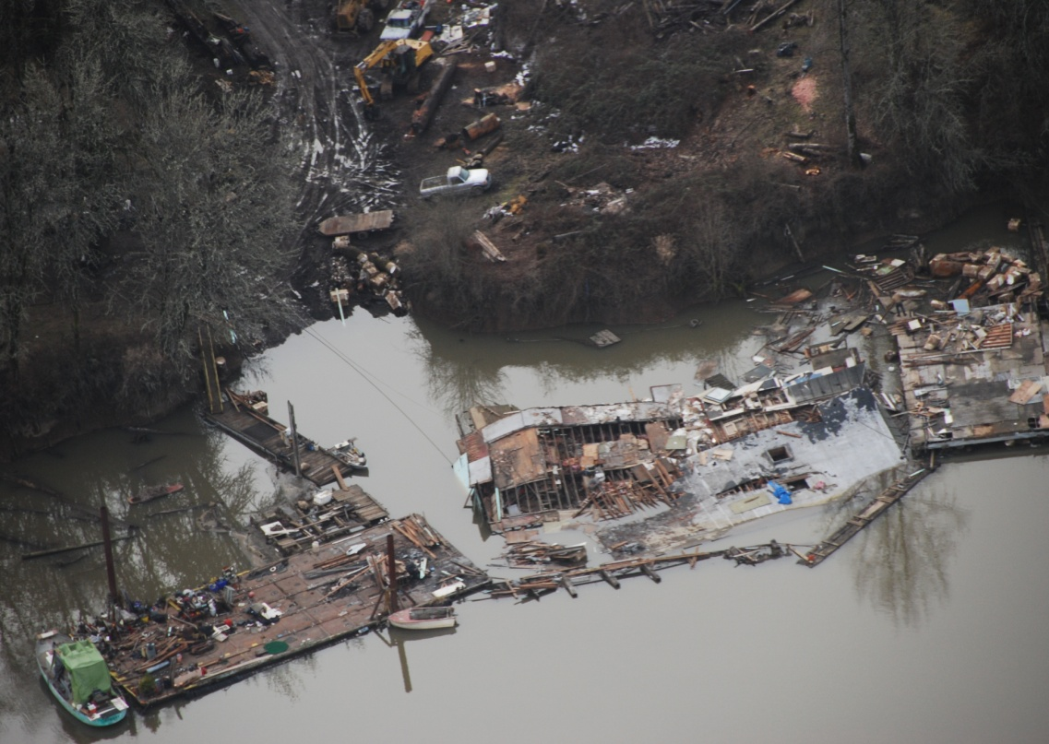
What are the Objectives? continued
5. Develop list of law & policy which could be changed to facilitate reduction of current & future derelict & abandoned vessels (now part of states policy group).
6. ID opportunities to align WA
& OR laws on derelict vessels to
develop a consistent regulatory
regime on Columbia River (now part of states policy group).
7. Maintain effective communications w/ state & local agencies, CG Auxiliary, & Federal partners.

Slide 11
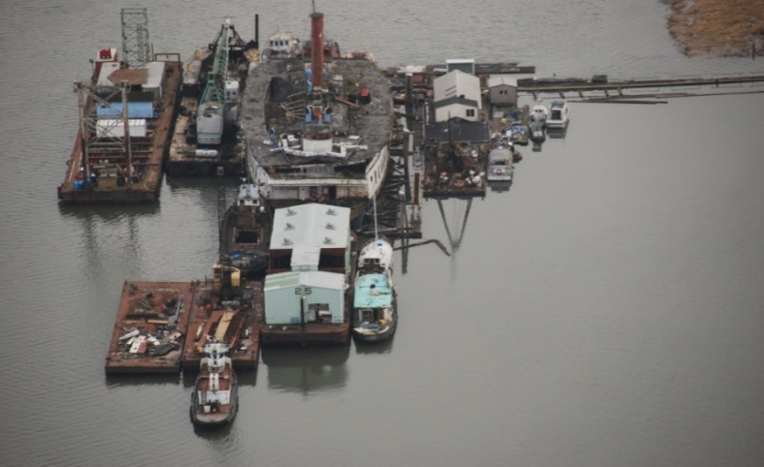
What have we accomplished?
Created Membership
Developed Charter
Reviewed/Compared Existing Programs
Developed Database & User Guide
Developed Category Matrix
Developed Info/Policy Hosting on RRT/NWAC Web Page
Developed Draft Authorities Matrix
Conducted Joint Patrols
Developed Communications Network
Developed Training Outline for Multi-Agencies
Developed List of Outreach Opportunities
Created list of Recommendations to RRT/NWAC
Expanded Task Forces to Seattle and San Francisco

Slide 12
What Role Do Local Agencies Play?
Assist with ID & inventory of derelict, abandoned, & wrecked vessels
Conduct regular, intense, smart surveillance of known sites for prevention of pollution, hazardous materials, or navigable threats
Maintain effective communications with Federal, State, & Local agencies
Melissa Ferris, Derelict Vessel Program Manager, DNR
(360) 902-1574; melissa.ferris@dnr.wa.gov
Rachel Bullene, Policy Analyst, OMB (503) 378-2836; rachel.e.bullene@state.or.us
Randy Clark, Security Specialist
(503) 247-4007; william.r.clark@uscg.mil

