Slide 1

AN ADAPTIVE MANAGEMENT PLAN FOR
PCBs IN STORMWATER AND SEDIMENTS
City of Spokane Wastewater Management
Lynn Schmidt, Stormwater Permit Coordinator

Slide 2
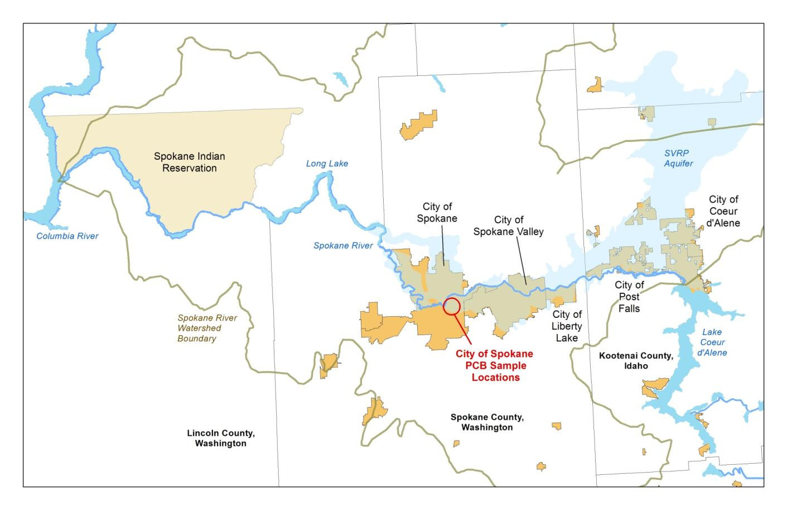
Study Area
Notes:
River starts at CDA Lake, flows through these cities.
Downstream is Long Lake and Spokane Tribe, then Columbia.
SVRP Aquifer is inter-linked, gaining and losing. Sole source aquifer to about ½ million people

Slide 3
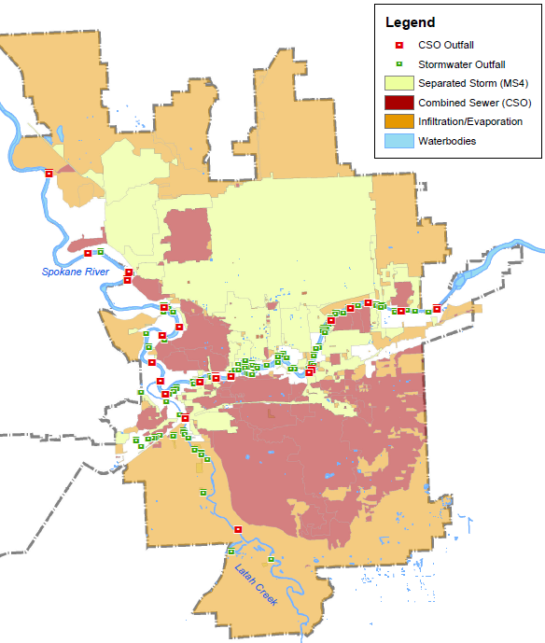
Stormwater Management in Spokane
Pathway for PCBs to enter the Spokane River
  MS4: Municipal Separate Storm Sewer System
  CSO: Combined Sewer Overflow (less frequent)
MS4
CSO
PCB Sample Locations
Notes:
Show MS4 area vs. CSO vs. Infiltration
Explain Spokane’s CSO program
Now have hundreds of overflows/year
Planning for one/year/outfall by 2017

Slide 4
Adaptive Management Plan
Reduce PCBs in stormwater and CSO discharges
Analyze and interpret existing data
Identify likely sources of PCBs. Design and implement remedial actions and BMPs.
Adaptive approach – further data collection and remedial action
Phase I: remedial maintenance, sampling, analysis of existing information
  PCBs particulate bound: sample catch basin sediments

Slide 5
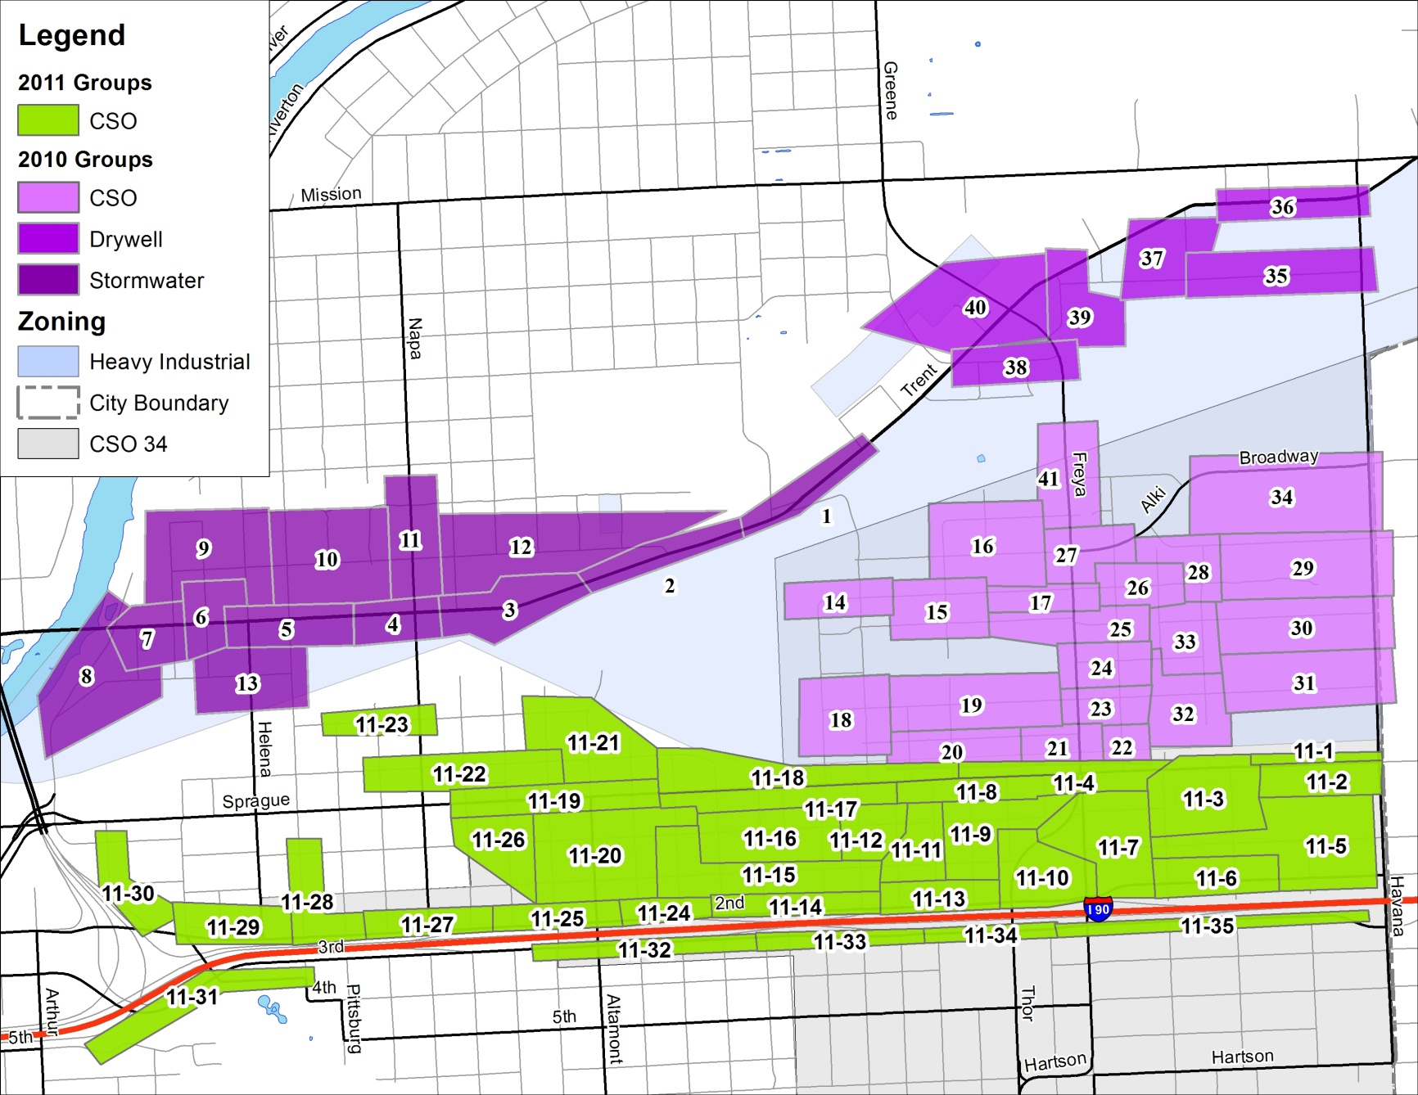
Priority Investigation Areas
Drywells
2012 Re-Sample
MS4
CSO
Notes:
Broken into sample groups for composite samples

Slide 6
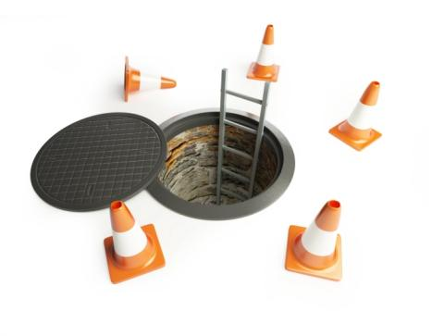
Sampling Procedures
Composite samples ~ 10 CBs each group
Individual samples from 1 CB only
Four sediment samples per catch basin
  Mix contents of each catch basin sample
Chain of custody procedures
  Anatek: Method 8082
  Pacific Rim: Method 1668
  Decontaminate sampling equipment:
  DI water rinse → Liquinox soap → DI water → acetone → air dry → foil wrap

Slide 7
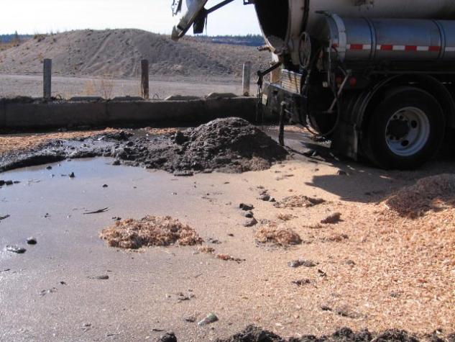
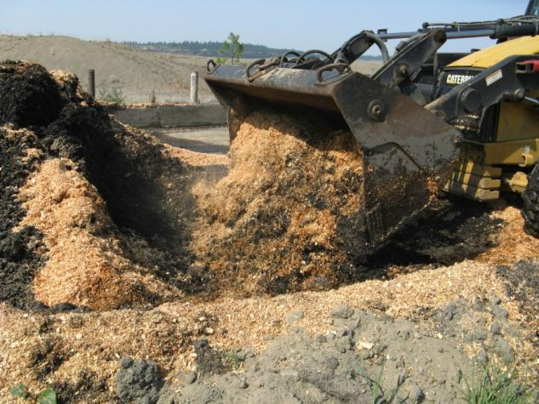
Remedial Maintenance
Review Aroclor analysis results
  Residential cleanup standard: 1.0 mg/kg
Remove all sediments from catch basins
Dump on separate pad, mix with sawdust
Haul to lined cell at landfill

Slide 8
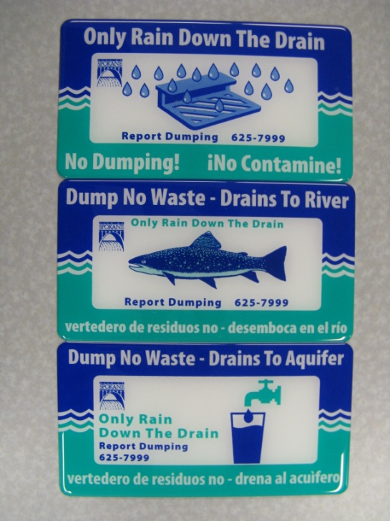
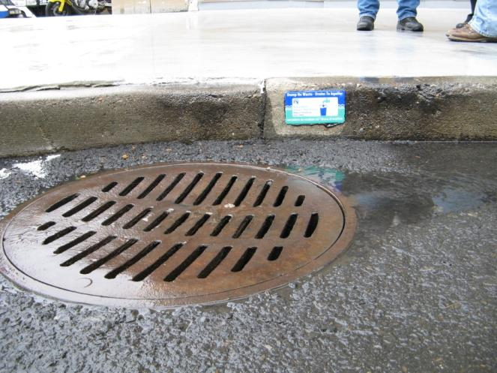
Curb Markers
Install markers at each basin after cleaning
Installation in progress throughout City on normal maintenance routes
Over 7,000 Installed
Notes:
**Note adaptive management – placing curbs on top instead of face of curb
Placed to inform the public not to dump waste down the drain
Include stormwater hotline for reporting illicit discharges

Slide 9
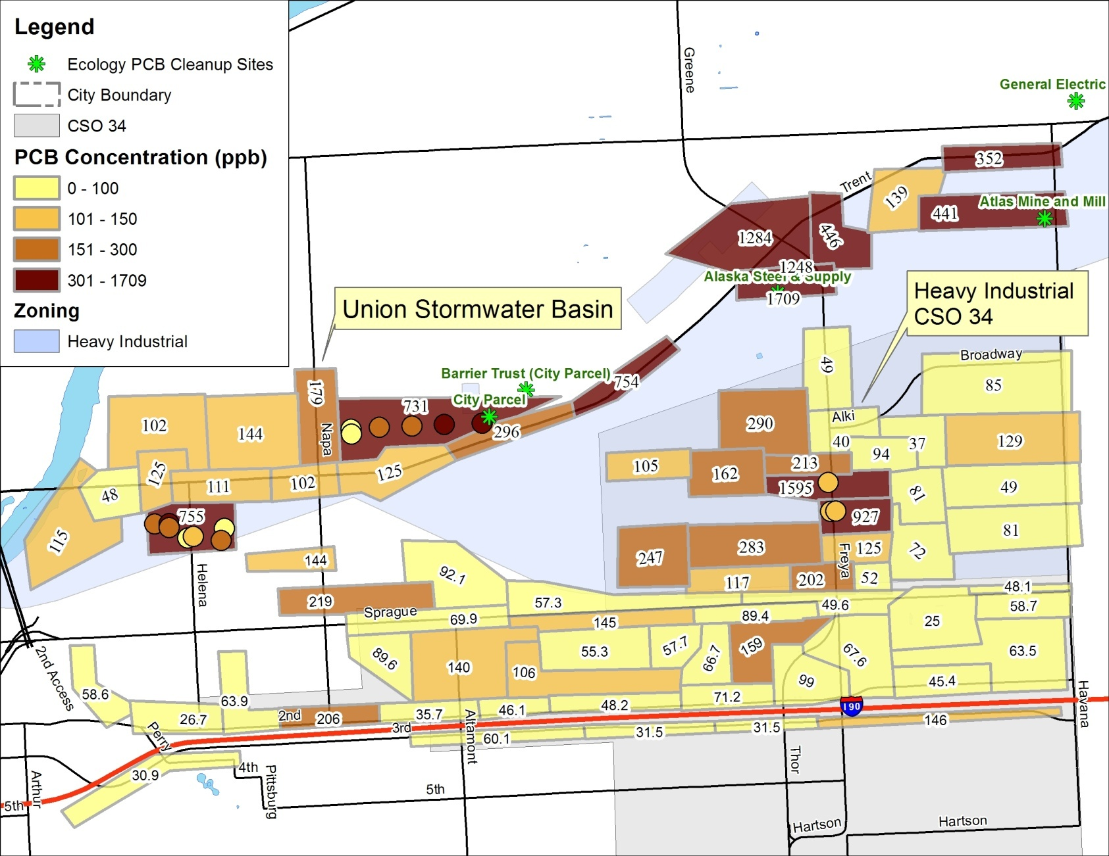
2010 and 2011 Catch Basin Sampling
Highest in Heavy Industrial Zone = Re-sample in 2012

Slide 10
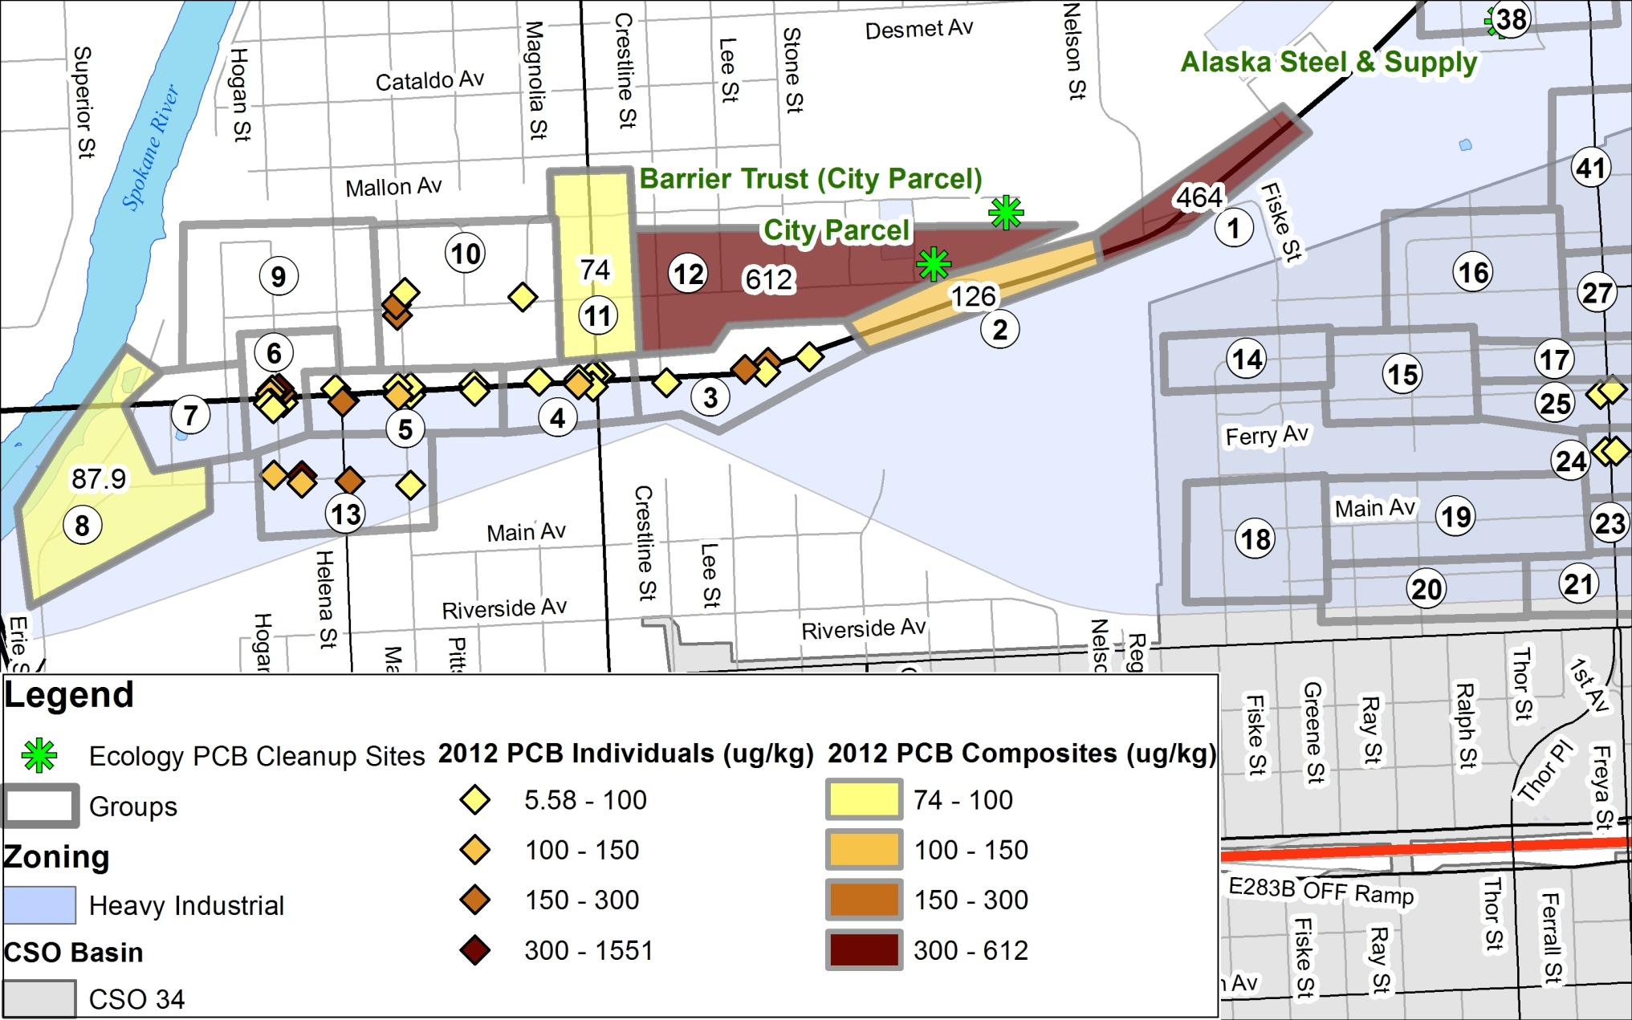
2012 Catch Basin Sampling

Slide 11
2010 – 2012 Sampling Recap
2010 - 2012 Catch Basin Samples
765 Catch Basins – broken into 76 Groups + individual basin re-samples
590,000 lbs sediments removed
32.4 grams PCBs removed
Individual Samples
Helped identify contaminated CB near City Parcel
Disconnected from MS4
PCBs still found in CBs after thorough cleaning in 2010 = continual PCB source in area
Ecology re-evaluating City Parcel site to investigate residual contamination off property
Average ~ 30% reduction in re-sampled CBs
Multiple older industrial sources: wind-blown and track-off

Slide 12
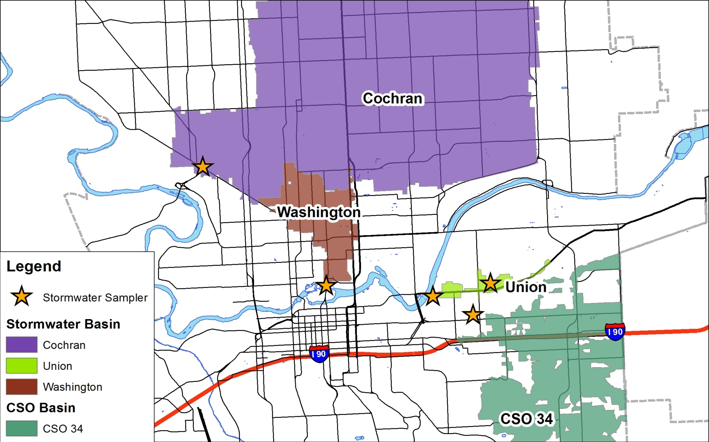
Stormwater Sampling: 2012-2014
Notes:
Initially started with Union Basin. Expanded to others for the Integrated Plan, to help identify highest loads to the River. Included PCBs in all sampling for comparison to Union Basin.

Slide 13
Stormwater Sampling
Heavy Industrial
Commercial
Near PCB Cleanup Site
“Average” City stormwater
Notes:
Our sample results, compared to Liberty Lake “background” study where there is no known point source of PCBs. Note that Cochran and Washington basins are within the range of the Liberty Lake study.

Slide 14
Product Sampling
PCBs are still incidentally produced in manufacturing processes. City is sampling products in summer 2014:
Road paint
Survey marking paint
Deicer
Vehicle wash soap
Vehicle wax
Pesticide/herbicide
Motor oil (new and used)
Diesel and gasoline
Dust suppressant
PVC pipe (rinsate)
Asphalt sealer
Firefighting foam
Other vehicle fluids

Slide 15
Conclusions
Individual sources difficult to identify
Widespread, diffuse source of PCBs
  Legacy sources from historic industrial activity
  PCBs found in everyday items (motor oil, hydraulic fluid, etc.)
Designing treatment and infiltration in Union basin (disconnect MS4 from river)
Integrated Plan: treat and infiltrate Cochran basin stormwater
CSO controls installed by 2017
  One overflow per year per outfall

Slide 16
Questions?
More information:
2013 PCB Annual Report
http://www.spokanewastewater.org/StormwaterDocs.aspx
(2014 report coming soon!)
City of Spokane Integrated Clean Water Plan
https://beta.spokanecity.org/publicworks/wastewater/integratedplan/

