Slide 1
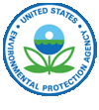
Lower Columbia Toxics Reduction Working Group Meeting
June 12, 2014 Vancouver, WA
Notes:
Good morning, thank-you for attending today. I look forward to talking a little about the world of Stormwater.

Slide 2
Stormwater Overview
Stormwater Permits 101: How Permits are Reducing Toxics, Lisa Cox-WA Dpt of Ecology
Case Study: One City’s Story of Eliminating Toxic Pollution, Lynn Schmidt, P.E. City of Spokane
WA Stormwater Center: Introduction to the Center’s work on Reducing toxics in Stormwater, Lisa Rozmyn WA Stormwater Center
Notes:
Joining me to day on the topic of stormwater are Lynn Schmidt (phone) and Lisa Rozmyn with the WA Stormwater Center.

Slide 3
Stormwater Permits 101
Presentation Overview
Introduction to the stormwater permits
Permit conditions that address toxics
Notes:
I will be going through in the next 15 minutes some of the basics of stormwater permits and a few of the permit conditions that address toxics.

Slide 4
Introduction to stormwater permits
Notes:
As authorized by the Clean Water Act, the National Pollutant Discharge Elimination System (NPDES) permit program controls water pollution by regulating point sources that discharge pollutants into waters of the United States. Point sources are discrete conveyances such as pipes or man-made ditches; In most cases, the NPDES permit program is administered by authorized states. Since its introduction in 1972, the NPDES permit program is responsible for significant improvements to our nation's water quality.

Slide 5
Introduction to the Stormwater Permits
Federal Water Pollution Control Act of 1972
NPDES
SSO’s
CAFO
Stormwater
Pesticide Discharges
CSOs
Aqua-
culture
Whole Effluent Toxicity
Vessel Discharge
Vessel Decon-struction
Fresh Fruit Packing
Pre-treatment
Notes:
The NPDES rules regulate polluters generally through permits and programs, including concentrated animal feeding operations (CAFOs), pesticide discharges, combined sewer overflows (CSOs), pretreatment, sanitary sewer overflows (SSOs), stormwater and whole effluent toxicity (WET). AND Vessel Discharges. As you can see there are many rules regulating many programs.
Water pollution degrades surface waters making them unsafe for drinking, fishing, swimming, and other activities. industrial, municipal and other facilities must obtain permits if their discharges go directly to surface waters.
Since its introduction in 1972, the NPDES permit program is responsible for significant improvements to our Nation's water quality.
WA State: General permits under NPDES: Boatyard, Aquatic Pest, CAFO, Vessel, Fresh Fruit packing, Sand&Gravel, upland Fin Fish, Vessel deconstruction, water treatment, Stormwater
Whole Effluent Toxicity
Whole Effluent Toxicity (WET) is a term used to describe the aggregate toxic effect of an aqueous sample (e.g., whole effluent wastewater discharge) as measured by an organism's response upon exposure to the sample (e.g., lethality, impaired growth or reproduction). WET tests replicate the total effect and actual environmental exposure of aquatic life to toxic pollutants in an effluent without requiring the identification of the specific pollutants. WET testing is a vital component of the water quality standards implementation through the NPDES permitting process and supports meeting the goals of the Clean Water Act (Section 402), "..maintain the chemical, physical and biological integrity of the nation's waters

Slide 6
Introduction to the Stormwater Permits
Federal Water Pollution Control Act of 1972
NPDES
Stormwater
Construction
Construction
Municipal
Municipal
Industrial
Industrial
Boatyard
Sand & Gravel
Notes:
Just one sliver are the stormwater regulations. Stormwater is rain and snow melt that runs off surfaces such as rooftops, paved streets, highways, and parking lots. As water runs off these surfaces, it can pick up pollution such as: oil, fertilizers, pesticides, soil, trash, and animal waste. From here, the water might flow directly into a local stream, bay, or lake. Or, it may go into a storm drain and continue through storm pipes until it is released untreated into a local waterway.
In addition, the large impervious surfaces in urban areas increase the quantity of peak flows of runoff, which in turn cause hydrologic effects such as scoured streambeds channels, instream sedimentation and loss of habitat. Furthermore, because of the volume of runoff discharges, mass loads of pollutants in stormwater can be significant.

Slide 7
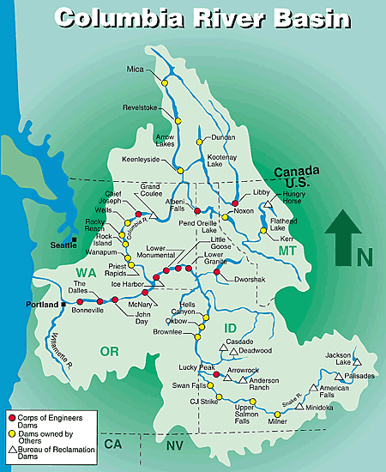
Introduction to the Stormwater Permits
EPA delegated
States:
Washington
Montana
Oregon
Idaho program administered
by the EPA
Permits authorize stormwater discharges to waters of the state.
Notes:
WA State, Montana, and Oregon have been delegated by EPA to administer the Clean Water Act National Pollutant Discharge Elimination System (NPDES) program.
Idaho’s program is administered by the EPA.
These programs administer permits to all facilities which discharge pollutants from any point source into water of the US. Pollutants include what have been defined as conventional, toxic (metals and man-made organic compounds) and non-conventional pollutants.
Bottom line the Permit authorizes discharges to Waters of the State.
The programs administered general and individual permits that are typically on a five-year cycle: permittees must apply MEP and all known and reasonable methods of prevention, control and treatment to stormwater discharges – this is typically referred to as AKART.
State and federal law require sites to use Best Management Practices or BMPs to keep the stormwater discharge in keeping with the state’s water quality standards.

Slide 8
The Industrial Stormwater permit
Notes:
Activities that take place at industrial facilities, such as material handling and storage, are often exposed to the weather. As runoff from rain or snowmelt comes into contact with these activities, it can pick up pollutants and transport them to a nearby storm sewer system or directly to a river, lake, or coastal water. To minimize the impact of stormwater discharges from industrial facilities, the NPDES program includes an industrial stormwater permitting component that covers 10 categories of industrial activity that require authorization under an NPDES industrial stormwater permit for stormwater discharges.
----------------
Extra
All but five states are authorized to implement the Stormwater NPDES permitting program. Therefore, the vast majority of industrial facilities will need to obtain NPDES permit coverage through their state. For industrial facilities located in areas where EPA is the permitting authority, coverage is available under the Multi-Sector General Permit (MSGP). On September 29, 2008, EPA published its final 2008 MSGP.
http://www.ecy.wa.gov/programs/wq/Stormwater/industrial/index.html

Slide 9
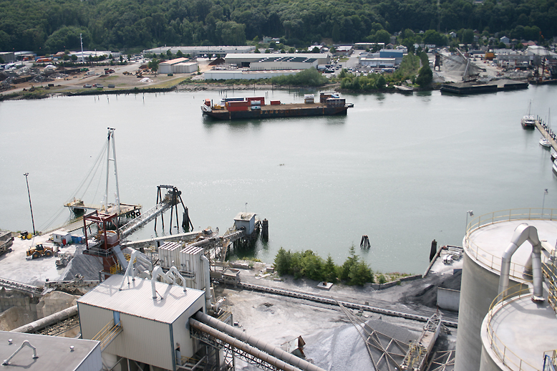
Industrial Stormwater
Introduction to the Industrial Permit
Industrial Sectors
Timber Products
Paper & Allied Products
Metal Mining
Landfills
Auto Salvage Yards
Textile Mills
Notes:
WA
http://www.ecy.wa.gov/programs/wq/stormwater/industrial/permitdocs/iswgpfinal051612.pdf
MT
http://deq.mt.gov/wqinfo/MPDES/StormwaterIndustrial.mcpx
Permit: file:///C:/Users/lcox461/Downloads/MTR000000PER.pdf
Looks like general permit:
file:///C:/Users/lcox461/Downloads/MTR000000PER%20(2).pdf

Slide 10
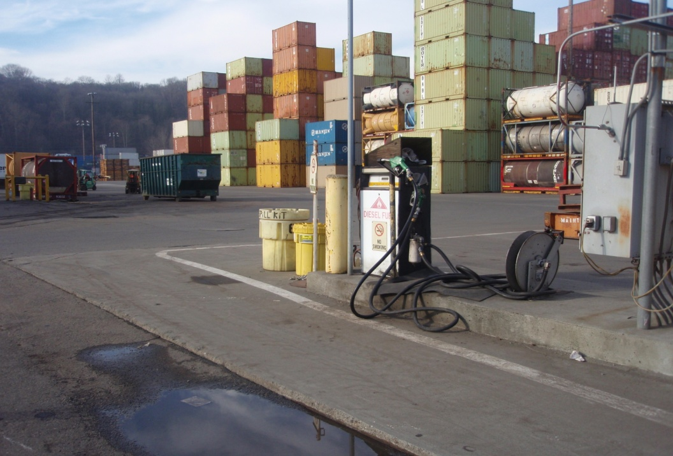
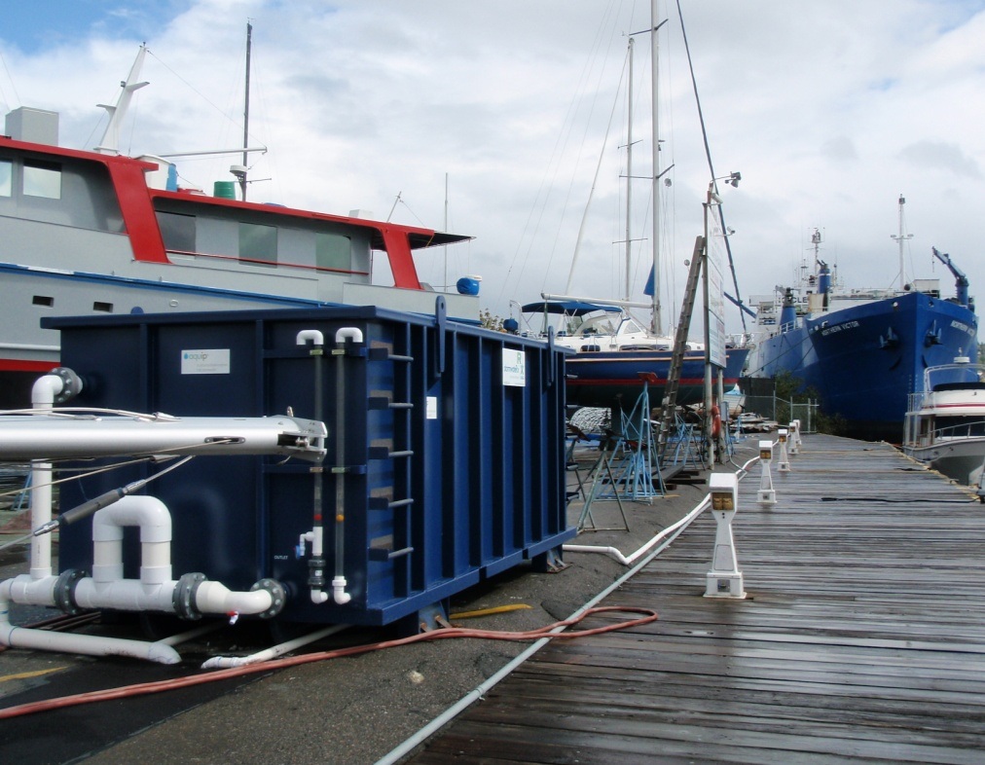
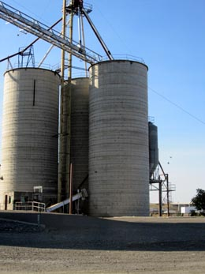
Industrial Stormwater
Introduction to the Industrial Permit
Activities regulated:
Manufacturing
Warehousing
Processing
Waste Disposal/Recycling
Transportation
Notes:
The types of activities being regulated

Slide 11
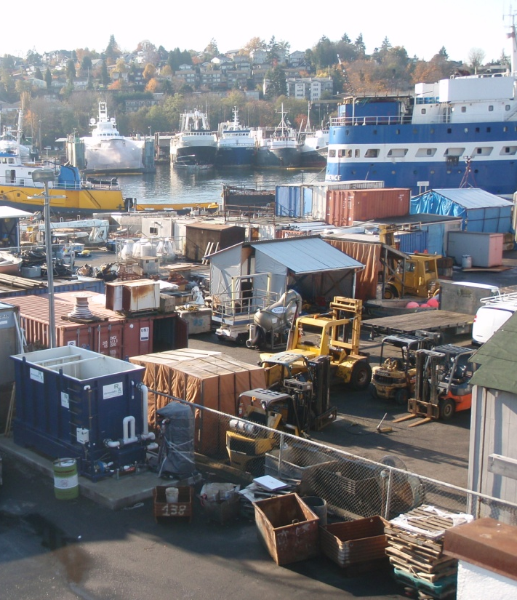
Industrial Stormwater
Introduction to the Industrial Permit
Permit Elements:
Stormwater Pollution Prevention Plan
Employ Plan & BMP’s
Sample (Benchmarks)
Corrective Actions
Reporting
Notes:
WA
http://www.ecy.wa.gov/programs/wq/stormwater/industrial/permitdocs/iswgpfinal051612.pdf
Talk about each element briefly
Sampling: Discharge monitoring reports 4/year
ID
OR
MT
http://deq.mt.gov/wqinfo/MPDES/StormwaterIndustrial.mcpx
Permit: file:///C:/Users/lcox461/Downloads/MTR000000PER.pdf

Slide 12
Industrial Stormwater Permit-WA
Washington State Parameters:
  Turbidity (Benchmark 25)
  pH (Benchmark 5-9.0)
  Oil & Grease (Benchmark No visible sheen)
  Zinc (Benchmark 117 ug/L)
  Copper (Benchmark W=14, E=32 ug/L)
  Montana Storm Water MS4 Contact: Paul Skubinna 444-3639
Jeff Killelea, CPESC Department of Ecology 360-407-6127 Jeff.killelea@ecy.wa.gov
Notes:
General permit (individual permits have more parameters)
Drives Incremental SWPPP Upgrades
Level 1 – Operational Source Control BMPs
Each time benchmark exceeded
Level 2 – Structural Source Control BMPs
Benchmark exceeded 2 Quarters/Year
Level 3 – Treatment BMP Benchmark exceeded 3 Quarters/Year
Chemical & Allied Products; Food & Kindred Products
BOD₅ 30 mg/L; Nitrogen 0.68 mg/L; Phosphorus 2.0 mg/L
Primary Metals; Metals Mining; Automobile Salvage & Scrap Recycling; Metals Fabricating
Lead 81.6 µg/L; Total Petroleum Hydrocarbons (TPH)10mg/L
Hazardous Waste TSDs
12 additional parameters (see permit)
Air Transportation
Ammonia 2.1 mg/L; BOD₅ 30 mg/L; COD 120 mg/L; Nitrate/Nitrite , as N 0.68 mg/L
Timber Products; Paper and Allied Products
COD 120 mg/L, and TSS 100 mg/L
Current permit expiring in Jan 1 2015, most permit conditions unchanged (improve clarity, streamline level 3 engineering reports, implement new federal regulations) Must use Ecology “applicable” BMP’s

Slide 13
Industrial Stormwater Permit-MT
Montana
Parameters specific to industry sectors, includes:
  Zinc (Sawmills, Rubber products Manufacturing)
  Copper (Iron/Steel Foundries, Scrap Recycling)
Notes:
Another example is the Montana permit. Patterned after EPA’s, organized by industrial sectors (which match SI code and match your benchmark monitoring)
Permit Types
NamePhone Number
(406)Storm Water Construction Janie Petaja 444-5349
Storm Water Industrial Matthew Kent 444-2856
Storm Water MS4 Paul Skubinna 444-3639
Parameters specific to industry sectors, includes:

Slide 14
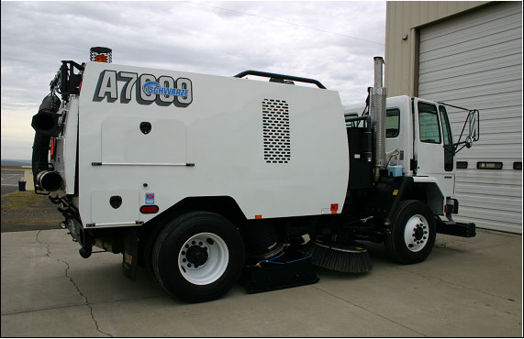
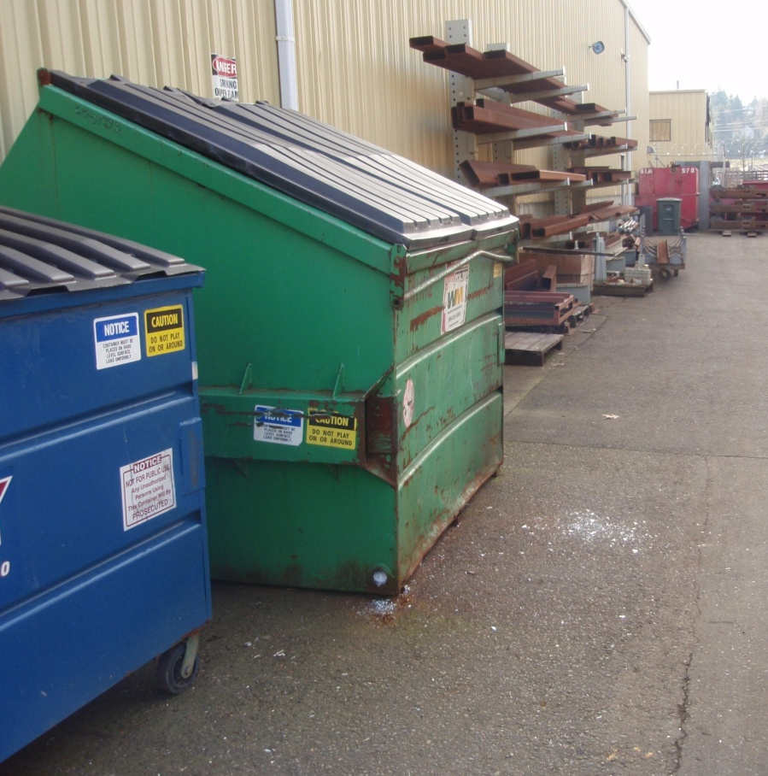
Sweeping, Covering Dumpsters
Industrial Permit BMP’s
Notes:
Level 1 Operational source Control

Slide 15
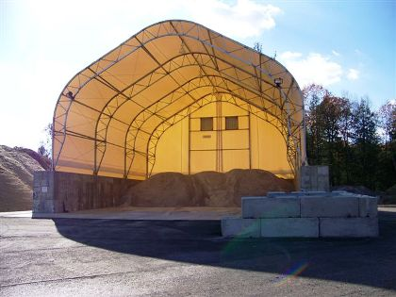
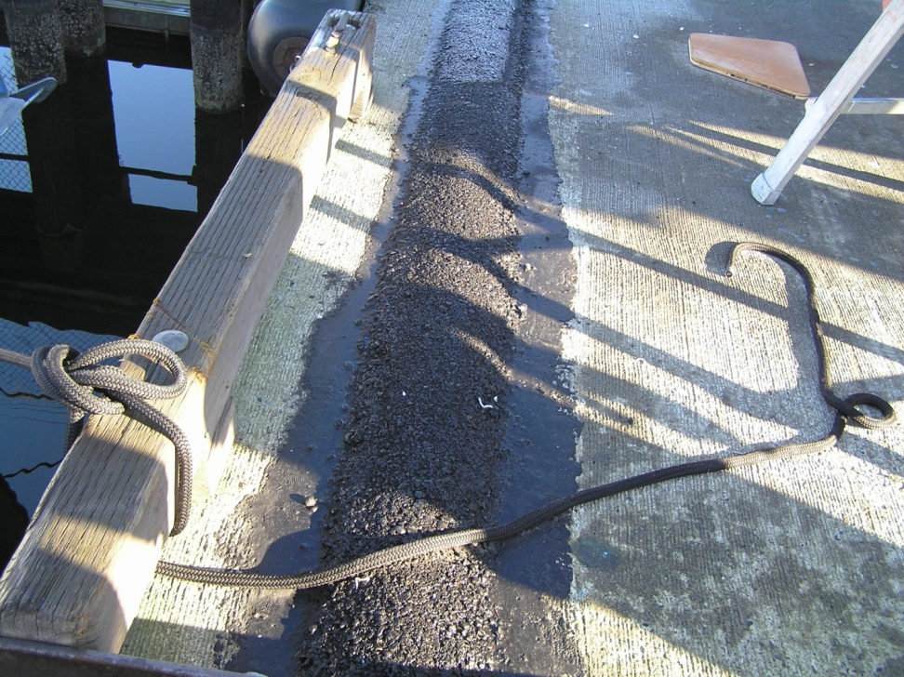
Redirect runoff, install cover
Industrial Stormwater Permit-BMP’s
Notes:
Level 2 corrective action-Structural

Slide 16
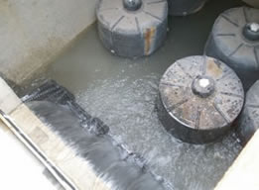
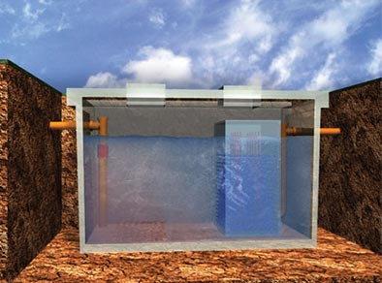
Industrial Stormwater Permit-BMP’s
Oil Water Separator, Media Filter
Notes:
Treatment BMP’s level 3

Slide 17
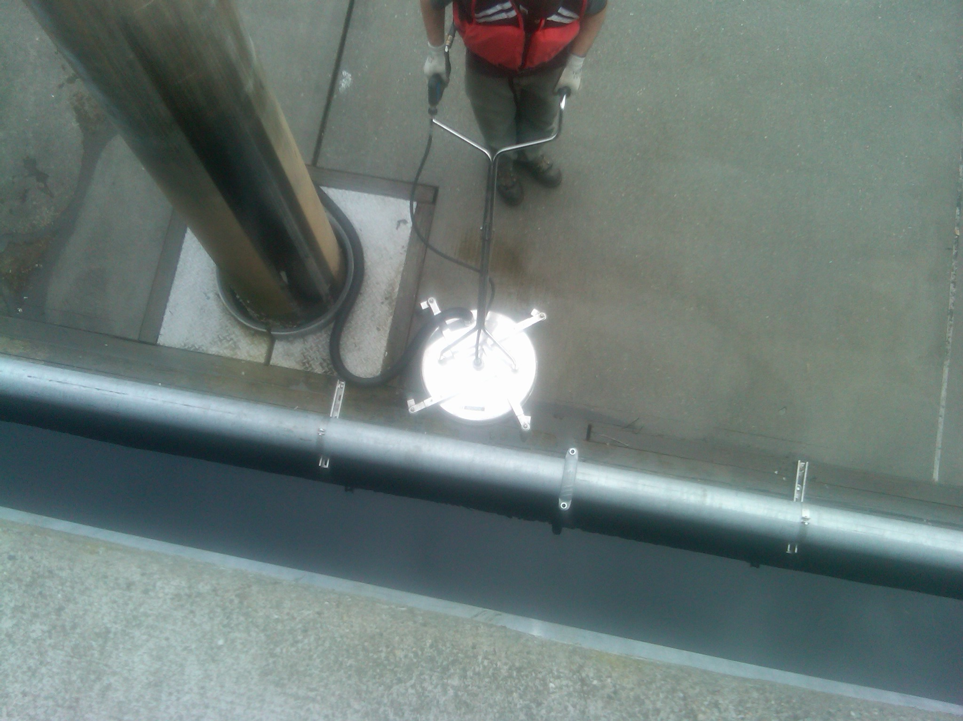
Industrial Stormwater Permit-BMP’s
Innovative Source Control
Notes:
Treatment BMP’s level 3
Port of Seattle
Wet vacuum scrubber attached to PowerWasher – connected to vactor truck
Scott Silcox - Compliance Supervisor - Marine Maintenance

Slide 18
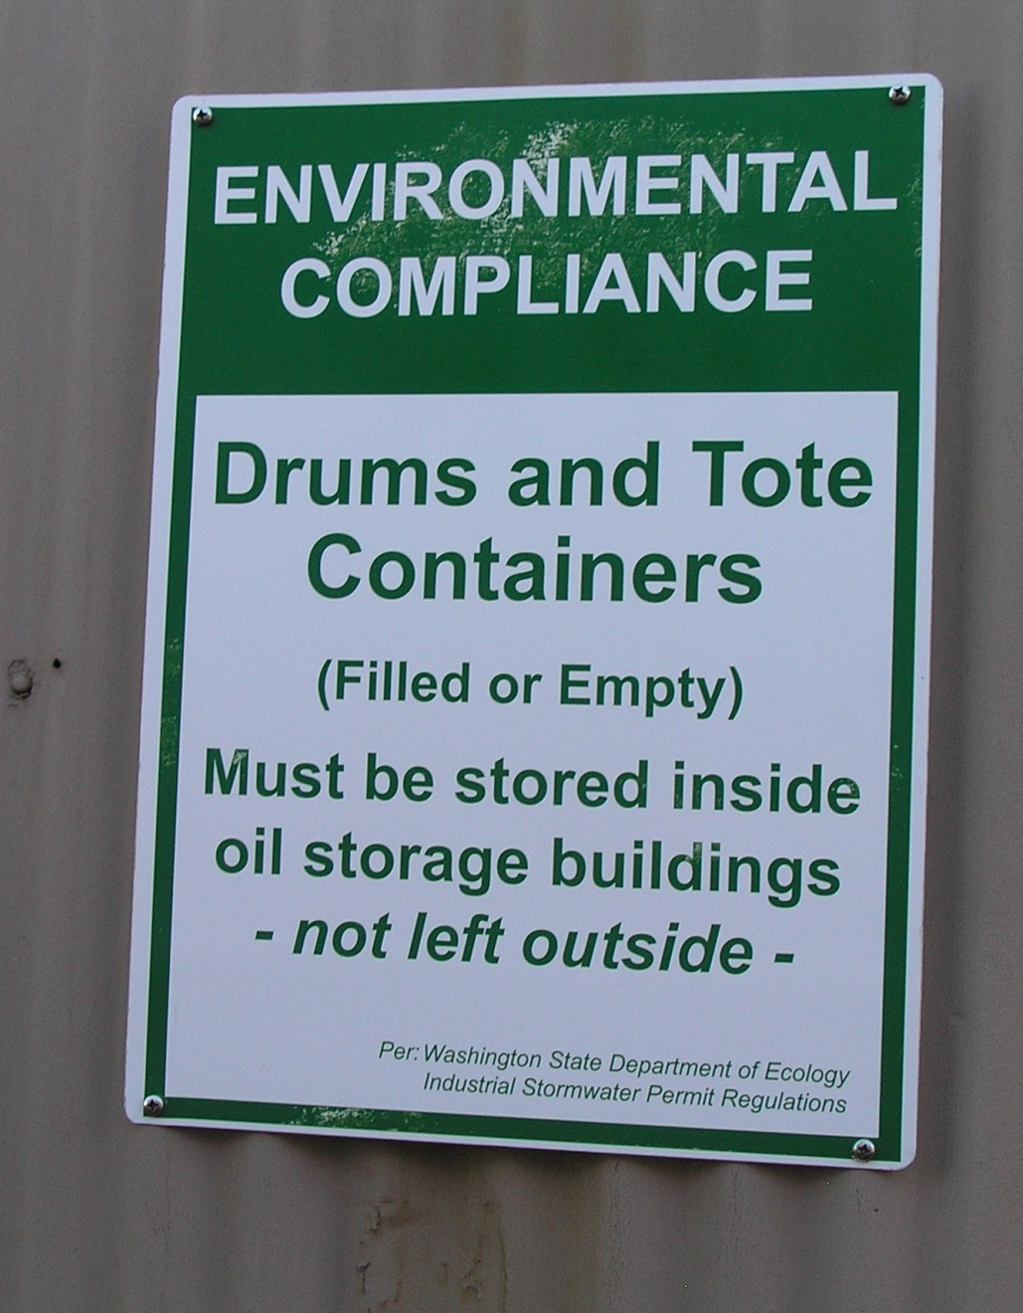
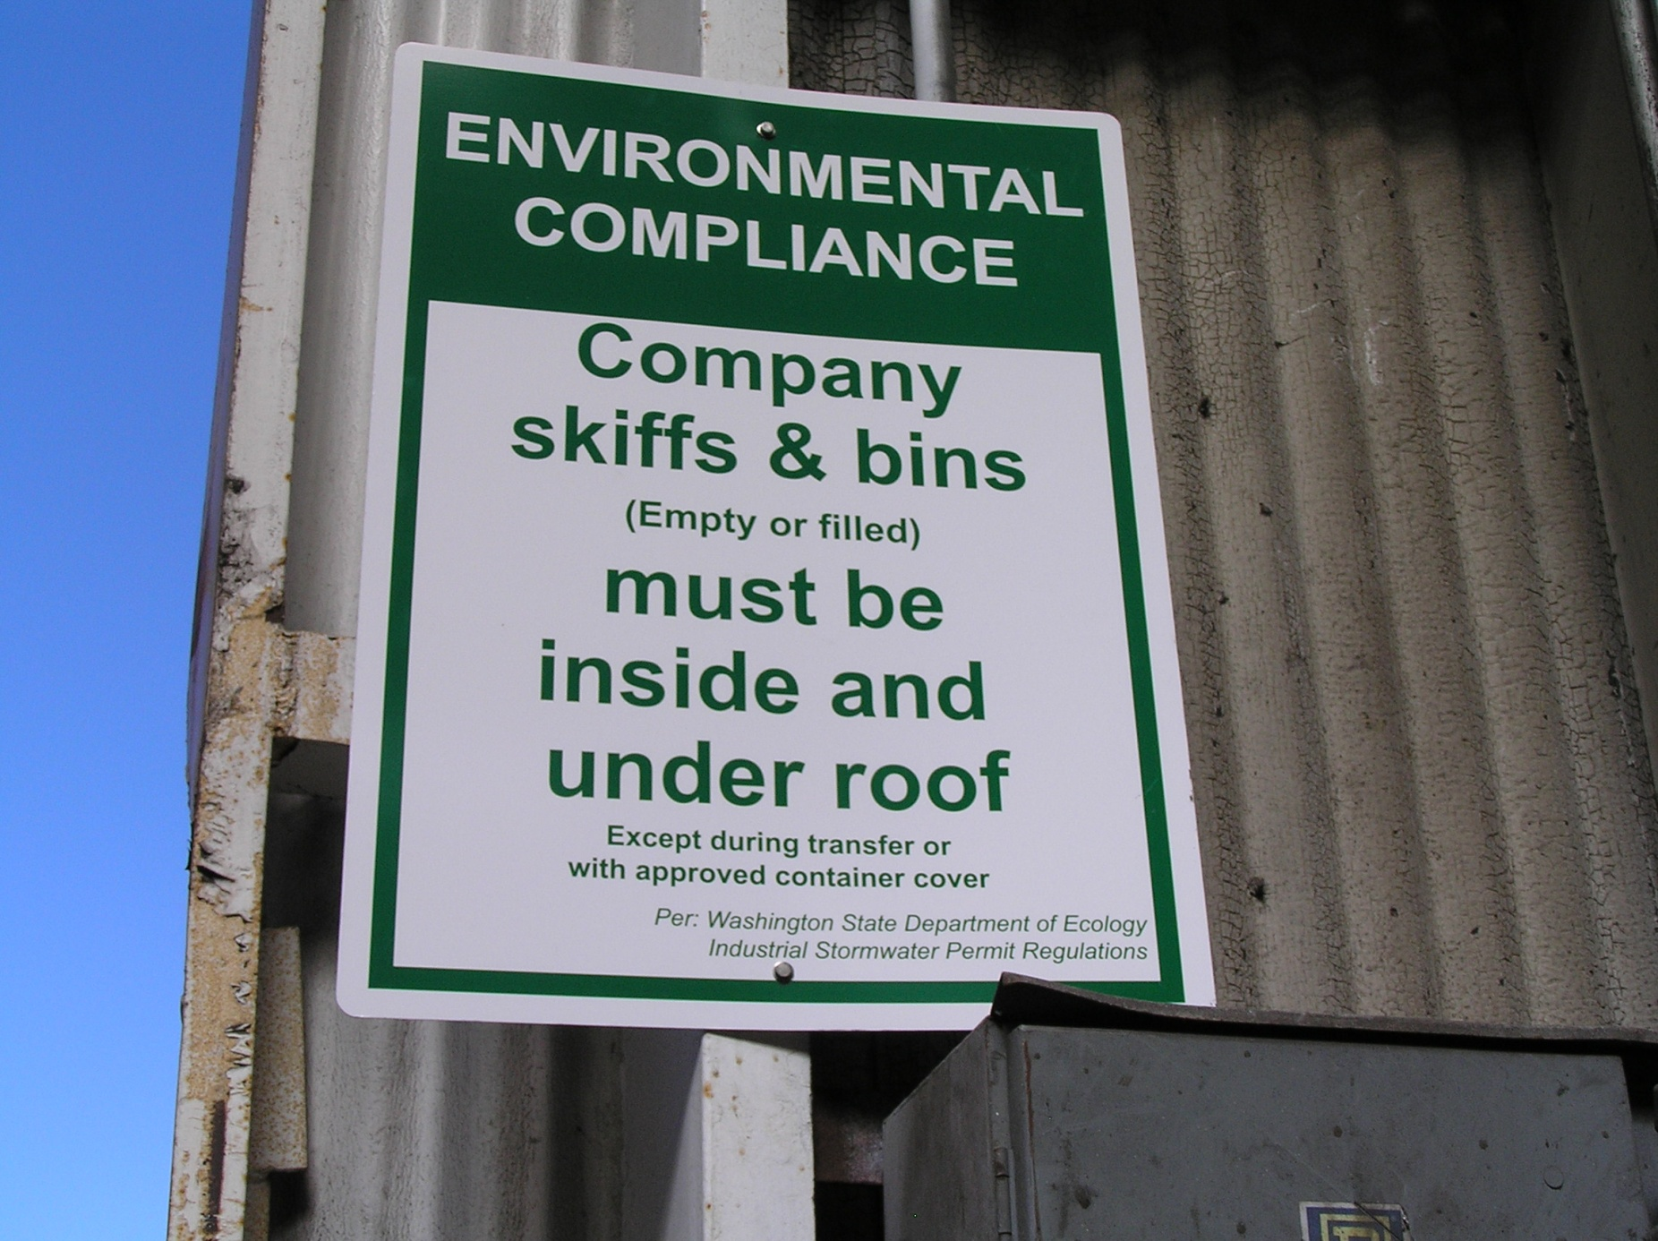
Industrial Stormwater Permit-BMP’s
Educational/informational

Slide 19
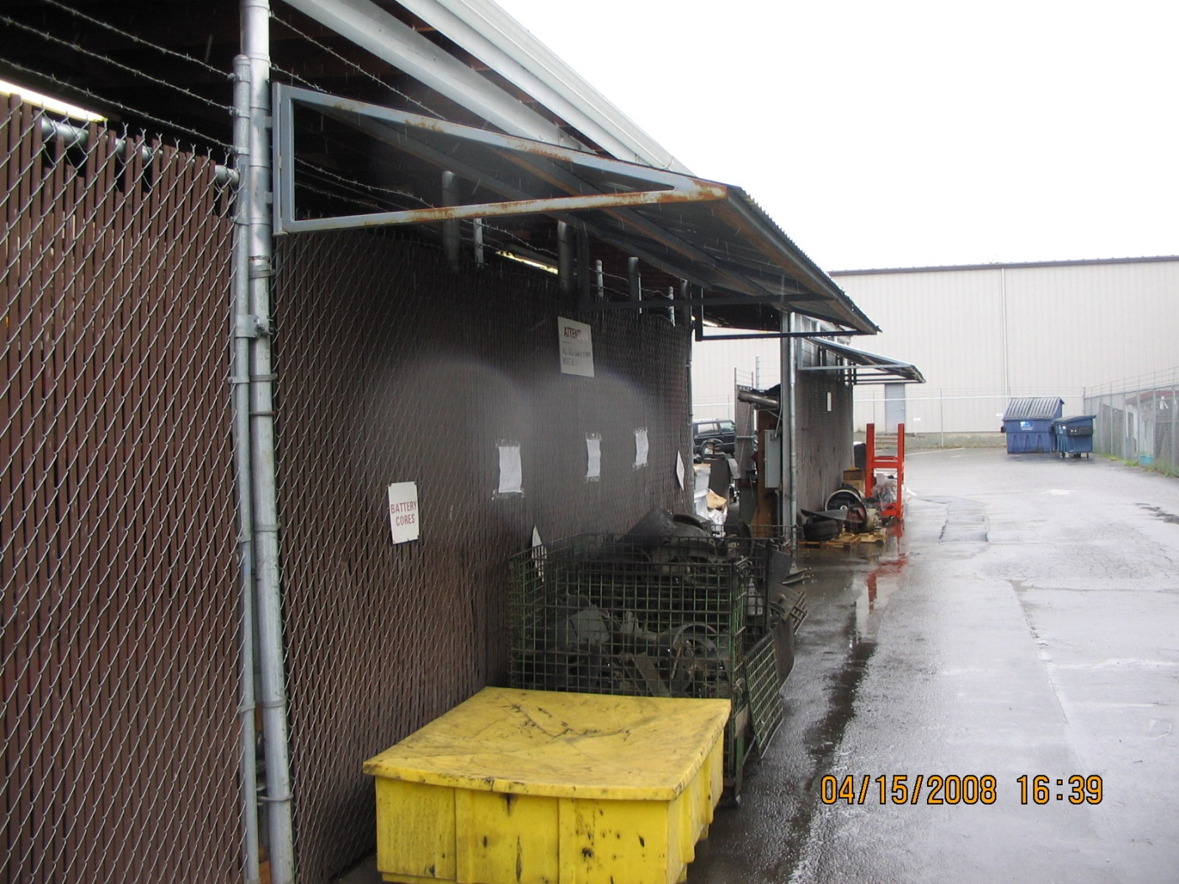
Industrial Stormwater Permit-BMP’s
Structural BMP’s (cover)
Notes:
Structural Source Control BMPs involve physical structures to prevent stormwater contamination

Slide 20



Industrial Stormwater Permit-BMP’s
Structural BMP’s
Notes:
If galvanized roofing is source of zinc, consider painting/re-sealing. Make sure paint is zinc free! Ames Snow Seal

Slide 21
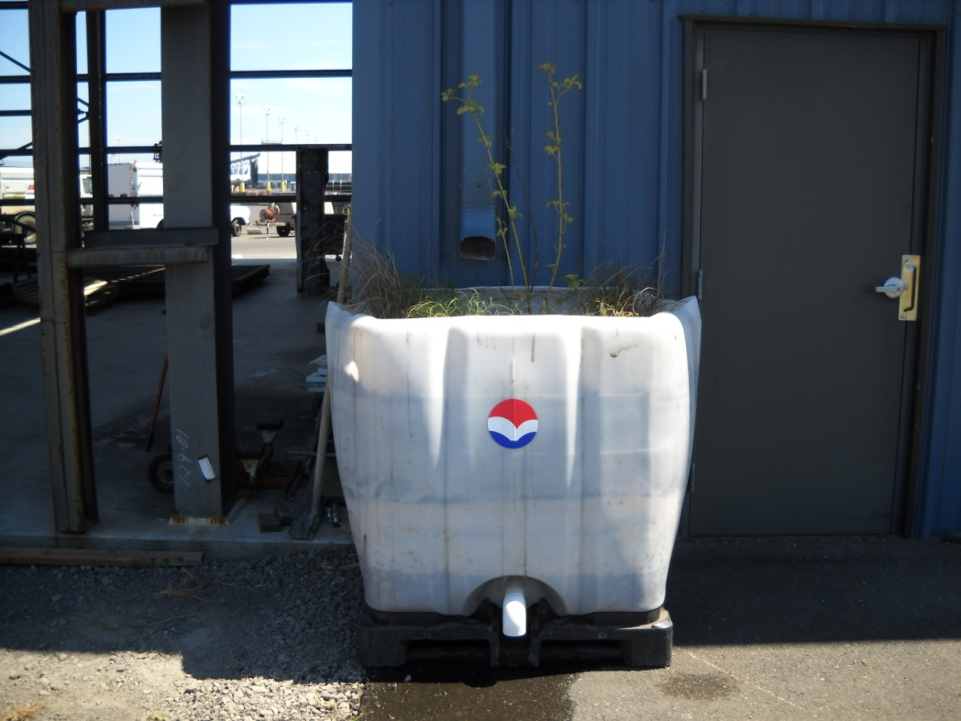
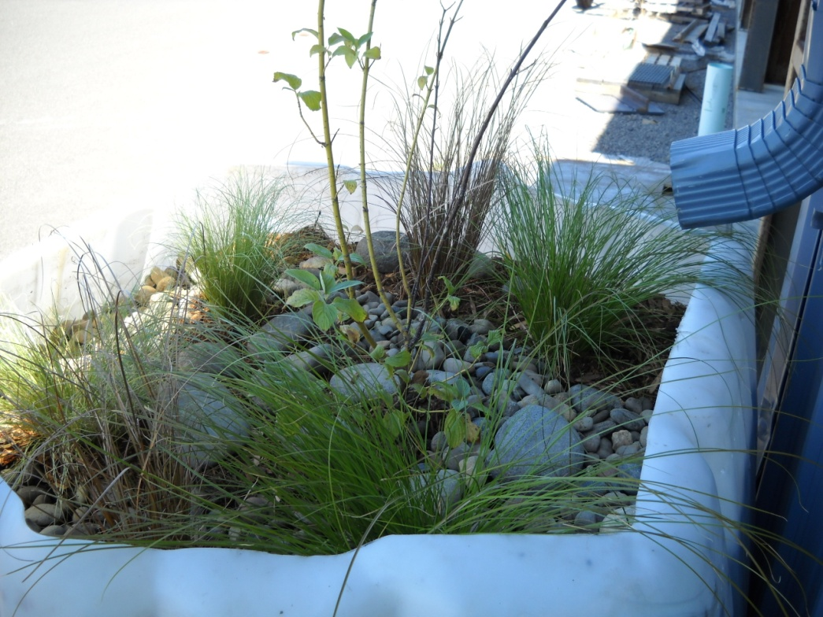
Industrial Stormwater Permit-BMP’s
Treatment BMP’s
Roof Downspout Biofiltration
Amended soil, plantings, sub-drains
90-98% reduction in total and dissolved metals
Notes:
Port plans to continue sampling the prototype to establish a maintenance routine and start building more for other areas around the port. The total cost to build the prototype was approximately $250.00; only maintenance on the system is replacing the top 3" bark mulch layer on the surface.

Slide 22
Industrial Stormwater Permit-BMP’s
Treatment BMP’s
Roof Downspout Biofiltration
Amended soil, plantings, sub-drains
90-98% reduction in total and dissolved metals
Notes:
Port plans to continue sampling the prototype to establish a maintenance routine and start building more for other areas around the port. The total cost to build the prototype was approximately $250.00; only maintenance on the system is replacing the top 3" bark mulch layer on the surface.

Slide 23
The Construction Stormwater permit
Notes:
Stormwater runoff from construction activities can have a significant impact on water quality. As stormwater flows over a construction site, it can pick up pollutants like sediment, debris, and chemicals and transport these to a nearby storm sewer system or directly to a river, lake, or coastal water. Polluted stormwater runoff can harm or kill fish and other wildlife. Sedimentation can destroy aquatic habitat, and high volumes of runoff can cause stream bank erosion.

Slide 24
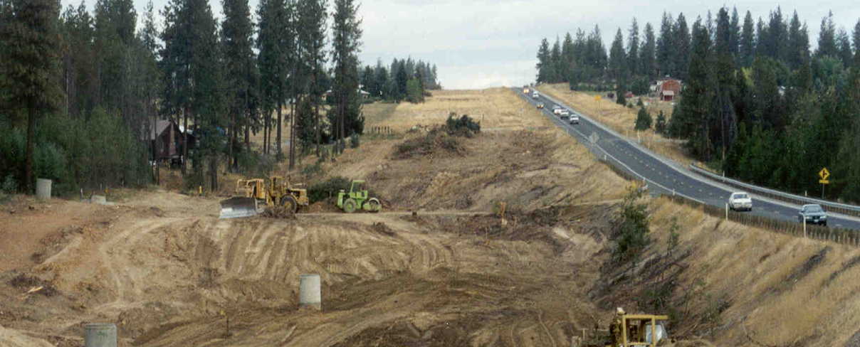
Industrial Stormwater
Introduction to the Construction Permit
Construction Projects that Disturb soil & discharge
Private-homes, buildings
Public-roads, bridges
Notes:
The NPDES stormwater program requires construction site operators engaged in clearing, grading, and excavating activities that disturb 1 acre or more, including smaller sites in a larger common plan of development or sale, to obtain coverage under an NPDES permit for their stormwater discharges.

Slide 25
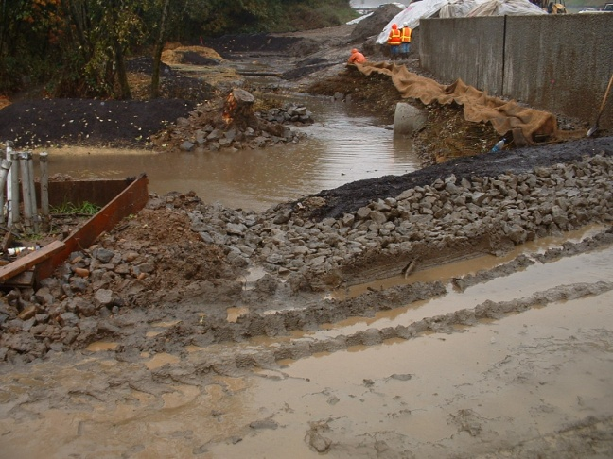
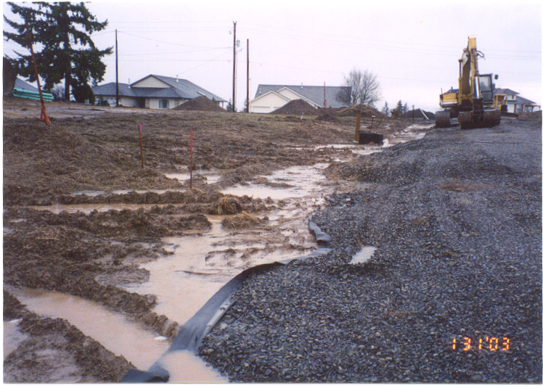
Industrial Stormwater
Introduction to the Construction Permit
Primary elements
Stormwater Pollution Prevention Plan
Install/Maintain BMP’s
Inspections
Sampling (Turbidity Benchmark 25 NTU)
Reporting
Notes:
Special benchmarks (pH?) for 303d listed waters

Slide 26
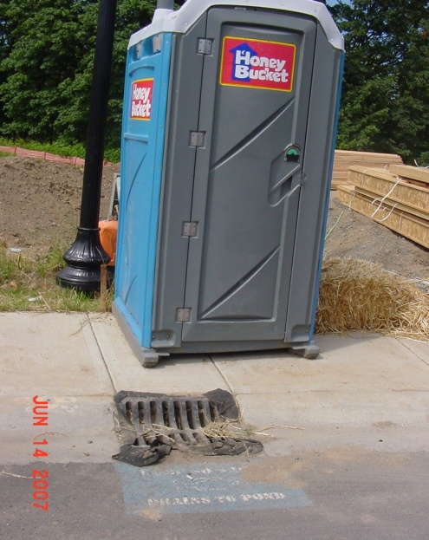
Industrial Stormwater
Introduction to the Construction Permit
Contaminated Sites
Applicant notifies and
proposes plan (capture & treat,
Infiltrate)
Allowable limits set through
Agreed Order
Notes:
Special conditions that account for contaminated sites
Special benchmarks (pH?) for 303d listed waters
Heavy metals, Hydrocarbon,
Tacoma smelter plume
Near ports

Slide 27
The Municipal Stormwater Permit
Notes:
A municipal separate storm sewer system (MS4) is a conveyance or system of conveyances (e.g., roads with drainage systems, municipal streets, catch basins, curbs, gutters, manmade channels or storm drains) owned or operated by a governmental entity that discharges to waters of the State. Sources that need to obtain an MS4 permit are classified as either "Phase I" or "Phase II". Phase I MS4s are those with populations greater than 100,000, while regulated Phase II (or "small") MS4s serve populations less than 100,000 located within Census Bureau-defined Urbanized Areas. Federal regulations also provide EPA and the states the discretion to require other MS4s outside of Urbanized Areas to apply for a permit.

Slide 28
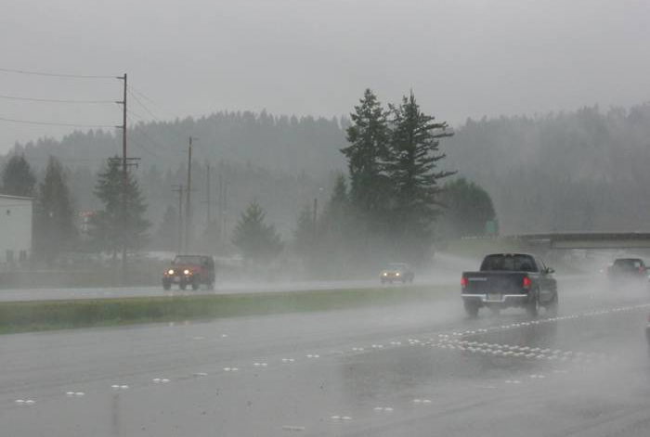
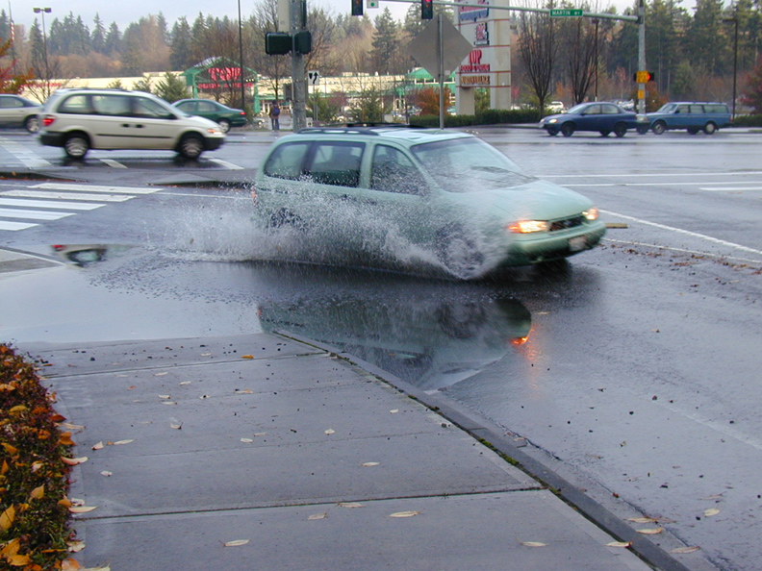
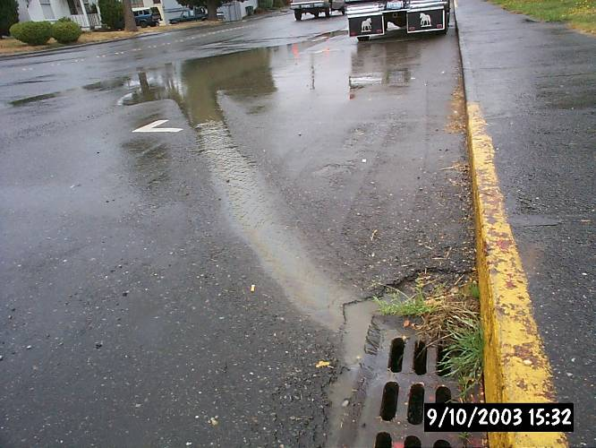
Introduction to the Stormwater Permits
Quick Facts about MS4 Permits
Regulate municipal stormwater runoff from 60 jurisdictions in the Columbia Basin
Most Permittees first covered in 2007
Notes:
Stormwater contributes to degraded WQ, drinking water through infiltration, impaired habitat.
Degraded Water Quality: Virtually all of our urban creeks, streams, and rivers are harmed by stormwater pollution. Stormwater is the leading contributor to water quality pollution of urban waterways in Washington.
Human Health: In general, untreated stormwater is unsafe. It can contain toxic metals, organic compounds, bacteria, and viruses. Untreated stormwater is not safe for people to drink and is not recommended for swimming. Polluted stormwater can lead to beach closures for swimming and shellfish harvesting. It can also trigger toxic algal blooms.
Drinking Water: In some areas of Washington, notably Spokane County, and parts of Pierce and Clark counties, gravelly soils allow rapid infiltration of stormwater. Untreated stormwater discharging to the ground could contaminate aquifers that are used for drinking water
Impaired Habitat: In Washington, urban stormwater harms and pollutes streams that provide habitat for fish and wildlife. Alterations to the watershed, such as building homes and other structures and clearing away trees and shrubs, are the leading causes for stormwater pollution. Federal agencies identified habitat loss from stormwater runoff as one of the primary obstacles to salmon recovery. (See more about regulating flows to protect habitat.)
The state of Washington, Department of Ecology, Water Quality Program, is delegated by the U.S. EPA as the state water pollution control agency, responsible for implementing all federal and state water pollution control laws and regulations. Wastewater and stormwater discharges are regulated primarily by wastewater discharge permits, which stipulate specific limits and conditions of allowable discharge.
Over the last 25 years, the quality of rivers, lakes and bays has improved dramatically as a result of the cooperative efforts by federal, state, tribal and local governments and communities to implement the public health and pollution control programs. Today, two-thirds of the nation's surveyed waters are safe for fishing and swimming. Wetland losses are estimated at seventy to ninety thousand acres annually.

Slide 29
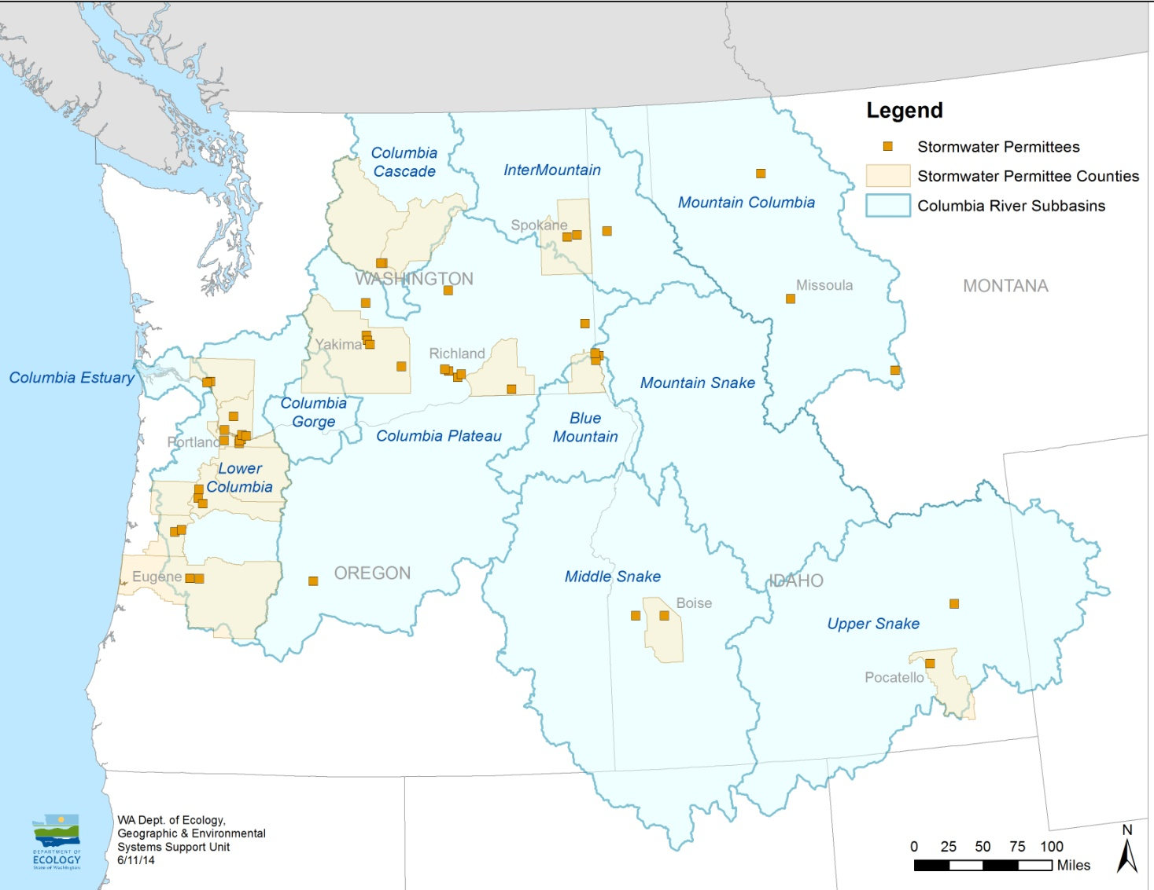
Introduction to the Municipal Permit
Stormwater = runoff during and following precipitation and snowmelt events, including surface runoff, drainage , and interflow.
Notes:
To clarify what the permits are for, they regulate discharges from municipal separate storm sewers, or MS4s to waters of Washington State.
27 entities and 19 permits in Idaho

Slide 30
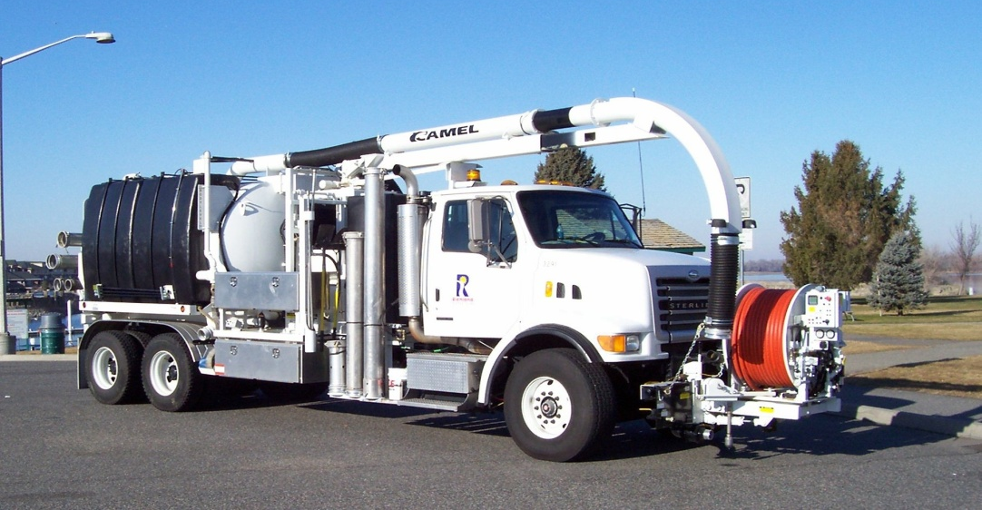
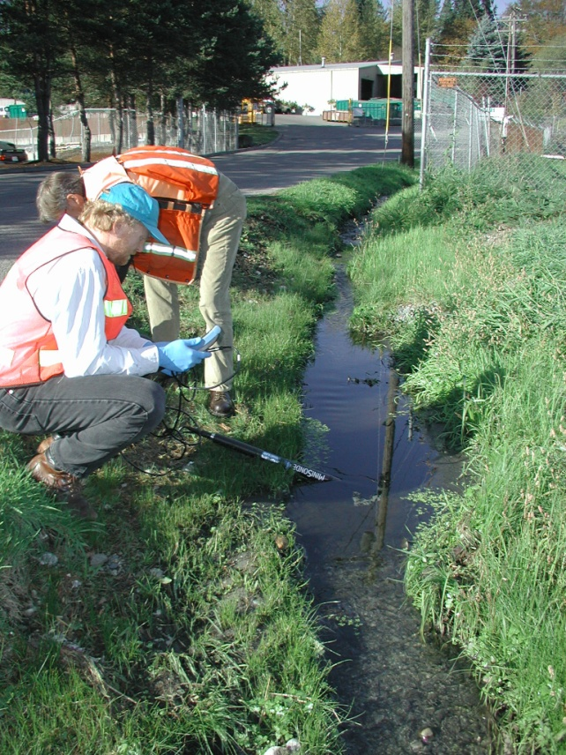
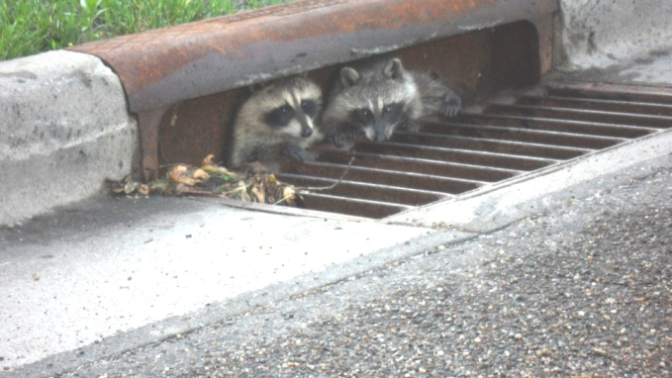
Stormwater Management Program Components
Introduction to the Municipal Permit
Education and Outreach
Mapping
Public Involvement
Operation and Maintenance
TMDL-related activities
Illicit Discharge Detection & Elimination, Source Control*
Runoff Controls for New and Re-development
Monitoring and Assessment
Notes:
The permit is a programmatic-type permit where there aren’t effluent limits; benchmarks aren’t developed.
Mapping: Helps Permittees know where stormwater facilities are located and how they are connected. This can make maintaining these facilities easier and can help when trying to track down spills or illicit connections.
Public Education & Outreach: Permittees teach their communities about the problems associated with stormwater pollution and what they can do about it.
IDDE: Lists what is and is not allowed to be discharged to the MS4. Requires local government to respond and eliminate illicit discharges and illegal connections to stormwater systems. Some explicit or implicit spill response.

Slide 31
Municipal Stormwater-IDDE
IDDE
(Illicit Discharge Detection & Elimination)
Systematically screen MS4 for illicit connections and discharges.
Flexible approaches allowed to meet target of % MS4 screened.
Notes:
One example of a permit element is the IDDE program where permittees find and eliminate sources of pollution (you are going to hear more details about that next)

Slide 32
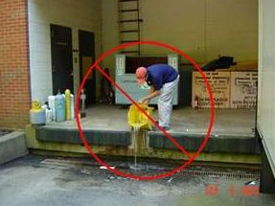

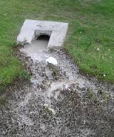
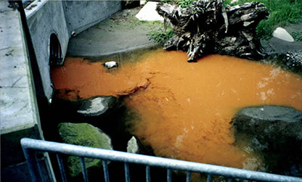
Municipal Stormwater-IDDE
Staff training
Map System
Screen
Detect & Identify
Eliminate
Report
Notes:
Requires a proactive approach to screening for illicit discharges, including but not limited to illicit connections. Used to specify “dry weather outfall” screening, but changes in both the Phase I and Phase II permits (effective 2013 WWA) allow more flexibility in field screening methods. New IDDE Field Screening Guidance Manual (funded by Ecology grant) provides resources for wide range of screening and source tracing methods, indicators and equipment. Business inspections and stormwater facility/catch basin maintenance inspections identified as an acceptable field screening methodology if IDDE program sufficiently integrated (i.e., training, protocols, record-keeping). Permittees must describe the methods in the annual report.
Phase I: Cities complete within incorporated area by July 31, 2018; Counties: within urban/higher density rural sub-basins by July 31, 2018
Phase II: 40% of MS4 by Dec 31,2017 [Aberdeen: 40% by July 31, 2018].
BOTH: 12% each year thereafter
Ecology leaves it to the permittee to determine how to measure the 40%, whether by 40% of the linear feet of the system, or 40% of the geographic area

Slide 33
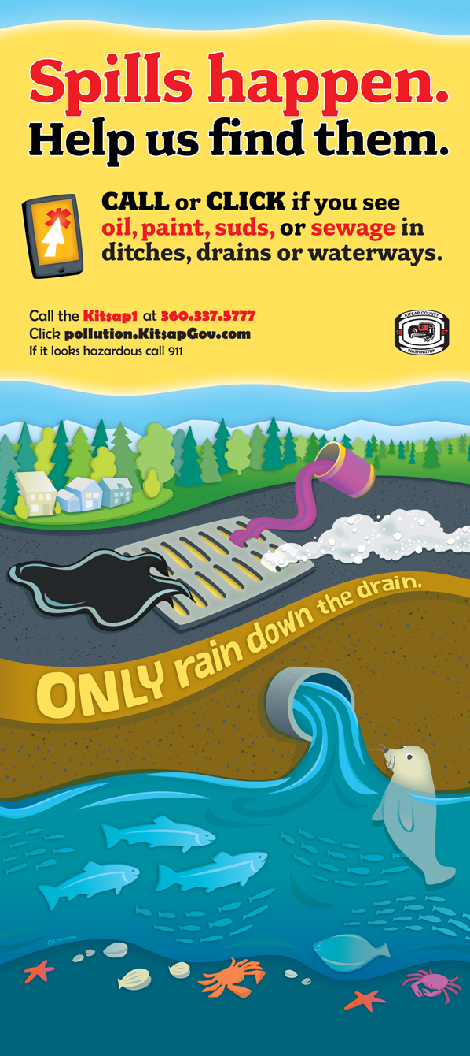
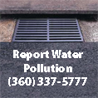
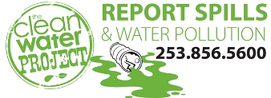
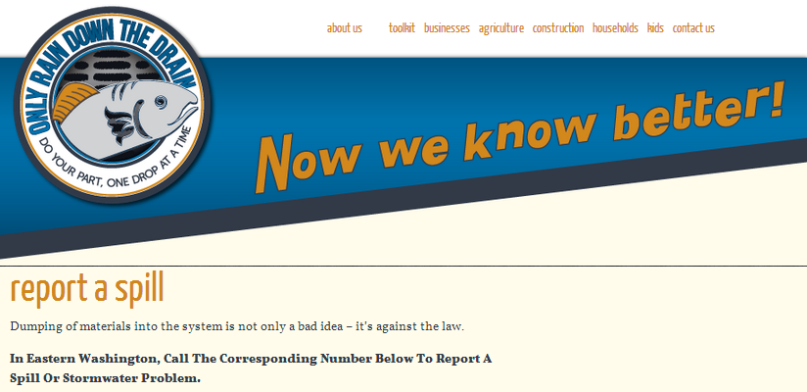
Municipal Stormwater-IDDE
Local Hotlines
Notes:
All required to have hotline

Slide 34
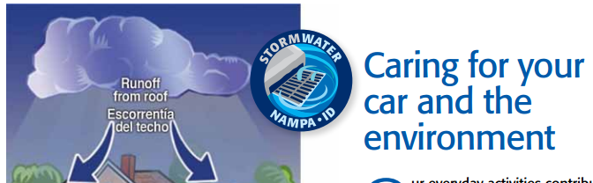
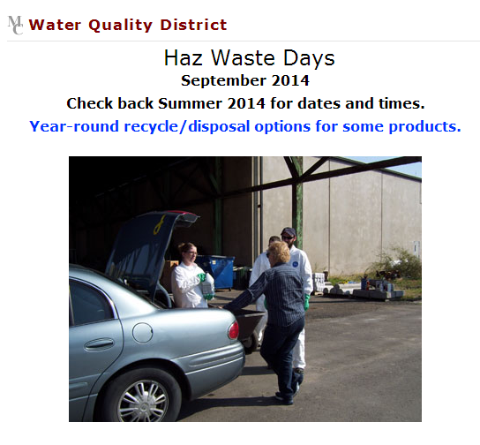
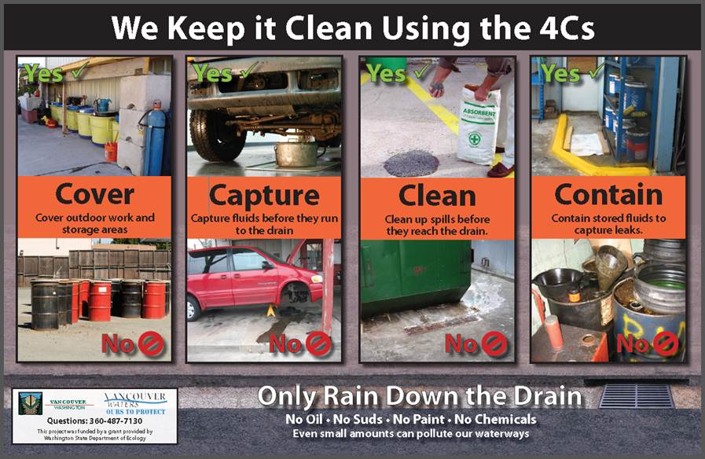
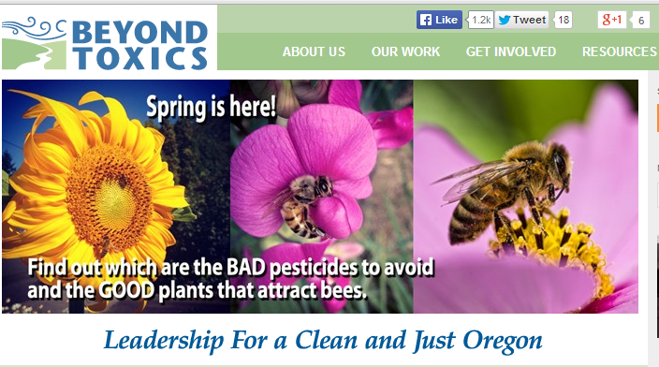

Municipal Stormwater-Public Education
Public Education

Slide 35
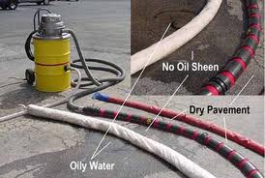
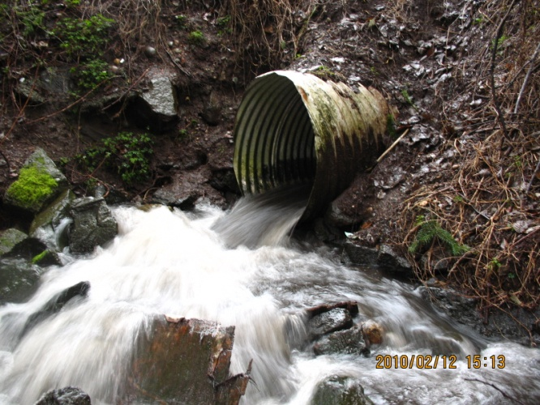
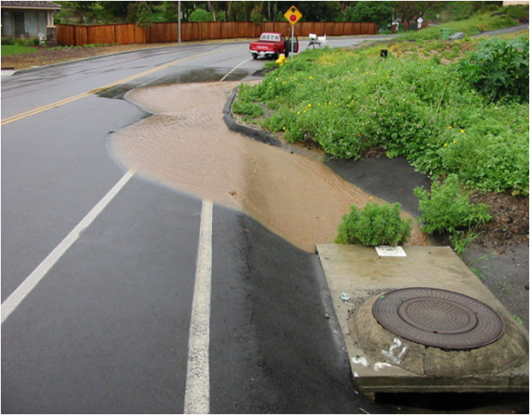
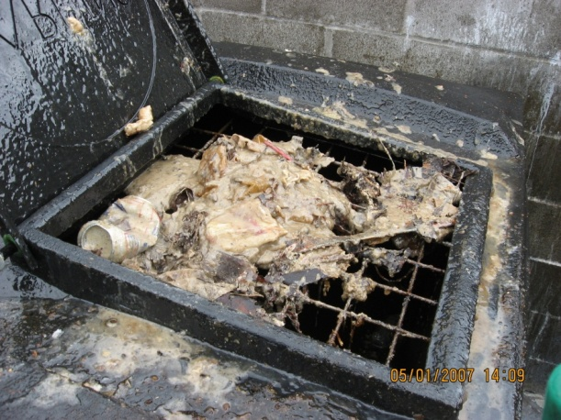
Municipal Stormwater- Local Source Control
LSC
Education & Outreach
Storm System Maps
Detect/ Identify Illicit Discharges
Report discharges that pose a threat
Eliminate Illicit Discharges
Notes:
What is: Source control tackles potential causes of pollution at their source. These potential sources exist inside and outside buildings.
By addressing possible causes of pollution at the source of use, technical assistance to small businesses is making a difference. This approach is expected to save businesses money while protecting our state’s water quality. Learn more about Source Control.
There are many pollution-prevention techniques and best management practices (BMPs) that serve to prevent, control, and treat contaminants before they enter the environment. These practices have been shown to save businesses money through conservation of resources, improved worker safety, reduction and avoidance of risk, possible decrease in insurance premiums, and an increase in business efficiencies. Because of these benefits, the business can realize a boost in its ability to be more competitive.
Local Source Control (LSC) is “boots on the ground” small business assistance delivered by local jurisdictions.
LSC specialists work to find and fix problems related to improperly stored and disposed chemicals and toxic wastes, including potential spills of toxic chemicals, illicit wastewater discharges and connections, and improperly maintained oil/water separators and storm drains.
To date, LSC has been limited to the Puget Sound and Spokane River basins. Ecology is seeking authority to add new capacity for new Local Source Control specialists in the Columbia River basin and to fund source tracing and watershed evaluation studies to target site visits to where they are needed most.
Since inception in 2008, the LSC specialists have completed over 16,000 site visits.
In FY13-15, LSC specialists visited businesses in 96 different industry sectors, found problems at 75% of the small businesses visited, and helped resolve approximately 4,400 environmental threats.
LSC specialists conduct over 6,000 site visits to small businesses each biennium with ELSA and National Estuary Program federal funds (Puget Sound Region).
Through voluntary business technical assistance visits, the LSC program provides a one-stop approach for small businesses and regulators to fix water, waste, and spill related problems.

Slide 36
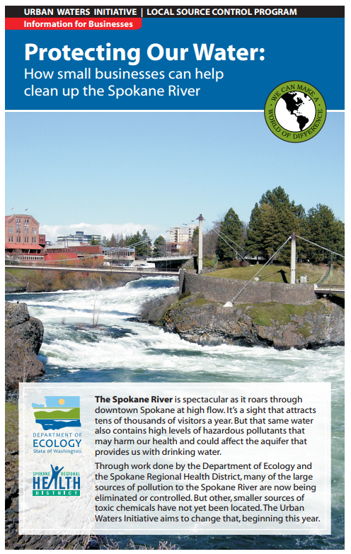
Municipal Stormwater-Local Source Control
Large Cities (Phase I)
Puget Sound
Spokane
Others?
http://www.srhd.org/documents/Enviro_Public_Health/UrbanWaters-business.pdf
Notes:
Fits in with permit BUT the Local Source Control (LSC) Partnership provides on-site technical assistance to small businesses in order to prevent polluted runoff to Puget Sound and the Spokane River Basin only.
The LSC Partnership uses a unique team approach, working with local jurisdictions to protect urban waters in Washington State through source control. Currently, there are 36 LSC Specialists in 22 jurisdictions helping to solve pollution problems and protect urban water quality at the local level.

Slide 37
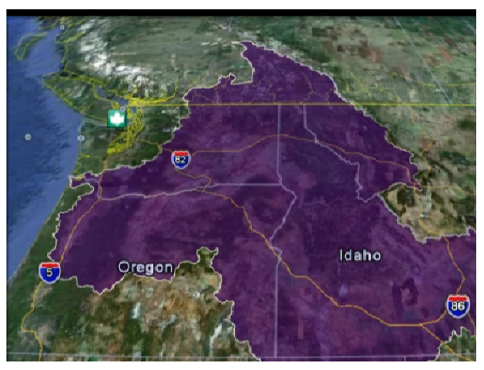
Municipal Stormwater-Local Source Control
Municipal Stormwater- Local Source Control
Expanding LSC:
Ecology supports expansion
Clark County/TriCities
Columbia River:
Write guidance for permit writers
Narrow focus of IDDE /Source Control to smaller number toxics
LSC
LSC
LSC
LSC
LSC
LSC
LSC
LSC
LSC
LSC
LSC
LSC
LSC
LSC
LSC
Notes:
Future: Expanding LSC statewide
Approximately 95% of the site visits are conducted in the Puget Sound region under the existing legislative mandate to focus on reducing toxics and polluted stormwater impacts. There is one authorized local source control partner for the Spokane River urban watershed.
Ecology would like to expand the program to support expansion of the program to other local governments outside the Puget Sound region and Spokane River watershed.
New funding could be used to hire local source control specialists to do the field work in new areas of the state that have expressed interest and demonstrate a high environmental need, such as Clark County and the TriCities.
Columbia River
Write Recommendation for permittees/permit writers: write specific minimum measures for permit language and Stormwater Management Plans Pub Ed/IDDE/Source Control programs, etc.
Min Measure:
All IDDE programs focus on elimination of _______these top five Toxics/heavy metals
Conduct inspections at 25% of all known car maintenance shops, etc
Details of how LSC works in WA:
Local source control partners enter into performance-based interagency agreements with Ecology for the site visits performed.
Ecology has performance criteria for the partners that outline key expectations, site visit commitments, data reporting, and staff training requirements.
Any local government would be eligible for the program and is required to submit a proposal of the number of site visits to be conducted to address local issues. Ecology staff evaluates the merits of the proposal to ensure that work is in alignment with the agency’s priorities.

Slide 38

CONTACT
Lisa R. Cox
Municipal Stormwater Permit Manager
Department of Ecology
2108 Grand Blvd. Vancouver, WA
(360) 798-2906
Lisa.cox@ecy.wa.gov
Notes:
Everything needs a place to live

Slide 39
Stormwater & You
Only rain down the drain
Scoop poop
Maintain septic systems
Use natural garden care
Fix car leaks
Install & maintain a rain garden
Report problems – call a hotline

