Slide 1

Willamette Toxics Reduction Partnership
Getting Input on an Alternative Format for Our Partnership Report
January 31, 2018
CRITFC Celilo Room
Alex Liverman | Oregon Department of Environmental Quality

Slide 2
Right Format for Right Purpose?
Instead of a report:
Interim recommendations or bulletins
Action desired over polished information
Education on personal actions associated with toxics important to include
Caution that DEQ program info explained can give the impression that issues are addressed
Maps of fishable/swimmable areas
Notes:
Here’s what we heard in the closing moments of our 1st Steering Committee Meeting on August 24, 2017. Does that sound right? Still resonate?
So we went looking at alternative reporting formats: Brochures, websites, periodic bulletins, and thought of other projects that were well served by Story Maps.

Slide 3
Right Format for Right Purpose?
Story Map examples
DEQ/EPA Willamette Warehouse Fire Response
https://epa.maps.arcgis.com/apps/MapSeries/index.html?appid=6ed5c0183f4249bd8098d859f1950222
NW Power & Conservation Council’s PAHs: Locations in the Columbia River Basin Where the Toxics Could be Affecting Fish & Wildlife
http://nwcouncil.maps.arcgis.com/apps/MapJournal/index.html?appid=99e5965fe1ac4dd38001e784d7c6aac6
Mississippi Watershed Management Organization
https://www.barr.com/maps/mwmostorymap/index.html
ESRI ArcGIS Gallery: http://storymaps.arcgis.com/en/gallery
Notes:
Tabs for navigating different content; maps of affected areas; photos of actions hard to describe
Scrolling storyline format; data intensive map; education & personal action section
Raindrop falling on your lawn and its path to the river feature

Slide 4
Right Format for Right Purpose?
Story Map Advantages:
Not a report
Potentially faster to produce
Adaptable and updatable as information is developed
Interactive and visually stimulating
Geographical information capabilities
Collaborative
Multi-layered
Notes:
Not static
Action sooner
Can start small and add complexity as data compilation and evaluation progresses; stays current
Education is more effective and personalizable
Maps are the crux of the format
Potentially easier to work together on than group writing and editing
Organizable by topic and navigation styles and able to link to more in depth technical information to satisfy multiple audiences

Slide 5
Right Format for Right Purpose?
Communicating Partnership progress on meeting goals:
Compile existing data and id gaps
Evaluate existing toxics reduction efforts
Look for additional upriver sources to PH
Identify new contaminant reduction strategies
Notes:
Time Frame initially limited to about 1 ½ years
Actions prior to/in tandem with PH remedy implementation
Short term vs. Long term?

Slide 6
Right Format for Right Purpose?
Secondary aims:
Educate the public
Recommend actions (community & personal)
Leverage limited resources
Data and information sharing
Others?
Notes:
Caution on mission creep
Realities of constraints on funding, authority, etc.

Slide 7
Audience?
Target: Partnership Members and their constituents
federal, state & local agencies
tribal governments
community and advocacy organizations
private sector
Secondary: general public
Notes:
Agreement?

Slide 8
Content?
Modules:
Willamette Toxics Reduction Partnership
The Partners – logos & websites
Toxics
Focus contaminants
How do they get into the river?
Data on location and magnitude
Reducing Toxics
Regulatory & Voluntary programs/actions
Stakeholder Activities
Evaluation & Recommended New Strategies
Notes:
Prioritization voting

Slide 9
Main Messages?
Understanding the state of the river above Portland Harbor
What does the data say?
What actions to reduce toxics are occurring and by what groups?
What other data and actions are needed?
Education on how toxics get into the river and actions needed to stop it

Slide 10
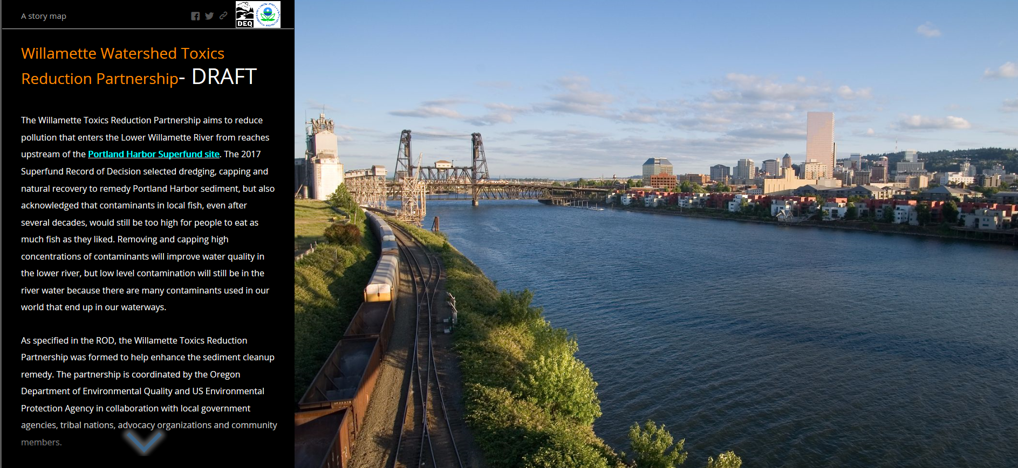
WRTP Story Map Mock Up

Slide 11
Partner Collaboration Areas
Partners module - How do you want to be presented?
Education pieces - How do contaminants get into the river?
Stakeholder Activities – What to highlight and at what level of detail? (links to other forums?)
Evaluation & Recommendation of New Strategies – Coalition forming, personal actions, etc.
Notes:
Group exercise on content generation and commitments on development/collaboration

