Slide 1

Dry Cleaner Program
Environmental recognition for dry cleaners
May 8, 2018
Oregon DEQ
Mitch Frister | Oregon Department of Environmental Quality

Slide 2
Documents can be provided upon request in an alternate format for individuals with disabilities or in a language other than English for people with limited English skills. To request a document in another format or language, call DEQ in Portland at 503-229-5696, or toll-free in Oregon at 1-800-452-4011, ext. 5696; or email deqinfo@deq.state.or.us.

Slide 3
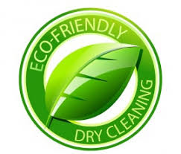
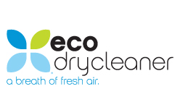




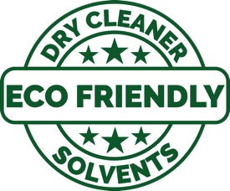


Slide 4



EcoBiz is a free, voluntary certification for automotive and landscaping businesses & public agencies in Oregon. Focus on pollution prevention, multi-media (air, water, hazardous waste).
Created by DEQ and local gov’t agencies
Mitch Frister | Oregon Department of Environmental Quality

Slide 5
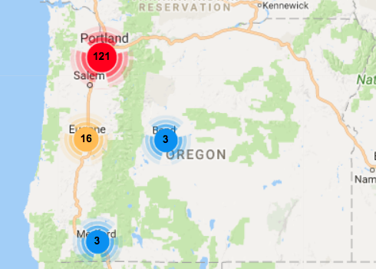
174 certified locations
98 Auto Repair & Body Shops
20 Carwashes
25 Landscapers
31 Public agency shops, parks dept.
Mitch Frister | Oregon Department of Environmental Quality

Slide 6
certified locations
98 Auto Repair & Body Shops
20 Carwashes
25 Landscapers
31 Public agency shops, parks dept.
200 Dry Cleaners in Oregon
80 PERC
120 Alternative solvent
Mitch Frister | Oregon Department of Environmental Quality

Slide 7
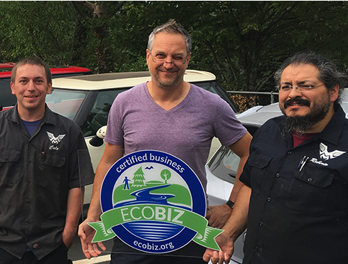
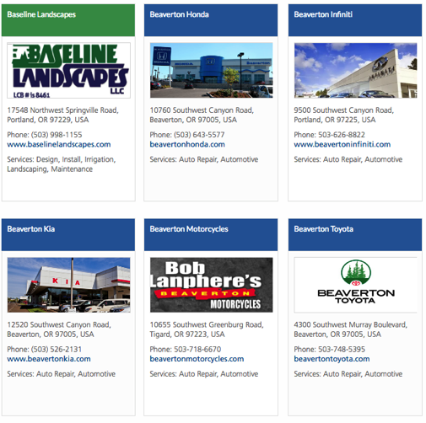
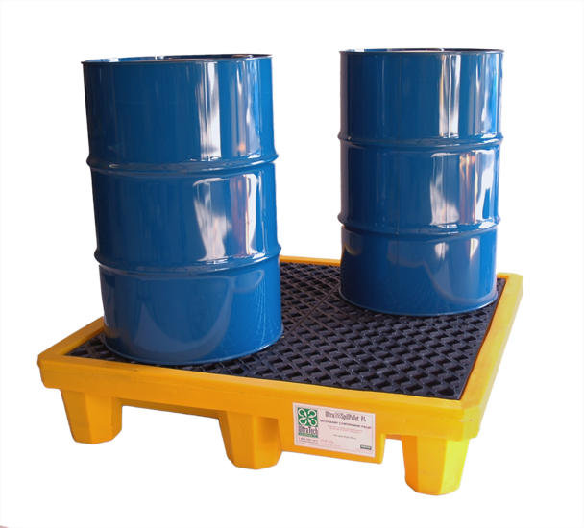
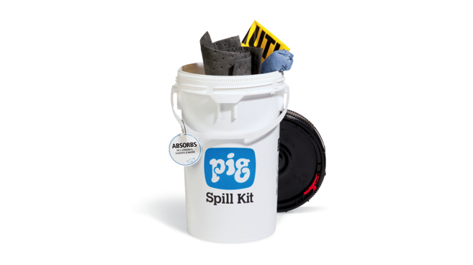
benefits
technical assistance
website listing
local advertisements
use of logo & sign
Mitch Frister | Oregon Department of Environmental Quality

Slide 8
why dry cleaners?
multi-media
consumer facing
identify as “green”
Program goals
reduce hazardous waste
reward businesses going “above and beyond”
add substance to the “GREEN” label
provide better guidance to dry cleaners transitioning from perc
Mitch Frister | Oregon Department of Environmental Quality
Notes:
We entered into this process with an open mind, but knowing that the challenges were real.

Slide 9
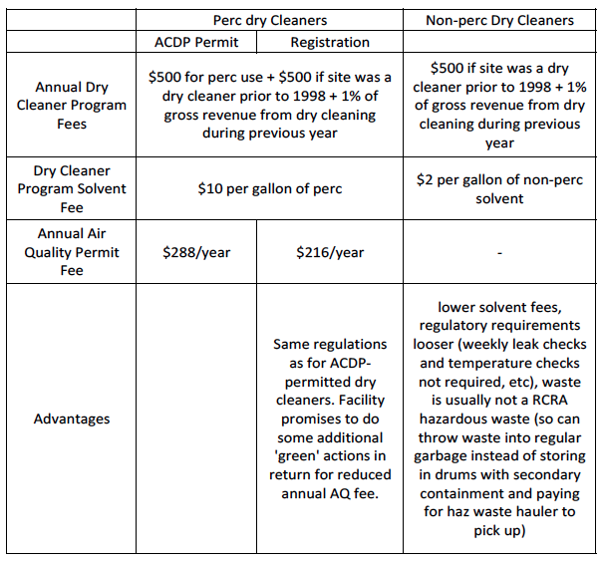
DEQ fees
*
Mitch Frister | Oregon Department of Environmental Quality

Slide 10
November 2016
EPA Source Reduction Grant
met with DEQ dry cleaner program
sent a letter to all dry cleaners in Oregon
convened group to develop the standards
  Note: We need support from businesses to create a new certification.
Mitch Frister | Oregon Department of Environmental Quality

Slide 11
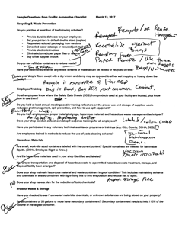
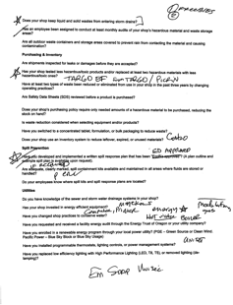
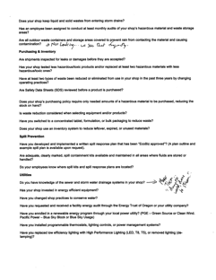
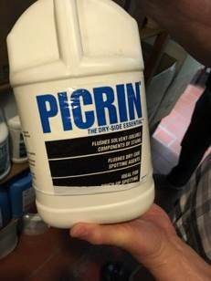
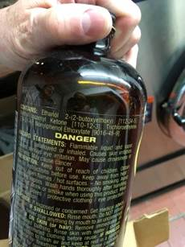
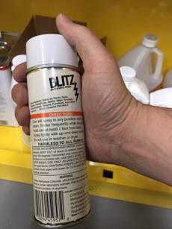
returning to the story
Oregon DEQ, City of Gresham, Clean Water Services, City of Portland, Washington County, PPRC, Six (6) commercial dry cleaners.
Meet
Create Standards
Visit
& repeat
APRIL 2017
Mitch Frister | Oregon Department of Environmental Quality
Notes:
Good stuff happened

Slide 12
Next Steps
Work internally to finalize certification
Update DEQ website and outreach materials.
Create outreach strategy with state and local partners.
Begin certifications this summer.
Mitch Frister | Oregon Department of Environmental Quality

Slide 13
Questions / comments
Mitch Frister
Cleanup site information coordinator
Oregon DEQ
frister.mitch@deq.state.or.us
503 229-6783
Mitch Frister | Oregon Department of Environmental Quality

