Slide 1

DEQ Integrated Toxics Reduction Strategy
Status of Current Strategy (2012) and 2018 Update
May 8th, 2018
Lower Willamette Toxics Reduction Partnership
Kevin Masterson | Oregon Department of Environmental Quality

Slide 2


Toxics Reduction Strategy Background
Complement Core Program Work
Integrated Strategic Approach
Partnerships
Source Reduction
2012 Strategy Actions
Notes:
In 2009 the DEQ Leadership Team determined that the agency should be looking at toxic pollutants in a more comprehensive and strategic way, which led to the development of the agency’s Toxics Reduction Strategy that was finalized in 2012. The purpose of this strategy was to complement and support our toxics work in water, air and land programs, and to take a more integrated approach to toxics in the environment. We recognized that many toxic pollutants readily cross environmental media boundaries, such as petroleum hydrocarbons which are released to the air, deposit to the land and run off to water. As such, the way we address these types of toxics needs to be similarly comprehensive.
An internal cross-program team worked with agency leadership, and in coordination with the EQC and external stakeholders, to identify 25 toxics reduction and assessment actions. We understood that this was an ambitious number, but wanted to outline a comprehensive set of short, medium and long term activities. We then concentrated our limited implementation resources on 5 short-term priority actions, knowing that progress could also be made by DEQ and partners on some of the other 20 over the next five years.
One of the overriding themes of the 2012 Strategy was on collaborating with other entities in addressing common toxics reduction priorities. These partnership initiatives allowed us to leverage resources and expertise across different agencies and organizations to get more accomplished. Another major theme of the 2012 Strategy was the emphasis on reducing toxic pollution at the source, rather than on controlling pollutants after they are generated as is the focus of most environmental regulations. These source reduction activities were seen as complementary to the regulatory control programs.

Slide 3
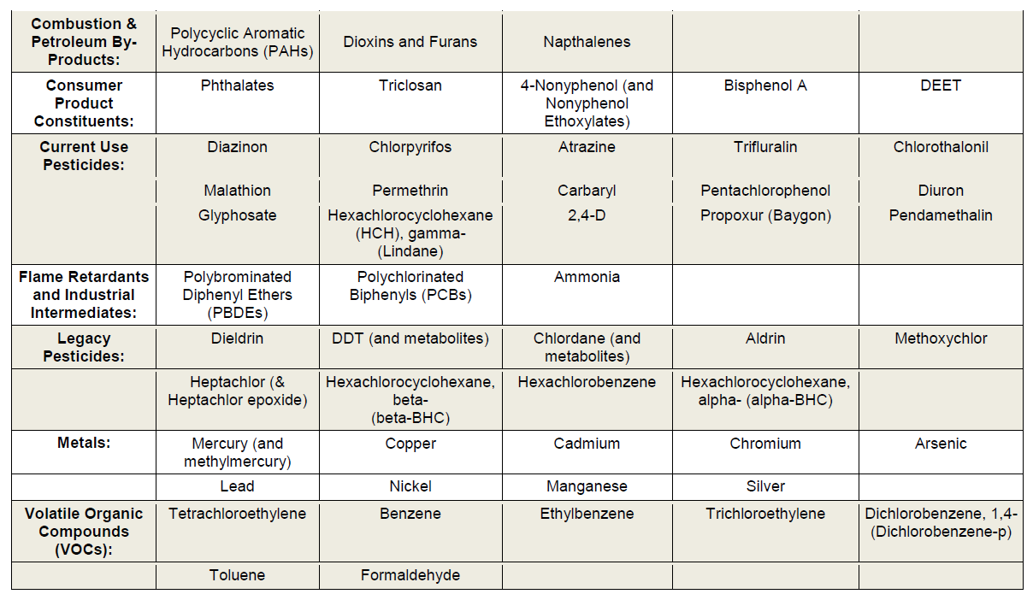
Toxics Reduction Strategy Background
Priority Chemical “Focus” List
Notes:
The first task in taking a more strategic approach to toxics was to identify a list of priority toxics that were of high concern to multiple programs in our air, water and land divisions. This list of 51 chemicals – or chemical categories – helps us focus our reduction and assessment actions in a way that makes the most efficient use of our resources. The list is divided into 7 broad categories and represents chemicals used by both individual consumers and businesses, as well as some legacy compounds that persist in the environment. In addition to providing focus to Strategy actions, this List has also been informative to other states and organizations – including large retail operations – who are interested in identifying common reduction priorities across regions of the country. We plan to update the Focus List in 2018 as the first implementation action of the updated Strategy.

Slide 4

Current Strategy Accomplishments:
Government Procurement
DEQ supporting DAS on low toxicity product procurement
Janitorial and Cleaning Supplies Pilot
General guidelines for all products
Recent efforts: office supplies and furniture
New DEQ Materials Management position
Notes:
- The Strategy action related to using state procurement to create more demand for lower toxicity products and chemicals received a major boost in 2012 when the Governor signed an executive order to advance green chemistry adopted same year as the our strategy. The order placed a major emphasis on state procurement to help advance safer chemistry.
The first initiative launched by the Department of Administrative Services under the order was janitorial supplies contract that required vendors to supply third-party certified products without Focus List toxic chemicals. This project was a partnership with the State of WA and was worth an estimated $20M.
In 2014, DEQ worked with DAS in developing general “green chemistry” purchasing guidelines for all product categories that were signed by the state’s COO as policy for the state. The guidelines included informational resources that all procurement professionals in the state can use.
DAS followed up the janitorial supplies pilot with an office supplies contract with similar criteria, and currently there’s a lot of work happening to advance purchasing specifications for office furniture that will reduce embedded toxics such as flame retardants and formaldehyde.
As part of implementing its 2050 Materials Management Vision, DEQ recently hired a person who will specialize in supporting sustainable government procurement, including a focus on low toxicity products.

Slide 5
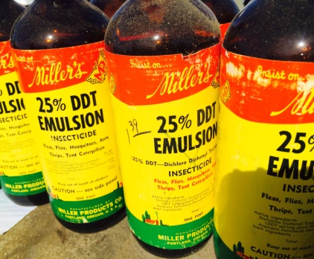
Strategy Accomplishments:
Pesticide Stewardship Partnerships
Oregon Legislature has provided funding to ODA and DEQ since 2013 to:
Expand water monitoring of current use pesticides in Oregon watersheds
Increase collection of waste pesticides:
345,000 pounds from 560 growers and applicators since 2014
Provide stewardship technical assistance support to local partners
Notes:
The Pesticide Stewardship Partnership program uses water monitoring data to drive collaborative actions to reduce the levels of current use pesticides in Oregon streams. It started with a successful pilot effort in Hood River’s tree fruit growing areas in the early 2000s, and slowly expanded to other parts of the state with the support of federal grants and in-kind contributions from various agencies. Making it a Toxics Reduction Strategy priority helped to focus efforts on getting more stable funding from the state in 2013. This support has allowed the program to bolster efforts in existing watersheds and expand to new areas. There are now 9 watershed partnerships, with preliminary monitoring occurring in 2 other watersheds. The program has expanded beyond agricultural land uses to encompass urban, forestry and mixed use areas.
Occasional grants were also used to pay for ag and commercial pesticide waste collection events in partnership watersheds. However, this wasn’t a consistent service that we were able to offer, and the events often weren’t directly tied to water quality goals. These collections are now part of the overall Pesticide Stewardship Partnership Program, and the results reflect this state commitment
The third component of the program is funding support for local and regional partners (including OSU Extension) to provide direct assistance to pesticide applicators in watersheds. In the past, we received significant in-kind assistance from OSU, SWCDs, watershed councils and others, but now we can ensure that consistent actions are taken to decrease pesticides getting into water.

Slide 6
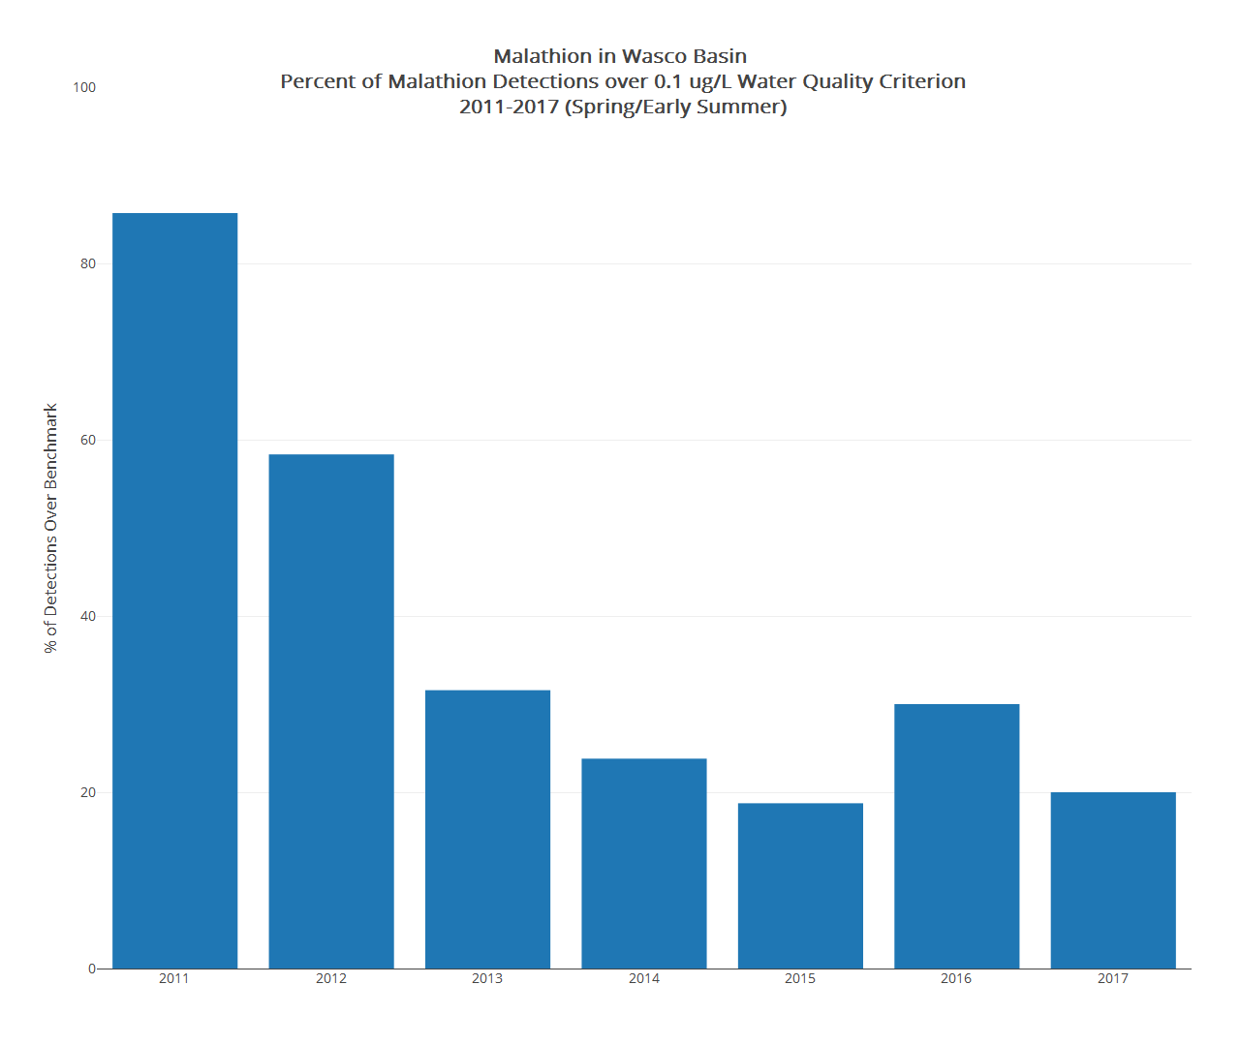
86%
Cherry growers increased use of weather stations to reduce wind drift, using more ground (rather than aerial) spraying near streams, and adding newer chemistries to control pest
20%
Notes:
This graph illustrates well the outcomes we’re looking for in every watershed where we have partnerships. In this instance, the cherry growers near The Dalles were faced with a new insect pest in 2010 that was penetrating un-ripened fruit on the trees, and they turned to old chemistry like malathion to deal with this pest. Soon after, our water monitoring showed numerous detections of malathion over DEQ’s aquatic life criterion, and this data was immediately shared with the growers and their service providers. New integrated pest management measures for this pest take a while to develop, but in the short term improved application practices were needed to reduce chemical drift into the local streams. Using weather stations more to avoid spraying in adverse conditions and using targeted ground spraying - instead of aerial application - near streams were a couple of the practices that were put in place to help reduce median concentrations by over 90% from the baseline monitoring year.

Slide 7
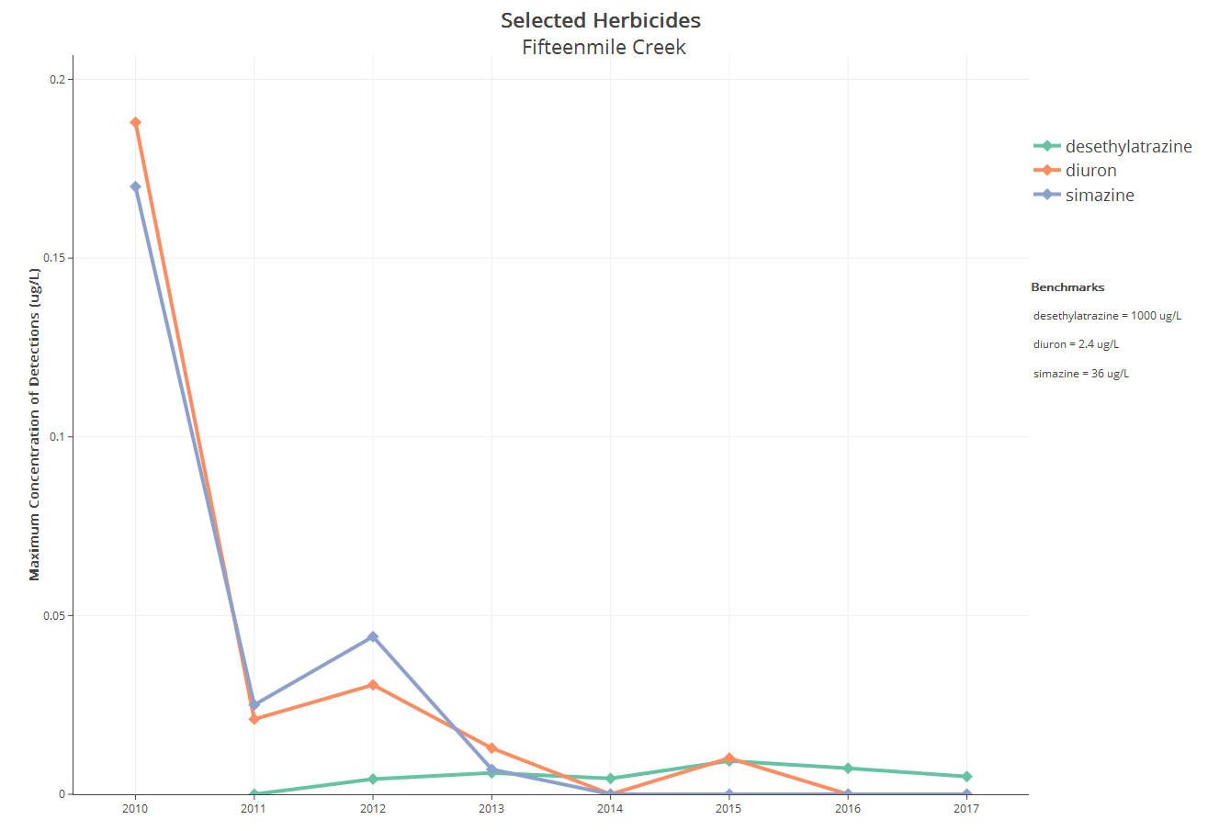

Slide 8
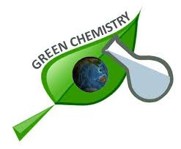
Current Strategy Accomplishments:
Advancing Safer Chemistry
Regional and Interstate Collaborations to Advance Safer Chemistry:
Developing alternatives assessment tools
Sharing data, expertise and resources
Conducting trainings on evaluating safer alternatives
Shaping federal toxics policies
Notes:
- We realized early on in developing the initial toxics reduction strategy that Oregon could have a more significant impact on reducing toxics in consumer and business products by coordinating our work with other states and organizations. DEQ has been actively participating in groups such as the Interstate Chemicals Clearinghouse and Northwest Green Chemistry (a non-profit research organization), as well as workgroups connected to the Environmental Council of the States, to accelerate the transition to safer products. DEQ also signed a Memorandum of Understanding with WA Ecology and CA Toxics Substances Department to leverage resources on common priority work efforts.
These collaborative initiatives allow us to interact with industry, EPA and non-governmental groups with a unified voice and set of objectives. Some of the deliverables from these efforts include a chemical alternatives assessment guide to help avoid regrettable substitutes that is being pilot tested right now for copper anti-fouling boat paint alternatives. The chemicals clearinghouse has also developed a resource library of other publically available (and peer-reviewed) comparative chemical hazard assessments. Most recently we’ve been working closely with WA Ecology to offer trainings in WA and OR for businesses and government agencies on chemical assessment tools and methods.
On the policy front, for several years Oregon participated with other states in reviewing and providing input on various iterations of a revised federal Toxics Substances Control Act, which was finally adopted in 2016 with overwhelming congressional support. The law provides EPA more authority to review and regulate chemicals in commerce. We continue to work through a State-EPA workgroup to ensure EPA implementation of the new law protects states’ interests, such as making available to state agencies information on chemicals that’s designated as confidential business information, so that we can better protect public health and the environment.

Slide 9

2018 Integrated Toxics Reduction Strategy Update
Assemble inventory of all DEQ toxics work
ELEMENTS OF UPDATE
New or Modified Actions
Short-term implementation plans
Notes:
Lisa
Thank you Kevin. Chair Armstrong, Commission members, my name is Lisa Cox and I’m the Toxics Reduction Analyst in Hazardous Waste and Tanks. We’ve made a lot of progress in the last 5 years. As we looked back at our work, we decided the Strategy needed to be updated and in 2016 we began that task. We formed a multi-program group, called Team Toxics, and I am a member of that team. We have met for the last year-developing our goals, vision, timeline, evaluating current work and DEQ priorities. We’ve identified the primary elements of the Strategy that include:
-completing an Inventory of all our toxics reduction work,
-developing Actions that build on the existing strategy’s Actions and identifying new actions to support program work
-and preparing an implementation timeline for Prioritized Actions

Slide 10
2018 DEQ Integrated Toxics Reduction Strategy
Integrate Toxics Reduction & Assessment Across Environmental Media
- Institutionalize DEQ cross-program team
- Pilot the integrated approach with Focus List Chemical(s)
Enhance Toxics Information and Data
Evaluate Regulatory Programs to Identify Toxics Reduction Needs
Expand Partnerships and Incentives to Reduce Toxics

Slide 11
2018 DEQ Integrated Toxics Reduction Strategy
Integrate Toxics Reduction & Assessment Across Environmental Media
Enhance Toxics Information and Data
* Update DEQ’s Toxics “Focus List” of priority chemicals
* Assess Fate & Transport of Focus List Toxics from Consumer Products
* Monitor for Focus List Toxics in All Environmental Media
* Assess & Characterize Impacts of Diesel Emissions Across Environmental Media
Evaluate Existing Regulatory Programs For Effectiveness in Reducing Toxics
* Evaluate Need for New or Modified Mercury Reduction Programs
* Assess Ways of Reducing Toxics through Municipal & Transportation Stormwater Permit and Technical Assistance Programs
* Evaluate Effectiveness of Oregon Toxics Use and Hazardous Waste Reduction Law and Program

Slide 12
2018 DEQ Integrated Toxics Reduction Strategy
Integrate Toxics Reduction & Assessment Across Environmental Media
Expand Partnerships and Incentives to Reduce Toxics
*Reduce Environmental and Human Exposure to Toxics from the Built Environment
* Build Demand for Low-Emission Vehicles & Equipment in Public Works Projects
* Effectively Communicate Toxics Data, Information & Reduction Opportunities to Oregonians
* Partner with Product Manufacturers to Disclose and Reduce Toxic Ingredients in Products
Expand Partnerships and Incentives to Reduce Toxics, con’t
* Expand Technical Assistance Outreach to Include Metals Manufacturing, Coating and Finishing Industries
* Enhance Pesticide Stewardship Partnership Program to Focus on Environmental Justice Communities
* Expand Government Procurement of Low Toxicity Products and Materials
* [Enhance Regional Partnerships to Accelerate Assessments of Safer Alternatives to Toxics]

Slide 14
Questions or feedback?
Strategy Document & Components?
Individual Actions?
Process and Communications?
Notes:
Back to Kevin
Stephanie suggested to add team members program name/office. Sense of connection
* Name, Position
Abby Boudouris Legislative Analyst
Cheryl Grabham Regional Solutions Team
David Collier Air Planning Manager
David Kunz Pollution Prevention Coordinator
Gil Wistar Site Assessment, Brownfields
Greg Svelund Public Affairs Specialist
Jordan Palmeri Waste Prevention Specialist
Kevin Masterson Toxics Coordinator
Lisa Cox Toxics Reduction Analyst
Lori Pillsbury Whole Effluent Toxicity Coordinator
Paula Calvert Columbia River Coordinator
Randy Jones Regional Solutions Team
Sarah Armitage Air Toxics Specialist
Sheree Stewart Drinking Water Protection Coordinator
Sue Langston Performance Manager, Facilitator
Wade Peerman Water Resources Specialist, Project Manager
Wendy Wiles Environmental Solutions Administrator
Discussion: Review Right membership for Gov Team and Team. Come back to leadership team on regular basis to give updates and get feedback

