Slide 1

Cully Rain Gardens Addressing Nonpoint Source Pollution in an Urban Landscape through Rain Gardens

Slide 2
Verde created program in 2014
Nestor Campos – Education and Community Engagement Coordinator.
Verde invited Columbia Slough Watershed Council (CSWC) as a partner in 2017.
Verde brought existing partnerships with Habitat 4 Humanity and Backyard Habitat Certification Program.
CSWC brought in long-time partner, Multnomah Youth Cooperative (MYC), based out of Reynolds Learning Academy in the Reynolds School District.

Slide 3
Project Goals
To install rain gardens on low income residential properties in the Cully Neighborhood.
Redirect runoff from impervious surfaces like: roofs, patios, driveways, streets, etc. to infiltrate onsite and into the ground.
Create more native landscaping and habitat for wildlife on private properties.
Provide outreach and education to homeowners on watershed health.
Provide Science, Technology, Engineering, and Math (STEM) education and training to youth through project based learning.
Save homeowners money on their sewer/stormwater bill (Downspout Disconnect).

Slide 4
Partner Roles
Verde: Outreach and homeowner education, site assessment and design, project lead, grant writing.
CSWC: Project co-lead/support, classroom lessons, procurement, coordination, field implementation, grant writing.
MYC: Enrolls students, transportation, field supervision, installation of rain gardens.
Americorps, Confluence Environmental Center: Provides professional interns and program support.
Habitat 4 Humanity: Identifies eligible homeowners through their databases and community contacts.
Backyard Habitat Certification Program: Enrolls homeowner in program, provides consultation on landscaping and native plant vouchers.

Slide 5
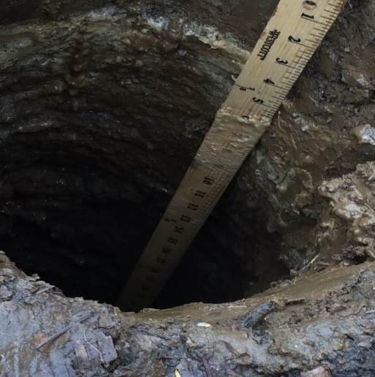
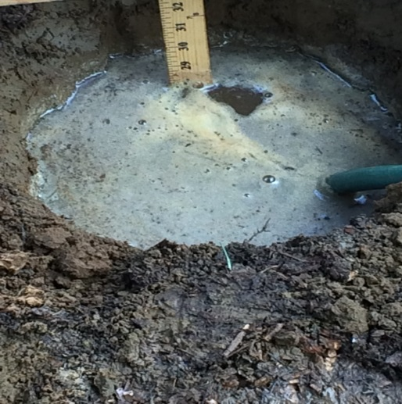
Project timeline
Fall –
Outreach and enrollment of homeowners.
1-1 rain garden workshops with homeowner on site.
Homeowner participates in design and native plant selection.
Impervious surface area calculation.
Percolation tests.

Slide 6
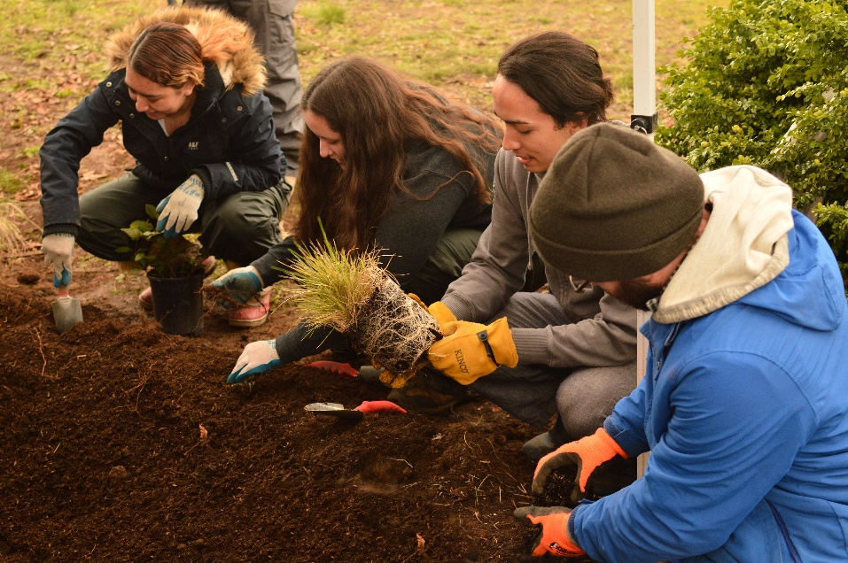
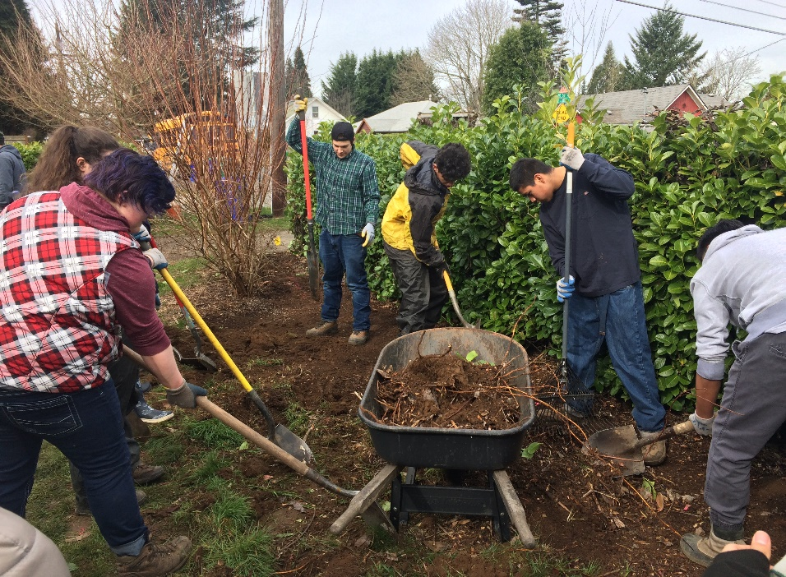
Project timeline
Winter-
Procure native plants and supplies.
Begin classroom education for MYC students.
Watersheds and water quality
Green infrastructure
Rain garden theory and design
Field training and installations
~6-8 rain gardens per year

Slide 7
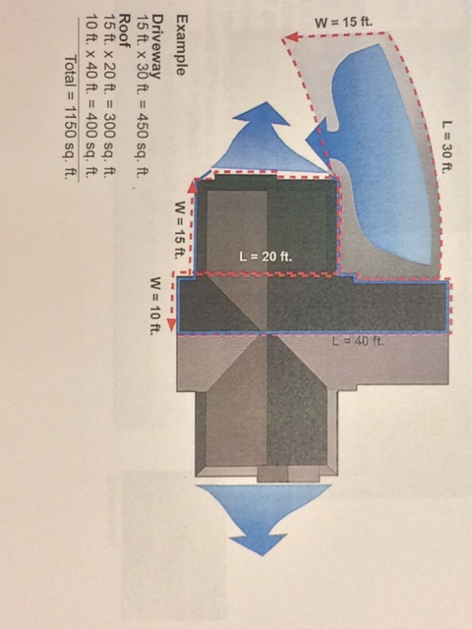
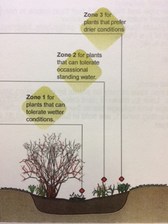
Field Training
Teach and reinforce calculations and site measurements.
Go through each step multiple times with students through the course of the program.
Identify native plants and planting zones.
Teamwork, time management, and critical thinking skills.

Slide 8
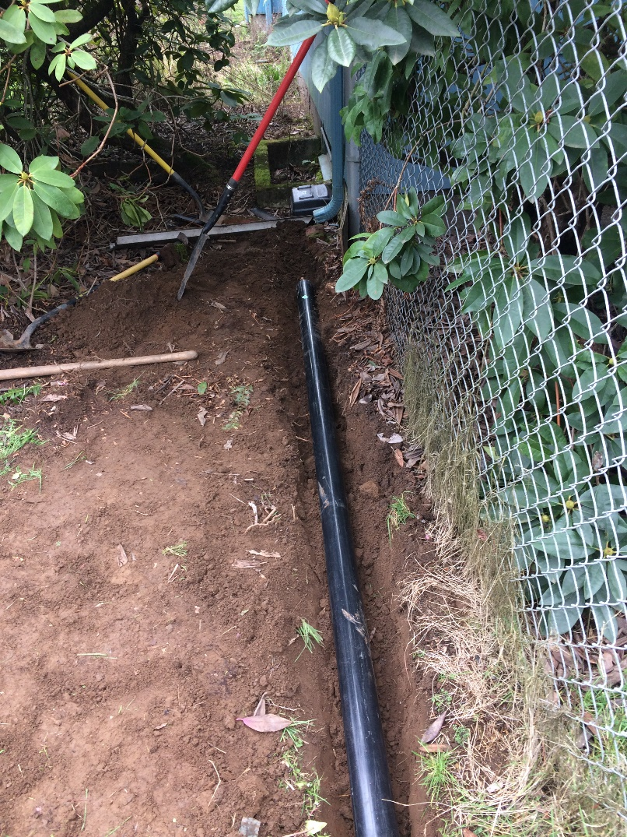
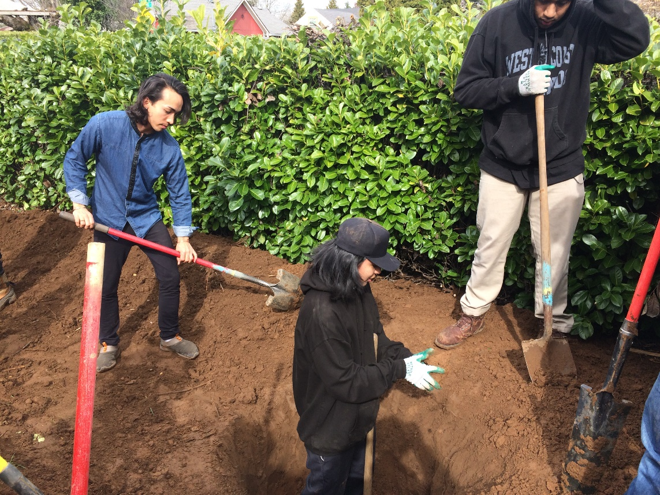
Construction

Slide 9
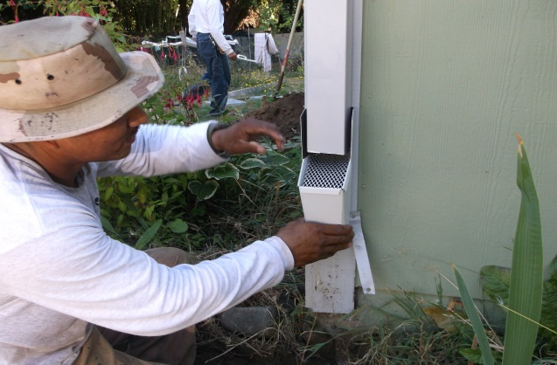
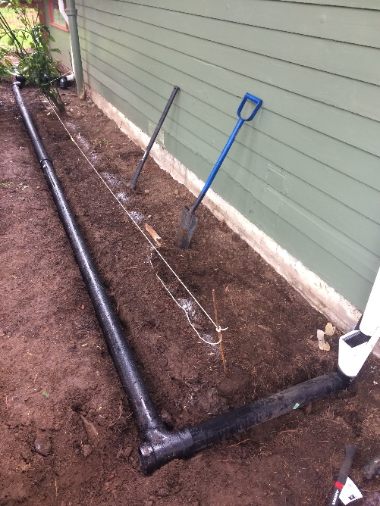
Project timeline
Spring/Summer
Final reporting
Landowner signatures
Backyard Habitat surveys
Assist homeowners in enrolling in the downspout disconnect program
Initial maintenance and post-installation maintenance (MYC)
~6-8 rain gardens per year

Slide 10
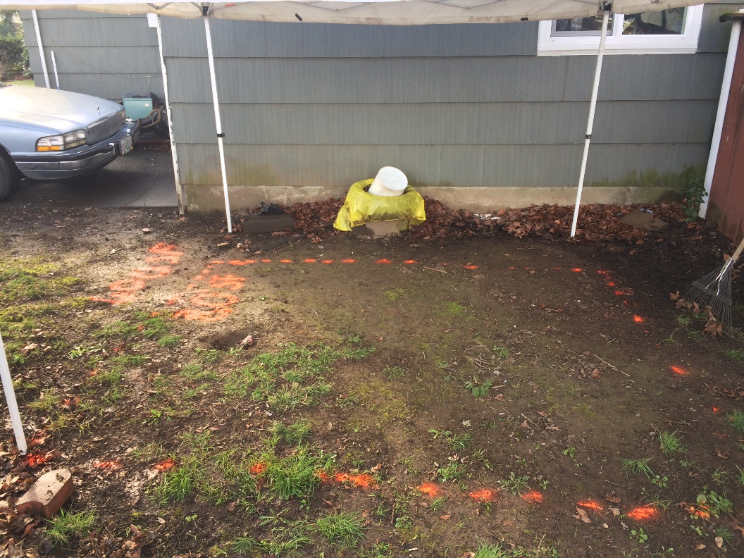
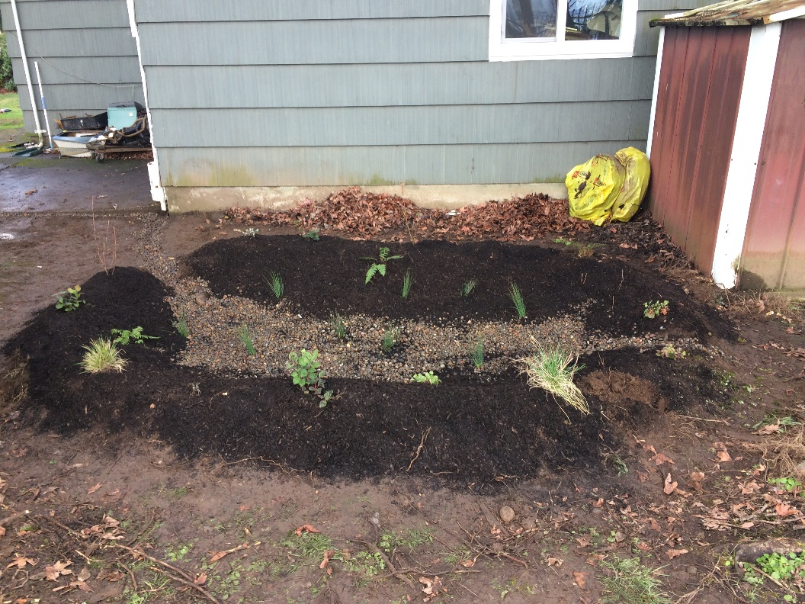
Rain Garden sites
Before
After

Slide 11
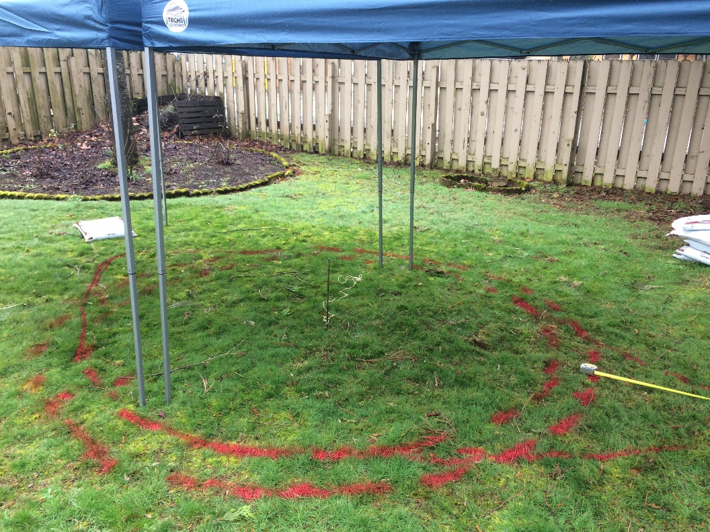
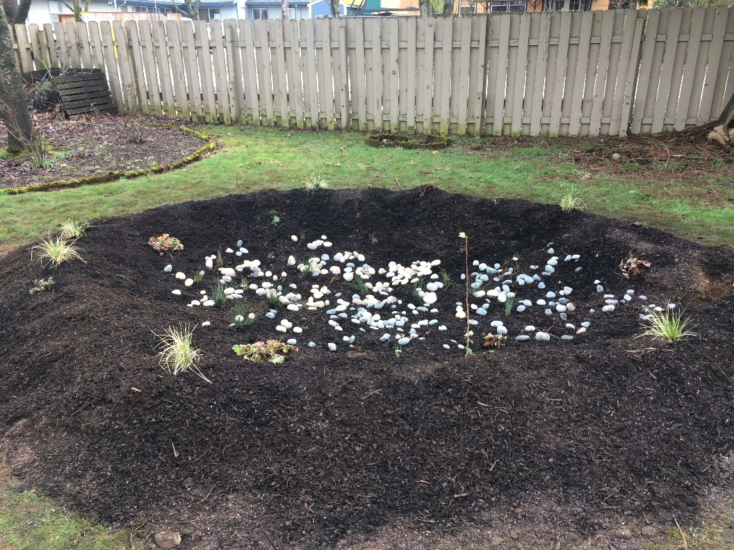
Rain Garden sites
Before
After

Slide 12
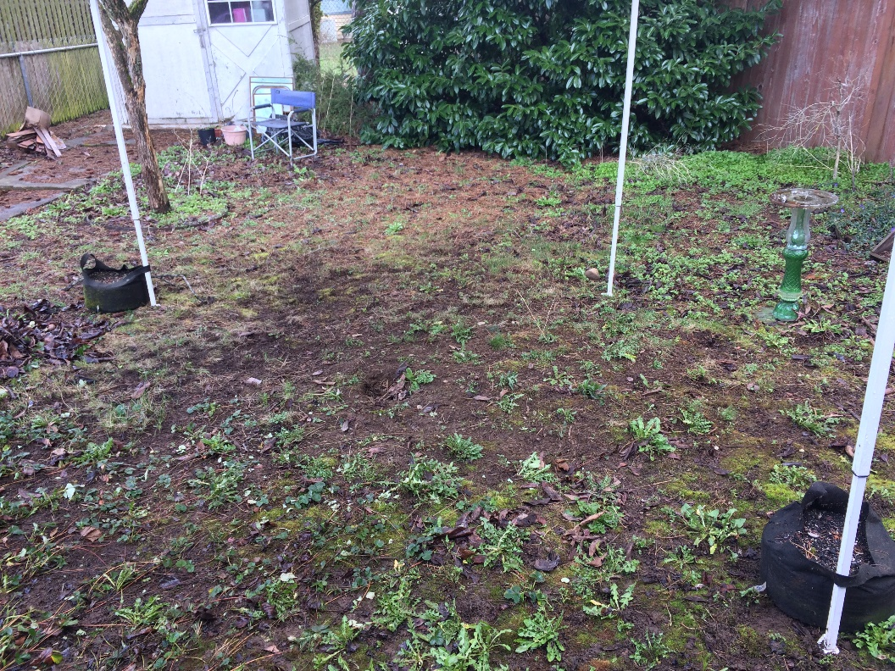
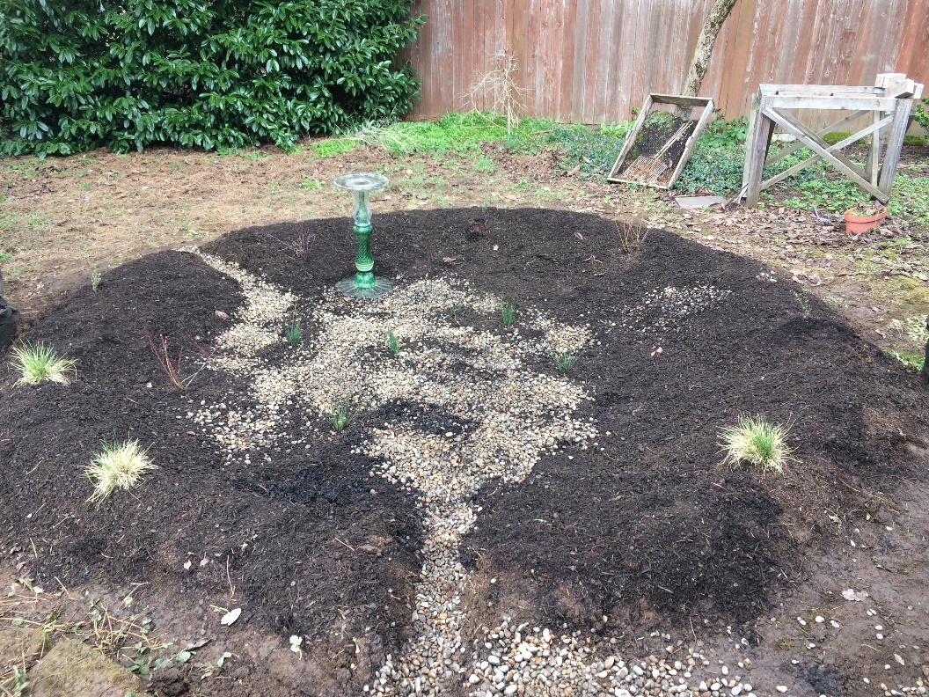
Rain Garden sites
Before
After

Slide 13
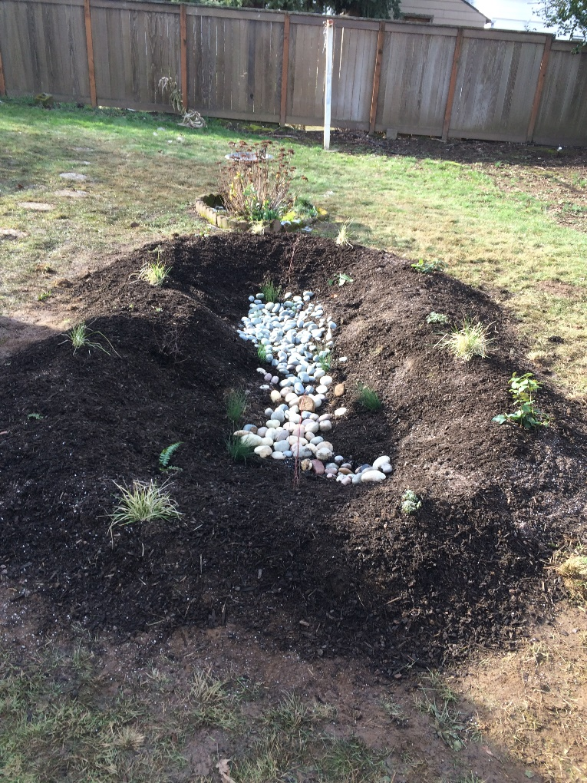
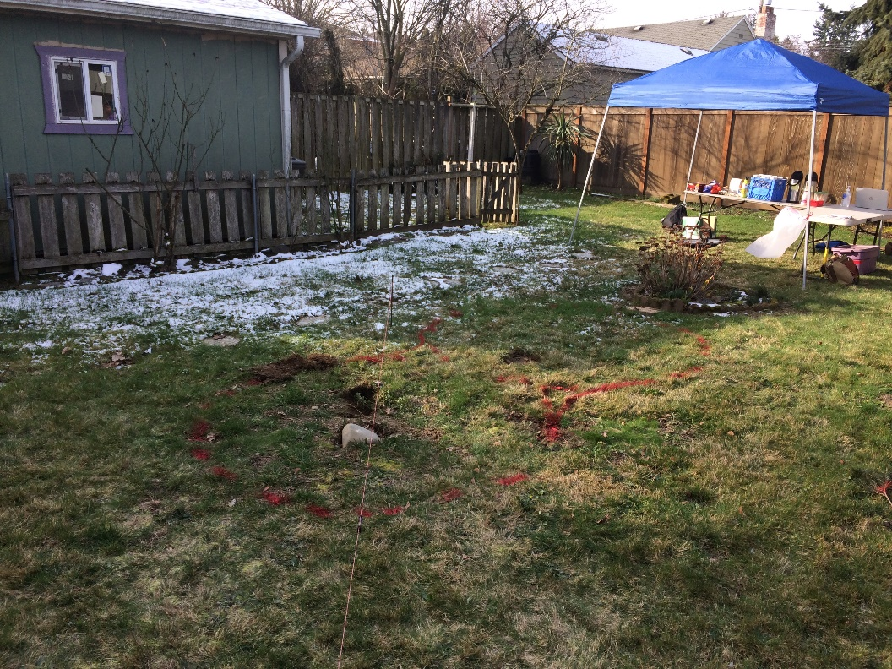
Rain Garden sites
After
Before

Slide 14
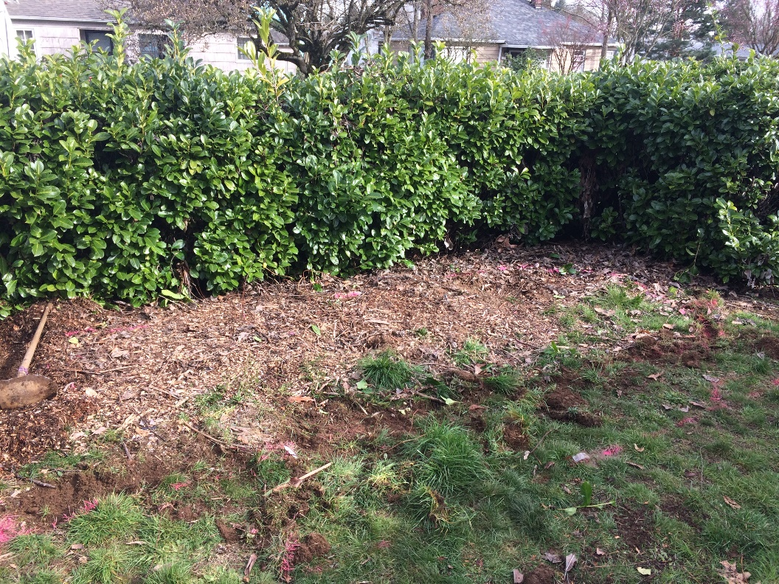
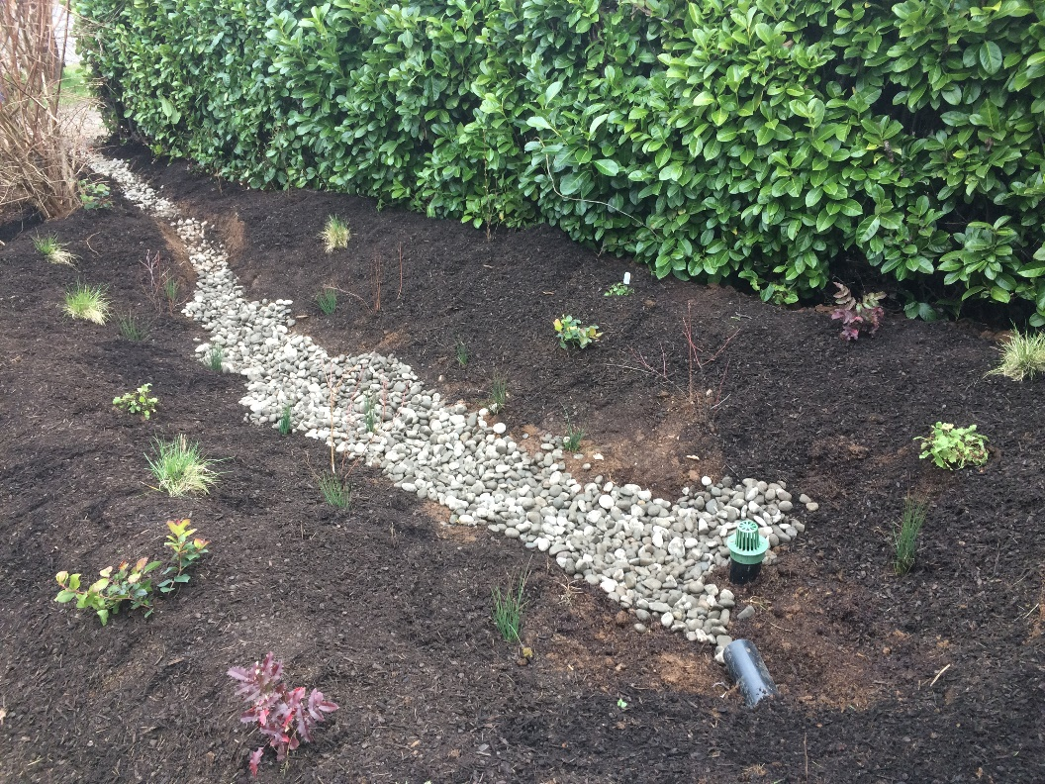
Rain Garden Sites
Before
After

Slide 15
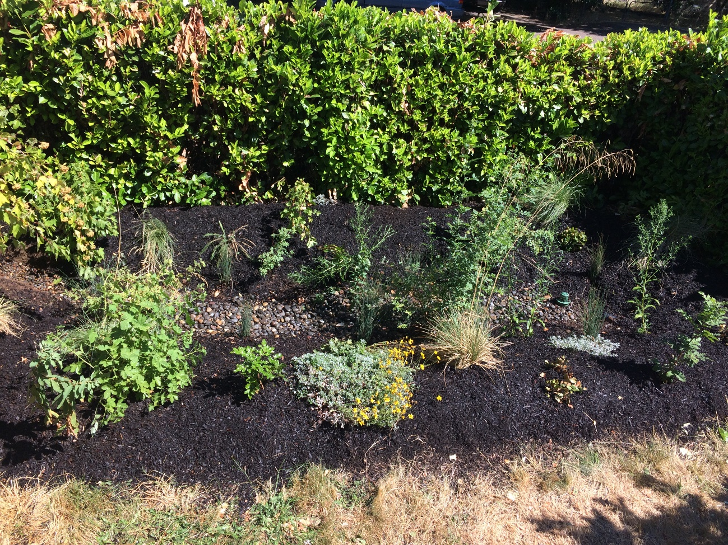
5 months later…

Slide 16
Program Results for 2017-2019
15 rain gardens installed on 13 low-income single family homes in the Cully Neighborhood.
Stormwater runoff diverted from 7865 sq. ft. of impervious surfaces.
Translates into 210,823 gallons diverted from the stormwater system every year.
463 native plants planted on 13 single family homes.
21 homeowners educated on rain garden design and theory, watershed health.
625 student hours constructing rain gardens in the field.

Slide 17
Next steps…
Verde secured funding for rain garden from City of Portland’s Community Watershed Stewardship Program (CWSP).
CSWC applied for funding through EPA’s Environmental Justice grant for expansion of the program to include new community partners and neighborhoods.
If funding is secured the collaboration will expand to include Blueprint Foundation as a partner and install rain gardens in North Portland.
Continue to build a post-maintenance program with MYC students during summer school sessions.
Secure long-term and sustainable funding source for this type of programming within the community.

Slide 18
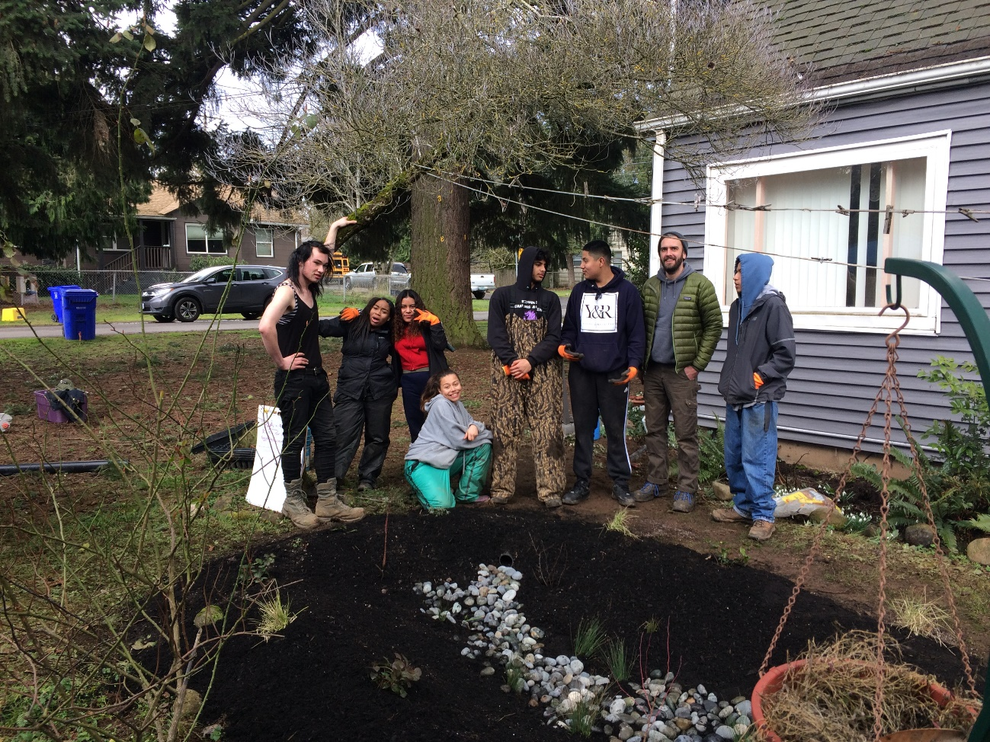
Questions??

