Slide 1
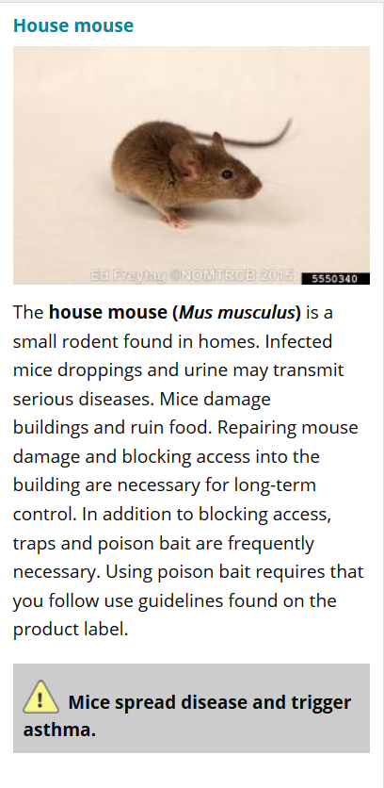
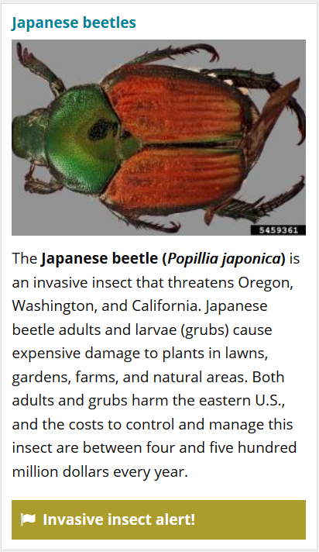
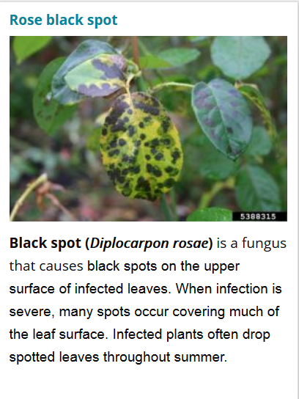
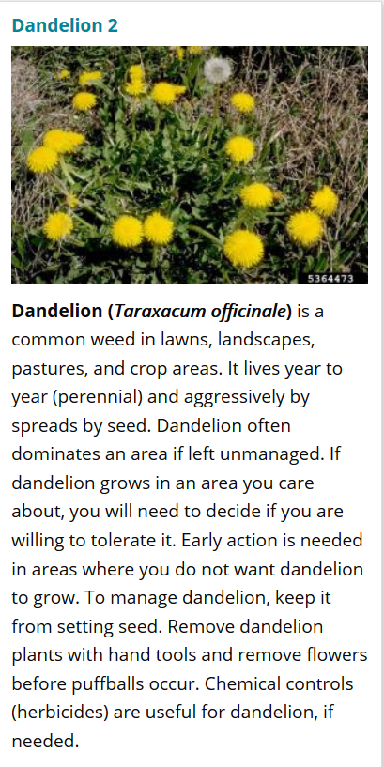
OSU Extension Service
Solve Pest Problems
Animals
Insects
Diseases
Weeds

Slide 2
Thank you to our sponsors!
Metro
East Multnomah Soil and Water Conservation District
West Multnomah Soil and Water Conservation District
City of Gresham
ODA Pesticide Stewardship Partnership
Benton County SWCD
Individuals
OSU Extension Service Clackamas County
OSU Pollinator Health
OSU College of Agricultural Sciences

Slide 3
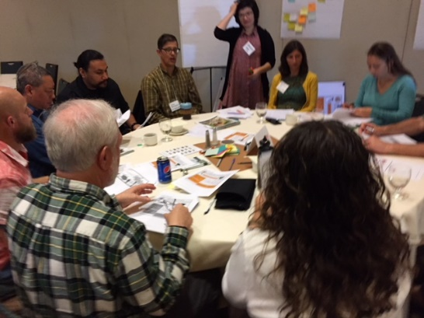
Stakeholder engagement
Steering committee
OSU, ODA, Metro, EMSWCD
Advisory- 15+ people
ODF, ODA, other agencies
Landscape, nursery
Community Engagement Liaisons (funded)
Spanish-language advisory (funded)

Slide 4














Broad coalition of support!

Slide 5
Audience question:
Who has experienced a pest problem at home in the last year?
Animals
Household
Plant problems
Weeds

Slide 6
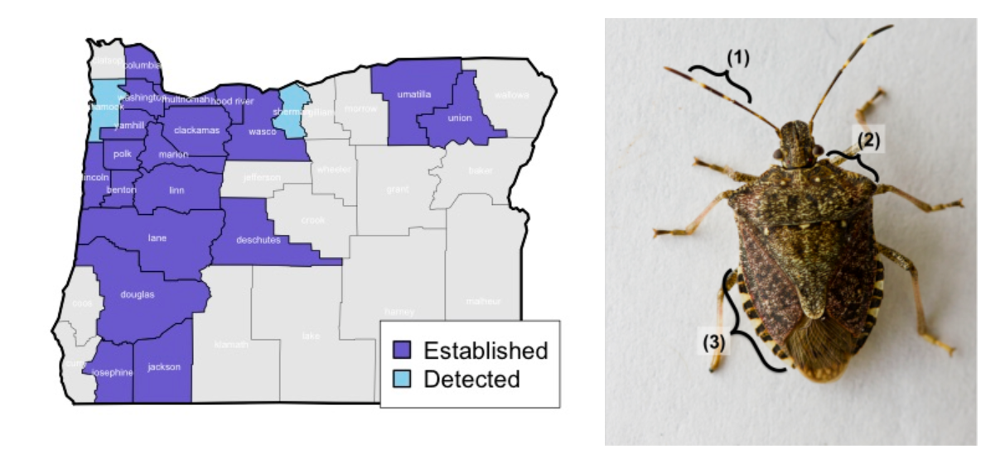
Pest problems happen!
Brown Marmorated Stink Bug
http://agsci.oregonstate.edu/bmsb

Slide 7
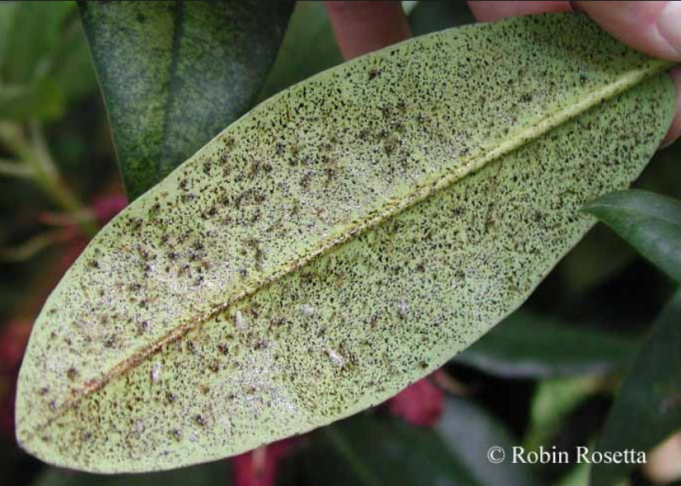
And increasing numbers of pests…
Azalea lace bug damage
Photo: Robin Rosetta, OSU

Slide 8
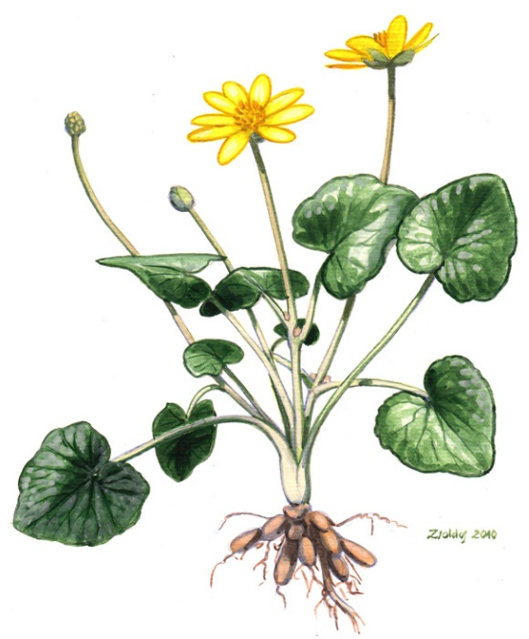
And increasing numbers of invasive species
Lesser celandine
http://www.nyis.info/index.php?action=invasive_detail&id=71

Slide 9
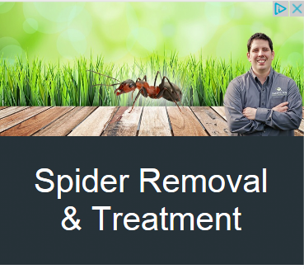
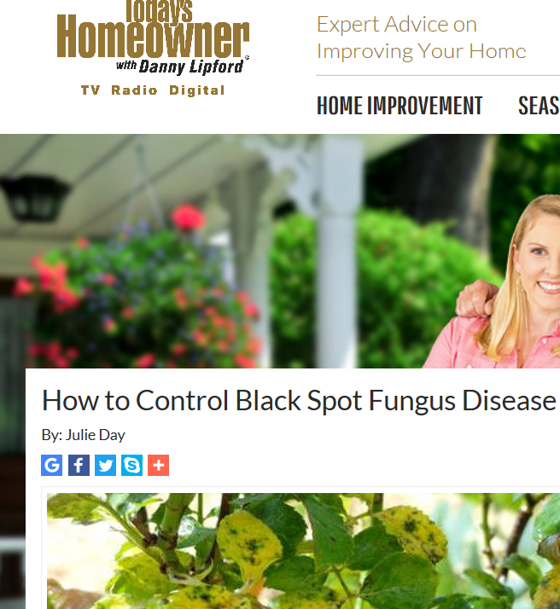
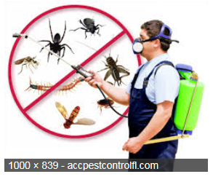
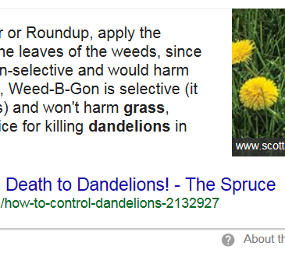




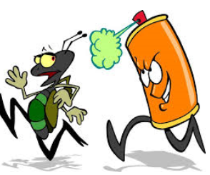

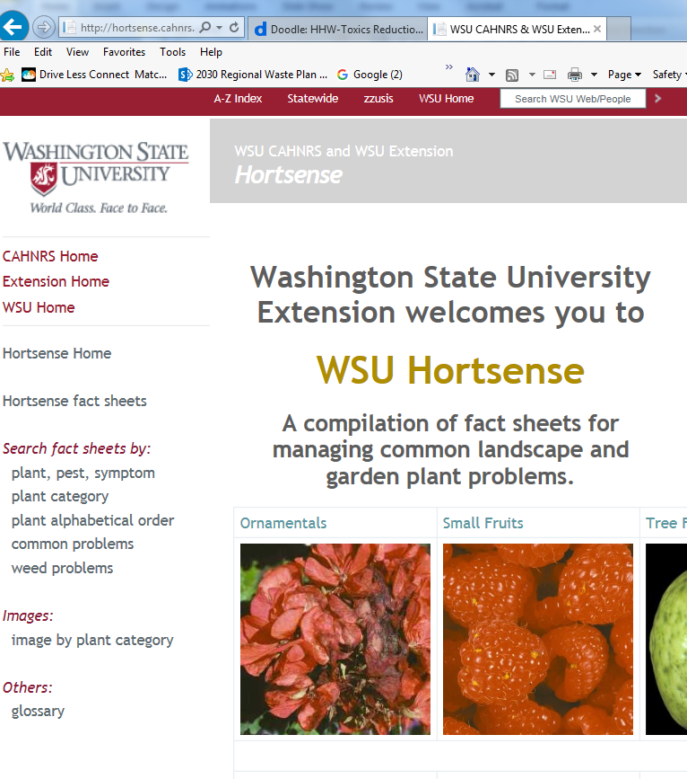


Confusing array of pest info

Slide 10

Information resources not always mobile friendly
Photo: http://thesceneisdead.com/2013/04/08/

Slide 11
Project purpose
The purpose of Solve Pest Problems is to reduce the impacts of pests and pest management practices on people and the environment in non-agricultural settings. The resource will be built in English and Spanish and will address inequities in access to unbiased, science-based pest management information.

Slide 12
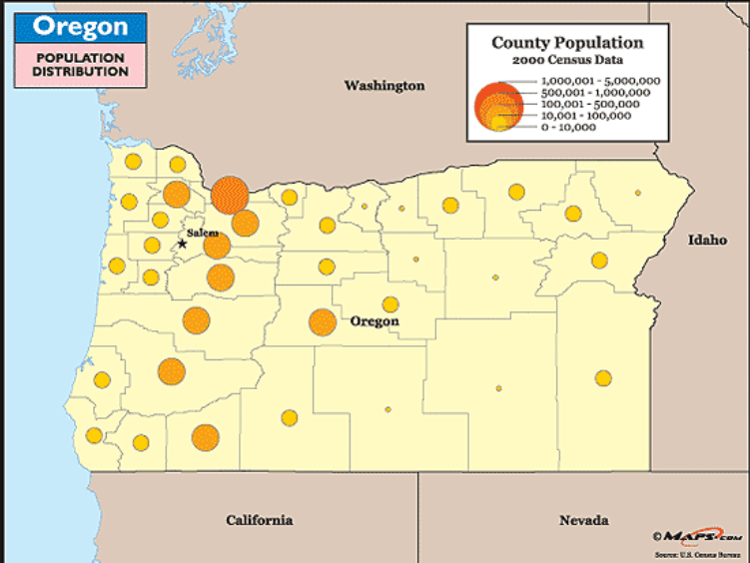
Intended audience
DYI Urban and rural residents
Public and private landscape professionals
Retail nursery workers
OSU Master Gardener, Naturalist, and Beekeeper volunteers
Communities historically underserved by OSU’s IPM resources

Slide 13
Audience groups
Super users
General public

Slide 14
Program goals
Provide access to effective science-based IPM information
Emphasize pest prevention
Reduce risks from pests and pest management practices
Reduce the use of pesticides by eliminating unnecessary use
Advise users about the risks of inaction
Facilitate use of product labels and PPE
Advise users about the risks of specific management techniques and pesticides and provide information to help avoid/minimize the risk.
Identify recommended practices for management of specific pests.

Slide 15
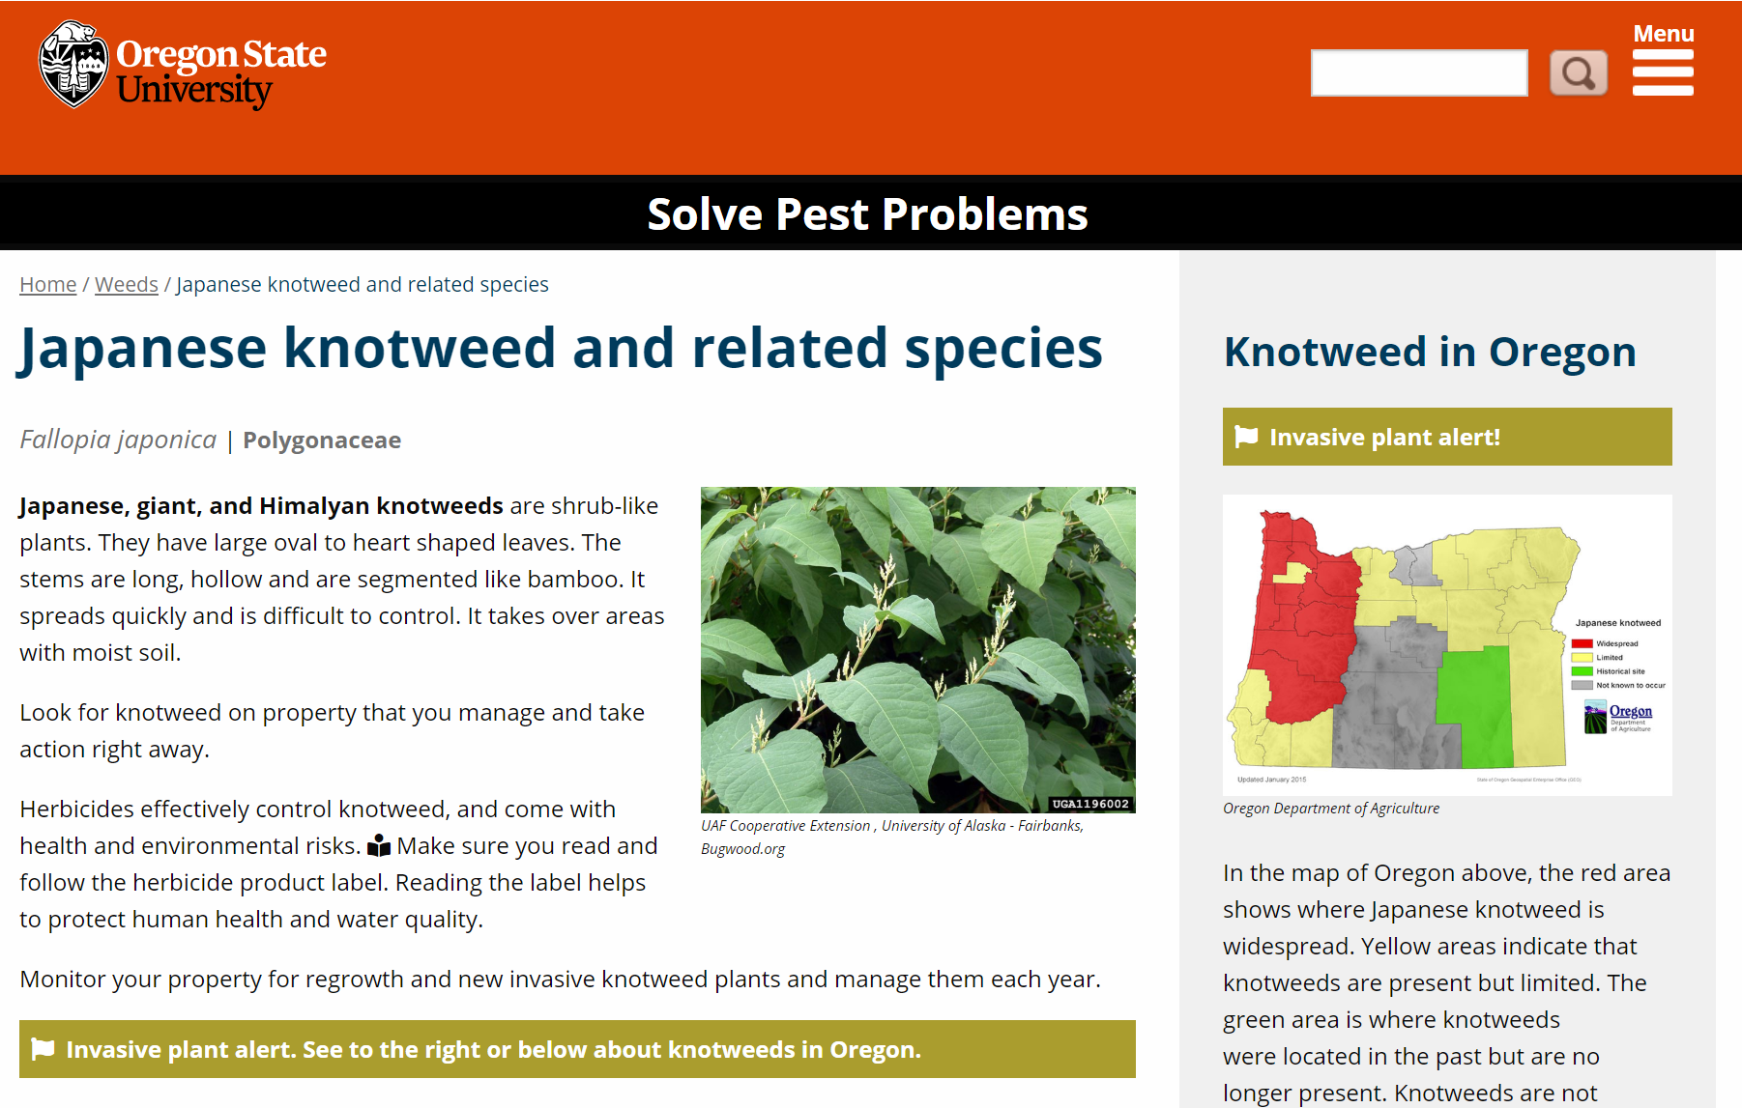
Content example, knotweed

Slide 16

Reduce the risk of pesticides to people
For both applicators and incidental exposure
Photo: Metro

Slide 17
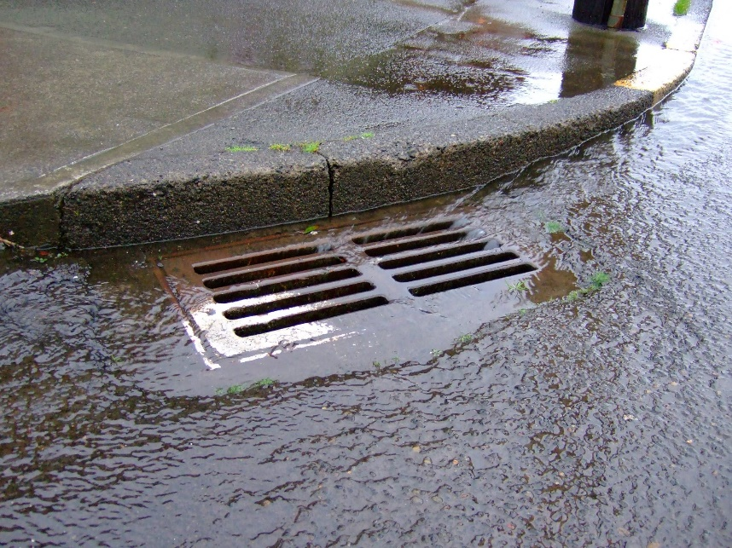
Reduce the risk of pesticides to waterways
Photo: Rob Emanuel, OSU Extension

Slide 18
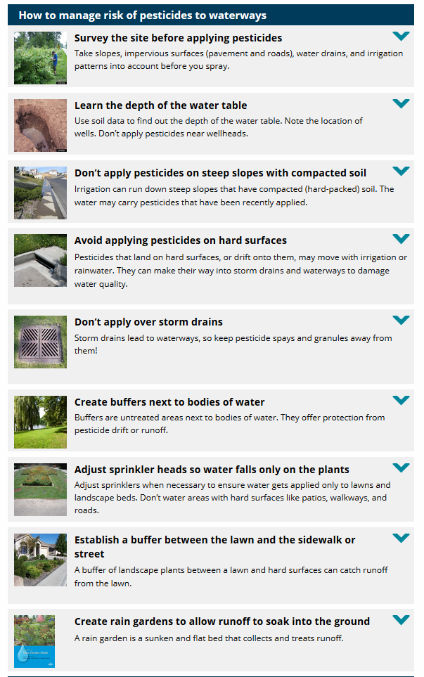
Water quality content example

Slide 19
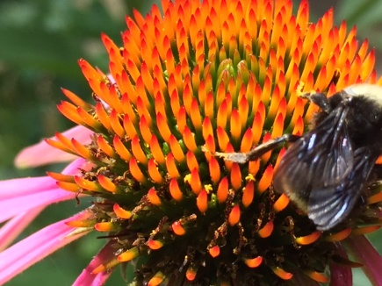
Reduce the risk of pesticides to pollinators
Oregon Legislature charge to improve pollinator health in the state (see House Bills 3361 and 3362).

Slide 20
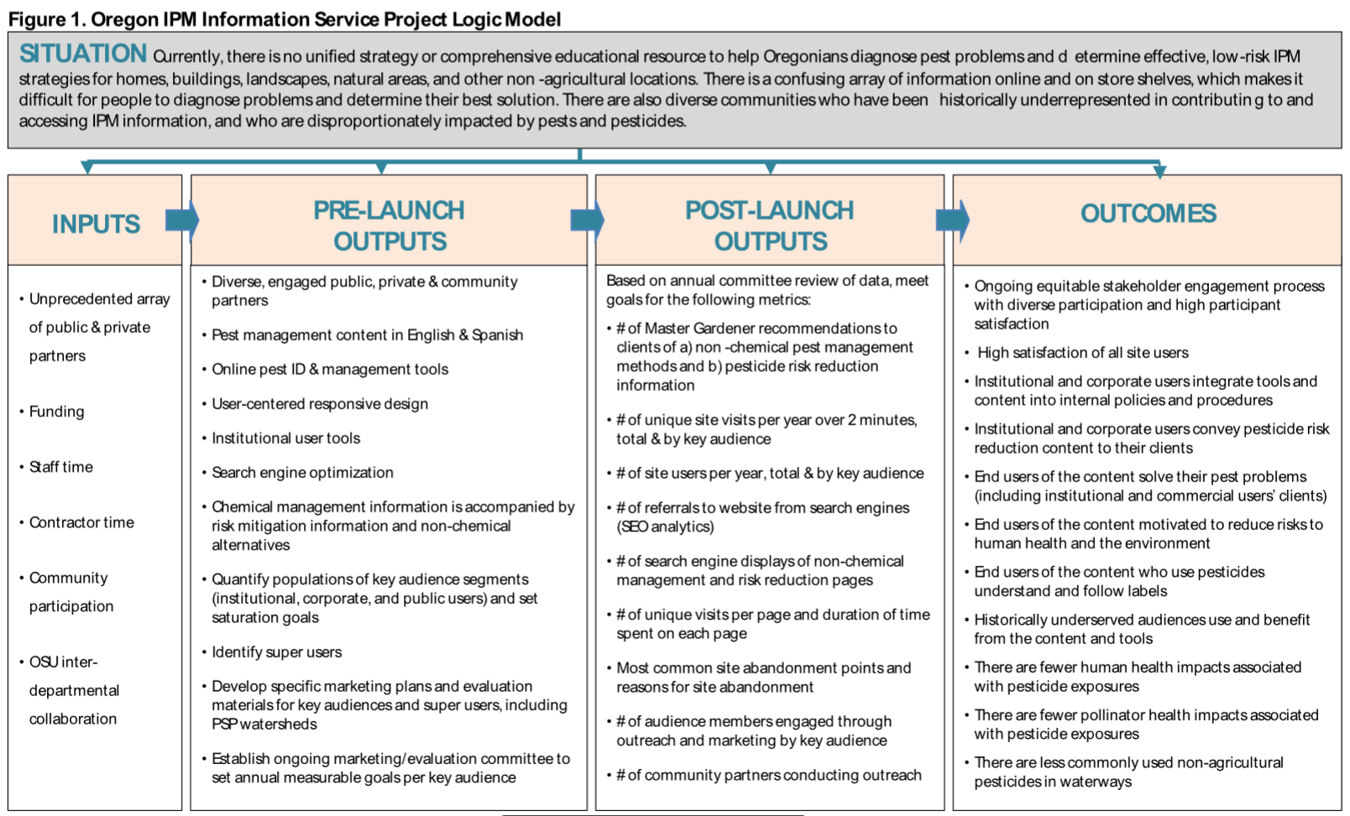
Evaluation plan

Slide 21
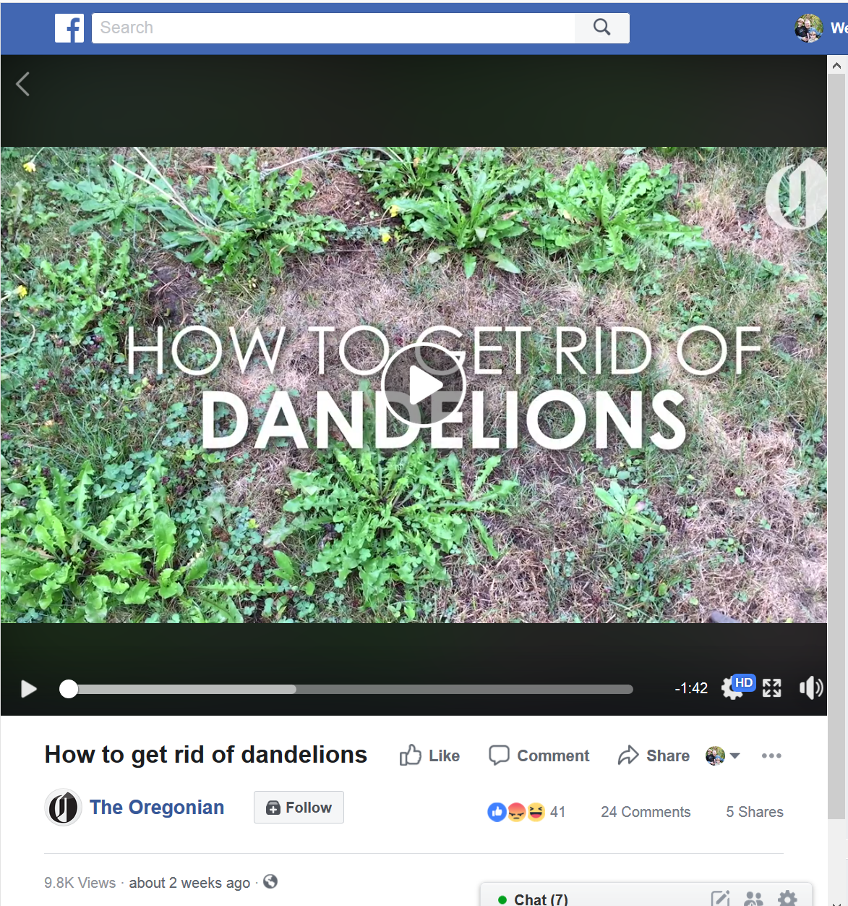
Built-in marketing plan
Leverage partners and existing relationships with media
Social media prompts
Postcard, bookmarks, and other prompts for OSU Master Gardener and partners to distribute at community events.
Prompts at garden centers and hardware stores with easy instructions to access the website.
Provide trainings for partners
Oregonian video series

Slide 22
The $3 Million Question?

Slide 23
Questions? Recommendations? Thoughts?
Solve Pest Problems

Slide 24

Please contact us:
SolvePestProblems.edu
Weston Miller, program manager
Weston.miller@oregonstate.edu
503-706-9193

