Slide 1

Water Quality Toxics Monitoring Program
Upcoming Monitoring
June 26, 2019
Willamette River Toxics Reduction Partnership
Michael Mulvey
Water Quality Toxics Monitoring Coordinator
Oregon Department of Environmental Quality | Laboratory and Environmental Assessment Division

Slide 2
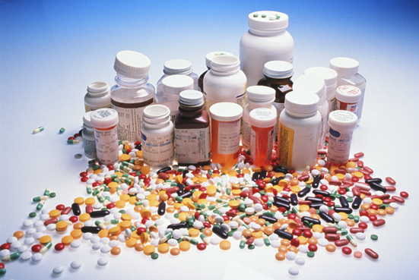
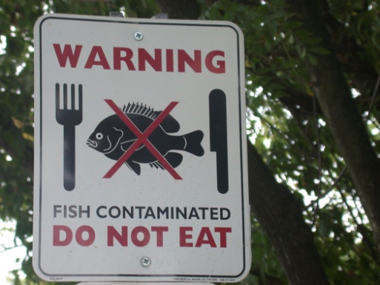

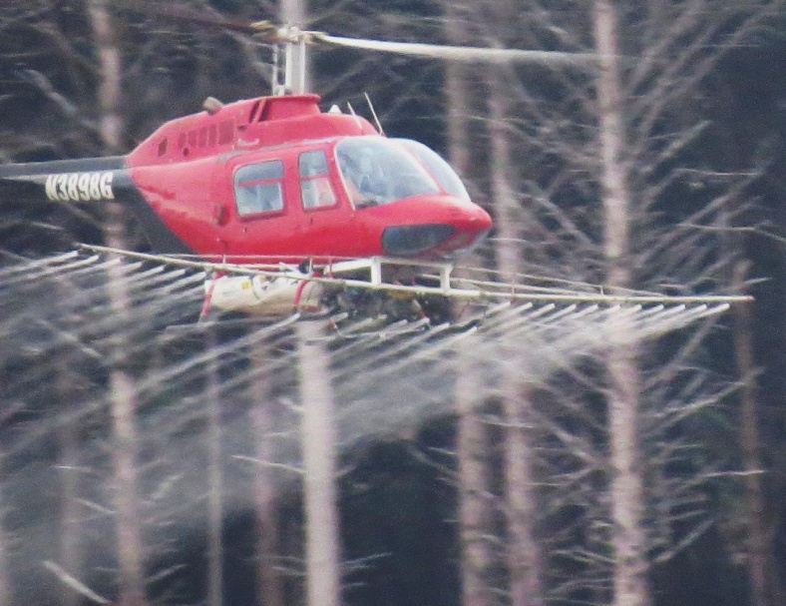

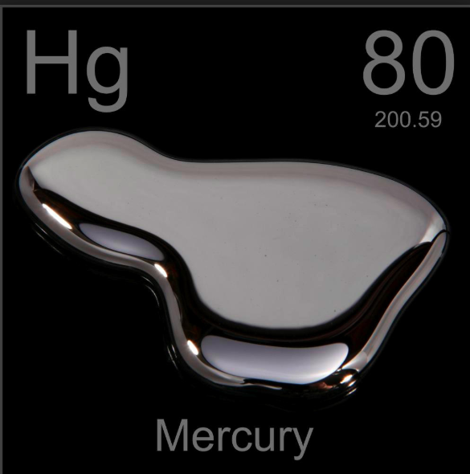
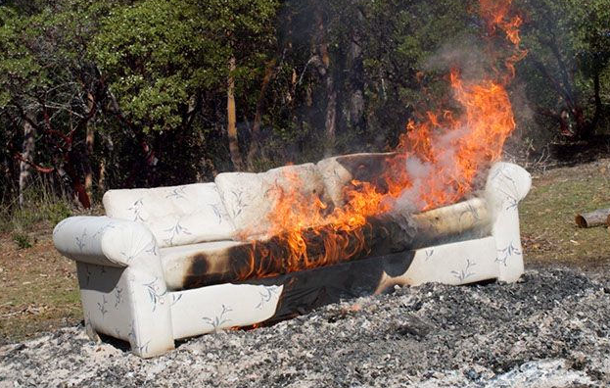
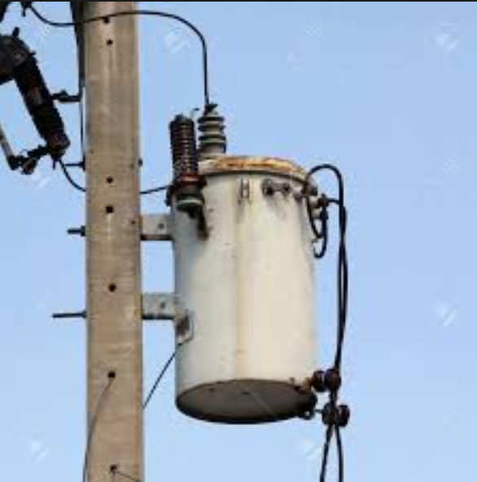

TMP Goal
Monitor & interpret levels of toxic chemicals in Oregon’s aquatic environment
TMP Objectives
Statewide
Comparable
Relevant
Sustained

Slide 3
TMP History: 2007 to 2019
2007: Oregon Legislature direct DEQ to evaluate a wide range of toxic substances in Oregon’s water. 11 positions.
2008-2016: DEQ implement a synoptic, 5-year basin rotation monitoring plan, ~40-60 river sites per year, water (3x), sediment, some fish/shellfish.
2015: First Toxics Summary Report
2017: Lakes state-wide with the EPA’s National Aquatic Resource Survey
2018: No Toxics Monitoring Program sample collection
2019: Second Toxics Summary Report
2019: DEQ reorganizes TMP: plans a state-wide status and trend network, 3 positions, 73%decrease in resources.

Slide 4
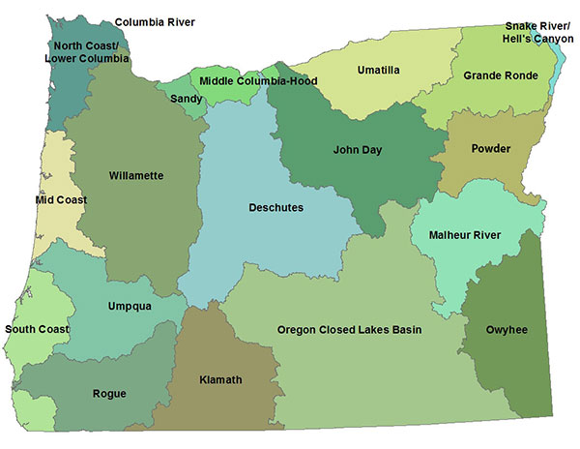
2014
2013
2015
2011, 2016
2012
2012
2011, 2016
2017 state wide lakes
2018 no Toxics Monitoring
2012, 2016
2008-10
2014
2016
2013
2012
2013
2013
2013
2015
2013
2011
2015
2013
2011, 2015

Slide 5
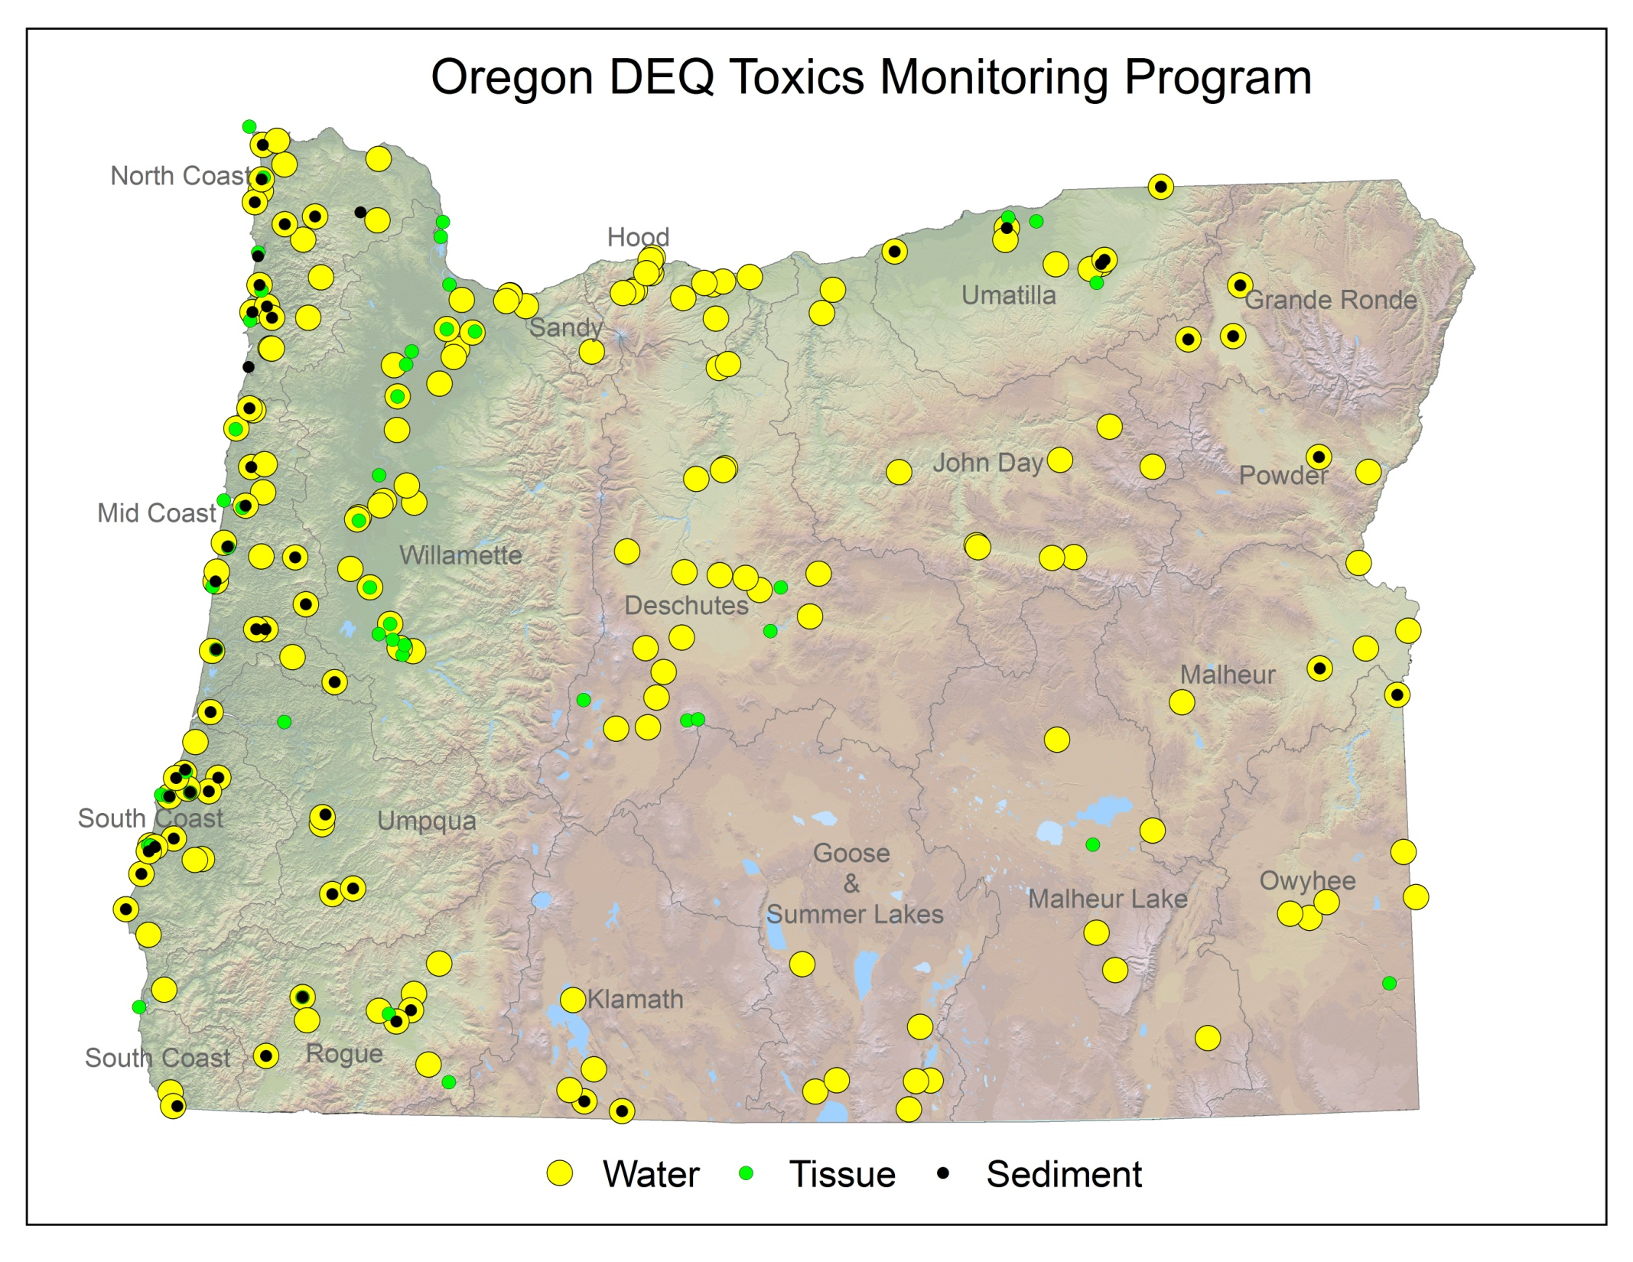
2008-2016

Slide 6
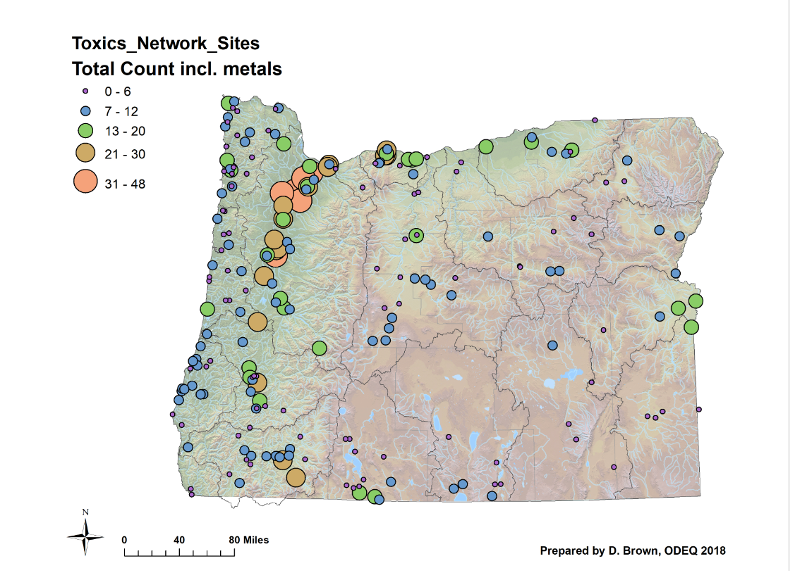
Tox Mon 2008-2017
232 sites for water
119 sites for sediment
80 sites for fish and shellfish

Slide 7
Issues:
73 % reduction in TMP resources for monitoring and analysis
2007: 11 positions
2019: 3 positions
Long time between sample collection and data release
Synoptic, rotating basin approach good for status but not trending
The original TMP not sustainable with existing resources and did not answering questions about trends
Solution :
Rescale the TMP to fit resources available and answer questions about trend
Network of fixed sites revisited annually
Reduced analysis to fit lab analytical capacity

Slide 8
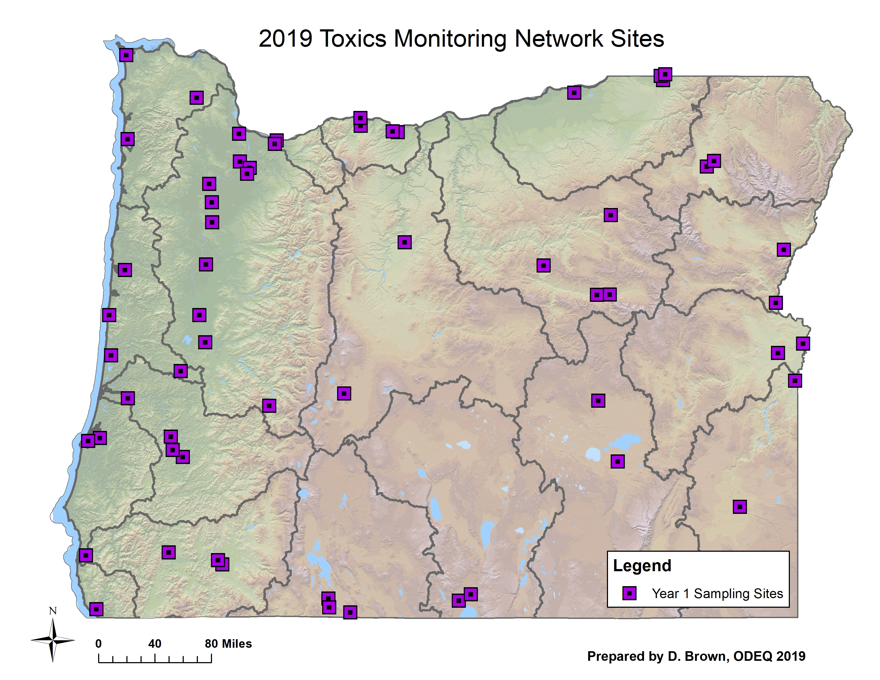
How we selected the new trending network sites
Tox Mon 2008-2017
Looked at Tox Mon data at more than 300 sites 2008-2017
Sites with large number of detections and high concentrations
Land uses, ecoregions representation
Spatial coverage, major tributaries
Background sites
Key assessment units for 303d List
Pesticide Stewardship Partnership basins
Selected 120 sites as a good trending network
60 sites feasible in 2019
~20 sites from 303d List needing more data
Metals and related parameters
Add sites and analytes as capacity allows

Slide 9
Parameters
 | 2008-2017 |  |  |  | 2019
 | Water | Sediment | Fish | Shellfish | Water | Sediment | Fish
Consumer product constituents | X
Current Use Pesticides | X
Legacy Pesticides | X | X | X | X
Flame Retardants | X | X | X | X
Combustion byproducts | X | X | X | X
Metals | X | X | Mercury only | X | X | ? | ? Mercury
Industrial Intermediates | X | X | X | X
Steroids and Sterols | X
Notes:
What did we look for?
We analyze for approximately 400 chemicals in the toxics monitoring program.
What we analyze for. It’s different in water, sediment and fish because we have identified different concerns and chemicals behave in different ways. Partitioning.
Give examples of chemicals that are in certain groups.
For water:
Metals
EPA priority pollutant metals (total & dissolved)
Combustion by-products
PAHs
Dioxins / furans
Consumer product constituents
Pharmaceuticals
Personal Care Products
Plasticizers
Legacy Pesticides
Flame retardants – brominated
Industrial compounds
PCBs
Current use pesticides

Slide 10
Willamette Basin Sites from State-wide list of 60 sites
Station ID | Site | Land Use | Notes
10821 | Willamette River at St. John's Bridge | Mixed | main stem 1, lower, many detections
10456 | Tualatin River at Boones Ferry Road | Urban | Trib. Many detections, mid
10916 | Tualatin River at Bridge upstream of mouth | Mixed | Trib. Many detections lower
31545 | Willamette River at Hebb Park Boat Ramp | Agriculture | main stem 2, lower, many detections
10363 | Yamhill River at Dayton | Agriculture | Tributary. many detections
10344 | Willamette River at Wheatland Ferry | Agriculture | main stem 3,mid, many detections
10555 | Willamette River at Marion Street (Salem) | Mixed | main stem 4, mid, some detections
10350 | Willamette River at Albany | Agriculture | main stem 5, upper, some detections
10355 | Willamette River at Hwy 99E (Harrisburg) | Agriculture | many fish detections, between Eugene and Albany water sites.
29044 | Willamette River at Greenway bike bridge, Eugene | Urban | main stem 6, upper, few detections. Lots of Fish detections, PCBs
27986 | Willamette R MF above Hills CR | Forest | background site, upper basin in national forest
Upstream to downstream

Slide 11
60 sites

Slide 12
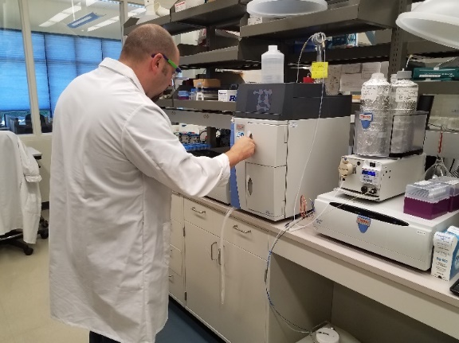
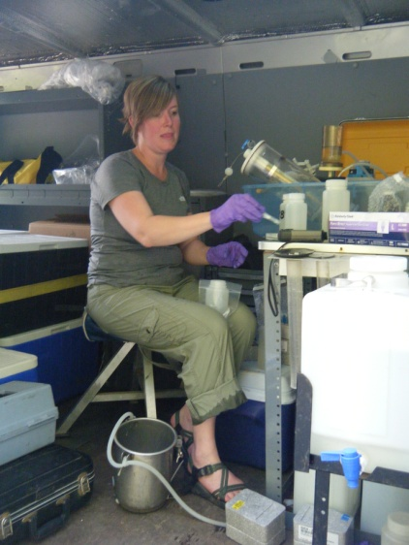
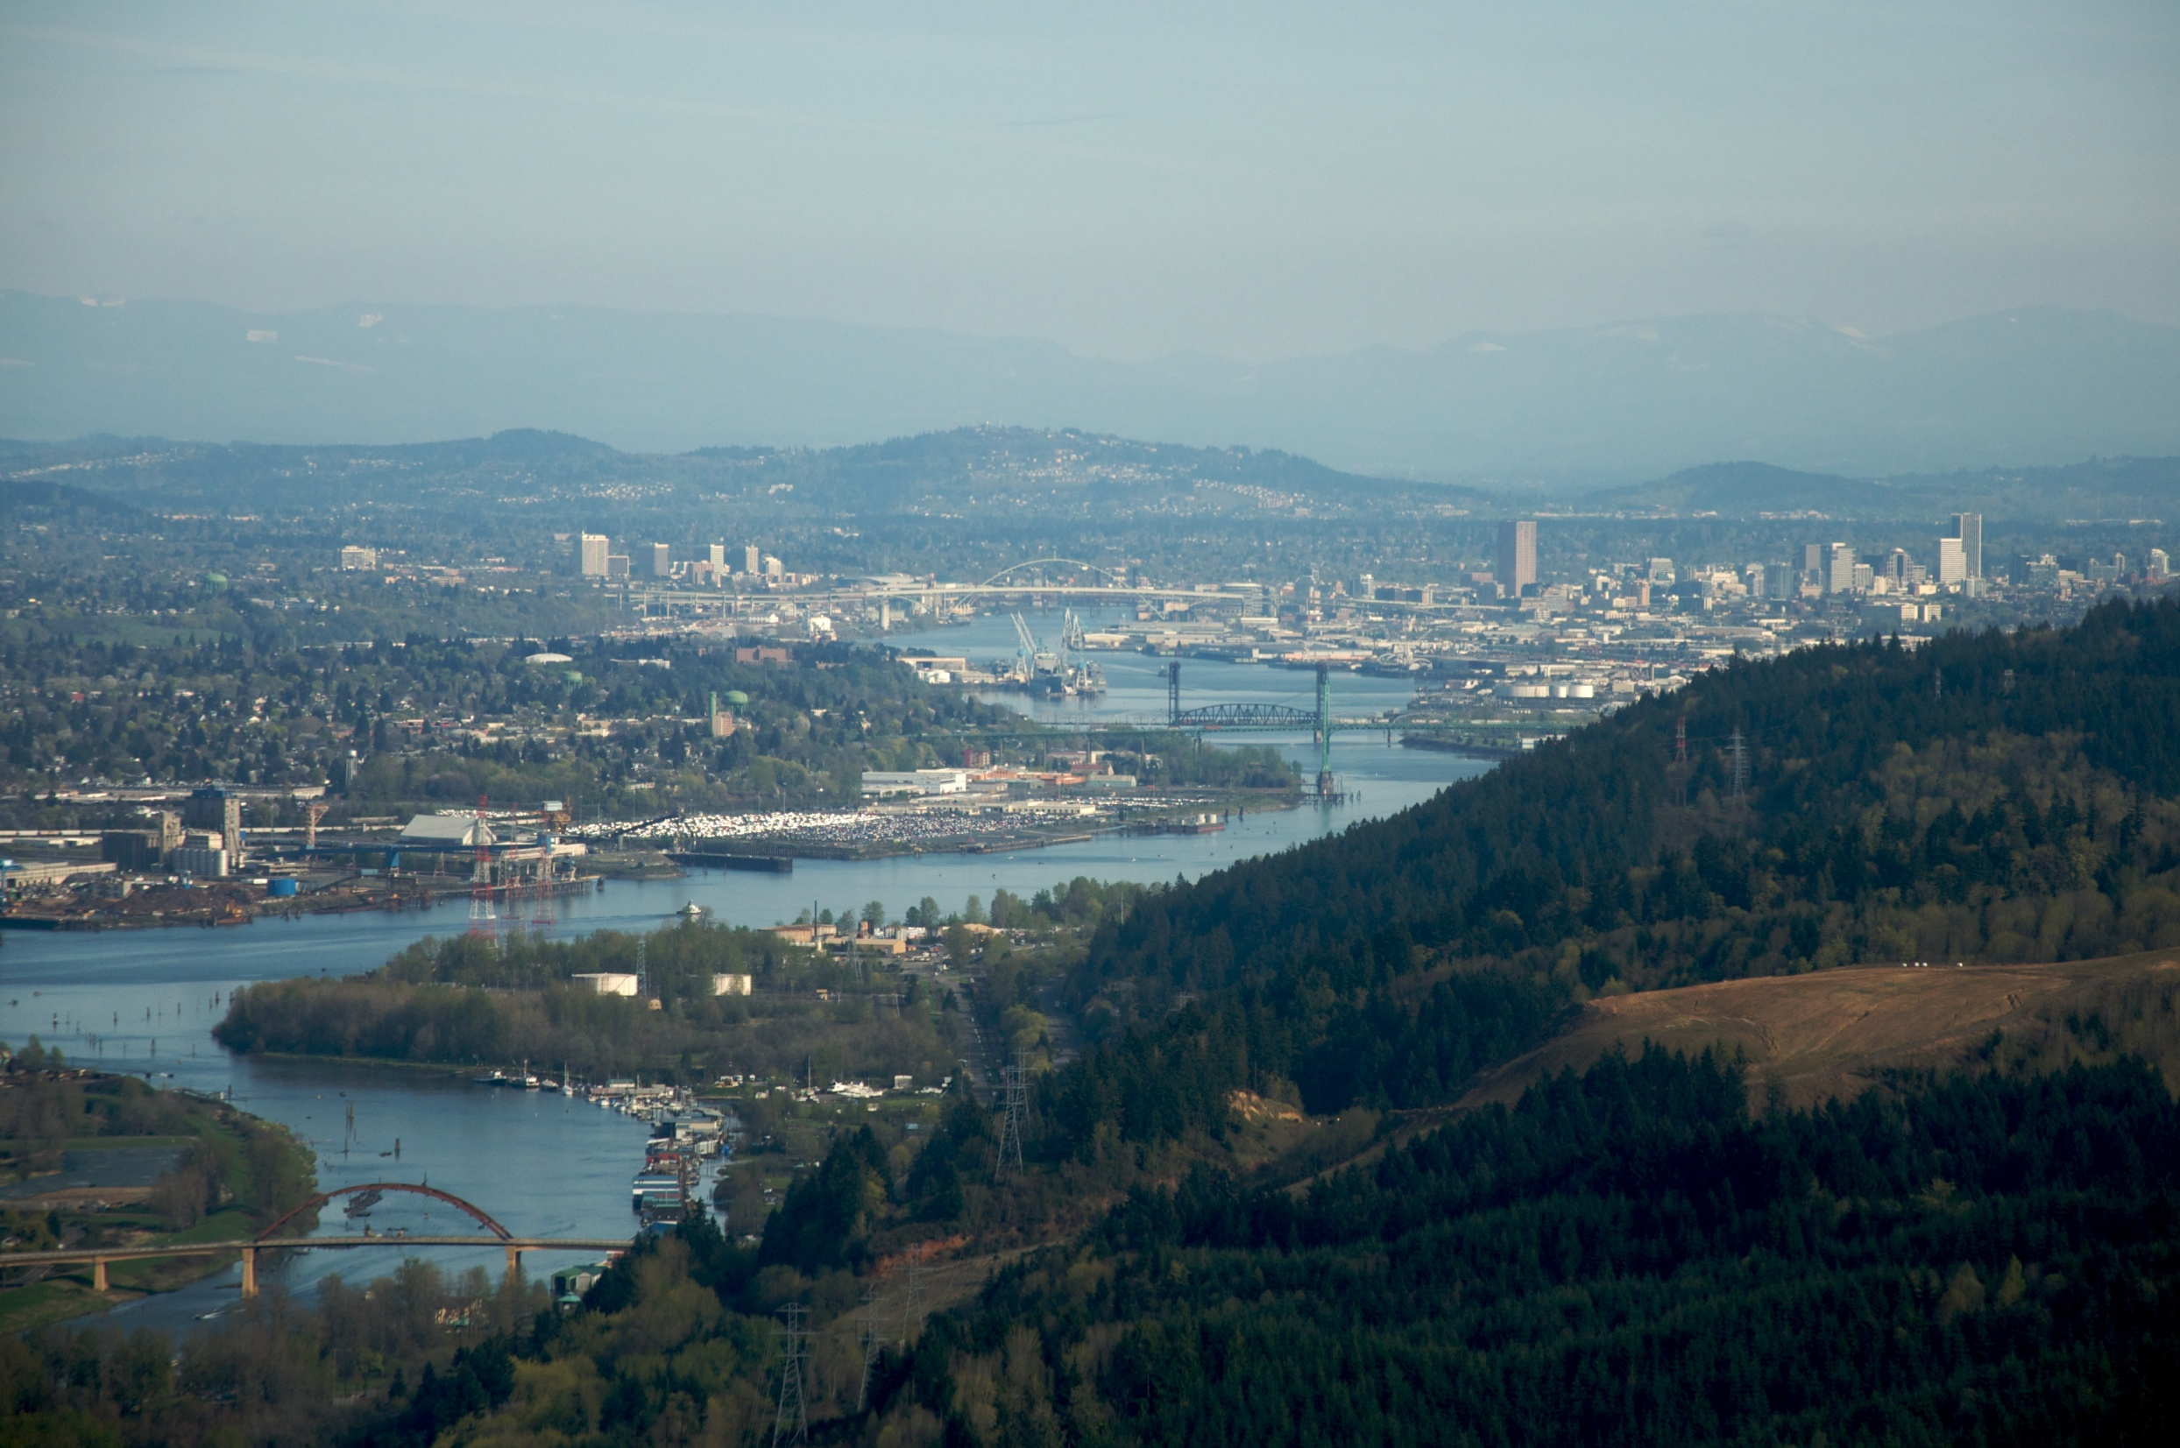
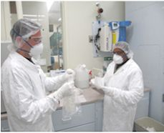
Toxics Trending Network NEW: planned for 2019
120 river sites network identified
60 sites monitored
Metals and Biotic Ligand Model parameters
~ follow-up 20 sites from list of WQ limited streams under the Clean Water Act (?)
Water samples spring, summer, fall
Sediment samples (?)
Fish samples at fewer sites (?)
Grow in sites and parameters as capacity increases

Slide 13
Michael Mulvey
Water Toxics Monitoring Coordinator
Oregon Department of Environmental Quality
Laboratory and Environmental Assessment
Water Quality Monitoring Section
7202 NE Evergreen Parkway, Suite 150
Hillsboro, Oregon 97124
503-693-5732
Mulvey.Michael@DEQ.state.or.us

Slide 14
Willamette Basin Sites from State-wide list of 120 sites
Station ID | Site | Land Use | Notes
10550 | Multnomah Channel at Coon Island | Mixed | high fish detections, not near any water sites,
10821 | Willamette River at St. John's Bridge | Urban | main stem 1, lower, many detections
38584 | Johnson Creek at SE Harney Drive downstream of Precision Cast Corp outfall | Urban | hot spot: fish site ds of PCC, probably interesting to Paul Siedel
11324 | Johnson Creek at Stanley Avenue (Milwaukie) | Urban | hot spot: fish site ds of PCC, probably interesting to Paul Siedel
11321 | Johnson Creek at SE 17th Avenue (Portland) | Urban | small stream hot spot: Portland stream. Many detections
10456 | Tualatin River at Boones Ferry Road | Urban | Trib. Many detections, mid
10916 | Tualatin River at Bridge upstream of mouth | Urban | Trib. Many detections lower
10360 | Clackamas River at Hwy 99E (Gladstone) | Urban | Tributary
31545 | Willamette River at Hebb Park Boat Ramp | Mixed | main stem 2, lower, many detections
10637 | Molalla River at Knights Bridge Road (Canby) | Agriculture | Trib. Some detections
33638 | Champoeg Creek near mouth at Champoeg State Park (Willamette) | Agriculture | small hot spot: mid valley stream. Many detections
10363 | Yamhill River at Dayton | Agriculture | Tributary. many detections
10640 | Pudding River at Hwy 211 (Woodburn) | Agriculture | Tributary. most Will detections
10344 | Willamette River at Wheatland Ferry | Agriculture | main stem 3,mid, many detections
28961 | Mill Creek at Front Street NE, Salem (tributary to Willamette River at River Mile 84) | Urban | small stream, many detections
10555 | Willamette River at Marion Street (Salem) | Mixed | main stem 4, mid, some detections
36875 | Luckiamute River at Buena Vista Road | Agriculture | Trib. Some detections
10792 | North Santiam River at Greens Bridge | Agriculture | Trib. Some detections
10350 | Willamette River at Albany (eastbound Hwy 20 bridge) | Agriculture | main stem 5, upper, some detections
10366 | South Santiam River Hwy 226 (Crabtree) | Agriculture | Trib. Some detections
11180 | Calapooia River at Queen Road | Agriculture | Trib, many detections
37248 | Lake Cr at Hwy 34 nr Tangent | Agriculture | small stream hot spot , many detections
10373 | Mary's River at 99W (Corvallis) | Mixed | Trib. Some detections
11140 | Long Tom River at Stow Pit Road (Monroe) | Agriculture | Trib, many detections
10376 | McKenzie River at Coburg Road | Mixed | Trib. Few water detections, but many fish detections
29044 | Willamette River at Greenway bike bridge, Eugene | Mixed | main stem 6, upper, few detections. Lots of Fish detections
38586 | Willamette R at west bank stormwater outfall Maurie Jacobs Park Eugene | Urban | small stream hot spot: Stormwater outfall in Eugene, sediment is high in detections
11275 | Coast Fork Willamette at Mt. Pisgah Park | Agriculture | Trib. Some detections
10386 | Middle Fork Willamette River at Jasper Bridge | Mixed | Tributary
27986 | Willamette R MF above Hills CR at USGS Gage 14144800 | Forest | background site, upper basin in national forest
Upstream to downstream

Slide 15
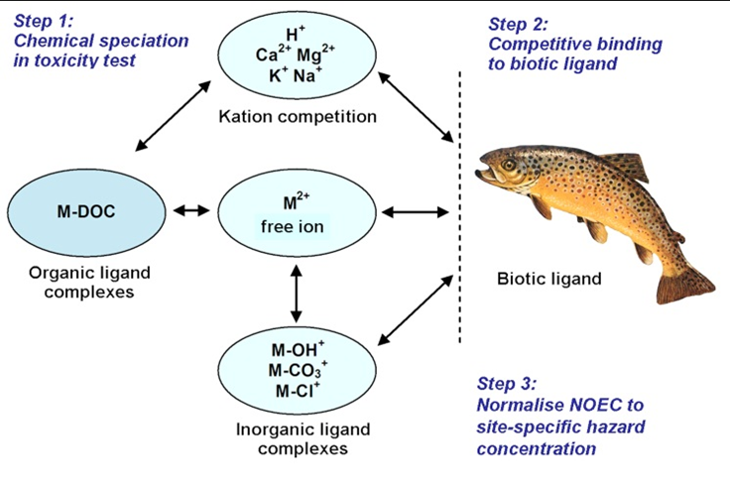
Biotic Ligand Model of Metals Toxicity in Water
Alkalinity
Ammonia
Chloride
Dissolved Organic Carbon
Total Organic Carbon
Field measured parameters: Conductivity, dissolved oxygen, pH, temperature, turbidity
Total Mercury
Nitrate + Nitrite
Total Phosphate
Total Nitrogen
Sulfate
Metals: Dissolved and Total
Aluminum
Antimony
Arsenic
Barium
Beryllium
Cadmium
Calcium
Chromium
Copper
Hardness as CaCO3
Iron
Lead
Magnesium
Manganese
Nickel
Potassium
Selenium
Silver
Sodium
Thallium
Zinc

