Slide 1

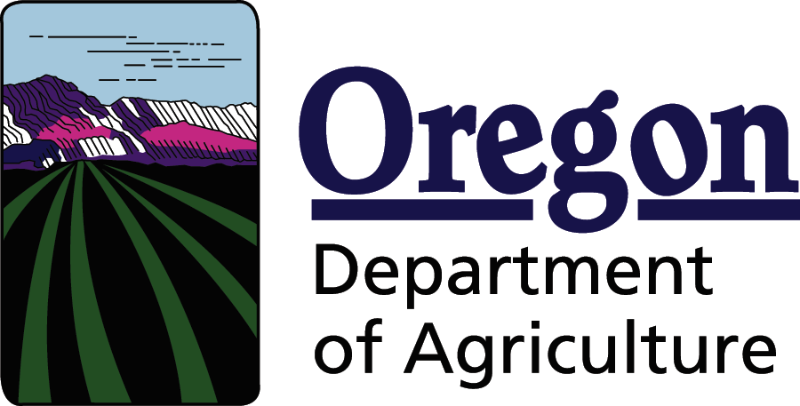
Toxics: Water Quality
Actions on Agricultural Lands
Willamette River Toxics
Reduction Partnership
June 26, 2019

Slide 2
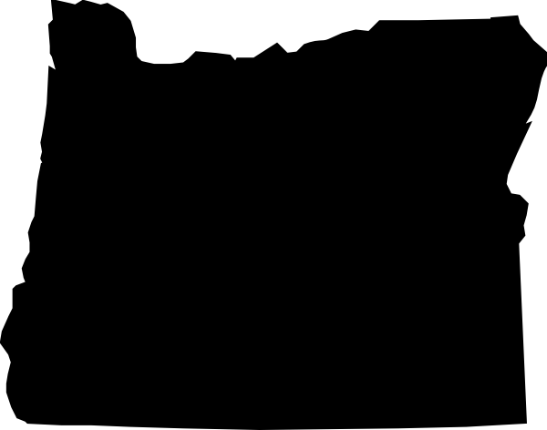
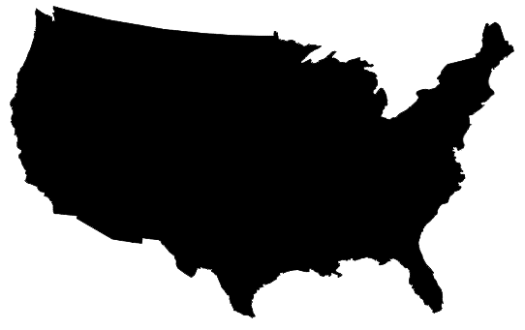



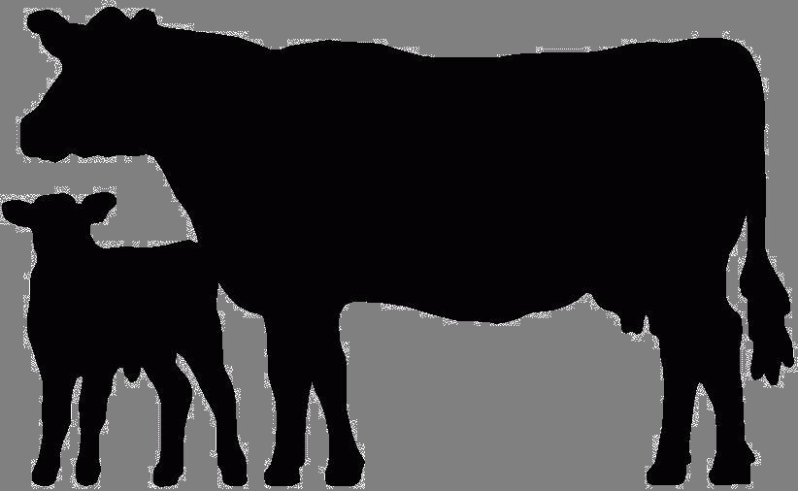
A Division of Responsibility
Oregon Department
of Environmental Quality
Oregon Department
of Forestry
1972 CWA
Oregon Department
of Agriculture
Agricultural Water Quality Management Act 1993
• Senate Bill 502 Clarified:
• ODA has lead authority to regulate farming practices for water quality
• Must meet water quality standards set by Environmental Quality Commission

Slide 3
Oregon Agricultural Water Quality Management Areas
Notes:
Talking point: DEQ and ODF also have regulatory authority

Slide 4
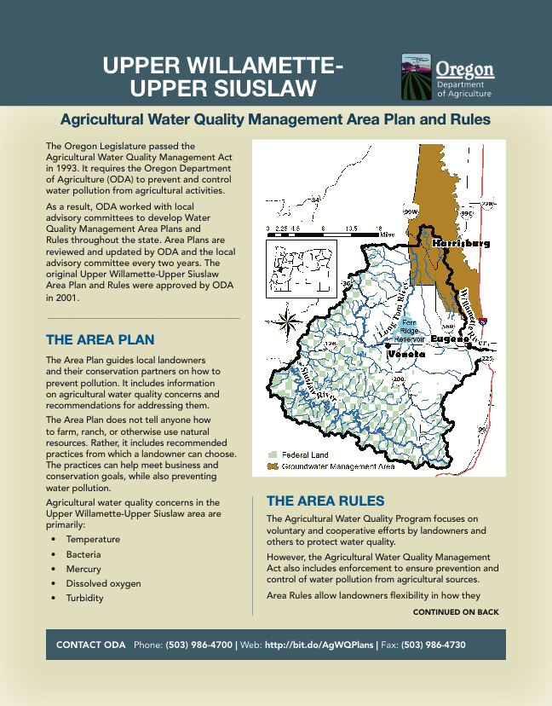
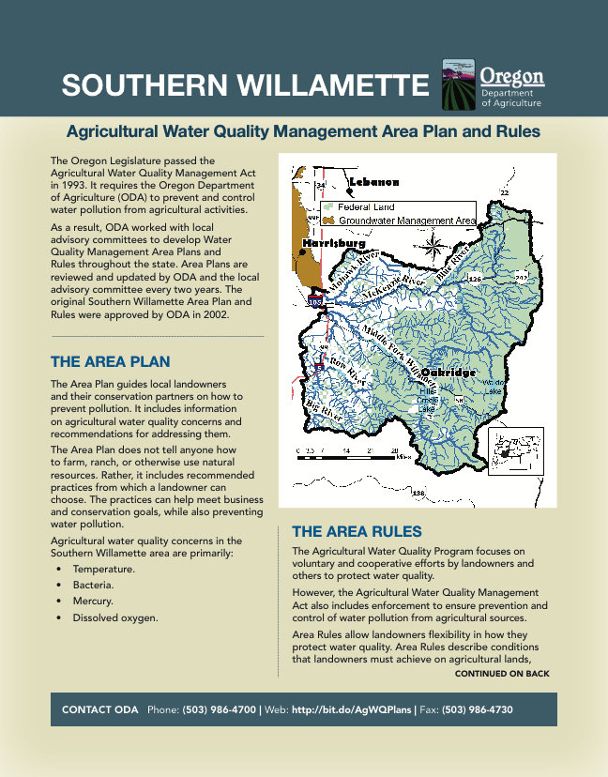
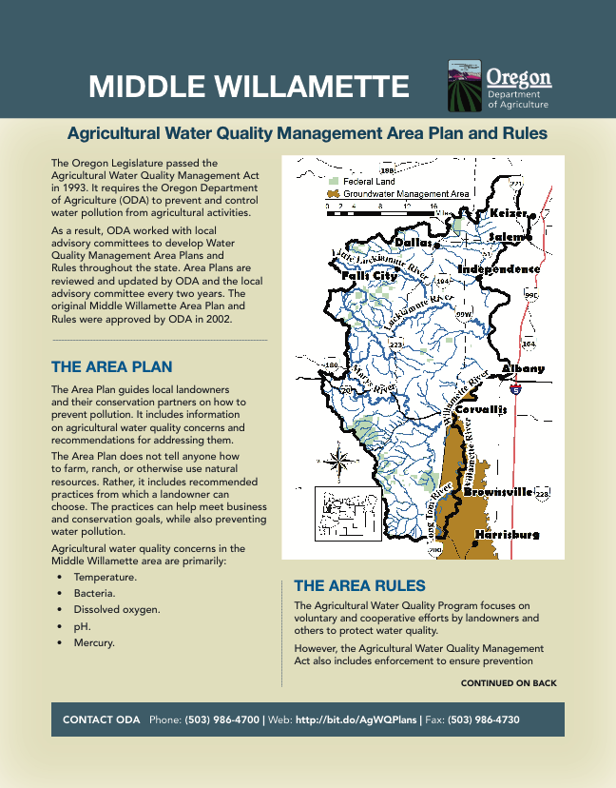
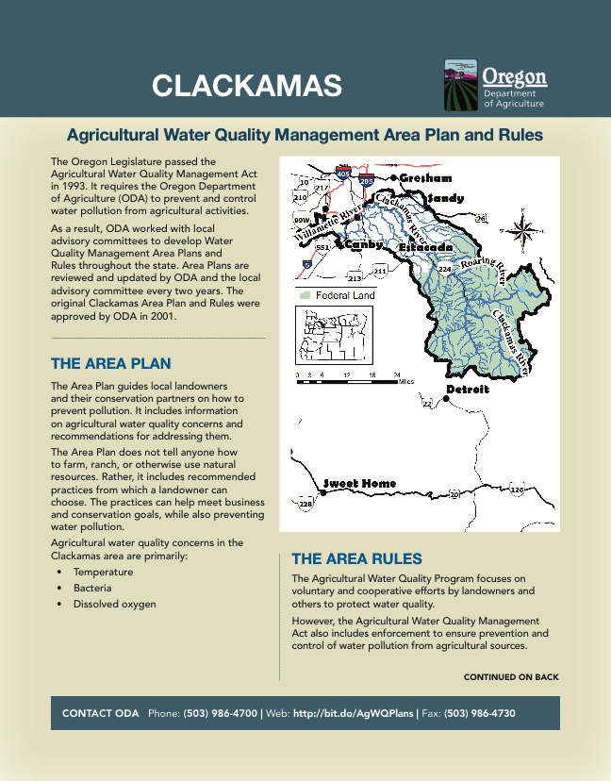
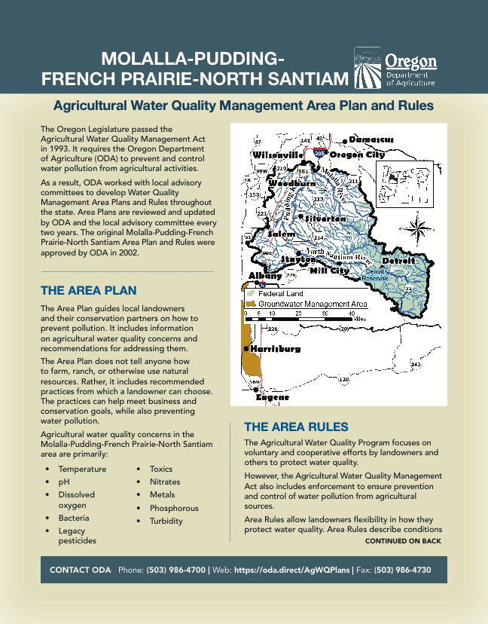
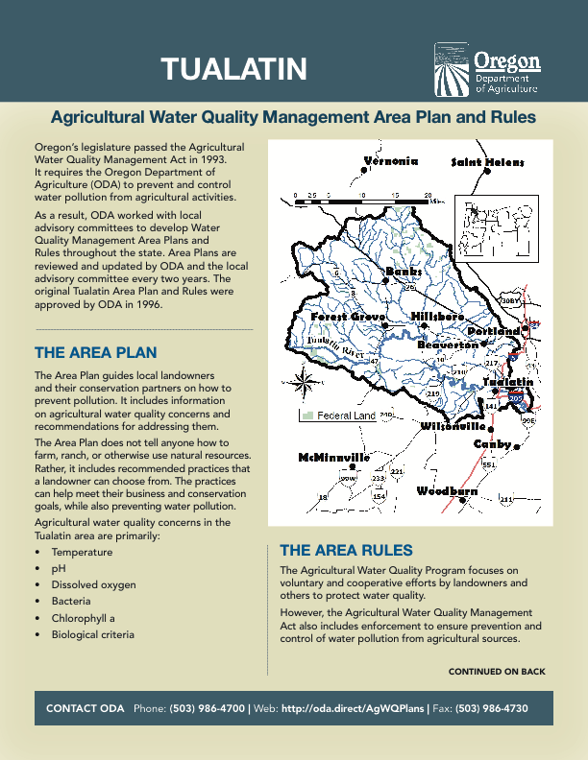
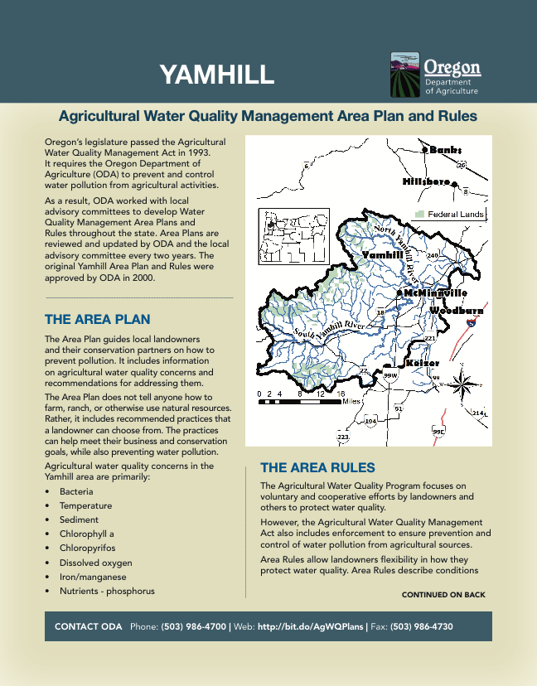
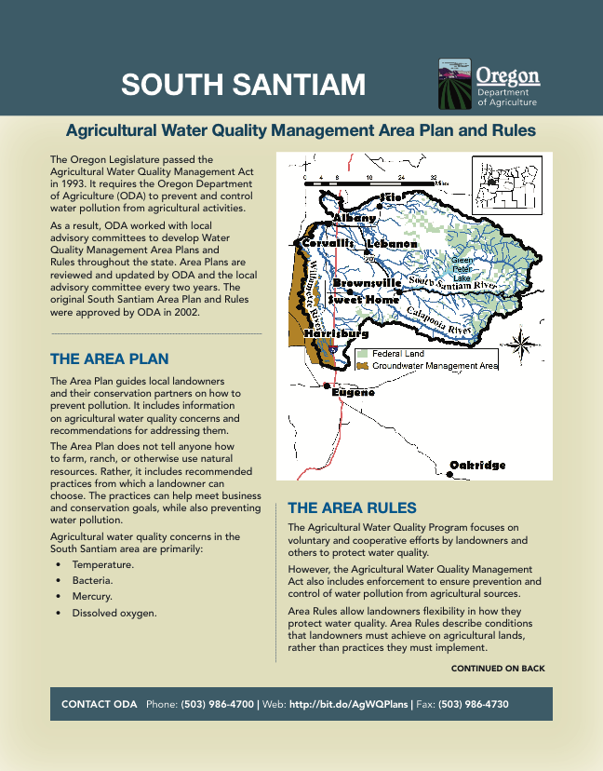
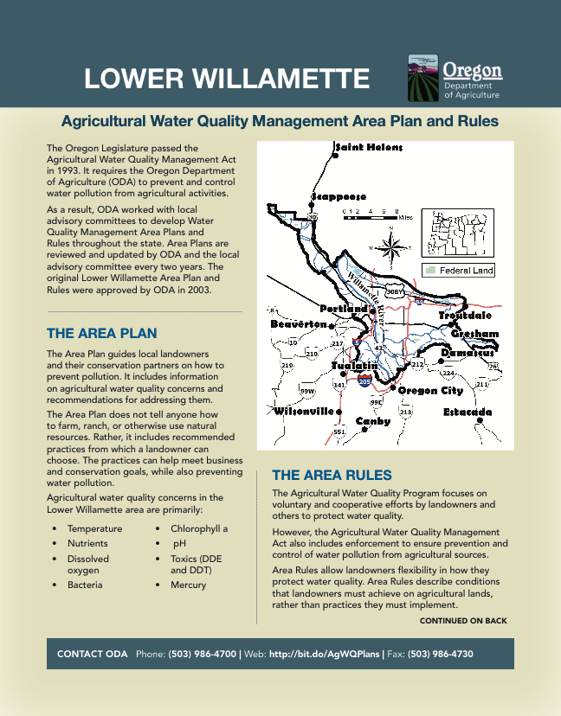

Slide 8

Water Quality Initiatives

Slide 11
ODA Natural Resources Program Area
Confined Animal Feeding Operation - CAFO
Water Quality Program
Pesticides & Fertilizer Program
Compliance
Program
Agricultural WQ Management Area Rules
Monitoring
Strategic Implementation Areas
Soil & Water Conservation Districts
Agricultural Water Quality Management Area Plans
Stream
Temperature
Pesticide Stewardship Partnership
Pesticide Analytical & Response Center
Pesticide Licensing
& Certification
Pesticide Registration
Monitoring & Assessment Group (MAG)
Coordinated Streamside Management

Slide 13
Toxics: Water Quality
Actions on Agricultural Lands

Slide 14
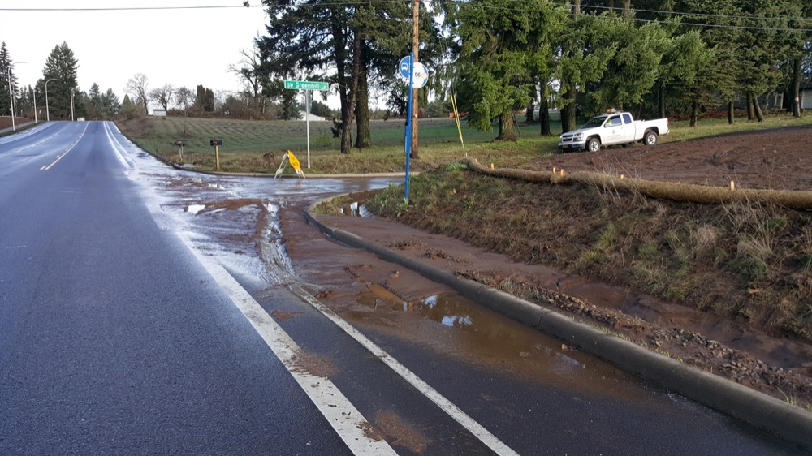
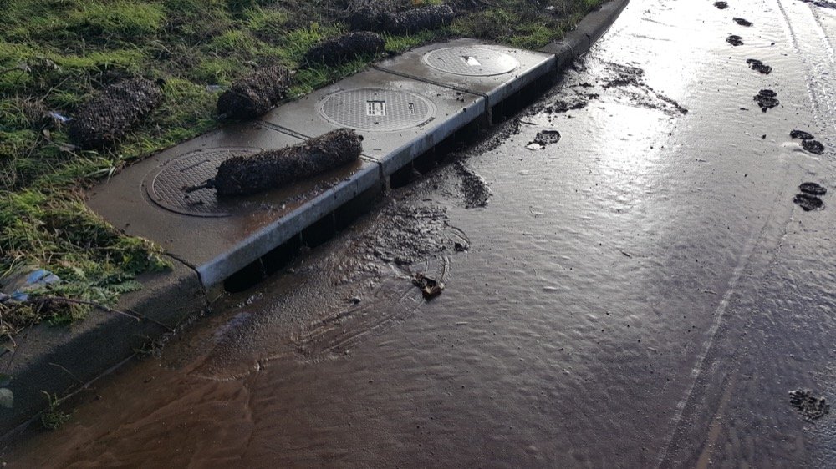
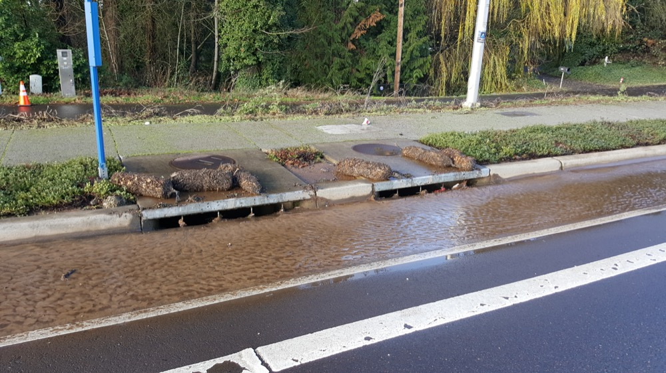

Slide 15
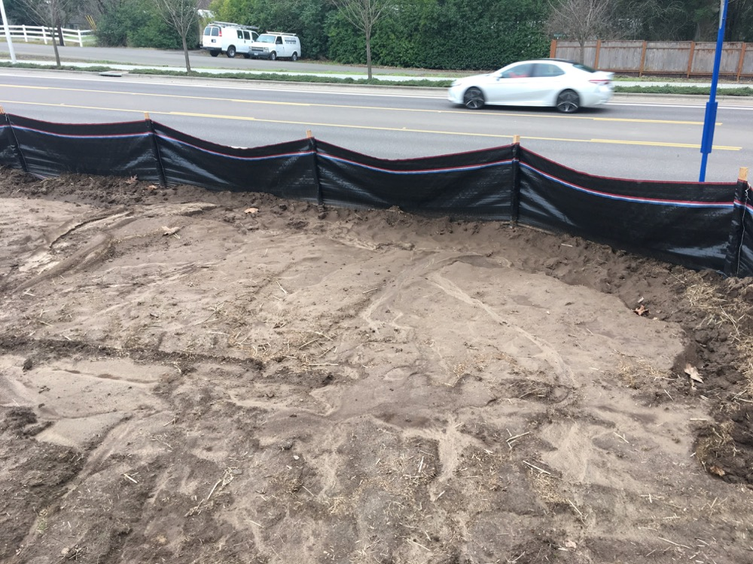
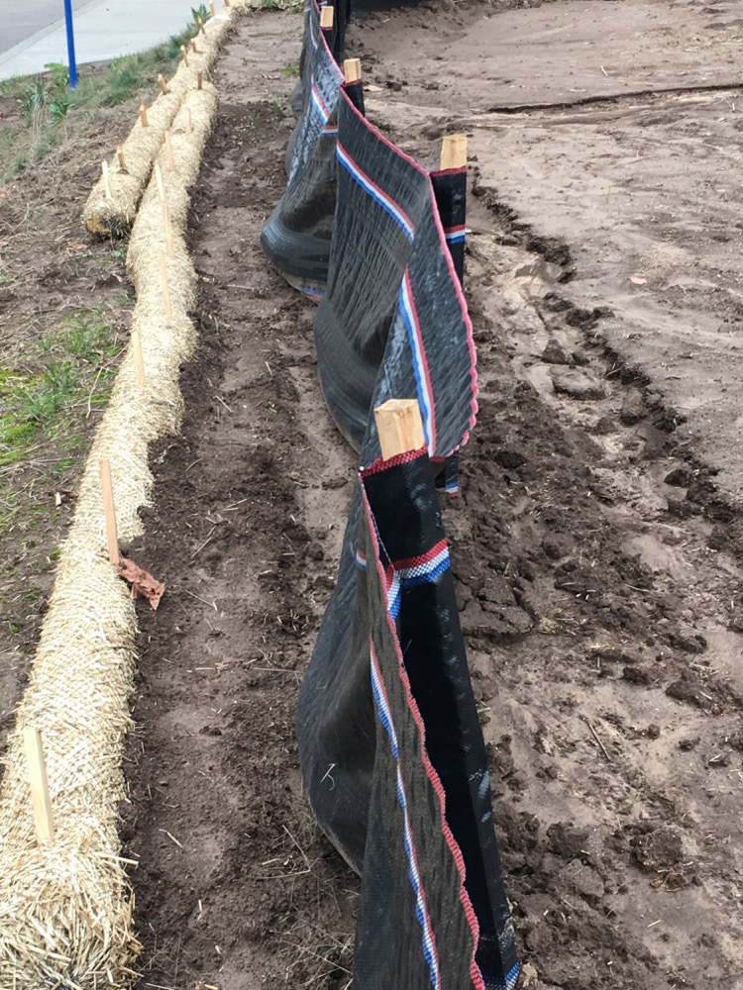
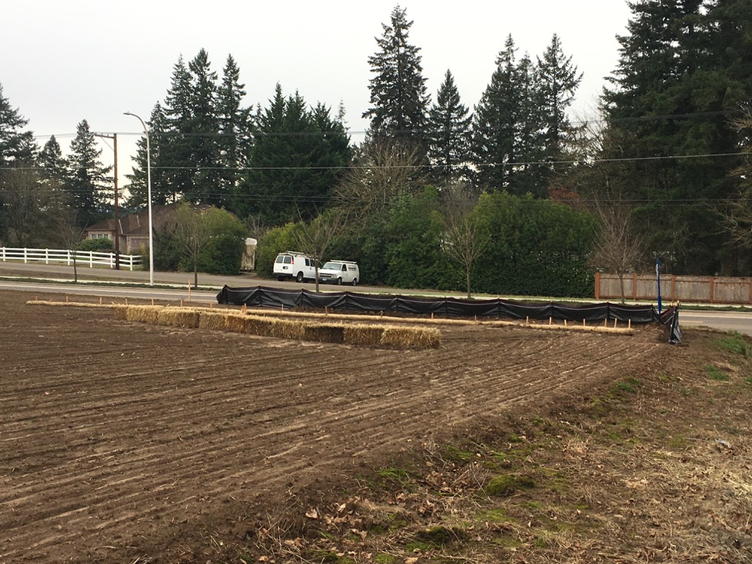

Slide 17
Back to Basics
ODA WQ emphasis on preventing and controlling soil erosion from ag activities in Area Plans through Biennial Reviews and discussions with LAC & SWCDs.
Supporting Soil Health practices and using as guidelines when working with upland landowners.
Working to draft soil erosion objectives and metrics into Area Plans.
SIAs – Have an evaluation priority of bare ground.
PSP is currently discussing how to link with the WQ program to assist in reduction actions.
Soil and Water Conservation Districts

Slide 19
Any Questions?

