Slide 1
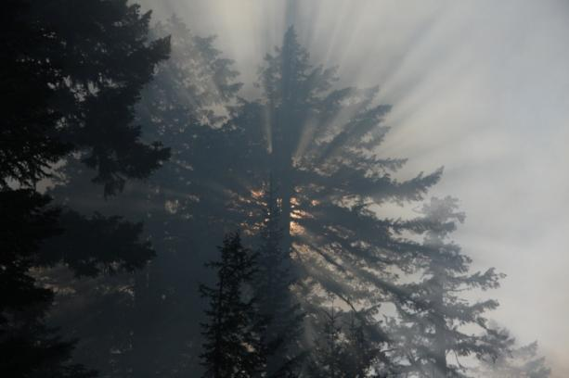
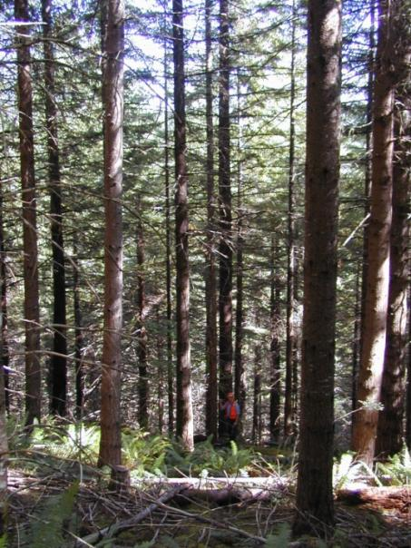
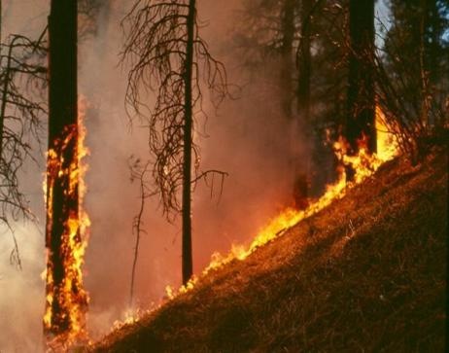
Wildfire Issues and Trends on Federal Lands in Oregon
William Aney
Fuels Specialist and
Long Term Fire Analyst
PNW Region, USFS

Slide 2
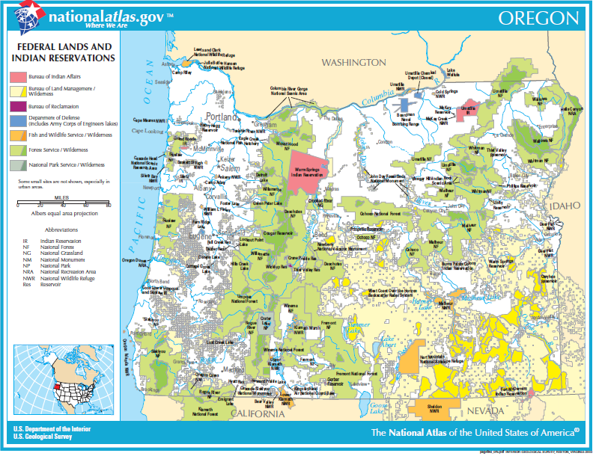

Slide 3
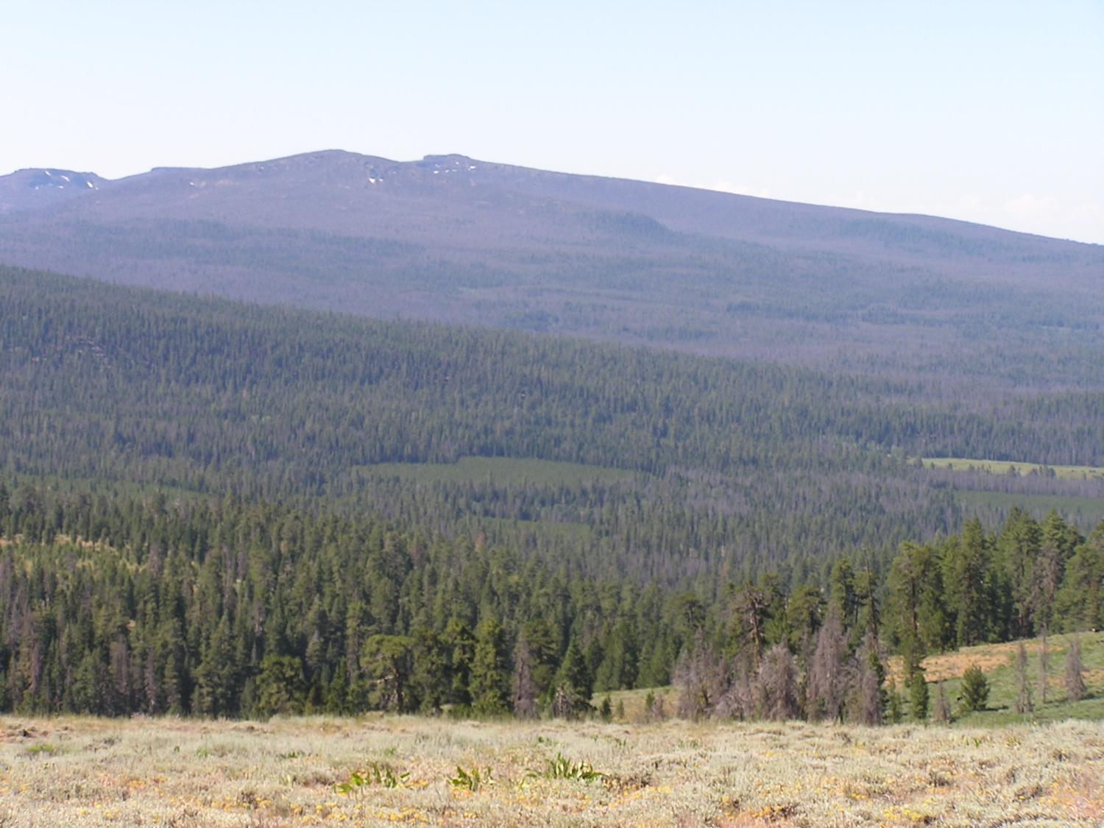

Slide 4
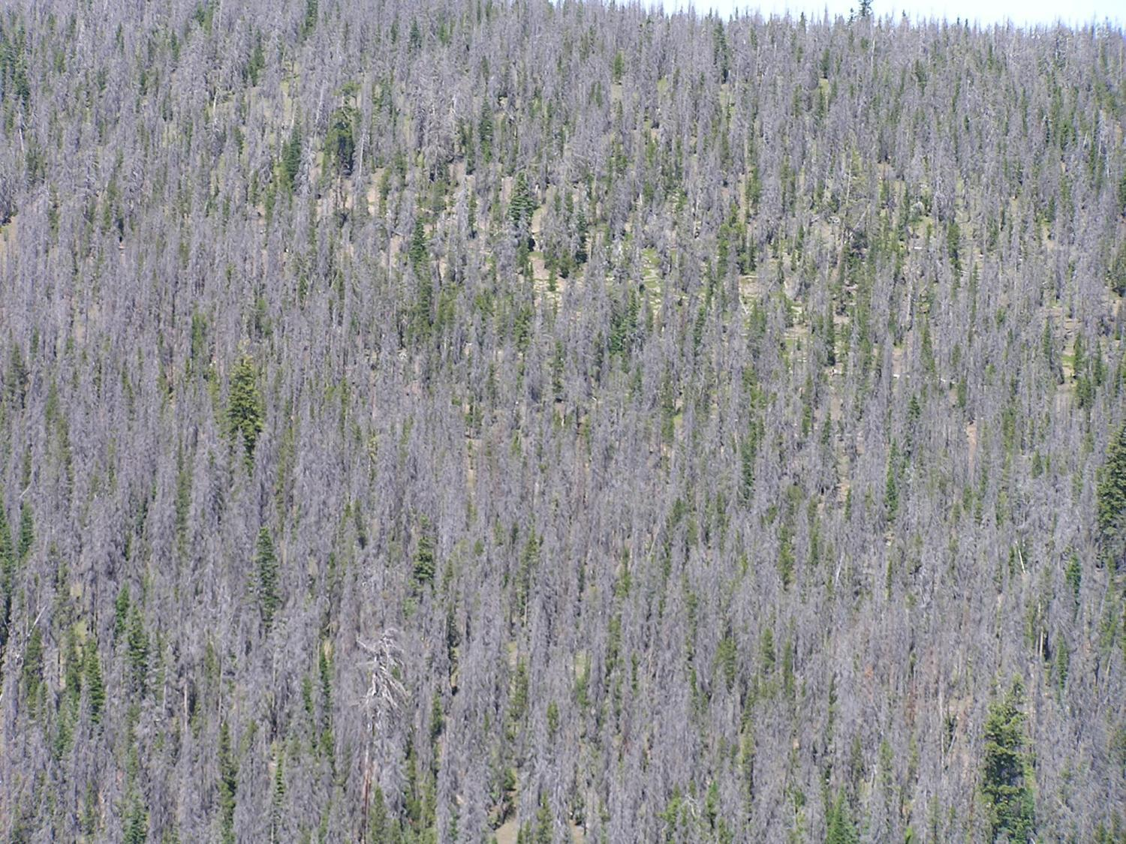

Slide 5
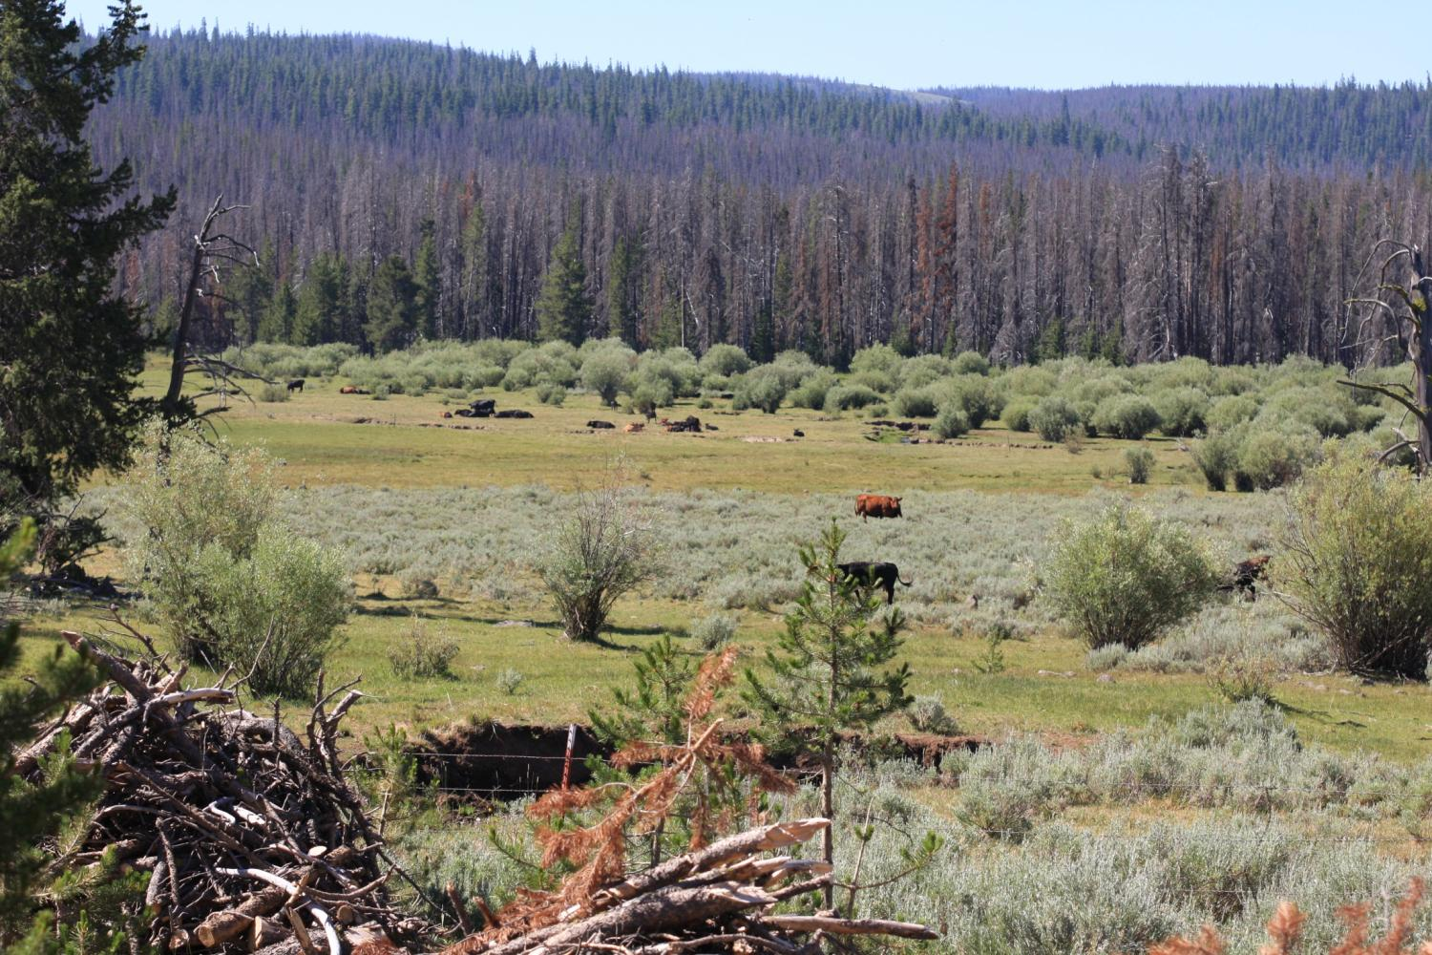

Slide 6
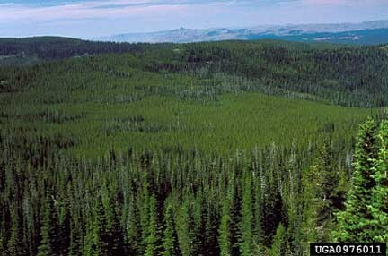

Slide 7
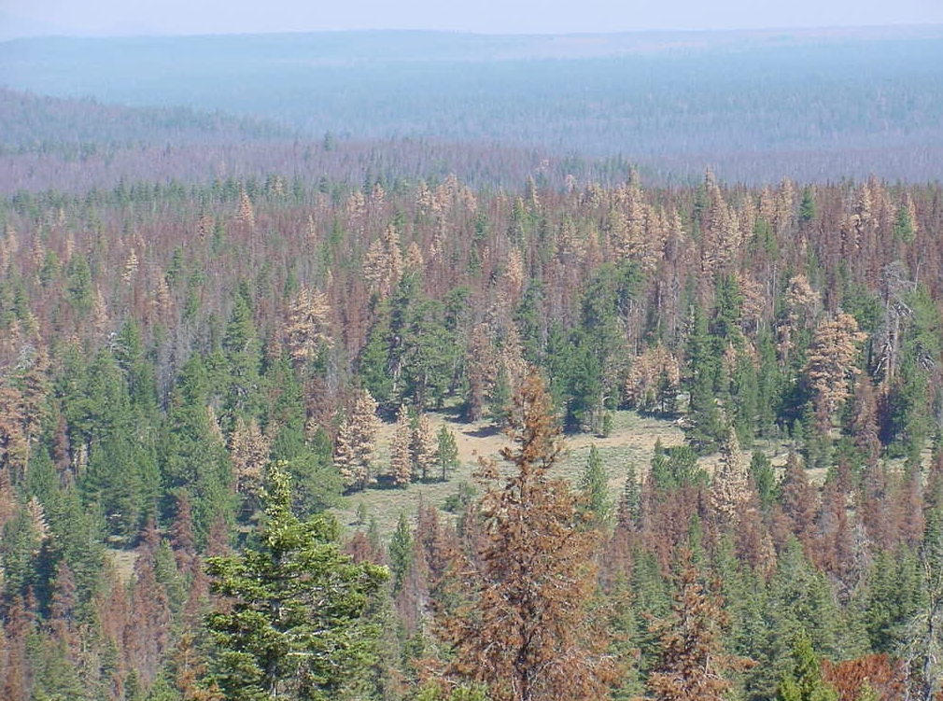

Slide 8
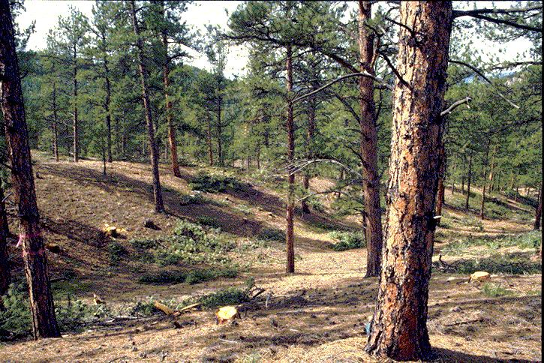
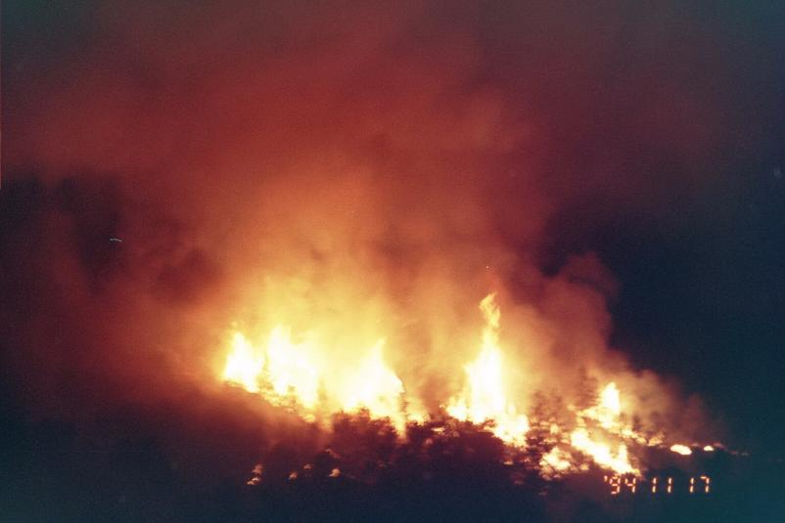
The FRCC Calculation
FRCC
Departure in Vegetation
seral stages
composition
Departure in Fire
frequency
severity

Slide 9
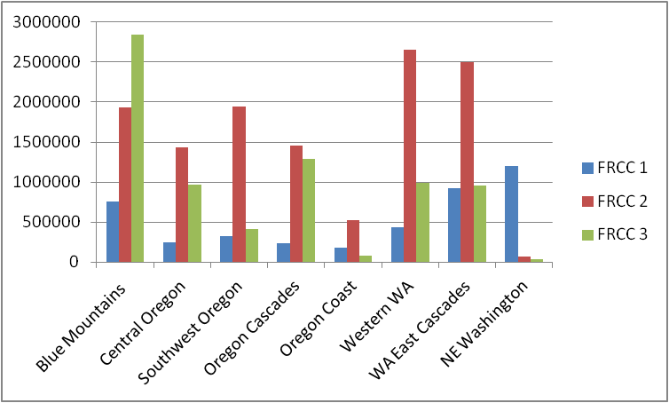
Current Condition

Slide 11
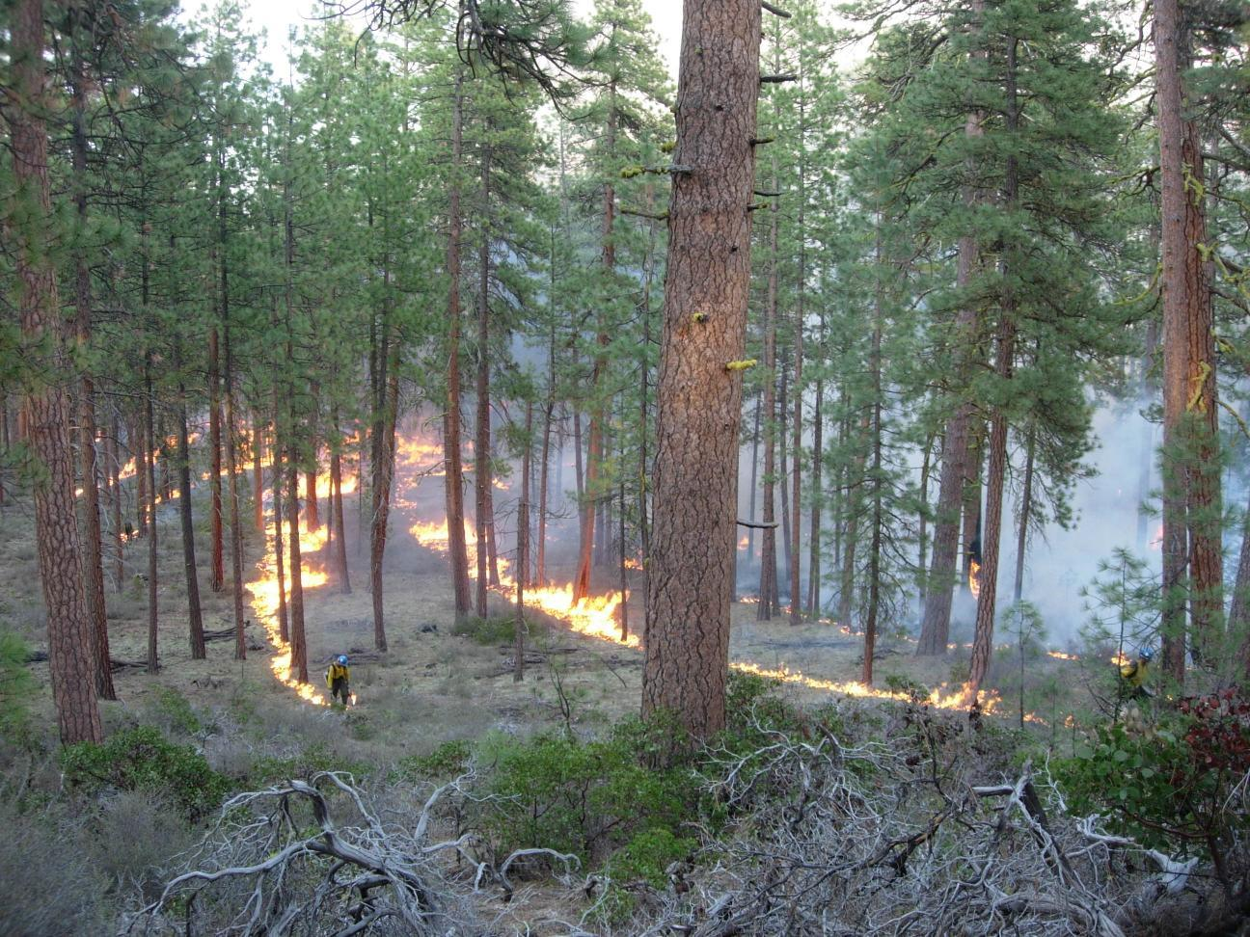

Slide 12
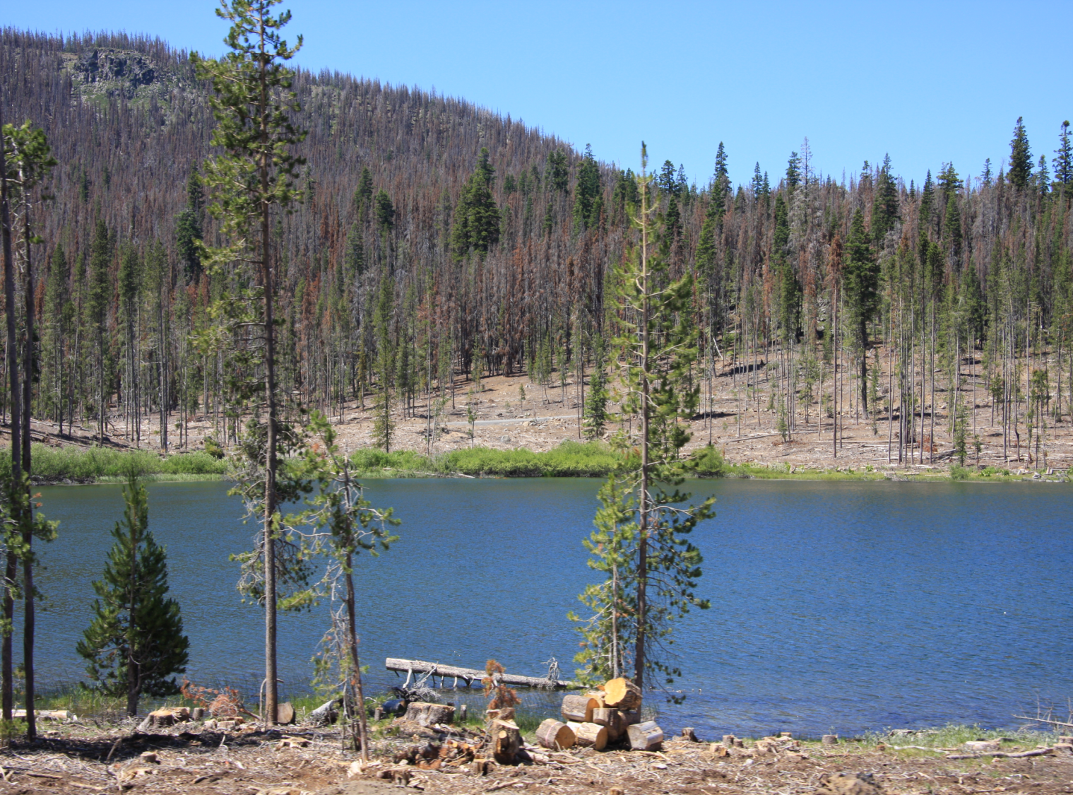

Slide 13
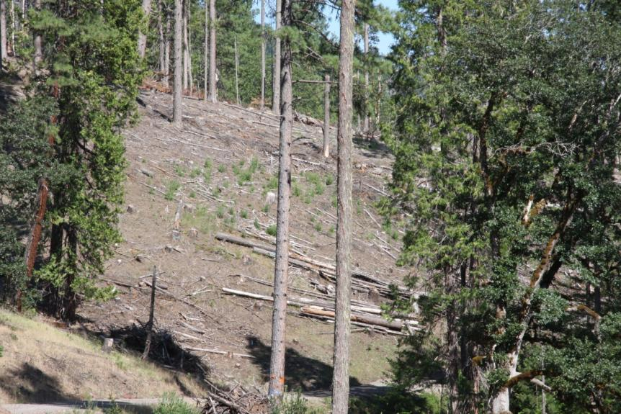
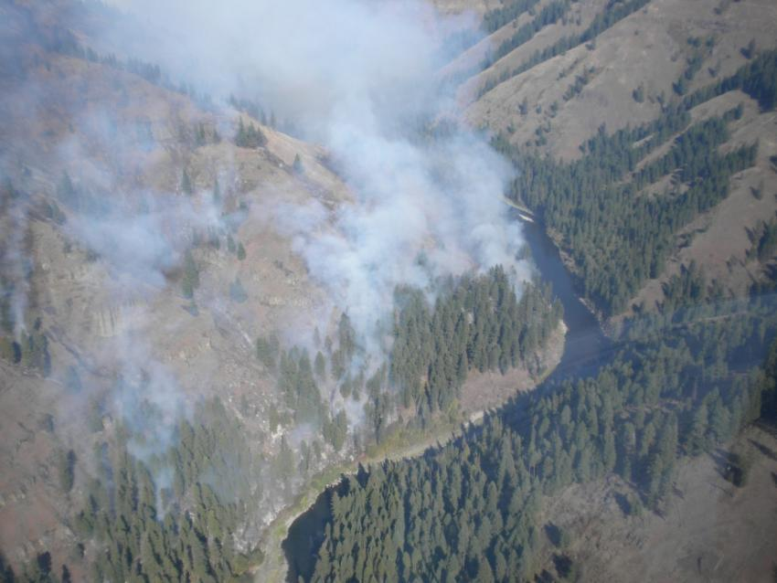
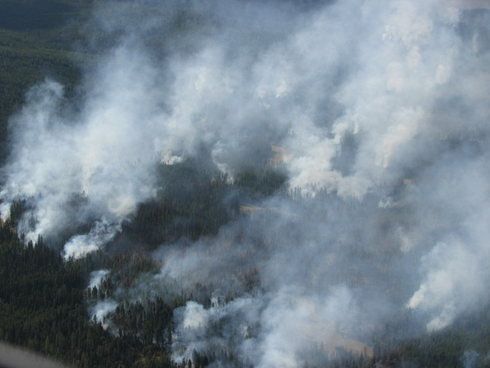
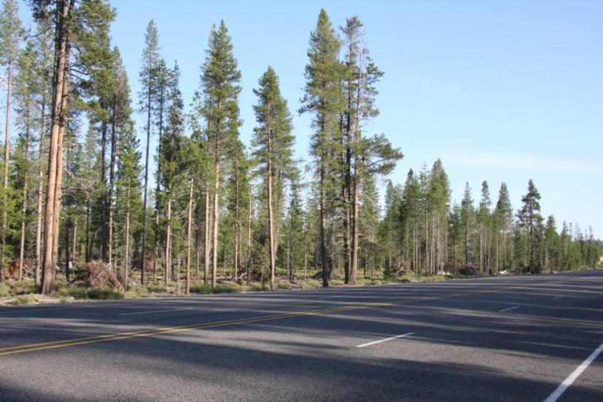

Slide 14
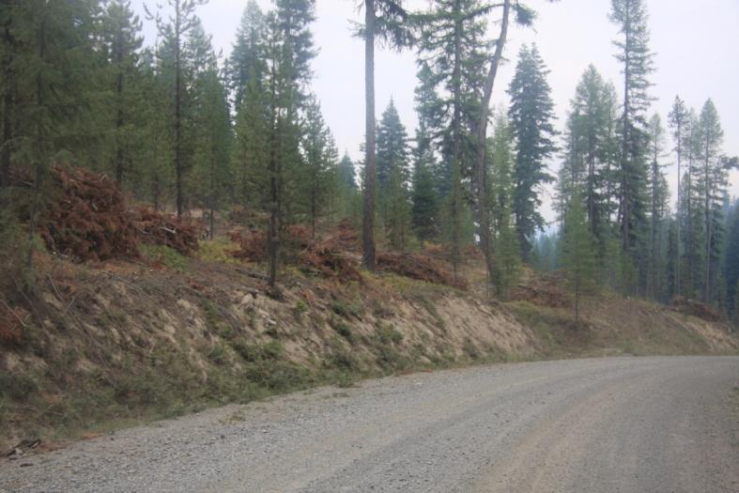
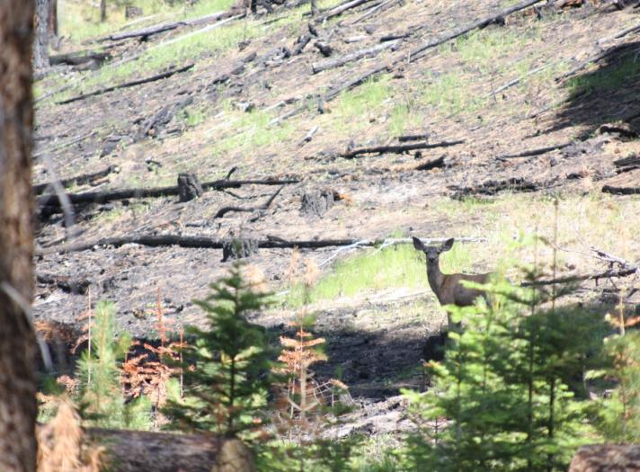
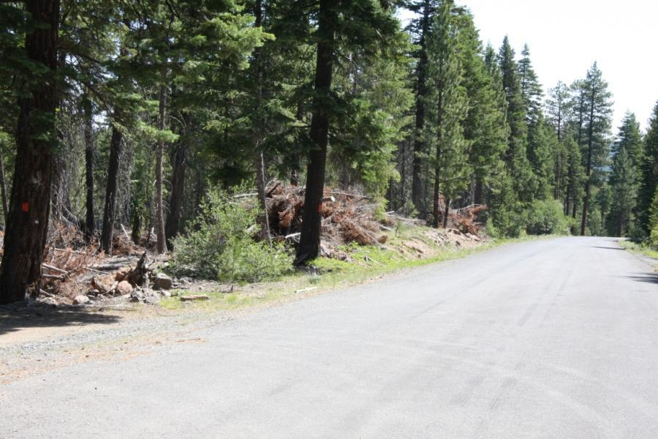
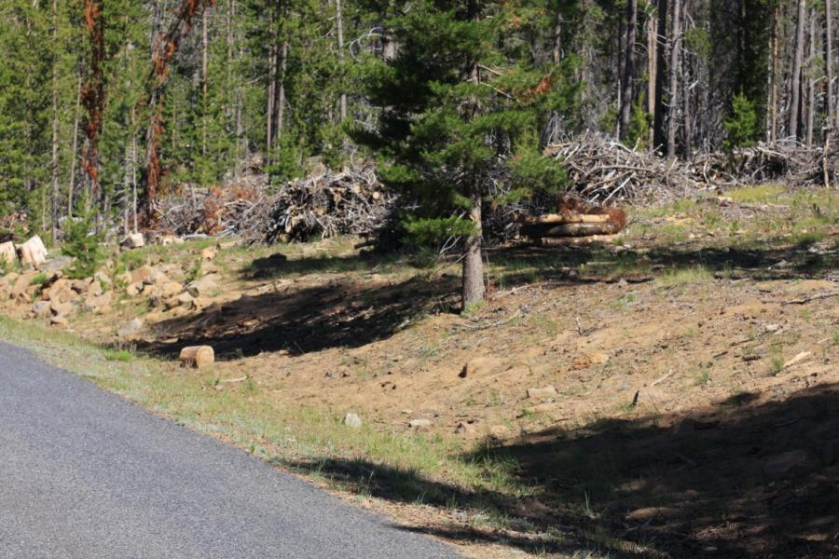

Slide 15
Fuels Treatment on Oregon National Forests, 2002-2011
Acres of Fuel Treatment

Slide 16
Fuels Treatment – Pacific Northwest National Forests
2002-2011
WFSU = wildfire acres
Rx fire = prescribed fire (broadcast burning and pile burning)

Slide 17
Fuels treatment prioritization
In anticipation of wildfire, focus on
Protection – of WUI, highly valued resources, infrastructure
Restoration – set up landscapes to include wildfire as a restoration agent

Slide 18
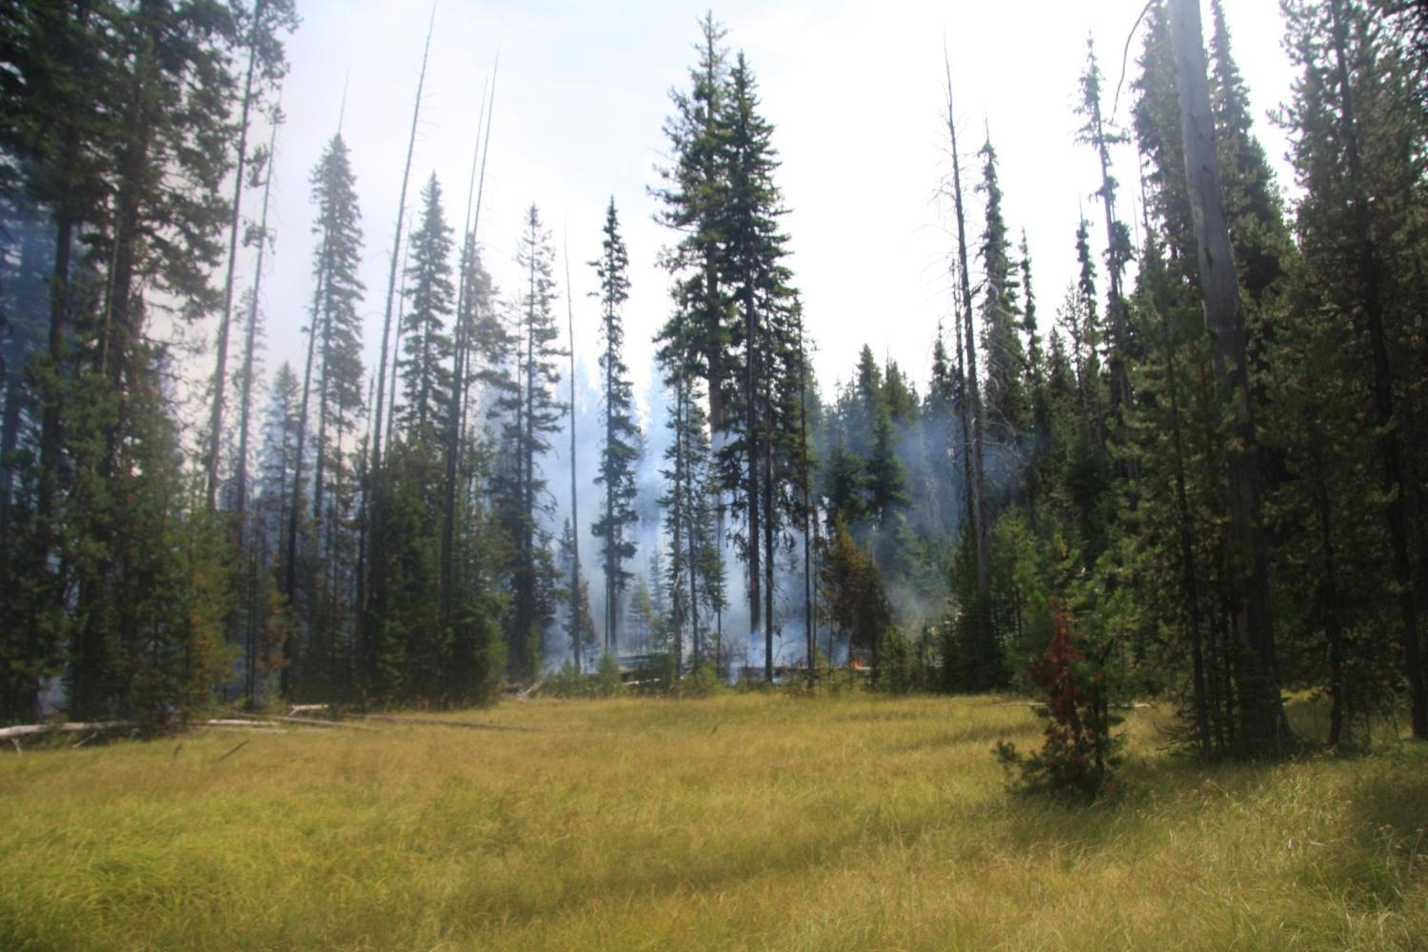

Slide 19
Acres Burned by Wildfire on National Forests in Oregon
1981-2009

Slide 20
Acres Burned by Wildfire on National Forests in Oregon
1981-2009, excluding 2002

Slide 22
Quail Mountain (SW OR)
Tupper/Case (NE OR)
Granddad/Toketee (WCentOr)
Cabin Lake (SE OR)

Slide 23
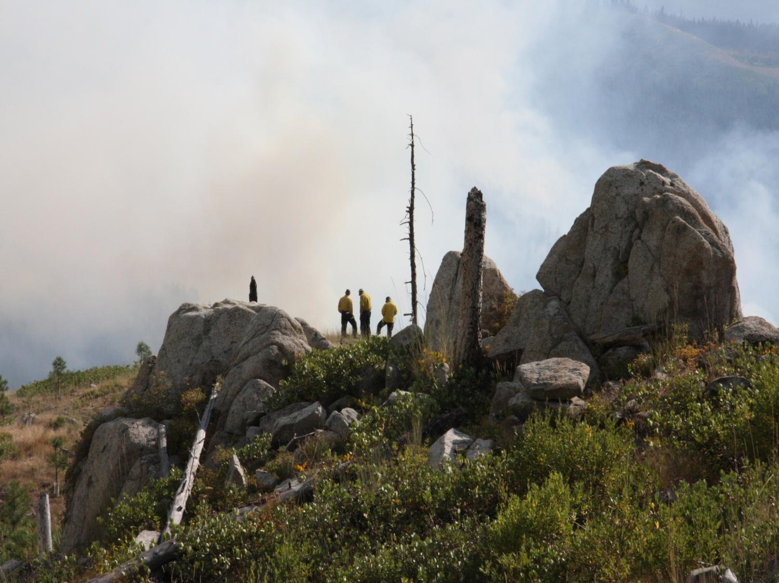

Slide 24
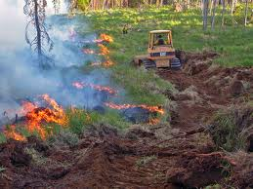
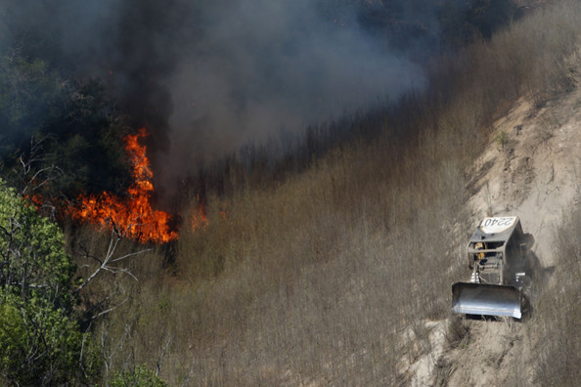

Slide 26
Risk Management the new currency in fire management
What is at risk?
  Public safety, health
  Property, improvements, infrastructure, natural resources
  Firefighters

Slide 27
Wildfire Terminology
Resource Benefit Fires
Appropriate management response
Wildfire Use for Resource Benefits
Suppression Fires
Prescribed Natural Fires

Slide 28
Federal Fire Policy
2011 Guidelines
2 Types of Wildland Fires
Planned
(Prescribed Fire)
Unplanned
(Wildfire)

Slide 29
Federal Wildfire Policy
Protection of life and property always an objective
A wildfire may be concurrently managed for more than one objective
Manage unplanned natural ignitions to achieve desired Land and Resource Management Plan objectives when risk is within acceptable limits

Slide 30
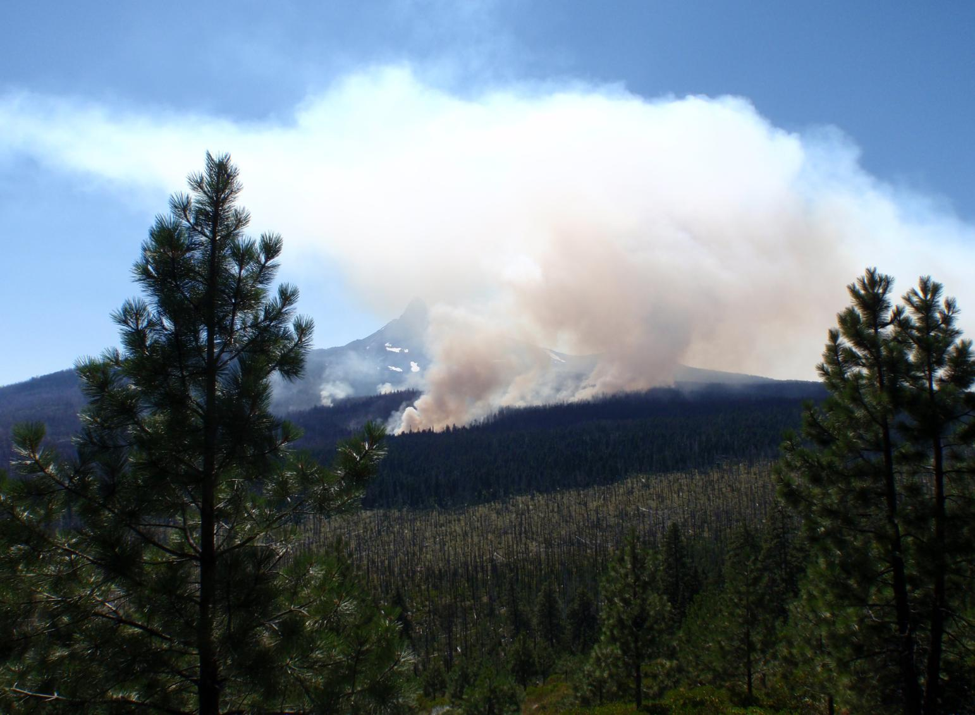

Slide 31
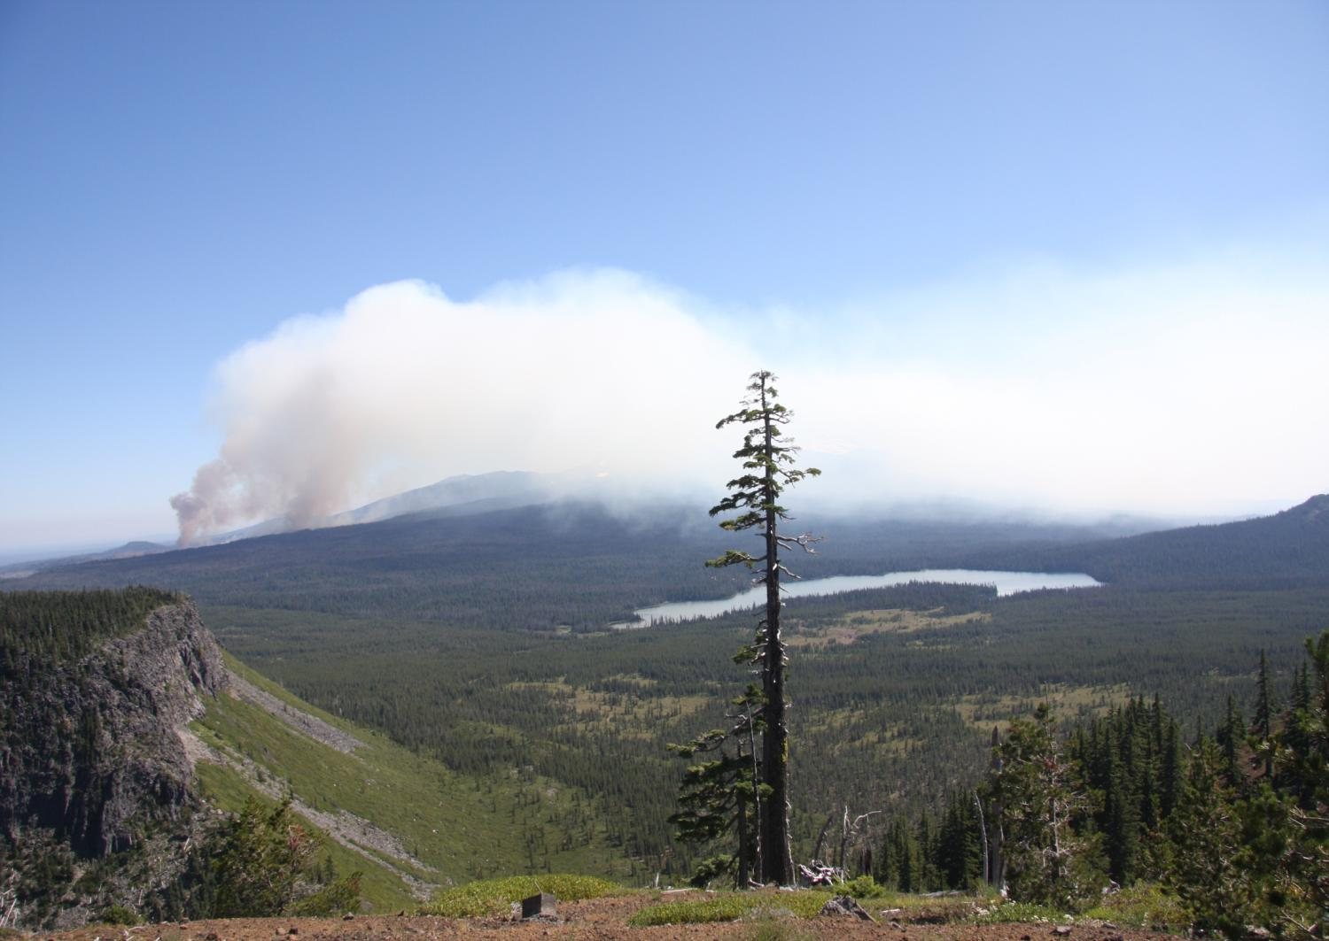

Slide 32
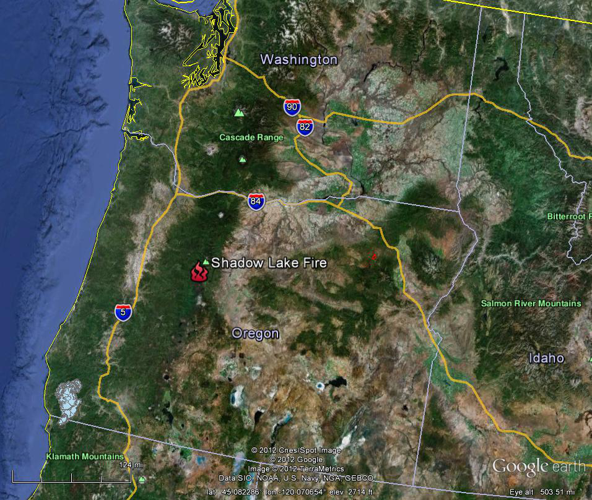

Slide 33
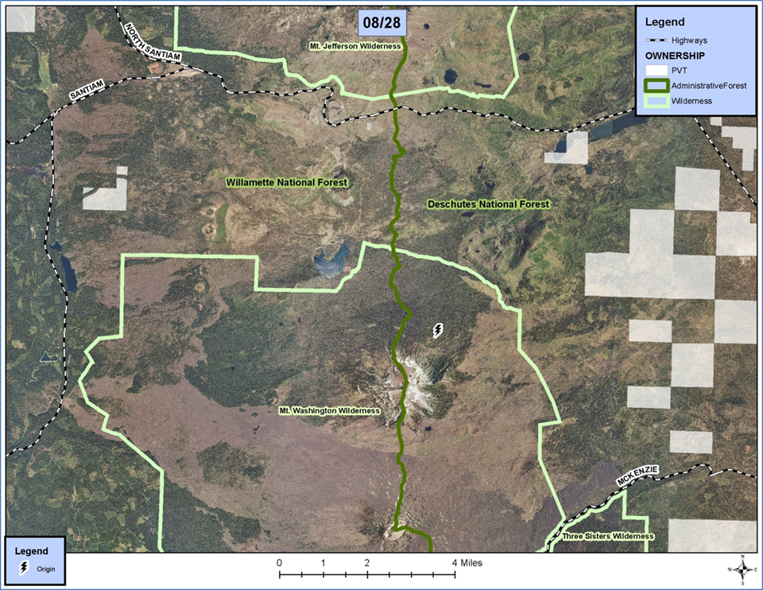

Slide 34
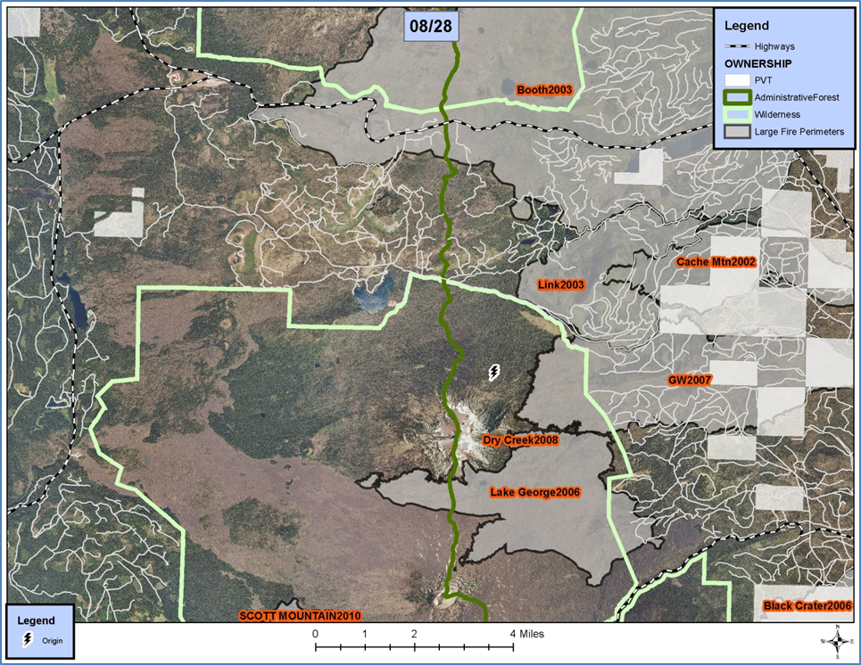

Slide 35
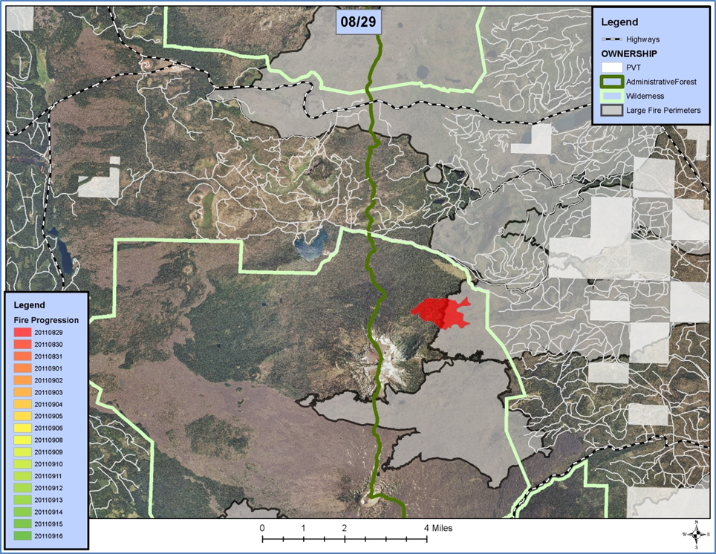

Slide 36
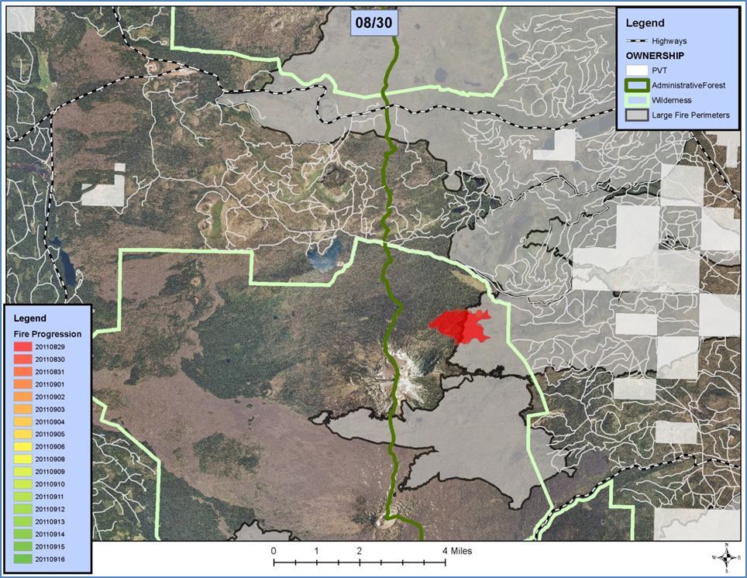

Slide 37


Slide 38


Slide 39


Slide 40


Slide 41
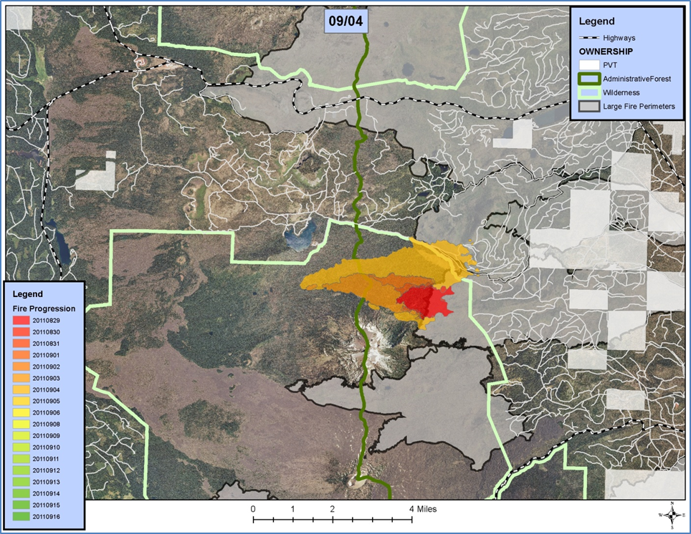

Slide 42
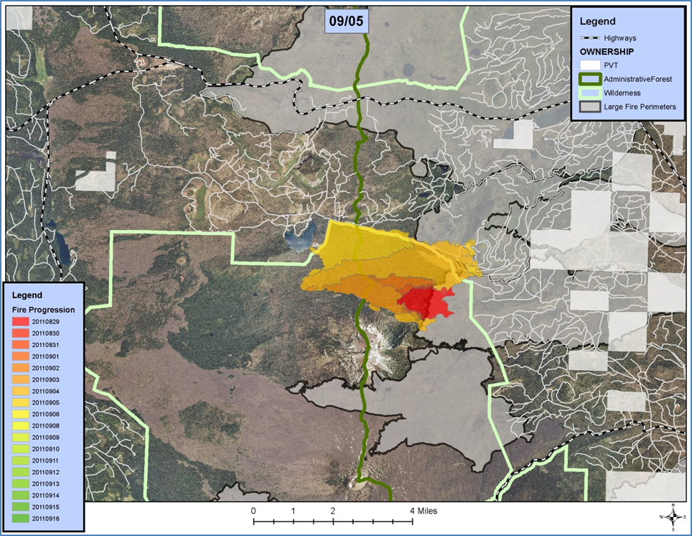

Slide 43
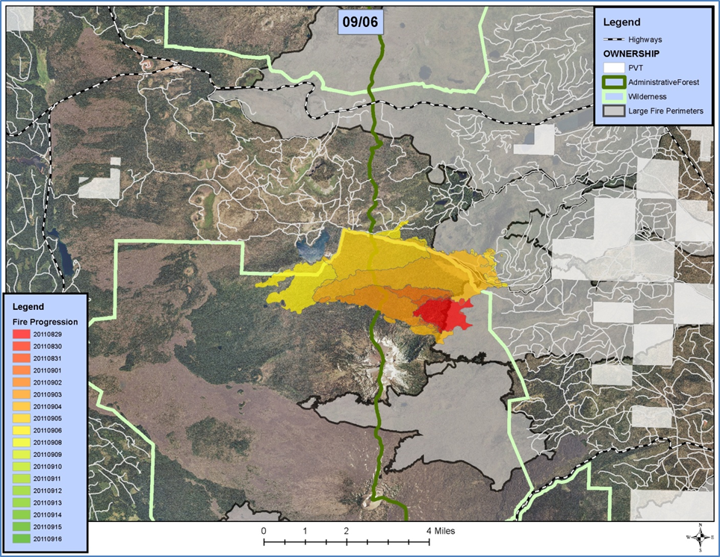

Slide 44
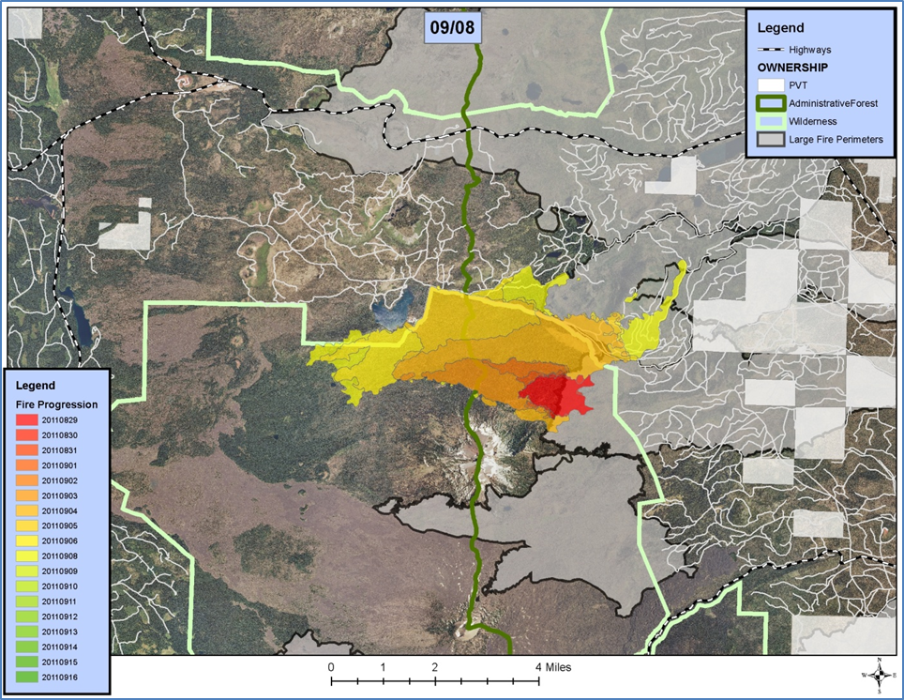

Slide 45


Slide 46
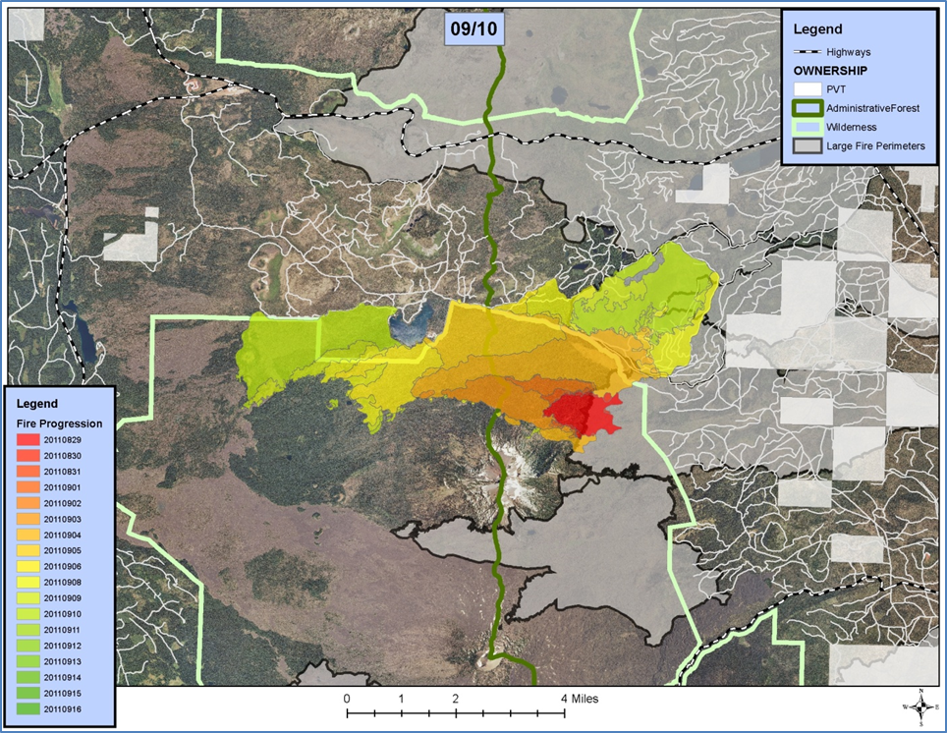

Slide 47


Slide 49


