Slide 1

Regional Haze & Smoke
2012 Smoke Management in the Northwest
Presenter
Mike Edwards

Slide 2
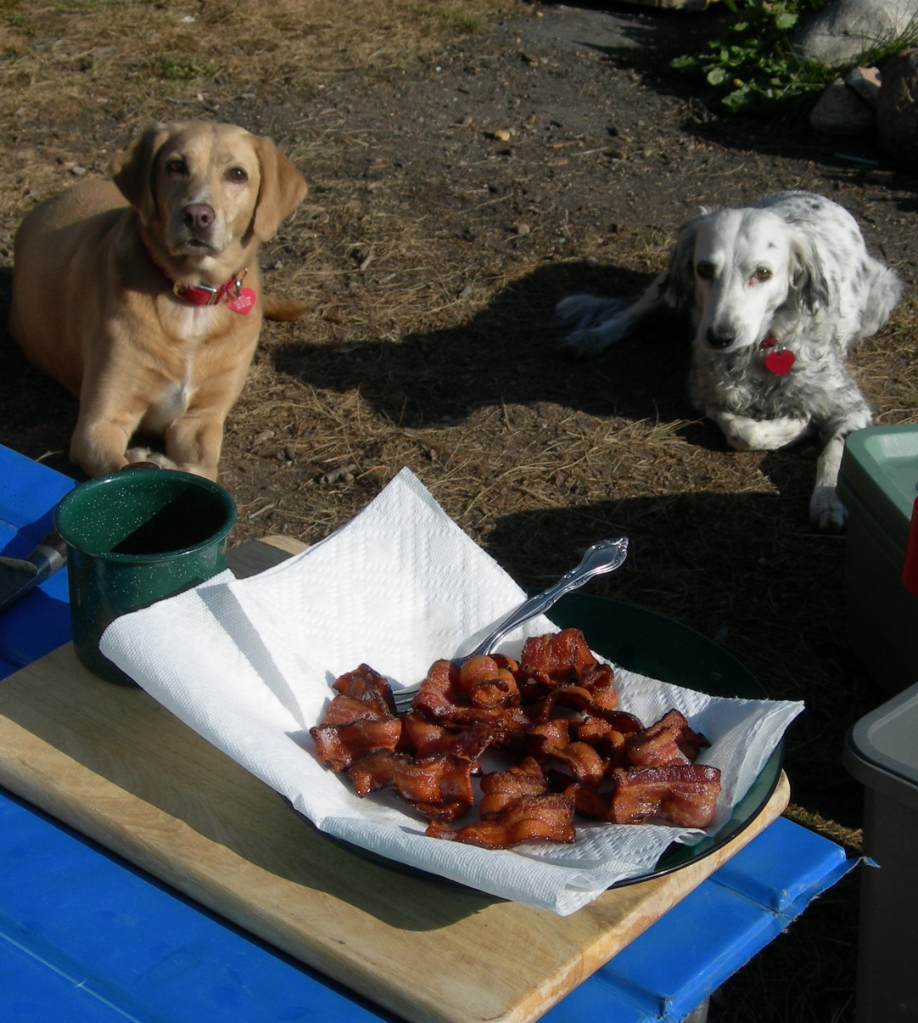
Why do people visit Class I Areas?
They go to clear the mind!
Provide clarity and focus!
Rejuvenate!
It means different things to different people!

Slide 3
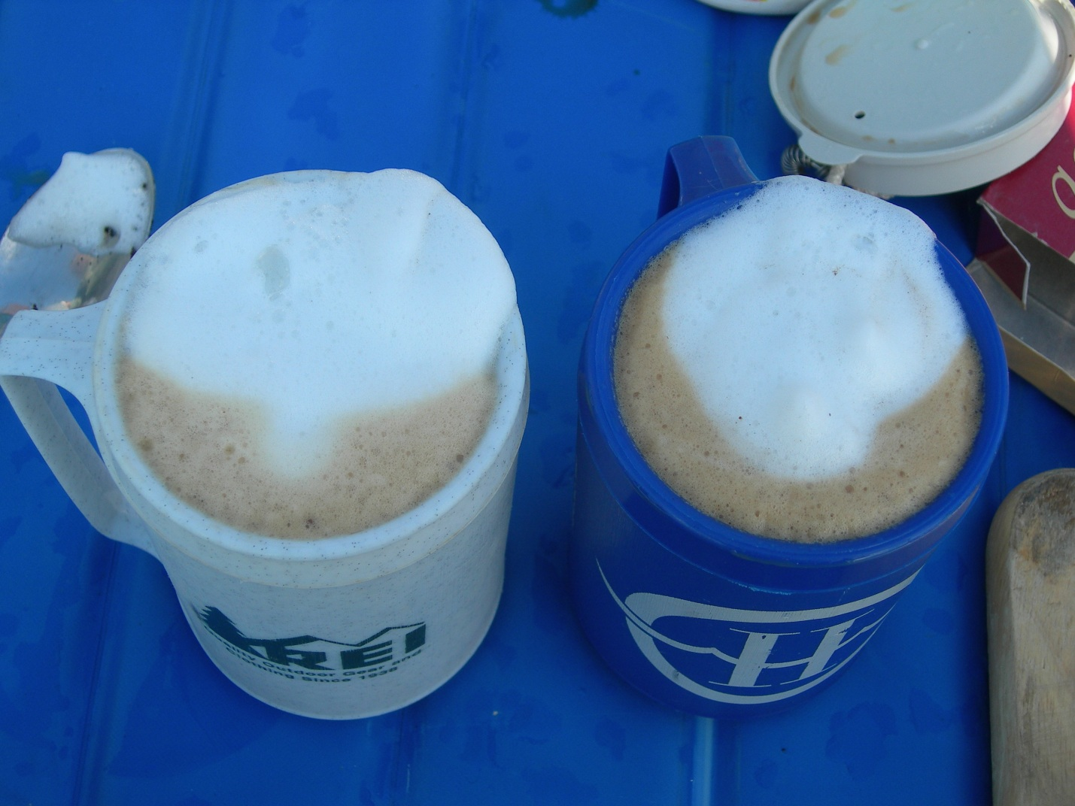
Regional Haze Rule in a nutshell
Improve the 20% Worst Days
Maintain 20% Best Days
Attain natural visibility by 2064

Slide 4
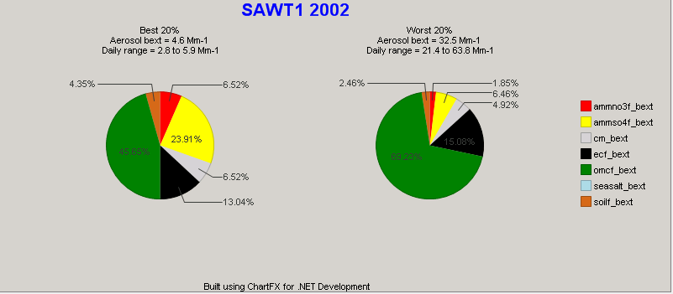
Sawtooth Improve Monitoring 2002

Slide 5
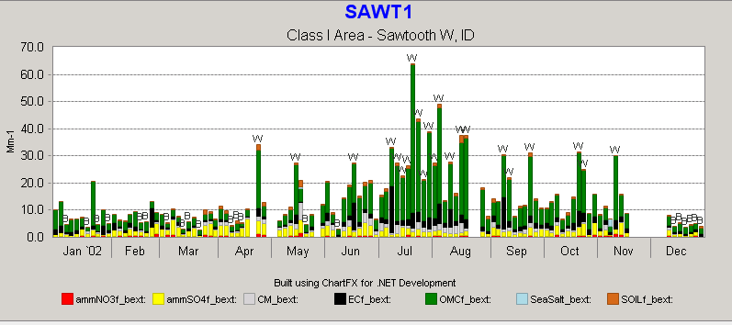
Sawtooth 2002

Slide 6
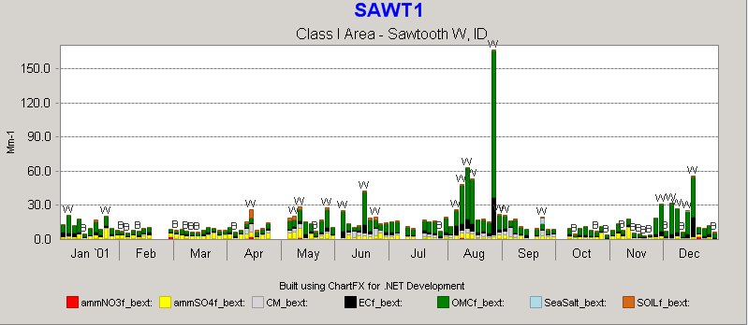
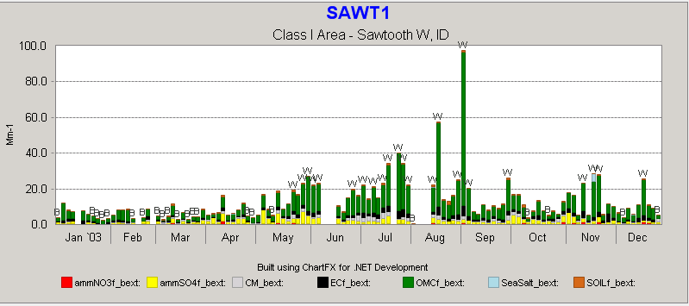
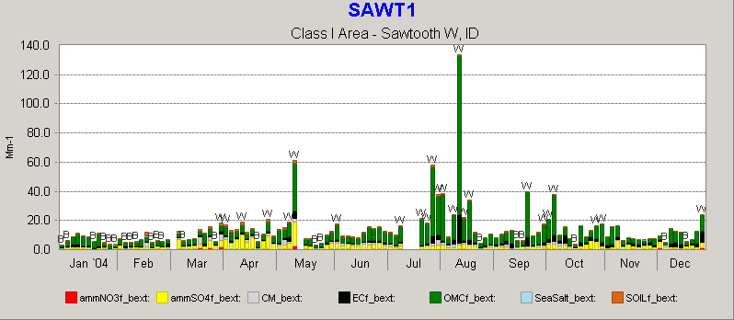
Sawtooth Monitoring 01-04

Slide 7
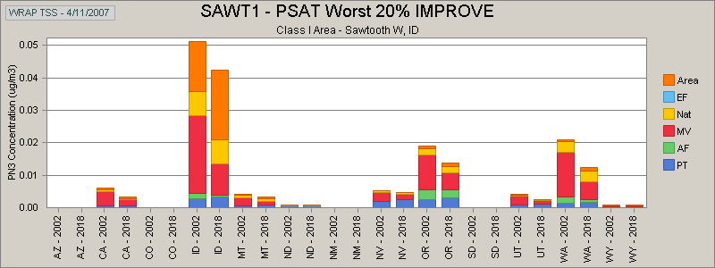
Sawtooth N0x PSAT WRAP Contributions Worst Days
Sawtooth NOx WRAP

Slide 8
Nitrate Emission Reductions
Idaho Statewide Nitrate Emissions (tons/year)
Source Category | Plan02d | Prp18b | Net Change |  | 2002 Source Contribution
 | 2002 | 2018
Point | 11,487 | 12,057 | 570 | 5.0% | 7%
Area | 30,318 | 42,068 | 11,750 | 38.8% | 19%
On-Road Mobile | 44,611 | 12,326 | -32,285 | -72.4% | 28%
Off-Road Mobile | 27,922 | 17,235 | -10,687 | -38.3% | 18%
Anthropogenic Fire | 3,461 | 1,693 | -1,768 | -51.1% | 2%
Natural Fire | 39,401 | 39,401 | 0 | 0.0% | 25%
Total | 157,199 | 124,780 | -32,420 | -20.6% | 100%

Slide 9
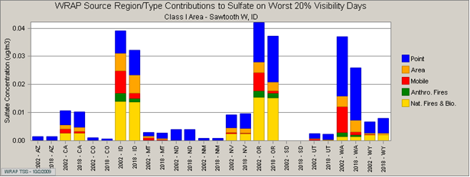
Sawtooth Sulfate PSAT WRAP Contributions Worst Days

Slide 10
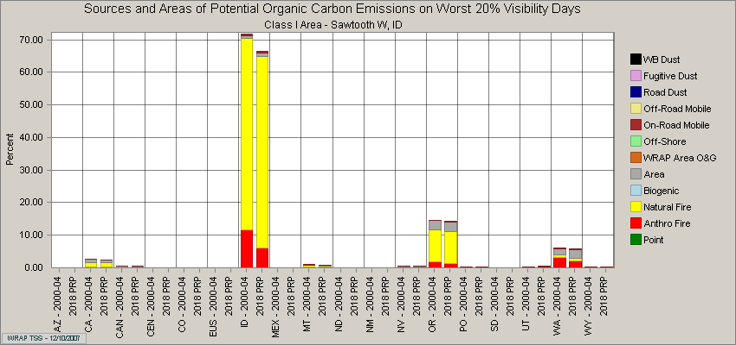
Sawtooth Organic Carbon WEP Baseline

Slide 11
Sulfate EmissinReductions
Idaho Statewide Sulfate Emissions (tons/year)
Source Category | Plan02d | Prp18b | Net Change |  | 2002 Source Contribution
 | 2002 | 2018
Point | 17,613 | 9,395 | -8,218 | -46.7% | 45%
Area | 3,280 | 3,539 | 259 | 7.9% | 8%
On-Road Mobile | 1,662 | 209 | -1,453 | -87.4% | 4%
Off-Road Mobile | 3,702 | 290 | -3,412 | -92.2% | 9%
Anthropogenic Fire | 895 | 445 | -450 | -50.3% | 2%
Natural Fire | 12,008 | 12,008 | 0 | 0.0% | 31%
Total | 39,159 | 25,885 | -13,274 | -33.9% | 100%

Slide 12
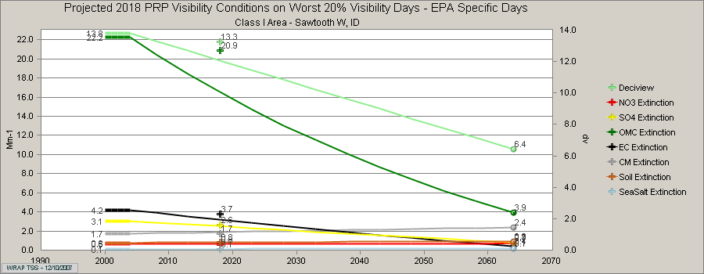
Sawtooth Total Baseline and Modeling Projections 2018 – EPA method

Slide 13
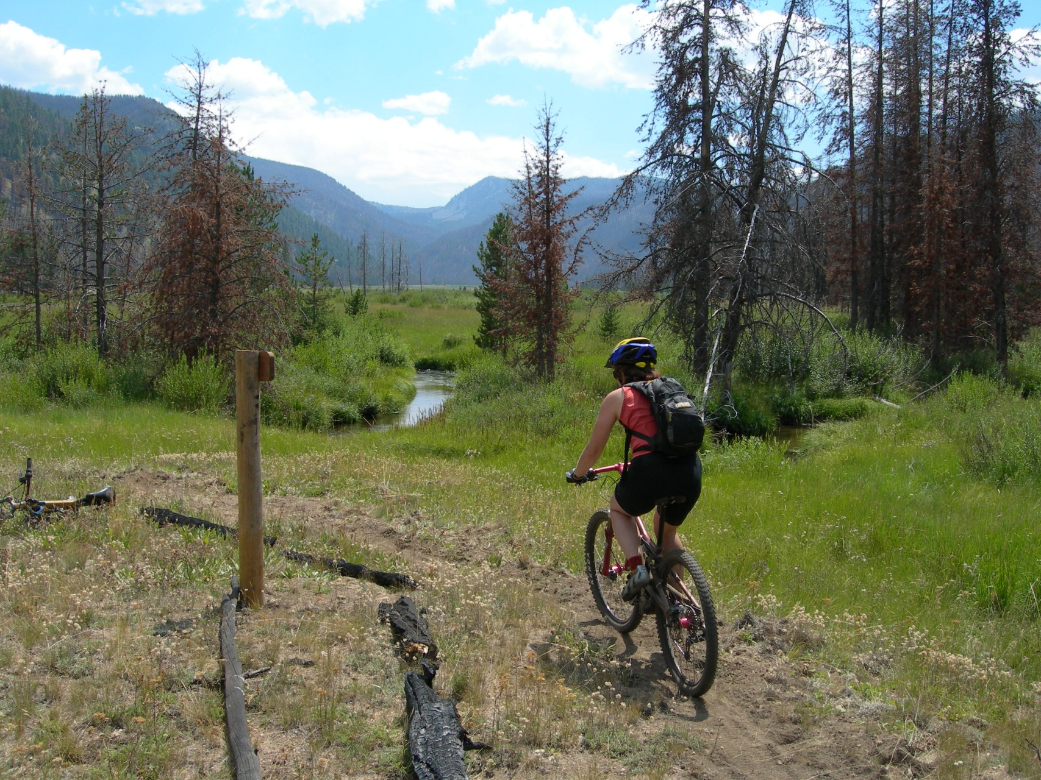
A life and a day in Wilderness with smoke!

Slide 14
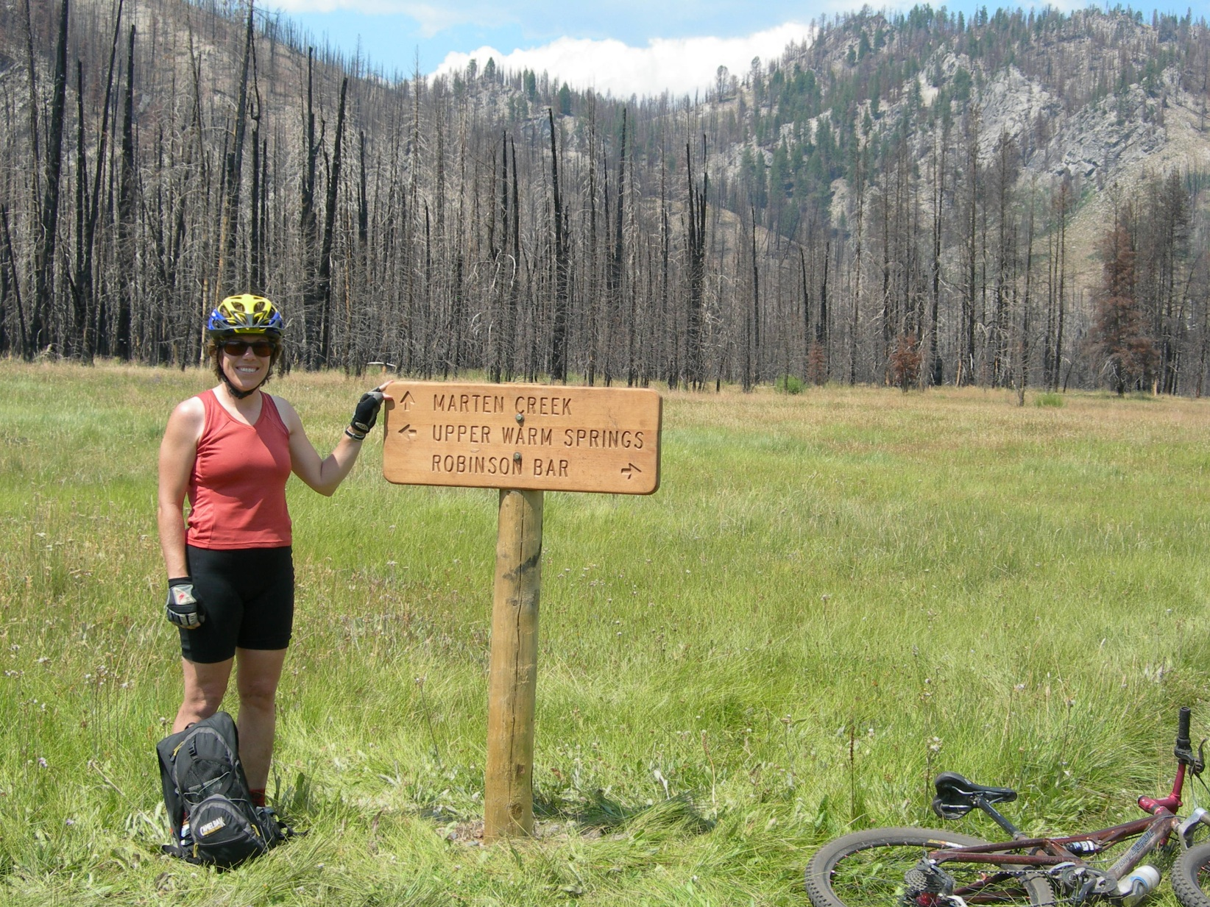
Going for broke

Slide 15
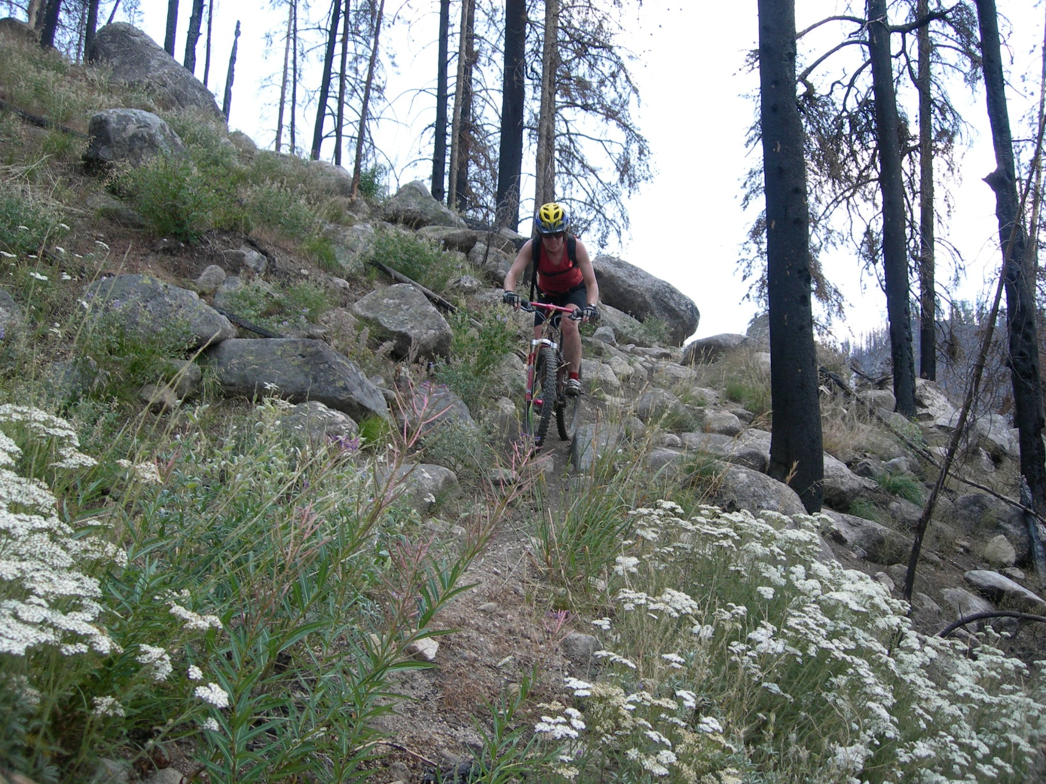
I’m not sure I’m liking this – wait till you see the view!

Slide 16
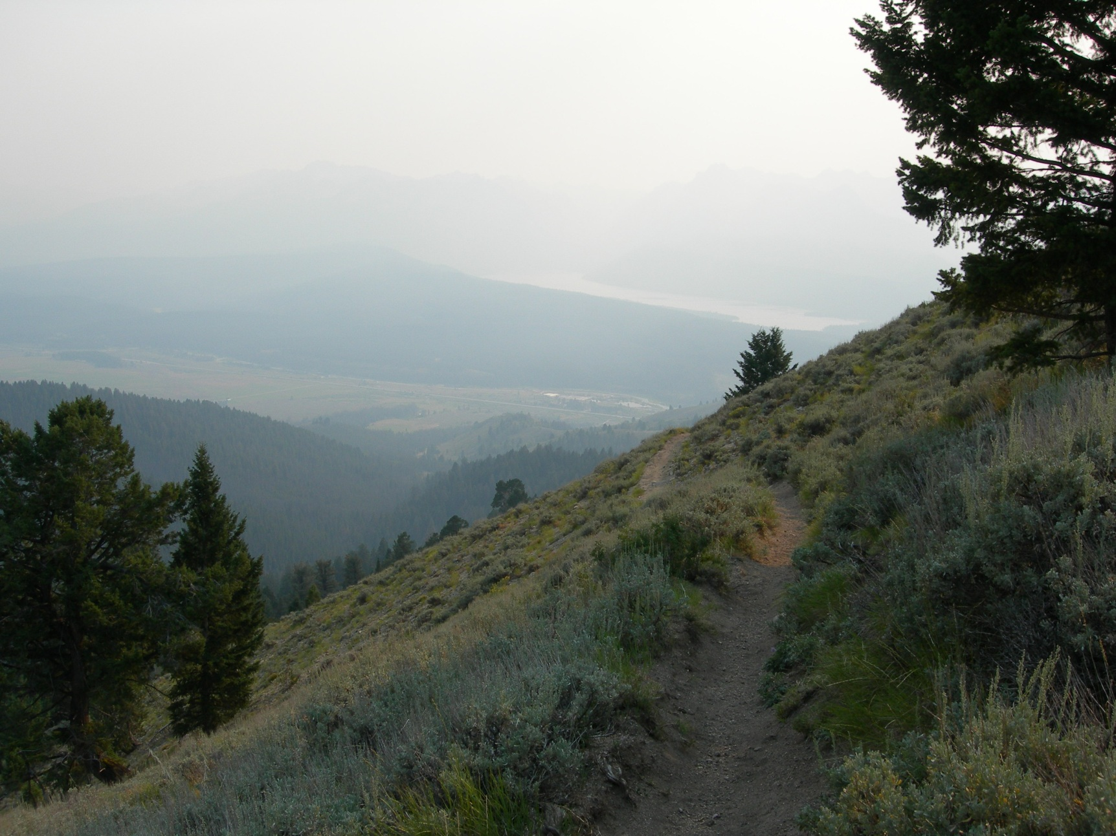
So much for the view!

Slide 17
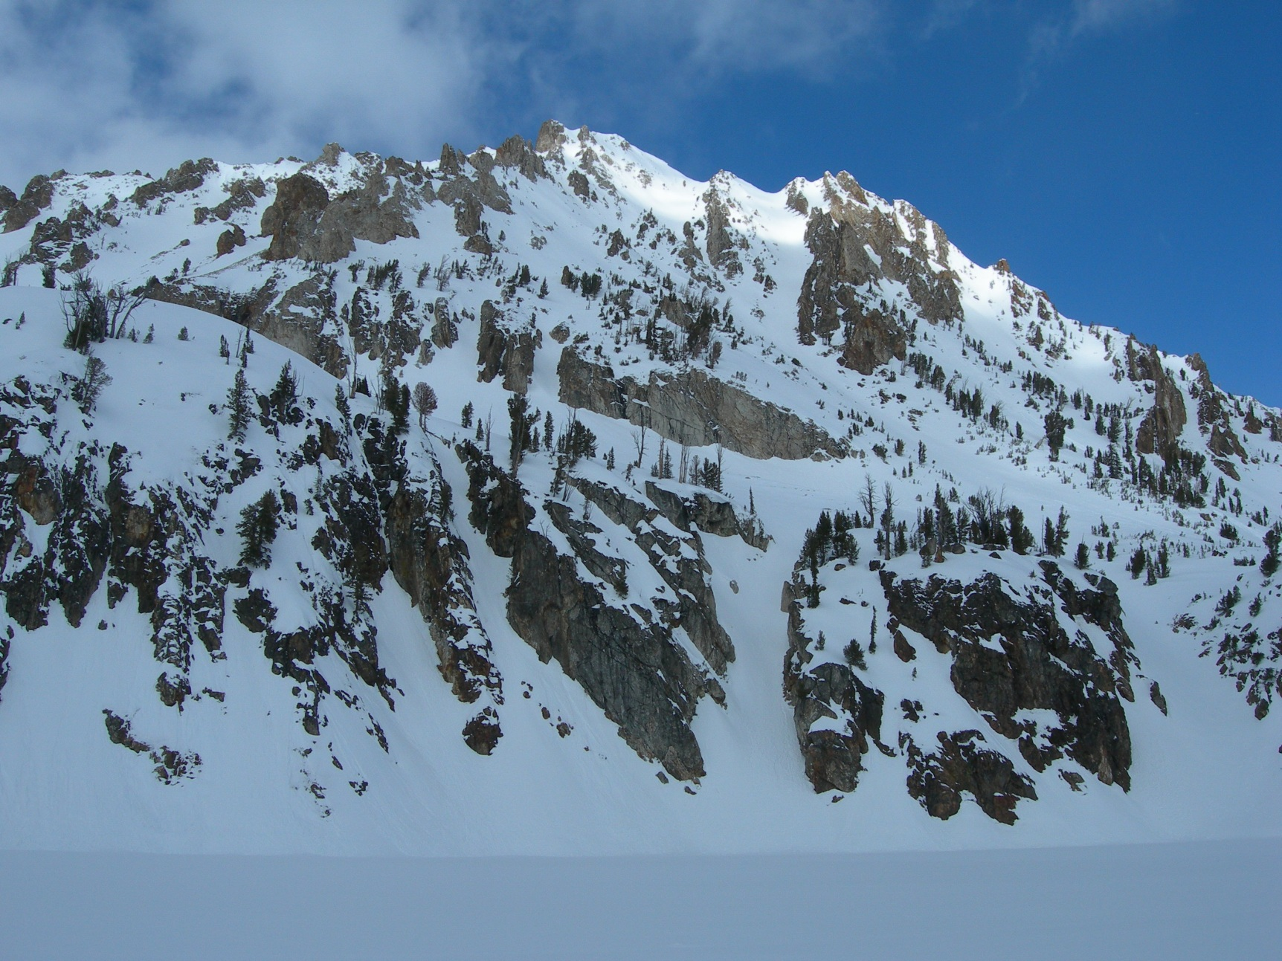
The view on a clear day!

Slide 18
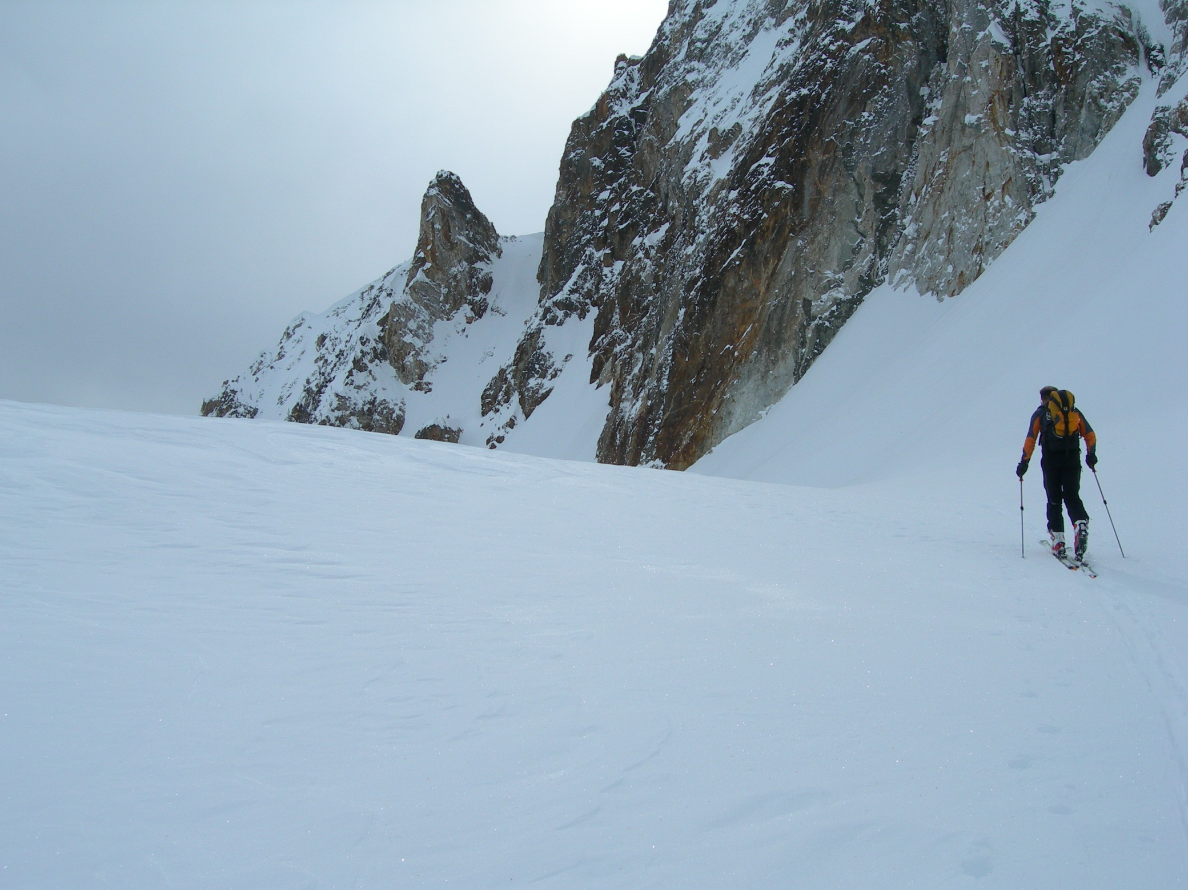

Slide 19
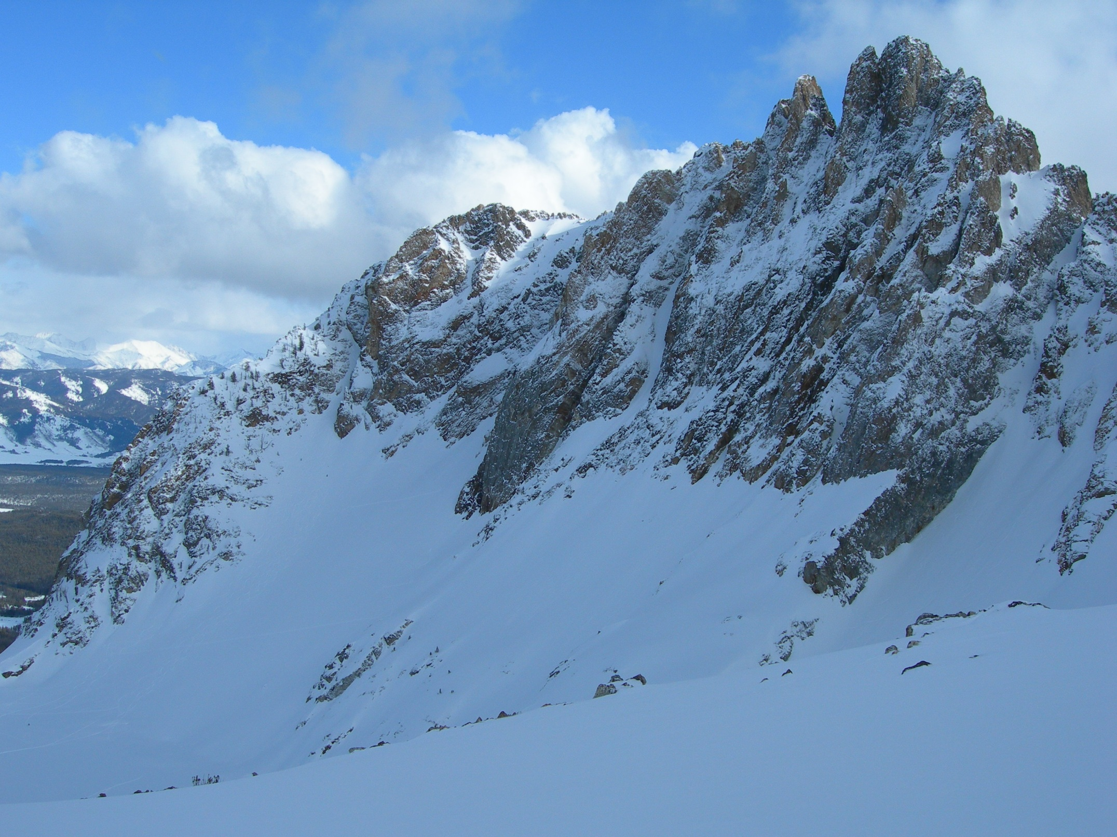

Slide 20
What’s needed on the Smoke Side
We need a better emission inventory that differentiates anthropogenic and natural smoke.
Managed unplanned ignition managed for multiple objectives – do we exclude or include?
Consistent definitions of fire categories.
A better way of tracking and giving credit for burn alternatives.
Better communications!

