Slide 1
WA Regional Haze SIP update
In 1977, Congress amended the Clean Air Act (CAA) with provisions to protect scenic vistas in certain Class I Areas. In these amendments, Congress declared the following national visibility goal:
“The prevention of any future, and the remedying of any existing, impairment of visibility in mandatory class I Federal areas which impairment results from manmade air pollution.”
January 2012

Slide 2
WA Regional Haze SIP update
This first RH SIP covers the initial (or foundational) planning period
that extends from 2005 to 2018.
The state’s foundational SIP establishes the basis for future
control RH SIPs addressing later planning periods &
Initiates the process of making Reasonable Progress toward the 2064
goal of natural visibility conditions.
January 2012

Slide 3
WA Regional Haze SIP update
Washington’s foundational RH SIP addresses basic requirements of
the RH Rule by:
Determining baseline (2000-2004) visibility conditions in each of the
state’s 8 mandatory Class I Areas
• Providing inventories of visibility-impairing emissions from the state’s
sources
• Analyzing natural and human-caused sources of haze for the state’s
mandatory Class I Areas
• Establishing Reasonable Progress Goals for 2018 for the state’s Class I
Areas
• Developing a Long-Term Strategy for visibility improvement
• Determining and requiring Best Available Retrofit Technology (BART) for
the 7 stationary point sources subject to BART
January 2012

Slide 4
WA Regional Haze SIP update
UPDATE FOR WA
Submitted Regional Haze SIP to EPA Jan 2011
Revised the Best Available Retrofit Technology (BART) compliance
order for TransAlta facility to comply with a new state law adopted in
spring 2011
Changes to the TransAlta BART documents submitted as revision in
Jan 2012
In RH SIP WA identified 10 specific industries and emission source
categories to determine which area to focus on for additional controls
using Reasonable Achievable Control Technology (RACT)
January 2012

Slide 5
WA Regional Haze SIP update
Currently evaluating identified industries and source categories to
determine areas to focus on for additional controls using RACT
Best Case Scenario: Ecology estimates two RACT rules by Dec 2016
These New Rules will be basis for controls in RH SIP due 2018
In WA, DNR regulates Rx burning; Ecology or Local Air Agencies
regulate Ag and Outdoor burning
Also DNR SMP was incorporated into 1999 revision of visibility SIP
Visibility SIP approved by EPA
January 2012

Slide 6
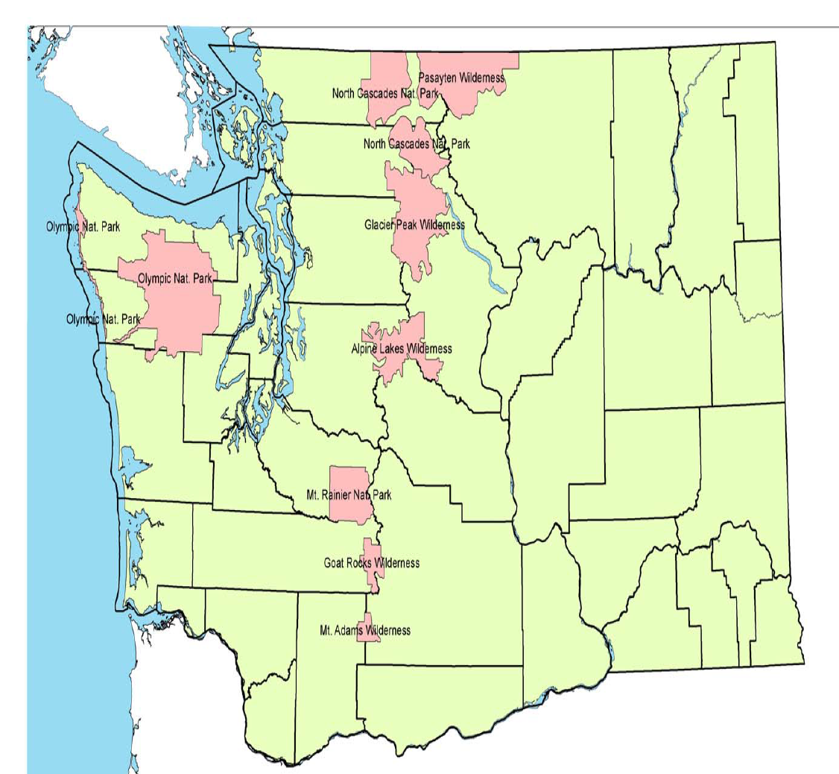
WA Regional Haze SIP update
January 2012

Slide 7
WA Regional Haze SIP update
Ecology Contact for Regional Haze SIP
Website:
http://www.ecy.wa.gov/programs/air/globalwarm_RegHaze/regonal_haze.htm
l
Julie Oliver
Program Development Section Manager
Air Quality Program
Washington State Department of Ecology
PO Box 47600
Olympia, WA 98504-7600
(360) 407-6823
(360) 485-7576 (cell)
Fax (360) 407-7534
julie.oliver@ecy.wa.gov
January 2012

