Slide 1
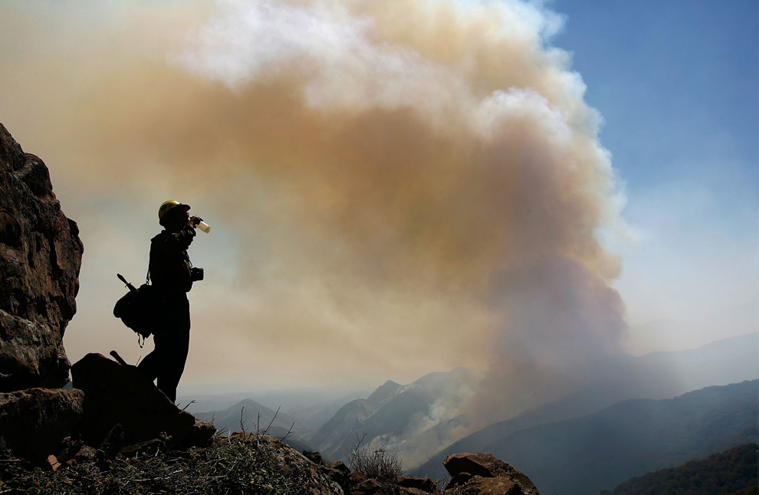

Inter-Agency Fire Policy Implementation: Air Quality, Communication & Decision-making
Pete Lahm
Forest Service
Fire and Aviation Management
Washington, D.C.
2012 Smoke Management in the Northwest Meeting
April 19, 2012

Slide 2
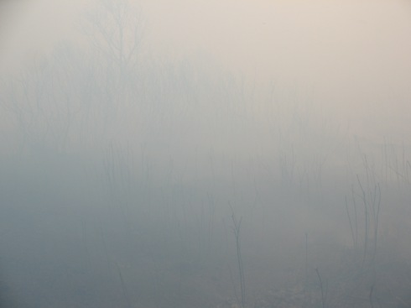
Interagency Strategy for the Implementation of Federal Wildland Fire Management Policy
2009
Two Fires
Inter-agency and stakeholder coordination
Forest Service Guidance:
Annual letters to the field on wildfire guides greater consideration of smoke
Where needed, use of suppression funds for air quality impacts
Wildland Fire Decision Support System
Risk based decisions (Safety First)

Slide 3
Health effects
Southern California 2003 wildfires (9-day) long , estimates show:
34% increase in respiratory hospitalizations =
~600 extra hospitalizations per day =
~$50 - $250 Million total direct costs
Estimated ~44 extra premature deaths per day =
~$80- $600 Million per day equivalent
Sources: EPA methodology; Delfino et al, 2009; Wu et al. (2006); Pope et al. (2002); Laden et al. (2006); Jerrett et al. (2005); EPA Integrated Science Assessment (2009); Krewski et al. (2009);

Slide 4
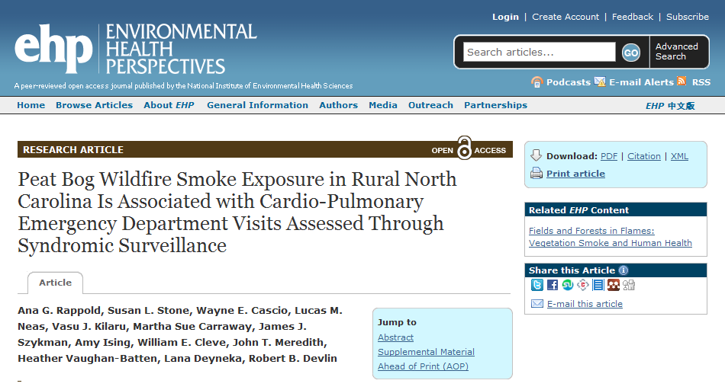
Notes:
Article based on the 2008 Evans Rd fire . . . .potentially more to come with the pains bay fire

Slide 5
2008 Evans Road Fire – North Carolina
In smoke affected counties, ER visits during heavy smoke exposure days relative to smokeless days increased by:
73% for Chronic Obstructive Pulmonary Disease (COPD)
65% for asthma
59% for pneumonia and bronchitis
37% for symptoms of heart failure
Notes:
Article based on the 2008 Evans Rd fire . . . .potentially more to come with the pains bay fire

Slide 6
Health effects
What does this mean for wildfire?
Rule of thumb:
  100 K people
  50 μg/m³
  10 days
  5 extra deaths
  $10-50 Million equivalent
  AND: Each 10μg/m³ of PM2.5 added exposure results in
  ~ 30% increase in chance of bronchitis
  ~ 10% increase in chance of death
Sources: EPA Integrated Science Assessment (2009); Krewski et al. (2009);

Slide 7
More effects
Transportation Safety:
-Gainesville 2012
60 acre wildfire with smoke caused traffic fatalities
-North Carolina 2009
2 Fire Fighters fatalities from smoke on the road
Personnel Exposure and Risk:*
Fire Fighters, Fire Support Personnel
- Base Camp
- On the Fire Line
- Silica exposure issues

Slide 8
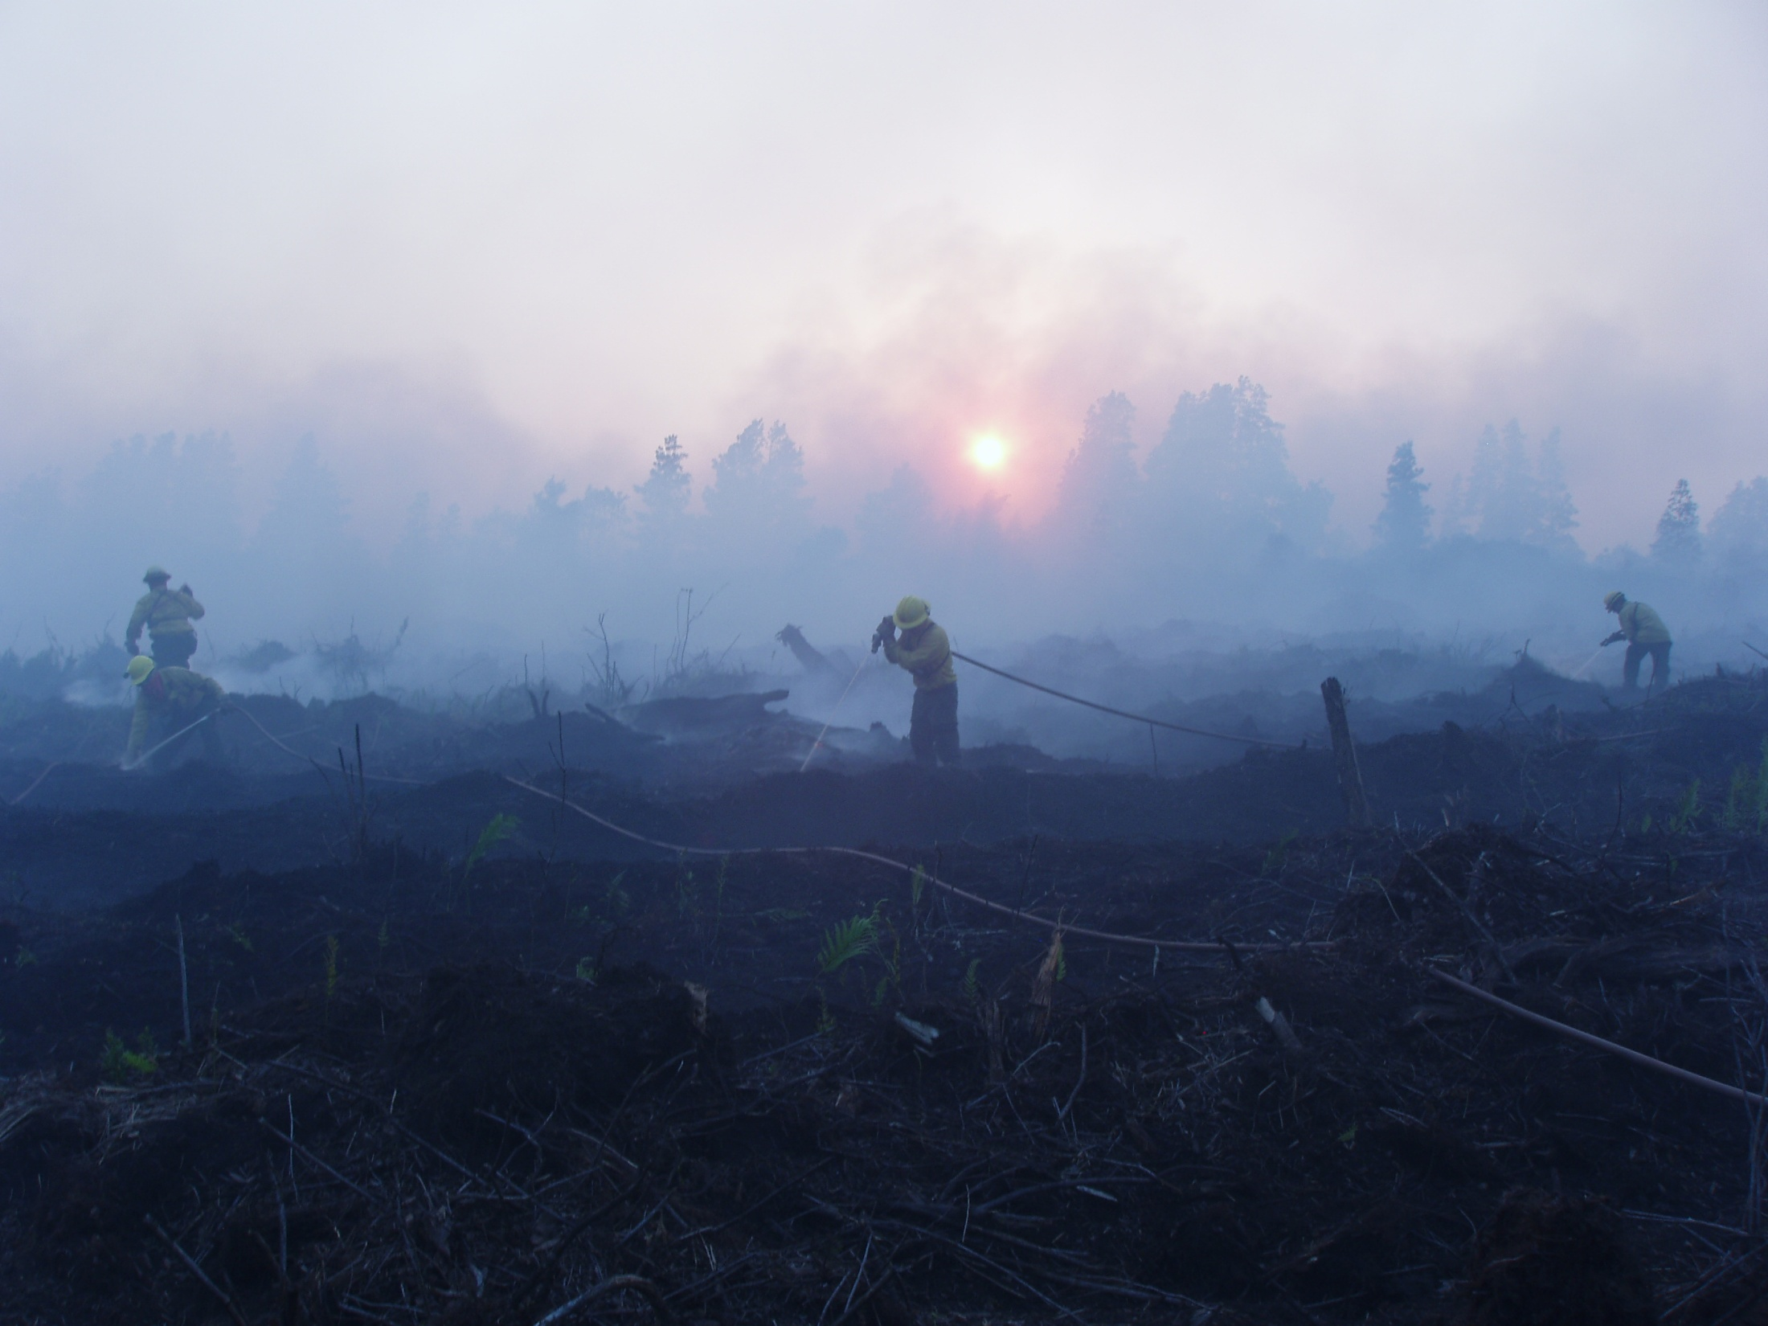
Approaches
Risk driven wildfire response
Training
Monitoring
Assessment Tools
Communications and Coordination

Slide 9
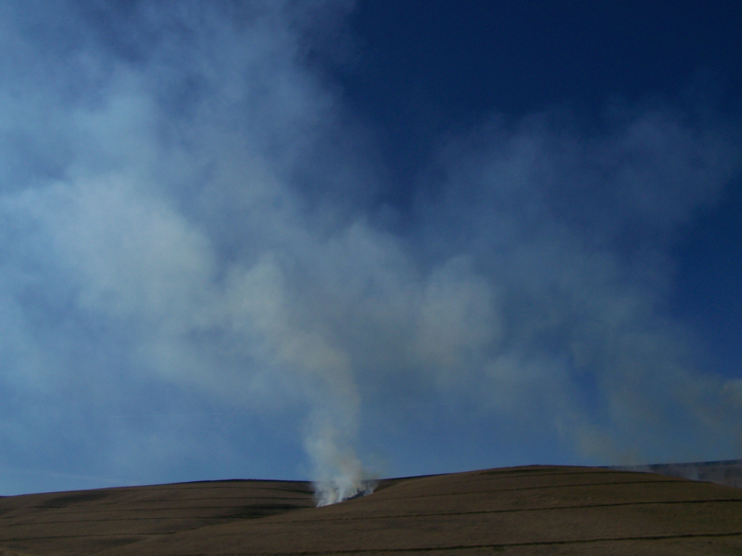
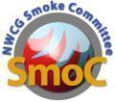

NWCG Smoke Committee
(SmoC)
One of 14 Committees chartered under the National Wildfire Coordinating Group (NWCG)
Current Members: USFS, NPS, FWS, BLM, BIA, NASF, NRCS, NACAA(State & Local Regulators), TNC, DoD
Products, Topics and Issues
  Training
  www.nifc.gov/smoke and www.myfirecommunity.net “Air Quality and Fire Issues” Neighborhood
  Fire emissions: Black Carbon, NO2, GHGs, PM2.5, Ozone precursors
  Smoke Monitoring
  Exceptional Events
  Federal Fire Policy
Notes:
NWCG – from 50+ working groups to 14 Committees. SmoC is one of the committees.
The Committee has the responsibility to:
Improve communication and understanding of the interface of wildland fire management and air quality.
Develop consistent guidelines, standards and recommendations for wildland fire management which account for the air quality impacts of planned and unplanned ignitions.
Assess and advance technical products and training to build wildland fire management field capabilities to address the air quality impacts of planned and unplanned ignitions and meet environmental rules, regulations, guidelines and concerns specifically focused on the interface of air quality and wildland management.
Provide a forum for open discussions on air quality issues associated with smoke from planned and unplanned wildland fires to promote coordination and collaboration between agencies, programs and partners.

Slide 10
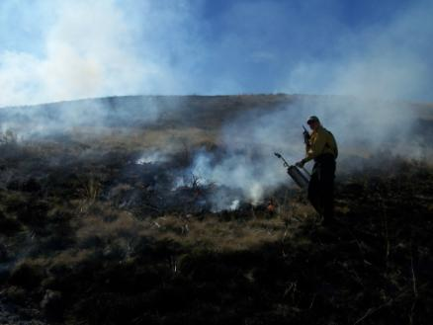
SmoC Subcommittees
Smoke Managers
Training
  Online Training
  Smoke Assessment
Technical Smoke Topics
  Smoke Management Guide Revision
  Smoke Monitoring
  Retrospective Emission Inventories Task Team
  ➔Over 100 people interacting under SmoC on a regular basis

Slide 11
SmoC Training Efforts
Smoke Management and Air Quality for Land Managers – Online 90 minute course
Wildfire and Air Quality Decision-making –
  4-hr online modular course under development

Slide 12
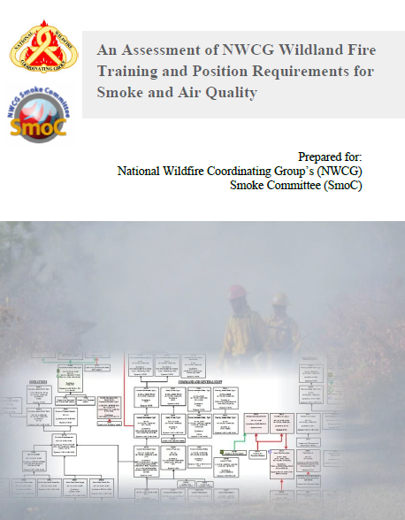

An Assessment of NWCG Wildland Fire Training and Position Requirements for Smoke and Air Quality
Objectives
Evaluate Position Requirements
Assess Standardized Course Content

Slide 13
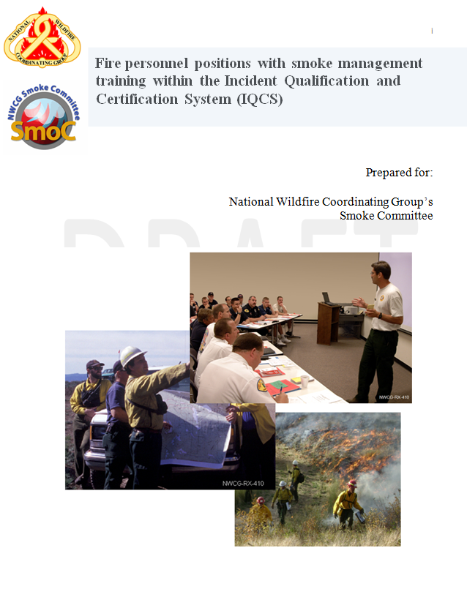
Fire personnel positions with smoke management training within the Incident Qualification and Certification System (IQCS)
Objective
Determine the extent of smoke training within positions with potential smoke management responsibilities

Slide 14
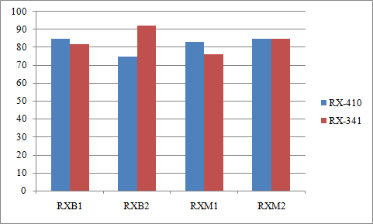
Results– Rx Fire Positions
Percent of personnel completion
Position
Notes:
All prescribed fire positions have a high a number of personnel who have completed RX-410 or RX-341, 70% or greater. These numbers will likely not reflect 100%, even for the FS, in which RXB2s are required to have taken RX-410, due to the fact that some personnel were occupying these positions prior to the development of these trainings.
In the previous report we found the position of RXM2 varied in the level of recommended training, with USFS requiring completion of RX-410. Other agencies did not require this for RXM2, or for any of the other prescribed fire positions. In evaluating the IQCS data the penetration of material across all agencies exceed what would be expected given the minimum requirements as of 2011.

Slide 15
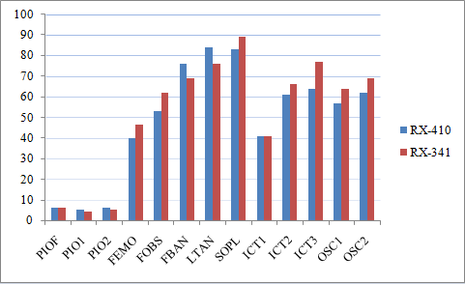
Results– Suppression Positions
Percent of personnel completion
Position
Notes:
There is a substantial number of personnel within suppression positions which have completed either RX-410 or RX-341, this is particularly true for FBANs, LTANs, and SOPLs, which have an interagency total of 70% or greater completion of RX-410. Of these positions ICTs and PIOs have the least proportion of personnel who have completed RX-410 or RX-341. Further, the positions of FEMO, FOBS, FBAN, and LTAN have varying levels of smoke responsibilities which require the monitoring of smoke or conditions which impact smoke; however there is no specific training material required for these positions that demonstrates the link between meteorology and smoke movement.

Slide 16
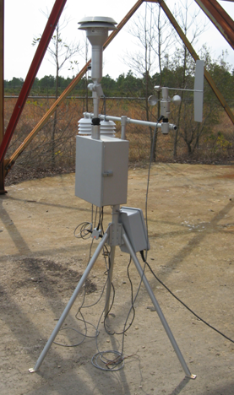
Monitoring:
-15 E-Samplers PM2.5
Tied to GOES available
from NIFC
-Data available on-line
-Best way to know impacts and guide public
-Many Forests, Parks, Refuges and others have monitors (PNW AirFire, MTDC)
➔EPA??? States???

Slide 17
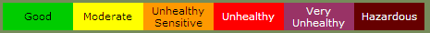
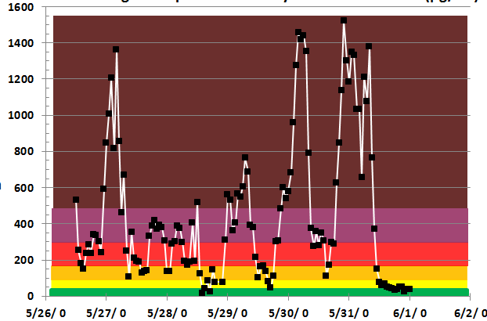
PM Concentrations (µ∕m³) on the Pains Bay Fire
EBAM Avg Hourly Concentration

Slide 18
Interagency Wildfire Smoke Communication
North Carolina – Pains Bay 2011
  Incident specific forecasting & modeling
  Monitoring
  Transportation, Personnel, Public Health & Safety concerns
SW Area - Wallow Fire and others 2011
  Area-wide multi-incident cohesive messaging
  Multi-state/agency modeling & forecasting
  Joint messaging and forecast
  Monitoring
  Air Quality Index communication issues
Florida – County Line Fire 2012 Active

Slide 19
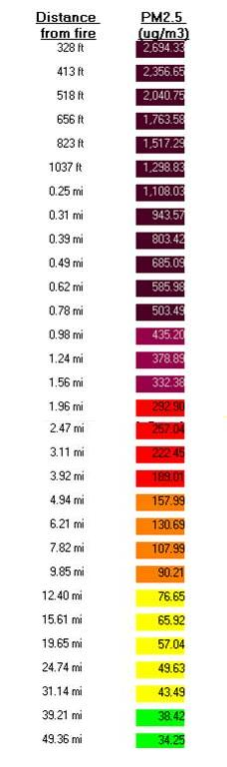
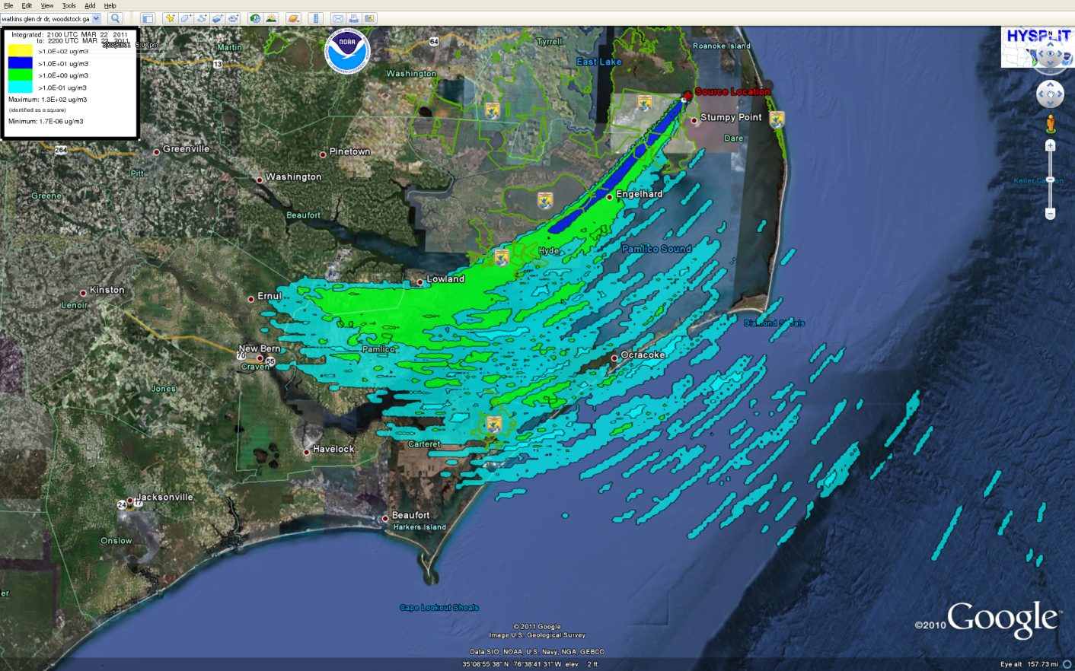
Estimation and Planning
VSMOKE
Pains Bay Fire 45,300 acres
~10 tons/acre (excluding peat)
Smoke Dispersion Models
HYSPLIT
Notes:
HYSPLIT and Vsmoke outputs (different senarios) demonstrating range of potential impacts and modeling tools.

Slide 20
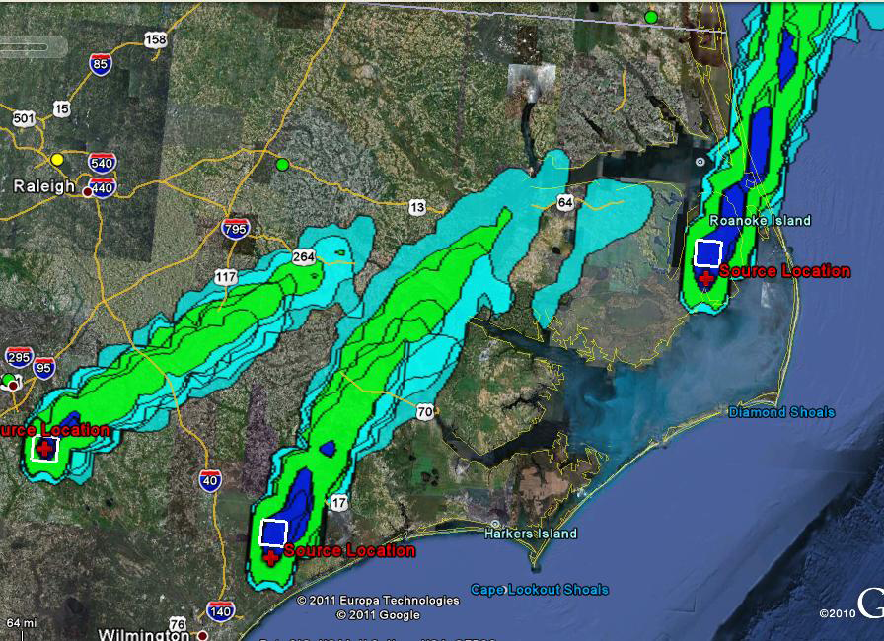

Slide 21
Pains Bay, NC 2011
Monitoring
  Communities and Base Camp
Modeling
  BlueSky, Hysplit, Vsmoke
Coordinated Messaging
  Traffic safety and Superfog
  Long-range and local smoke impacts (DC!)
  NCDEP and EPA’s AirNow
  Inciweb, NWS WFO,

Slide 22
Southwest Wildfires 2011
  Record breaking fire activity = Record breaking smoke
  Questions being asked:
    How much?
    When?
    Where?
    How to respond?
    What level of response?
    Who responds?
    What can be done?
    Messaging?
    Why respond?

Slide 23
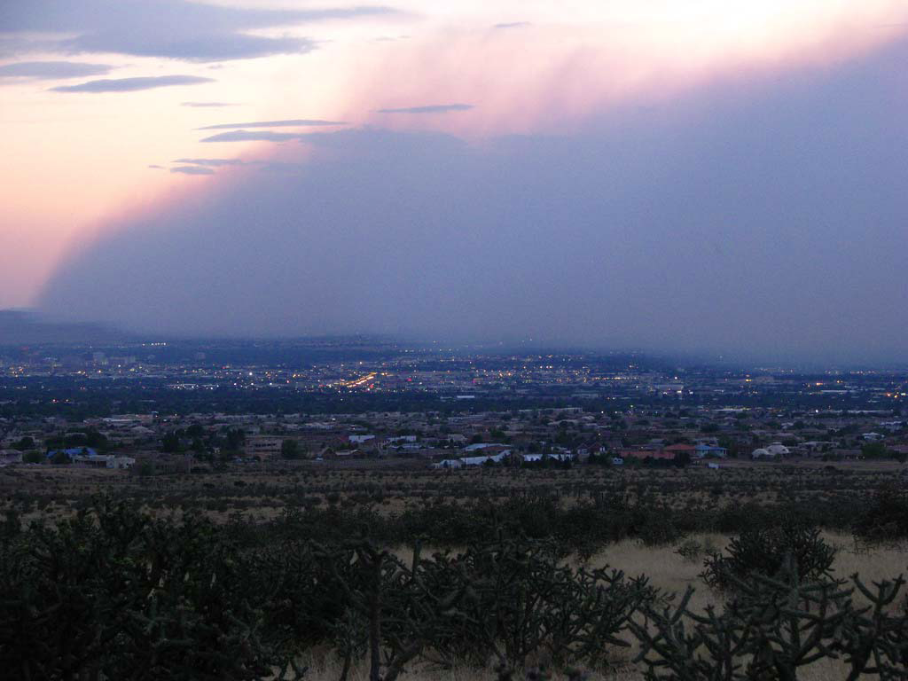

Slide 24
Objectives SW Wildfires 2011
Communicate coordinated consistent and clear messages to the public about smoke impacts and how to protect themselves
  Risk Assessment (Health & Safety):
    NM 911 system crash
    Transportation Effects
    Fire Personnel Exposure
    Off-grid communication/Tribes
    Opening of evacuated communities

Slide 25
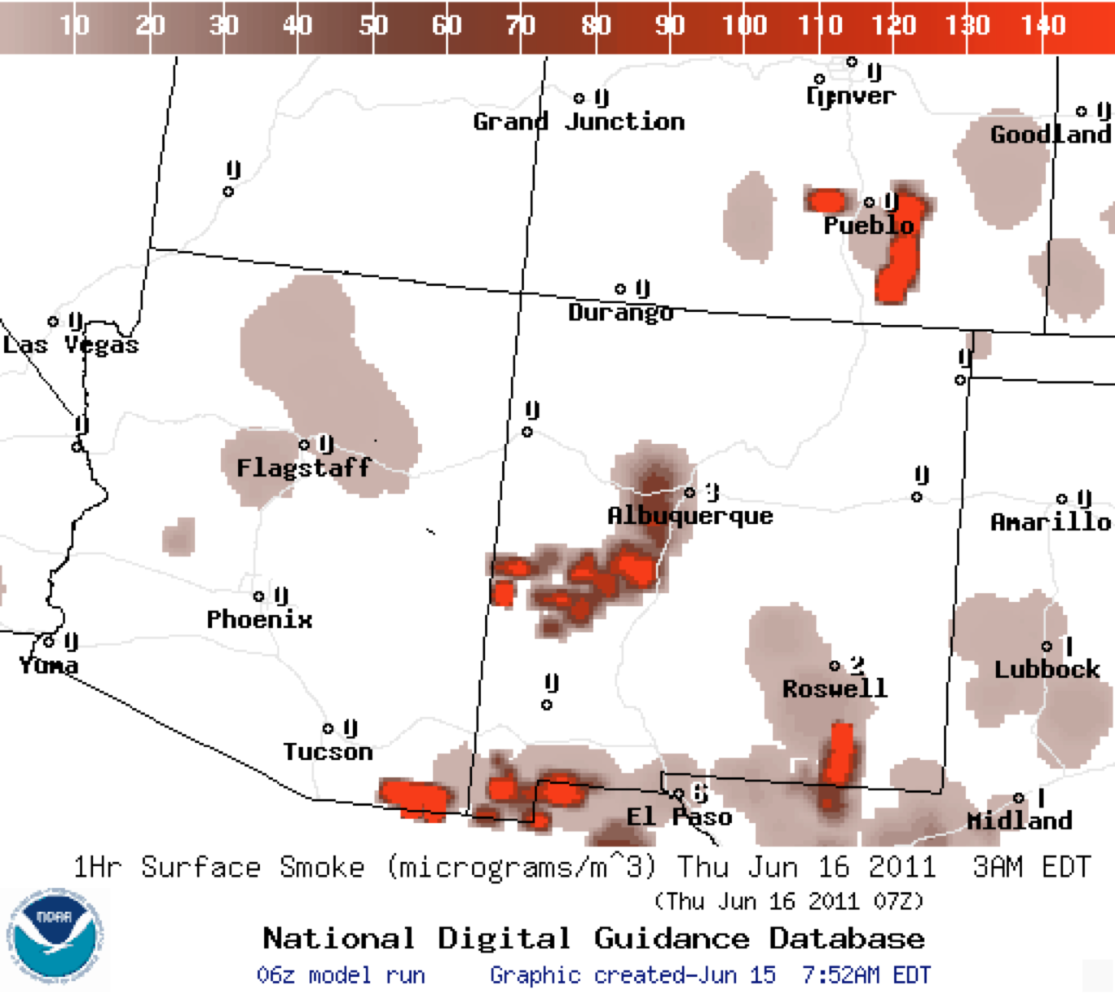
BlueSky and real-time smoke predictions
FS AirFire’s BlueSky Smoke Modeling Framework led to the first comprehensive nationwide smoke predictions.
  USFS produces daily
  smoke forecasts
  the National Weather
  Service’s operational
  smoke product uses
  BlueSky
  also now in Canada,
  Southeast Asia,
  Portugal, …

Slide 26
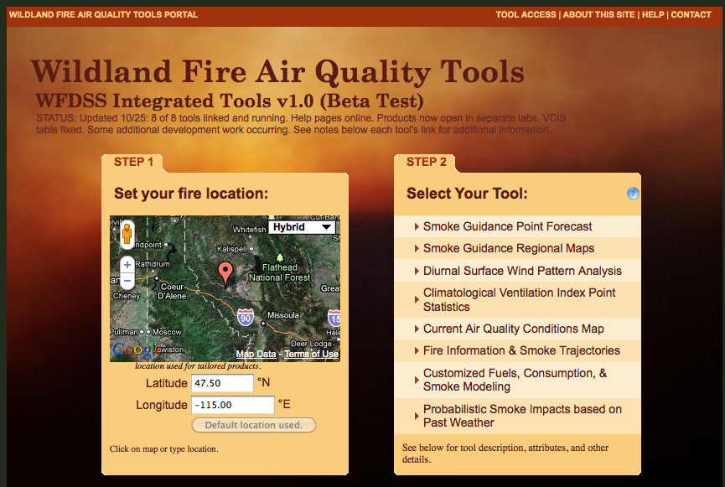
WFDSS Air Quality Tools
Multiple tools in one place; all on the web
Multi-criterion assessments
http://firesmoke.us

Slide 27
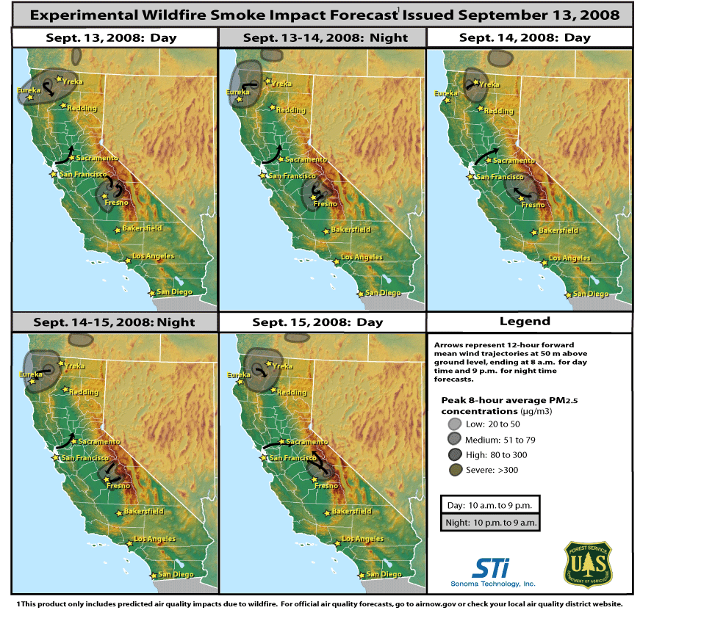
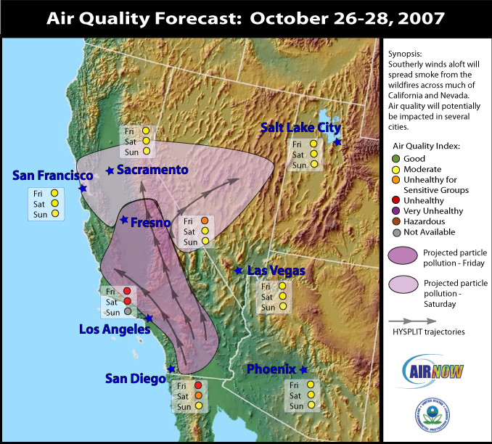
Emergency Smoke Response System
CA 2007, 2008
Specialized model runs
Rapid response air quality monitoring
Air quality expert developed forecast guidance
For use by USFS in fire management
Also useful for public outreach (EPA AirNow, CNN, USA Today, local TV, newspapers)

Slide 28
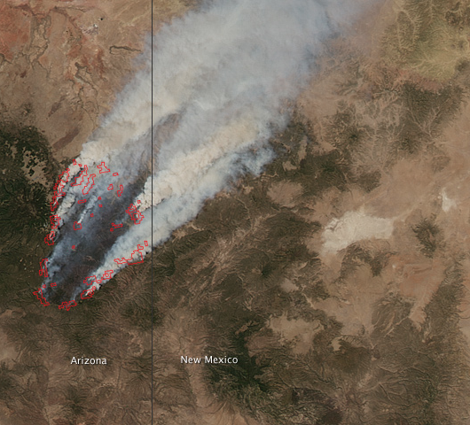
2011 AZ / NM Fires
Wallow: 538,049 acres
Horseshoe 2: 222,954
+ Monument, Track, Loop, Pacheco,
Willow, and many others
Historically low fuel moistures
30,000++ acre daily growth
9+ mile runs reported
Multiple towns evacuated,
some hospitals and emergency
services closed
100,000s in Unhealthy to Hazardous smoke daily
Significant smoke impacts in AZ, NM, TX, CO, beyond

Slide 29
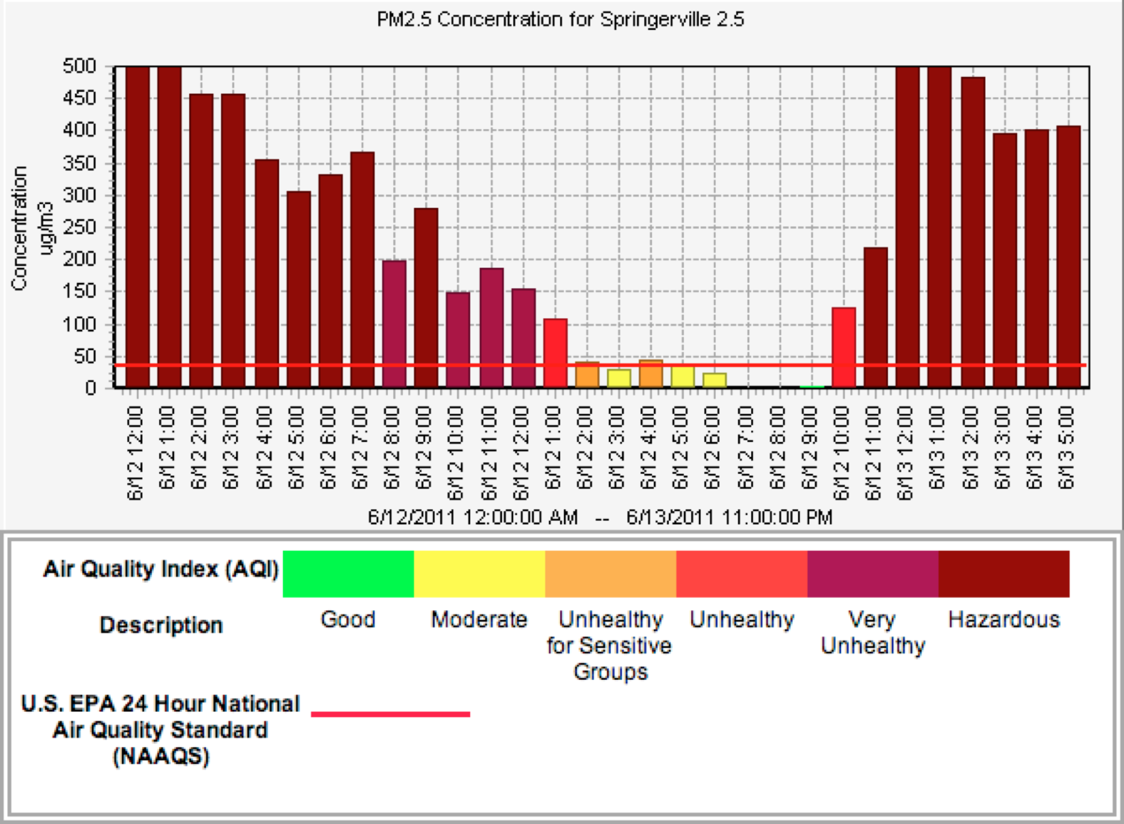

Slide 30
Air Quality Guide for Particle Pollution
Adjective | Air Quality Index (AQI) | Concentration PM 2.5 (ug/m3- 1-3 hr. avg.) | Concentration PM 2.5 (ug/m3- 8 hr. avg.) | Concentration PM 2.5 (ug/m3- 24 hr. avg.) | Visibility (miles) | Cautionary Statement | Health Effects Statement
Good | 0-50 | 0-38 | 0-22 | 0-15 | >10 | None
Moderate | 51-100 | 39-88 | 23-50 | 16-35 | 6-10 | Unusually sensitive people should consider reducing prolonged or heavy exertion
Unhealthy for Sensitive Groups | 101-150 | 89-138 | 51-79 | 36-65 | 3-5 | People with heart or lung disease, older adults, and children should reduce prolonged or heavy exertion. | Increasing likelihood of respiratory symptoms in sensitive individuals, aggravation of heart or lung disease and premature mortality in persons with cardiopulmonary disease and the elderly.
Unhealthy | 151-200 | 139-351 | 80-200 | 66-150 | 1.5-2.75 | People with heart or lung disease, older adults, and children should avoid prolonged or heavy exertion. Everyone else should reduce prolonged or heavy exertion | Increased aggravation of heart or lung disease and premature mortality in persons with cardiopulmonary disease and the elderly; increased respiratory effects in general population.
Very Unhealthy Alert | 201-300 | 352-526 | 201-300 | 151-250 | 1.25-1 | People with heart or lung disease, older adults, and children should avoid all physical activity outdoors. Everyone else should avoid prolonged or heavy exertion. | Significant aggravation of heart or lung disease and premature mortality in persons with cardiopulmonary disease and the elderly; significant increase in respiratory effects in general population.
Hazardous | 300+ | 526+ | 300+ | 250+ | <1 | People with heart or lung disease, older adults, and children should avoid all physical activity outdoors. Everyone else should avoid prolonged or heavy exertion. | Significant aggravation of heart or lung disease and premature mortality in persons with cardiopulmonary disease and the elderly; significant increase in respiratory effects in general population.

Slide 31
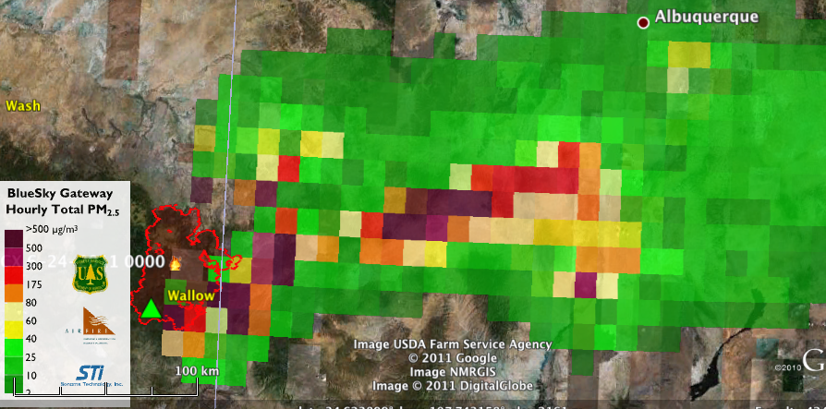
Response
Specialized modeling runs to predict smoke impacts using fire growth models
Fire Growth Projections
WFDSS FARSITE Runs
MAC Group
NWS and other met experts
8-12 nightly
AirFire generated
Fire Growth “Scenarios”
Smoke impact
scenarios
Smoke impacts
MAC Group
MAC Group

Slide 32
PNW AirFire’s Response
Specialized modeling runs to predict smoke impacts
Fire Growth Projections
WFDSS FARSITE Runs
MAC Group
NWS and other met experts
8-12 nightly
AirFire generated
Fire Growth “Scenarios”
Smoke impact
scenarios
Smoke impacts
MAC Group
MAC Group
WFDSS,
Area Command

Slide 33
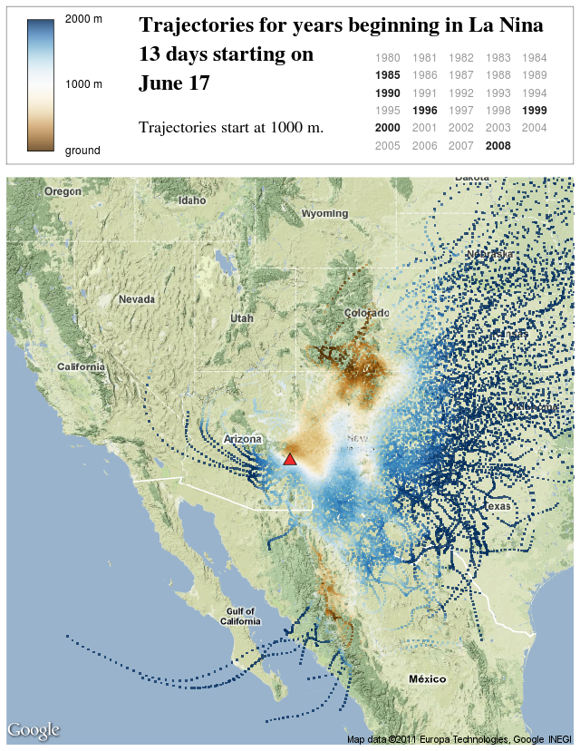
AirFire’s Response
Not just real-time
smoke
Risk analyses based
on climatological
information
    Longer-range impacts
    beyond ability to predict
    weather patterns
Other research
analyses and tools
brought into analyses

Slide 34
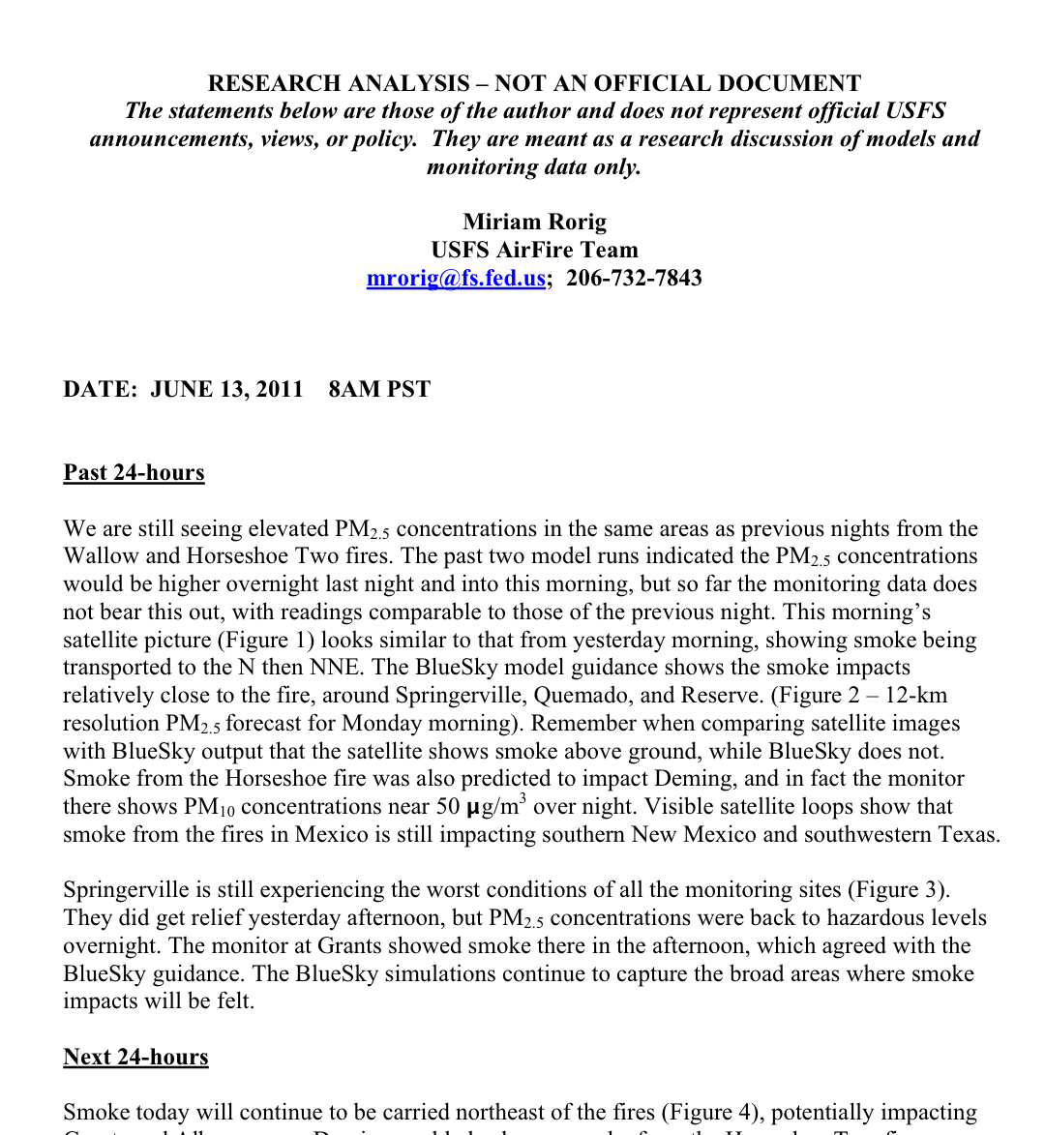
Response
Daily smoke modeling analysis reports
Written by smoke
experts
Analysis of model
predictions &
performance
Using all available
data
Delivered to inter-
agency group

Slide 35
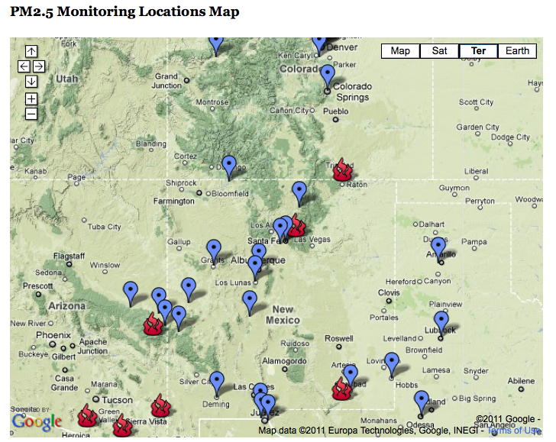
Publicly Available Information
Aggregated smoke monitoring information
Linked off
Inciweb
All sources:
USFS, EPA,
states, tribes,
local

Slide 36
Smoke Monitoring Report- 6-14-11
Summary of PM 2.5 Values from Particulate Monitors in AZ & NM
Location/ Monitor | 1- hour peak ug/m3 (hour¹) | 8- hour peak ug/m3 (hour¹) | 24- hour peak ug/m3 (hour¹) | Air Quality Index ²
Near the Fire
Springerville (ADEQ) | 260 (0300)³ | 183 (0500)³ | 88 (0600) | Unhealthy
Springerville (USFS) | 191 (0100) | 105 (0600) | NA | Unhealthy
St. Johns | 36 (0600)⁴ | 12 (0600)⁴ | 14 (0600)⁴ | Limited Impact (AQI Good)
Reserve | 90 (0500) | 68 (0800) | 33 (0800) | Unhealthy for Sensitive Groups
Quemado | 54 (1400) | 30 (1600) | 15 (0700) | Moderate
Show Low | 8 (0000) | 4 (0600) | 4 (0600) | Good
I-40 Corridor between Grants & Albuquerque
Grants | 14 (1600) | 8 (1700) | 5 (0800) | Good
Four Corners
Navajo Lake | 7 (0200) | 5 (0600) | 3 (0600) | Good
Upper Rio Grande Valley
Santa Fe Runnells | 31 (1600) | 19 (1600) | 10 (0700) | Limited Impact (AQI Good)
Santa Fe Airport | 12 (1200) | 9 (1600) | 6 (0700) | Good
Taos | 7 (2000) | 8 (0800- 6/13) | 4 (0700) | Good
Middle Rio Grande Valley
Albuquerque | 35 (1800) | 27 (1900) | 17 (0700) | Moderate
Los Lunas | 41 (1800) | 22 (2100) | 11 (0500) | Moderate
Socorro | 25 (0200) | 8 (0800) | 4 (0800) | Limited Impact (AQI Good)
Southern New Mexico
Silver City
Deming (PM 10) | 144 (1500) | 87 (2100) | 53 (0700) | Unhealthy

Slide 37
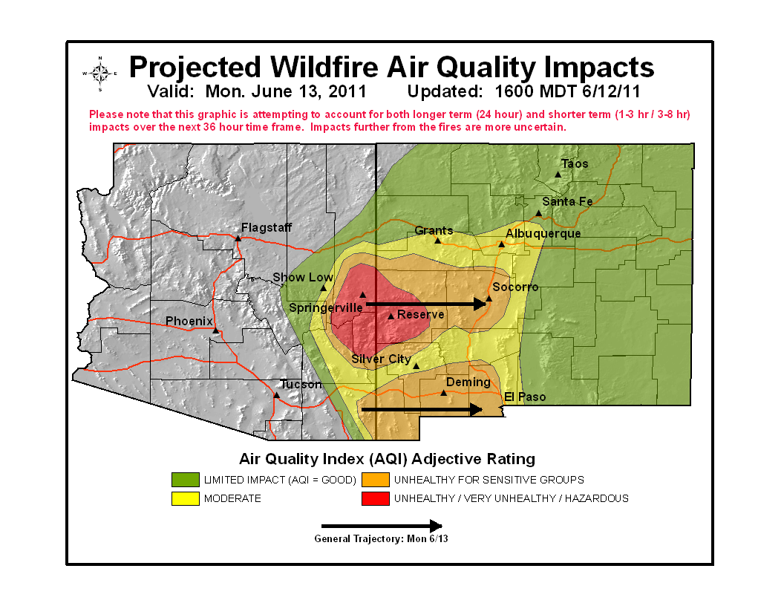
Official Interagency Smoke Guidance
Created by USFS. Included NWS, EPA, AZDEQ, NMENV, Cities, many, many others (typically 20+ groups) through daily phone calls
Official guidance issued through SWCC
Downloaded ~1000+/ day
Picked up and redistributed by media
(TV, Newspapers)

Slide 38
Successes
-Deployment of the Cache smoke monitoring equipment to key impact areas
-Customized smoke model runs and forecast
-1000’s of downloads of the forecast and the monitoring summary information
-National distribution of joint information (covered well with coordination on Inciweb, Twitter, AirNow, IMT PIO’s, R3 PIO’s, etc.)
-Altered times of outdoor activities tiered to smoke forecast affecting 1000’s in NM & beyond

Slide 39
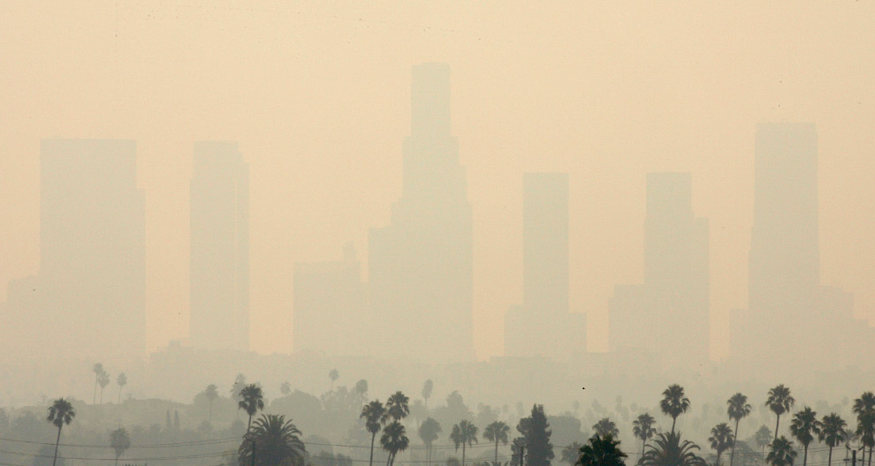
Challenges
No protocol in place to address wildfire smoke
Incident, regional, national response levels?
How to operationally support response?
No set language or thresholds for warnings (visual range approach has science issues)

Slide 40
Coalition of Prescribed Fire Councils
Mission: to promote the appropriate use of prescribed fire for enhancing public safety, managing resources, and sustaining environmental quality. www.prescribedfire.net
Governing Board Membership:
  The Nature Conservancy –Jeremy Baily – UT
  National Wild Turkey Federation – Gary Burger – SC
  Inter-Tribal Timber Council - James R. Erickson – ID
  Sand County Foundation - Brent M. Haglund – WI
  Larson & McGowin, Inc. - L. Keville Larson – AL
  The Jones Center – Mark Melvin –Chair – GA
  National Association of State Foresters – Dan Smith - NC
  Forest Service (Liaison)– Pete Lahm - DC
  Fish and Wildlife Service (Liaison) – Vacant
  Natural Resources Conservation Service (Liaison)– Pat Shaver- OR
  University of Idaho – Alistair Smith- ID

Slide 41
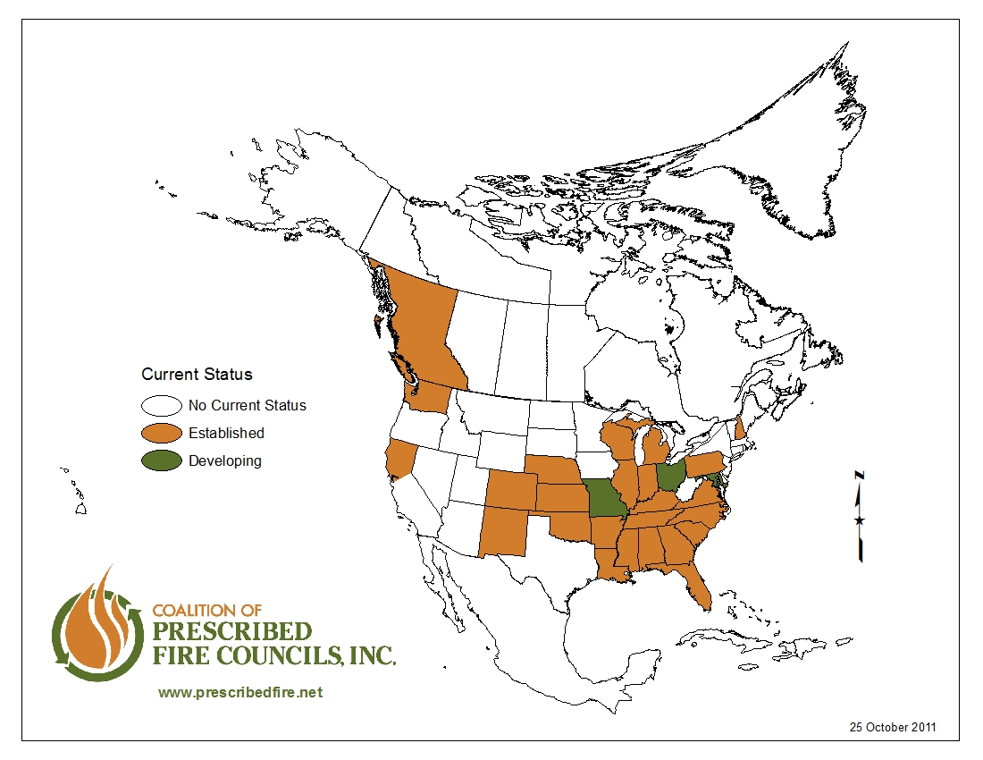

Slide 42
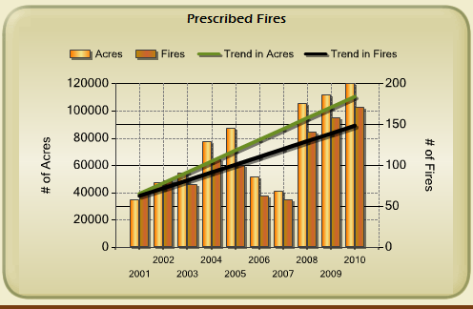
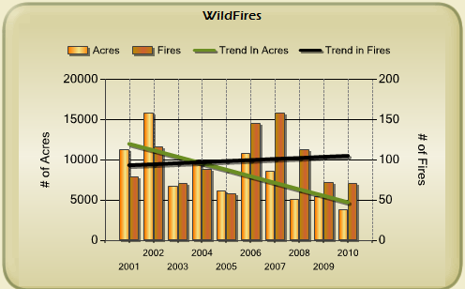
Eglin AFB: Managing Wildfire Risk

Slide 43
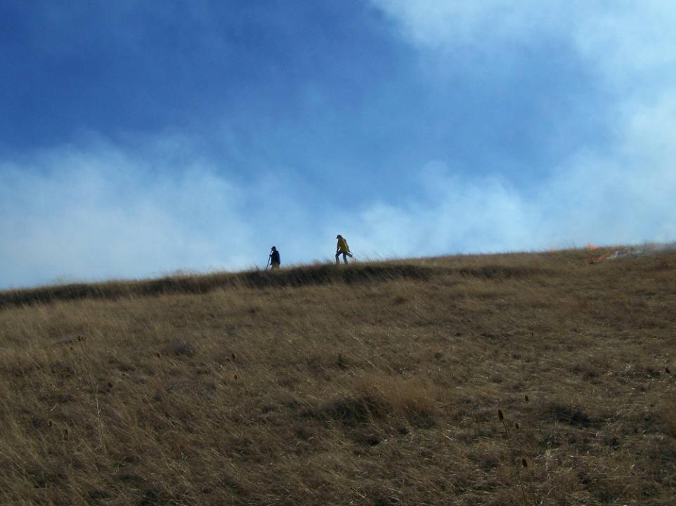
Thank you! Questions, Comments & Discussion
AND IAWF/NWCG SmoC International
Smoke Symposium - Fall 2013
“A merging of fire science and operations with an improved understanding of smoke and its impacts.”
Pete Lahm
202-205-1084
The U.S. Department of Agriculture (USDA) prohibits discrimination in all its programs and activities on the basis of race, color, national origin, age, disability, and where applicable, sex, marital status, familial status, parental status, religion, sexual orientation, genetic information, political beliefs, reprisal, or because all or a part of an individual's income is derived from any public assistance program.
Photo courtesy Lorraine Vogt

Slide 44

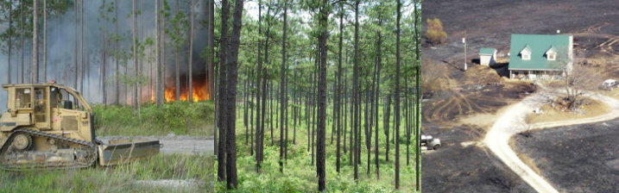
Cohesive Strategy

Slide 45
Phase I – Key Messages
CS Vision: “Safely and effectively extinguish fire, when needed; use fire where allowable; manage our natural resources; and as a nation, live with wildland fire.”
The Cohesive Strategy builds on previous work and the Foundational Documents.
Notes:
The Foundational Documents are:
(1) 1995 Federal Wildland Fire Policy and Program Review; (2) the documents that comprised the National Fire Plan; (3) A Collaborative Approach for Reducing Wildland Fire Risks to Communities and the Environment: A 10-Year Strategy; (4) both editions of the Quadrennial Fire Review; (5) Mutual Expectations for Preparedness and Suppression in the Interface; (6) A Call to Action; and Wildland Fire Protection and Response in the United States, The Responsibilities, Authorities, and Roles of Federal, State, Local and Tribal Governments.

Slide 46
Phase I – Key Messages
WFLC defined three primary factors as presenting the greatest challenges and opportunities to make a positive difference:
    Restoring and Maintaining Resilient Landscapes
    Creating Fire-Adapted Communities
    Responding to Wildfires
Notes:
Three primary factors that WFLC identified as presenting the greatest challenges and the greatest opportunities for making a positive difference in addressing the wildland fire problems to achieve this vision are:
(1) Restoring and maintaining resilient landscapes - The strategy will recognize the current lack of ecosystem health and variability of this issue from geographic area to geographic area. Because landscape conditions and needs vary depending on local climate and fuel conditions, among other elements, the strategy will address landscapes on a regional and sub-regional scale.
Creating fire-adapted communities - The strategy will offer options and opportunities to engage communities and work with them to become more resistant to wildfire threats.
Responding to Wildfires - This element will consider the full spectrum of fire management activities and will recognize the differences in missions among local, state, tribal and federal agencies. The strategy will offer collaboratively developed methodologies to move forward.

Slide 47
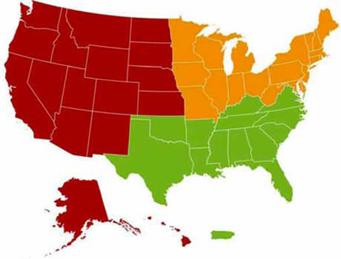
Phase II
Phase II National Report – developed from the three Regional Assessments
Notes:
Recognize the engagement, hard work and commitment to the CS by the all the regions.
Common themes among the regions:
Collaboration is key to getting things done.
Policies and regulations guiding wildland fire management pose both shared and unique challenges for each of the regions. Across the country, wildland fire management is a cross-jurisdictional issue that must respect the unique missions and management objectives of local, state, tribal, and federal agencies and organizations.
Several values were common to all three regions, including: safety of firefighters and the public, protection of private property, air and water quality, and aesthetics.
Unique factors:
Values - The Northeast cited recreation as significant, the Southeast noted industrial infrastructure, and the West noted cultural values such as honoring tribal heritages and land uses, respecting the frontier culture, and stewarding public lands. These and the other values expressed provided the basis for developing regional objectives, actions, performance measures, and areas to explore for reducing risk.
Culture that supports the extensive use of prescribed fire in the southeast.
Goals/Objectives -
All regions adopted the national goals as their own: resilient landscapes, fire-adapted communities, and wildfire response, and crafted a suite of objectives and actions to implement each one. Several cross-cutting objectives, so called because they will affect all three national goals simultaneously, were identified across the regions:
Invest in, learn from, and build upon successful partnership and collaboration efforts.
Develop and conduct effective education and outreach to empower citizen engagement in and support for wildland fire management activities.
Proactively use a variety of active vegetation management tools and techniques including prescribed fire to achieve local and large landscape objectives.
Support working forests, local economies and jobs, and diverse forest products markets.

Slide 48
Phase III Objectives (underway)
  Increase internal and external communication
  Scientific risk assessment and analysis for reducing risk at the local, regional, and national levels
  Continuing to Identify Immediate Opportunities.
  Further Regional Action Plans and develop a National Action Plan.
  Due February 2013
Notes:
Recognize the engagement, hard work and commitment to the CS by the all the regions.
Common themes among the regions:
Collaboration is key to getting things done.
Policies and regulations guiding wildland fire management pose both shared and unique challenges for each of the regions. Across the country, wildland fire management is a cross-jurisdictional issue that must respect the unique missions and management objectives of local, state, tribal, and federal agencies and organizations.
Several values were common to all three regions, including: safety of firefighters and the public, protection of private property, air and water quality, and aesthetics.
Unique factors:
Values - The Northeast cited recreation as significant, the Southeast noted industrial infrastructure, and the West noted cultural values such as honoring tribal heritages and land uses, respecting the frontier culture, and stewarding public lands. These and the other values expressed provided the basis for developing regional objectives, actions, performance measures, and areas to explore for reducing risk.
Culture that supports the extensive use of prescribed fire in the southeast.
Goals/Objectives -
All regions adopted the national goals as their own: resilient landscapes, fire-adapted communities, and wildfire response, and crafted a suite of objectives and actions to implement each one. Several cross-cutting objectives, so called because they will affect all three national goals simultaneously, were identified across the regions:
Invest in, learn from, and build upon successful partnership and collaboration efforts.
Develop and conduct effective education and outreach to empower citizen engagement in and support for wildland fire management activities.
Proactively use a variety of active vegetation management tools and techniques including prescribed fire to achieve local and large landscape objectives.
Support working forests, local economies and jobs, and diverse forest products markets.

