Slide 1

Burn Call Decision Making
Erin Law
Smoke Management Program Coordinator

Slide 2
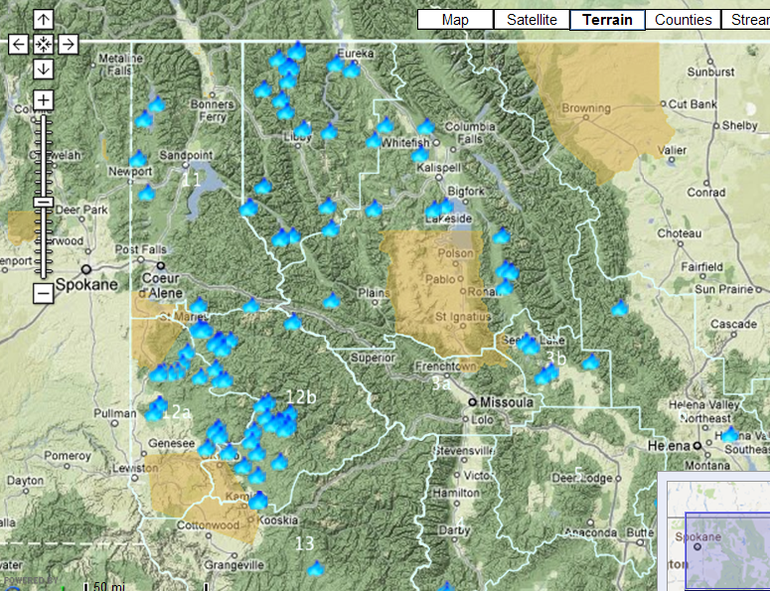
Communicating Decisions Within an Airshed

Slide 3
MT DEQ
ID DEQ

Slide 4
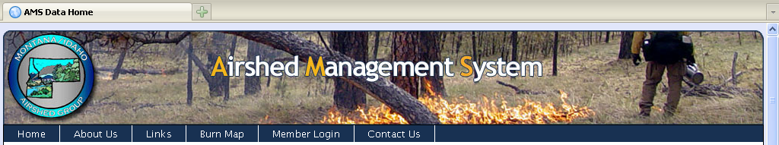
The Airshed Management System
www.smokemu.org
The Montana/Idaho Airshed Group’s internet-based database that serves as the foundation to the coordination and decision support process.

Slide 5
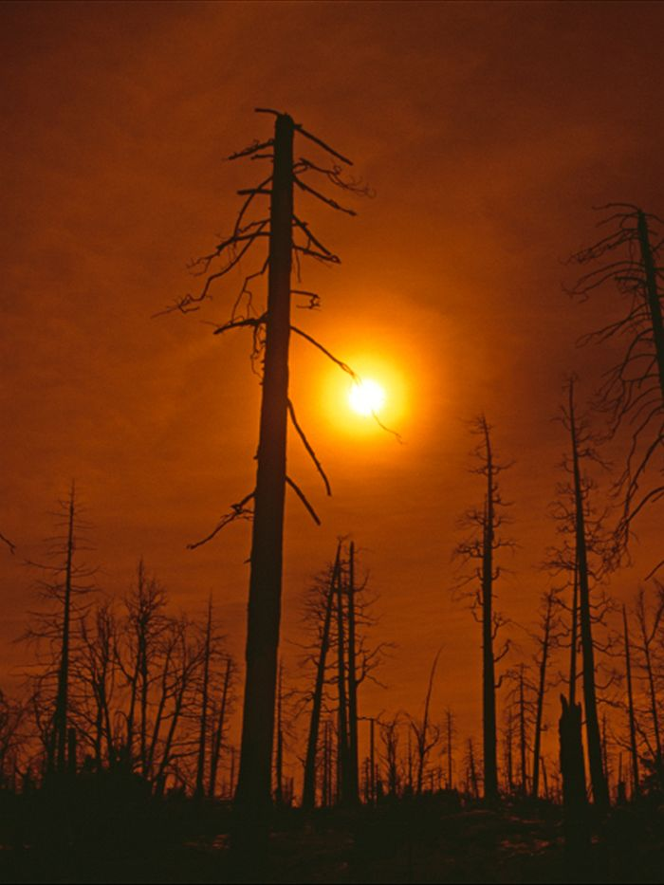
Fuels
Topography
Weather
Air Quality

Slide 6
Preseason - Burner enters detailed burn unit information regarding fuels, and a location (lat/long or PLSS) including elevation.

Slide 7
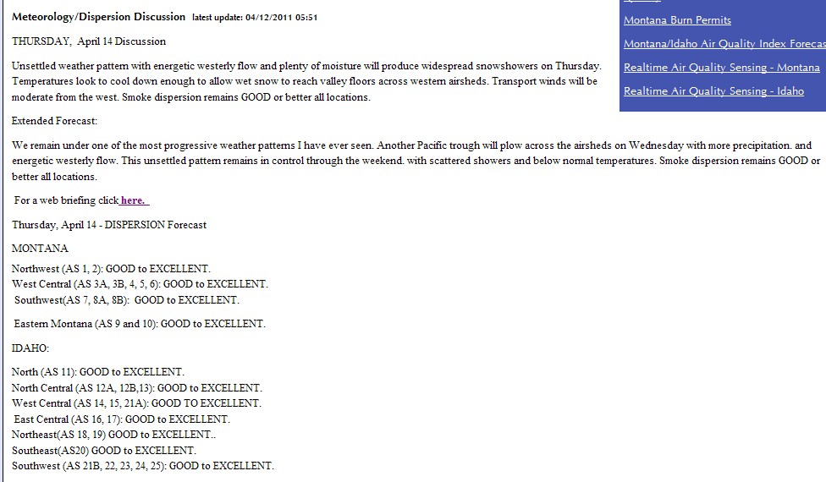

Slide 8
October 19, 2011
Proposed Burns

Slide 9
FORECAST
IDAHO:
North (AS 11): POOR valleys, becoming GOOD ridges.
North Central (AS 12A, 12B, 13): POOR valleys, becoming GOOD ridges.
West Central (AS 14, 15, 21A): POOR valleys, becoming GOOD ridges..

Slide 10
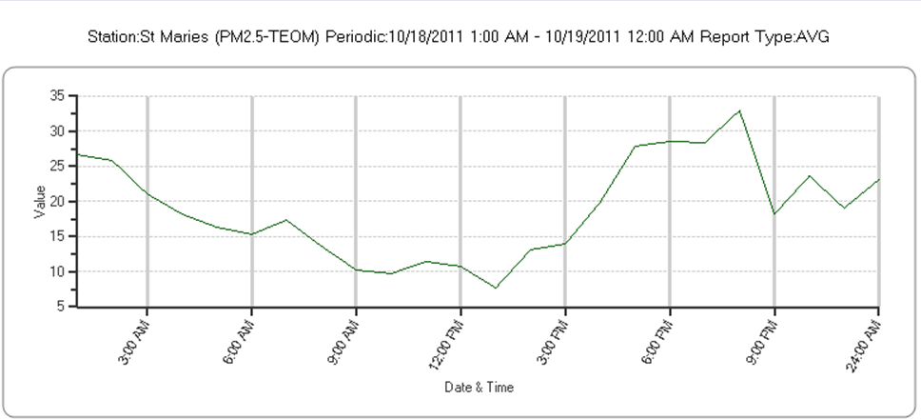
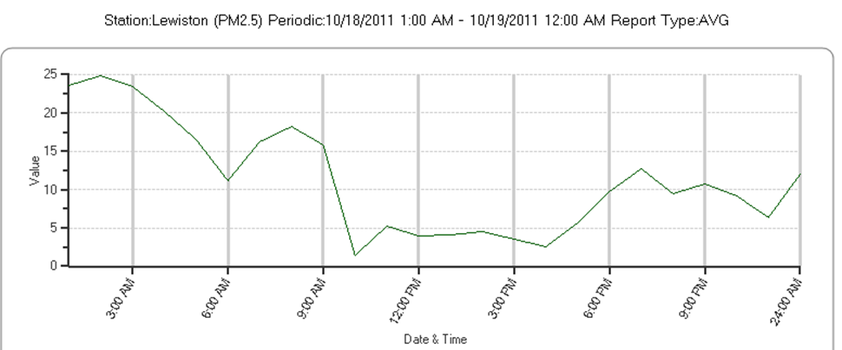

Slide 11
Proposed Burns

Slide 12
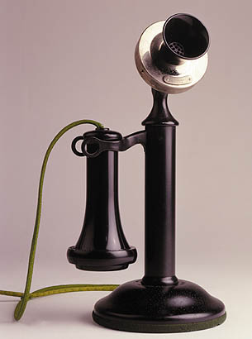
NOW WHAT?

Slide 13
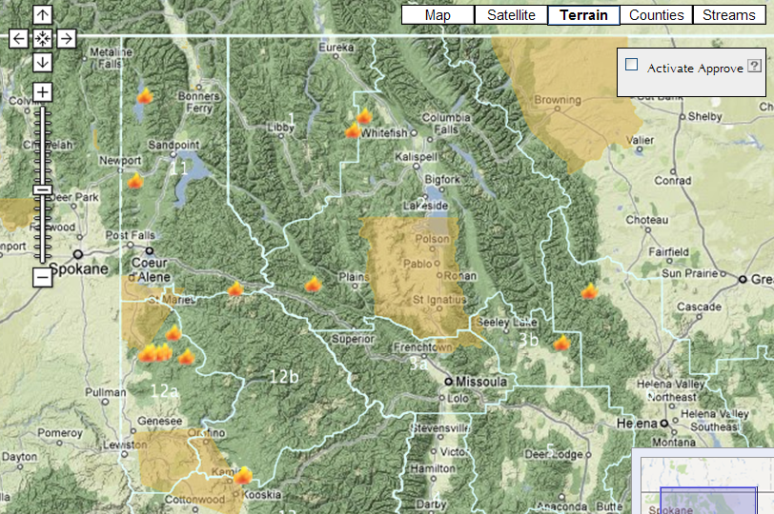
Approved Burns

Slide 14
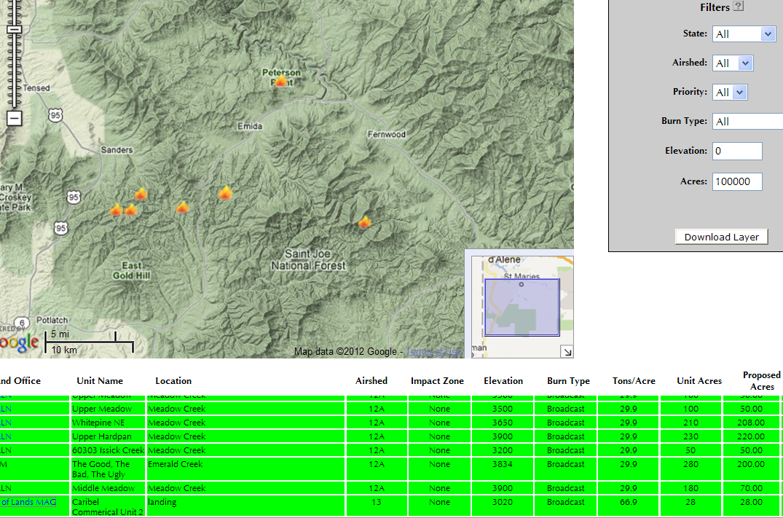

Slide 15
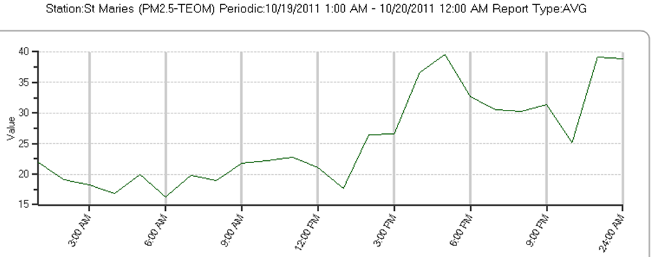


Slide 16
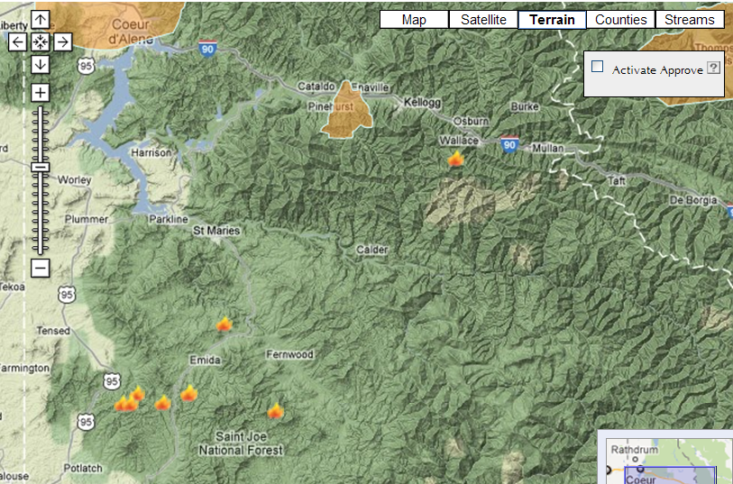

Slide 17
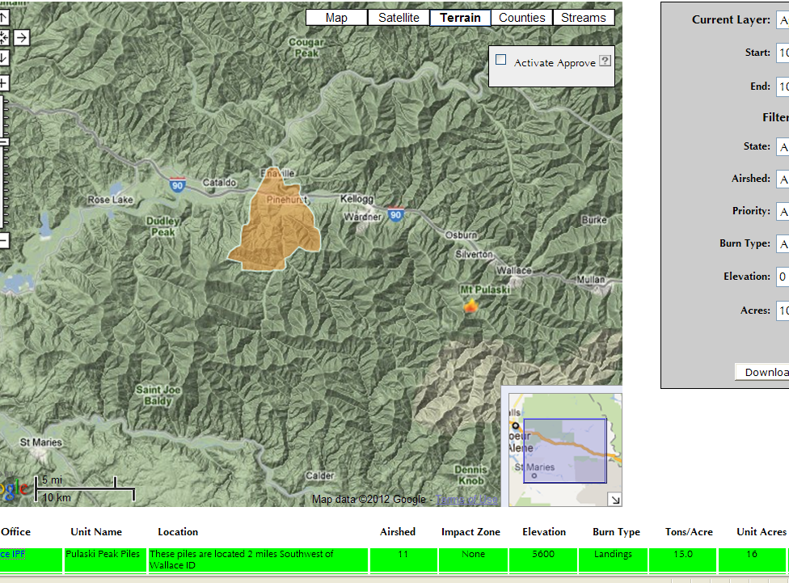

Slide 18
