Slide 1


Alaska’s radon program history, challenges, successes, and future work
Jennifer E. Athey
alaska DNR/Division of Geological & Geophysical Surveys
R10 Radon Stakeholders Virtual Summit
November 9, 2021

Slide 2
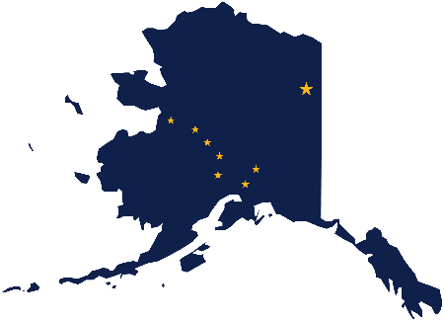
Current program structure
EPA SIRG
AK Department of Environmental Conservation
Division of Air Quality
- Alice Edwards, Director
- Joey Ausel, Admin Operations Manager
AK Department of Natural Resources
Division of Geological & Geophysical Surveys
- Jen Athey, Geologist
University of Alaska Fairbanks
Cooperation Extension Service
- Art Nash, Energy Specialist

Slide 3
Program history and structure
State Indoor
Radon Grant
National radon
mapping
Exchange
Network

Slide 4
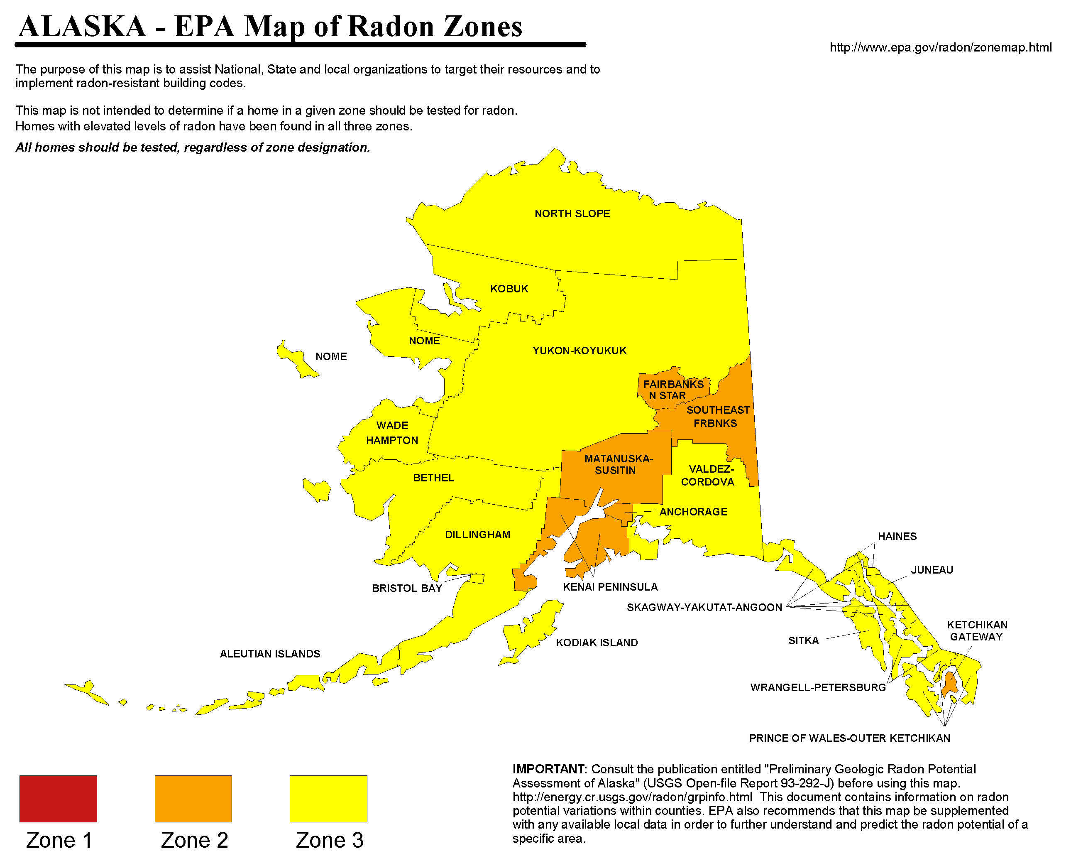
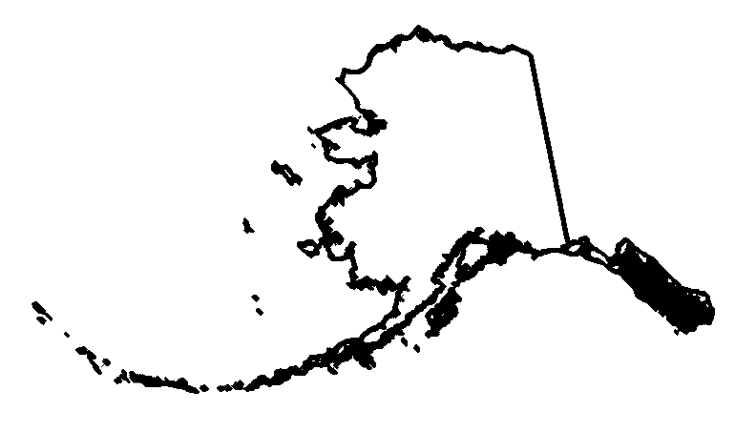
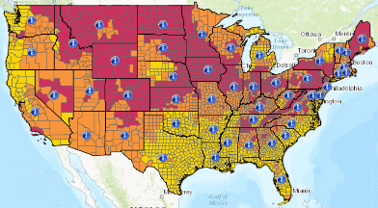
https://www.epa.gov/sites/production/files/2014-08/documents/alaska.pdf

Slide 5
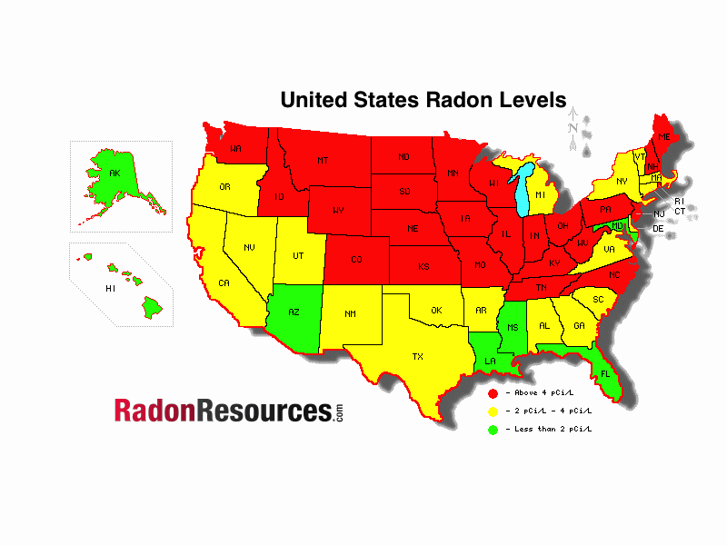
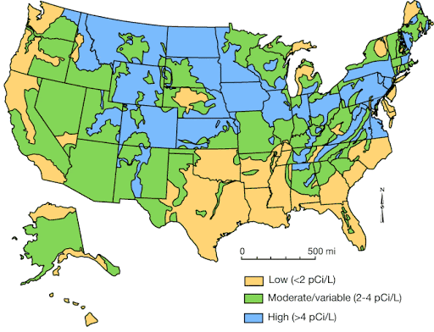
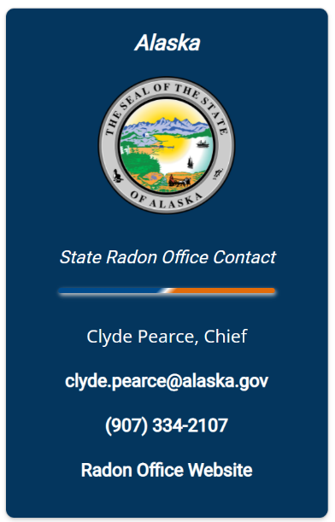
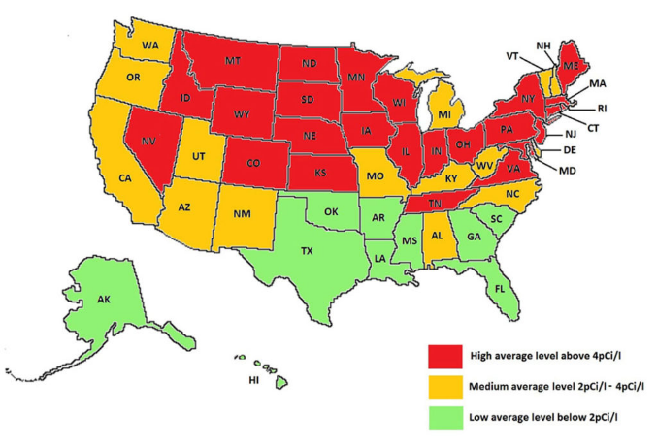
https://www.integritympls.com/minnehttp://www.kgs.ku.edu/Publications/PIC/pic25.htmlapolis-radon-testing.html
https://radonresources.com/radon-levels/
http://www.kgs.ku.edu/Publications/PIC/pic25.html
https://www.integritympls.com/minneapolis-radon-testing.html
https://nrpp.info/

Slide 6
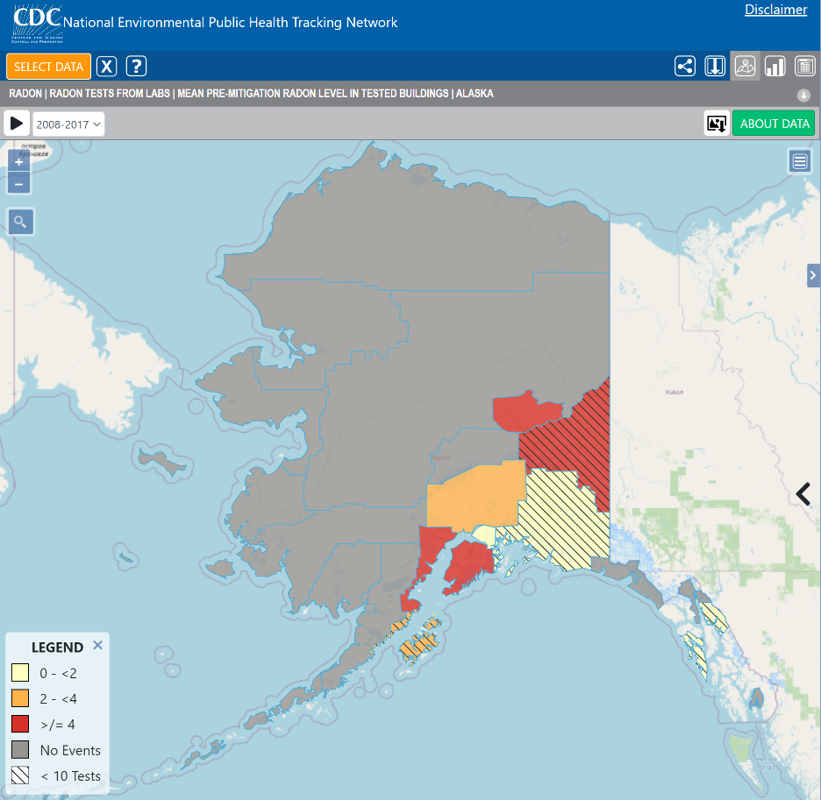
Average radon values per borough
Data from labs
Multiple tests per residence
Challenge of testing in rural areas
< 11 tests
< 10 tests
< 2 pCi/L
2 to < 4 pCi/L
≥4 pCi/L
https://ephtracking.cdc.gov/DataExplorer/

Slide 7
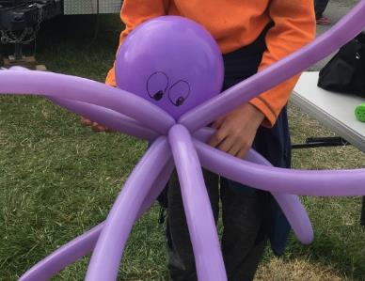
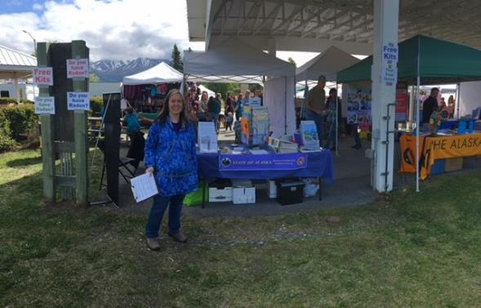
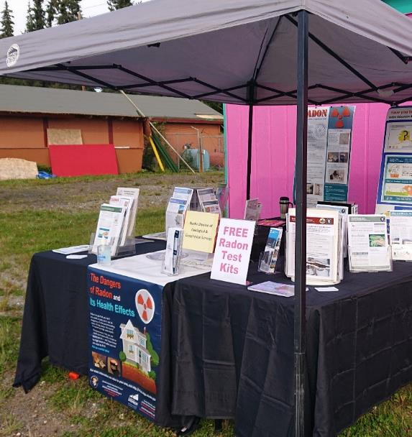
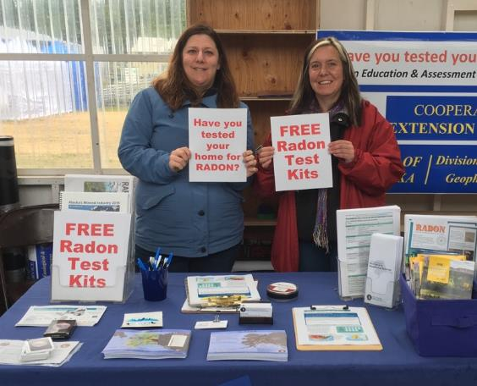
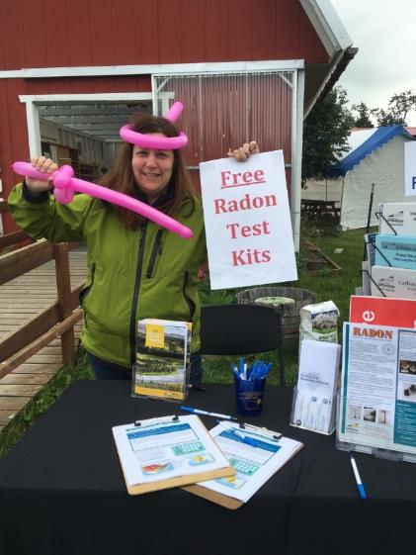
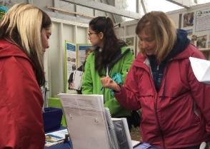
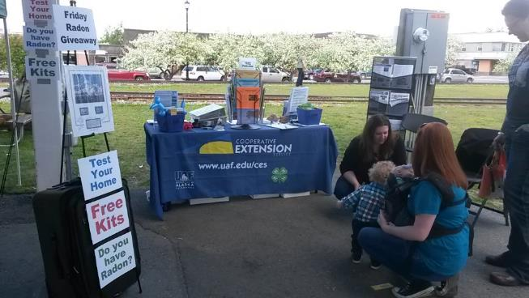
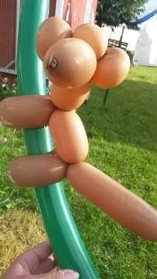
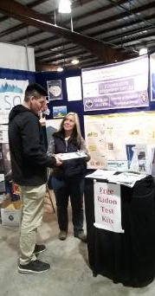

Slide 8
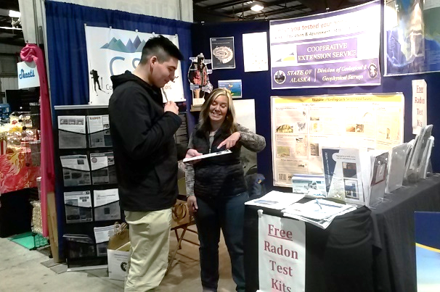
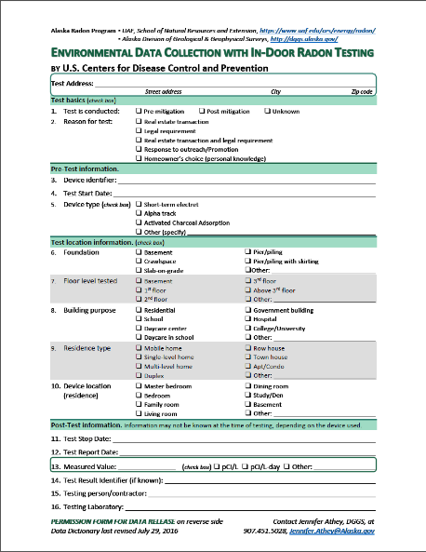
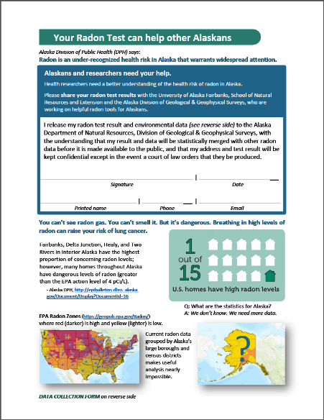
Quality data collection
DATA CONFIDENTIALITY
DGGS treats radon data as confidential and will not release the data unless required to do so by a court of law. Data will be statistically merged with other radon data before they are made avail-able to the public.
http://dggs.alaska.gov/hazards/download/radon-questionnaire.pdf

Slide 9
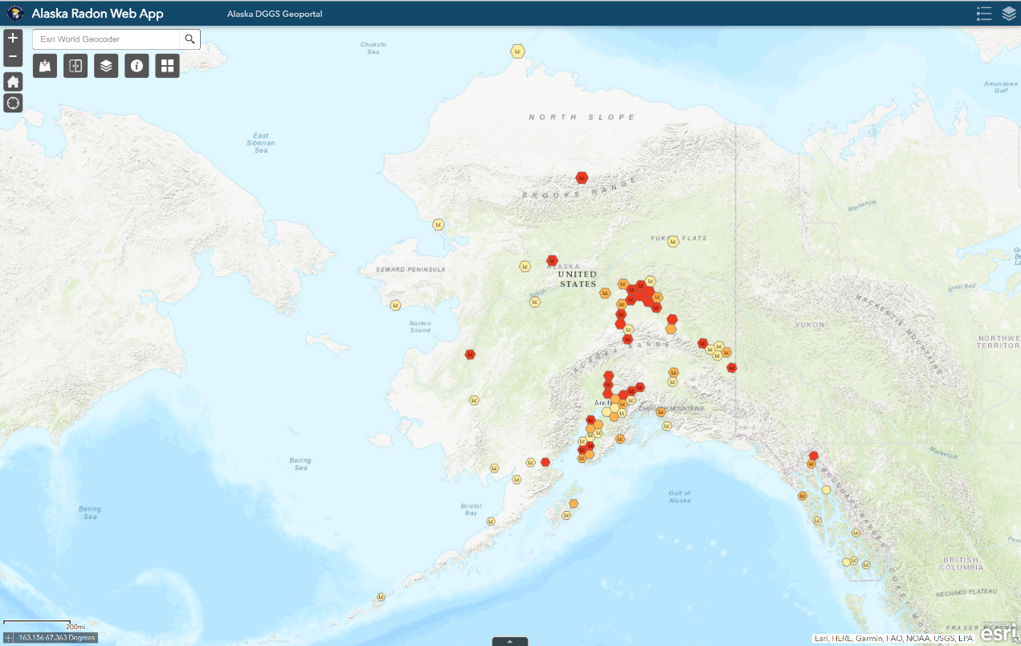
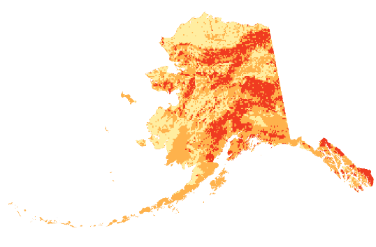
https://maps.dggs.alaska.gov/radon/

Slide 10
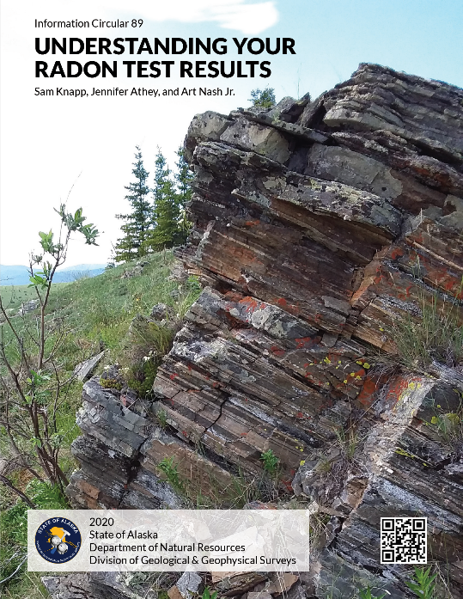
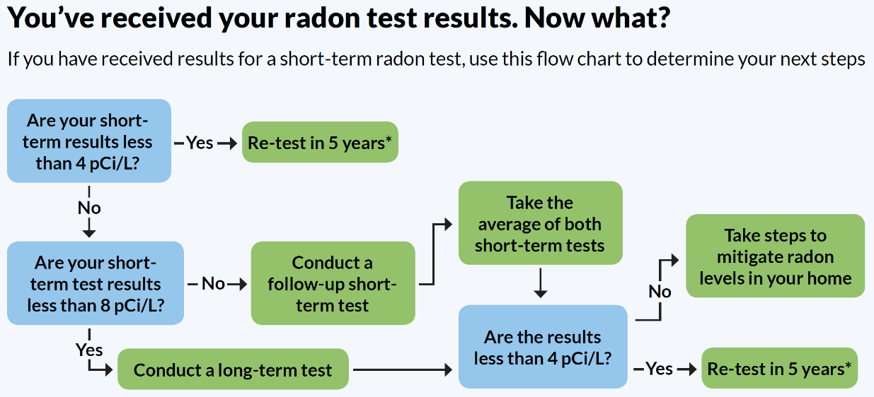
I’ve tested. Now what?
https://doi.org/10.14509/30467

Slide 11
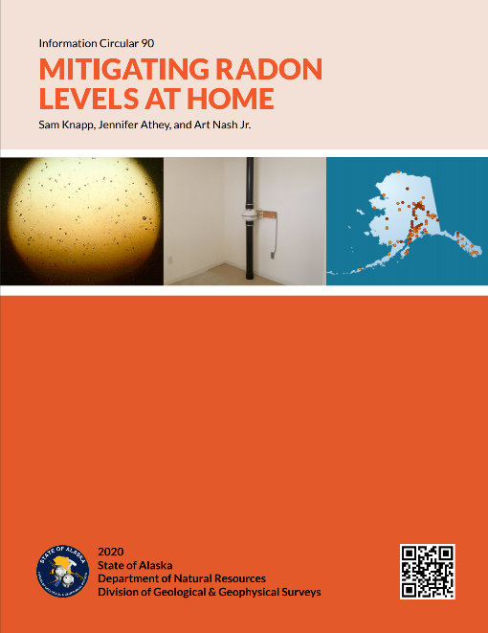

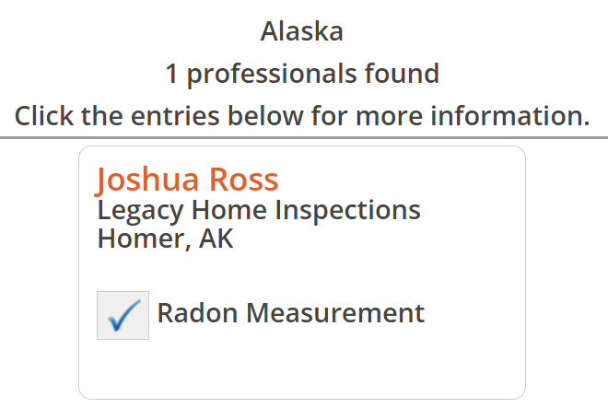
Do-It-Yourself Mitigation
https://doi.org/10.14509/30474

Slide 12
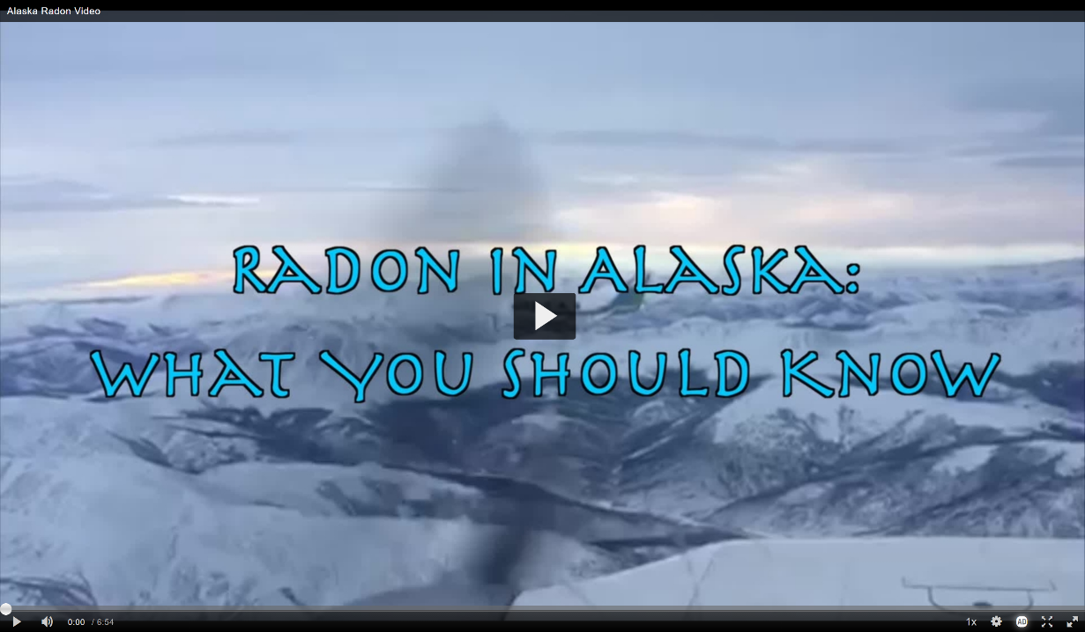
Other media
https://doi.org/10.14509/30745

Slide 13
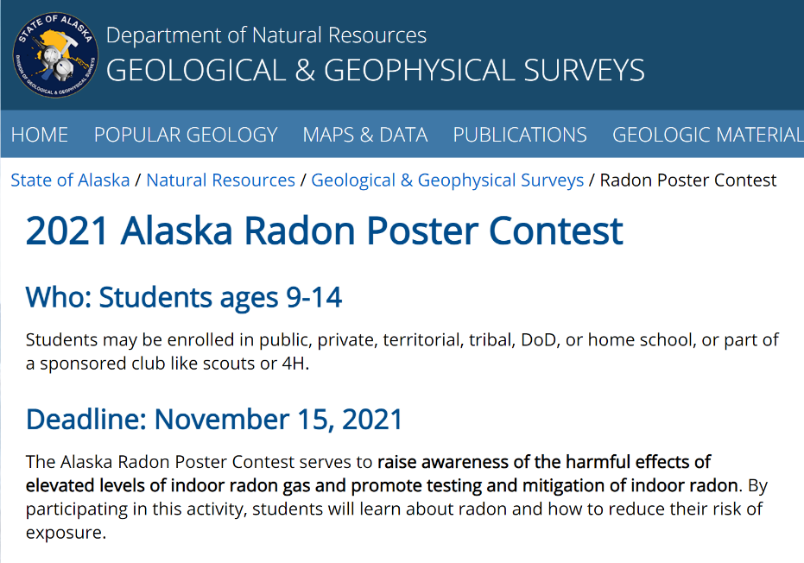
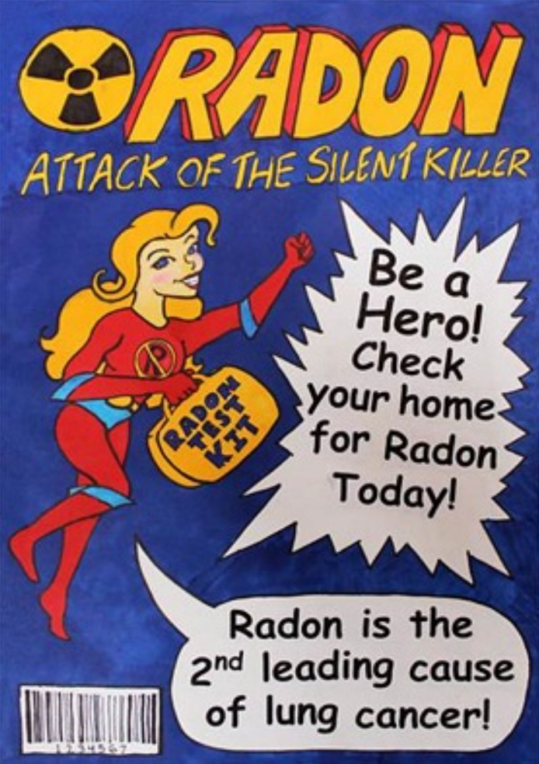
Future work

Slide 14
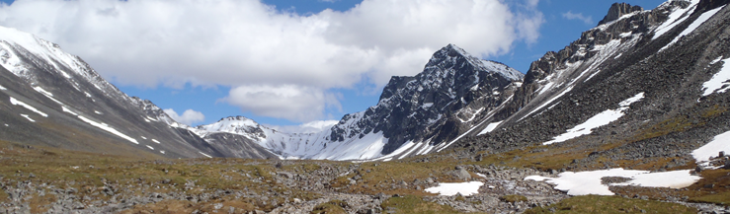
Contact us
Jen Athey, Geologist, Mineral Resources & Geologic Information Center
State of Alaska, Division of Geological & Geophysical Surveys
jennifer.athey@alaska.gov 907.451.5028
Art Nash, Assistant Professor
UAF Cooperative Extension Service
alnashjr@alaska.edu 907.474.6366

