Slide 1

The University of Alaska does not discriminate on the basis of race, religion, color, national origin, citizenship, age, sex, physical or mental disability, status as a protected veteran, marital status, changes in marital status, pregnancy, childbirth or related medical conditions, parenthood, sexual orientation, gender identity, political affiliation or belief, genetic information, or other legally protected status.
Naturally occurring
contaminants thawing
in the Last Frontier 11/9/21

Slide 2

National Extension Healthy Homes Partnership principals:
Clean
Contaminant-free
Well maintained
Pest-free
Safe
Well ventilated
Dry

Slide 3
Water and home intrusion
Concern for vapor …
“A typical person generates about 3 pints of water per day just from breathing, cooking produces about 1 pint of water per meal, a 5-minute shower creates ½ pint of water, five to seven houseplants create about 1 pint per day…”
But also private drinking water …highest level known of radon in water has been ~23,000 pCi/L

Slide 4
Water contaminants are a Healthy Homes concern (USDA, HUD, EPA)
Safe Drinking Water Act-
Physical (silt)
Biological (organisms)
Radiological (ionizing radiation)
Chemical (metals- and even human/animal drugs)

Slide 6
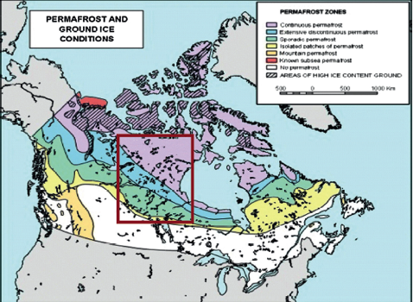
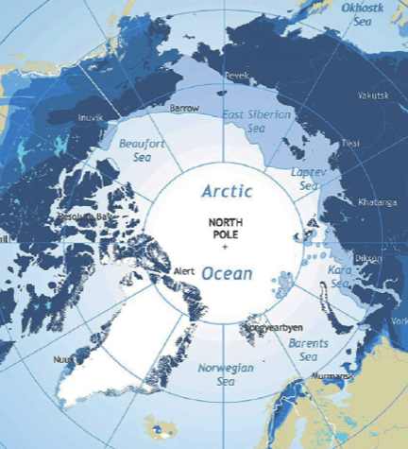
Circumpolar and North America

Slide 7
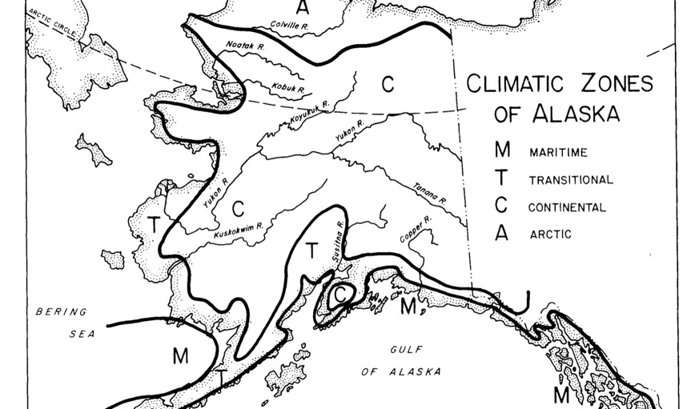
Some deposits scattered in subarctic- and in permafrost

Slide 9
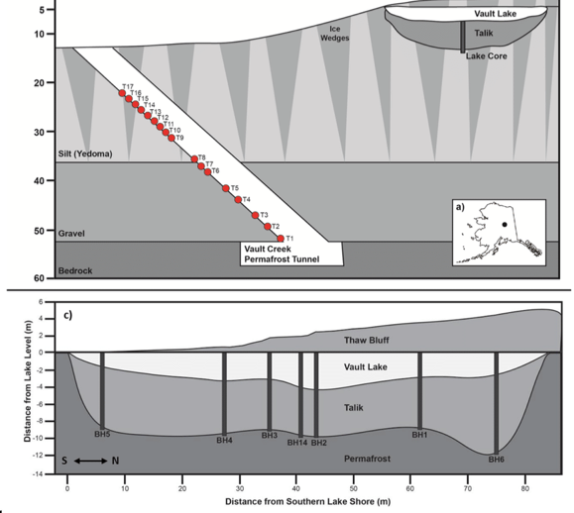
Ice lenses and wedges…

Slide 10
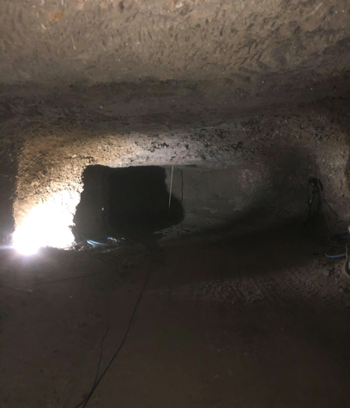
Permafrost faults, chimneys and tunnels
Draw up samples of radionuclides 30 meters down the tunnels and faults

Slide 11
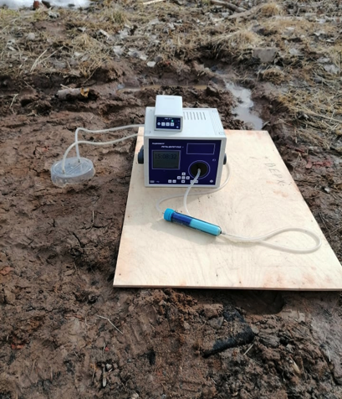
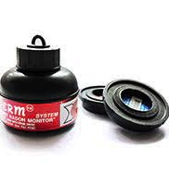
Subsurface samples

Slide 12
Info on future research
907-322-2309
alnashjr@alaska.edu
(Art Nash, UAF Cooperative Extension)

