Slide 1
EPA Radon Program and
NRAP Update
November 9, 2021

Slide 2
SIRG
FY21 SIRG funding was appropriated at $7.795M
FY22 – Under a CR, awaiting Congressional appropriations
March 2021 – EPA finalized the 2020 Annual SIRG Activities Report
2021 SIRG Annual Reports due 11/1/21
EPA’s SIRG Resources webpage
https://www.epa.gov/radon/state-indoor-radon-grants-resources

Slide 3
Performance Partnership Grants (PPG)
EPA’s Office of Congressional and Intergovernmental Relations (OCIR) and the American Indian Environmental Office (AIEO) requested an exception to make PPGs more accessible to tribes.
The Office of Grants and Debarment (OGD) granted the requested exemption to eliminate the cost share for PPGs with tribes and intertribal consortia currently required by 40 CFR 35.536.

Slide 4
PPG (cont.)
The class exception took effect on 10/1/21 and applies only to new tribal or intertribal consortia PPGs and new funding awarded via supplemental amendments to tribal or intertribal consortia PPGs awarded on or after that date.
Class Exception to the Cost Share Requirements for Tribal and Intertribal Consortia Performance Partnership Grants (https://www.epa.gov/grants/rain-2022-g01)

Slide 5
Building Codes
EPA has been a participant with AARST, CRCPD, and others in the efforts to update Appendix F of the IRC (International Residential Code) and incorporate radon controls in other ICC (International Code Council) codes.
6 Radon Code Proposals Submitted in January
Proposals defended at the Committee Action Hearings (CAH) in April – disapproved
Public comments due July 2
Public comment hearings in September in Pittsburgh, PA

Slide 6
Credentialing
EPA sought public feedback in 2017
Developing a framework that will help align existing credentialing systems for radon service providers and promote access to a qualified workforce
The Agency plans to post an updated proposal online that reflects stakeholder feedback and hold an information session

Slide 7
National Radon Action Plan
Progress Report and NRAP 2021-2025

Slide 8
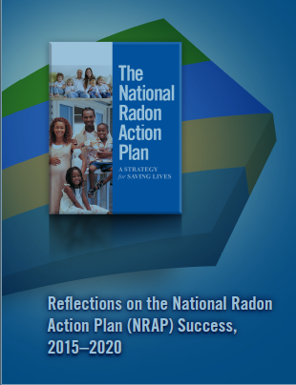
Briefing Overview
Progress Report
NRAP|2021-25

Slide 9
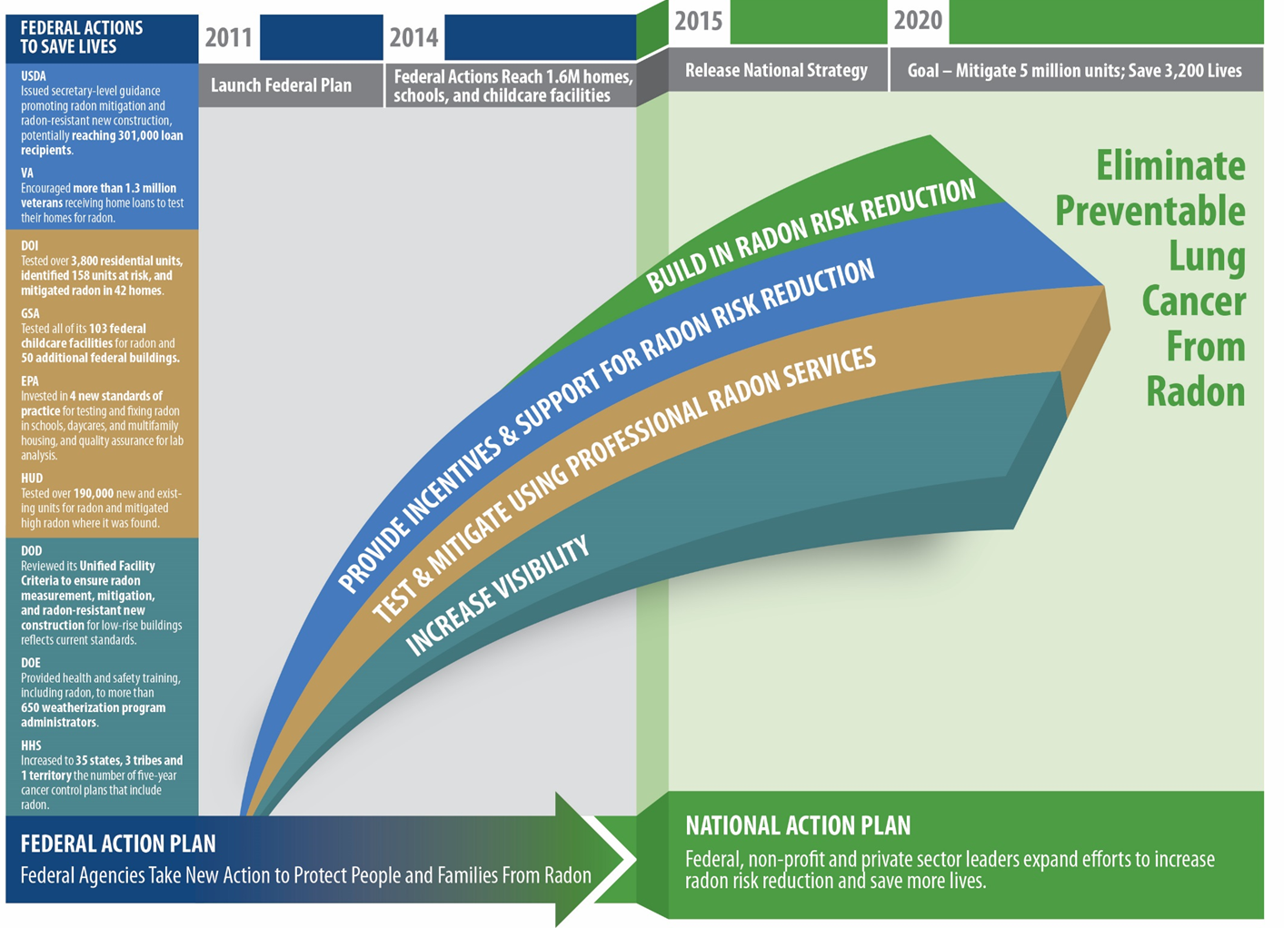
By 2014, Federal actions had led to steps that:
Reached 1.6 million homes, schools, childcare centers
Tested for and mitigated high risk in 200,000 units

Slide 10
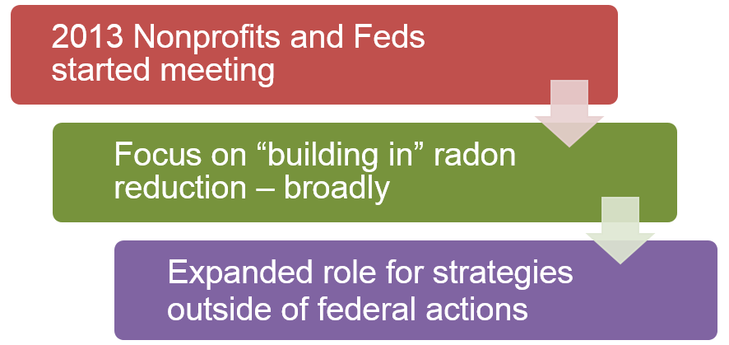
Moving to a National Radon Action Plan

Slide 11

National Radon Action Plan Adopted 11/2015
Fourteen organizations committed to act.
American Lung Association
American Association of Radon
Scientists and Technologists
AARST Foundation
American Society of Home Inspectors
Cancer Survivors Against Radon
Children’s Environmental Health Network
Citizens for Radioactive Radon Reduction
Conference of Radiation Control Program Directors

Slide 12
National Radon Action Plan Adopted 11/2015
Fourteen organizations committed to act.
Environmental Law Institute
National Center for Healthy Housing
National Tribal Air Association
U.S. Environmental Protection Agency
U.S. Department of Health and Human Services
U.S. Department of Housing and Urban Development

Slide 13
National Radon Action Plan Signers
4 organizations signed on in support.
American Public Health Association
American Thoracic Society
Trust for America’s Health
Asthma & Allergy Network
Others are in review

Slide 14
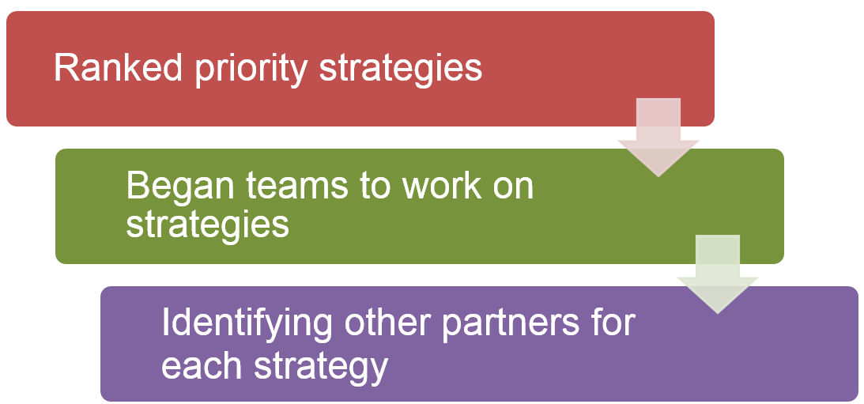
Moving to a National Radon Action Plan

Slide 15
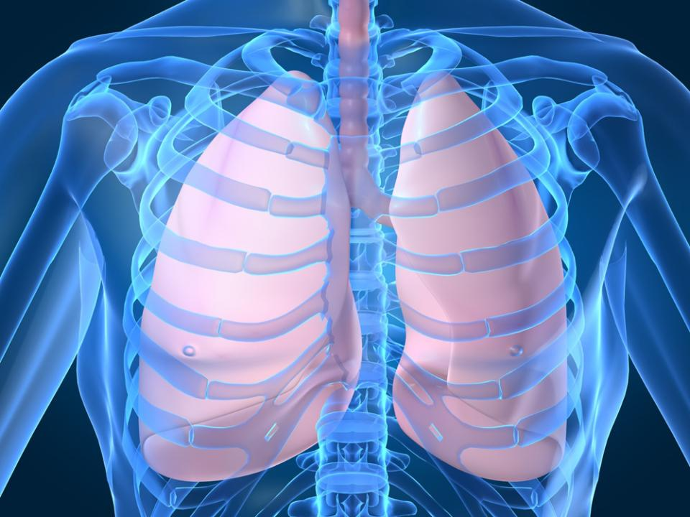
Our Bold Goal
Mitigate 5 million high-radon homes and save 3,200 lives annually by 2020

Slide 16
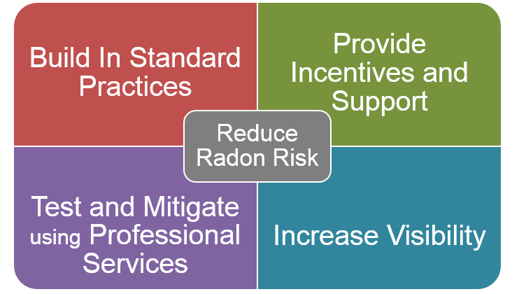
National Radon Action Plan

Slide 17
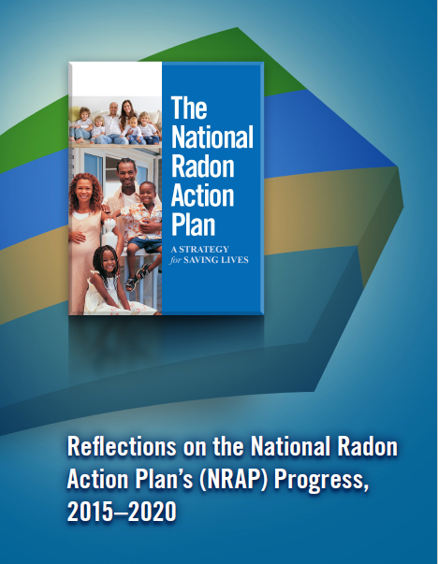
We dedicate our NRAP progress report, our past NRAP efforts, and our future radon action plans to the memory of our dedicated team leader and friend, Janice Nolen. Janice led this team to create and deliver the NRAP. The progress we can report in 2020 is indebted to Janice’s bold, gracious, and righteous work. We miss Janice and will seek to honor our friend daily with lives saved from lung cancer.
Reflections on the National Radon Action Plan's (NRAP) Progress, 2015-2020

Slide 18
NRAP Progress Report 2015-2020
Goal Area 1: Integration of radon requirements across some HUD programs, including guidance about implementing FHA mortgage insurance for multifamily housing.
Goal Area 2: Evidence from HUD and DOE that simple, low-cost radon interventions curb increases in radon that might otherwise occur during home energy retrofits.
Goal Area 3: ANSI accredited standards for testing and mitigation adopted in HUD’s programs for multifamily housing and residential care facilities.
Goal Area 4: More state cancer control plans than ever before address radon and include radon objectives.

Slide 19
NRAP Progress Report 2015-2020
Building codes require that homes be built to resist radon.
Criteria for national programs promoting healthy homes include radon risk reduction.
Radon mitigation is financed where occupants are unable to afford mitigation.
Home health and safety programs (in-home) include radon.
More certified radon professionals are available nationwide.
State/local laws require disclosure/information, and borrowers request testing and mitigation.
Increased coordination of communication makes clear that radon is a serious risk that needs priority.
Medical, public health and childcare practitioners educate about and reduce radon in environments.

Slide 20
NRAP Progress Report 2015-2020
New sources of funding are available to motivate owners to test and mitigate.
Tax incentives exist that increase voluntary radon testing and mitigation.

Slide 21
NRAP|2021-25 – Next Steps
Build on success from FRAP→NRAP→NRAP|2021-25.
The NRAP| 2021-25 retains our purposeful focus on institutional levers of change for saving the greatest number of lives most quickly.
Release Date – EOY 2021 (tentative)

Slide 22
NRAP|2021-25 – Emerging Themes
A commitment to changing building codes, as well as a focus on tenant resources and action.
Leveraging available sources of funding and recognizing opportunities to seek additional funding.
And finally, a commitment to address disparities in radon risk reduction.

Slide 23
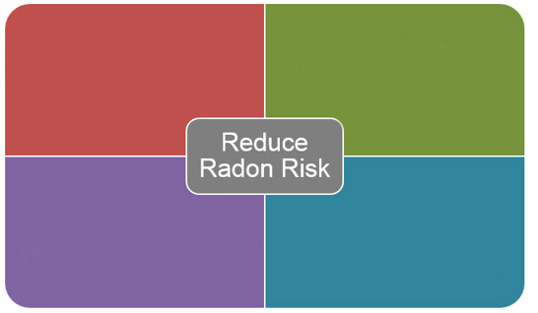
National Radon Action Plan 2021-2025
Build in Radon Risk Reduction
Support Radon Risk Reduction
Build Capacity to Test and Mitigate Using Professional Radon Services
Increase Awareness of Radon Risk and Effective Control Strategies

Slide 24
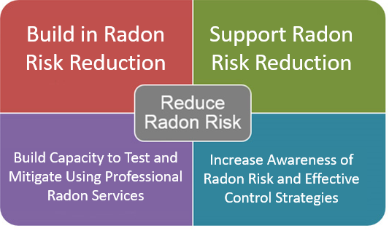
Refinements to NRAP
2015-2020
2021-2025

Slide 25
National Radon Action Plan 2021-2025
#1: BUILD IN RADON RISK REDUCTION
Strategy 1.1: Embed comprehensive radon notification and health risk warning statements, and radon test result disclosure, in real estate sales and rental transactions.
Strategy 1.2: Work with government, quasi-governmental and private sector lending entities to adopt radon testing and mitigation requirements.
Strategy 1.3: Promote radon control requirements for new construction within building codes and standards.
Strategy 1.4: Seek local, state and federal policies and codes that require all existing buildings to be tested for radon and mitigated as needed.

Slide 26
National Radon Action Plan 2021-2025
#2: Support Radon Risk Reduction
Strategy 2.1: Increase access to government-backed and other sources of housing financing for property owners of low-income housing to cover radon testing and mitigation.
Strategy 2.2: Support establishment of tax incentives to cover radon mitigation costs.
Strategy 2.3: Increase local, state and tribal programs that address problems in existing housing to provide radon testing and, if needed, mitigation.
Strategy 2.4: Support state cancer control programs to include radon indicators and interventions.

Slide 27
National Radon Action Plan 2021-2025
#3: Build Capacity to Test and Mitigate Using Professional Radon Services
Strategy 3.1: Expand the scope and usability of radon testing data in the National Environmental Public Health Tracking Network by increasing the number of participating states and laboratories.
Strategy 3.2: Continue to promote adherence to consensus standards for testing, mitigating and measurement device accuracy.
Strategy 3.3: Support finalization and implementation of a federal framework to align private and state radon credentialing programs.
Strategy 3.4: Support states that do not regulate radon service providers with adoption of radon credentialing programs.
Strategy 3.5: Expand the availability of credentialed radon practitioners through the training and certification of qualified professionals.

Slide 28
National Radon Action Plan 2021-2025
#4: Increase Awareness of Radon Risk and Effective Control Strategies
Strategy 4.1: Promote integration of radon into coordinated messaging to decision-makers about health risks in housing, schools and workplaces.
Strategy 4.2: Promote radon awareness through non-traditional radon stakeholders —including clinical, public health, health equity, social service and faith-based organizations, through consistent outreach using targeted materials.
Strategy 4.3: Tailor effective radon messaging to underserved, poor, racial and ethnic populations.

Slide 29
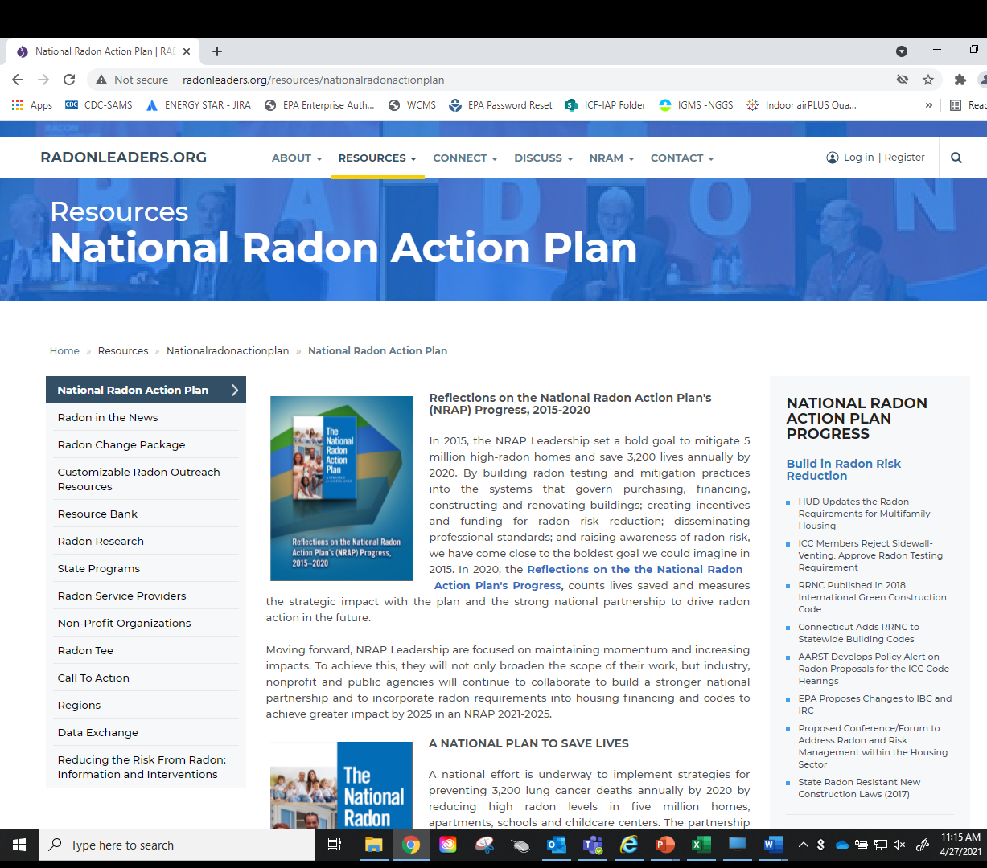
http://www.radonleaders.org/resources/nationalradonactionplan

Slide 30
Meeting NRAP|2021-25 Goals
Expand our work in the states to build coalitions and partnerships and to educate decision-makers.
Support expansion of professional credentialing requirements in states
Make sure all available data is being reported to CDC tracking
Share your stories of need and opportunity to educate decision-makers about policy priorities
Celebrate the lives you are saving

Slide 31

Peggy Bagnoli
Bagnoli.Peggy@epa.gov
202.343.9398
Kirsten Hesla
Hesla.Kirsten@epa.gov
202-564-2984

