Slide 1
Idaho Environmental Health Radon Activities-Radon Action Month
Radon Stakeholders Virtual Summit
November 9, 2021

Slide 2
Brigitta Gruenberg, M.Ed., REHS
Environmental Health Program Manager
16 years of environmental health experience including land development, food safety, produce safety, drinking water and more. I have been in my current position with the Idaho Department of Health and Welfare for about 3 months. Radon is a relatively new topic for me since starting my new role.

Slide 3
Overview
July 1, 2021-June 30, 2022
Received approximately 2,392 radon test results
Answered over 60 radon specific hotline calls
Received and responded to 3 radon specific emails a week
16,977 website visits on www.idahoradon.org
Provided eight (8) Radon mitigation training courses between February 2021-March 2021.
Idaho Radon Coalition
Idaho radon presentation and lesson plan for schools
Radon Action Month

Slide 4
Radon Action Month-Trainings
In-person and virtual Radon Resistant New Construction trainings
Describe radon and its health effects.
Explain how radon enters homes and how to test for it.
Learn to interpret radon test results.
Explain the requirements of installing radon mitigation systems.
8 RRNC trainings between February 2021-March 2021
Trained 47 individuals including homeowners, builders and inspectors
Free trainings
2021-2022 Plan
6 trainings planned ( 4 virtual, 2 live) with goal to train 100 individuals throughout Idaho.
Notes:
Radon Resistant New Construction Curriculum Training
Goal: Increase public awareness of high radon levels in Idaho. This course explains how to properly mitigate or find mitigation professionals in Idaho, why it is overall more cost effective to deal with radon during construction, applicable protocols, codes, permits and inspections.

Slide 5
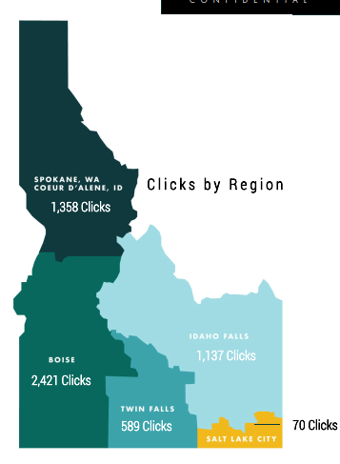
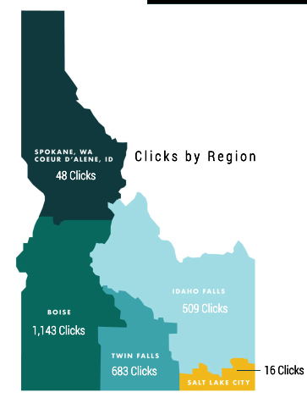
Radon Action Month-Media campaign
Facebook
Facebook English campaign (1/11/21 - 2/7/21): 5,575 clicks, 541,702 impressions
Facebook Spanish campaign (1/11/21 - 2/7/21): 2,399 clicks, 276,784 impressions
English
Spanish
Notes:
Idaho Radon Action Month Media Campaign
Goal: To inform the public about the importance of testing for Radon, exposure sources and associated health effects. There are so many areas throughout Idaho that have high levels of radon; about 2 out of 5 homes that have been tested in the state have levels above 4.0 pCi/L.
Marketing Strategies: Streaming radio (English and Spanish), Social Media boosters, and Google ad campaign.

Slide 6
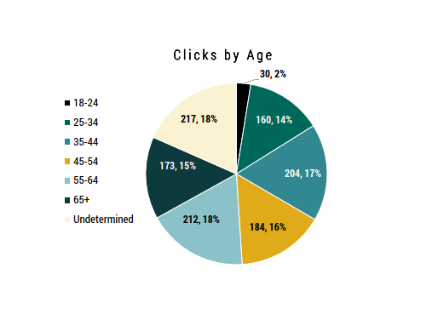
Radon Action Month-Media campaign
Google
Google search campaign (1/11/21 - 2/7/21): 1,254 clicks, 15,656 impressions

Slide 7
Radon Action Month-Media campaign
Radio
English Radio spots (1/11/21 - 2/7/21); markets included Boise, Idaho Falls/Pocatello, Lewiston/Moscow, Spokane, Twin Falls/Jerome, total paid and match spots 4,355, reached an average of 51.9% of adults 25-64 years of age 7.43 times throughout the campaign.
Spanish Radio spots (1/11/21 - 2/7/21); markets include Boise, Idaho Falls, Twin Falls, total paid and match spots 593, Spanish Radio is unrated no projected frequency of reach, the campaign still met the 1:1 match.

Slide 8
Individuals Educated-1,000,000+
Facebook: 818,486 impressions
Google: 15,656 impressions
Website: 16,977 visits
Phone calls: 74
Virtual trainings: 47
Radio: reached an average of 51.9% of adults 25-64 years of age 7.43 times throughout the campaign

Slide 9

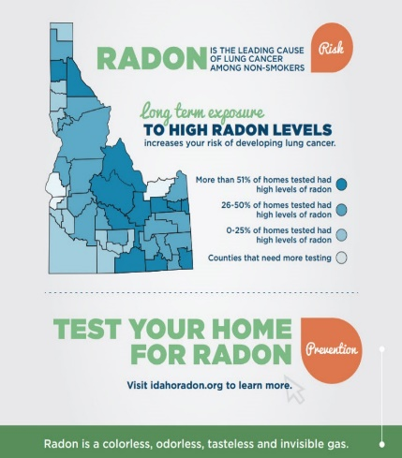
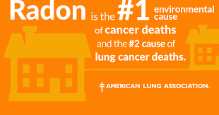
Media Images
Notes:
2 out of 5 homes tested for radon show dangerous levels of the gas.
How does radon get into homes?
Why should we care about this in Idaho?
How does radon cause lung cancer?
How can you tell if your home has radon in it?
Where can we get a test?
How would someone know what to do after they receive their results?

Slide 10
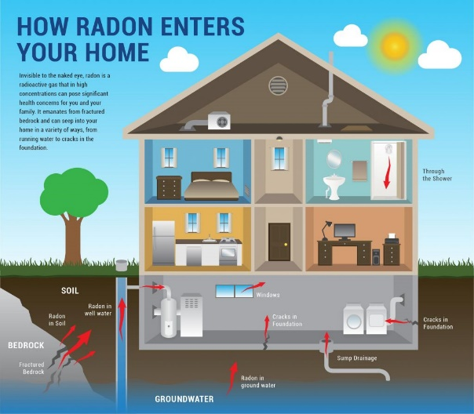
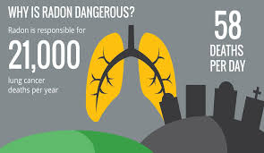
Media Images

Slide 11

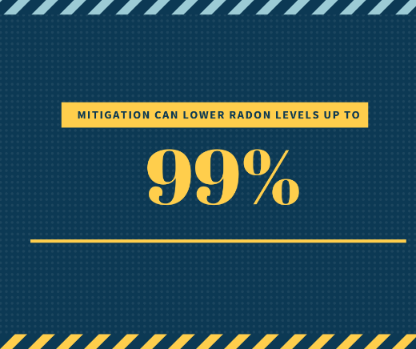
Media Images

Slide 12
Test Kit Ordering
DHW Website
https://healthandwelfare.idaho.gov/health-wellness/environmental-health/radon
Healthy Tools
https://healthtools.dhw.idaho.gov/collections/other-environmental-health/products/radon-air-test-short-term
2-1-1
https://healthandwelfare.idaho.gov/services-programs/211
Notes:
The 2-1-1 Idaho CareLine — a free, statewide, community information and referral service — is a program of the Idaho Department of Health and Welfare (DHW).

Slide 13
Thank you!

Slide 14
Contact Information
Brigitta Gruenberg, M.Ed., REHS
Environmental Health Program Manager
Division of Public Health | Idaho Department of Health and Welfare
Cell: 208.616-5271 | Brigitta.gruenberg@dhw.idaho.gov
Nicole Rogers, CHES
Section Manager | Risk Reduction & Prevention
Division of Public Health | Idaho Department of Health and Welfare
Desk: 208-332-7319 | Cell: 208-949-1617 | Nicole.Rogers@dhw.idaho.gov

