Slide 1

WQX 3.0 Benthic Macroinvertebrate Best Practices
WQX User Call
August 27, 2020

Slide 2

  Background
Convened Biological Workgroup to determine requirements
Goals:
  Make datasets more user-friendly
  Promote consistency when submitting data
  Maximize the extent data can be reused
Created a best practices document addressing new and important data elements

Slide 3

Assemblage Sampled Name &
Biological Intent
Assemblage is the group of organisms that co-occur in the same trophic or spatial relationships, such as benthic macroinvertebrates
  Used to derive metadata requirements
  Required
Biological intent is the goal of the assessment such as species density or population census
  Helps users understand the data to expect
  Required

Slide 4
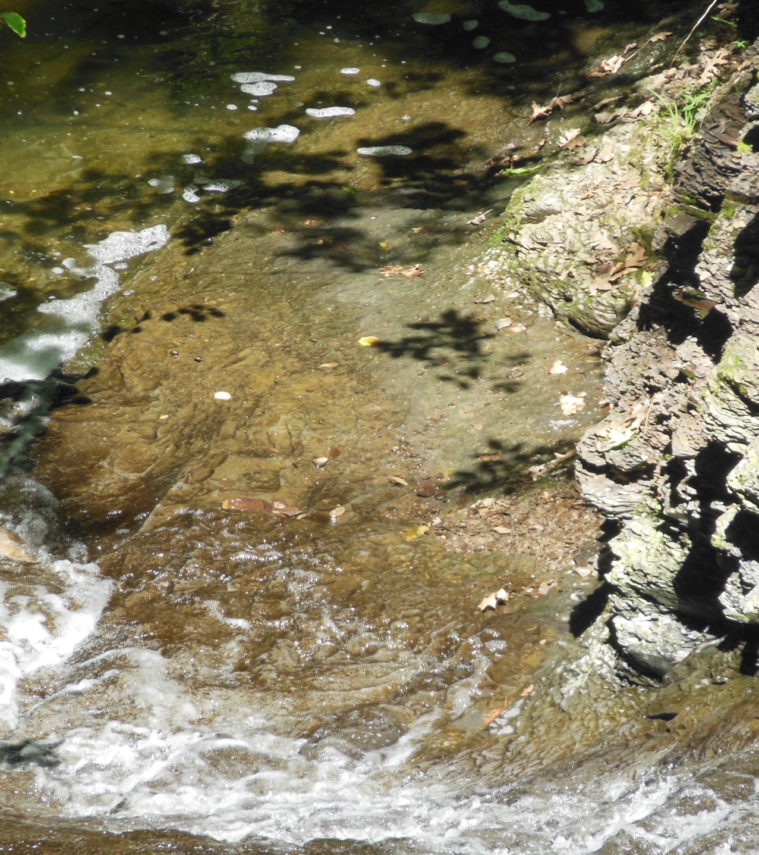
  Habitat Selection Method
Targeted vs. Non-Targeted
Most productive habitat is sampled with a targeted method
  More likely to capture all taxa
Non-targeted uses a systematic sampling technique
  Often more quantitatively representative
Conditionally required
New field in WQX 3.0

Slide 5

Collection Effort
Time-Constrained
  Collection Duration Measure and Units
Area-Constrained
  Collection Area Measure and Units
  Needed along with Proportion Sample Processed to calculate total abundance
  New fields in WQX 3.0
Constrained by staff or equipment
  Gear Procedure Measure and Units
  New fields in WQX 3.0
Optional but recommended

Slide 6
Sample Collection Equipment Name &
Net Mesh Size
Equipment such as D-frame net can impact what taxa or life stages are captured
  Optional but recommended
Net mesh size and net surface area used in sampling can also impact what taxa or life stages are captured
  Used with net type such as non-tow
  Optional but recommended

Slide 7

Characteristic Name
Characteristic name is the parameter being monitored
Usually a count with the value of the count being the result
Required

Slide 8
Target Count
Sorter will count a certain number of individual specimens and stop
Useful in determining data comparability or if the data user needs to randomly subset the data before use
Conditionally required
New field in WQX 3.0

Slide 9
Proportion Sample Processed
ø | √ | ø | ø
ø | ø | ø | √
√ | ø | √ | ø
ø | ø | ø | ø
Prior to sorting the sample is placed in a sampling grid where a sorter chooses a subset of the sample for identification
This information is important to know when aggregating data
Conditionally required
New field in WQX 3.0

Slide 10
Target Taxonomic Levels
Organizations identify specimens to a certain level of taxonomic resolution and life stage
Data users need to know this information to determine if a life stage or taxon was not encountered or was deliberately excluded
Also important to know whether identification is done to the genus level or the family level
Should be specified in Sample Collection Method

Slide 11
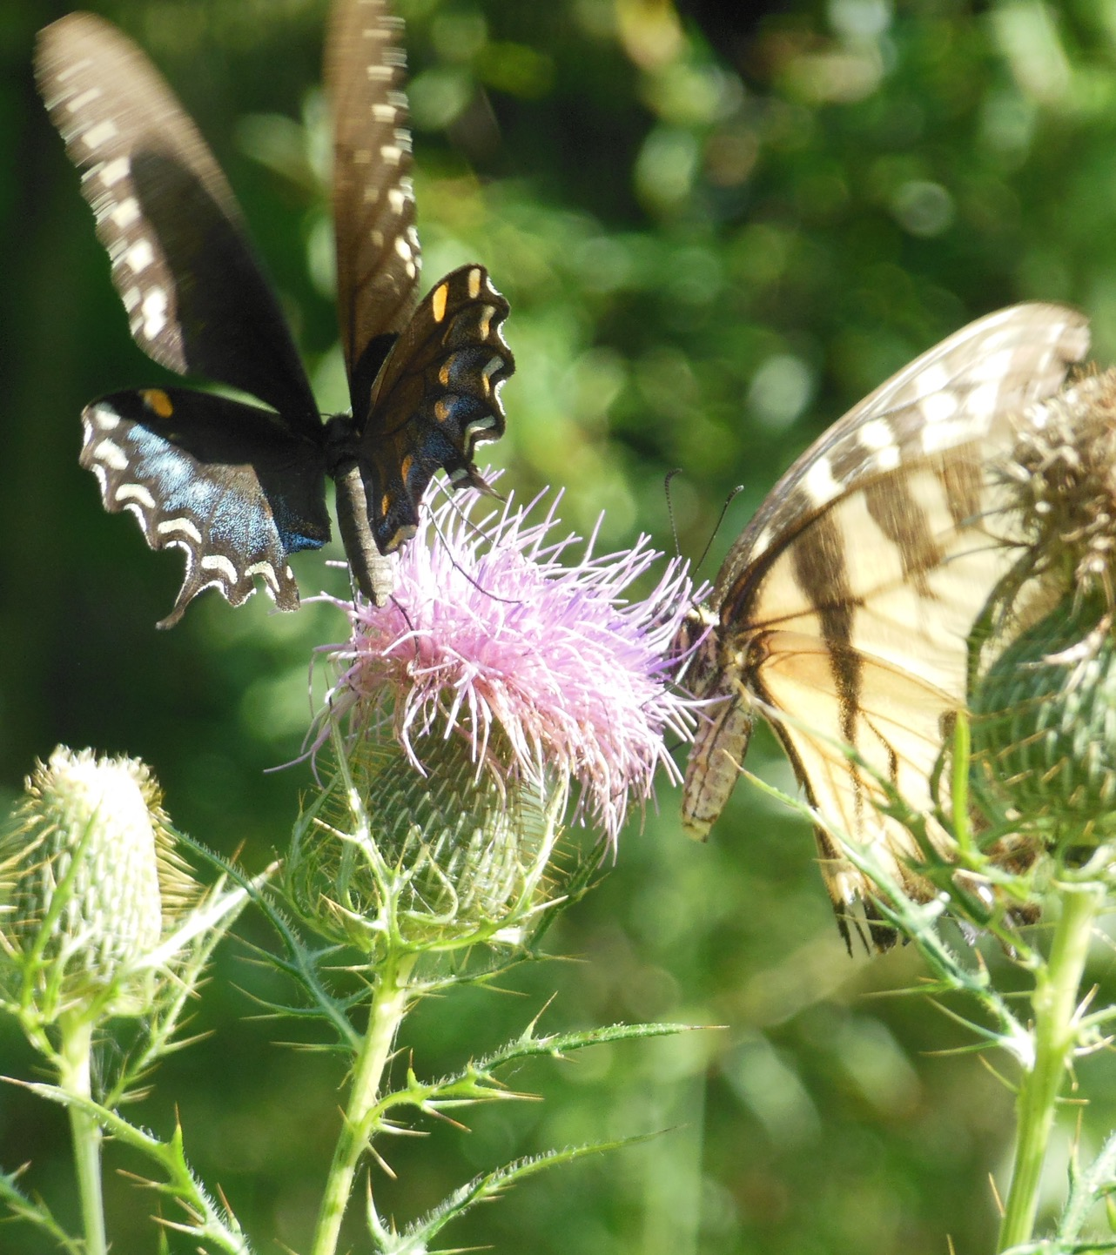
Subject Taxonomic Name &
Subject Taxonomic Name User Supplied
Subject taxonomic name is the name of the specimen identified
  Required
Subject taxonomic name user supplied is for organizations who use a preferred name that may be different than WQX domain values
  Used with subject taxonomic name user supplied reference text
  Optional
  New field in WQX 3.0

Slide 12
Uploading QA/QC Documents
QAPP outlines data and measurement quality objectives of a monitoring program and contains metrics to quantify data quality
Data users use the QAPP to screen for comparable protocols and comparable data quality
Optional but recommended to upload at the Project or Activity level

Slide 13
Status
New data elements included with WQX 3.0
EN users can still submit to WQX 2.2, but must move to WQX 3.0 to use new data elements
WQX Web users have already been migrated to WQX 3.0
Best practices document is available at: https://www.epa.gov/sites/production/files/2020-08/documents/wqx-benthics-best-practices-guide.pdf

Slide 14

Questions?
boorman-padgett.jesse@epa.gov

