Slide 1

QAQC API web services
Tetratech Team
(Jennifer Turaka, EPA Contractor)

Slide 2
PURPOSE
To satisfy the need to validate and verify if the Latitude and Longitude submissions made for the Stations are nearly accurate.
To check if the combination of latitude and longitude submissions are already submitted by another station.
To check if the submitted latitude and longitude precision scale is meeting the requirements to validate it against the data WQX holds.

Slide 3
QAQC API web services
Web Service Calls: POST submission of lat, longs to be validated. http://QAQCSERVER/submitStation
curl -X POST -F "file=@C:\locationpath\station.csv" -F "TransactionId=testcrlsubmit" http://QAQCSERVER/submitStation
Webservice Calls GET URL made from a browser. http://QAQCSERVER/getStation/transactionid
Webservice Calls GET STATS made from a browser.http://QAQCSERVER/getstationstats/transactionid

Slide 4
Inputs to the services
Webservice calls use the URL inputs provided by the WQP.
Example URL from WQP from which the parameters can be obtained https://www.waterqualitydata.us/data/Station/search?countrycode=US&statecode=US%3A01&providers=STORET&mimeType=csv
Example Parameter inputs for Station service: CSV file and email/user/transactionid

Slide 5
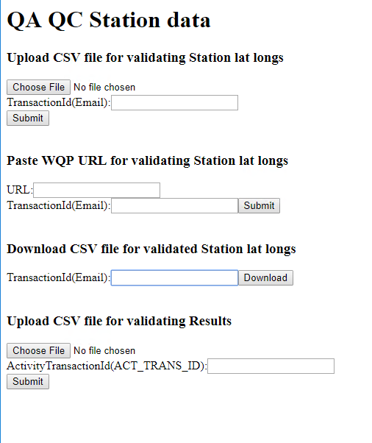
QAQC API web services
Demo web page designed to call or submit to QAQC service endpoints.
Upload CSV File/ URL
Input file queued for processing to QAQC Parse and Load operations
Download validated file qaqcLocations.CSV
GetStationStats
Parameter: Transaction ID
GetStation
Parameter: Transaction ID
Transaction ID: (EmailAddress)

Slide 6
QaQclocations.csv
Webservice calls developed to output a csv file to download.
The contents of the csv file include:
Original columns appended by generated columns
Original columns: MlocIdentifier, MlocName, LatitudeMeasure, LongitudeMeasure, CountryCode, StateCode, CountyCode ( min req – latitudemeasure, longitudemeasure)
Generated columns: Gen_CountryCode, Gen_StateCode, Gen_city, Gen_County, Duplicate, Precision

Slide 7
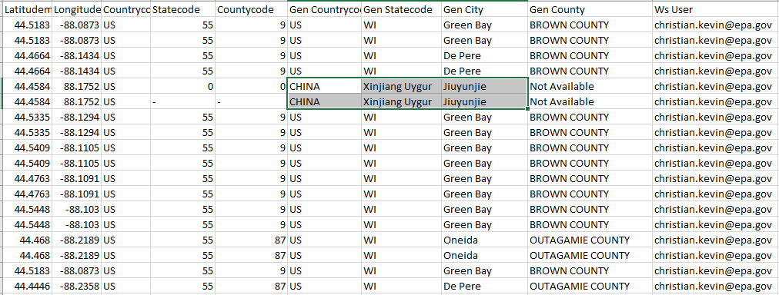
Generated columns can also help identify if the Lat and Longs fall way far off.

Slide 8
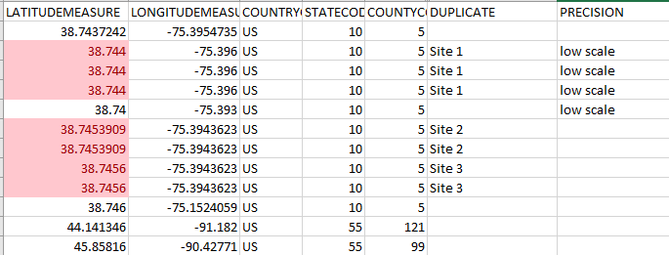
Duplicate: identifies the duplicates by latitude measure and longitude measure to a precision scale of 4
Precision: Populated as low scale where latitude measure and longitude measure scale is less than 4.

Slide 9
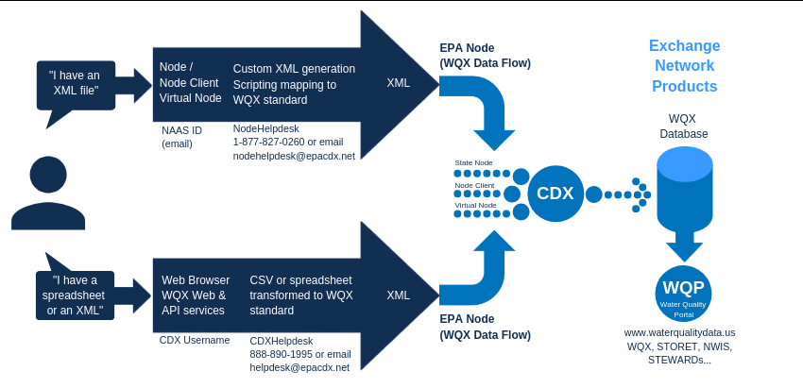
Current submission Dataflow to WQX :

Slide 10
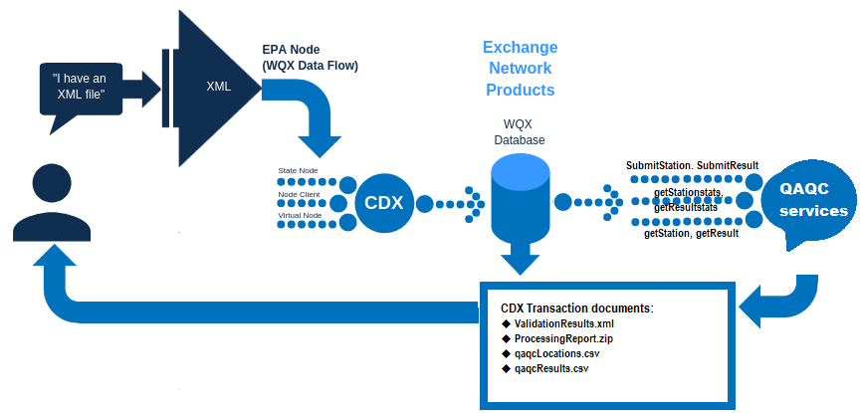
XML submission required for QAQC validation to WQX 3.0 : (currently)

