Slide 1
Appendix:
CAMD EJ Tool & Proximity Analysis

Slide 2
Question 2:
How to determine whether an EGU might negatively impact a community?
Proximity Analysis
Identifies all communities within a given radius of each EGU
Captures potential air, water, waste, and other impacts
Transport modeling
Identifies all communities to which each EGU might impact air quality
Captures downwind air pollution impacts

Slide 3
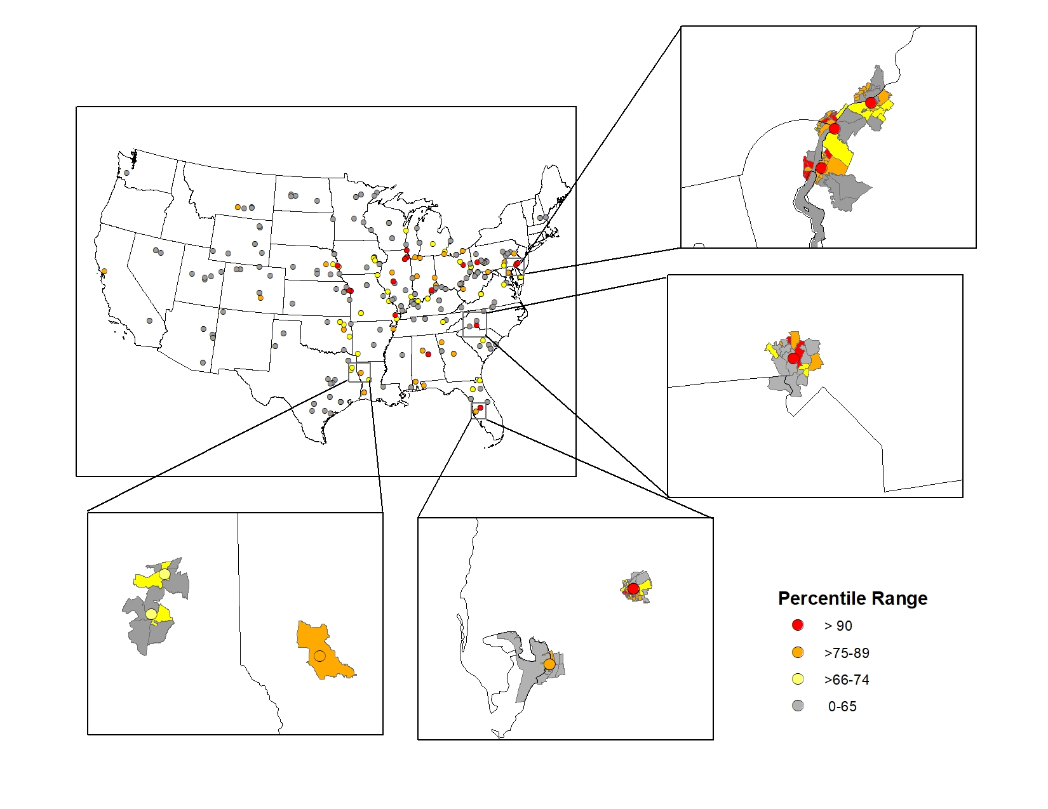
Proximity Analysis
All EGUs linked to the census block groups that are within a 5km radius
Able to quickly filter EGUs based on nearby census block group ranking

Slide 4
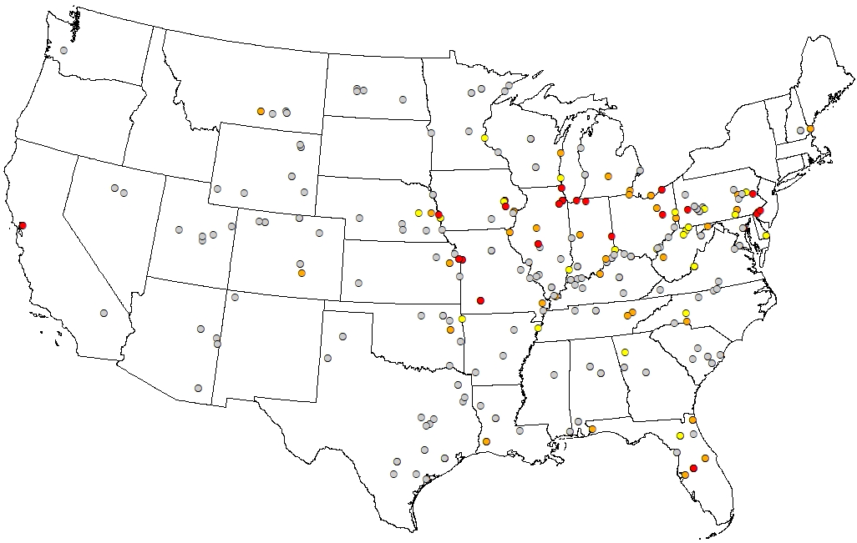
Proximity Analysis: Ranking EGUs
Account for EGUs located near many disproportionately-impacted communities
Considers:
  Number of nearby disproportionally-impacted communities
  Relative difference in disproportionate impacts that communities face
  Total population
Next step: consider emissions

