Slide 1
CAMD EJ Analytics for EGUs
March 2021

Slide 2
Two Complementary Efforts
Screening Analysis Methodology
CAMD(EJ) Tool
Methodology that allows EPA to evaluate relative EJ implications of all plants comprehensively
Primarily for EPA analysis
Identifies and ranks EGUs based on potential to affect disproportionately-impacted communities
Considers pollution burden and vulnerability, nearby and downwind
Web-based mapping tool that introduces EJ concepts to CAMD data users on a plant-by-plant basis
Primarily public-facing
Contextualizes each EGU individually in the fleet, showing plant attributes, emissions, and nearby demographics
Highlights vulnerability of nearby population
Both efforts will ultimately be methodologically consistent, accessible, and fully transparent

Slide 3
Screening Analysis: How to evaluate EGUs based on their potential to affect disproportionately-impacted communities?

Slide 4
Screening Analysis: How to evaluate EGUs based on their potential to affect disproportionately-impacted communities?
Two key questions
How to determine the extent to which a community might be considered disproportionately impacted?
How to determine which EGUs might negatively impact a community?
We have been learning from what states, cities, and NGOs have been doing to answer similar questions
Currently working on a draft approach as a starting point with two near-term objectives:
Facilitate outreach
Inform preliminary internal policy discussions

Slide 5
Question 1: How to determine the extent to which a community might be considered disproportionately impacted?
Cumulative Impacts
Identifies communities most impacted by pollution by considering both pollution burden and vulnerability together.
Combines all EJSCREEN indicators (pollution burden and population characteristics)
Socioeconomic Factors Only
Identifies communities vulnerable to pollution based on two demographic indicators (percent of low-income and people of color), regardless of potential pollution burden
Single EJSCREEN indicator (demographic index)

Slide 6
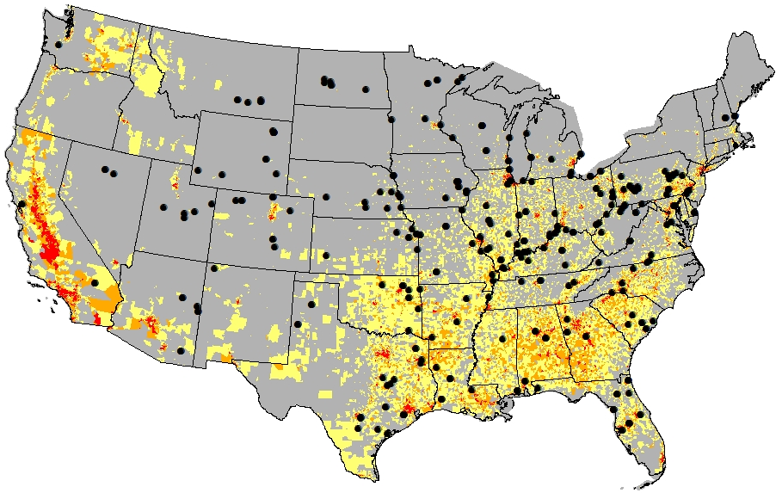
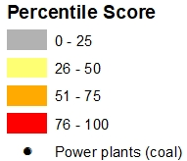
Cumulative Impact Scores (DRAFT)
Higher cumulative impact scores identify communities that are disproportionately impacted by pollution
Considers pollution burden and increased vulnerability to pollutants
Note: Blocks groups that fall within the "76-100" category are in the top 25% of scoring areas (as opposed to having the top 25% of cumulative impact scores).

Slide 7
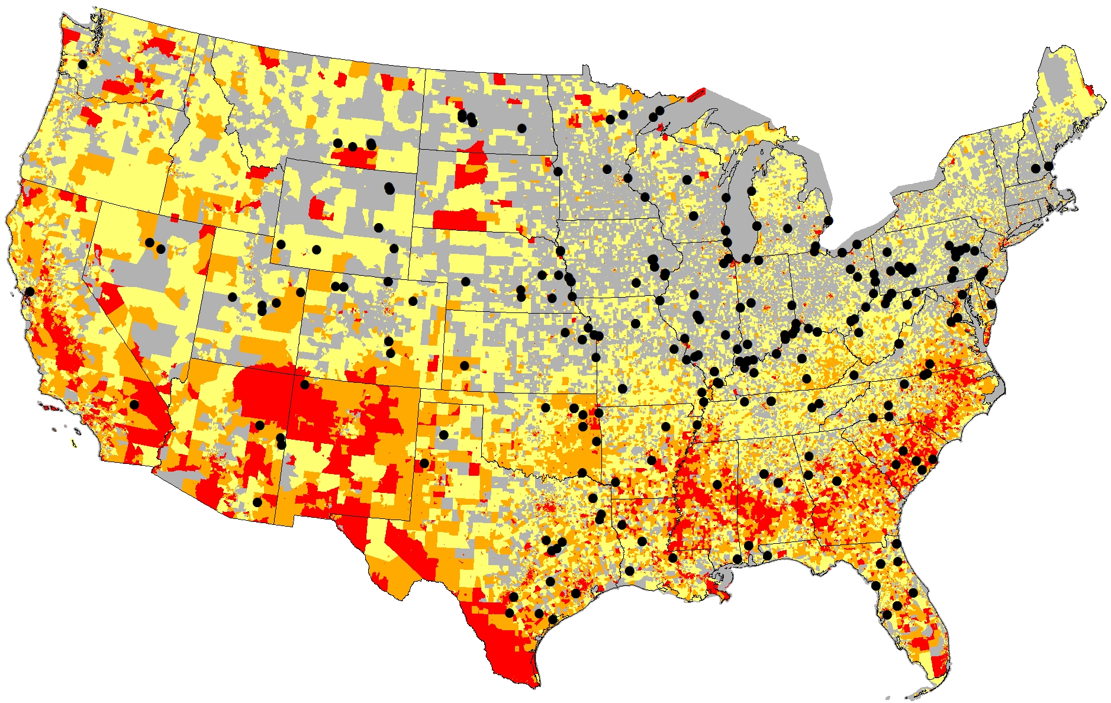
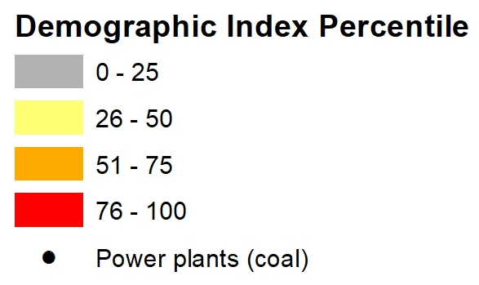
EJSCREEN Demographic Index
Socioeconomic factors are community characteristics that result in increased vulnerability to pollutants
Does not consider existing environmental health threats

Slide 8
Question 2: How to determine whether an EGU might negatively impact a community?
Proximity Analysis
Identifies all communities within a given radius of each EGU
Captures potential air, water, waste, and other impacts
Transport modeling
Identifies all communities to which each EGU might impact air quality
Captures downwind air pollution impacts

Slide 9
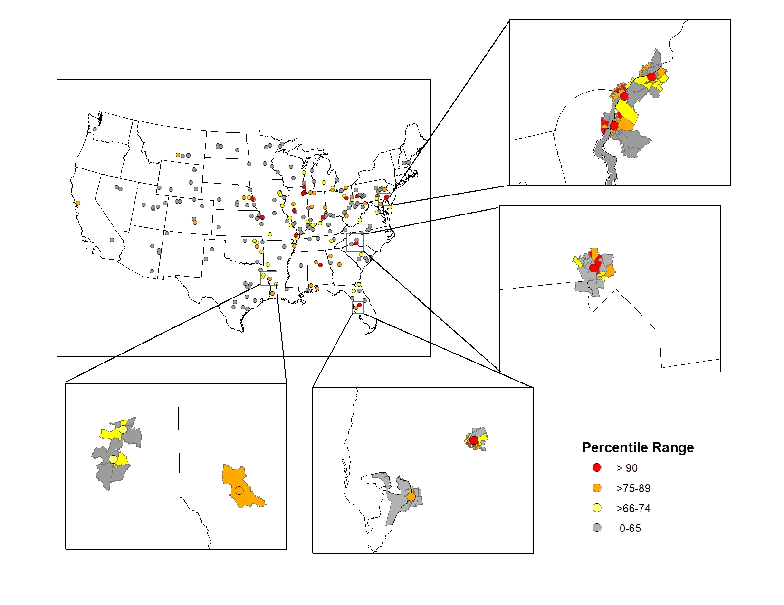
Proximity Analysis
All EGUs linked to the census block groups that are within a 5km radius
Able to quickly filter EGUs based on nearby census block group ranking

Slide 10
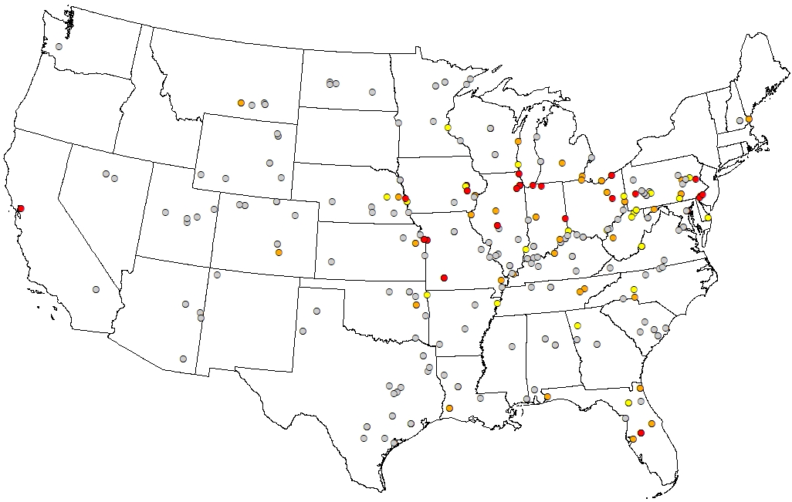
Proximity Analysis: Ranking EGUs
Account for EGUs located near many disproportionately-impacted communities
Considers:
Number of nearby disproportionally-impacted communities
Relative difference in disproportionate impacts that communities face
Total population
Next step: consider emissions

Slide 11
Air Transport Modeling
Using HYSPLIT to estimate particle trajectories from fossil-fired EGUs
Combining these trajectories estimates a plume that can be layered on top of communities
Like proximity analysis, can link EGUs to downwind communities

Slide 12
Potential Applications
Screening Analyses
How to prioritize EGU emissions reductions from an EJ perspective?
Which EGUs might negatively affect disproportionately-impacted communities?
Which EGUs have more potential than others to affect disproportionately-impacted communities? How many communities? Population? Potential to emit?
Which of those EGUs are at higher risk of closure?
Facilitate outreach and discussion, by asking stakeholders:
How can these approaches be improved?
How can we make this work more useful to the public?
Policy Analyses
Which policy options are projected to have a greater impact on EGUs that affect disproportionately-impacted communities?
What share of health benefits might accrue to disproportionately-impacted communities?

Slide 13
CAMD(EJ) Tool: Presenting publicly available power plant data together with EJSCREEN data in order to highlight the demographics of areas surrounding power plants

Slide 14
CAMD(EJ) Tool Goals
Promote the awareness and use of CAMD Power Sector data, eGRID, and EJSCREEN.
Introduce EJ concepts and data to users already familiar with CAMD data.
Encourage users to take advantage of available EPA data in their EJ analyses and investigations.
Provide a data set that allows users to perform EJ analytics.
Start a conversation with the public, NGOs, other agencies, and within EPA.

Slide 15
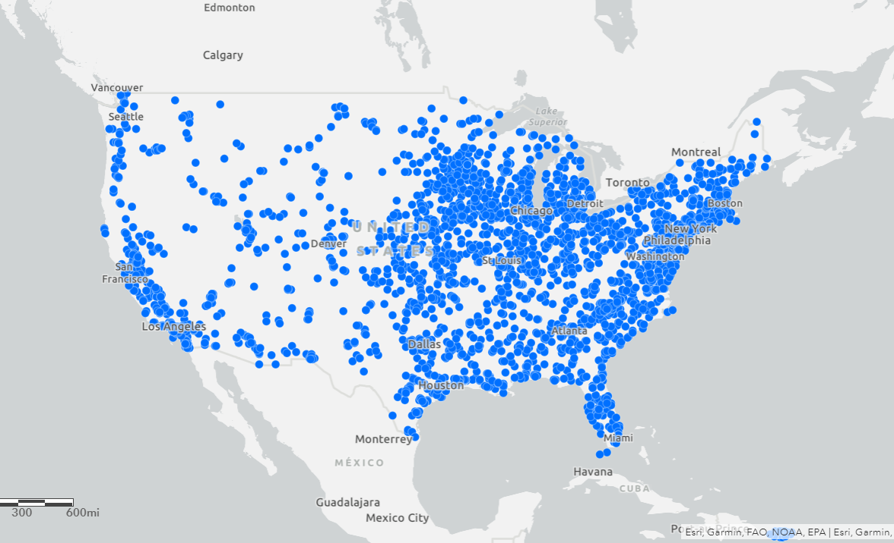
Step 1
Map the U.S. fossil fuel-fired power plants (~3,400)

Slide 16
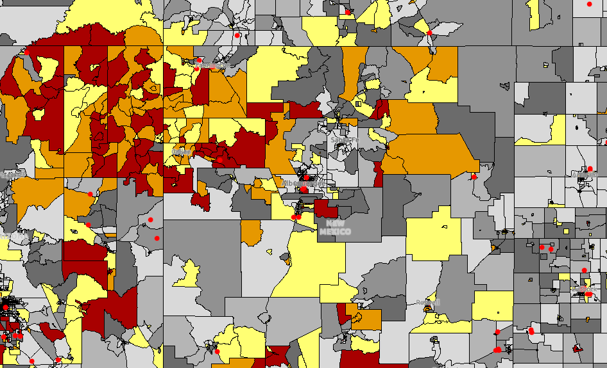
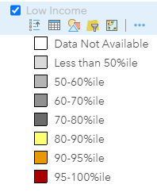
Step 2
Layer EJSCREEN Data
An EPA developed environmental justice screening tool that provides maps and data reports
Data is available at the census block group
A 95th percentile means that an area has an equal or higher % population (e.g., low-income) than where 95% of the US population lives.

Slide 17
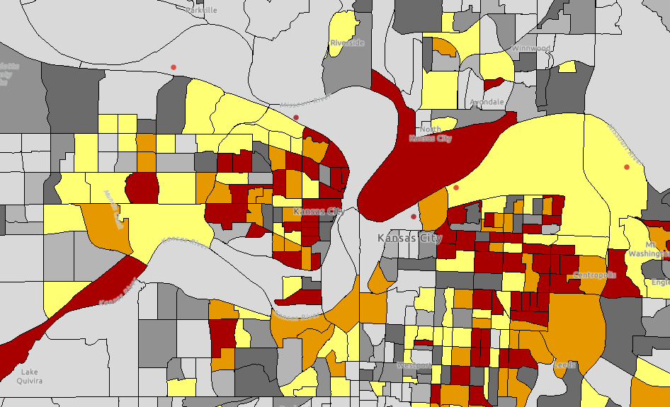
Step 3
Less than 50%ile to 87%ile
Proximity Analysis
Summarize the demographics of residents within a 3-mile buffer of each plant
Designed to represent the average resident within the buffer,
Provides an estimate of the total population residing in the buffer
Initial approach overlays CAMD/eGRID data and EJSCREEN socioeconomic data but may evolve based on lessons from the screening analysis.
Less than 50%ile to 84%ile

Slide 18

Starting with EJSCREEN Data
Environmental Indicators (11)
Such as ozone level in air, amount of vehicular traffic nearby, and proximity to waste and hazardous chemical facilities or sites
Demographic Indicators and Demographic Index
Percent low-income, percent people of color, less than high school education, linguistic isolation, individuals under age 5, and individuals over age 64
Demographic Index is based on the average of two demographic indicators (percent low-income and percent people of color).
EJ Indexes (11)
An EJ index summarizes how an environmental indicator and demographics come together in the same location.
CAMD(EJ)
Socioeconomic

Slide 19
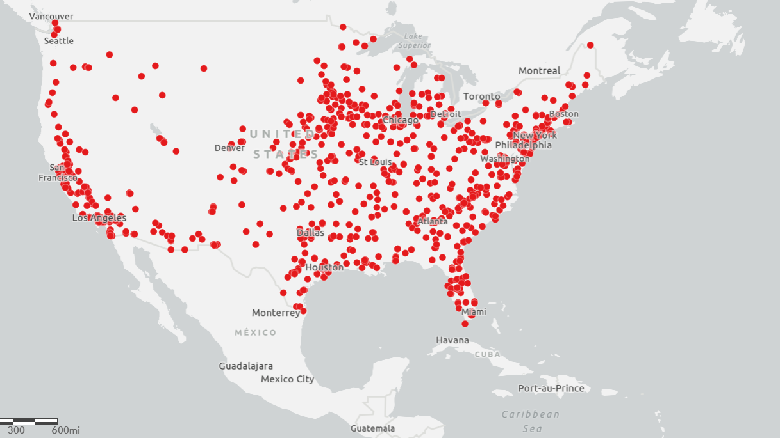
CAMD(EJ) Map
The community demographics for each plant location will be presented
Highlighted plants are in communities that meet or exceed 80th percentile for one or more demographic indicators
Percent low-income, percent people of color, less than high school education, linguistic isolation, individuals under age 5, individuals over age 64

Slide 20
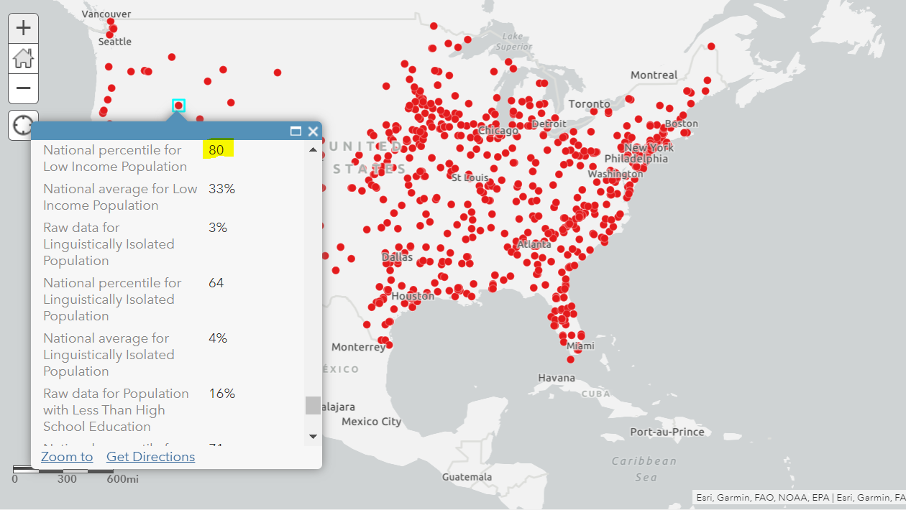
CAMD(EJ) Map
Selecting a marker will display plant-level data
Facility information and attributes, operating data, generation, emissions, and demographics for the adjacent communities
Also available via a spreadsheet

Slide 21
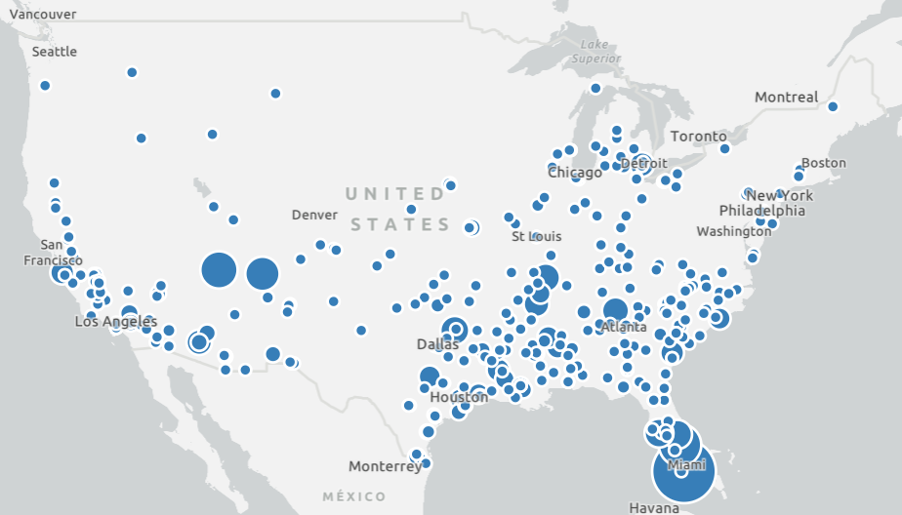
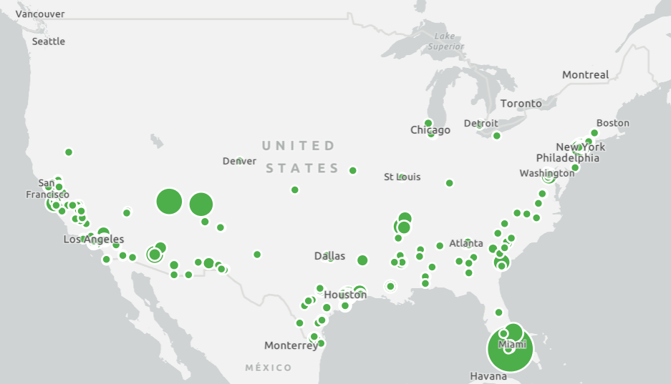
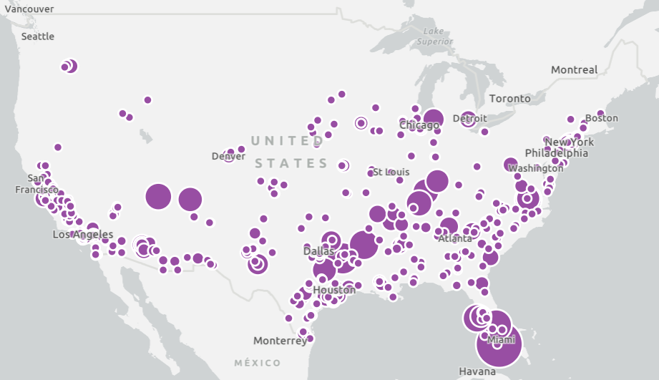
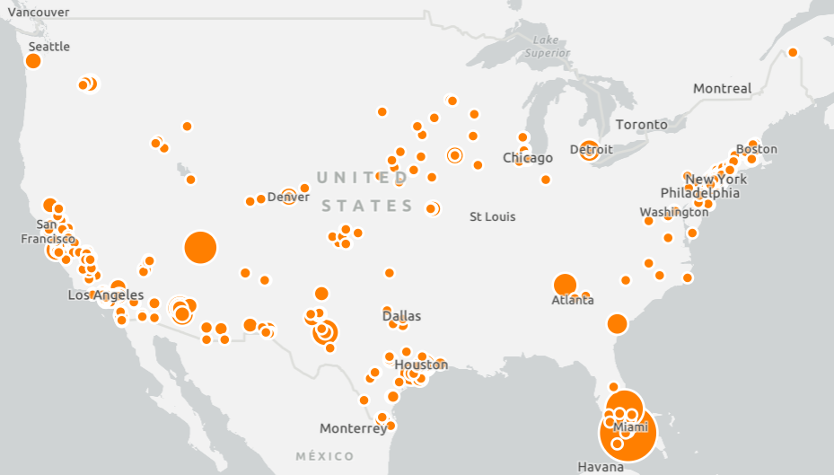
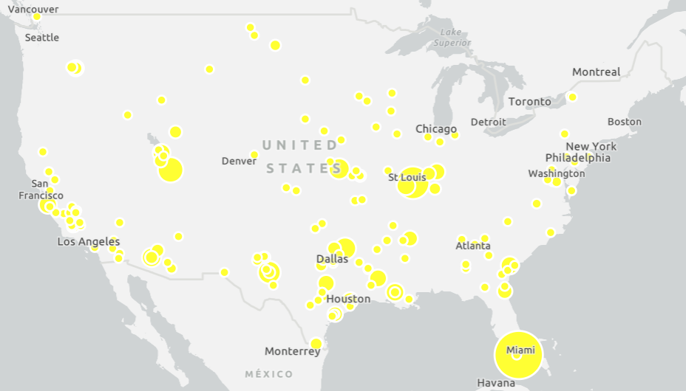
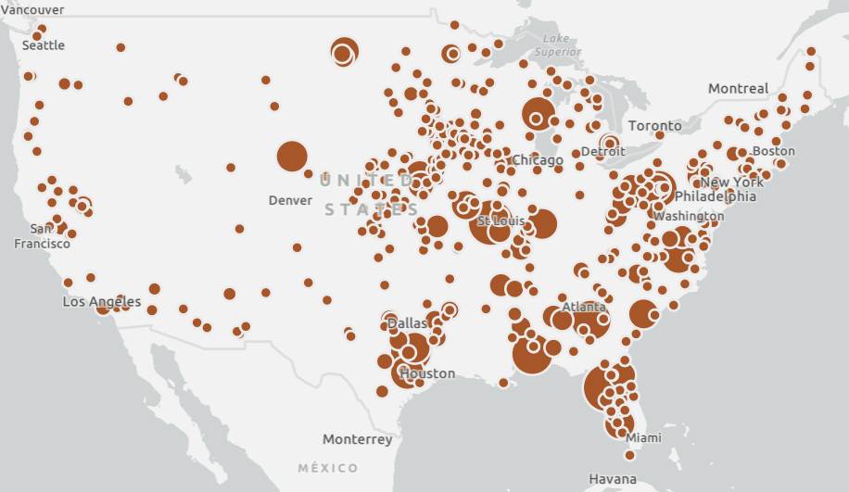
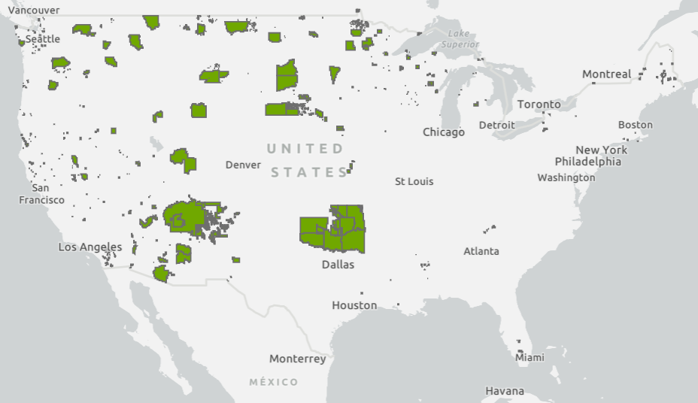
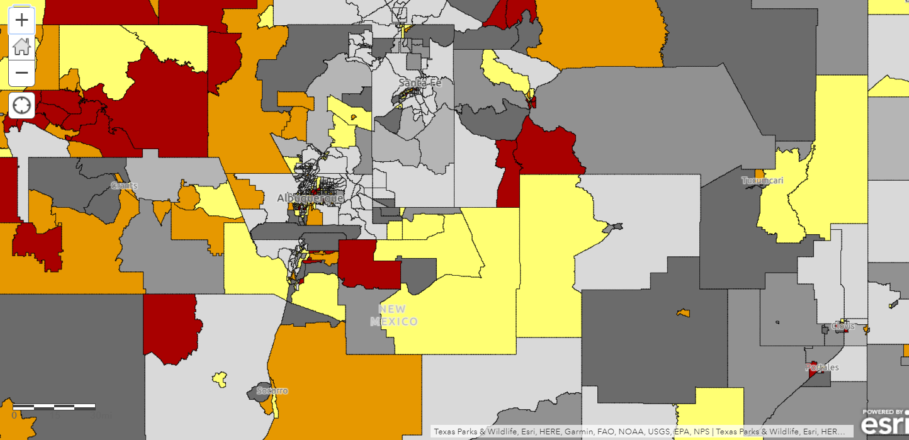
CAMD(EJ)Map Layers
≥80%ile
Low Income
People of Color
Less than high school education
Linguistically Isolated
Population less than 5
Population over 64
Tribal
EJSCREEN Indicators

Slide 22
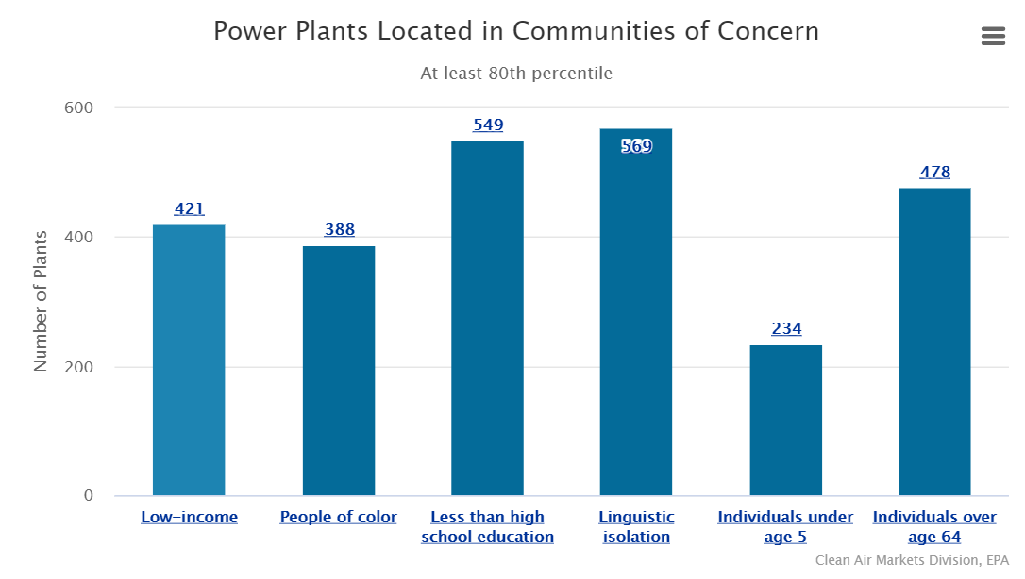
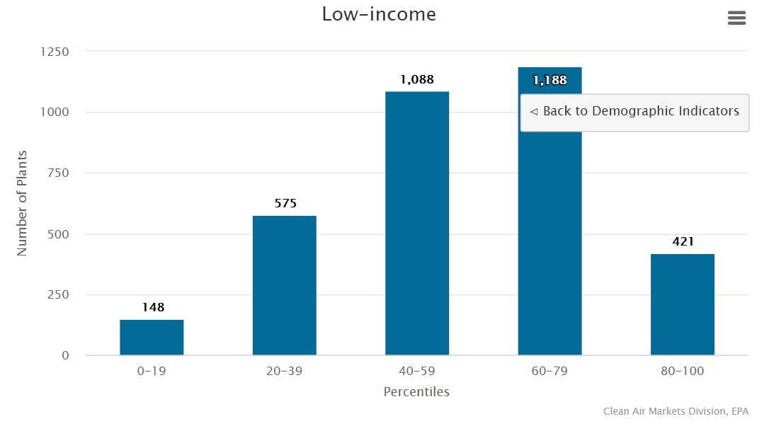
Percentile Graphs: Demographic Indicators Drilldown

Slide 23
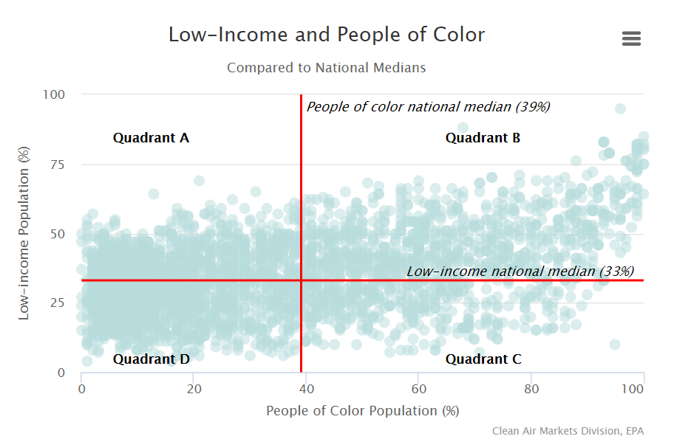
Population Percentage Graphs: Low-Income & People of Color Scatter
Quadrant | Findings
A | 895 plants (26%) are greater than the low-income national median and less than the people of color national median
B | 934 plants (27%) are greater than the low-income national median and greater than the people of color national median
C | 410 plants (12%) are less than the low-income national median greater than the people of color national median
D | 1,201 plants (35%) are less than the low-income national median and less than the people of color national median

