Slide 1
Multi-Pollutant (MP) OEJ Briefing
OAQPS’s Multi-Pollutant Team
Beth Landis & Carey Jang
August 30, 2021

Slide 2
MP Team Members
HEID
Beth Landis / Kimber Scavo
Robin Langdon / Darryl Weatherhead
Matt Woody/ Kelly Rimer
Sara Terry
Carrie Wheeler
Ben Gibson
Rob Pinder
Scott Voorhees
Chris Davis
AQPD
Rich Damberg / Megan Brachtl
AQAD
Carey Jang / Tyler Fox
Jim Kelly
Joe Mangino
Jeanette Reyes
OID
Amanda Kaufman
James Payne
SPPD
Lisa Conner

Slide 3
Outline
MP Background
MP Background
MP Projects (Detroit, SC & Louisville)
NEXUS MP Tool
Expected Use
Examples
NEXUS and EJSCREEN
Next Steps
Briefings, Demos & Planned Outreach
NEXUS Improvements and Updates
NEXUS 1.9 Demo

Slide 4
MP Background
Support a comprehensive, MP treatment of air quality problems to effectively improve air quality and make the most efficient use of available resources
Primary Goal - identify & evaluate local control strategies targeting emissions of O₃ & PM_{2.5} and their precursors while at the same time reducing Air Toxics of concern for communities to maximize both health benefits and air quality improvements
MP planning has the potential to reduce the costs and increase benefits associated with air quality management (AQM)
Supports S/L/T air agencies in developing MP, risk-based AQM plans and implementing strategies that reduce air pollution emissions & improve public health
Success has been demonstrated in Detroit and SC; another project is currently underway in Louisville, KY
Tools needed to analyze MP data are either available currently or being developed in OAQPS (e.g., NEXUS)

Slide 5
Detroit – MP Case Study
Partners: EPA, MDEQ, SEMCOG & LADCO
Goals: Assess and compare two contrasting air quality control strategies
“Status Quo” approach – controls selected separately to address O₃ & PM nonattainment
“Multi-pollutant, risk-based” approach – aimed at further reducing population risk from exposure to O₃, PM and select air toxics while still addressing ozone and PM nonattainment
Results showed the multi-pollutant approach:
Achieved the same or greater reductions of PM and O₃
Improved air quality regionally and across the Detroit urban core for multiple pollutants
Produced ~2x greater monetized benefits for PM and O₃
Reduced non-cancer risk
Resulted in greater net benefits & was more cost effective

Slide 6



South Carolina MP Project
Partners: EPA, SC DHEC & local community and business leaders in 10 upstate South Carolina counties
Goals:
Develop and analyze a multi-pollutant, risk based AQM strategy
Maximize both health benefits and air quality improvements, identify and evaluate a local control strategy targeting emissions of O₃, PM & their precursors while also reducing air toxics of concern for communities
Results demonstrated improving air quality in areas already attaining the NAAQS can yield significant health benefits

Slide 7
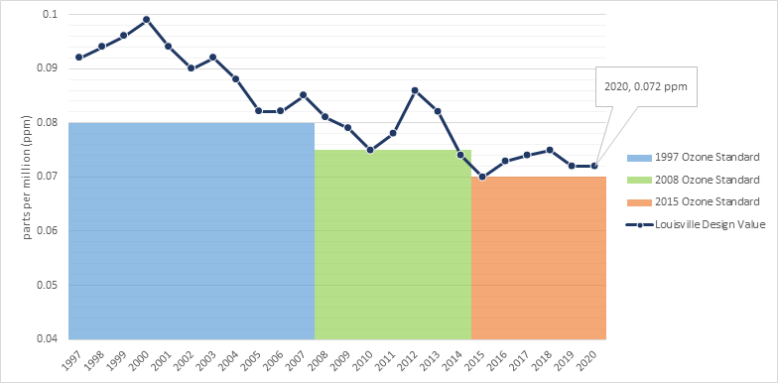
Louisville MP Project
Partners: EPA, Louisville Metro Air Pollution Control District (LMAPCD) & Louisville Metro Department of Public Health and Wellness (LMPHW)
Goals:
Identify local- and state-level emission reduction measures that address multiple pollutants, with a focus on attainment of the 2015 O₃ NAAQS
Build a plan to achieve and maintain compliance of all NAAQS
Demonstrate that the selected strategies can reduce health risk from exposure to O₃, PM and selected air toxics
Integrate existing health risk-based pollution control programs into a multi-pollutant air quality management plan
Build institutional capacity among LMAPCD and LMPHW to perform air quality modeling and health benefit analysis projects
Results pending
Graphic provided by LMAPCD

Slide 8
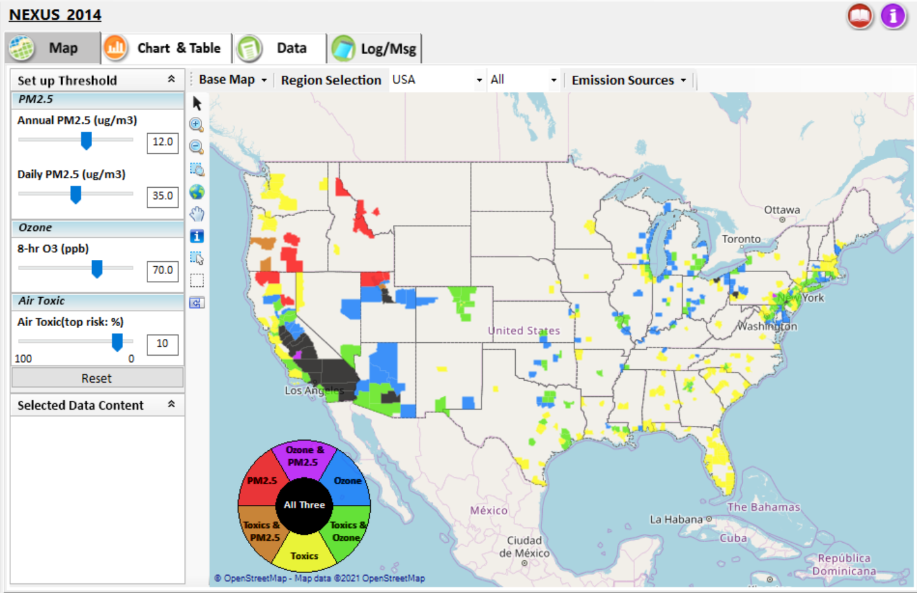
NEXUS - Tool Development
A new NEXUS Advanced Screening Tool is being developed to identify geographic areas where health risks related to O₃, PM_{2.5} and air toxics overlap and will be used to identify additional areas for MP collaboration

Slide 9
NEXUS - Expected Use
The NEXUS tool will allow users to do the following:
National screening to identify areas with MP issues: Phase 1 development provides ability to quickly screen areas across nation that have combination of high air quality and/or risk levels for O₃, PM_{2.5} and Air Toxics.
Area screening to understand nature of MP problem: Phase 2 development provides ability to ‘dial-into’ specific areas to determine extent to which common emissions sources are causing the MP issues.
We expect to use this tool in conjunction with Regions and identify areas that would potentially benefit most from MP approaches to reduce emissions (including current NA areas).
The NEXUS tool will essentially provide a ‘conceptual model’ of an area’s MP issues to facilitate engagement with state/local/tribal agencies and community stakeholder groups.
We also expect that it can have additional value-added uses across the Office for Air Toxics, Environmental Justice and other programs.

Slide 10
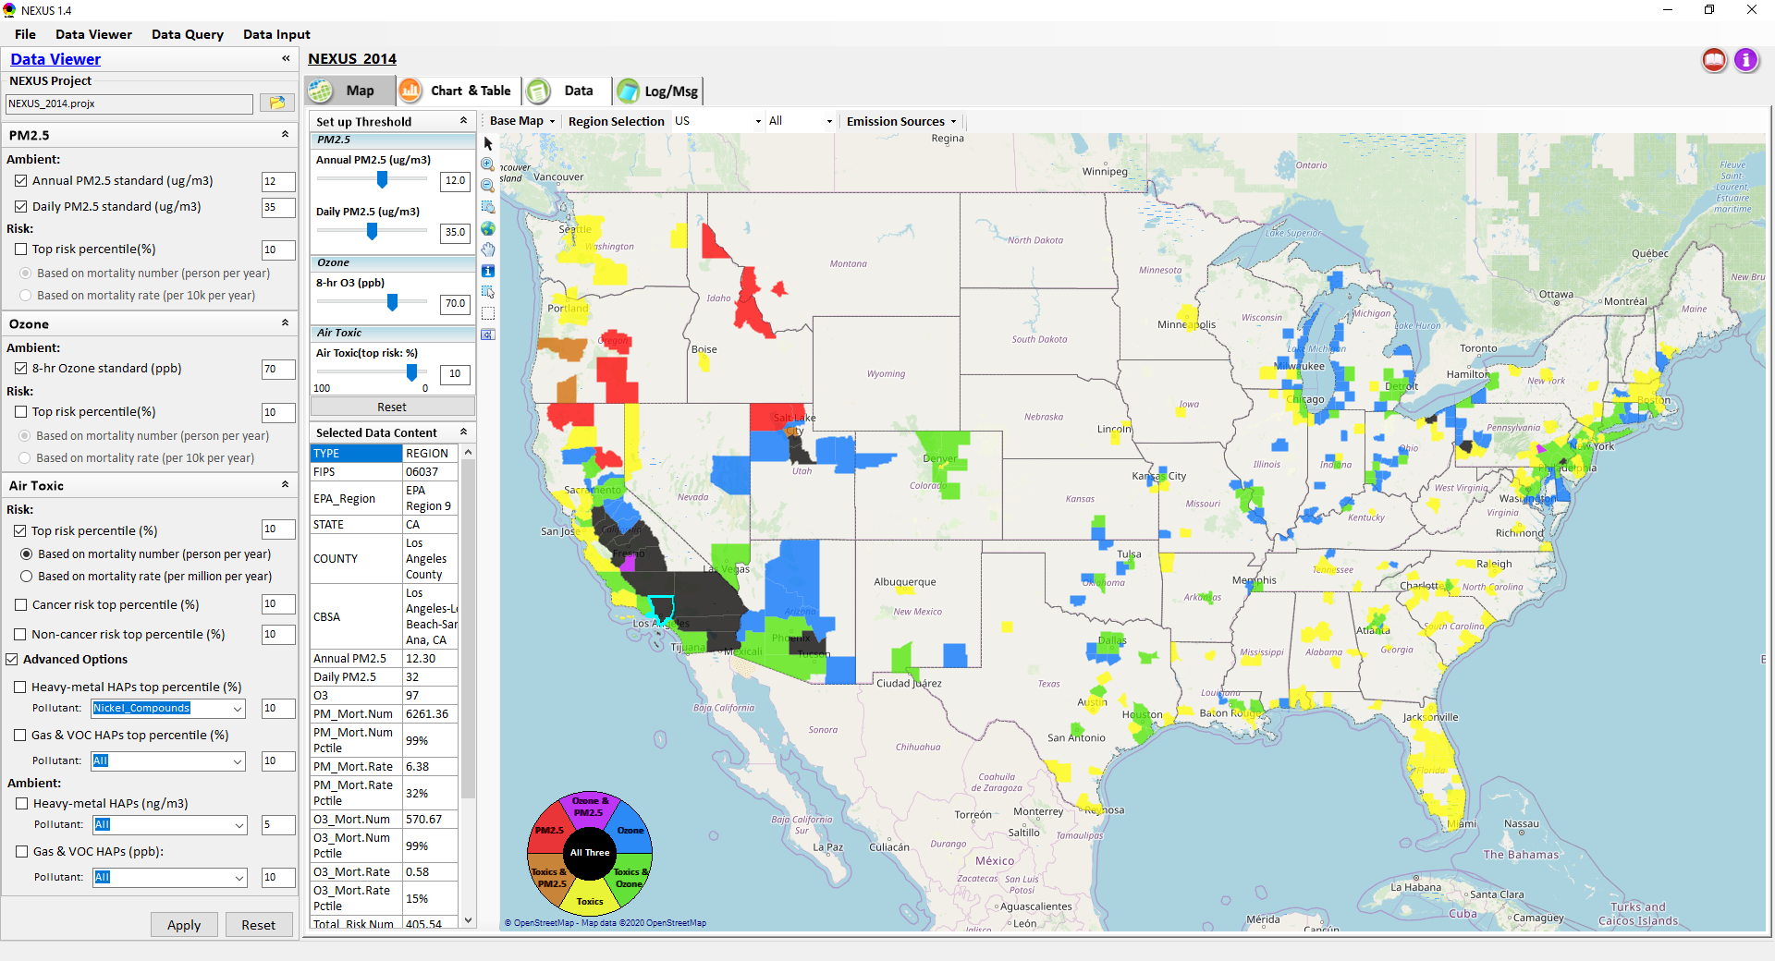
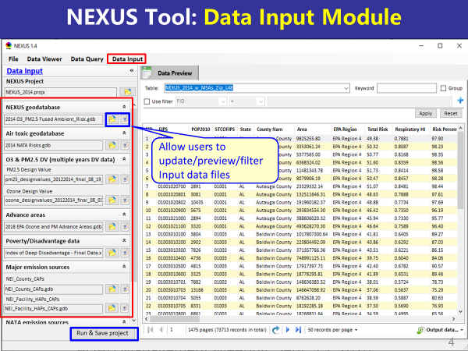
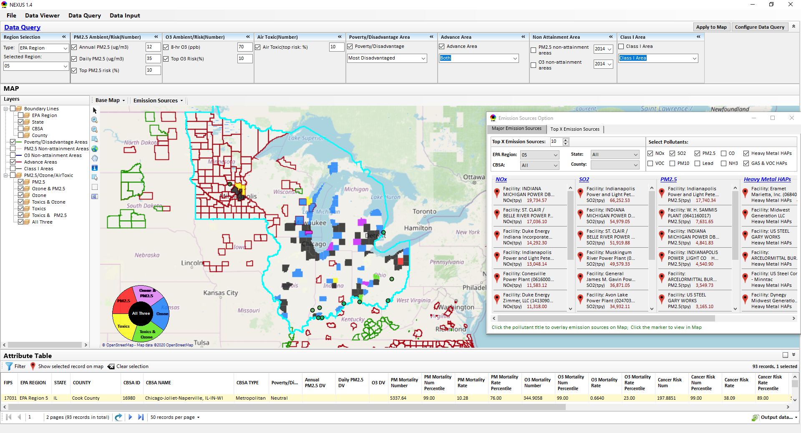
NEXUS - Three Key Modules
Data Viewer module
Data Input module
Data Query module
View and create interactive Map/Data/Chart/Table
Provide flexible selections & mapping of “Ambient” and/or “Risk” levels of PM_{2.5}, O₃ and Air Toxics
Provide regional analysis for “EPA region”, “States”, “CBSA”, and “County”
Link and display major emission sources’ locations & emitted pollutants info.
Expand data field selections and flexibility for exploratory/advanced users
Provide overlaying map and summary table for data query results
Current data query based on selected data fields: “Ambient/Risk, Advance area, Socio-demographic (EJ) area, NA Area, Class I area”
Allow to update & change input data files
Provide data preview and filter functions
Currently uses 10 sets of publicly available input data files (~4GB)
Quick turnaround to run & save to a new “project” using new input data files

Slide 11
NEXUS - Examples
How can NEXUS be used to identify highest risk areas across O₃, PM_{2.5}, and Air Toxics, summarize the source(s) contributing to communities with possible EJ concerns, and review specific industrial sources for potential impacts?
Example 1 → Detroit
How can NEXUS be used to understand the nature of multi-pollutant risks in Advance areas?
Example 2 → Louisville

Slide 12
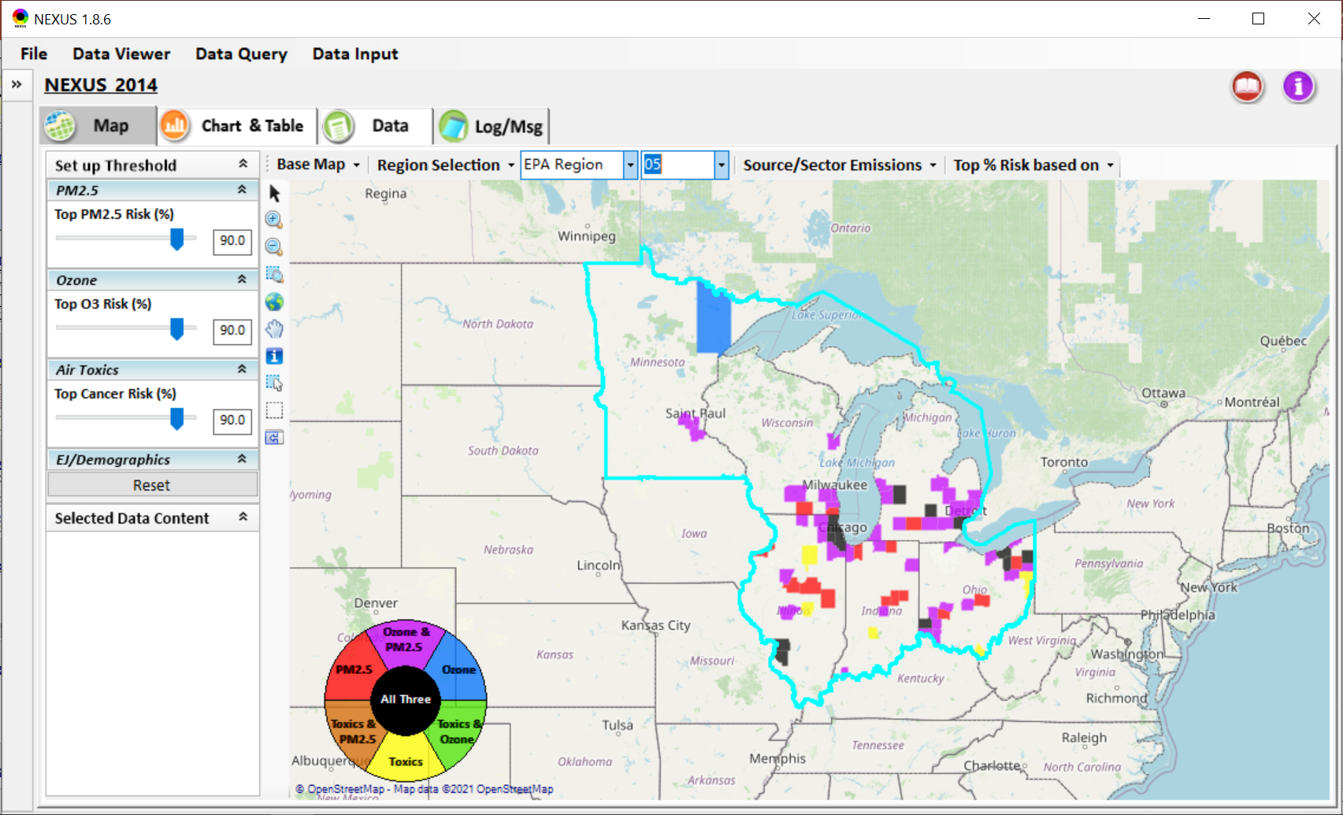
NEXUS – Detroit Example
NEXUS can be used to identify highest risk areas across O₃, PM_{2.5}, and Air Toxics.
Example map above is for Region 5

Slide 13
NEXUS - Highest MP Risk Areas in R5 (Data Query Module)
STATE | COUNTY | CBSA | Annual PM_{2.5} DV | Daily PM_{2.5} DV | O₃ DV | PM Mortality Number% | O₃ Mortality Number% | Cancer Risk Rate (max)%
IL | Cook County | Chicago-Naperville-Elgin, IL-IN-WI |  |  | 73 | 99.97 | 99.97 | 99.00
OH | Cuyahoga County | Cleveland-Elyria, OH | 11.7 | 25 | 70 | 99.78 | 99.53 | 97.00
IL | DuPage County | Chicago-Naperville-Elgin, IL-IN-WI |  |  | 70 | 98.73 | 97.70 | 99.00
MI | Wayne County | Detroit-Warren-Dearborn, MI | 11.2 | 28 | 73 | 99.91 | 99.84 | 95.00
MI | Kent County | Grand Rapids-Wyoming, MI | 9.1 | 25 | 68 | 97.92 | 96.71 | 99.00
IL | Lake County | Chicago-Naperville-Elgin, IL-IN-WI |  |  | 73 | 97.83 | 96.56 | 99.00
NEXUS can be used to identify highest risk areas across O₃, PM_{2.5}, and Air Toxics. Information above was generated in Data Query for Region 5 and exported into excel where rankings were applied.
Top CBSAs (using this approach) – Chicago, Cleveland, Detroit and Grand Rapids

Slide 14
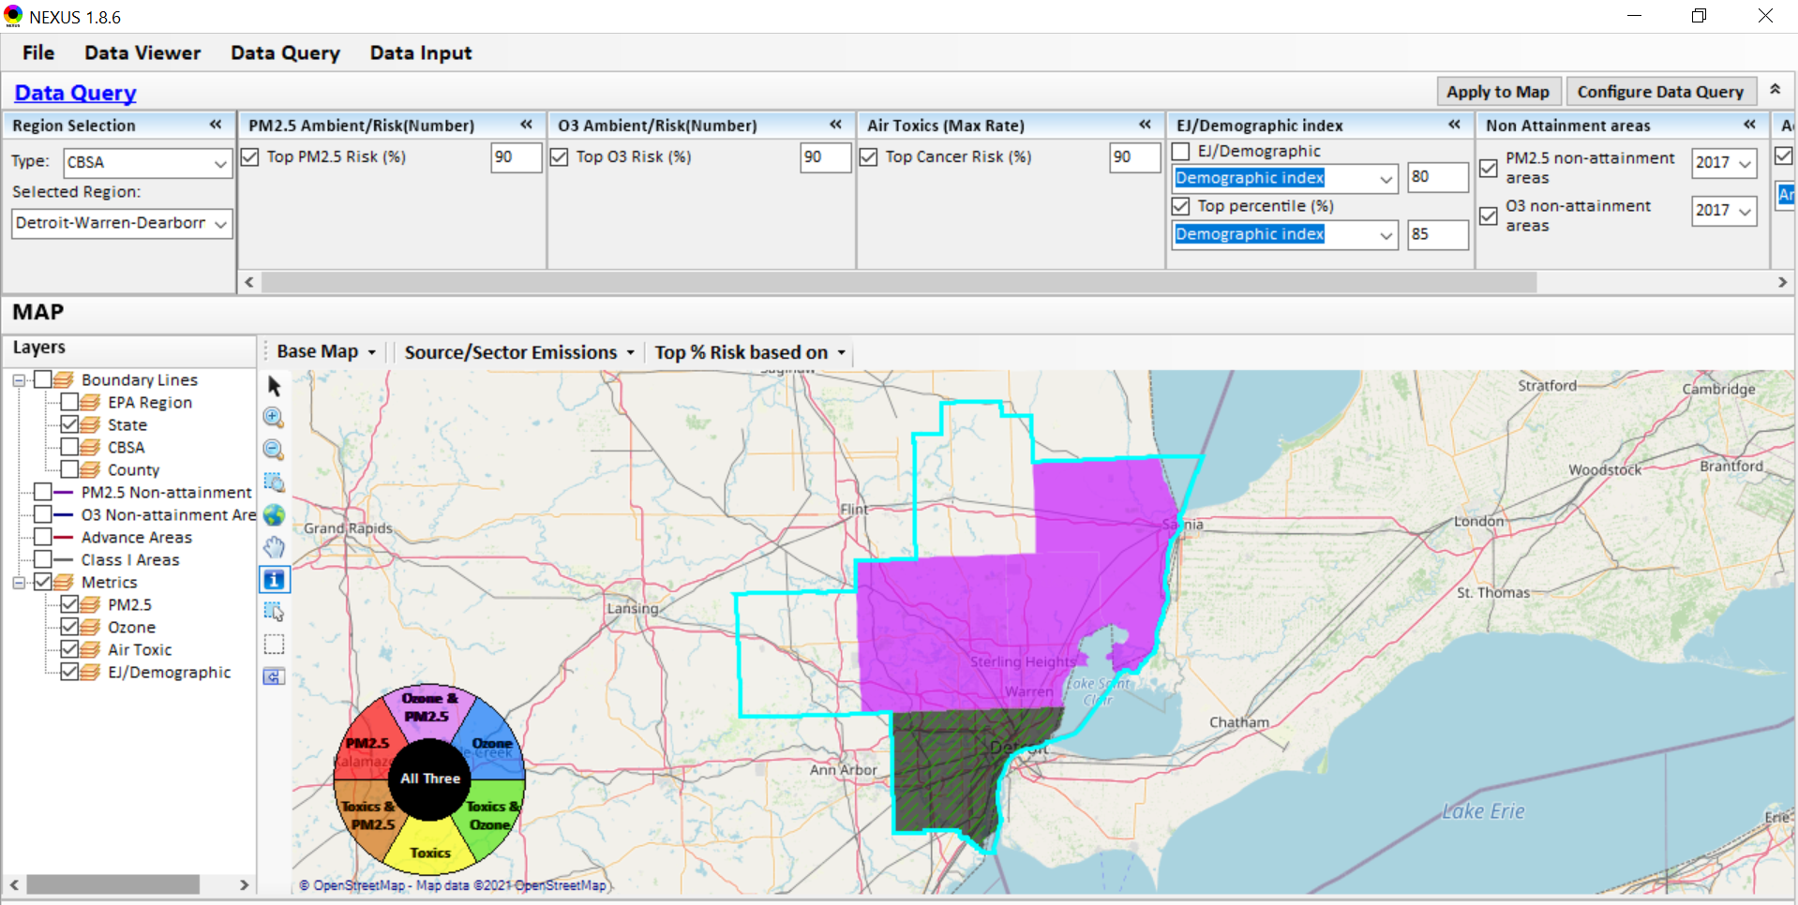
NEXUS - Detroit CBSA
NEXUS can be used to explore CBSAs with MP concerns. This information was generated in Data Query for the Detroit CBSA. Wayne County has dashed green lines, showing that the demographic index percentile is ≥ 85%. Let’s see where the major sources are located…
14

Slide 15
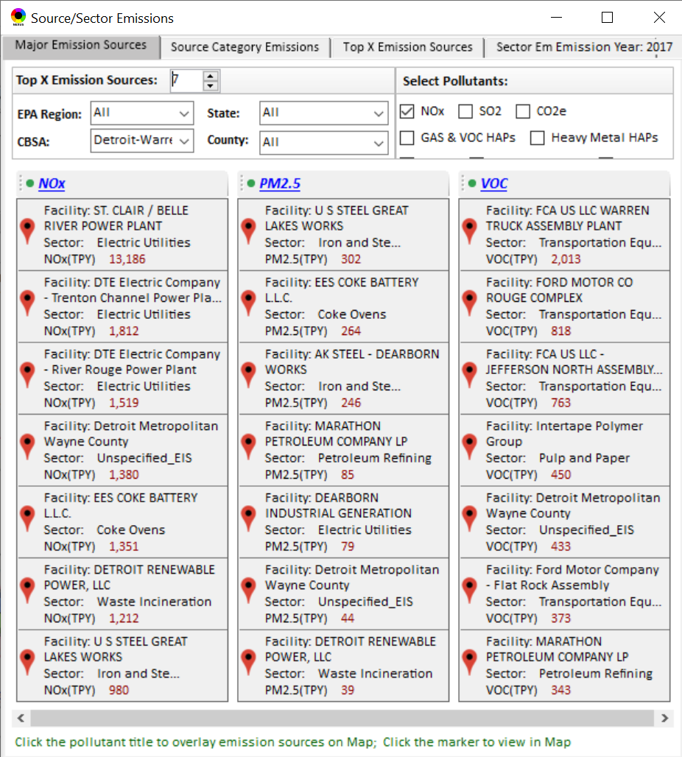
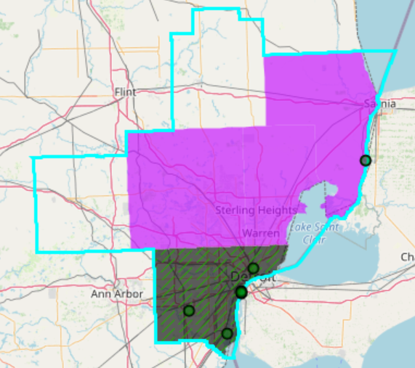
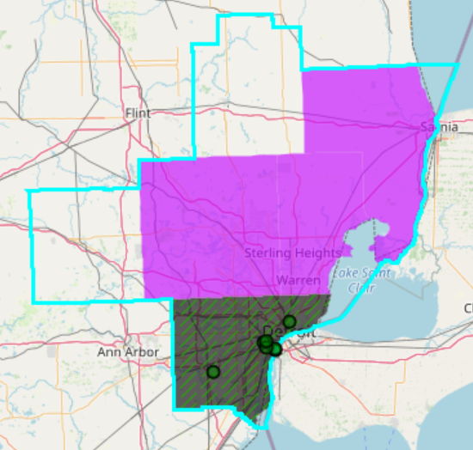
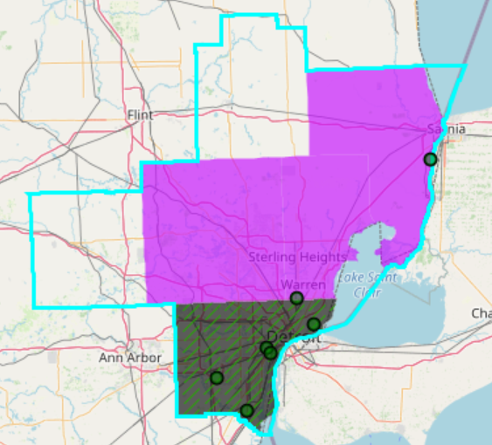
NEXUS - Emissions Sources in Detroit CBSA
Top NOx Emission Sources
Top PM_{2.5} Emission Sources
Top VOC Emission Sources
NEXUS can be used to identify top emission sources. The information above was generated in Data Query for the Detroit CBSA . We can quickly see that the majority of the NOx, PM_{2.5} and VOC & emission sources are located in Wayne County. Let’s explore the Wayne County sources further…
15

Slide 16
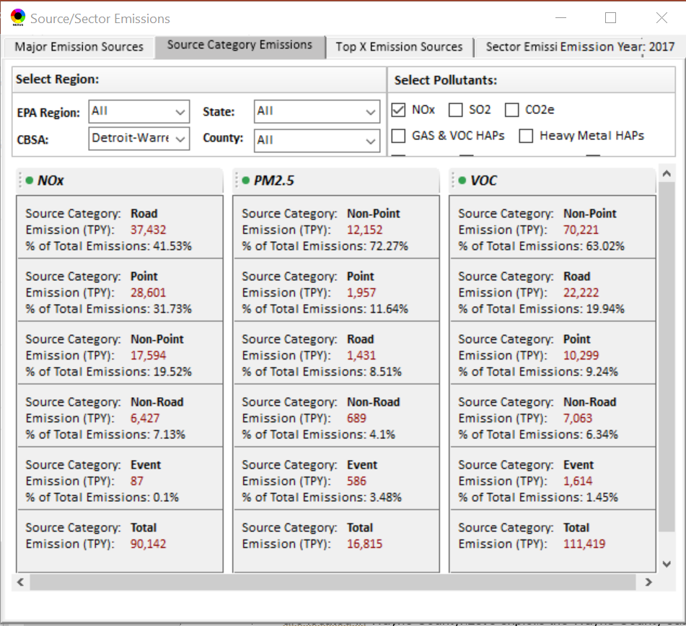
NEXUS – Source Category Emissions in Detroit CBSA
NEXUS can display source category emissions. This information above was generated in the Data Query module for the Detroit CBSA.
16

Slide 17
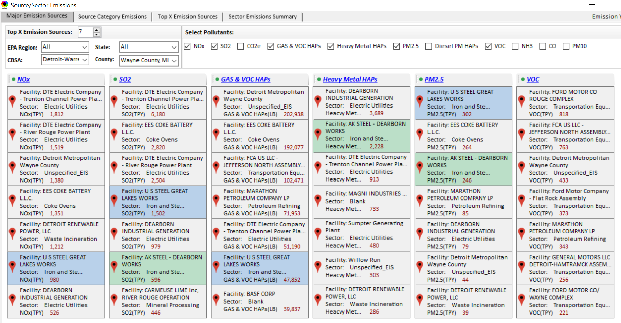
NEXUS Tool - Emissions Sources in Wayne County
NEXUS can be used to identify top emission sources. The information above was generated in Data Query for Wayne County, MI. This can help identify the potential co-benefits of controls. Let’s explore AK Steel and US Steel further...
17

Slide 18
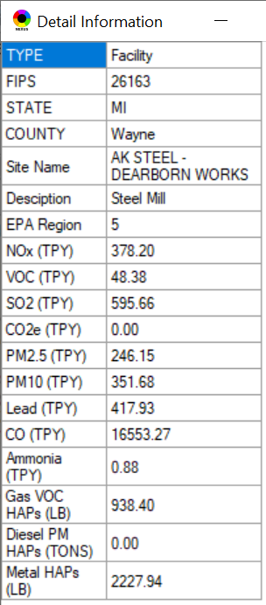
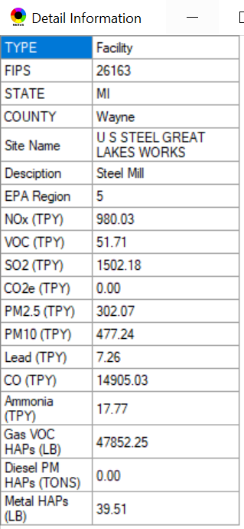
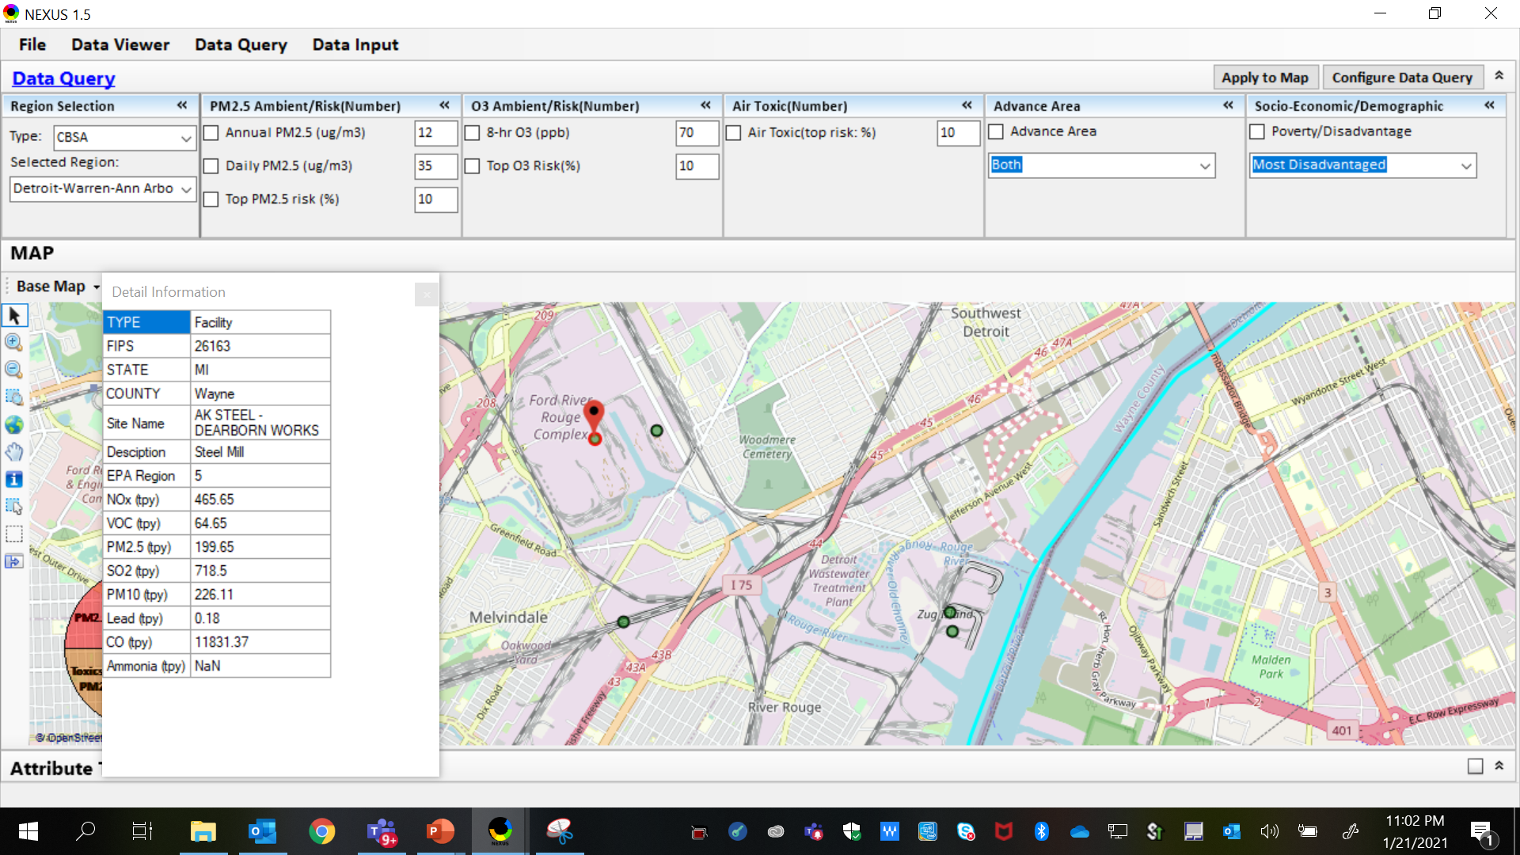
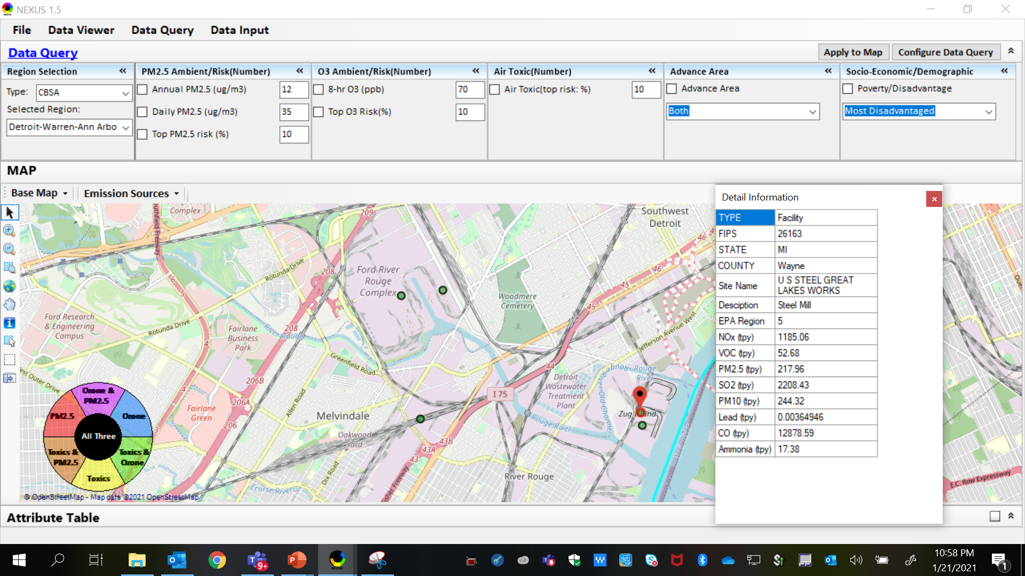
NEXUS Tool - Steel Mills in Wayne County
AK Steel & US Steel were identified as top emitters for NOx, SO₂, Gas and VOC HAPs, Heavy Metal HAPs and PM_{2.5}, highlighting the potential co-benefits of controls in these steel mills. The above map was generated in NEXUS Data Query. Let’s see the proximity of these steel mills to communities with potential EJ concerns…
AK Steel
US Steel
18

Slide 19
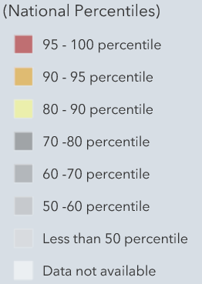
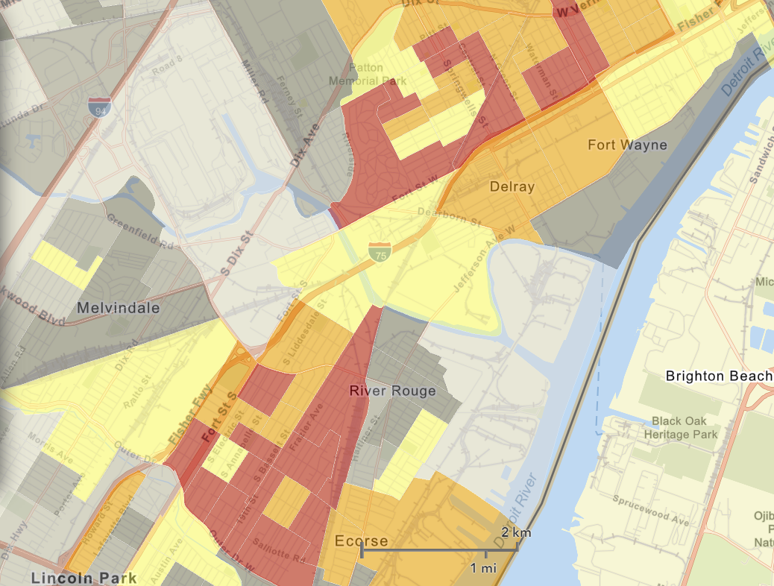
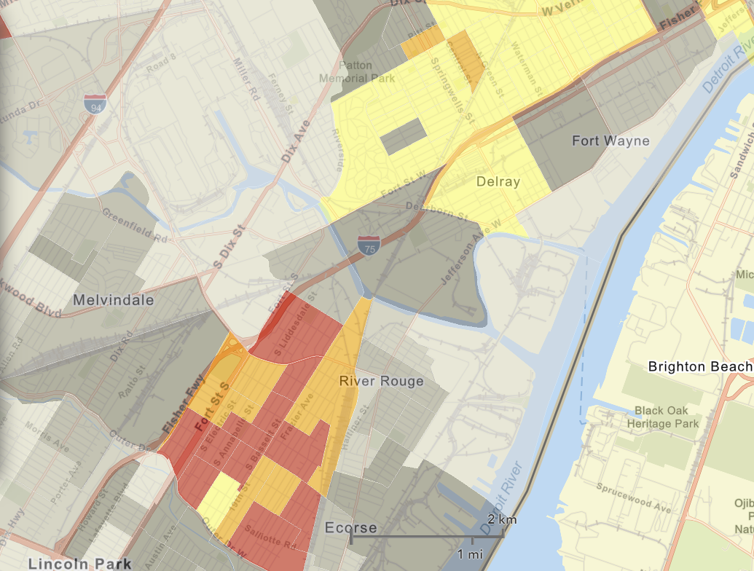
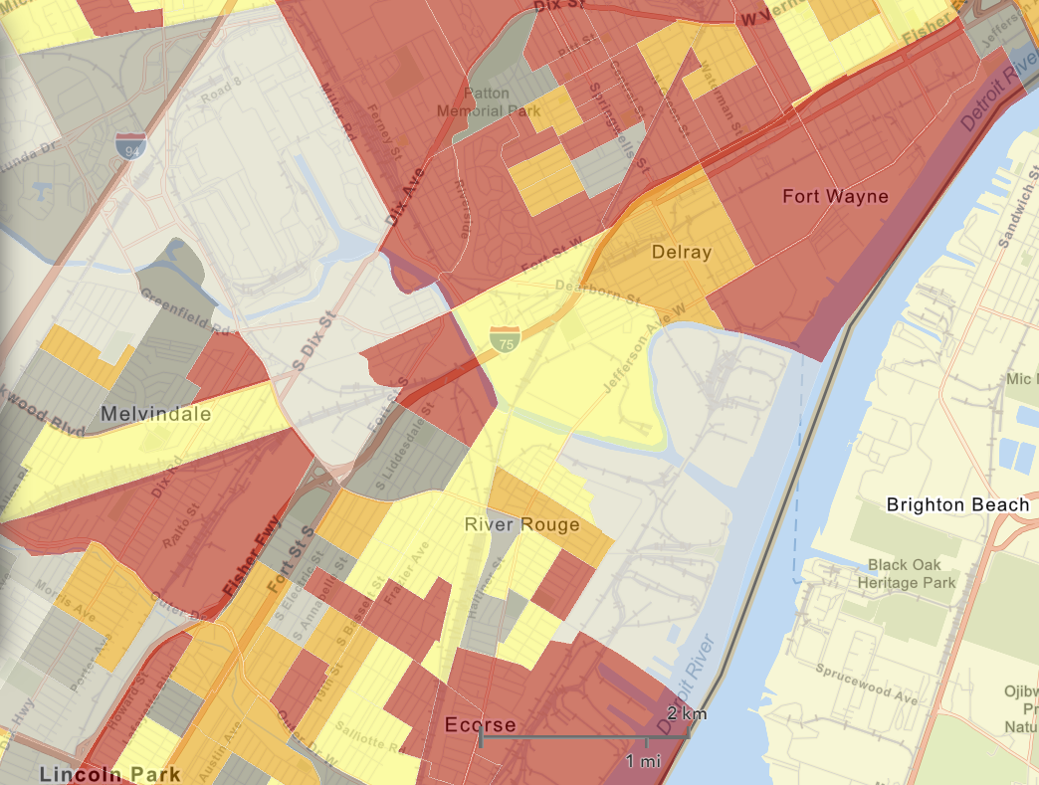

NEXUS Tool - EJ Indices in Wayne County
NEXUS Map
NEXUS can determine the presence or absence of environmental justice concerns in communities in areas with MP concerns. We are incorporating additional EJ metrics such as the data inputs below from EJSCREEN. These indices show the close proximity of AK Steel & US Steel to EJ communities.
AK Steel
US Steel
EJSCREEN Demographic Index
EJSCREEN People of Color Population
EJSCREEN Low Income Population
19

Slide 20
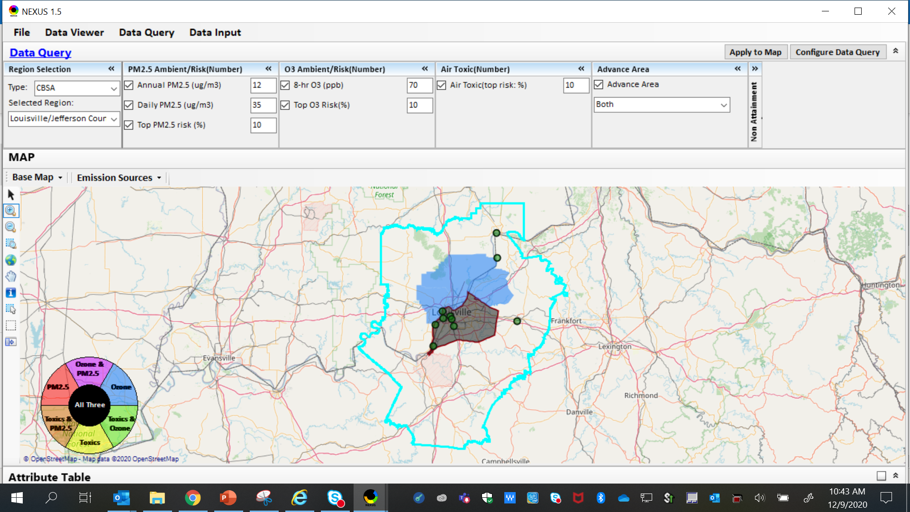
NEXUS Example - Louisville
The map above was generated for the Louisville/Jefferson County - Elizabethtown - Madison, KY-IN CBSA (2014 O₃ NAA), using the data query module. The top 10 Gas & VOC HAPS emission sources are identified.
20

Slide 21
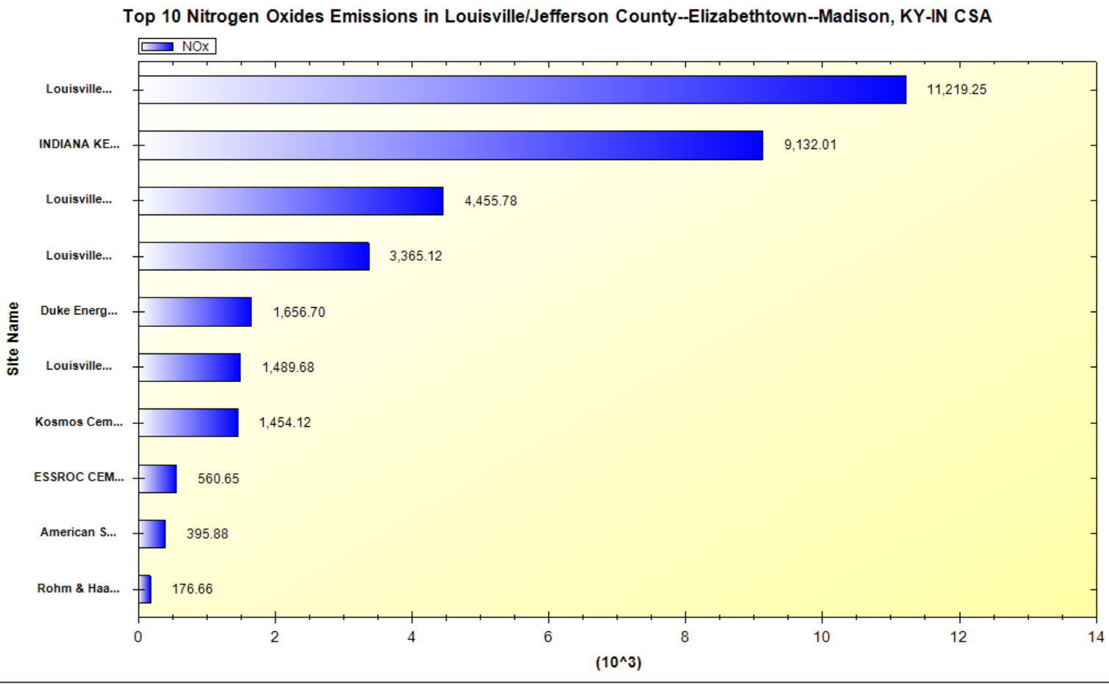
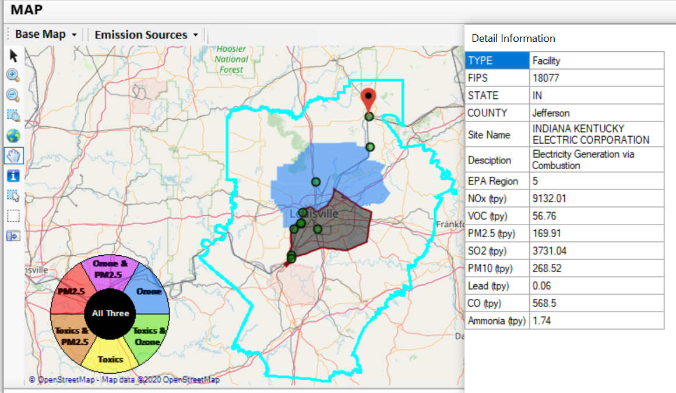
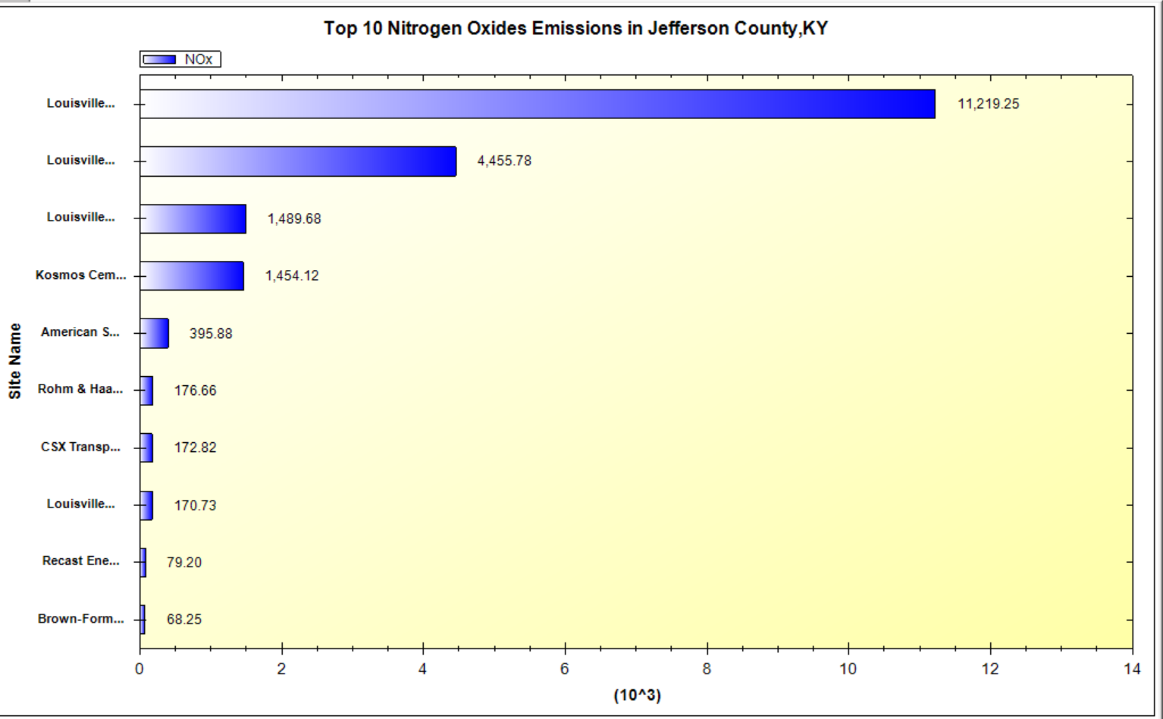
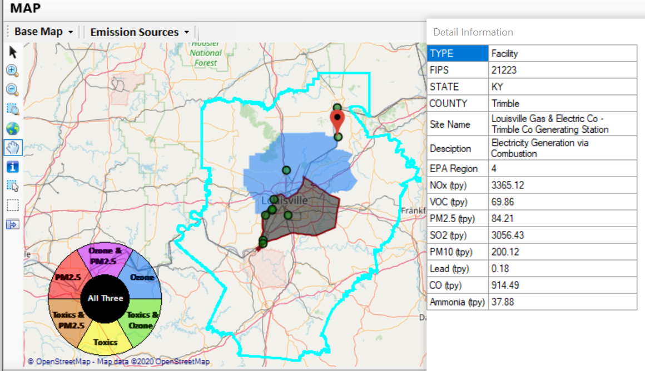
NEXUS Example - Louisville
2 of the top 4 NOx emission sources outside Jefferson County, KY (Jefferson County, IN & Tremble, KY)
21

Slide 22
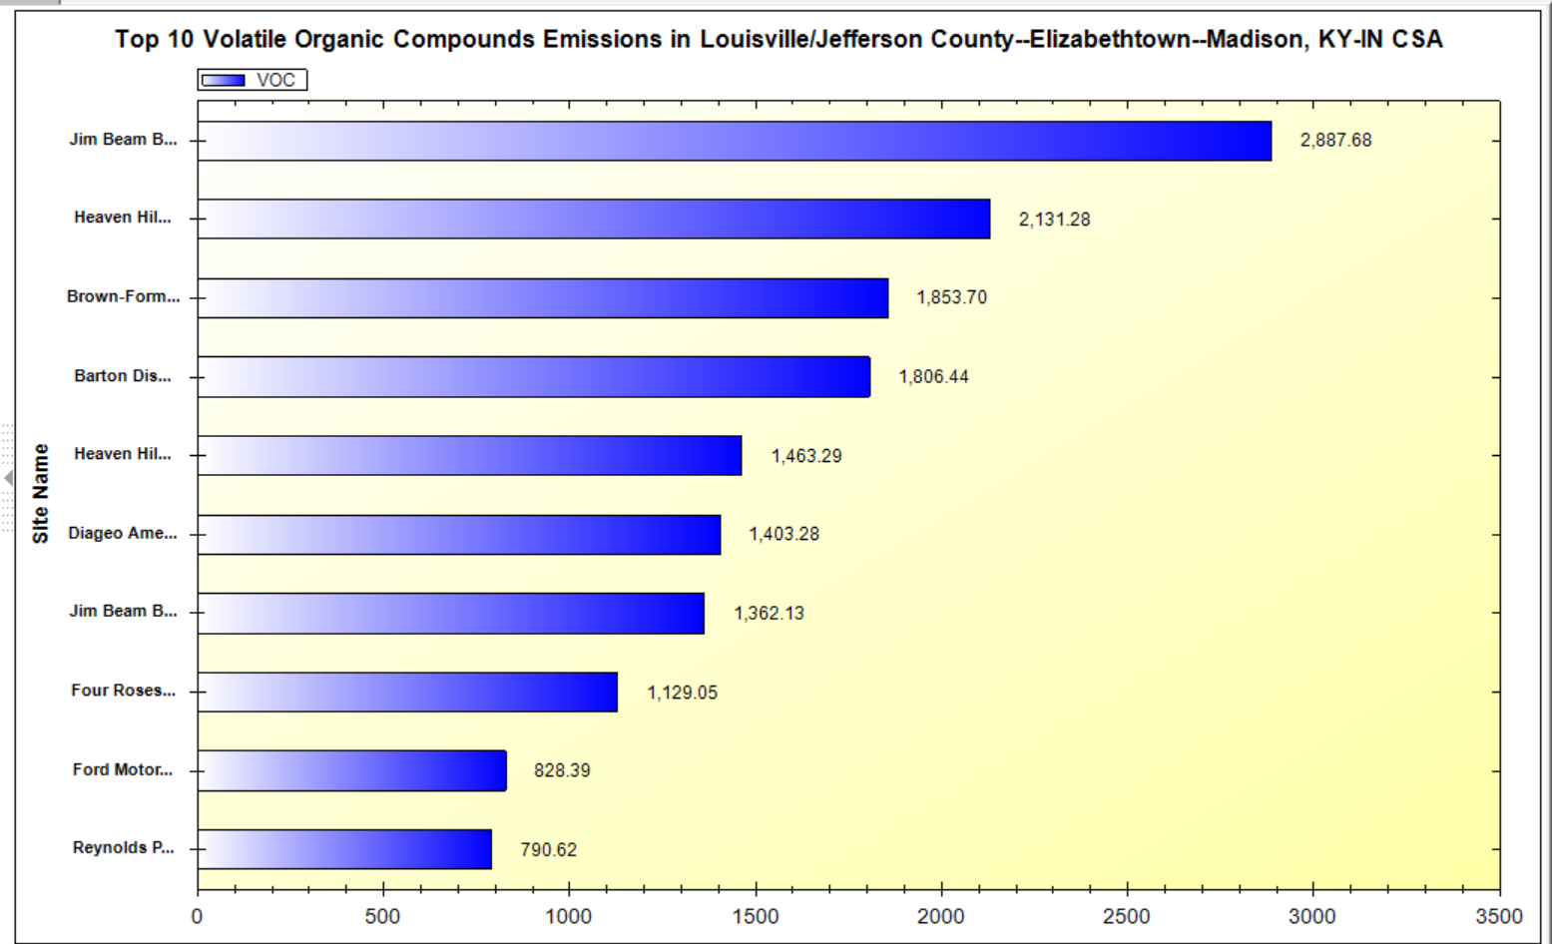
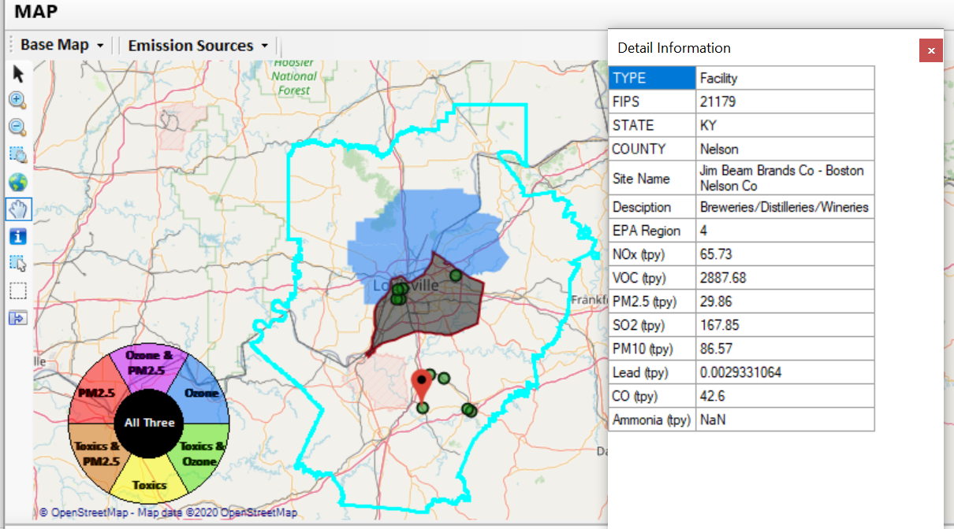
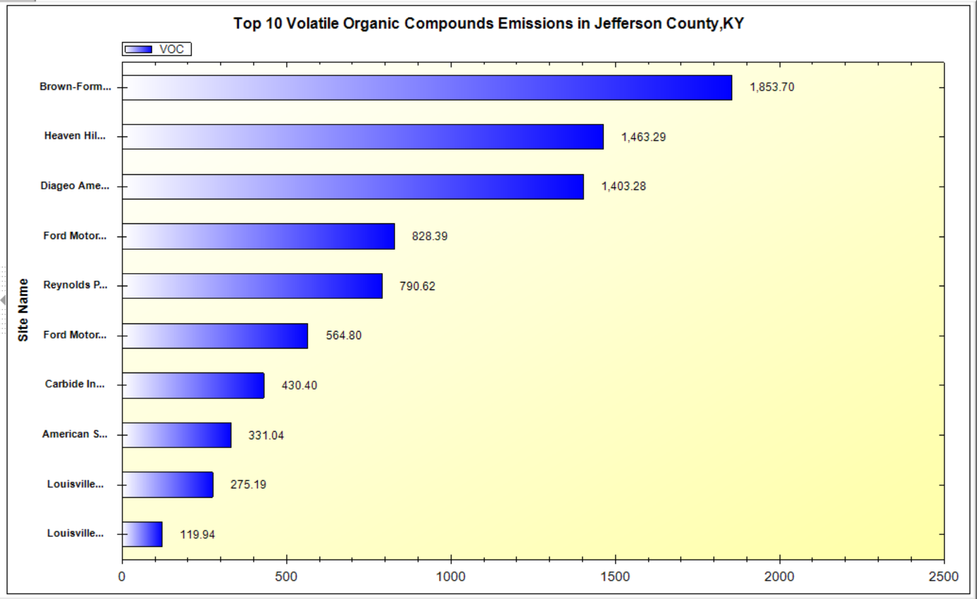
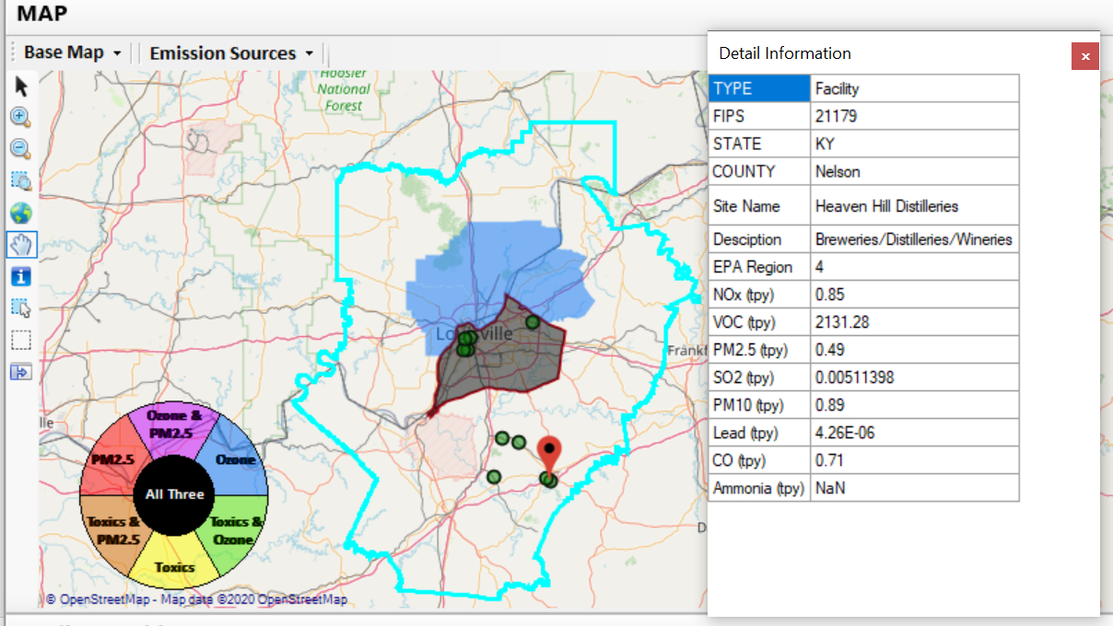
NEXUS Example - Louisville
Top 2 VOC emission sources are in Nelson County, KY
22

Slide 23
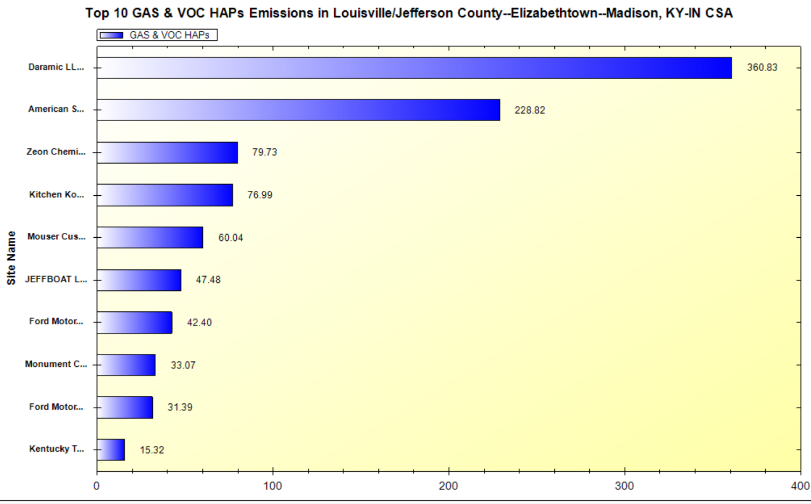
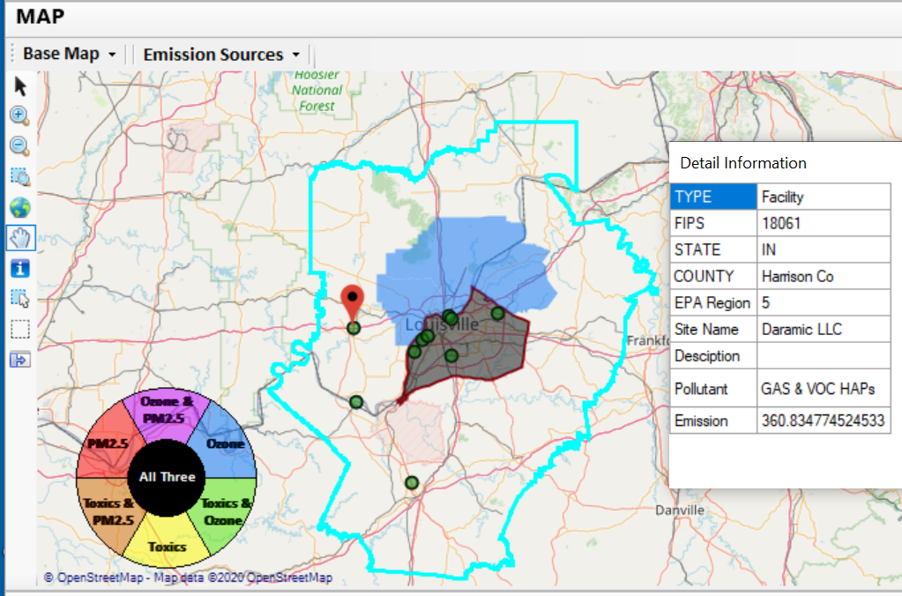
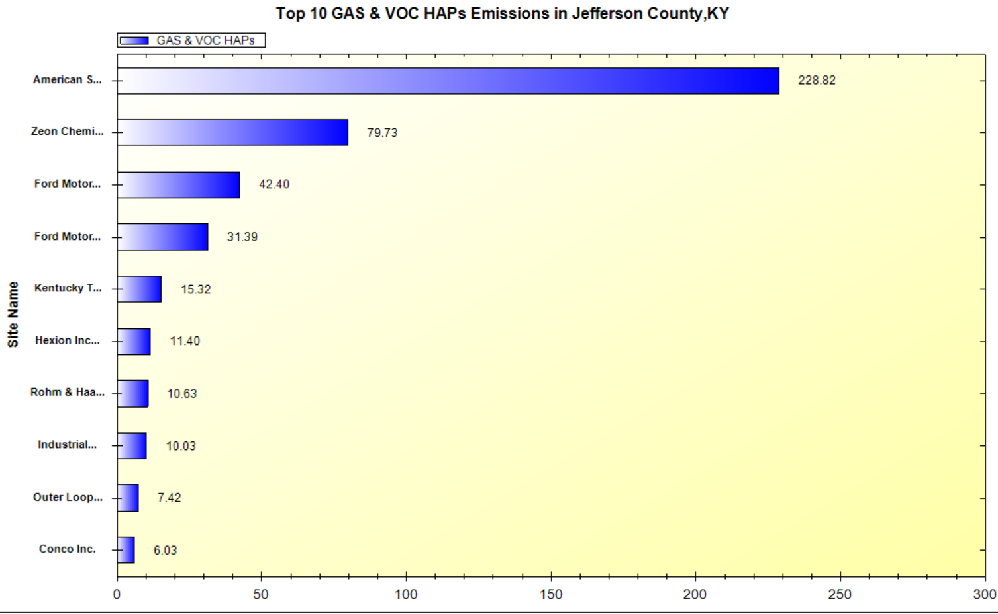
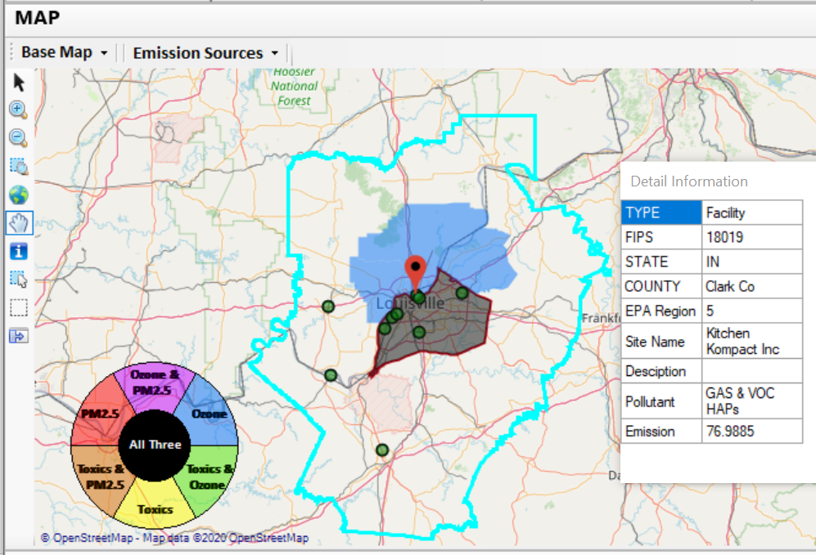
NEXUS Example - Louisville
2 of the top 4 gas & VOC HAPs emission sources in Indiana (Harrison & Clark County)
23

Slide 24
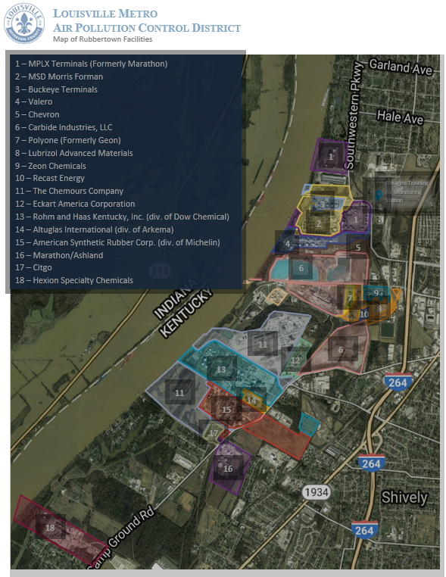
NEXUS Example - Louisville
“Rubbertown is the nickname given to an industrial area along the Ohio River at the southwest corner of the pre-merger City of Louisville. It gets its name from tire and synthetic rubber plants that were built there during World War II near existing refineries. Factories in Rubbertown now produce a wide variety of chemicals and materials…”
“For many years, residents of western Louisville and nearby areas in Jefferson County had complained of health problems they attributed to air pollutant emissions from the many industrial facilities in Rubbertown.”
https://louisvilleky.gov/government/air-pollution-control-district/rubbertown-air-toxics-risk-assessment
Image provided by LMAPCD
24

Slide 25
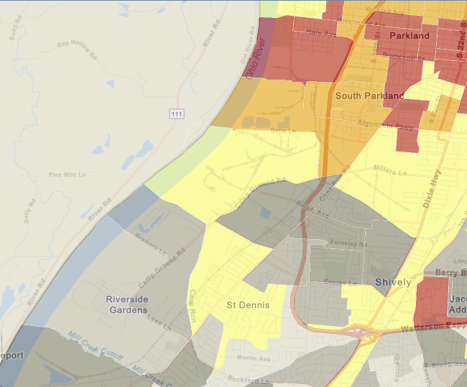
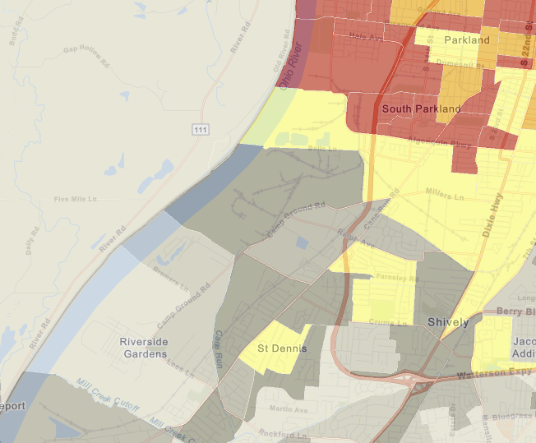
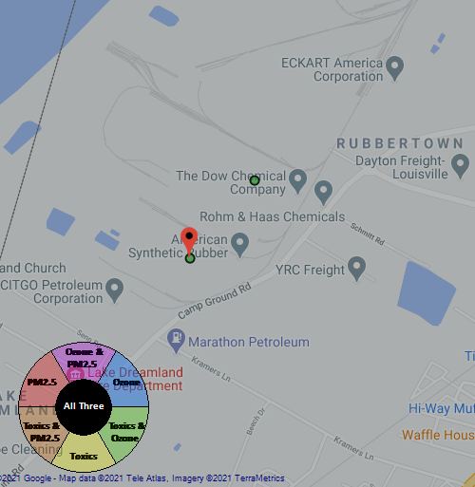
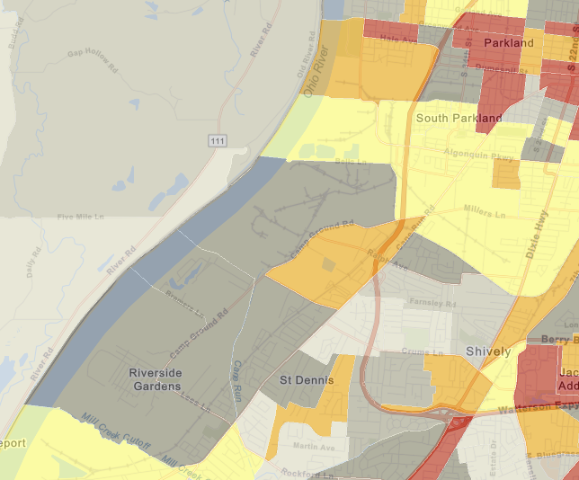
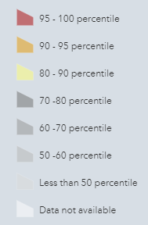













NEXUS Example - Louisville
Rubbertown Map Generated in NEXUS
Demographic Index
Generated in EJSCREEN
People of Color Population
Generated in EJSCREEN
Rubbertown
Rubbertown
Low Income
Generated in EJSCREEN
National Percentiles
Rubbertown
25

Slide 26
NEXUS & EJSCREEN
EJ Layers
Hazardous waste
EJ Grants
Water features
Places
Schools & Parks
Transportation
Boundaries
Prisons
Public Housing
Subsidized Housing
Climate
Sites reporting to the EPA
Superfund (NPL)
RSEI
Environmental Indicators
Wastewater Discharge Indicator
Hazardous Waste Proximity
Superfund Proximity
Lead Paint Indicator
Traffic Proximity
RMP Proximity
EJ Layers
Tribal Areas
Nonattainment Areas
Environmental Indicators*
NATA Respiratory HI
NATA Cancer Risk
NATA Diesel PM
Ozone Model Concentrations
PM_{2.5} Model Concentrations
Demographic Indicators
People of Color Population
Less Than HS Educated
Low Income Population
Linguistically Isolated
Demographic Index
Under Age 5
Over Age 64
Ozone and PM_{2.5}
Emissions and source data
Mortality Risk data
Monitoring data
Air Toxics
Emissions and source data
Modeled concentration data
Risk data
Monitoring data
GHG emissions
*Provided to OEJ by OAQPS (AQAD & HEID)
26

Slide 27
NEXUS and EJSCREEN
NEXUS specifically designed for AQ planning: overlays publicly available air quality information to identify geographic areas where health risks related to O₃, PM_{2.5} and air toxics overlap
EJSCREEN specifically designed for EJ screening: combines environmental & demographic data to highlight areas where vulnerable populations may be disproportionately impacted by pollution
NEXUS contains air data not available in EJSCREEN: detailed emissions and source characterization, O₃ and PM_{2.5} risk data, NATA cancer and non-cancer risk by pollutant and source)
NEXUS relevance for OAQPS EJ screening and outreach efforts: By incorporating EJ indicators and data from EJSCREEN, it can highlight the nature of multi-pollutant AQ issues for communities with EJ concerns
Enhanced NEXUS screening capabilities: We plan to update NEXUS to incorporate proximity screening capabilities similar to EJSCREEN & the OAP/CAMD tool
27

Slide 28
Multi-Pollutant Team
Next Steps
Louisville - Develop MP AQMP
Based on Office wide engagements, continue to update NEXUS tool and use it to inform Multi-pollutant, Air Toxics, NAA/Advance controls, and EJ efforts as appropriate
Incorporate climate considerations into MP process
Use NEXUS to develop packets for regions regarding MP areas of concern
Continue exploring MP partnerships

Slide 29
Multi-Pollutant Team
Briefings, Demos & Planned Outreach
9/25/2020– AQAD & HEID
11/3/2020 – MP Team
11/4/2020 – Air Toxics Group
12/10/2020 – AQPD
1/25/2021 – OID
1/28/2021 – SPPD
2/1/2021 – Peter/SMT
4/12/2021 – HEID & AQAD
5/17/2021 – Peter/SMT
5/24/2021 – MP Team
6/29/2021 – ORD
7/12/2021– HEID & AQAD
7/19/2021 – OID
8/10/2021– OAP
8/26/2021 – OAR
8/30/2021 – OEJ
8/30/2021 - Region 4/Louisville
9/7/2021 – Air Division Directors
10/5/2021 – APMs
TBD – MJOs

Slide 30
NEXUS - Recent Improvements and Planned Updates
NEXUS “1.5” (December 2020) → “1.9” (August 2021)
New/revised Metrics (PM_{2.5}, O₃, Air Toxics & EJ)
New/updated data inputs and functions:
EJ/Demographic data (from EJSCREEN)
Tribal areas & Advance areas
2017 emissions data (including GHG & sector mapping) (updated from 2014)
“Source & Sector emissions” module to support “Sector prioritization” effort
“Source Category emissions” module (point, non-point, on-road, non-road, event)
On-going Improvements and Upgrades
Update to 2017 fused PM_{2.5} and O₃ health risk data (Sept) and air toxic and risk data (Nov/Dec) from current 2014 data
Include and display monitoring sites/data (PM_{2.5}, O₃ and Air Toxics) (Sept/Oct)
Develop prototype for “Proximity analysis for MP risks and EJ” module (Nov/Dec)
30

Slide 31

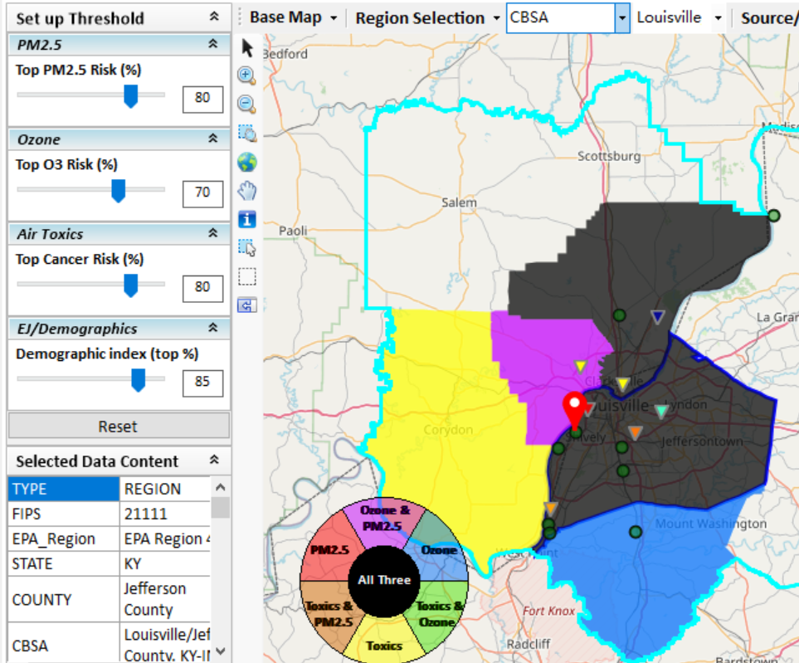
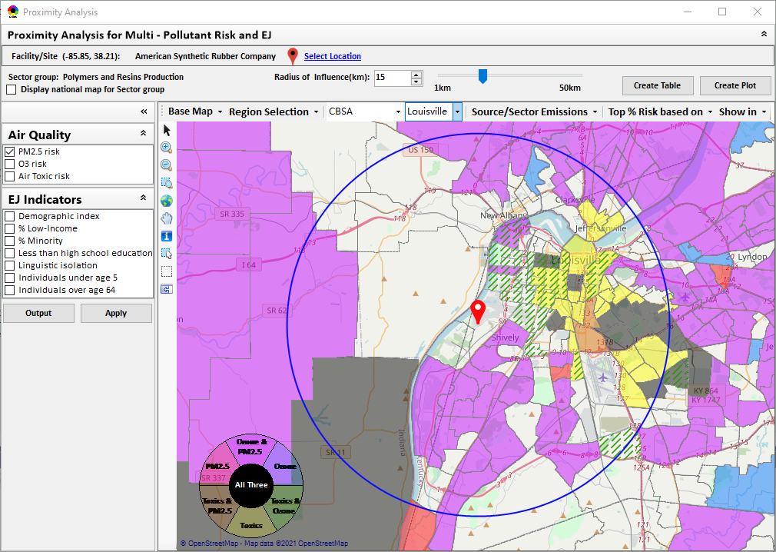
New “Proximity Analysis” Module (under development)
Proximity Analysis for MP Risks and EJ
Right-click to invoke
County – level (current)
Census Tract - level
31

Slide 32
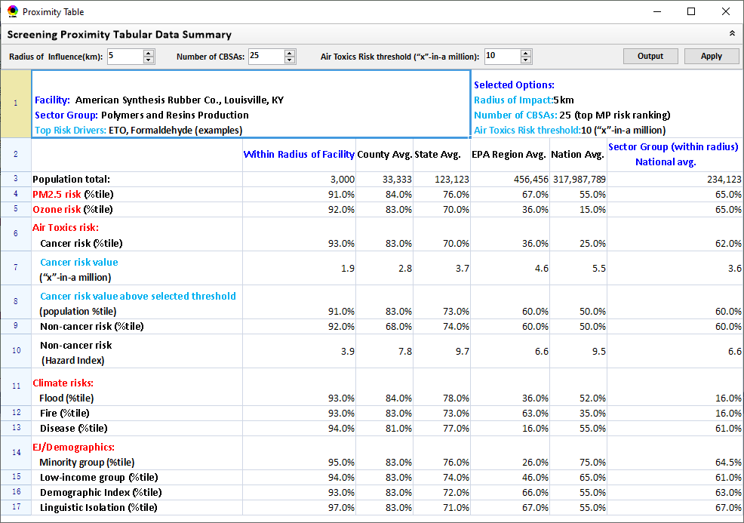
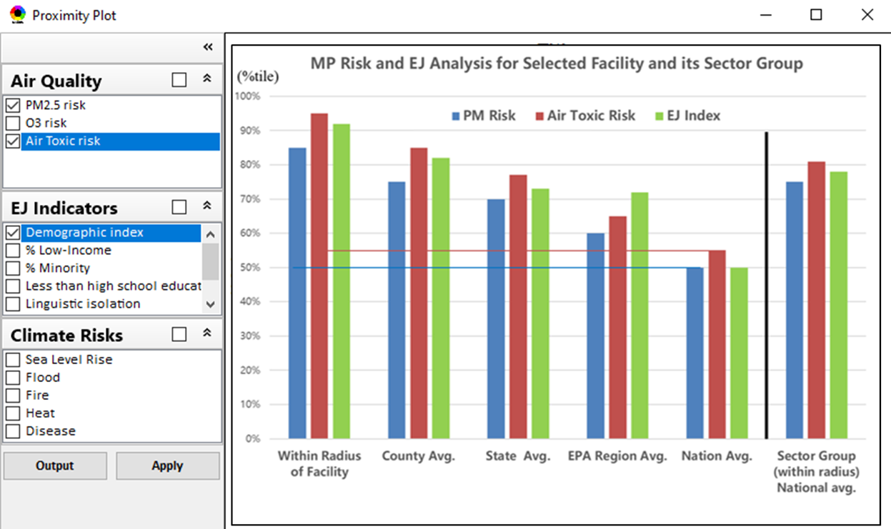
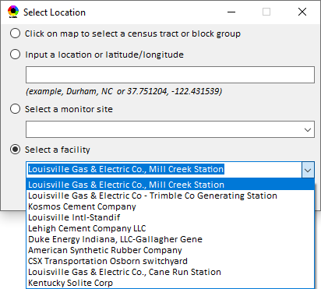
Proximity Analysis: Select “Location” & “Radius”
Select “Radius”
Choice of
Selecting a Location
32

Slide 33
Appendix “NEXUS 1.9”Demo
NEXUS 1.9 “Quick Tutorial” slides attached
Download “NEXUS” tool at: https://gaftp.epa.gov/aqmg/cjang/NEXUS/
Carey Jang
33

Slide 34
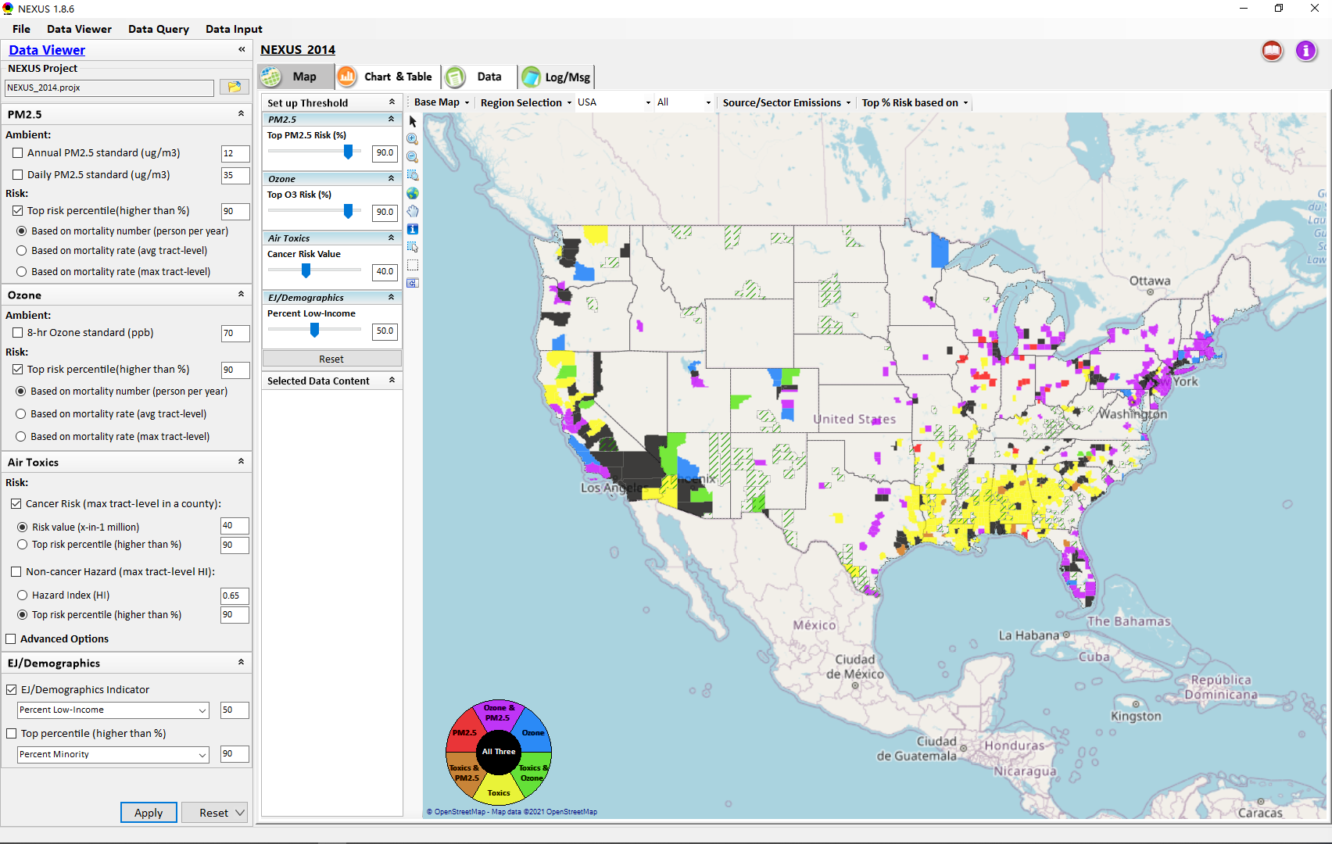
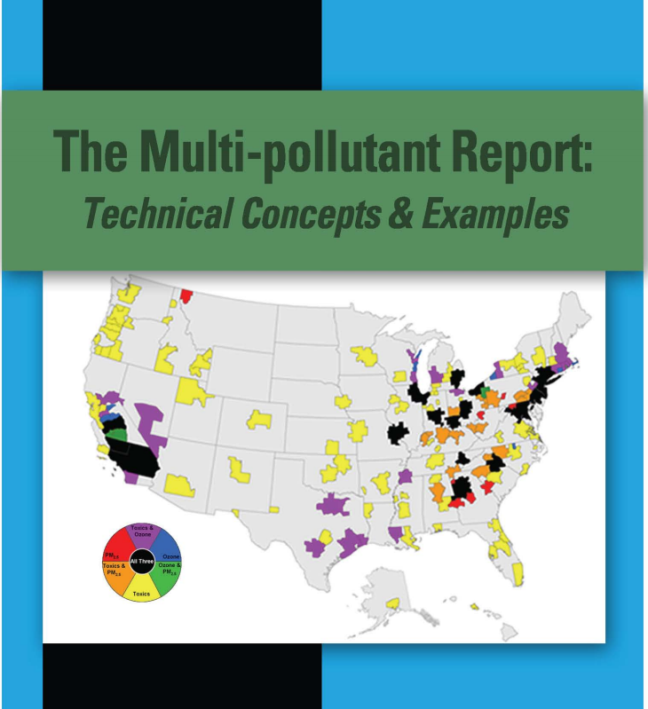
“NEXUS 1.9” Demo: 2014 NEXUS Case
Launching Page
2008
Roadmap for Demo:
(Use example cases)
National View: Use “NEXUS” across pollutants to provide an initial “SCREEN” at the national level by providing an indicator where there may be a common set of sources contributing to Multi-pollutant issues.
Regional View: Dial into a region or area of interest to understand the pollutant/source connections, and potential for more effective and efficient multi-pollutant solution.
34

Slide 35
“NEXUS 1.9”: Quick Tutorial
Download “NEXUS” tool: The “NEXUS 1.9” package (“NEXUS 1.9 Setup.exe” & “NEXUS 1.9 Data.exe”: run both “*.exe” files to install) can be downloaded at EPA’s new FTP site:
https://gaftp.epa.gov/aqmg/cjang/NEXUS/NEXUS 1.9/*
Note: Require software installation privilege or “Power Broker” (limited elevated privilege) to install “NEXUS tool” at EPA’s PC; Check “This PC\Documents\My NEXUS files\data\* (\tool\*, \result\*)” to see if NEXUS program & input dataset are installed successfully
35

Slide 36
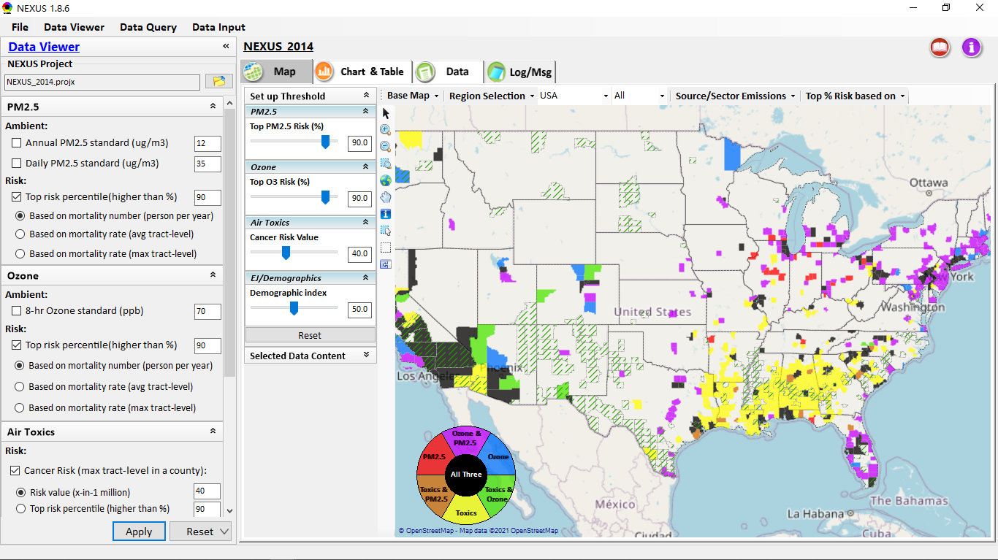
NEXUS Tool: On-line User’s Manual
Click “book” icon to launch “User’s manual”
Hot link to User’s manual’s “Data Viewer” chapter (same for “Data Input” module & “Data Query” model)
36

Slide 37
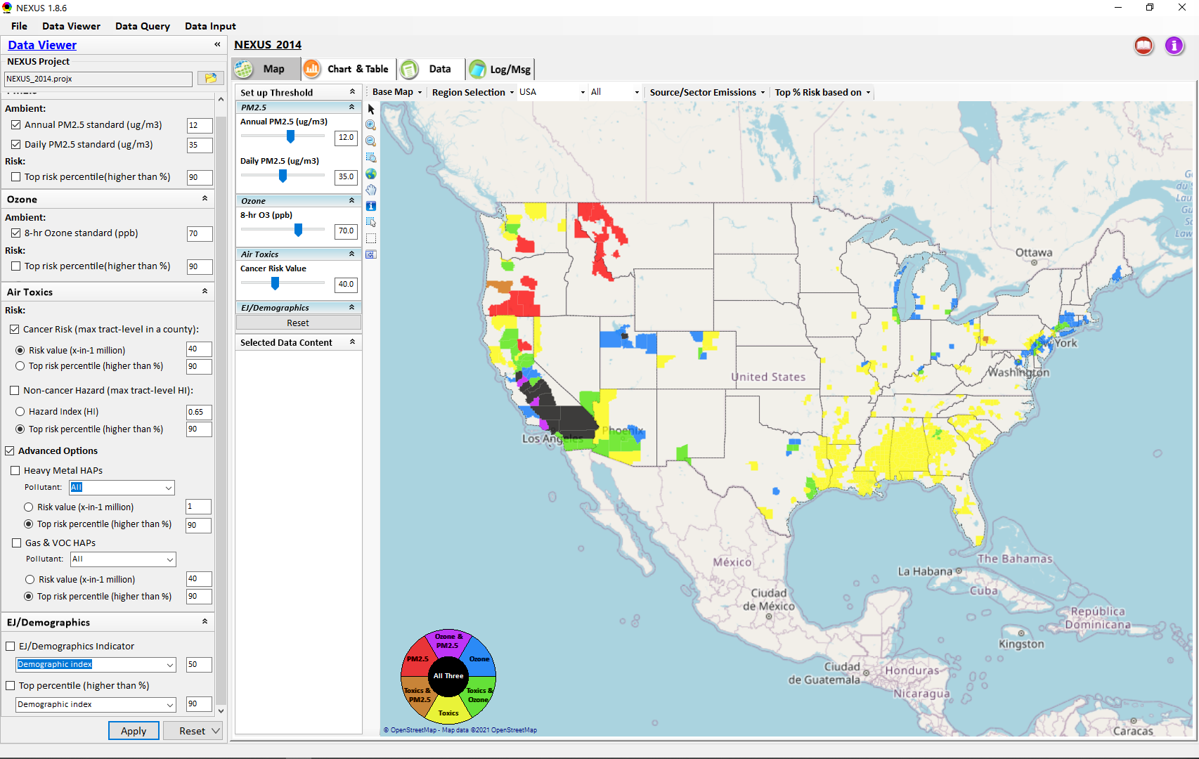

NEXUS Tool: Data Viewer Module
Click “File” to open or save a project
Switch between 3 key modules
NEXUS project file name
Select & adjust “Ambient” or “Risk” levels
“Advanced Option”: provide HAPs & species selections
37

Slide 38
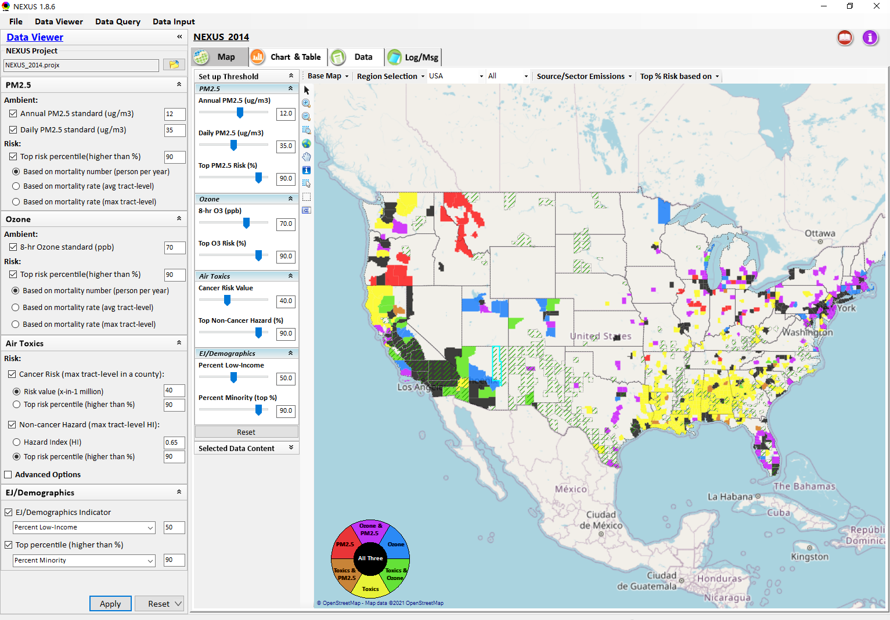
Data Viewer: “Apply” New Selections
“Check” boxes to change/add selections
New selections will appear in “Slider bars” panel and map display
“Slider bars” allow to select & adjust “Ambient” and/or “Risk” threshold levels and displaying color map
“Apply” new selections
38

Slide 39
NEXUS Update: New EJ Metric and Data
39

Slide 40



Data Viewer Module: Base Map & Color
“Base Map”: Change boundary lines and background map
“Right-click” map to save image
Click to change color & transparency
40

Slide 41




Data Viewer: “Region Selection”
Allow to select “EPA regions”, “States”, or “CBSA”
41

Slide 42



Data Viewer: Select EPA Region/State/CBSA
Examples:
EPA Region 4
NC State
Louisville CBSA
42

Slide 43

Data Viewer: Major Emission Sources
Click “Emission Sources” tab to display emission sources (green dots) and launch new window
Click any “facility” to link & display source location and emission information
43

Slide 44

Data Viewer: Major Emission Sources
Allow to scroll down to county-level (e.g., Wake County, NC)
Wake county, NC
44

Slide 45



Data Viewer: Top “x” Emission Sources
Provide selection of CAPs precursors & HAPs species
Durham county, NC
45

Slide 46



“Monitoring Data/Site” Module
Right-click to invoke
AQ trend
Click to display
AQ trend at monitor site
Monitor Site/Data
Click to select monitor site
& pollutant
46

Slide 47

NEXUS Update: “Source/Sector” Emissions Summary
“Source/Sector Emission Summary” function allow to select major CBSAs and provides source and sector emissions summary to support OAQPS’s “Sector Prioritization” project effort
47

Slide 48

Data Viewer: EPA Region Table Generator
“EPA Region Table Generator” provides attainment status of O3 and PM2.5 and their DVs; also allows to select any EPA region based on data updated to 2018.
48

Slide 49

Data Viewer: Data Search & Filter
Click “+” to add filters; Click “x” to remove current filter;
Show specified records per page.
Click “Output data…” to output current page records or all records
49

Slide 50

Data Query Module: Overlaying Map
Region Selection
Data Query Configuration
Data Query qualifier selection
Overlaying Map selection
50

Slide 51

Data Query Module: Configure Data Query
“Data Query Filter” allows to select “qualifiers” for query
“Data Query Preview” displays the selected “qualifiers” at the same time
51

Slide 52


Data Query Module: Attribute Table
Filter/search/export functions
Detachable “Attribute Table”
52

Slide 53



Data Query Module: Attribute Table
Click a “record” to link and display its location & info.
53

Slide 54

Data Input Module: Data Preview
“Transparency” & “Open-Source”:
All NEXUS input/output data files are available under:
“This PC\Documents\My NEXUS files\Data (\Result)”
Check to use filter to query data
Select a table to view if there are multiple tables in the selected data source file
Click to change input data file
Click to view data
Click to run & save project
54

Slide 55
End
55

