Slide 1
“NEXUS” Multi-Pollutant Screening Analysis Tool AQAD All-Hands
OAQPS’s Multi-Pollutant Team
November 18th, 2021

Slide 2
Multi-Pollutant Team Members
HEID
Beth Landis / Kimber Scavo
Robin Langdon / Darryl Weatherhead
Matt Woody/ Kelly Rimer
Sara Terry
Carrie Wheeler
Ben Gibson
Rob Pinder
Scott Voorhees
Chris Davis
SPPD
Lisa Conner
AQAD
Carey Jang / Tyler Fox
Jim Kelly
Shannon Koplitz
Joe Mangino
Jeanette Reyes
AQPD
Rich Damberg / Megan Brachtl
OID
Amanda Kaufman
James Payne

Slide 3
Overview
Multi-Pollutant (MP) Background
NEXUS 2.0
Tool Development
Expected Use
Data Inputs and Major Functions
Recent & Ongoing Development
Briefings/Demos/Planned Outreach
Live Demo
3

Slide 4
Multi-Pollutant Background
Support a comprehensive, MP treatment of air quality problems to effectively improve air quality and make the most efficient use of available resources
Primary Goal - identify & evaluate local control strategies targeting emissions of O₃ & PM_{2.5} and their precursors while at the same time reducing Air Toxics of concern for communities to maximize both health benefits and air quality improvements
MP planning has the potential to reduce the costs and increase benefits associated with air quality management (AQM)
Supports S/L/T air agencies in developing MP, risk-based AQM plans and implementing strategies that reduce air pollution emissions & improve public health
Success has been demonstrated in Detroit and SC; another project is currently underway in Louisville, KY
Tools needed to analyze MP data are either available currently or being developed in OAQPS (e.g., NEXUS)
4

Slide 5
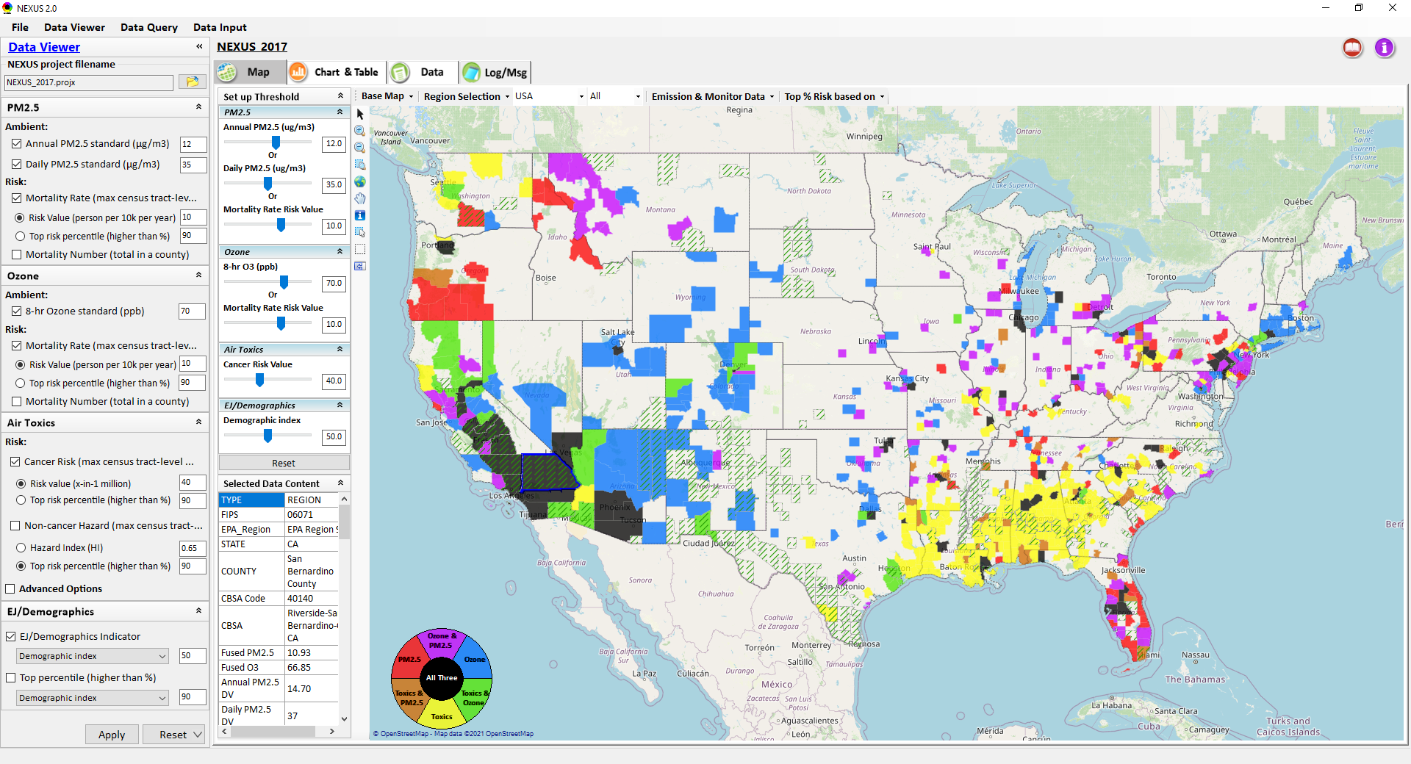
NEXUS: Tool Development
A new Multi-Pollutant (MP) Advanced Screening Tool (NEXUS) is being developed to:
Identify geographic areas where health risks related to O₃, PM_{2.5} and air toxics overlap
Characterize the nature of MP AQ issues for specific areas to consider MP AQ planning
5

Slide 6
NEXUS: Expected Use
The NEXUS tool will allow users to do the following:
National screening to identify areas with MP issues: Phase 1 development provides ability to quickly screen areas across nation that have combination of high air quality and/or risk levels for O₃, PM_{2.5} and Air Toxics.
Area screening to understand nature of MP problem: Phase 2 development provides ability to ‘dial-into’ specific areas to determine extent to which common emissions sources are causing the MP issues.
We expect to use this tool in conjunction with Regions and identify areas that would potentially benefit most from MP approaches to reduce emissions (including current NA areas).
The NEXUS tool will essentially provide a ‘conceptual model’ of an area’s MP issues to facilitate engagement with state/local/tribal agencies and community stakeholder groups.
We also expect that it can have additional value-added uses across the Office for Air Toxics, Environmental Justice and other programs.
6

Slide 7
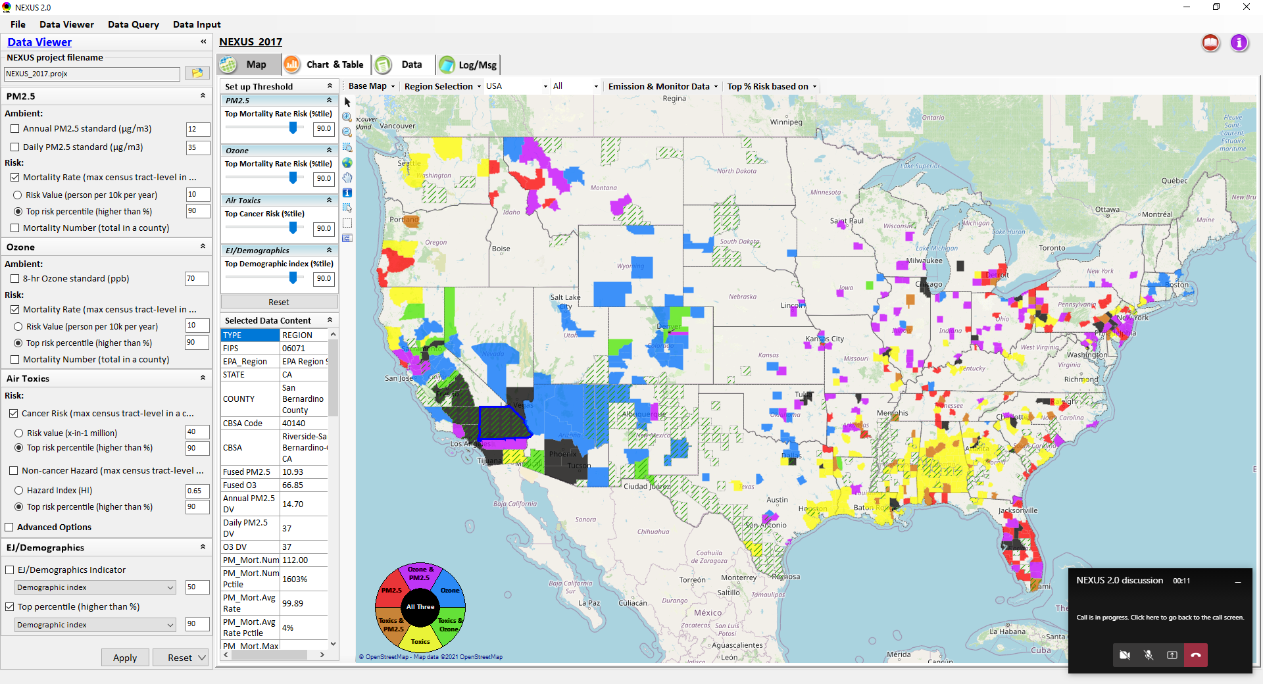
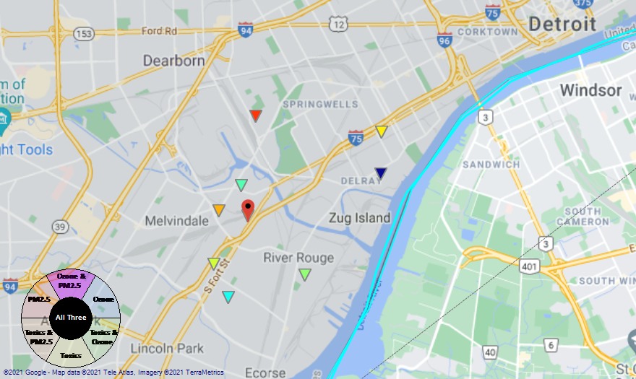
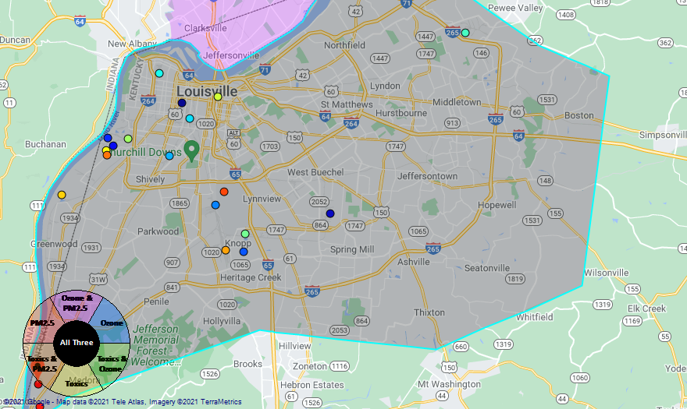
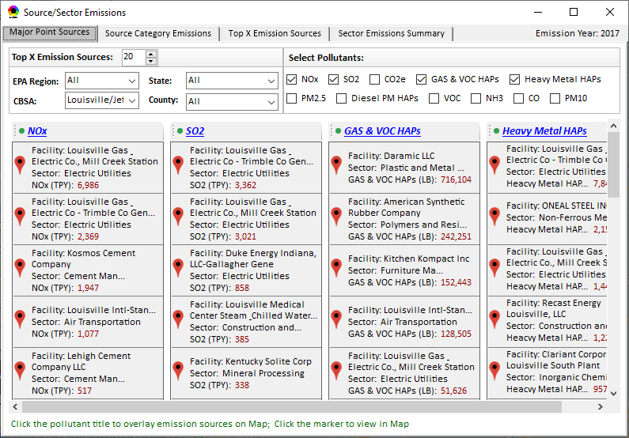
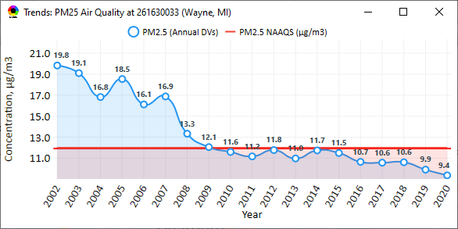
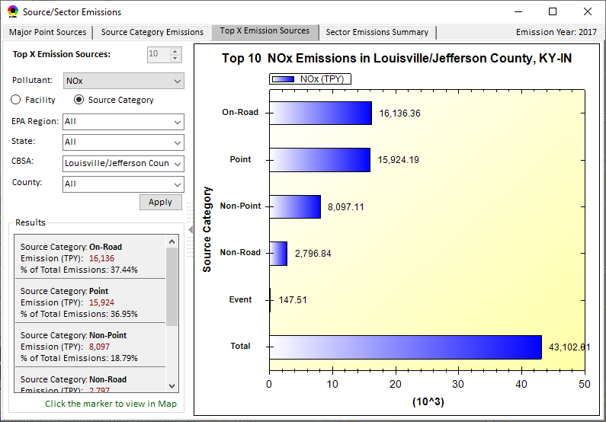
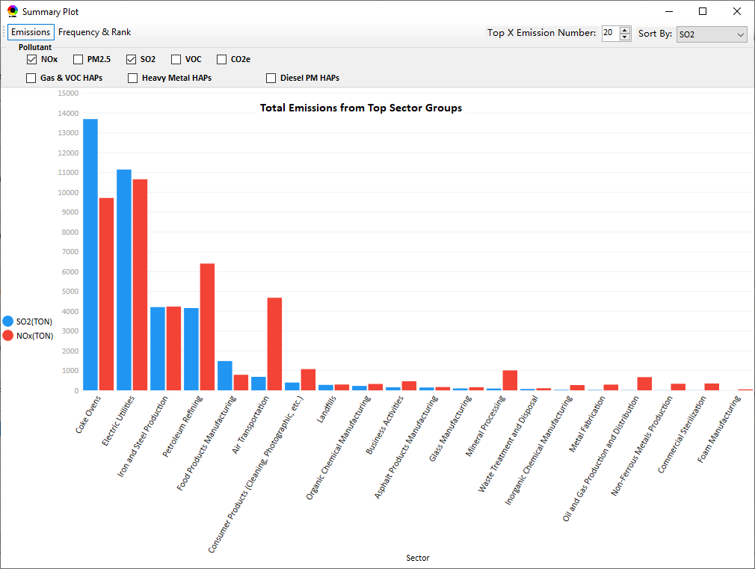
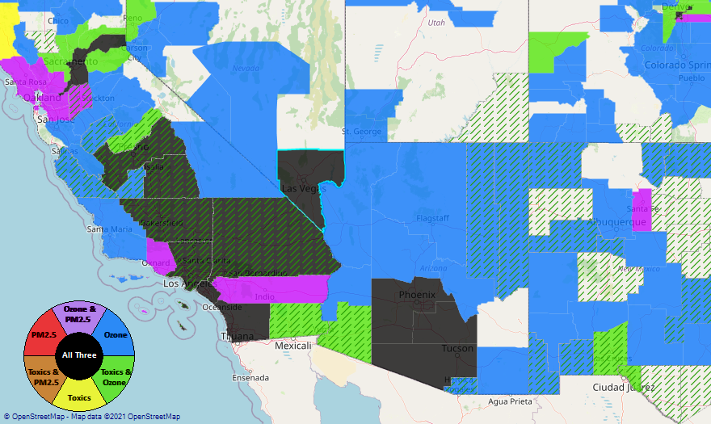
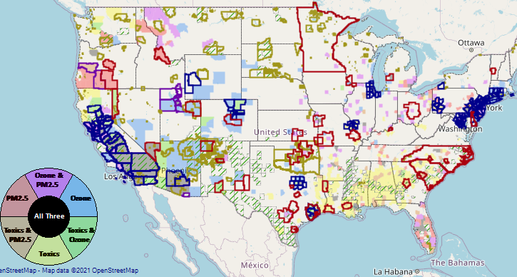
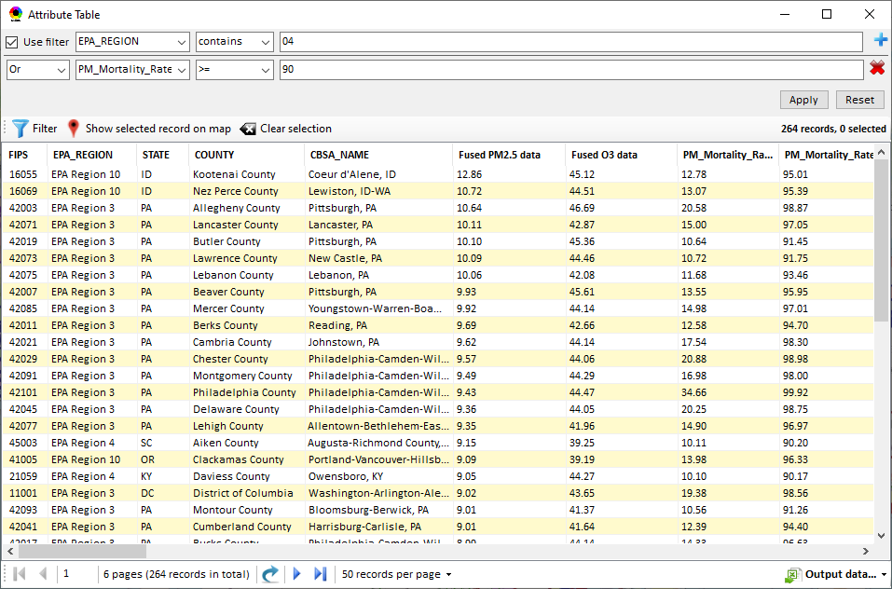
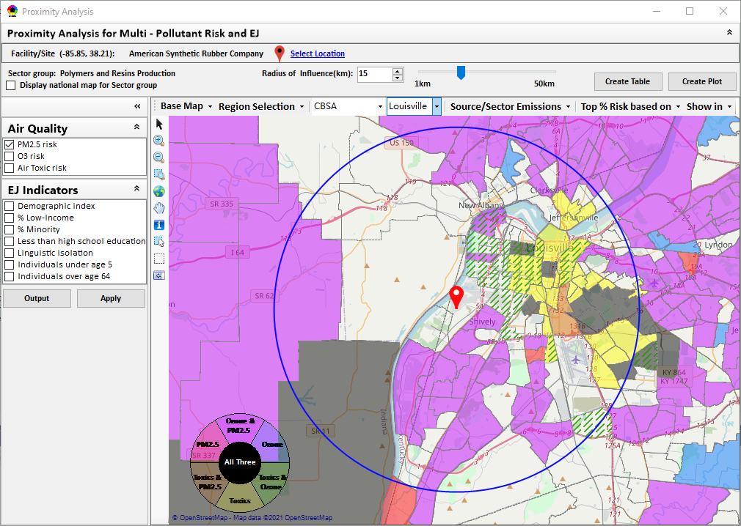
NEXUS: Data Inputs and Major Functions
O₃ & PM_{2.5}
Ambient/Design Value
(2012-2020)
(County-level)
Multi-Pollutant
Ambient and/or Risk National & Areal Mapping
Display Monitoring Sites & Trend Data
O₃, PM_{2.5} & Air Toxics Risk Data &
Conc. (fused AQ) Data
(2017 & 2014)
(Census tract-level)
Display Major Point Emissions Sites/Data
Provide Source Category Emissions
NEXUS
O₃, PM_{2.5} & Air Toxics Monitoring Data
(2002-2020 & -2018)
Provide Sector Emissions Summary
NEI County &
Facility Emissions
(2017 & 2014)
Include EJ/Demographic Indicators
Map Overlay with NAA, Advance Area, Class-I Area, or Tribal Area
Environmental Justice & Demographic Data
(from EJSCREEN)
Data Query, Search, Filter & Export
Advance Area
Class-I Area
Tribal Area
Proximity Screening Analysis (ongoing)

Slide 8
NEXUS: Recent & Ongoing Development
NEXUS “1.5” (Jan. 2021) → NEXUS “2.0” (Sep. 2021)
New/revised Metrics (PM_{2.5}, O₃, Air Toxics + EJ/Demographics as 4th metric)
New/updated data inputs and functions:
EJ/Demographic data (from EJSCREEN)
Tribal areas, Advance areas, Attainment/DVs data, etc.
2017 emissions data (including GHG & Sector mapping) (updated from 2014)
“Sector Emissions Summary” module to support “Sector prioritization” effort
“Source Category Emissions” module (point, non-point, on-road, non-road, event)
Monitoring sites/data (PM_{2.5}, O₃ and Air Toxics)
Near-term (Ongoing) Updates/Improvements
Updating to 2017 fused PM_{2.5} & O₃ and health risk data (Nov.) and fused air toxics and risk data (Dec.) from current 2014 data
Developing “Proximity analysis for MP risks and EJ” module (Dec.)
8

Slide 9
Briefings, Demos & Planned Outreach
Outreach with EPA Regional Offices
Feedback requested by January 21st
Based on feedback received to date:
Update air quality risk data to 2017
Incorporate climate risk indicators
Incorporate proximity analysis module for community-based MP & EJ analysis
9/25/2020– AQAD & HEID
11/3/2020 – MP Team
11/4/2020 – Air Toxics Group
12/10/2020 – AQPD
1/25/2021 – OID
1/28/2021 – SPPD
2/1/2021 – Peter/SMT
4/12/2021 – HEID & AQAD
5/17/2021 – Peter/SMT
5/24/2021 – MP Team
6/29/2021 – ORD
7/12/2021– HEID & AQAD
7/19/2021 – OID
8/10/2021– OAP
8/26/2021 – OAR
8/27/2021 - OP
8/30/2021 – OEJ
8/30/2021 - Region 4/Louisville
9/7/2021 – RO Air Division Directors
9/20/2021 – OAR Demo
10/14/2021 – OP/NCEE
11/2/2021 – RO APMs
11/8/2021- RO APMs Demo
TBD – MJOs
“Fascinating… phenomenal… I’m blown away!”
- Caroline Freeman (R4 ADD)
“Breathtaking… incredibly powerful… I feel like we discovered nuclear fusion!”
- Joe Goffman (OAR Acting AA)
9

Slide 10
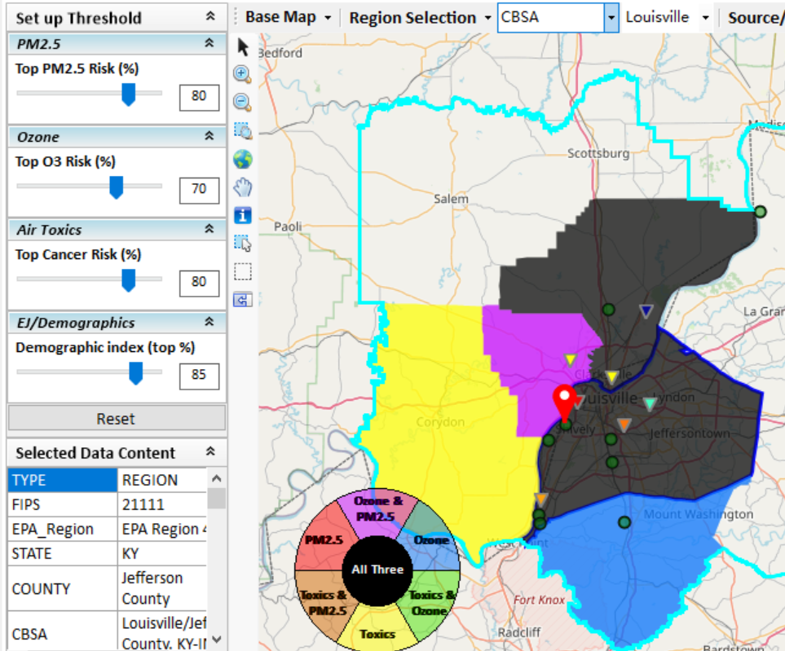
New “Proximity Analysis” Module (under development)
Currently in NEXUS
Proximity Analysis for MP Risks and EJ
County – level (current)
Community (Census Tract) - level
10

Slide 11
“NEXUS 2.0” Live Demo
11

Slide 12
Questions?
12

Slide 13
“NEXUS 2.0”: Quick Tutorial
Appendix
Download “NEXUS” tool: The “NEXUS 2.0” package (“NEXUS 2.0 Setup.exe” & “NEXUS 2.0 Data.exe”: run both “*.exe” files to install) can be downloaded at EPA’s new FTP site:
https://gaftp.epa.gov/aqmg/cjang/NEXUS/NEXUS 2.0/*
Note: Require software installation privilege or “Power Broker” (limited elevated privilege) to install “NEXUS tool” at EPA’s PC; Check “This PC\Documents\My NEXUS files\data\* (\tool\*, \result\*)” to see if NEXUS program & input dataset are installed successfully
13

Slide 14
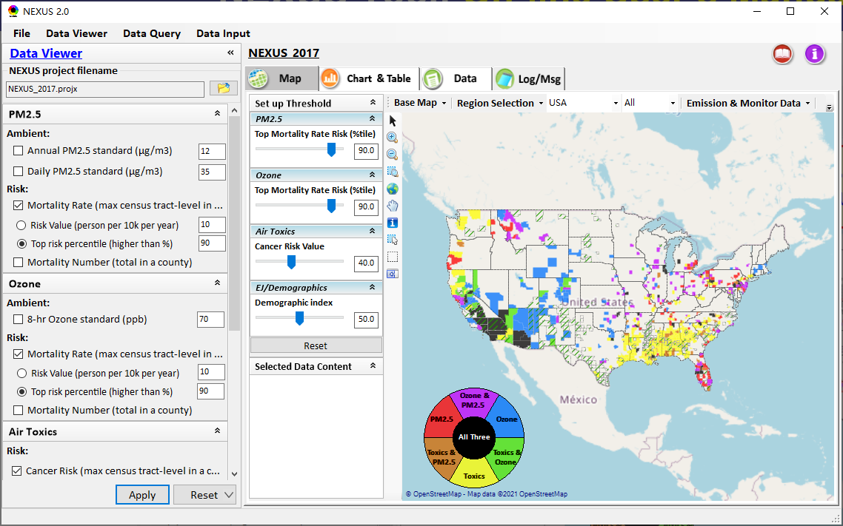
NEXUS Tool: On-line User’s Manual
Click “book” icon to launch “User’s manual”
Hot link to User’s manual’s “Data Viewer” chapter (same for “Data Input” module & “Data Query” model)
14

Slide 15
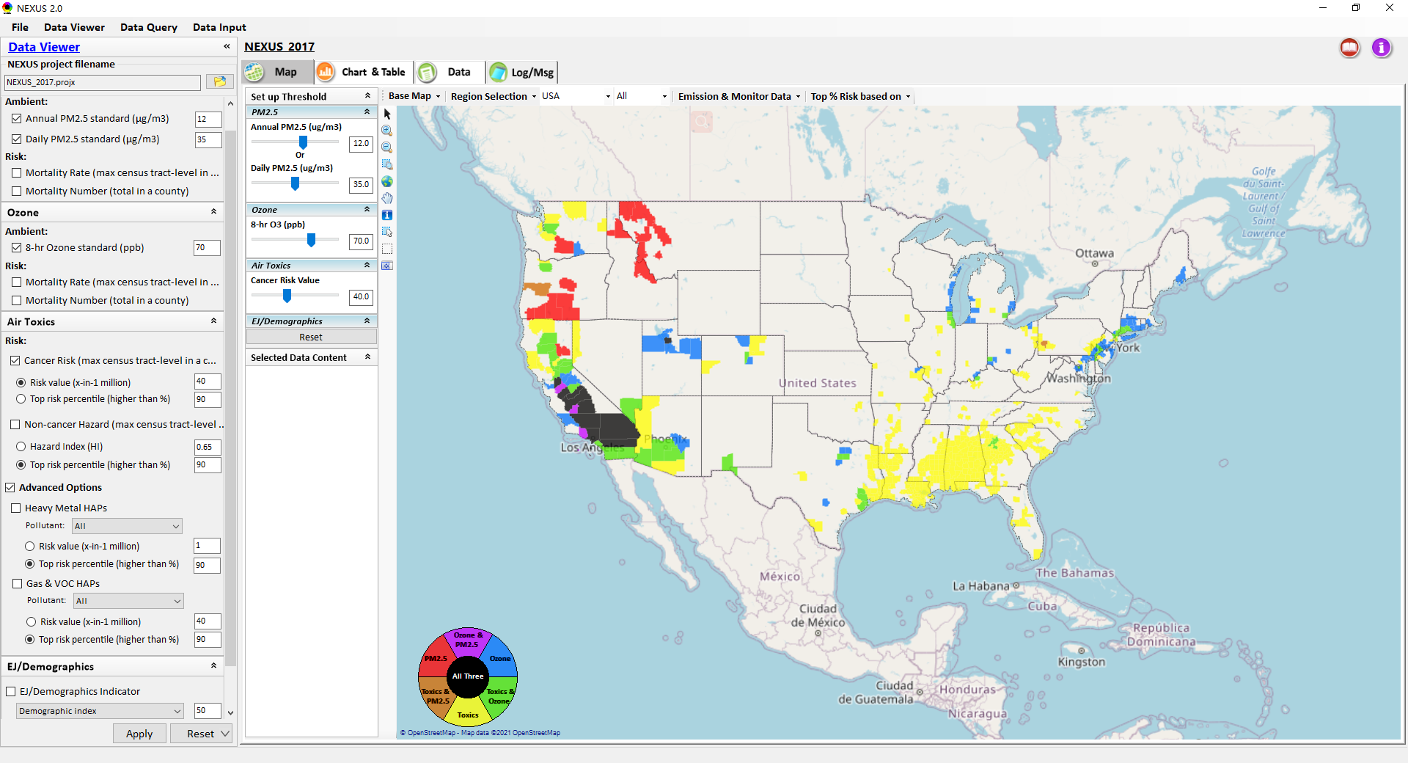
NEXUS Tool: Data Viewer Module
Click “File” to open or save a project
Switch between 3 key modules
NEXUS project file name
Select & adjust “Ambient” or “Risk” levels
“Advanced Option”: provide HAPs & species selections
15

Slide 16
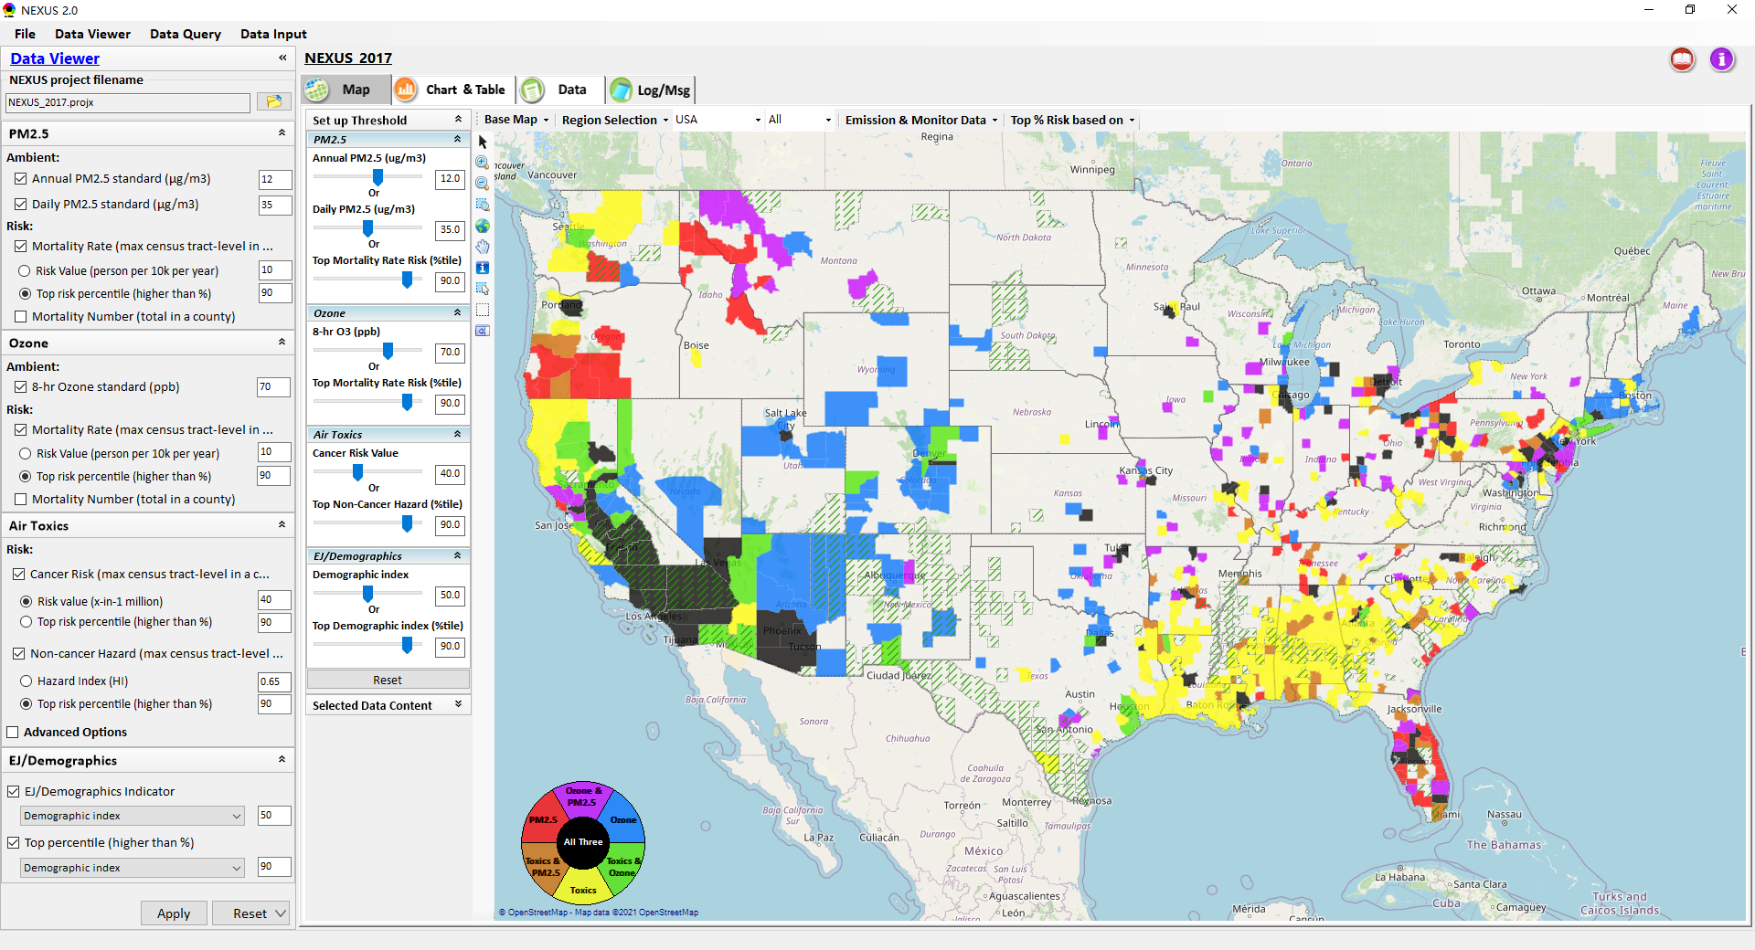
Data Viewer: “Apply” New Selections
“Check” boxes to change/add selections
New selections will appear in “Slider bars” panel and map display
“Slider bars” allow to select & adjust “Ambient” and/or “Risk” threshold levels and displaying color map
“Apply” new selections
16

Slide 17
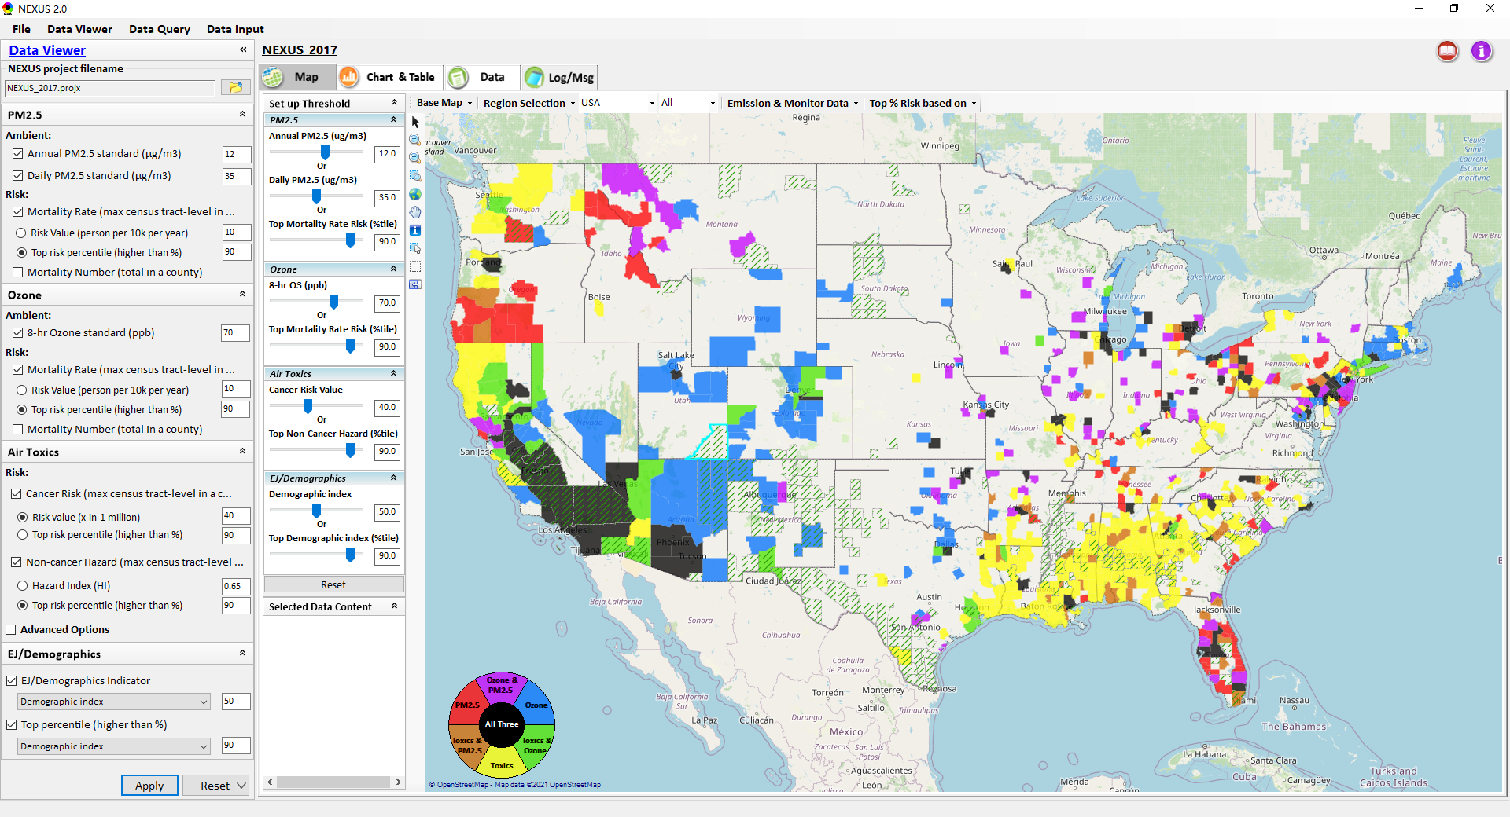
NEXUS Update: New EJ Metric and Data
New EJ/Demographic metric is added to display in “Green dash” for counties exceeding selected threshold
17

Slide 18
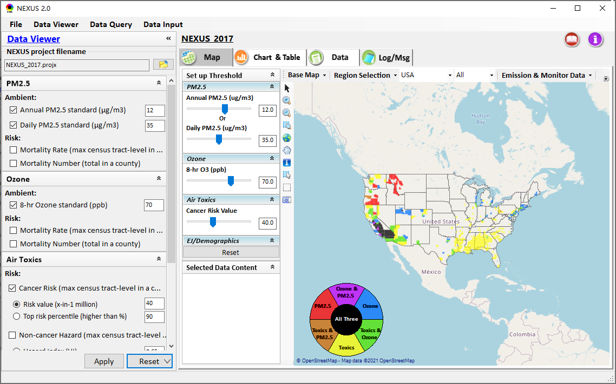
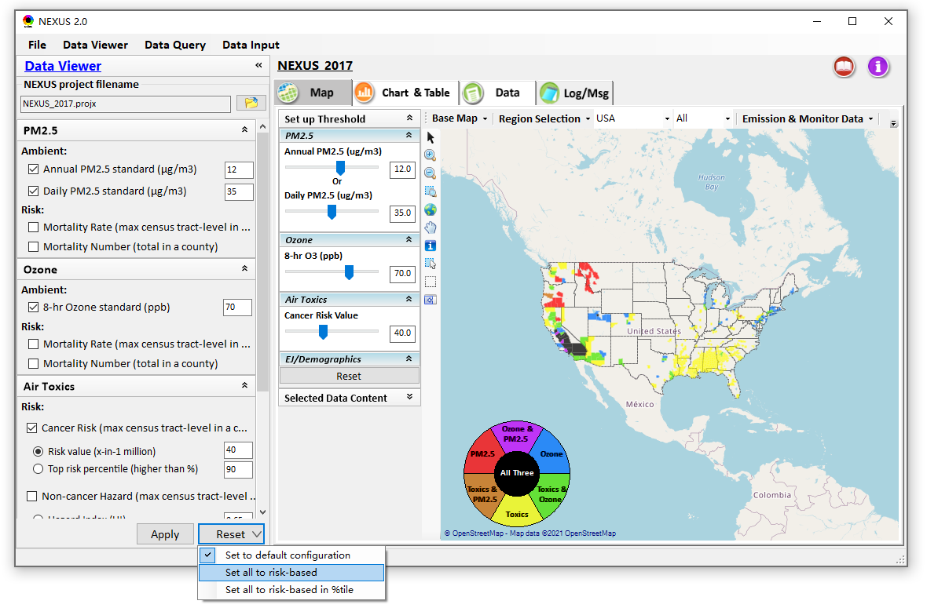
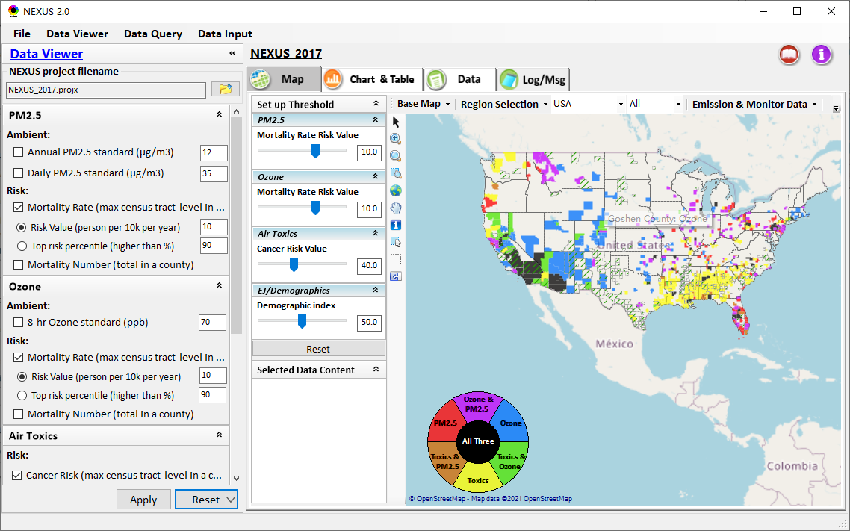
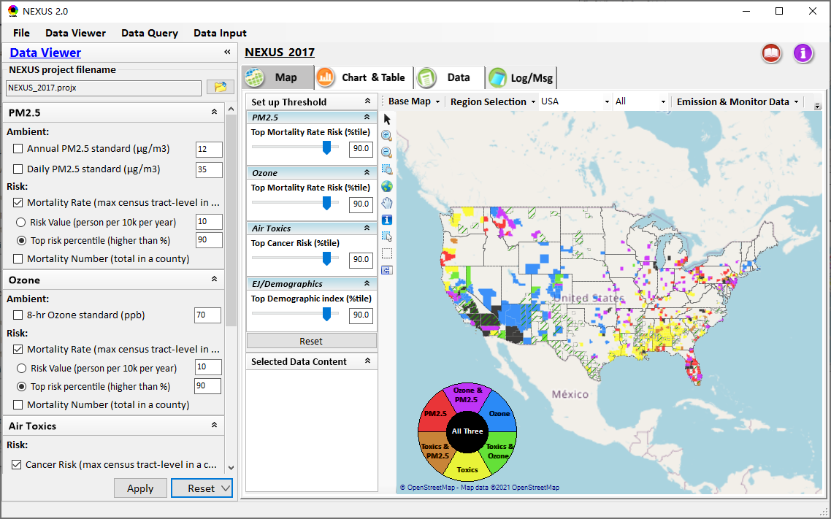
Data Viewer: “Reset” New Selections
default configuration
risk-based
“Reset” new selections
risk-based in %tile
18

Slide 19
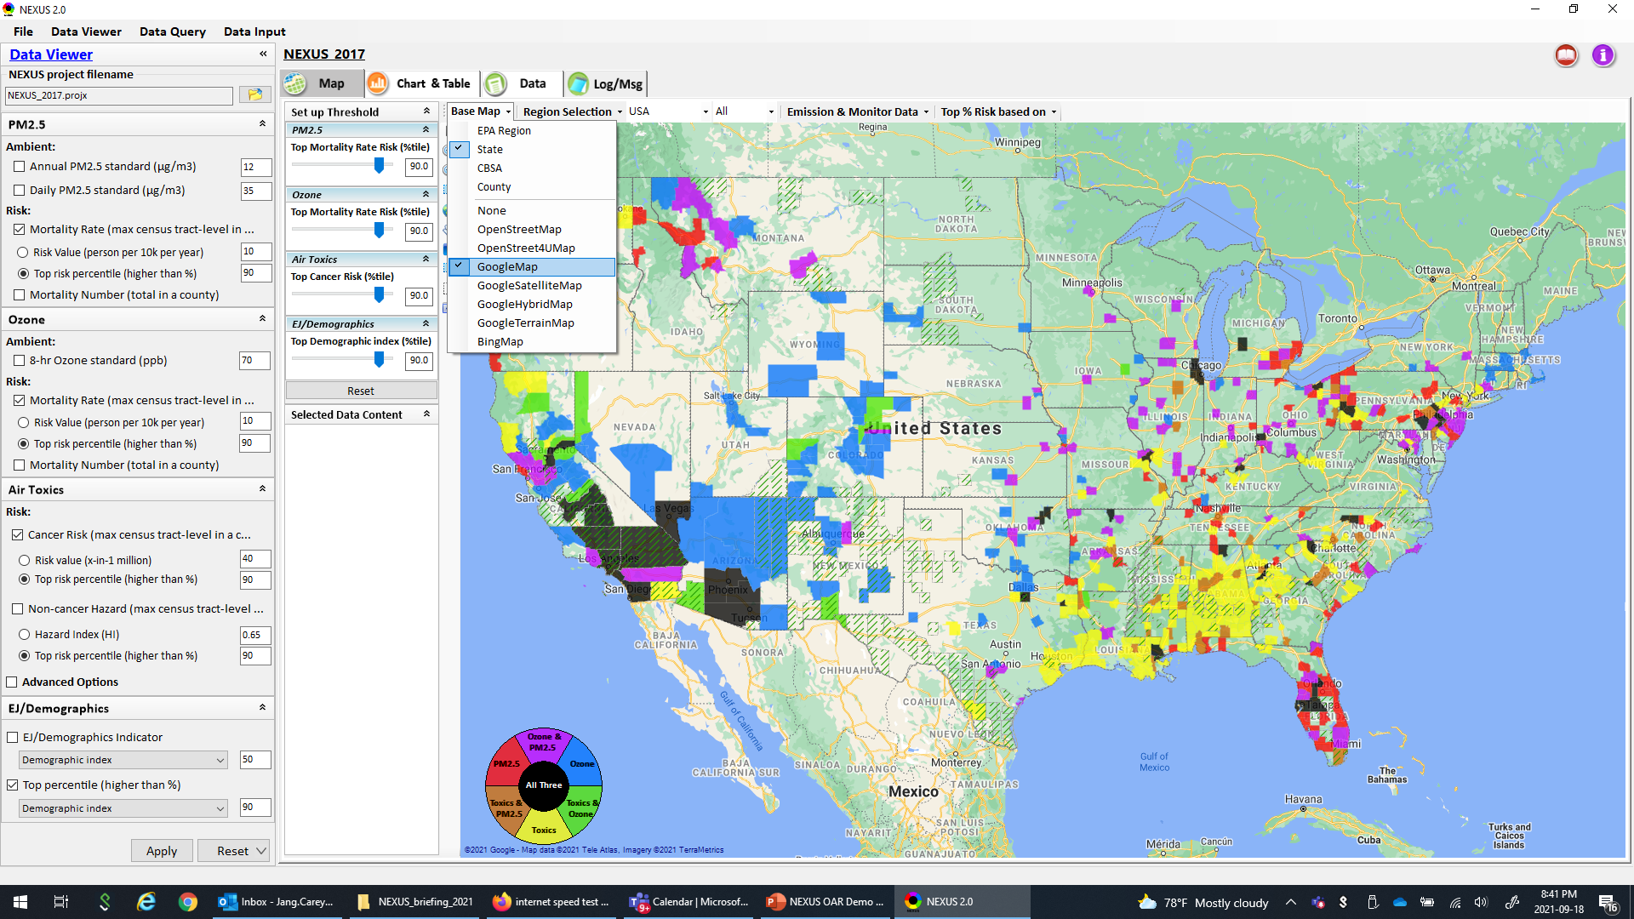
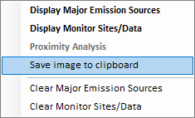
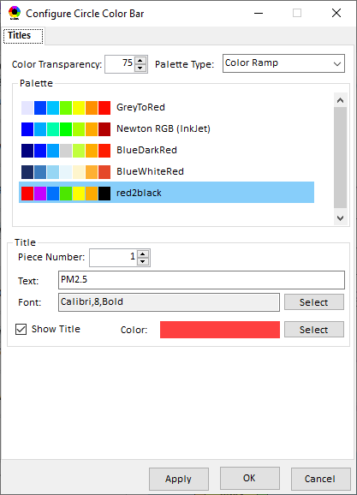
Data Viewer Module: Configure Base Map & Color
“Base Map”: Change boundary lines and background map (e.g., “Google Map”)
“Right-click” map to save map image
Click “color map” to change color & transparency
19

Slide 20
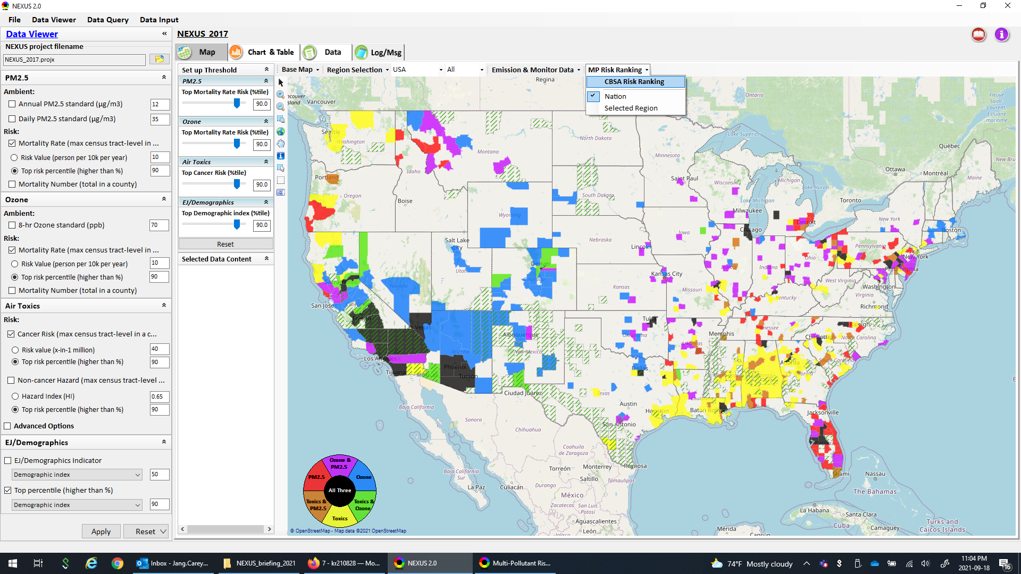
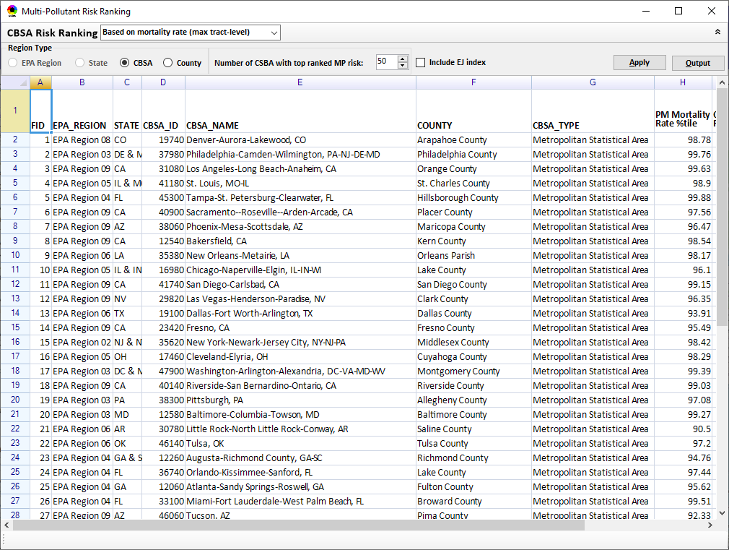
Data Viewer Module: MP Risk Ranking
“CBSA Risk Ranking”: provide MP risk ranking by CBSA or County
20

Slide 21
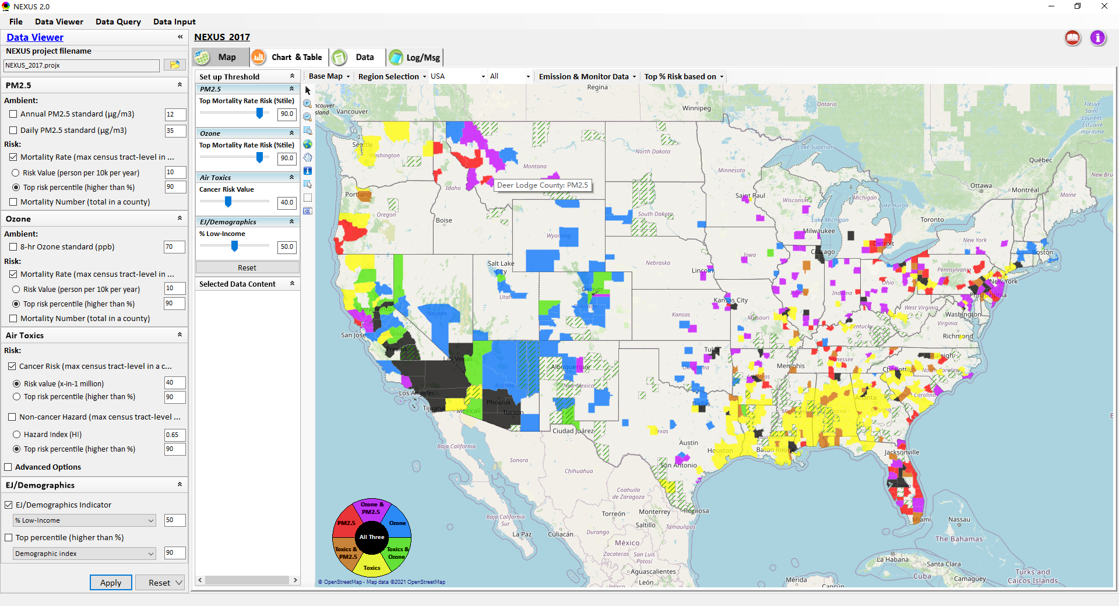
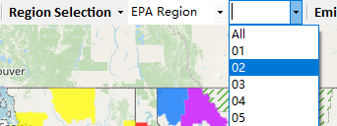
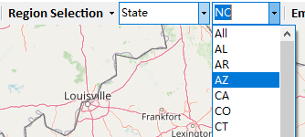
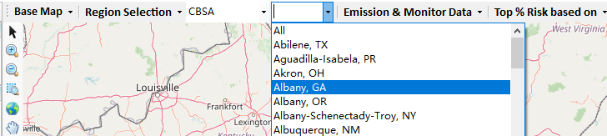
Data Viewer: “Region Selection”
Allow to select “EPA regions”, “States”, or “CBSA”
21

Slide 22
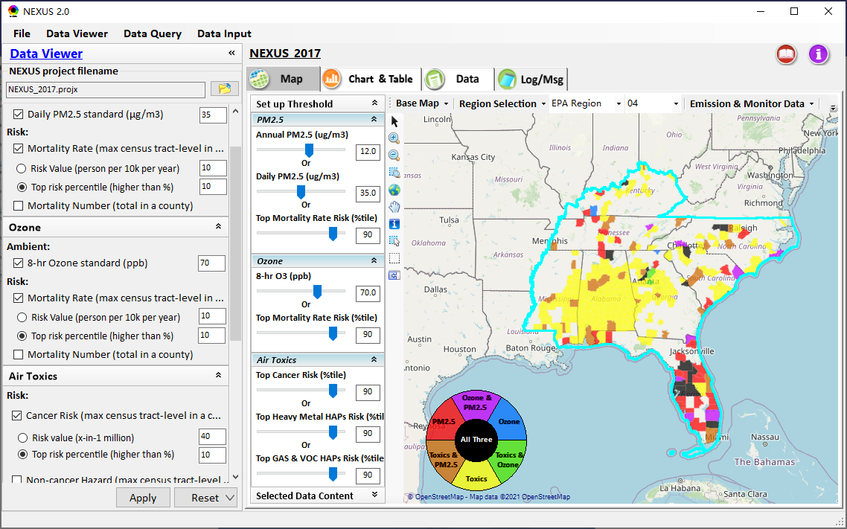
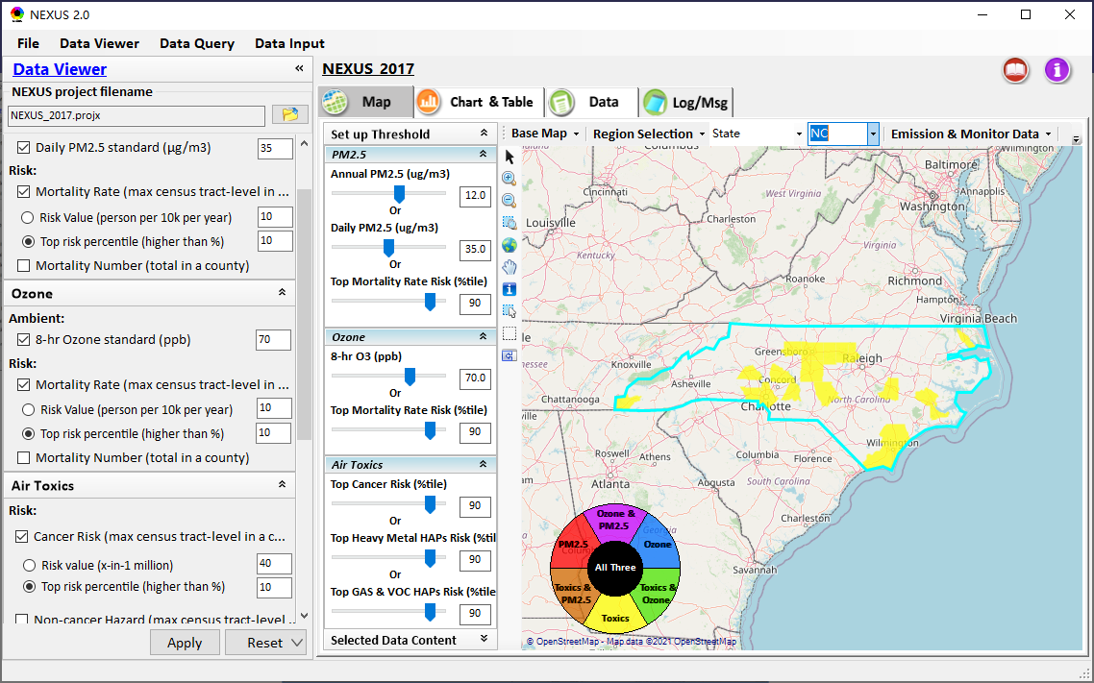
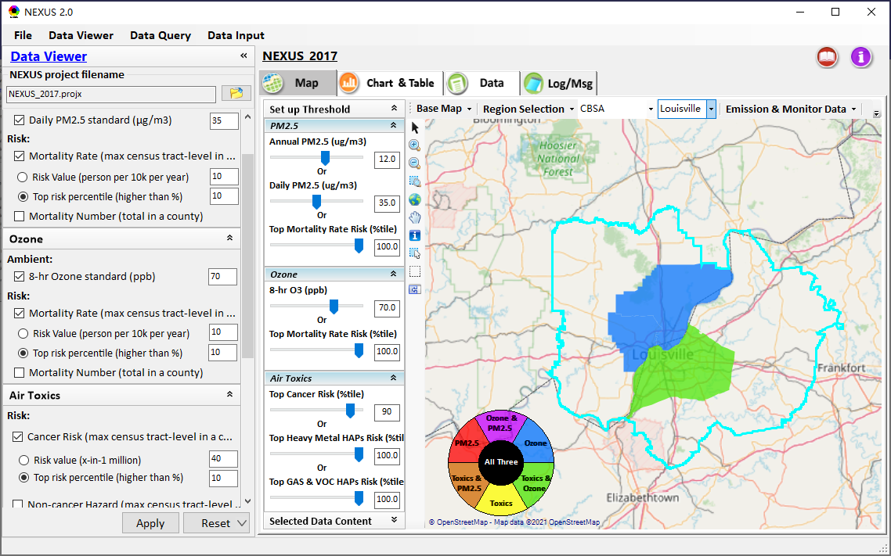
Data Viewer: Select EPA Region/State/CBSA
Examples:
EPA Region 4
NC State
Louisville CBSA
22

Slide 23
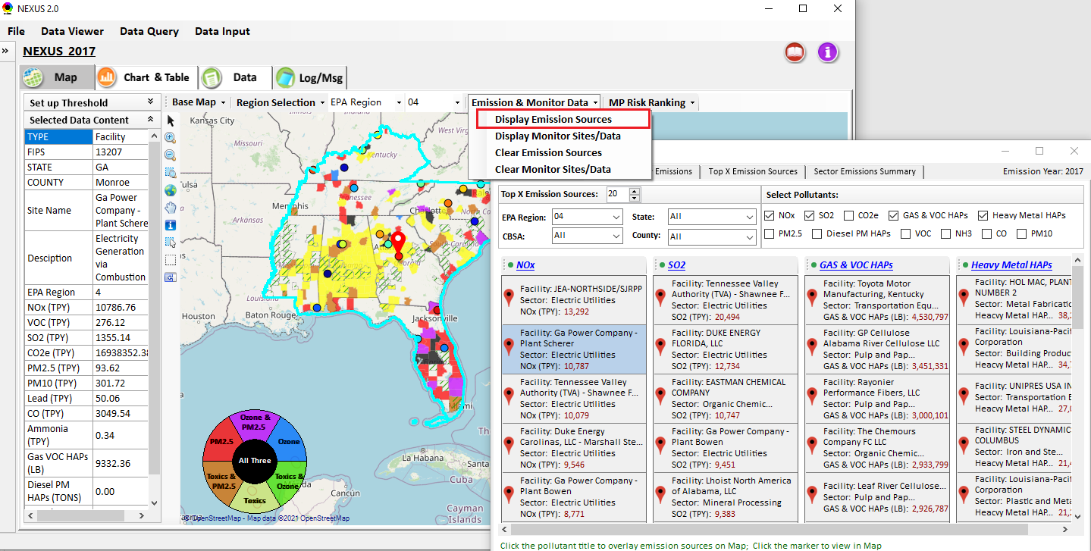
Data Viewer: Major Emission Sources
Click “Display Emission Sources” tab to display emission sources and launch new window
Click any “facility” to link & display source location and emission information. Same facility emitting various pollutants can be easily identified with the highlighted color
23

Slide 24
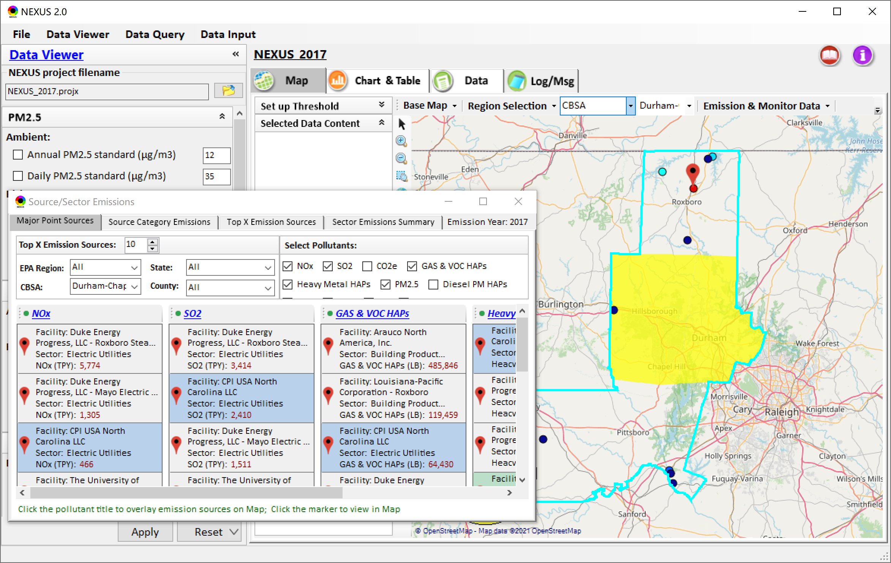
Data Viewer: Major Emission Sources
Allow to scroll down to CBSA-level (e.g., Durham CH CBSA ) or County-level
Durham CH CBSA
24

Slide 25
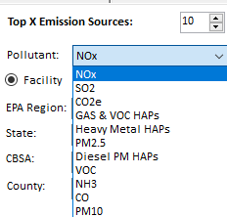
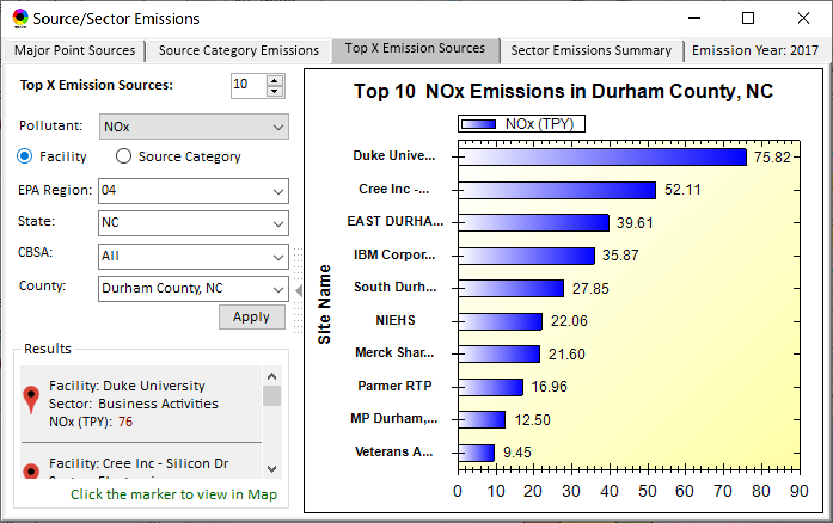
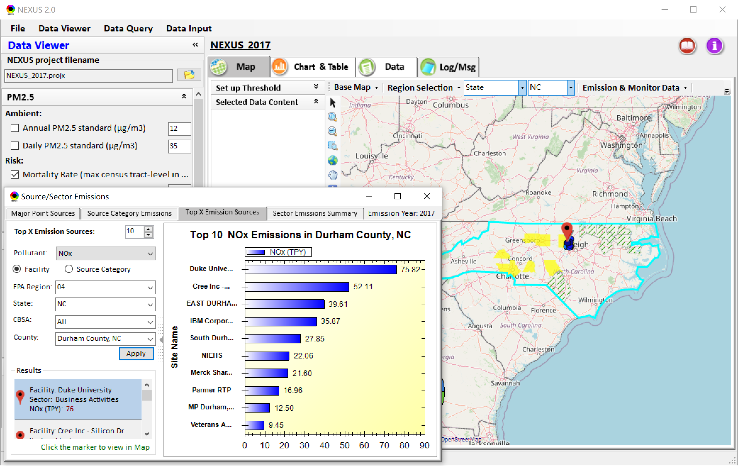
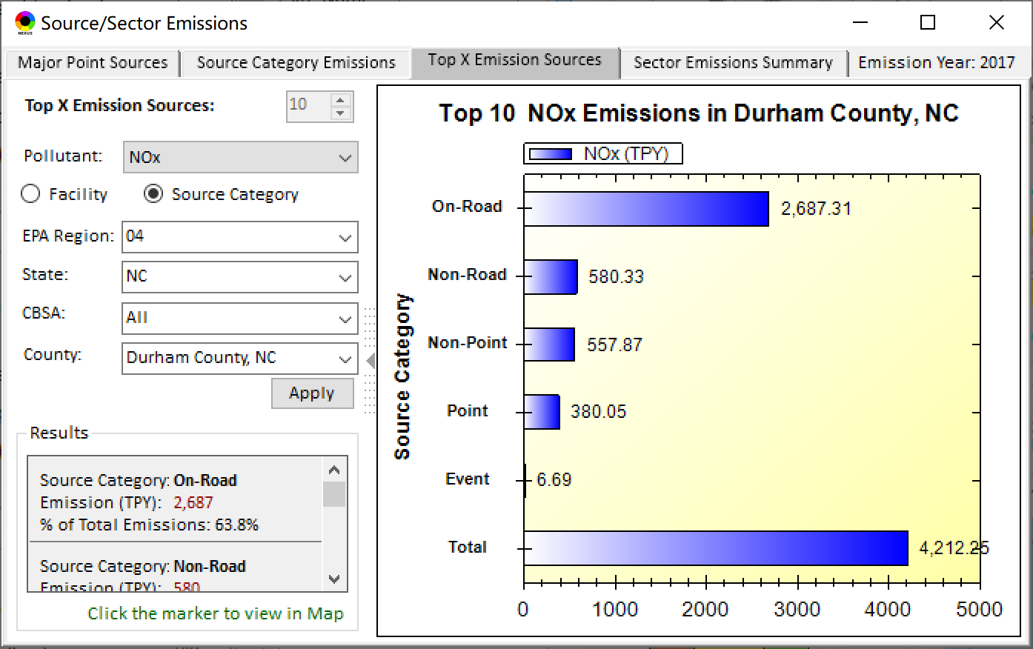
Data Viewer: Top “x” Emission Sources
Provide selection of Facility & Source Category
Provide selection of Facility & Source Category
Durham county, NC
25

Slide 26
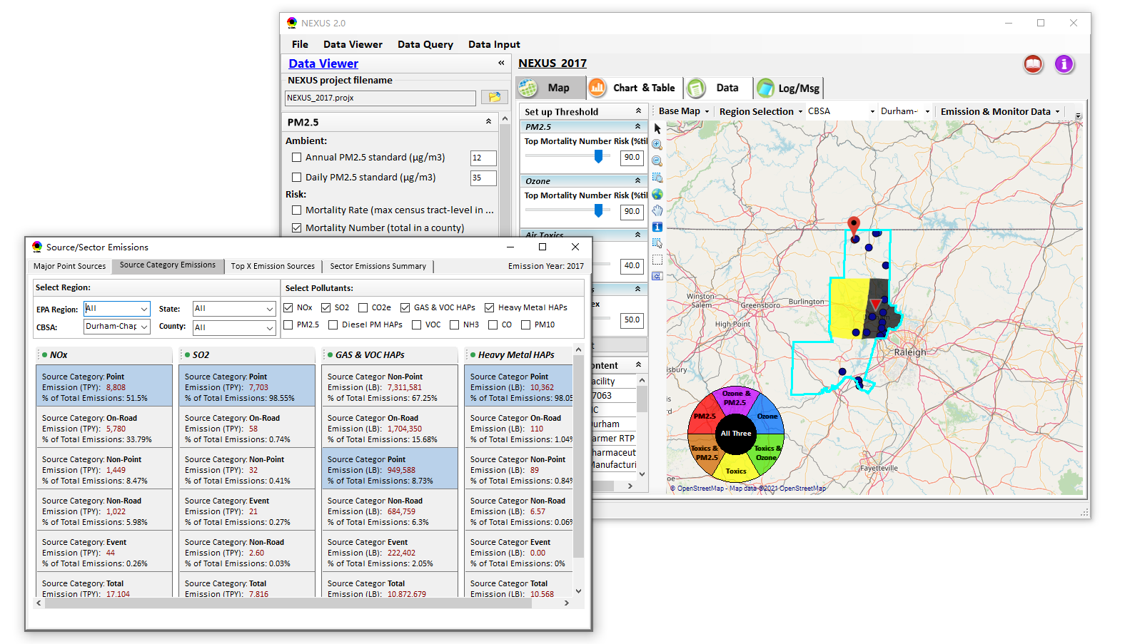
NEXUS Update: “Source Category Emissions”
“Source Category Emissions” module provide five source categories, including “point”, “non-point”, “on-road”, “non-road”, and “event” emissions for the selected region, CBSA, or county.
26

Slide 27
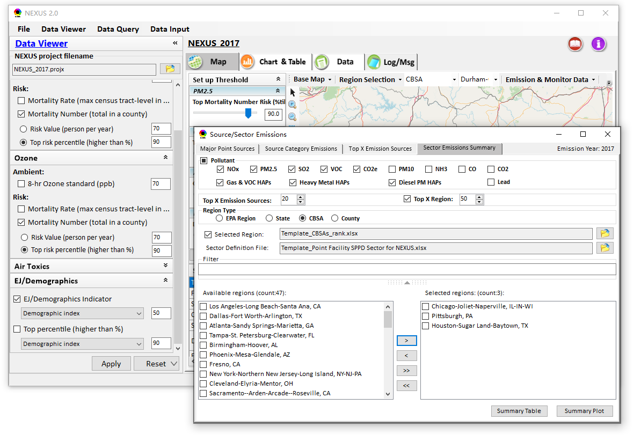
NEXUS Update: “Sector Emissions Summary”
“Sector Emission Summary” function allow to select major CBSAs and provides source and sector emissions summary to support OAQPS’s “Sector Prioritization” project effort
27

Slide 28
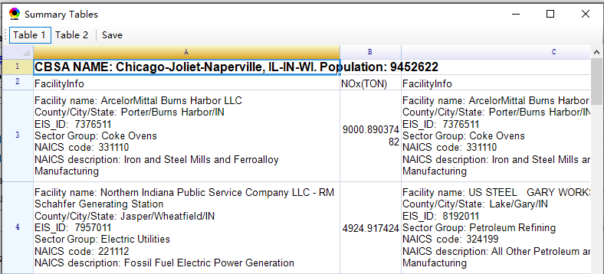
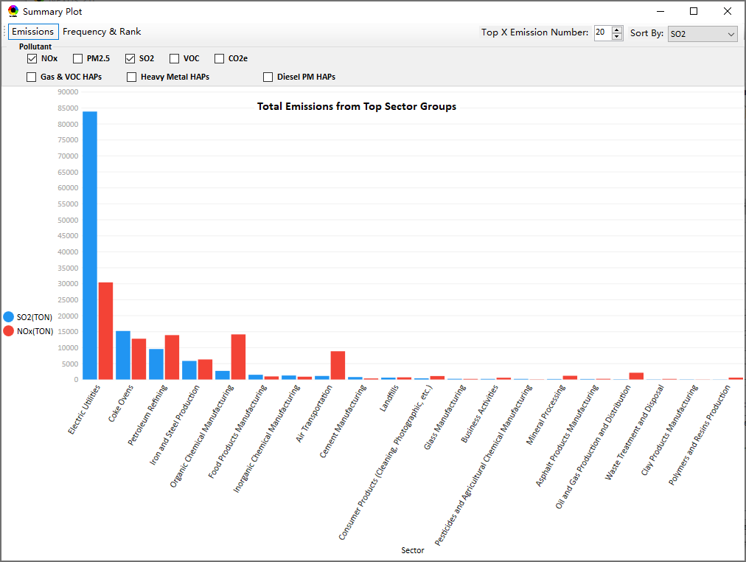
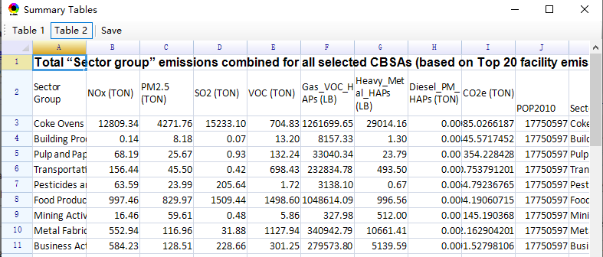
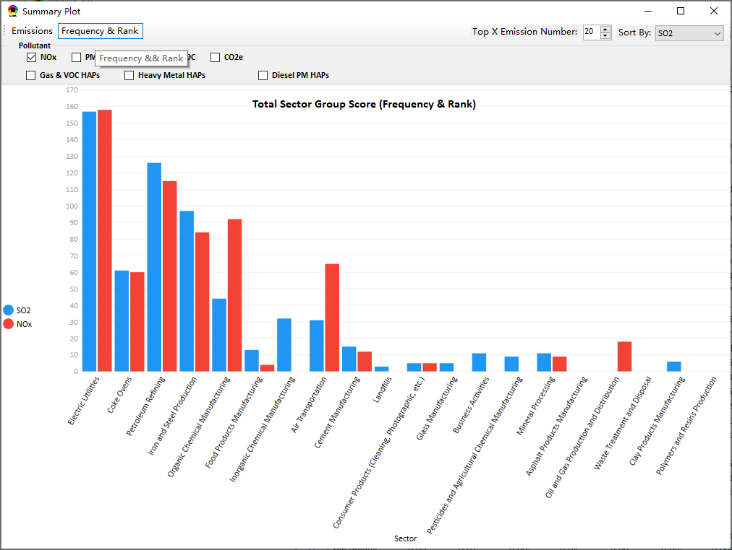
NEXUS Update: “Sector Emissions Summary”
Summary table
Summary plot
Emissions
Frequency & Rank
28

Slide 29
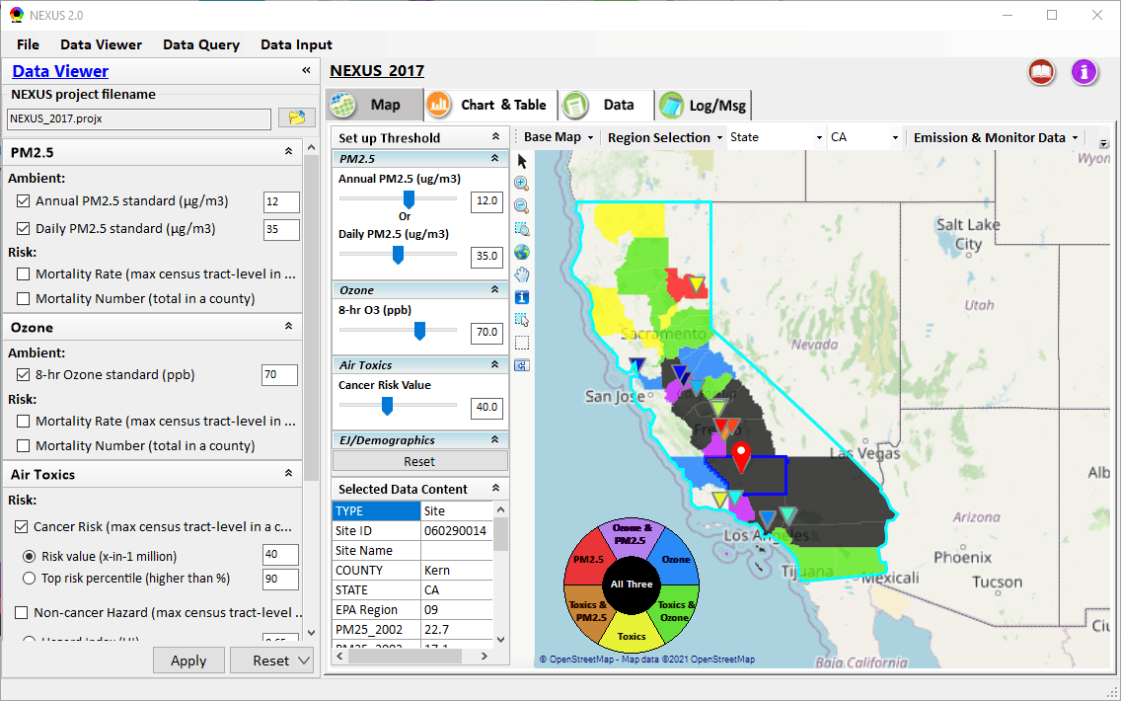
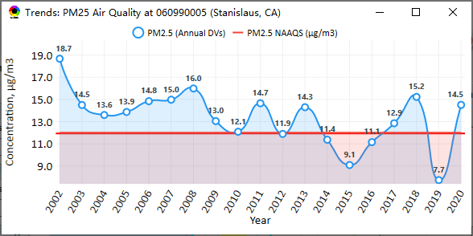
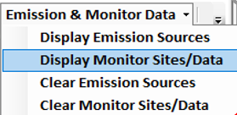
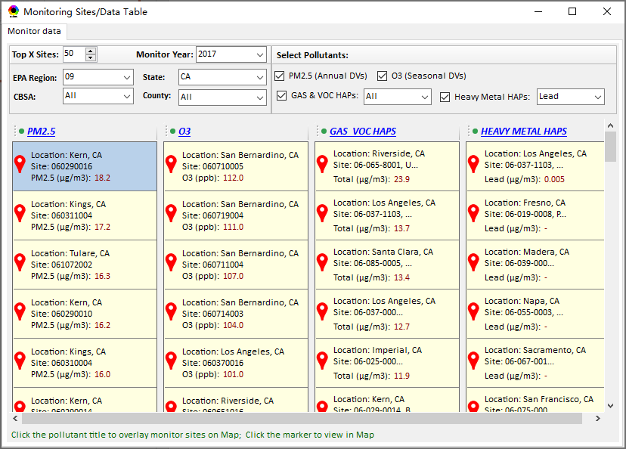
NEXUS Update: “Monitoring Data/Site” Module
AQ trend
Right-click to invoke
Click to display
AQ trend at monitor site
Monitor Site/Data
Click to select monitor site
& pollutant
29

Slide 30
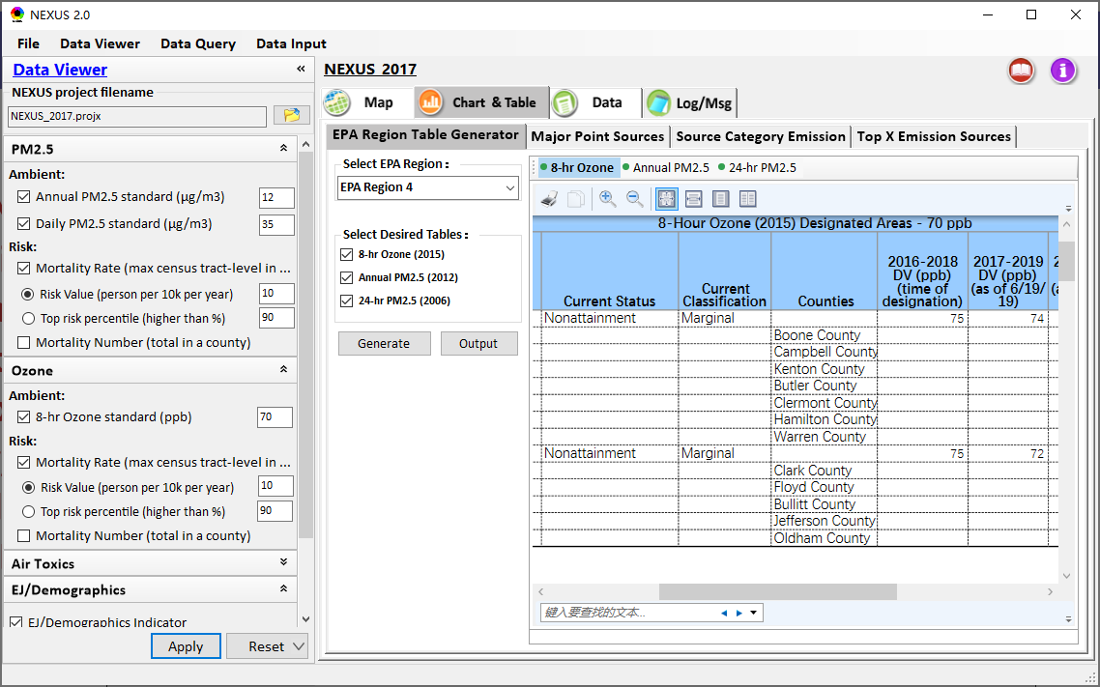
Data Viewer: EPA Region Table Generator
“EPA Region Table Generator” provides attainment status of O3 and PM2.5 and their DVs; also allows to select any EPA region based on data updated to 2020.
30

Slide 31

Data Viewer: Data Search & Filter
Click “+” to add filters; Click “x” to remove current filter;
Click “Output data…” to output current page records or all records
Show specified records per page.
31

Slide 32

Data Input Module: Data Preview
“Transparency” & “Open-Source”:
All NEXUS input/output data files are available under:
“This PC\Documents\My NEXUS files\Data (\Result)”
Check to use filter to query data
Select a table to view if there are multiple tables in the selected data source file
Click to change input data file
Click to view data
Click to run & save project
32

Slide 33

Data Query Module: Overlaying Map
Region Selection
Data Query Configuration
Data Query qualifier selection
Overlaying Map selection
33

Slide 34

Data Query Module: Configure Data Query
“Data Query Filter” allows to select “qualifiers” for query
“Data Query Preview” displays the selected “qualifiers” at the same time
34

Slide 35

Data Query Module: Attribute Table
Filter/search/export functions
Detachable “Attribute Table”
35

Slide 36


Data Query Module: Attribute Table
Click a “record” to link and display its location & info.
36

Slide 37
Quick Tutorial Slides
End
37

