Slide 1
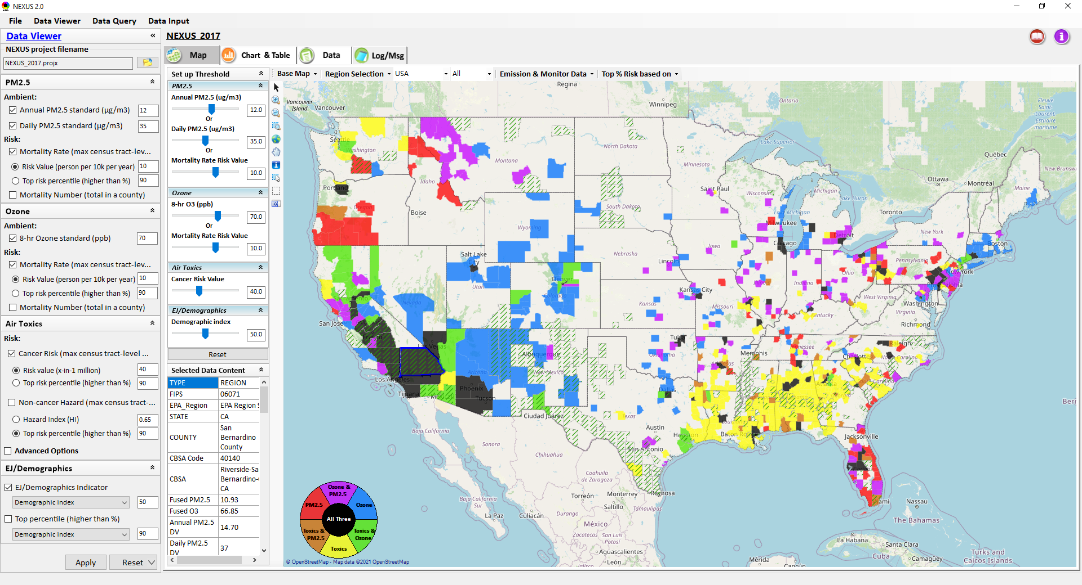
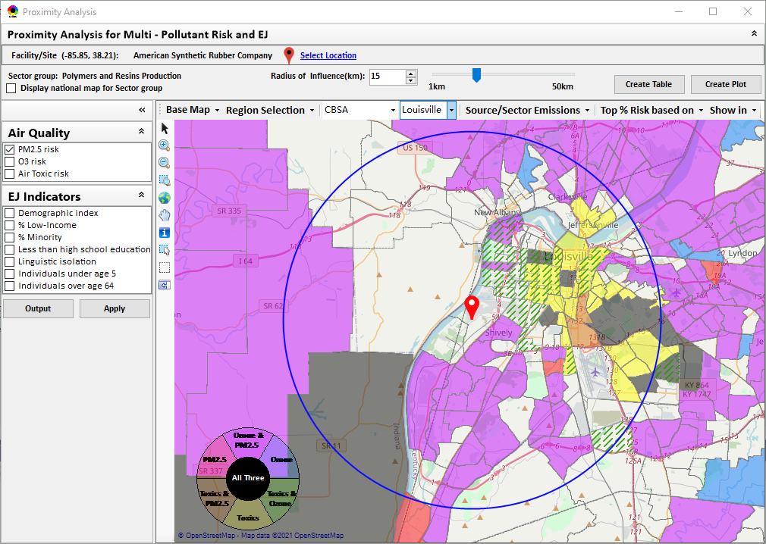
“NEXUS” Multi-Pollutant Advanced Screening Tool EJ in Rulemaking Community of Practice
Data Viewer: National/Regional Level
Proximity Analysis: Community Level
Beth Landis, HEID/Climate, International, & Multi-Media Group
Carey Jang, AQAD/Air Quality Modeling Group
7/21/22
1

Slide 2
Multi-Pollutant Team Members
HEID
Beth Landis / Kimber Scavo
Matt Woody / Kelly Rimer
Robin Langdon / Darryl Weatherhead
Sara Terry
Carrie Wheeler
Rob Pinder
Chris Davis
Conor Mulderrig
Kayla McCauley
OID
Amanda Kaufman
James Payne
Loren Fox
AQAD
Carey Jang / Tyler Fox
Jim Kelly
Shannon Koplitz
Joe Mangino
Jeanette Reyes
AQPD
Rich Damberg / Megan Brachtl
Mia South
SPPD
Lisa Conner
2

Slide 3
NEXUS: Overview
“NEXUS” is an advanced screening tool for multi-pollutant (MP) risks and EJ/Demographic analysis developed by OAQPS’s MP team
“NEXUS” integrates a suite of MP data, including emissions, monitoring, modeling, fused AQ data and health risk data for PM_{2.5}, O₃ & air toxics as well as EJ/demographic data, into one single platform to allow national and areal overlay mapping & analysis of MP ambient & risk data
“NEXUS” provides MP analysis across from national level “Phase 1” to regional (EPA region/State/CBSA) level “Phase 2”, and now down to community level “Phase 3” (Proximity analysis” in census tract-level)
We expect to use this tool in conjunction with Regions and identify areas that would potentially benefit most from MP approaches to reduce emissions (including current NA areas)
We also expect that it can have additional value-added uses across the Office for Air Toxics, Environmental Justice and other programs
The NEXUS tool will essentially provide a ‘conceptual model’ of an area’s MP issues to facilitate engagement with state/local/tribal agencies & community stakeholder groups
3

Slide 4
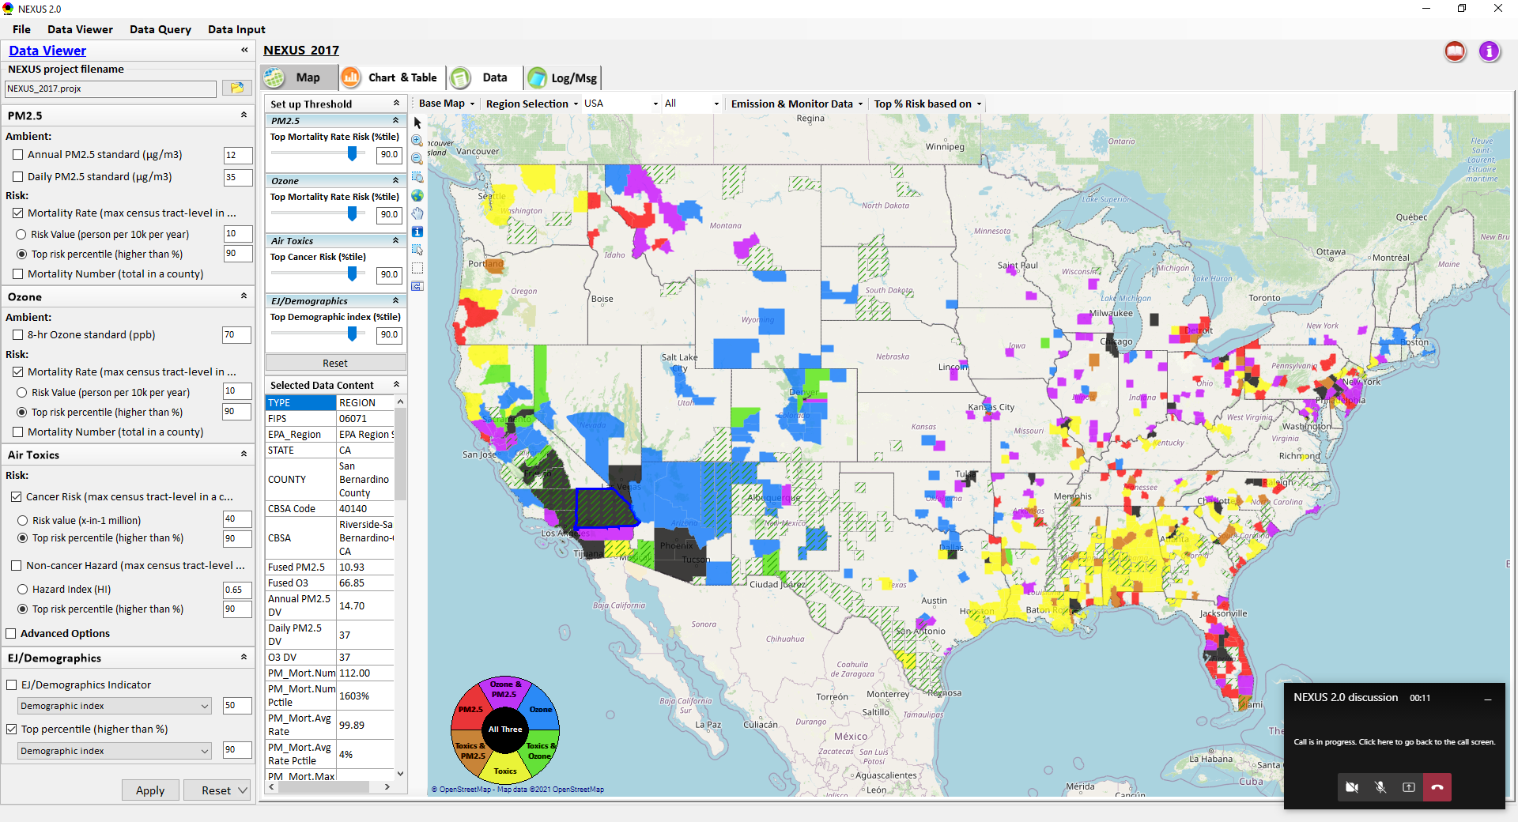
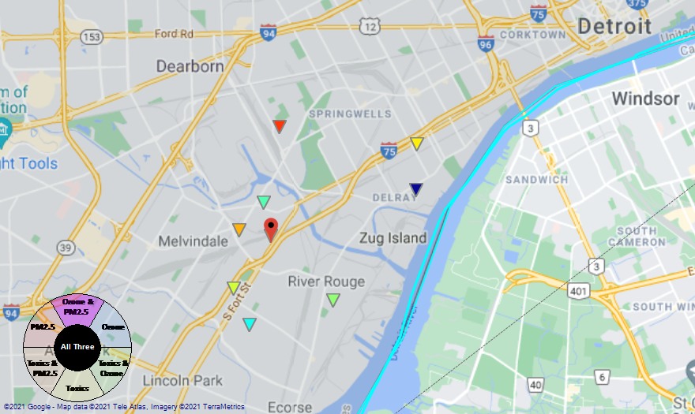
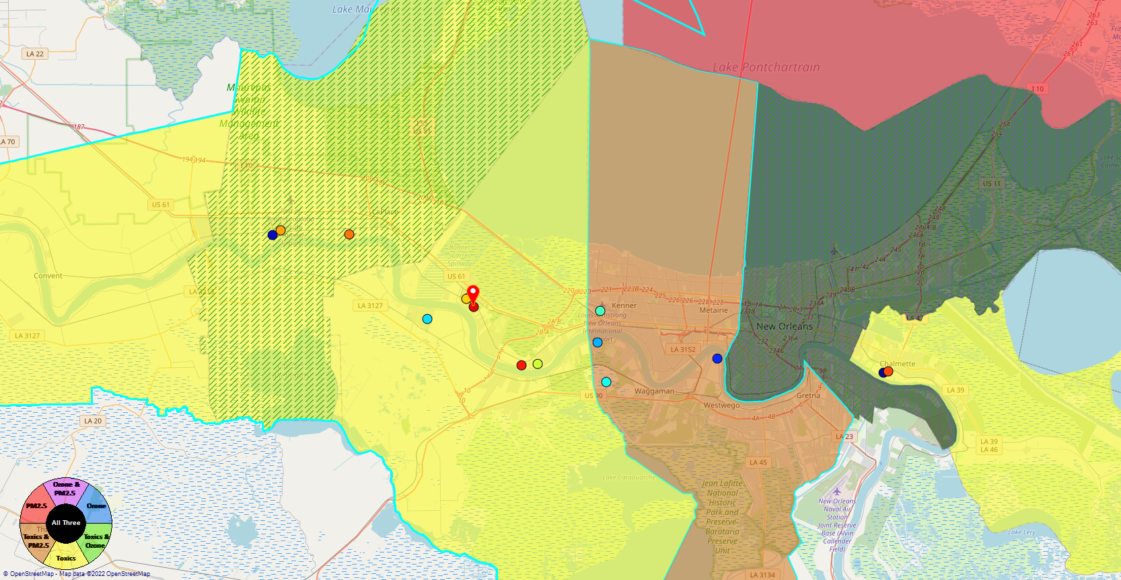
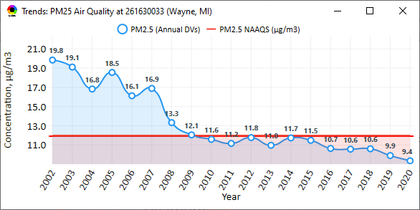
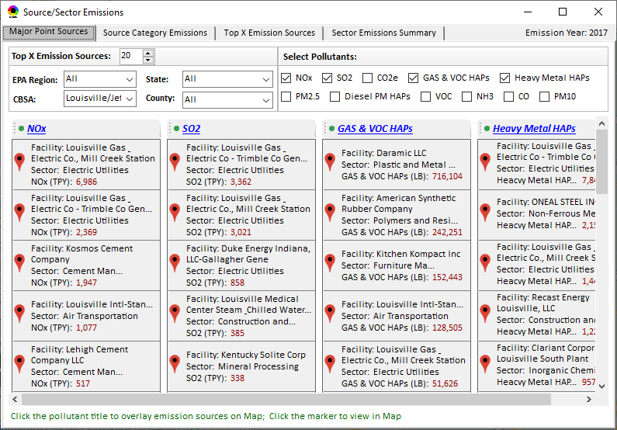
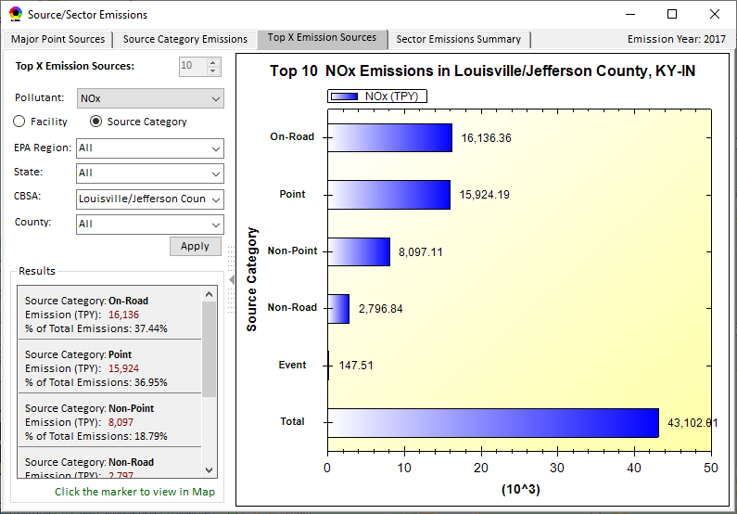
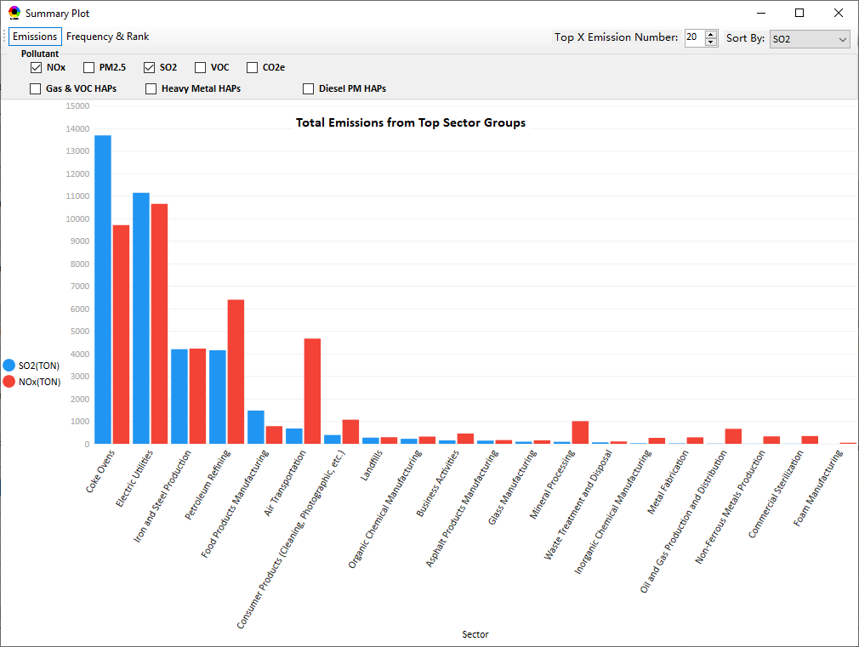
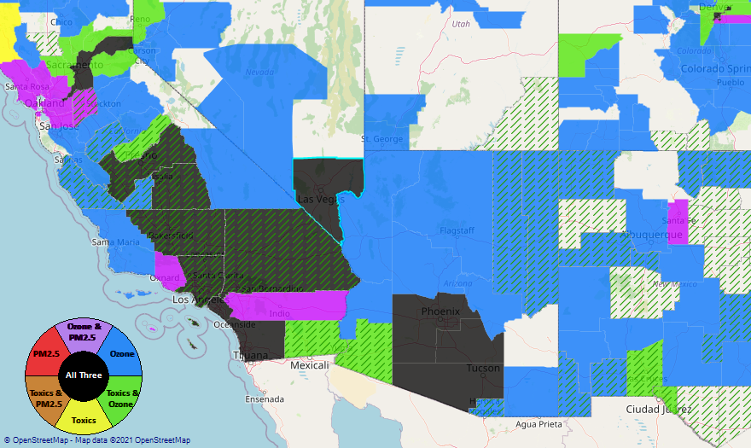
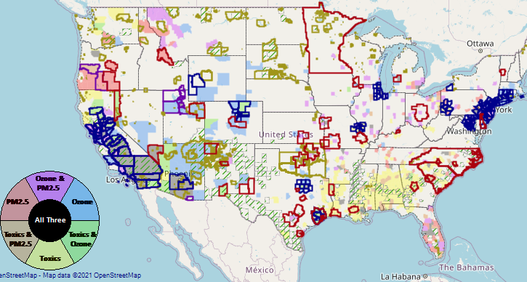
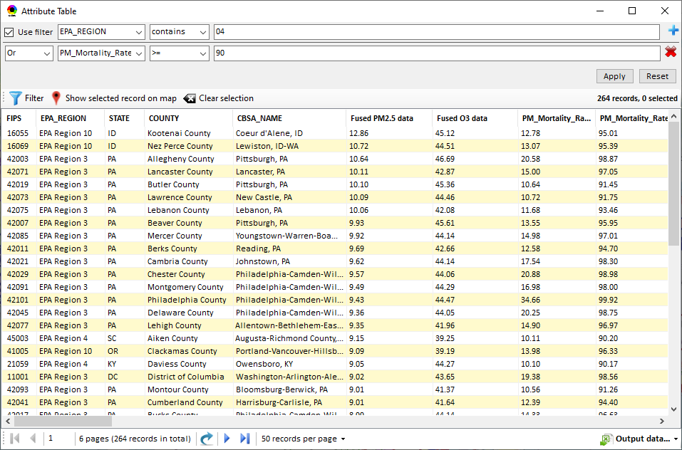
NEXUS: Data Inputs and Major Functions
O₃ & PM_{2.5}
Ambient/Design Value
(2012-2020)
(County-level)
Multi-Pollutant
Ambient and/or Risk National & Areal Mapping
Display Monitoring Sites & Trend Data
O₃, PM_{2.5} & Air Toxics Risk Data &
Conc. (fused AQ) Data
(2017 & 2014)
(Census tract-level)
Display Major Point Emissions Sites/Data
Provide Source Category Emissions
NEXUS
O₃, PM_{2.5} & Air Toxics Monitoring Data
(2002-2020 & -2018)
Provide Sector Emissions Summary
NEI County &
Facility Emissions
(2017 & 2014)
Include EJ/Demographic Indicators
Map Overlay with NAA, Advance Area, Class-I Area, or Tribal Area
Environmental Justice & Demographic Data
(from EJSCREEN)
Data Query, Search, Filter & Export
Advance Area
Class-I Area
Tribal Area
Proximity Screening Analysis
4

Slide 5
“NEXUS 3.2” Live Demo
5

