Slide 1
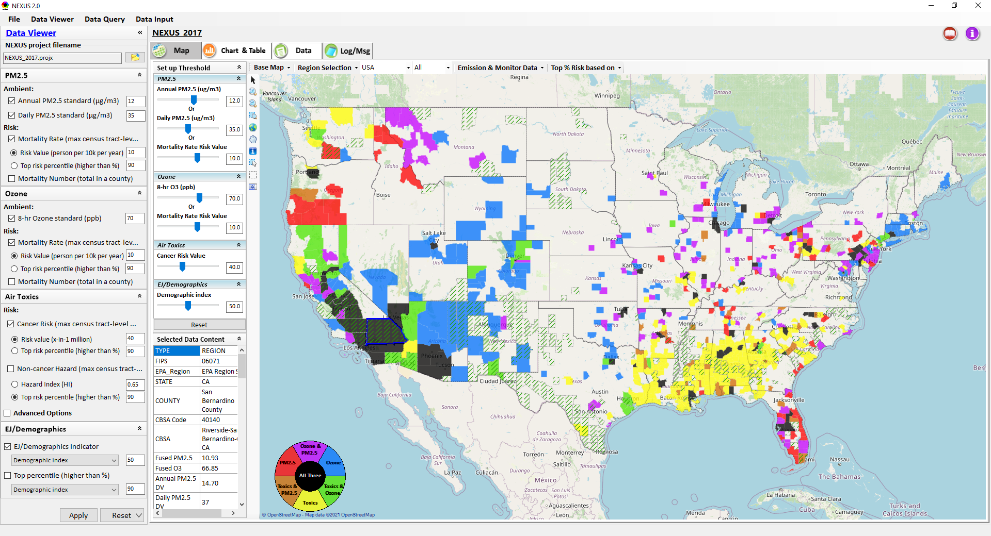
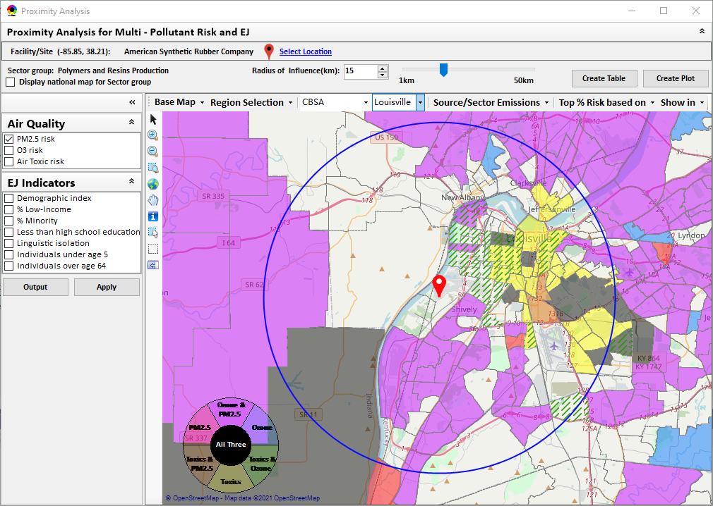
“NEXUS” Multi-Pollutant Advanced Screening Tool OAP/OTAQ/OAQPS Briefing
Data Viewer: National/Regional Level
Proximity Analysis: Community Level
Beth Landis, HEID/Climate, International, & Multi-Media Group
Carey Jang, AQAD/Air Quality Modeling Group
1/3/23
1

Slide 2
Multi-Pollutant Team Members
HEID
Beth Landis / Kimber Scavo
Matt Woody / Kelly Rimer
Robin Langdon / Darryl Weatherhead
Sara Terry
Carrie Wheeler
Rob Pinder
Chris Davis
Conor Mulderrig
Kayla McCauley
OID
Amanda Kaufman
James Payne
Loren Fox
AQAD
Carey Jang / Tyler Fox
Jim Kelly
Shannon Koplitz
Joe Mangino
Jeanette Reyes
AQPD
Rich Damberg / Megan Brachtl
Mia South
SPPD
Lisa Conner
2

Slide 3
Overview
Multi-Pollutant (MP) Background
NEXUS 3.3
Overview
Mobile Sources
Climate
Data Inputs and Major Functions
Current and Potential Uses
Examples
Briefings/Demos
Feedback
Next Steps
Live Demo
3

Slide 4
Multi-Pollutant Background
Support a comprehensive, MP treatment of air quality problems to effectively improve air quality and make the most efficient use of available resources
Primary Goal - identify & evaluate local control strategies targeting emissions of O₃ & PM_{2.5} and their precursors while at the same time reducing Air Toxics of concern for communities to maximize both health benefits and air quality improvements
MP planning has the potential to reduce the costs and increase benefits associated with air quality management (AQM)
Supports S/L/T air agencies in developing MP, risk-based AQM plans and implementing strategies that reduce air pollution emissions & improve public health
Success has been demonstrated in Detroit and SC; another project is currently underway in Louisville, KY
Tools needed to analyze MP data are either available currently or being developed in OAQPS (e.g., NEXUS)
4

Slide 5
NEXUS: Overview
“NEXUS” is an advanced screening tool for multi-pollutant (MP) risks and EJ/Demographic analysis developed by OAQPS’s MP team
“NEXUS” integrates a suite of MP data, including emissions, monitoring, modeling, fused AQ data and health risk data for PM_{2.5}, O₃ & air toxics as well as EJ/demographic data, into one single platform to allow national and areal overlay mapping & analysis of MP ambient & risk data
“NEXUS” provides MP analysis across from national level “Phase 1” to regional (EPA region/State/CBSA) level “Phase 2”, and now down to community level “Phase 3” (Proximity analysis” in census tract-level)
We expect to use this tool in conjunction with Regions and identify areas that would potentially benefit most from MP approaches to reduce emissions (including current NA areas)
We also expect that it can have additional value-added uses across the Office for Air Toxics, Environmental Justice and other programs, including IRA
The NEXUS tool will essentially provide a ‘conceptual model’ of an area’s MP issues to facilitate engagement with state/local/tribal agencies & community stakeholder groups
5

Slide 6
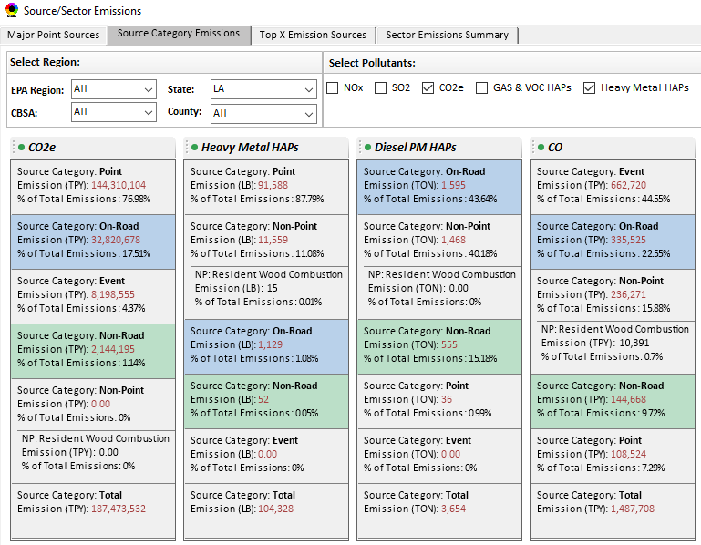
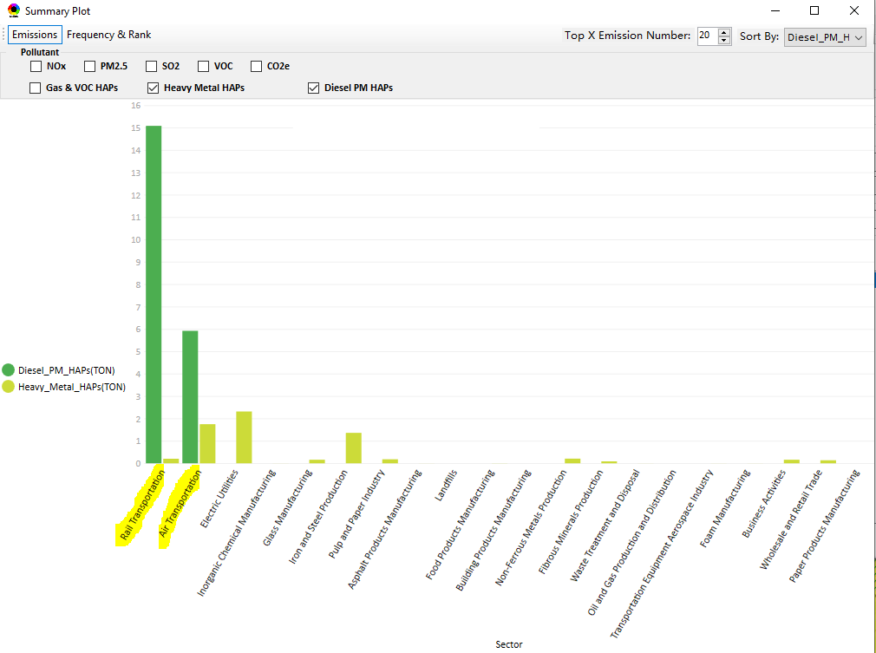
NEXUS: Mobile Sources
NEXUS was developed as an air quality planning tool with a focus on stationary sources
NEXUS accounts for mobile contributions per emissions and air quality concentrations
However, NEXUS not equipped to answer mobile specific questions
Most SLTs have limited ability to address these sources
Recognize OTAQ has mobile centric tools
Total Emissions from Top Sector Groups
6

Slide 7
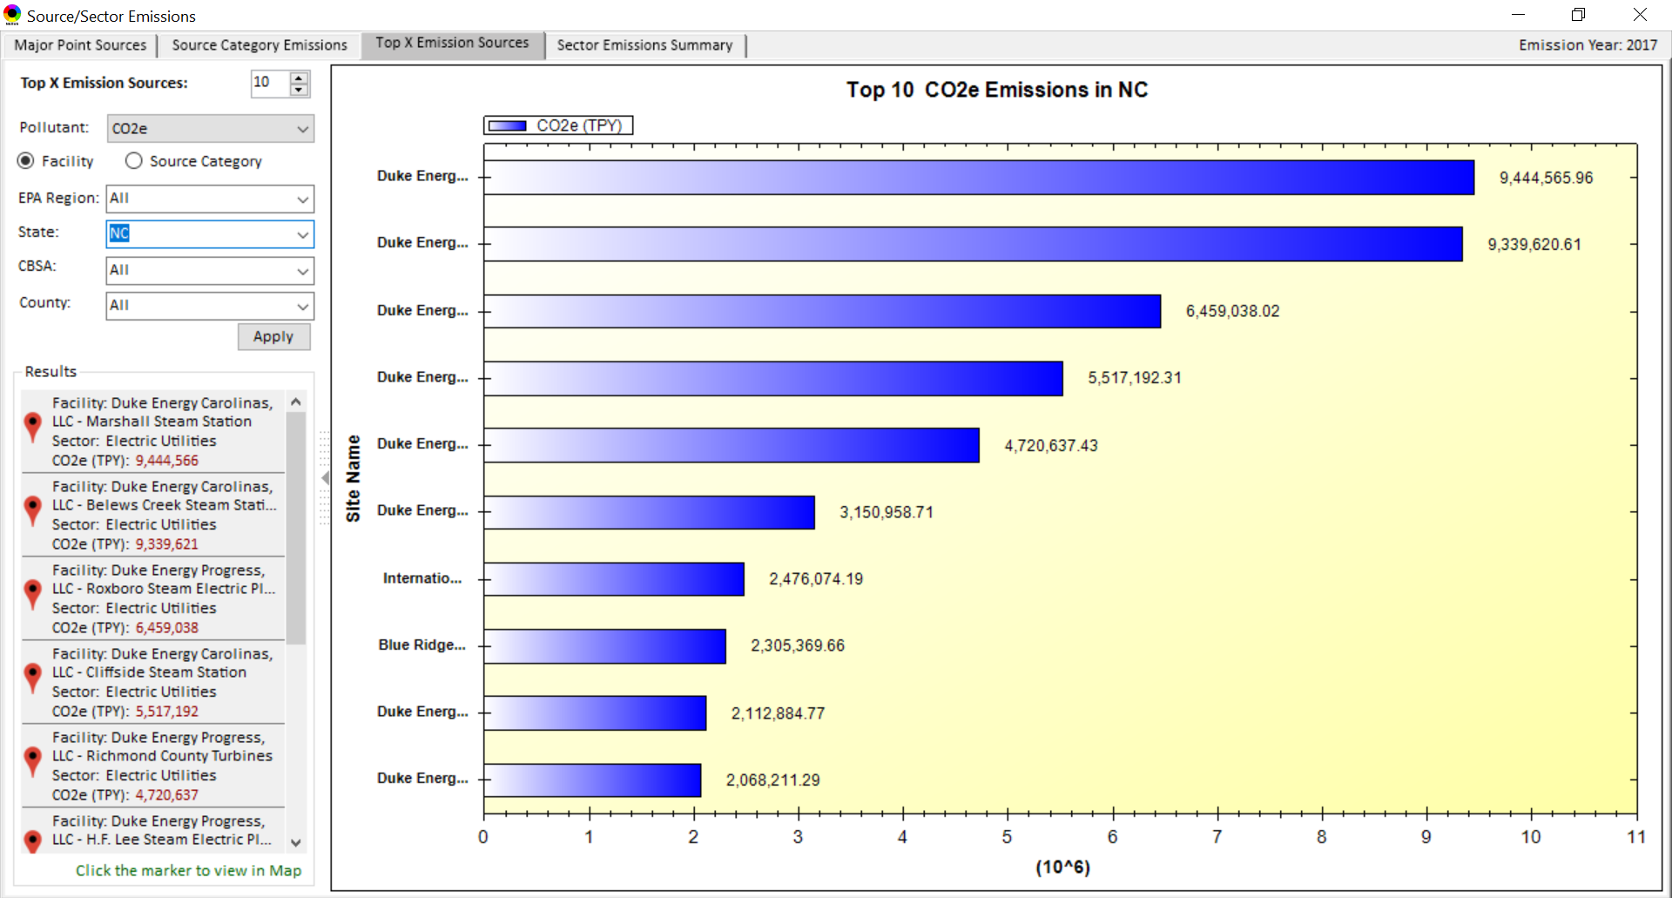
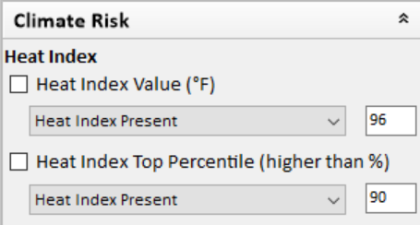
NEXUS: Climate
NEXUS originally developed as an air quality planning tool; however, we recognize the importance of climate considerations in that context
Currently includes CO2e emissions information
Coordinating with OAP to incorporate EPA indices for climate that relate to air quality:
Extreme Heat Index
Wildfire Vulnerability Index
Urban Heat Island
7

Slide 8
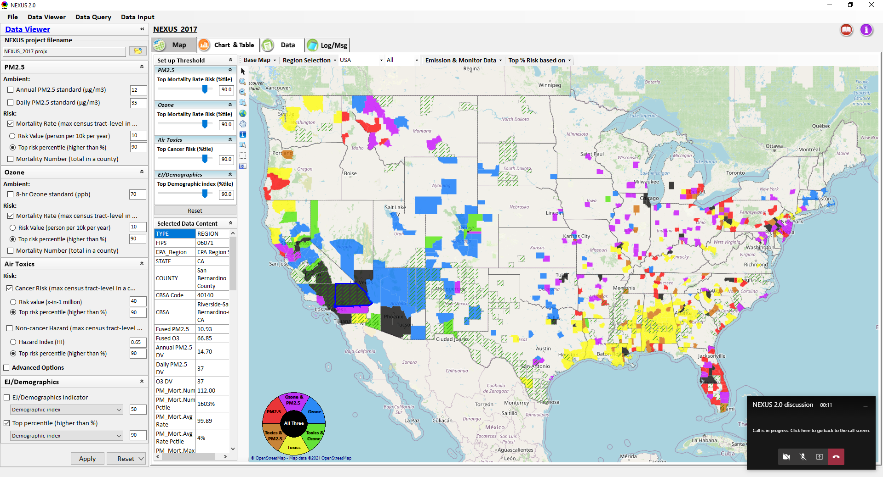
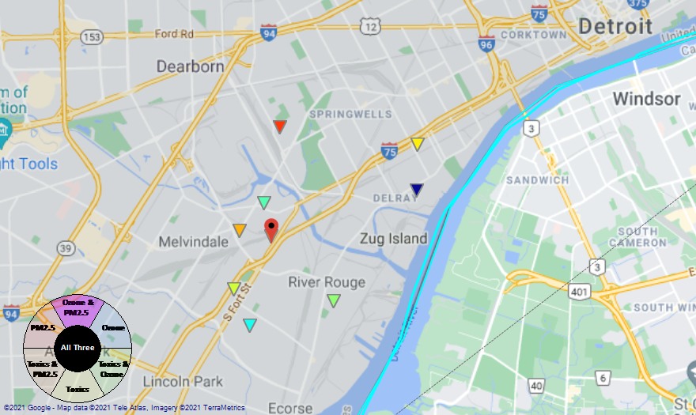
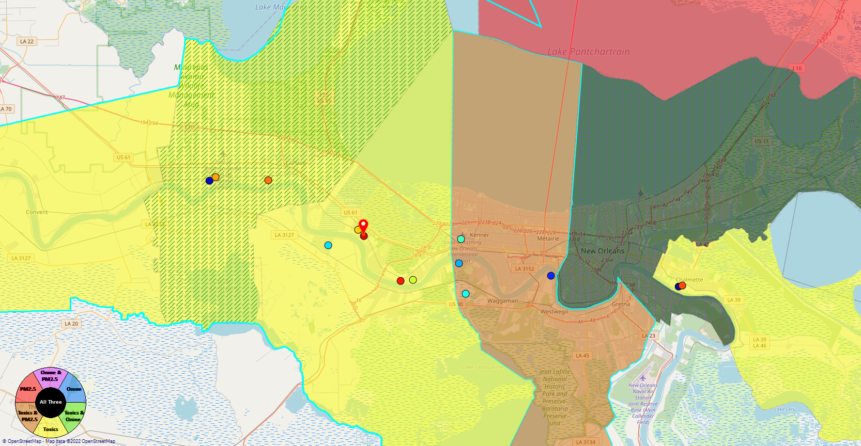
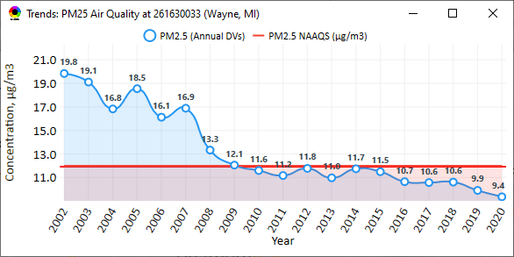
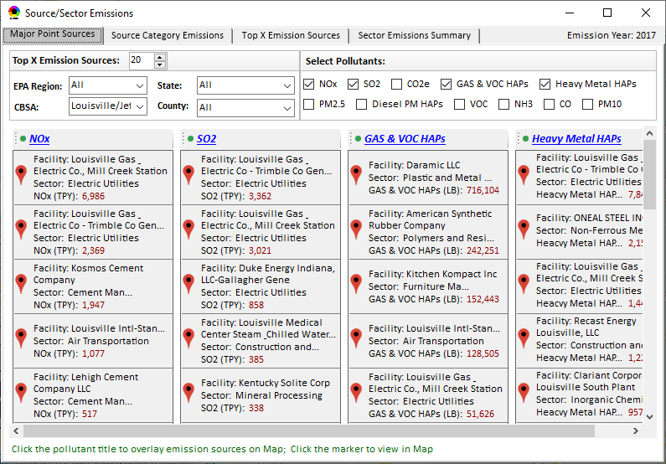
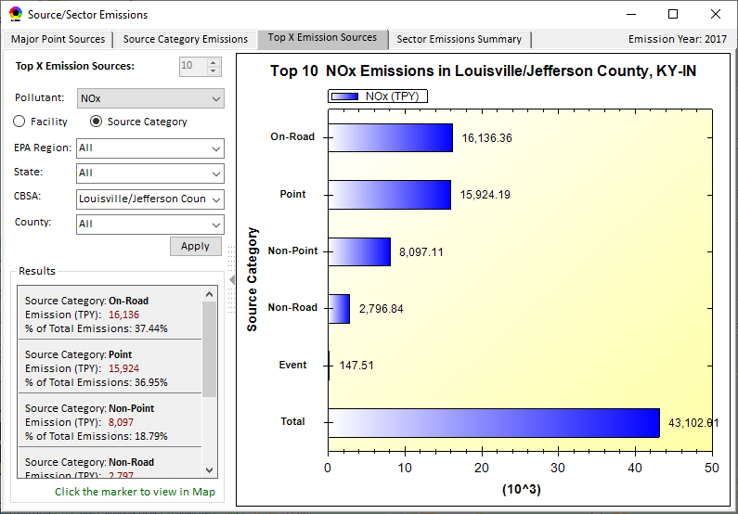
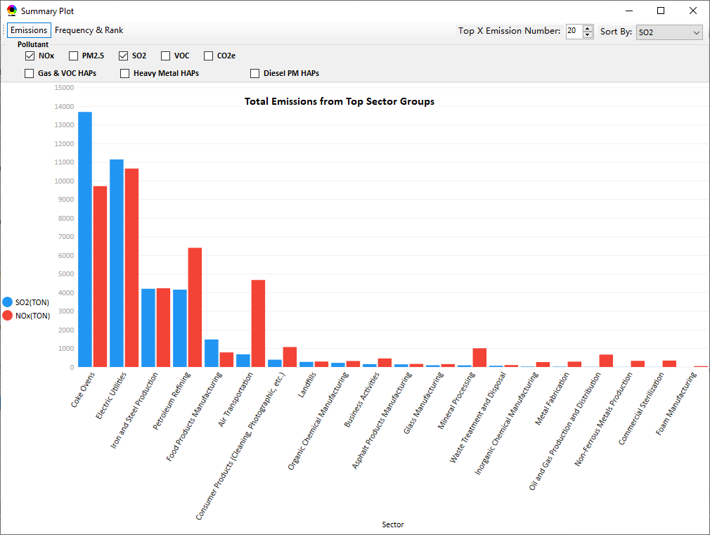
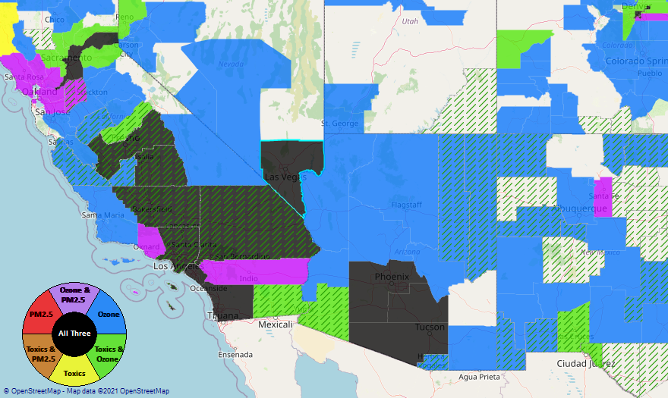
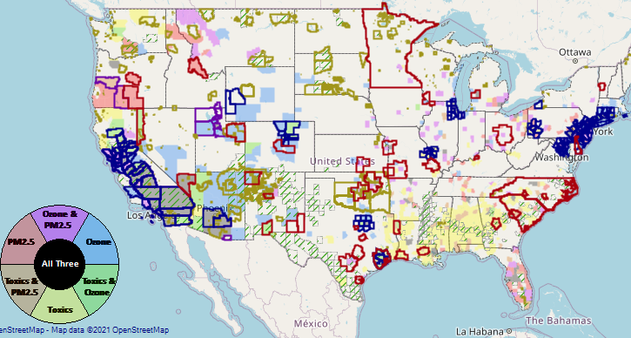
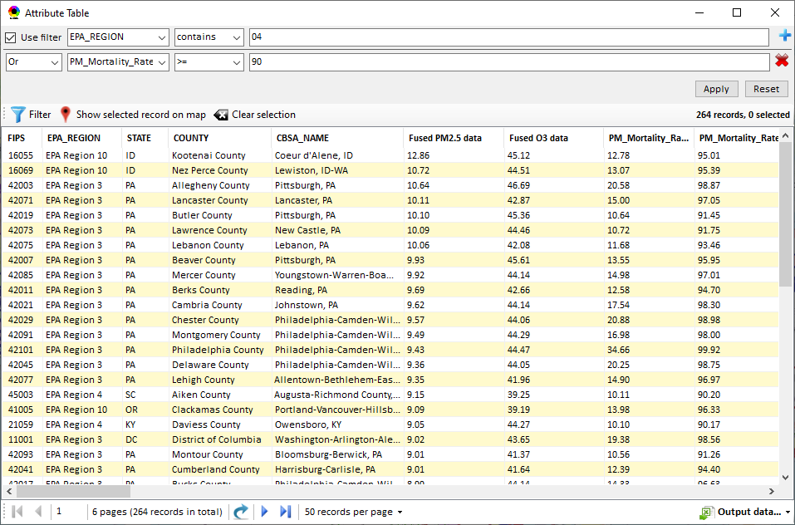
NEXUS: Data Inputs and Major Functions
O₃ & PM_{2.5}
Ambient/Design Value
(2012-2020)
(County-level)
Multi-Pollutant
Ambient and/or Risk National & Areal Mapping
Display Monitoring Sites & Trend Data
O₃, PM_{2.5} & Air Toxics Risk Data &
Conc. (fused AQ) Data
(2019/2018/2017)
(Census tract-level)
Display Major Point Emissions Sites/Data
Provide Source Category Emissions
NEXUS
O₃, PM_{2.5} & Air Toxics Monitoring Data
(2002-2020)
Provide Sector Emissions Summary
NEI County &
Facility Emissions
(2017 & 2014)
Include EJ/Demographic Indicators
Map Overlay w/ NAA, Advance Area, Class-I Area, Tribal Area, CEJST Area
Environmental Justice & Demographic Data
(from EJSCREEN 2.1)
Data Query, Search, Filter & Export
NAA, Advance
Area, Class-I Area,
Tribal Area, CEJST Area
Proximity Screening Analysis
8

Slide 9
NEXUS: Current and Potential Uses
MP Risk Prioritization (current)
Develop list of high MP risk areas to share with Regions and engage in potential MP area projects/efforts to reduce air emissions/exposure in these communities
Monitoring Assessments (current & potential)
Assess monitoring networks to determine where sites are located in/near communities with potential EJ concerns
Identifying gaps in monitoring network near overburdened communities
Input and review state’s Annual Monitoring Network Plans
Informing outreach and new source permitting (potential)
EJ screening for outreach purposes and for EJ assessments in federal permitting
ADVANCE Area/Regional SIP Planning (potential)
Develop conceptual model information consistent with EPA’s SIP modeling guidance that lays out the nature of air quality within the area
Inform IRA planning efforts (potential)
9

Slide 10
NEXUS: Beta Team Feedback - Uses
SIP Related Activities
Develop conceptual models for NAAs and areas close to NAAQS
Areas preparing path forward document to join Advance program
Future weight-of-evidence analysis for SIP demos
Air Quality Planning Activities
Identity areas to focus emission reduction efforts with possible lowering of NAAQs
Visually understand MP issues
Visualize areas of concern, run reports & focus efforts
Inform new source permit applications
Response to citizen complaints about new/existing sources
Environmental Justice
Generate maps and reports for EJ workgroup
Identify areas with air quality and EJ concerns
Review Tribal areas
Ensuring MP cumulative impacts are considered
Robust evaluation of potential EJ concerns and plans to address community needs
Outreach
Support AQ planning conversations with SLT air agencies
EtO community outreach
Briefings with RAs and management
Monitoring Activities
Review Annual Monitoring Network Plans and site/monitor relocation requests
Review new development proposals
Ongoing network assessments
Assessments
Evaluate air quality impacts in local communities
Supplement AirToxScreen Assessments
Assess burden of individual or combination of air pollutants
Complement existing techniques for emissions, modeling, monitoring & risk assessment
Identity air quality and human health focus areas
Other
Help new employees learn about areas with O₃, PM_{2.5}, toxics and/or EJ concerns
Assist with determining distribution of grant funding
10

Slide 11
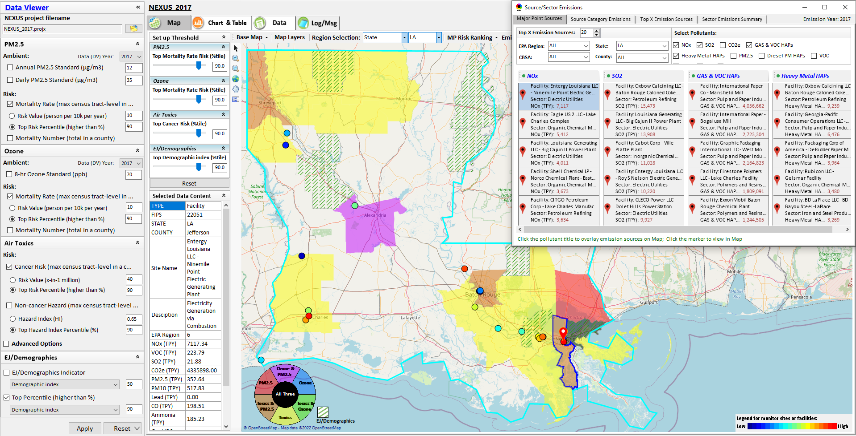
NEXUS Example: Display Major Point Sources
11

Slide 12
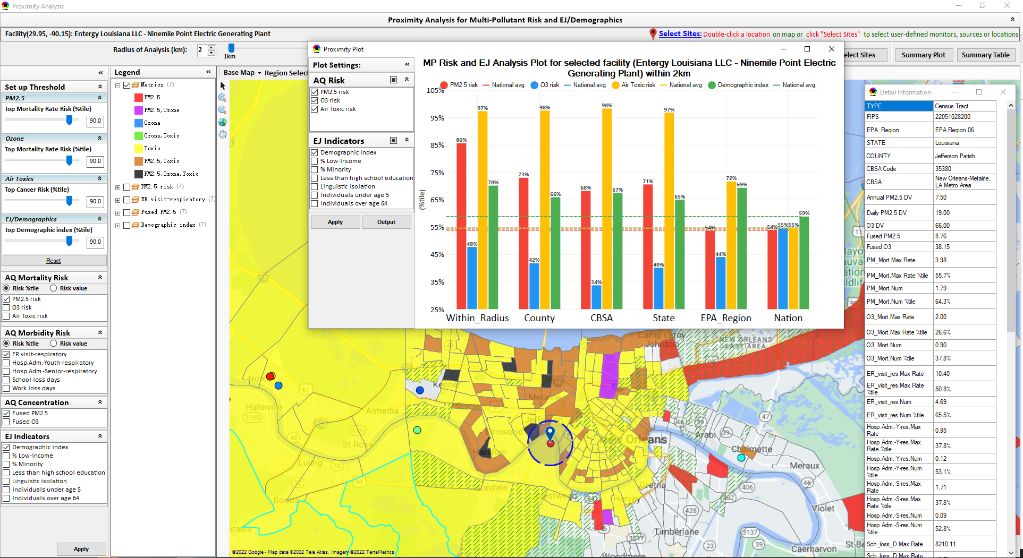
NEXUS Example: Proximity Analysis for Facility
12

Slide 13
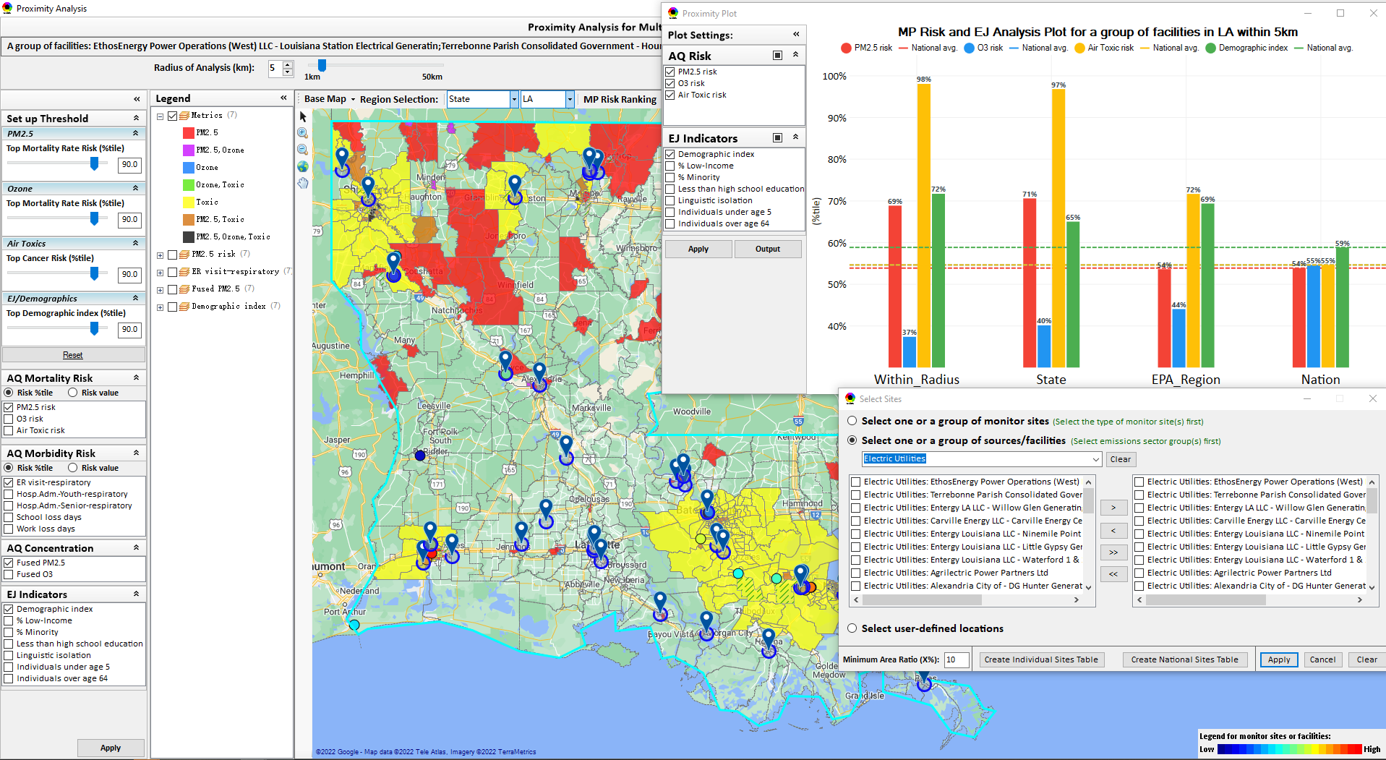
NEXUS Example: Proximity Analysis for Electric Utilities
13

Slide 14
NEXUS: Briefings and Demos
9/25/2020– AQAD & HEID
11/3/2020 – MP Team
11/4/2020 – Air Toxics Group
12/10/2020 – AQPD
1/25/2021 – OID
1/28/2021 – SPPD
2/1/2021 – Peter/SMT
4/12/2021 – HEID & AQAD
5/17/2021 – Peter/SMT
5/24/2021 – MP Team
6/29/2021 – ORD
7/12/2021– HEID & AQAD
7/19/2021 – OID
8/10/2021– OAP
8/26/2021 – OAR
8/27/2021 - OP
8/30/2021 – OEJ
8/30/2021 - Region 4/Louisville
9/7/2021 – RO ADDs
9/20/2021 – OAR Demo
10/14/2021 – OP/NCEE
11/2/2021 – RO APMs
11/8/2021- RO APMs Demo
11/16/2021 – R1 (RARE) Project
11/28/2021 – AQAD All-Hands
11/23/2021 – R3 NEXUS Beta Testers
2/15/22 – AQPD (NSRG, OPG & SLPG)
2/17/22 – AT Strategy Mgmt & Mitigation Team
3/15/22 – OID (CTPG)
4/26/22 – EPA Regional NEXUS Beta Testing Team
4/28/22 – AQAD (AAMG)
5/3/22 – HEID & AQAD
5/4/22 – Air Toxics Data Analysis Team
5/10/22 – ADVANCE Workgroup
5/26/22 - OAP/CCD
6/15/22 – Regional Ambient Air Monitoring
6/23/22 – SPPD All-Hands
7/21/22 – EJ in Rulemaking Comm. Of Practice
8/15/22 – OGC & ECRCO – Title VI
8/16/22 – Pre-brief for HEID & AQAD
8/17/22 – Peter
8/22/22 – OID/CTPG – Liz
8/31/22 – BenMAP Team
9/12/22 – OAPPS/AAOP (Economists)
9/14/22 – CAAAC
9/15/22 – Title VI / SIP Workgroup
9/29/22 – AAPCA
10/6/22 – OAP Pre-Brief
10/19/22 – OTAQ Pre-Brief
10/19/22 – RO APMs
10/31/22 – OEJ
11/1/22 – Regional Air Division Directors
12/1/22 – Region 1 - Packet Discussion
12/1/22 - OAR
12/1/22 - OAR IT/IM Coordination Council
12/14/22 – Stephanie G.
1/3/23 – OAP/OTAQ/OAQPS
1/11/23 – EPA Administrator
TBD –MJOs
14

Slide 15
NEXUS: Feedback from Briefings & Demos
“Fascinating… phenomenal… I’m blown away!”
- Caroline Freeman (R4 ADD)
“The R3 air program has evaluated 18 web tools … NEXUS overall has been the most useful to our air program”
- Cynthia Stahl, PhD
(R3 Integrated Assessment Analyst)
“Your presentation of the NEXUS tool was absolutely awesome!!! … The NEXUS tool looks very promising”
- Osmond Lindo (OAPPS Lead Economist)
“Breathtaking… incredibly powerful… I feel like we discovered nuclear fusion!”
- Joe Goffman
(OAR Acting AA)
“The tool is well designed and provides a wealth of information that is useful for evaluating air quality impacts in local communities”
- Rick Gillam
(R4 Air Modeling Team Lead)
“Dr. Nance [R6 RA] will be thrilled with the NEXUS tool and excited with its capabilities.”
- Fran Verhalen
(recently retired R6 Monitoring Section Chief)
15

Slide 16
NEXUS: Next Steps
Partner within EPA on use of NEXUS for programmatic purposes
NEXUS Improvements:
Address comments and feedback from EPA Beta Testing Team
Incorporate / revise “Climate risk” indicators (as 5th metric)
Update EJ/demographics data to be consistent with lates EJScreen dataset
Update to 2018/2019 MP platform (O₃, PM_{2.5}, and Air Toxics data)
Develop a web-based NEXUS version
Work towards making the tool publicly available
Continue discussions on use of NEXUS to inform IRA (briefing with Administrator on Jan 11th)
16

Slide 17
“NEXUS 3.3” Live Demo
**NEXUS is currently an advanced screening tool for internal EPA use. A beta version is available for EPA staff to use and provide feedback on for improvement. Additional updates/improvements are necessary before the NEXUS tool is ready to be released to the public.**
17

Slide 18
Important Caveats
NEXUS Caveat
The NEXUS screening tool uses data from a variety of sources. This data is publicly available, except for the BenMAP data at the tract level. EPA is currently still in an internal review process and is not using this tool to support regulatory analyses.
BenMAP Caveat
The estimated number of PM and ozone-attributable deaths and illnesses reported at each tract are subject to important uncertainties and should be interpreted with caution. When using the BenMAP-CE tool to calculate these tract-level results, EPA lacked information regarding the baseline health status of individuals living at each tract; these data are a key input to the calculation of benefits. EPA instead used data available at the county- or state-level, which does not account for differences in baseline health between tracts. Estimating benefits in this way is not consistent with the peer-reviewed methods EPA follows when estimating air quality benefits in a Regulatory Impact Analysis. EPA will continue to refine its methods with the goal of reporting tract-level health benefits with confidence.
18

