Slide 1
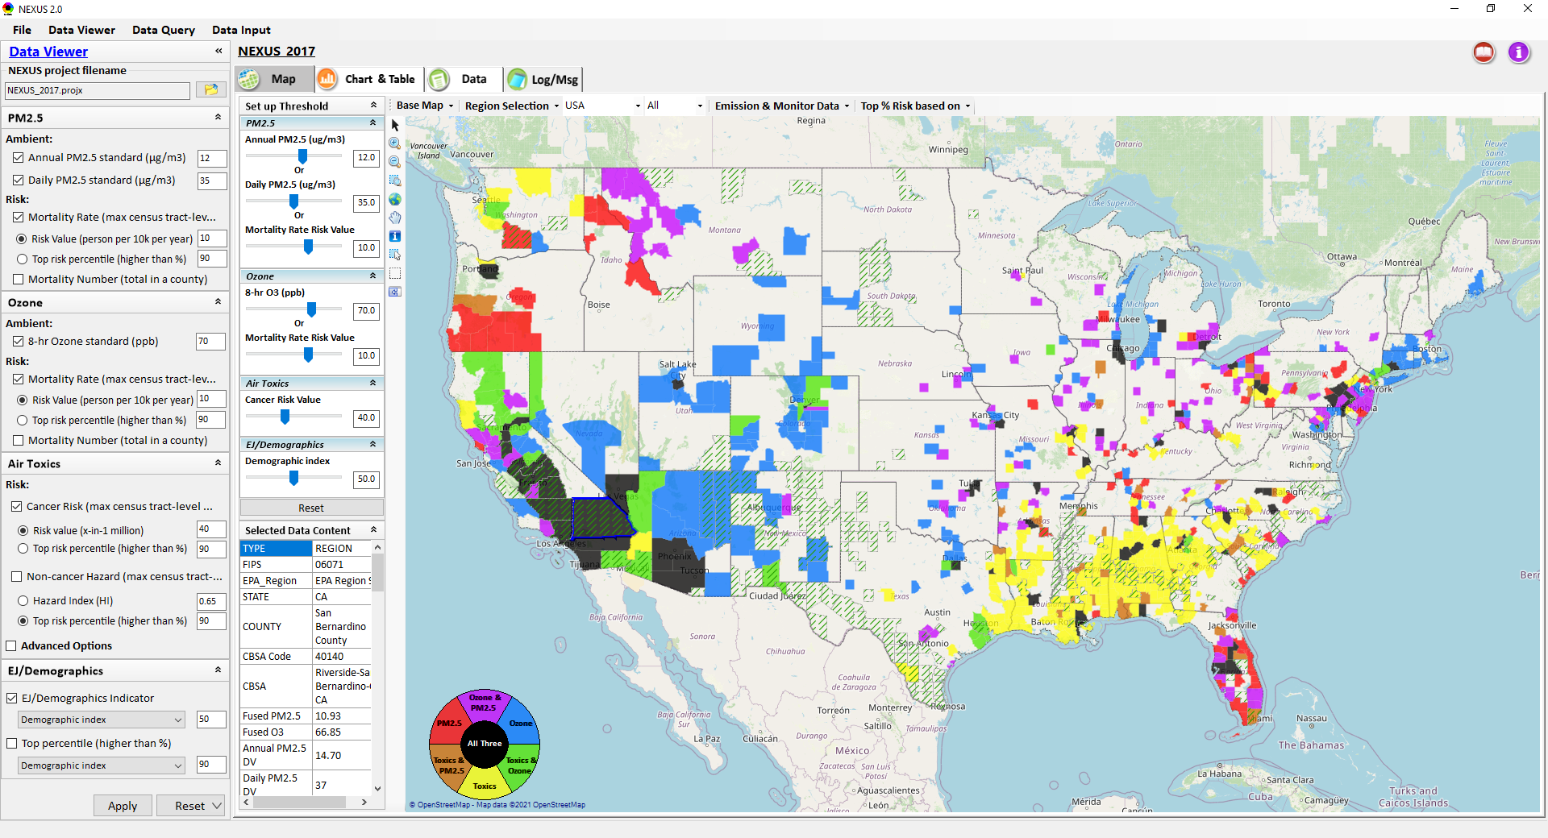
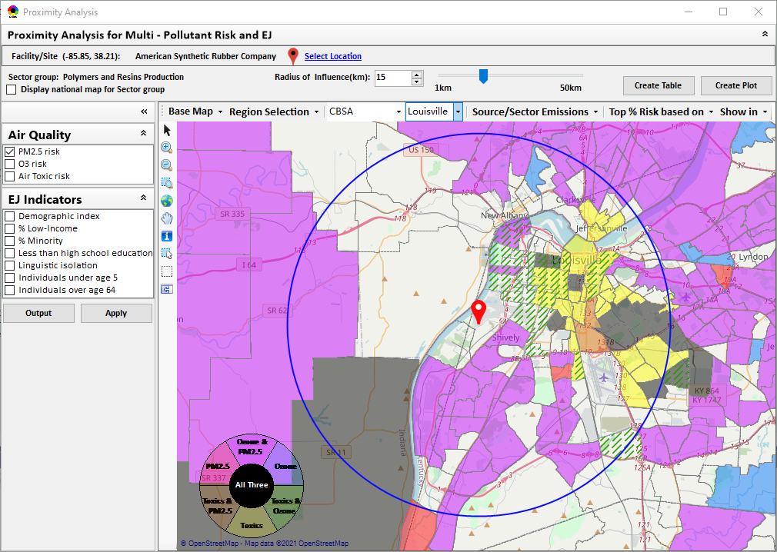
“NEXUS” Multi-Pollutant Advanced Screening Tool
OAR Update
Data Viewer: National/Regional Level
Proximity Analysis: Community Level
OAR Briefing
12/1/22
1

Slide 2
Purpose & Overview
Purpose
  Provide an update on the NEXUS tool and planned next steps
Overview
  NEXUS Activity Updates
    Regional Beta Testing Team
    OAP/OTAQ/OEJ Briefings
    Recent Coordination with Regions
    Web Development Plans
  Next Steps
  Region 1 Example Packet (Boston)
2

Slide 3
NEXUS Updates: EPA Regional Beta Testing Team
Convened a group of OAR and regional office members that see the benefit of NEXUS and plan to use it on a routine basis to assist in their job duties.
Requested feedback to help shape the direction of future tool development and ensure we are making updates and additions that are most beneficial to those Regions who are encouraging a multi-pollutant approach to air quality management (see Appendices D-F)
Working to identify specific applications to collaborate on with Regions, e.g.:
  Select area with MP and potential EJ concerns and explore a MP approach using NEXUS.
  Support EJ screening and related analysis for Federal permit or related action.
3

Slide 4
NEXUS Updates: OAP/OTAQ/OEJ Briefings
OAP Pre-Brief (10/6/22)
  Focus on including climate metrics that directly impact air quality
OTAQ Pre-Brief (10/19/22)
  Suggest targeted outreach briefings, particularly with people who live around impacted communities
  Important to consider uncertainties as transition from screening to planning tool
OEJ (10/31/22)
  Coordinate with EJSCREEN – recent version 2.1 released
  Suggested coordination with OAR IT/IM Coordination Council (scheduled for 1pm today)
  Suggest early engagement with the states early before going public
OAQPS/OAP/OTAQ briefing request has been submitted
4

Slide 5
NEXUS Updates: Recent Coordination with Regions
Briefings with APMs (10/19/22) & ADDs (11/1/22) to share:
  Findings from beta testing team
  Example Regional Packet (Region 1 – Boston)
  Interest in developing Regional Packets using NEXUS to identify:
    A location with EJ concerns interested in partnering in the near term
    MP areas as potential candidates for IRA funding
  Demo of NEXUS 3.2
R1 ADD (Lynne H.) requested R1 briefing (scheduled for this AM)
  Working on NPDES permit & have agreed to do a cumulative risk analysis. Interested in using NEXUS as a basis for helping the air portion of the cumulative risk analysis
R6 expressed interest in Regional Packet – under development
5

Slide 6
NEXUS Updates: Web Development Plans
Extensive interest in moving from a desktop application to a web/cloud-based application
  Demo at 1pm for IT/IM Coordination Council to receive feedback from other program offices on how to move from desktop → web, hosting options, etc.
OAQPS funding support planned for development of web-based NEXUS Version
  Web-based development
  Deployment and IT security
6

Slide 7
NEXUS: Next Steps
Briefing for OAP/OTAQ/OAQPS Senior Management (Dec 2022/Jan 2023)
Partner within EPA on use of NEXUS for programmatic purposes
NEXUS Improvements:
  Address comments and feedback from EPA Beta Testing Team
  Incorporate / revise “Climate risk” indicators (for consideration in AQ planning)
  Update EJ/demographics data to be consistent with new “EJScreen 2.0” dataset
  Include top air toxic cancer risk drivers in the “proximity analysis” module
  Update to 2018/2019 MP platform (O₃, PM_{2.5}, and Air Toxics data)
  Explore feasibility of developing a web-based NEXUS version (similar to EJScreen)
  Explore automation of regional packets
Work towards making NEXUS publicly available
  BenMAP tract level results (PM and O₃ mortality) are the only NEXUS data that are not publicly available – additional work (and possible funding) is necessary before information can be shared publicly.
7

Slide 8
Example Multi-Pollutant Packet for Region 1: Boston CBSA
8

Slide 9
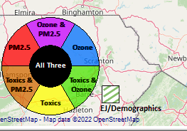
Region 1 Example: Criteria
PM2.5 Top Mortality Rate Risk Percentile ≥ 75%
Ozone Top Mortality Rate Risk Percentile ≥ 75%
Air Toxics Top Cancer Risk Percentile ≥ 75%
EJ/Demographics Top Demographic Index Percentile ≥ 75%
9

Slide 10
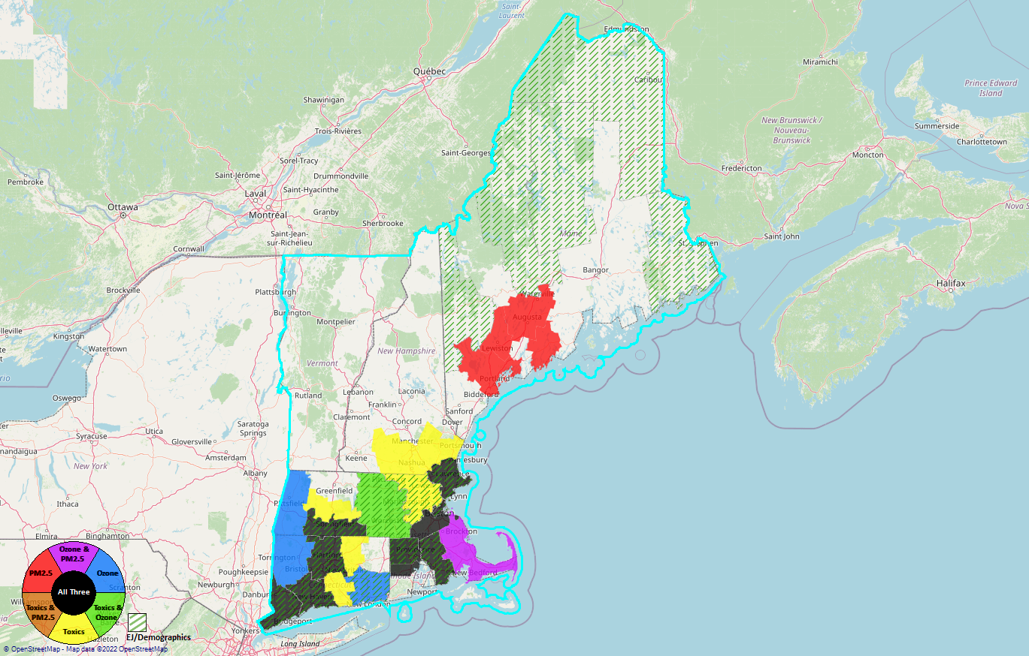
Region 1
PM2.5 Top Mortality Rate Risk Percentile ≥ 75%
Ozone Top Mortality Rate Risk Percentile ≥ 75%
Air Toxics Top Cancer Risk Percentile ≥ 75%
EJ/Demographics Top Demographic Index Percentile ≥ 75%
10

Slide 11
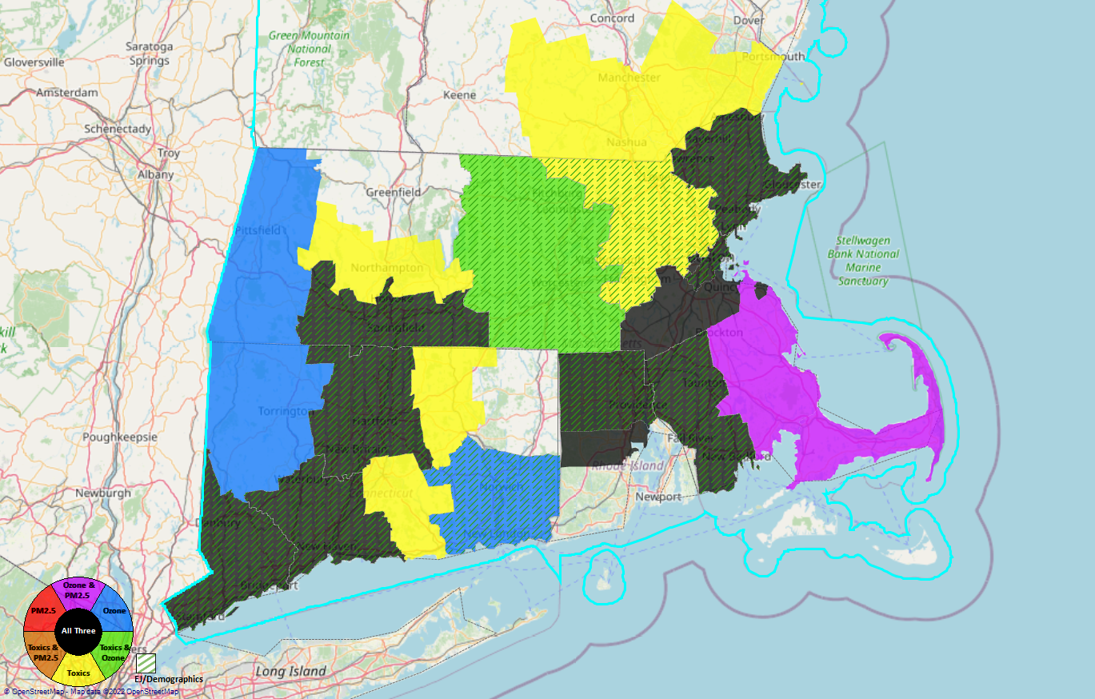
Fairfield County, CT
New Haven County, CT
Hartford County, CT
Hampden County, MA
Providence County, RI
Bristol County, MA
Suffolk County, MA
Essex County, MA
8
7
4
5
6
3
2
1
Region 1
11

Slide 12
Region 1 Example: Counties/CBSAs
County | CBSA
Fairfield County, CT | Bridgeport-Stamford-Norwalk, CT
New Haven County, CT | New Haven-Milford, CT
Hartford County, CT | Hartford-West Hartford-East Hartford, CT
Hampden County, MA | Springfield MA
Providence County, RI | Providence-Warwick, RI-MA
Bristol County, MA
Suffolk County, MA | Boston-Cambridge-Newton, MA-NH
Essex County, MA
12

Slide 13
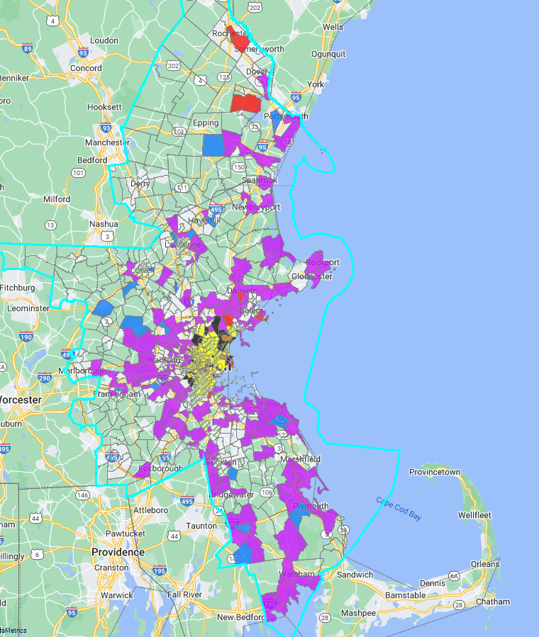
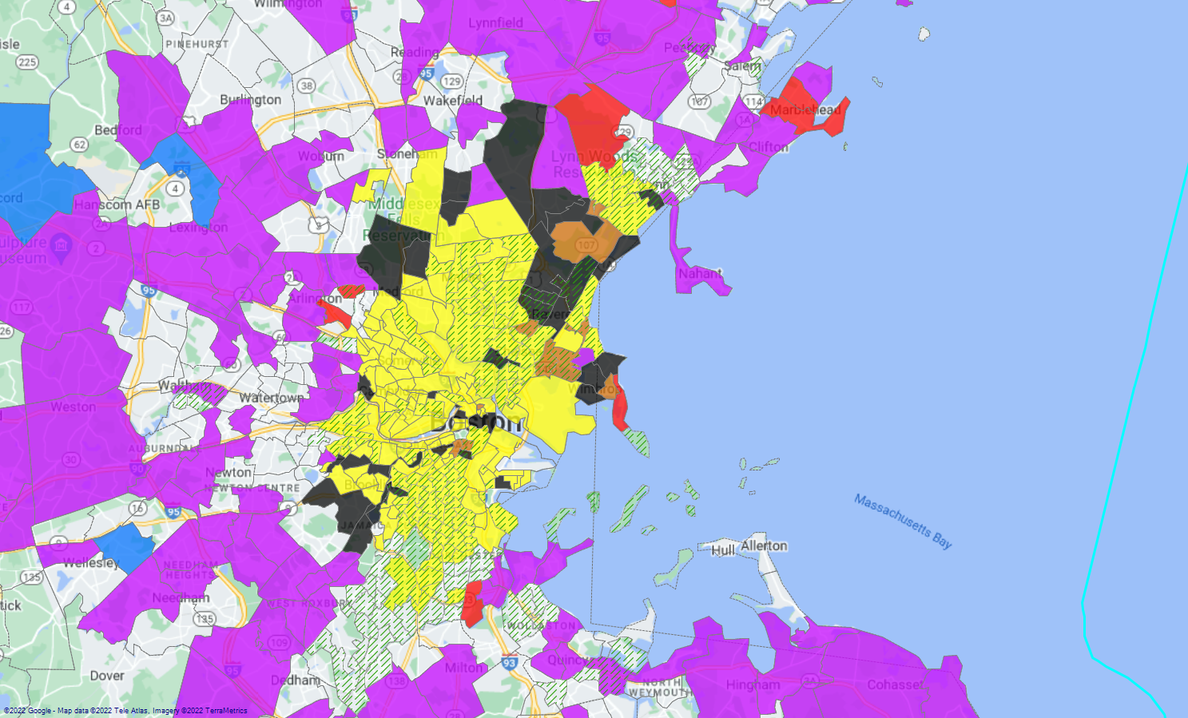
Region 1 Example: Boston-Cambridge-Newton, MA-NH
13

Slide 14
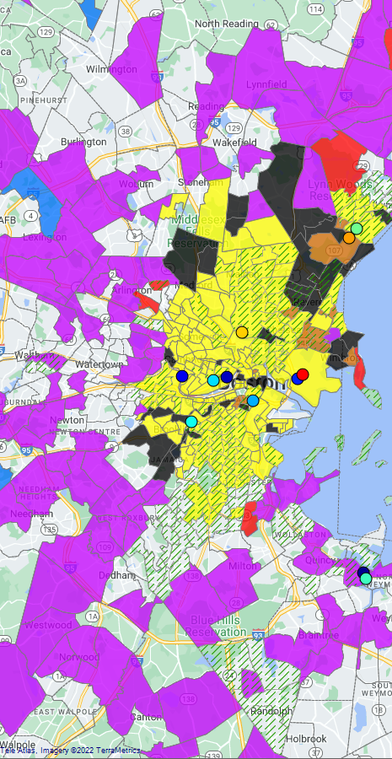
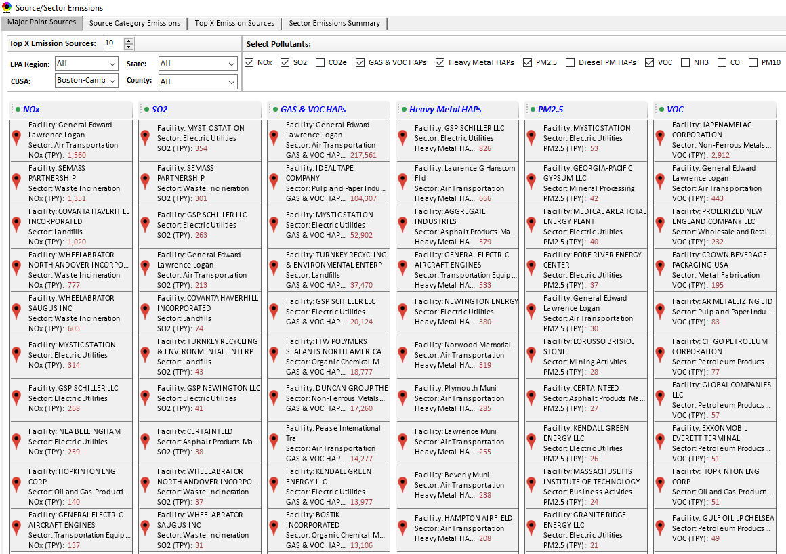
Region 1 Example: Boston CBSA
Top Emission Sources
14

Slide 15
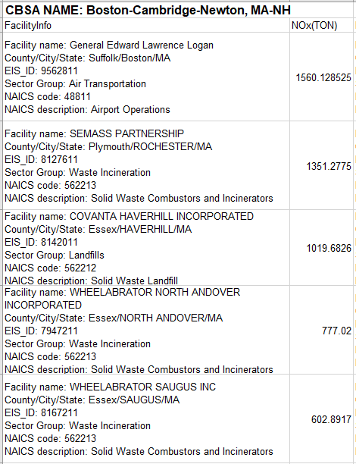
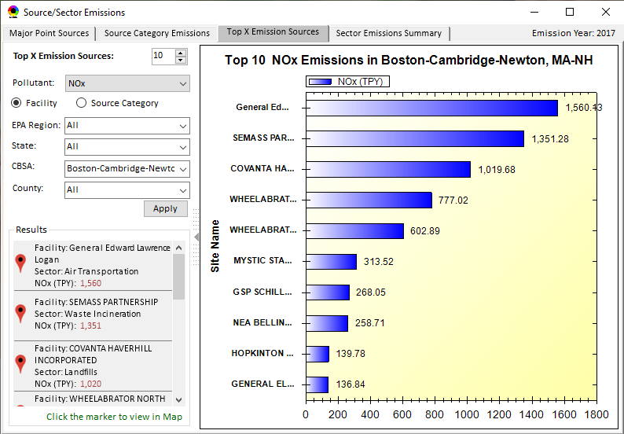
Region 1 Example: Boston-Cambridge-Newton, MA-NH CBSA
Top Emission Sources
15

Slide 16
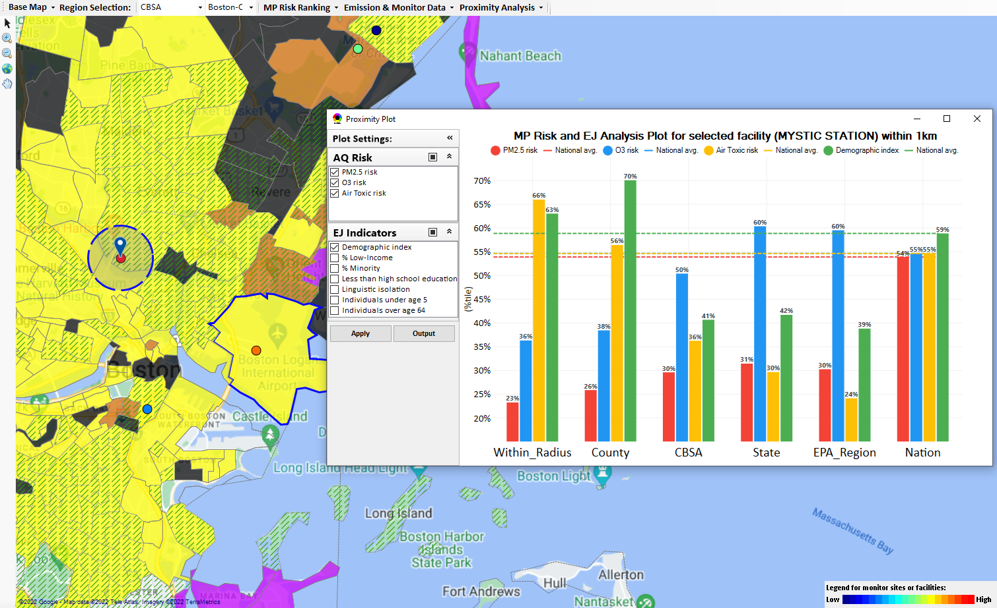
Region 1 Example: Boston-Cambridge-Newton, MA-NH CBSA
Mystic Station EGU
Top emitter in CBSA for SO2 & PM2.5
Top 10 emitter in the CBSA for NOx & Gas & VOC HAPs
16

Slide 17
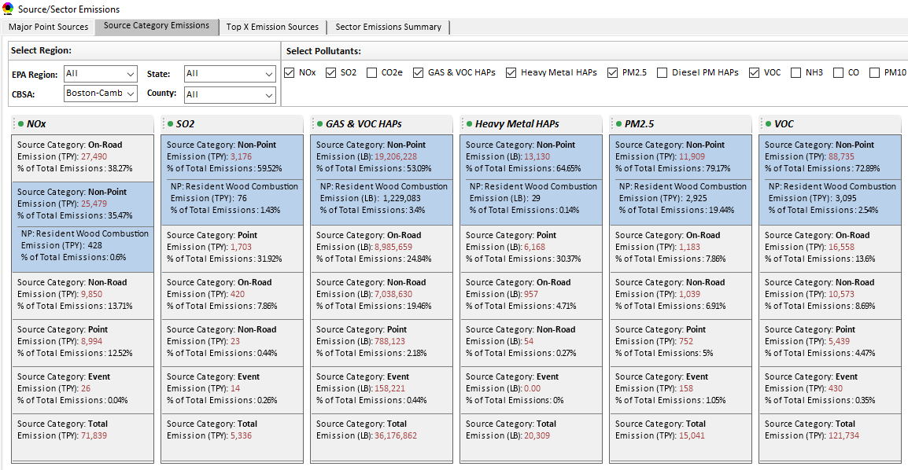
Region 1 Example: Boston-Cambridge-Newton, MA-NH CBSA
Top Emission Source Categories
17

Slide 18
Region 1 Example: Boston-Cambridge-Newton, MA-NH CBSA
Top Emission Source Categories
18

Slide 19
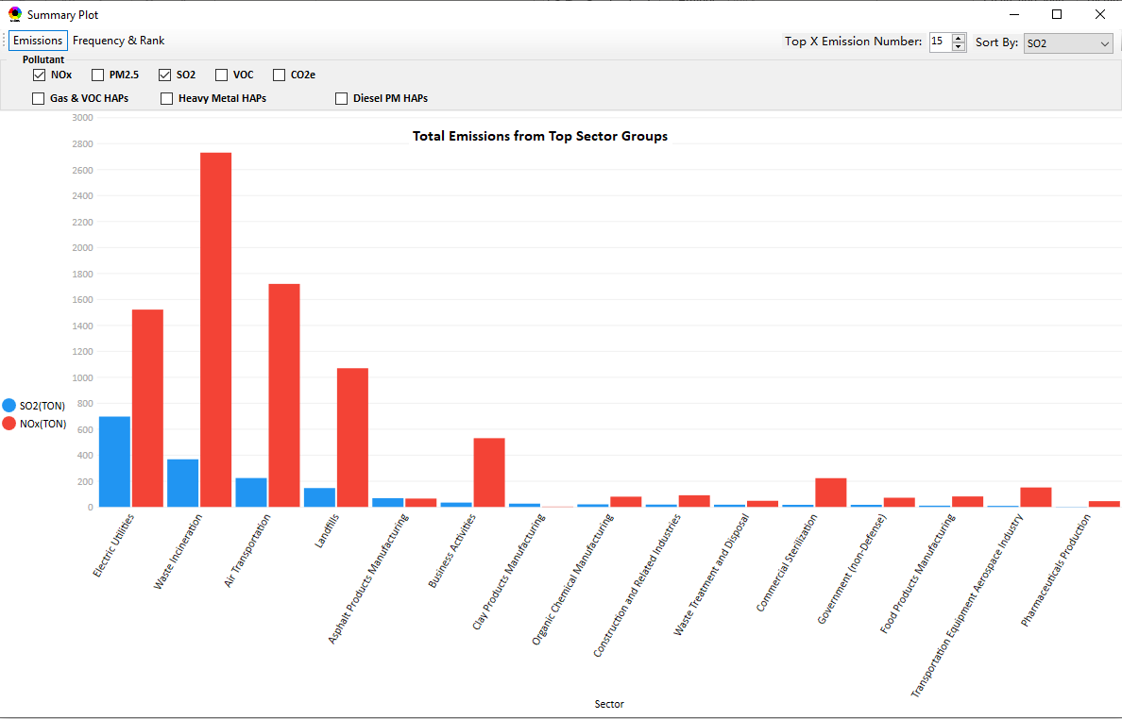
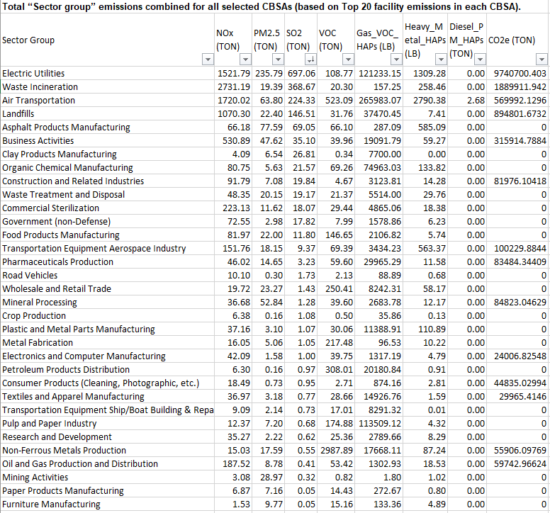
Region 1 Example: Boston-Cambridge-Newton, MA-NH CBSA
Total Emissions from Top Sector Groups
19

Slide 20
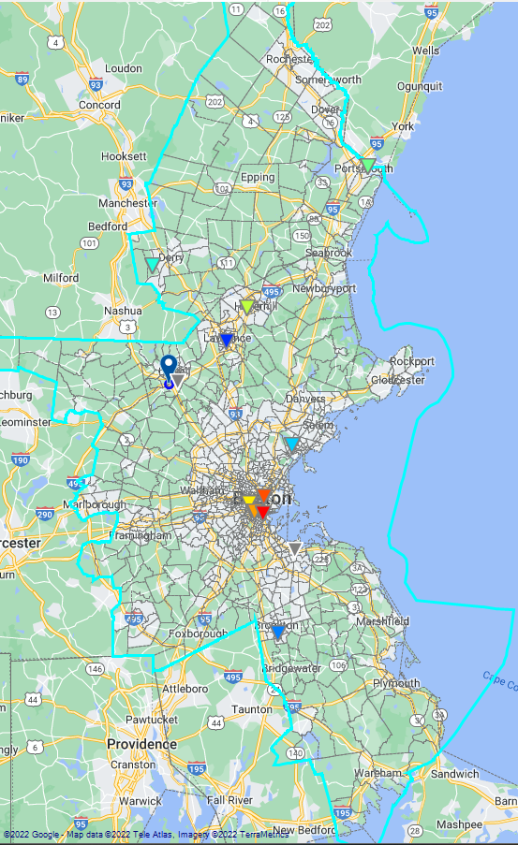
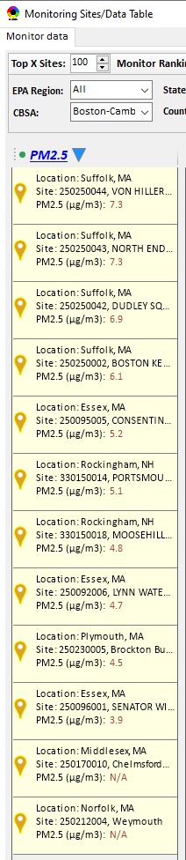
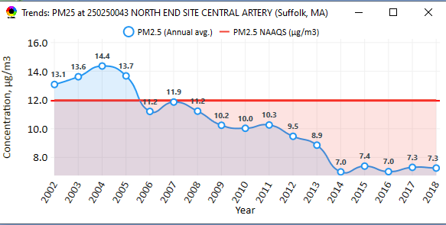
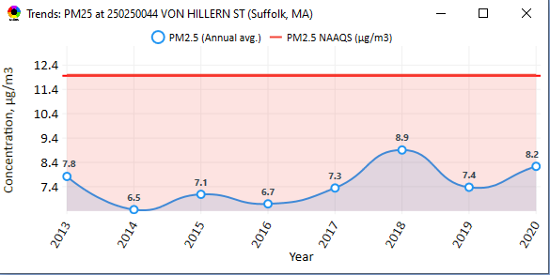
Region 1 Example: Boston CBSA
PM_{2.5} Monitoring Sites
20

Slide 21
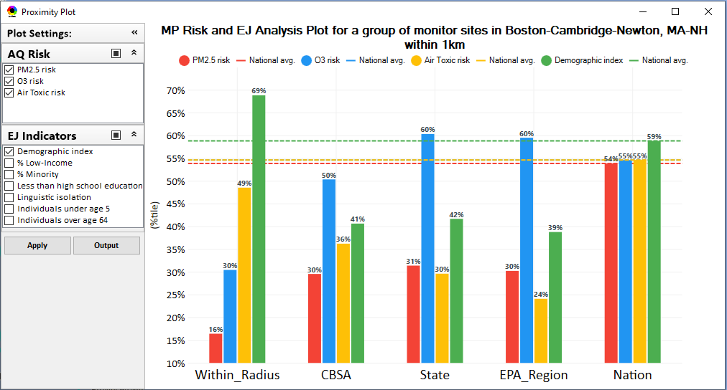
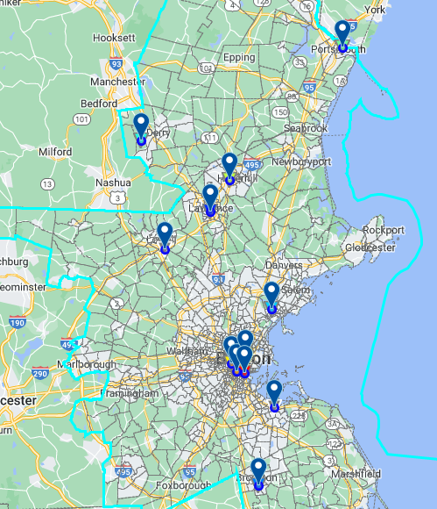
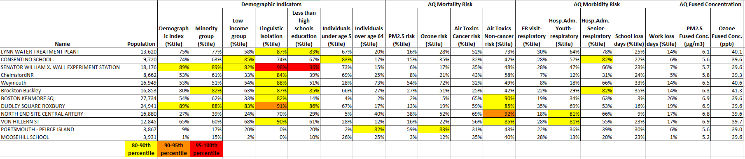
Region 1 Example:
Boston CBSA
PM_{2.5} Monitoring Sites
21

Slide 22
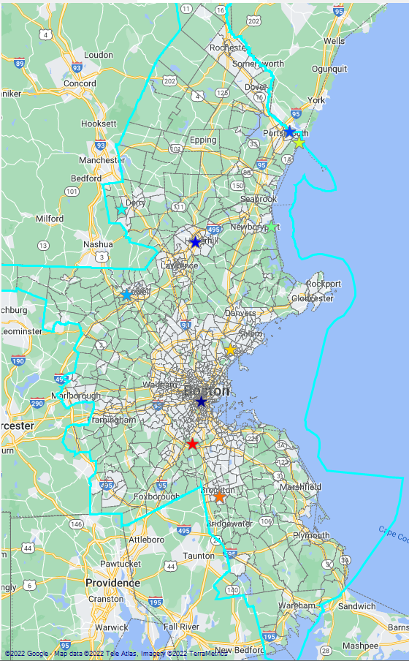
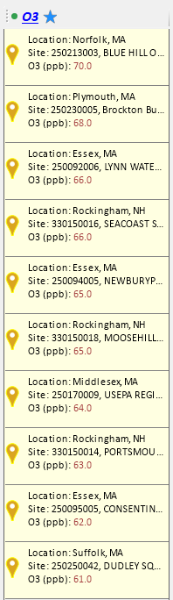
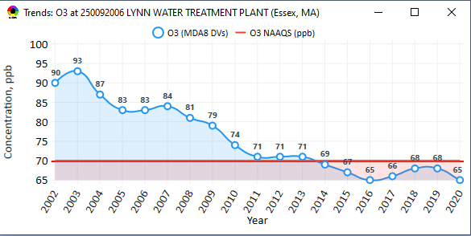
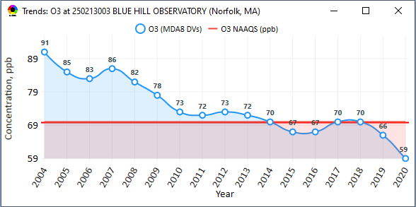
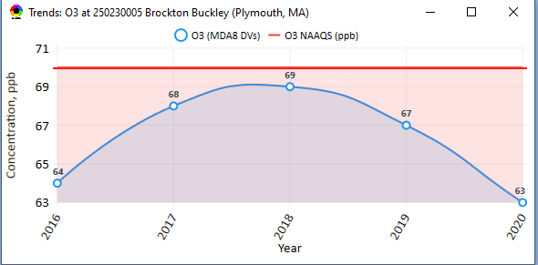
Region 1 Example: Boston CBSA
Ozone Monitoring Sites
22

Slide 23
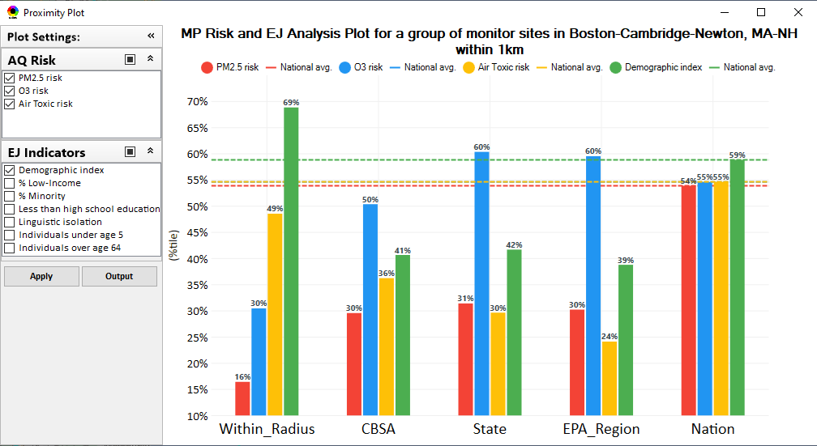
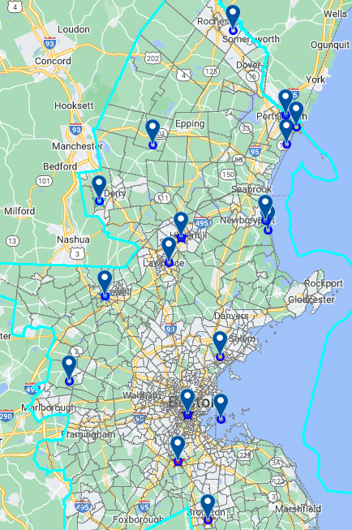
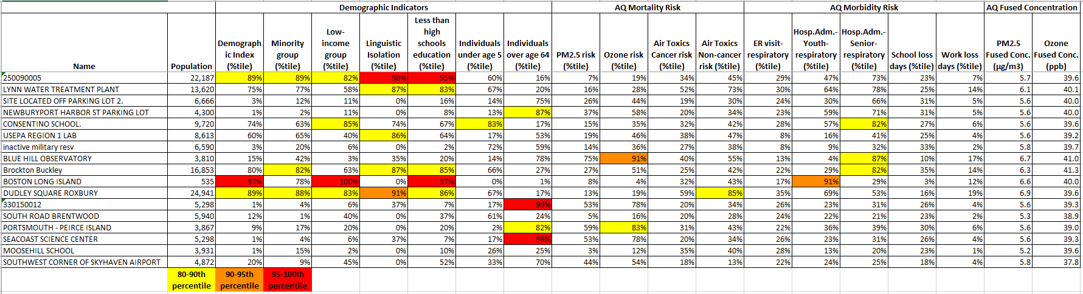
Region 1 Example:
Boston CBSA
Ozone Monitoring Sites
23

Slide 24

Questions?
Today is Kimber Scavo’s last day with EPA and we would like to send her a huge THANK YOU for her decades of hard work to advance multi-pollutant air quality managment and bring the NEXUS tool to fruition!
We will miss you, Kimber!!
24

Slide 25
Appendices
25

Slide 26
Appendix A: Important Caveats
**NEXUS is currently an advanced screening tool for internal EPA use. A beta version is available for EPA staff to use and provide feedback on for improvement. Additional updates/improvements are necessary before the NEXUS tool is ready to be released to the public.**
NEXUS Caveat
The NEXUS screening tool uses data from a variety of sources. This data is publicly available, except for the BenMAP data at the tract level. EPA is currently still in an internal review process and is not using this tool to support regulatory analyses.
BenMAP Caveat
The estimated number of PM and ozone-attributable deaths and illnesses reported at each tract are subject to important uncertainties and should be interpreted with caution. When using the BenMAP-CE tool to calculate these tract-level results, EPA lacked information regarding the baseline health status of individuals living at each tract; these data are a key input to the calculation of benefits. EPA instead used data available at the county- or state-level, which does not account for differences in baseline health between tracts. Estimating benefits in this way is not consistent with the peer-reviewed methods EPA follows when estimating air quality benefits in a Regulatory Impact Analysis. EPA will continue to refine its methods with the goal of reporting tract-level health benefits with confidence.
26

Slide 27
Appendix B: Briefings and Demos
9/25/2020– AQAD & HEID
11/3/2020 – MP Team
11/4/2020 – Air Toxics Group
12/10/2020 – AQPD
1/25/2021 – OID
1/28/2021 – SPPD
2/1/2021 – Peter/SMT
4/12/2021 – HEID & AQAD
5/17/2021 – Peter/SMT
5/24/2021 – MP Team
6/29/2021 – ORD
7/12/2021– HEID & AQAD
7/19/2021 – OID
8/10/2021– OAP
8/26/2021 – OAR
8/27/2021 - OP
8/30/2021 – OEJ
8/30/2021 - Region 4/Louisville
9/7/2021 – RO ADDs
9/20/2021 – OAR Demo
10/14/2021 – OP/NCEE
11/2/2021 – RO APMs
11/8/2021- RO APMs Demo
11/16/2021 – R1 (RARE) Project
11/28/2021 – AQAD All-Hands
11/23/2021 – R3 NEXUS Beta Testers
2/15/22 – AQPD (NSRG, OPG & SLPG)
2/17/22 – AT Strategy Mgmt & Mitigation Team
3/15/22 – OID (CTPG)
4/26/22 – EPA Regional NEXUS Beta Testing Team
4/28/22 – AQAD (AAMG)
5/3/22 – HEID & AQAD
5/4/22 – Air Toxics Data Analysis Team
5/10/22 – ADVANCE Workgroup
5/26/22 - OAP/CCD
6/15/22 – Regional Ambient Air Monitoring
6/23/22 – SPPD All-Hands
7/21/22 – EJ in Rulemaking Comm. Of Practice
8/15/22 – OGC & ECRCO – Title VI
8/16/22 – Pre-brief for HEID & AQAD
8/17/22 – Peter
8/22/22 – OID/CTPG – Liz
8/31/22 – BenMAP Team
9/12/22 – OAPPS/AAOP (Economists)
9/14/22 – CAAAC
9/15/22 – Title VI / SIP Workgroup
9/29/22 – AAPCA
10/6/22 – OAP Pre-Brief
10/19/22 – OTAQ Pre-Brief
10/19/22 – RO APMs
10/31/22 – OEJ
11/1/22 – Regional Air Division Directors
12/1/22 – Region 1 - Packet Discussion
12/1/22 - OAR
12/1/22 - OAR IT/IM Coordination Council
TBD –MJOs
27

Slide 28
Appendix C: Feedback from Briefings & Demos
“Fascinating… phenomenal… I’m blown away!”
- Caroline Freeman (R4 ADD)
“The R3 air program has evaluated 18 web tools … NEXUS overall has been the most useful to our air program”
- Cynthia Stahl, PhD
(R3 Integrated Assessment Analyst)
“Your presentation of the NEXUS tool was absolutely awesome!!! … The NEXUS tool looks very promising”
- Osmond Lindo (OAPPS Lead Economist)
“Breathtaking… incredibly powerful… I feel like we discovered nuclear fusion!”
- Joe Goffman
(OAR Acting AA)
“The tool is well designed and provides a wealth of information that is useful for evaluating air quality impacts in local communities”
- Rick Gillam
(R4 Air Modeling Team Lead)
“Dr. Nance [R6 RA] will be thrilled with the NEXUS tool and excited with its capabilities.”
- Fran Verhalen
(recently retired R6 Monitoring Section Chief)
28

Slide 29
Appendix D: EPA Regional Beta Team Members
Region 1
  Shutsu Wong
  Emily Bolger
Region 2
  Ysabel Barron
Region 3
  Cynthia Stahl
  Carol Ann Gross-Davis
  Jessie Fry
  Angus Welch
  Alice Chow
Region 4
  Rick Gillam
  Byron Gary (LMAPCD)
Region 5
  Alexis Cain
  Margaret Sieffert
  Rae Trine
  Yana Genchanok
Region 6
  Nia Riddick
Region 7
  Adam Zachary
  Allie Donohue
Region 8
  Ethan Brown
  Adam Eisele
Region 9
  Julia Carlstad
Region 10
  Claudia Vaupel
OAQPS
  Rob Pinder
  Matt Woody
  Beth Landis
  Carey Jang
  Joe Mangino
  Mia South
  Shomik Ghosh
  Kimber Scavo
  Tyler Fox
29

Slide 30
Appendix E: Beta Team Feedback - Uses
SIP Related Activities
  Develop conceptual models for NAAs and areas close to NAAQS
  Areas preparing path forward document to join Advance program
  Future weight-of-evidence analysis for SIP demos
Air Quality Planning Activities
  Identity areas to focus emission reduction efforts with possible lowering of NAAQs
  Visually understand MP issues
  Visualize areas of concern, run reports & focus efforts
  Inform new source permit applications
  Response to citizen complaints about new/existing sources
Environmental Justice
  Generate maps and reports for EJ workgroup
  Identify areas with air quality and EJ concerns
  Review Tribal areas
  Ensuring MP cumulative impacts are considered
  Robust evaluation of potential EJ concerns and plans to address community needs
Outreach
  Support AQ planning conversations with SLT air agencies
  EtO community outreach
  Briefings with RAs and management
Monitoring Activities
  Review Annual Monitoring Network Plans and site/monitor relocation requests
  Review new development proposals
  Ongoing network assessments
Assessments
  Evaluate air quality impacts in local communities
  Supplement AirToxScreen Assessments
  Assess burden of individual or combination of air pollutants
  Complement existing techniques for emissions, modeling, monitoring & risk assessment
  Identity air quality and human health focus areas
Other
  Help new employees learn about areas with O₃, PM_{2.5}, toxics and/or EJ concerns
  Assist with determining distribution of grant funding
30

Slide 31
Appendix F: Beta Team Feedback - Asks
Common Requests
Access issues - web-based / cloud-based application is preferable
More recent data
Addition of available Pb data
Ability to filter emissions, monitor data, and drop downs selections by map extent or user defined boundaries (e.g., boundary box or lasso)
Addition of GHG reporting program data
Report capabilities: Automated 1–2-page summary document
Unique Requests
Ability to layer multiple years of data
Ability to see all monitors in a selected area
Ability to see all facilities within proximity analysis selected area versus county-wide
Ability to see modeled concentrations from AirToxScreen
Ability to import air dispersion modeling results in .kmz format
Ability to filter facilities by industry/NAICS
Ability to adjust the data value year in proximity analysis
See individual HAP/VOC emissions
Add driving pollutant for elevated cancer risk and HI for census block
Add data for Hawaii and Alaska
Wind roses to help assess monitor siting
31

Slide 32
Appendix G: Multi-Pollutant Team Members
HEID
  Beth Landis / Kimber Scavo
  Matt Woody / Kelly Rimer
  Robin Langdon / Darryl Weatherhead
  Sara Terry
  Carrie Wheeler
  Rob Pinder
  Chris Davis
  Conor Mulderrig
  Kayla McCauley
OID
  Amanda Kaufman
  James Payne
  Loren Fox
AQAD
  Carey Jang / Tyler Fox
  Jim Kelly
  Shannon Koplitz
  Joe Mangino
  Jeanette Reyes
AQPD
  Rich Damberg / Megan Brachtl
  Mia South
SPPD
  Lisa Conner
32

